Slide 1
MMX
Lecture 12

Slide 2
Definition
MMX (MultiMedia eXtension) is a set of instructions introduced by Intel to improve the performance of multimedia and data processing tasks, like image, audio, and video processing.
It uses SIMD (Single Instruction, Multiple Data), which means one instruction can process multiple pieces of data at once.

Slide 3
SIMD
Single Instruction works on Multiple Data
Is there a way to manipulate array data with single instruction while working with General Purpose Registers (GPRs)?
No, we need indexing (offset + index; [BX+SI])
Time consuming
Less efficient
Need a method that works on all elements of array parallelly
Data must be packed into a vector

Slide 4
SIMD Registers
GPRs only work on scalar (one value at a time) data
They do not support SIMD
SIMDS needs 64 bit storage space as registers.
Makes use of Floating Point Unit (FPU) registers
FPU is a part of CPU designated to perform operations on floating point data
MMX uses these FP registers to manipulate integer data only

Slide 5
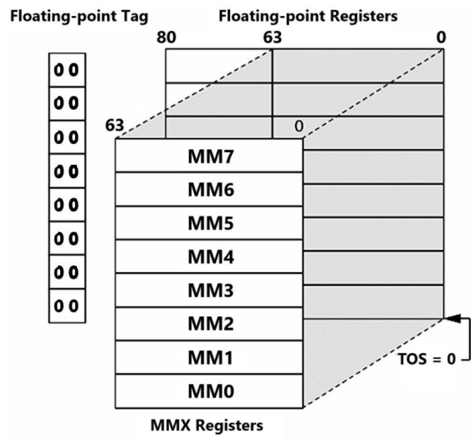
SIMD Registers
Eight 80 bit registers, out which only least 64 bits are used for MMX
MMX0 … MMX7
Stacked together, keeping MMX0 on top
Switching modes between FPU and MMX
EMMS instruction

Slide 6
Why SIMD for MMX
MMX is used for image, audio or video processing
Bulk data has to be processed like;
Processing pixels of an image
Applying filters or transformations to audio samples
Applying effects frame by frame on video samples
Matrix multiplication
Calculations for animations in games
If GPRs are used, the processing will take a lot of time.

Slide 7
Key Points
MMX operates on 64-bit registers (reusing the floating-point registers).
It works with integer data types (e.g., bytes, words, double words).
Commonly used for operations like adding, multiplying, or shifting multiple data values simultaneously.
It makes multimedia tasks faster by processing data in parallel instead of one at a time.

Slide 8
Limitations
Works only on integer data, not FP
Applies uniform operation of all data elements
Cannot work on irregular data structures like linked lists, trees
Performing division operation is challenging because of irregular pattern
Performs well with data-parallel processes rather than task-parallel processes
Notes:
Data Parallelism: Focuses on dividing data. Task Parallelism: Focuses on dividing tasks.

Slide 9
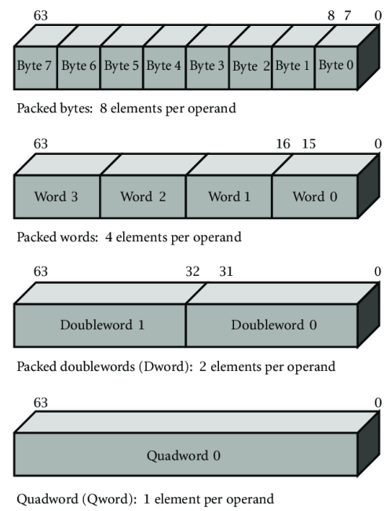
Organization of MMX Registers

Slide 10
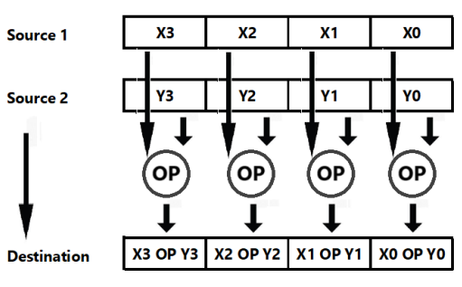
MMX Operations

Slide 11
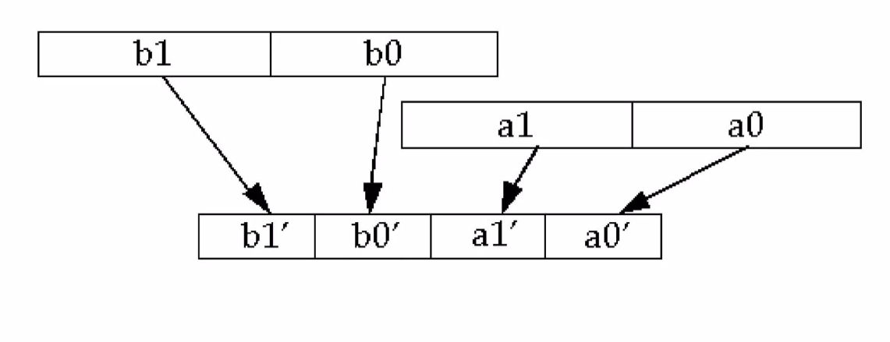
Pack: The PACK instructions in MMX are used to pack data elements from two MMX registers into a single MMX register

Slide 12
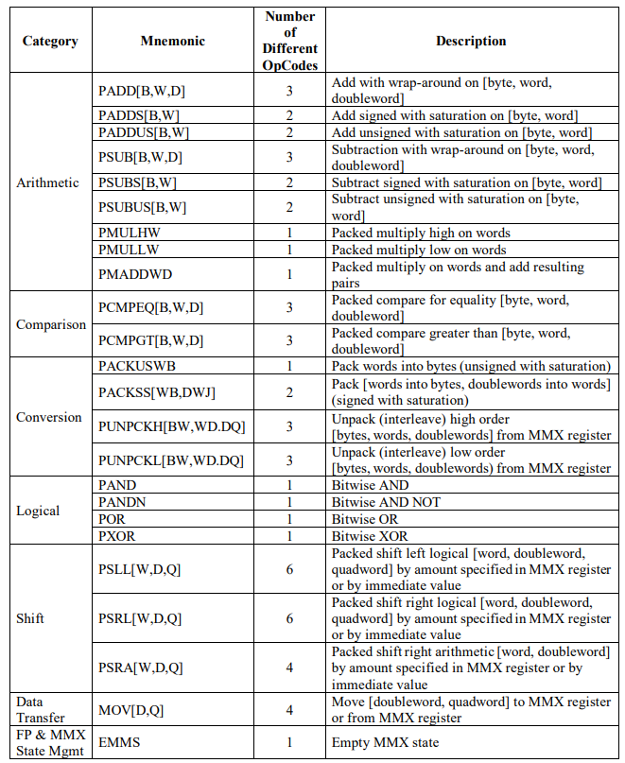
MMX Instruction Set

Slide 13
Wrap Around Add
Suppose, we are dealing with 16 bit packed data
4 slots of 16 bit data comprising 64 bits in total
If sum exceeds 16 bits in any of the destination slot, or in other words, there is a carry on the most significant bit;
The carry (or the 17th bit) will be discarded and the sum will be wrapped around to keep it to 16 bits
Wrap-around: Adding anything to the max → goes back to min (like a clock).
Saturation: Adding anything to the max → stays at max; subtracting from min → stays at min.

Slide 14
Wrap Around and Saturation
Bit-width | Type | Addition Behavior | Min | Max | Example (FF + 01)
8-bit | - | Wrap-around | 00 | FF | FF + 01 → 00
8-bit | Unsigned | Saturation | 00 | FF | FF + 01 → FF
8-bit | Signed | Saturation | 80 | 7F | 7F + 01 → 7F
16-bit | - | Wrap-around | 0000 | FFFF | FFFF + 0001 → 0000
16-bit | Unsigned | Saturation | 0000 | FFFF | FFFF + 0001 → FFFF
16-bit | Signed | Saturation | 8000 | 7FFF | 7FFF + 0001 → 7FFF
32-bit | - | Wrap-around | 00000000 | FFFFFFFF | FFFFFFFF + 1 → 00000000
32-bit | Unsigned | Saturation | 00000000 | FFFFFFFF | FFFFFFFF + 1 → FFFFFFFF
32-bit | Signed | Saturation | 80000000 | 7FFFFFFF | 7FFFFFFF + 1 → 7FFFFFFF

Slide 15
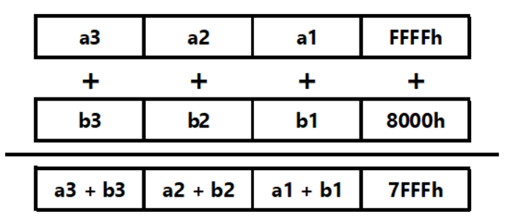
Signed Saturation

Slide 16
Unsigned Saturation
In case of overflow or underflow (for subtraction), the result will be saturated/clamped to a specified value
The range for 16 bit data is 0x0000 to 0xFFFF (0-65535 in decimal)
If the result is lower than zero, it will be automatically converted (saturated) to 0x0000
If the result exceeds 65535, it will be saturated to 0xFFFF
For a signed word the largest and the smallest representable values are 7FFFh and 0x8000.

Slide 17
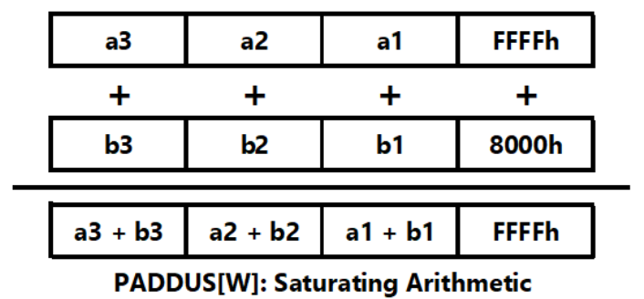
Unsigned Saturation

Slide 18
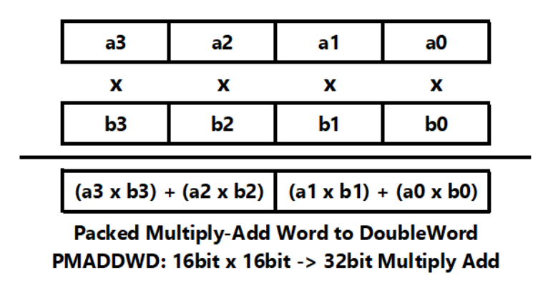
Multiplication using MMX

Slide 19
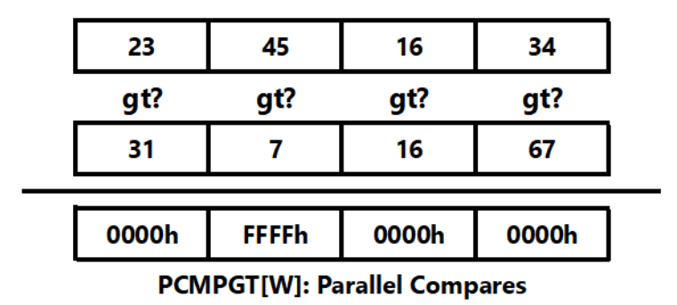
Comparison using MMX

Slide 20
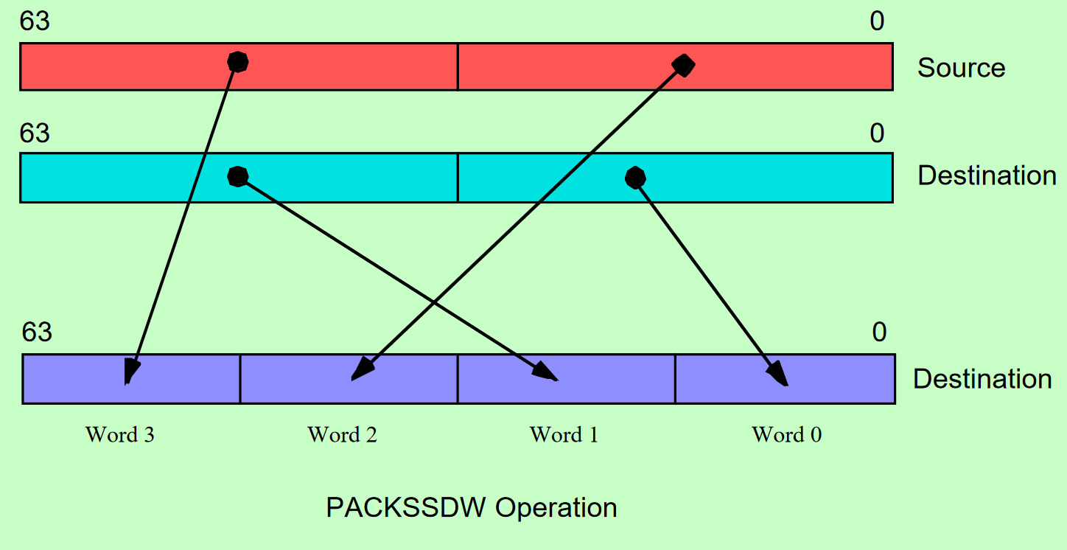
Double Word -> Word

Slide 21
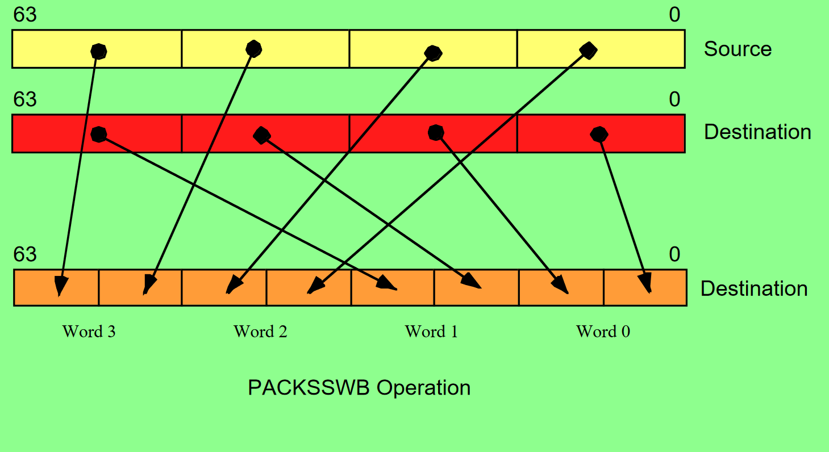
Word -> Byte

Slide 22
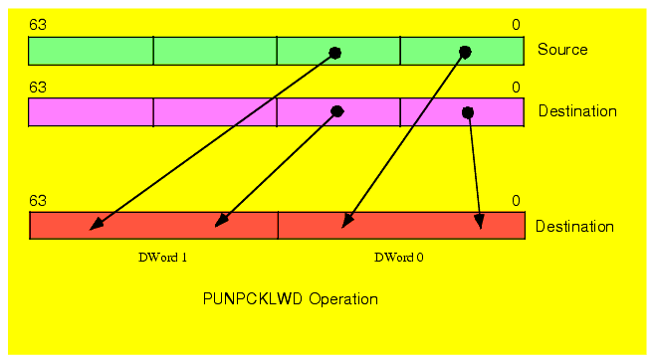
Interleave – punpcklwd

Slide 23
EMMS Instruction
Used to clear the multimedia state after performing MMX operations
Used to ensure that the MMX state is not accidentally used in subsequent floating-point operations
Used to reset the multimedia state of the processor, clearing any MMX registers and freeing them up for use by other instructions
Used at the end of a block of code that uses MMX instructions to ensure that the processor’s multimedia state is in a known state before continuing to execute other instructions

Slide 24
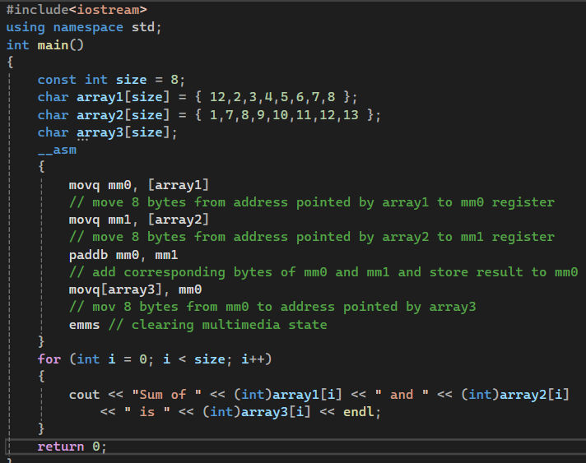
Example – 1
Notes:
#include<iostream>
using namespace std;
int main()
{
const int size = 8;
char array1[size] = { 12,2,3,4,5,6,7,8 };
char array2[size] = { 1,7,8,9,10,11,12,13 };
char array3[size];
__asm
{
movq mm0, [array1]
// move 8 bytes from address pointed by array1 to mm0 register
movq mm1, [array2]
// move 8 bytes from address pointed by array2 to mm1 register
paddb mm0, mm1
// add corresponding bytes of mm0 and mm1 and store result to mm0
movq[array3], mm0
// mov 8 bytes from mm0 to address pointed by array3
emms // clearing multimedia state
}
for (int i = 0; i < size; i++)
{
cout << "Sum of " << (int)array1[i] << " and " << (int)array2[i]
<< " is " << (int)array3[i] << endl;
}
return 0;
}

Slide 25
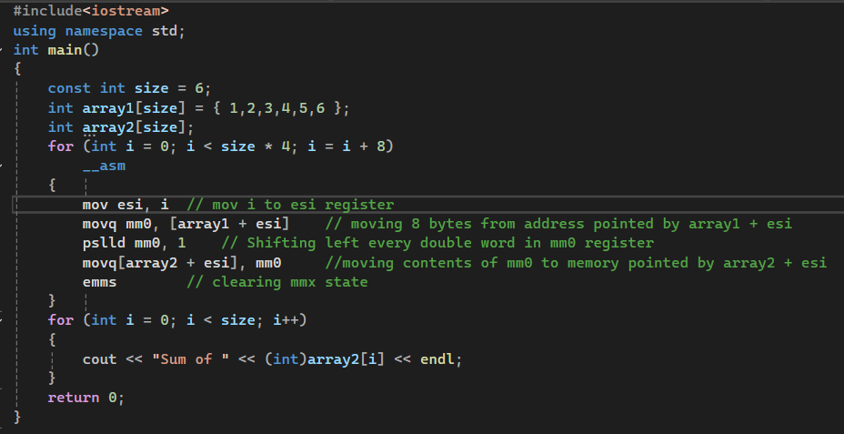
Example – 2
Notes:
#include<iostream>
using namespace std;
int main()
{
const int size = 6;
int array1[size] = { 1,2,3,4,5,6 };
int array2[size];
for (int i = 0; i < size * 4; i = i + 8)
__asm
{
mov esi, i// mov i to esi register
movq mm0, [array1 + esi]// moving 8 bytes from address pointed by array1 + esi
pslld mm0, 1// Shifting left every double word in mm0 register
movq[array2 + esi], mm0//moving contents of mm0 to memory pointed by array2 + esi
emms// clearing mmx state
}
for (int i = 0; i < size; i++)
{
cout << "Sum of " << (int)array2[i] << endl;
}
return 0;
}

Slide 26
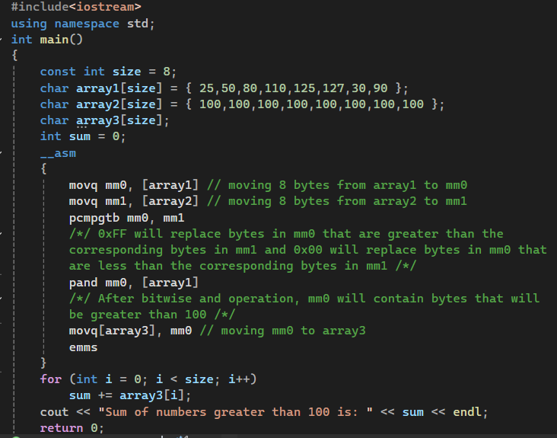
Example – 3
Notes:
#include<iostream>
using namespace std;
int main()
{
const int size = 8;
char array1[size] = { 25,50,80,110,125,127,30,90 };
char array2[size] = { 100,100,100,100,100,100,100,100 };
char array3[size];
int sum = 0;
__asm
{
movq mm0, [array1] // moving 8 bytes from array1 to mm0
movq mm1, [array2] // moving 8 bytes from array2 to mm1
pcmpgtb mm0, mm1
/*/ 0xFF will replace bytes in mm0 that are greater than the
corresponding bytes in mm1 and 0x00 will replace bytes in mm0 that
are less than the corresponding bytes in mm1 /*/
pand mm0, [array1]
/*/ After bitwise and operation, mm0 will contain bytes that will
be greater than 100 /*/
movq[array3], mm0 // moving mm0 to array3
emms
}
for (int i = 0; i < size; i++)
sum += array3[i];
cout << "Sum of numbers greater than 100 is: " << sum << endl;
return 0;
}

Slide 27
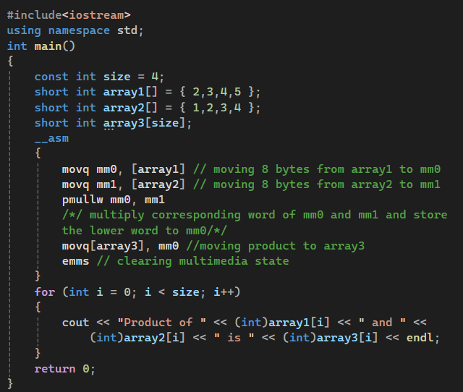
Example – 4
Notes:
#include<iostream>
using namespace std;
int main()
{
const int size = 4;
short int array1[] = { 2,3,4,5 };
short int array2[] = { 1,2,3,4 };
short int array3[size];
__asm
{
movq mm0, [array1] // moving 8 bytes from array1 to mm0
movq mm1, [array2] // moving 8 bytes from array2 to mm1
pmullw mm0, mm1
/*/ multiply corresponding word of mm0 and mm1 and store
the lower word to mm0/*/
movq[array3], mm0 //moving product to array3
emms // clearing multimedia state
}
for (int i = 0; i < size; i++)
{
cout << "Product of " << (int)array1[i] << " and " <<
(int)array2[i] << " is " << (int)array3[i] << endl;
}
return 0;
}

