Slide 1
Performance Measure
Performance measures are used to evaluate how well a classification model is working.
The most common measures are based on the Confusion Matrix.

Slide 2
1. Confusion Matrix (Binary Classification)
Binary classification means there are only 2 classes:
Yes / No
Spam / Not Spam
Disease / Healthy
Suppose we built a model to detect Spam Emails.

Slide 3
Confusion Matrix
TP = Actual Positive & Predicted Positive
TN = Actual Negative & Predicted Negative
FP = Actual Negative but Predicted Positive
FN = Actual Positive but Predicted Negative

Slide 4
Example
False Positive (FP)
Model predicted Spam, but actually it was Not Spam.
FP = 5
Also called:
Type I Error
False Alarm
False Negative (FN)
Model predicted Not Spam, but actually it was Spam.
FN = 10
Also called:
Type II Error
Missed Detection
Actual / Predicted | Spam | Not Spam
Spam(40) | 40 | 10
Not Spam (45) | 5 | 45
True Positive (TP)
Model predicted Spam, and actually it was Spam.
TP = 40
True Negative (TN)
Model predicted Not Spam, and actually it was Not Spam.
TN = 45

Slide 5

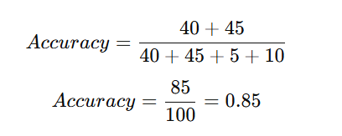
2-Accuracy
Accuracy tells:
Out of all predictions, how many were correct?
Accuracy 85%

Slide 6
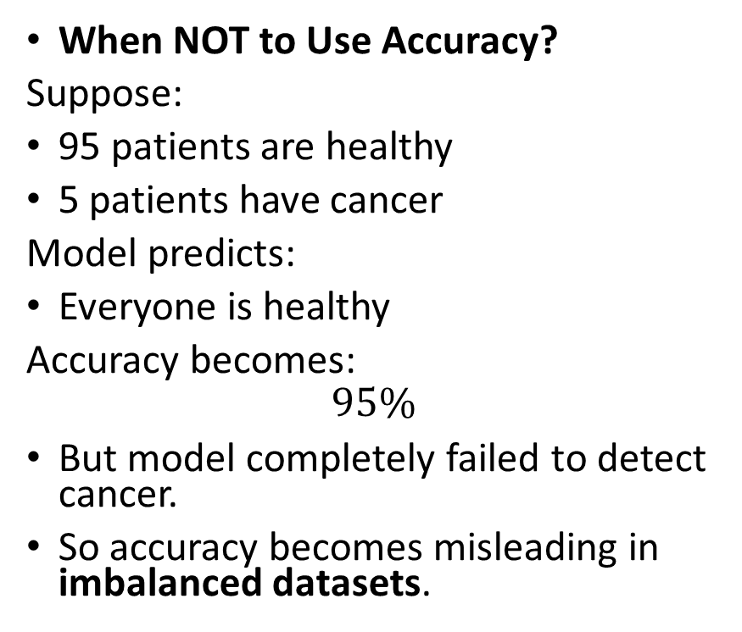
When to Use Accuracy?
Use Accuracy when:
Classes are balanced
Both errors are equally important
When NOT to Use Accuracy?
Suppose:
95 patients are healthy
5 patients have cancer
Model predicts:
Everyone is healthy
Accuracy becomes:
$$95\%$$
But model completely failed to detect cancer.
So accuracy becomes misleading in imbalanced datasets.
Actual / Predicted | TP | TN
healthy(95) N | 0 | 95
unhealthy (5) P | 0 | 5
 | FP | FN
Notes:
TP (Unhealthy correctly detected) = 0 TN (Healthy correctly detected) = 95 FP (Healthy predicted as unhealthy) = 0 FN (Unhealthy predicted as healthy) = 5

Slide 7
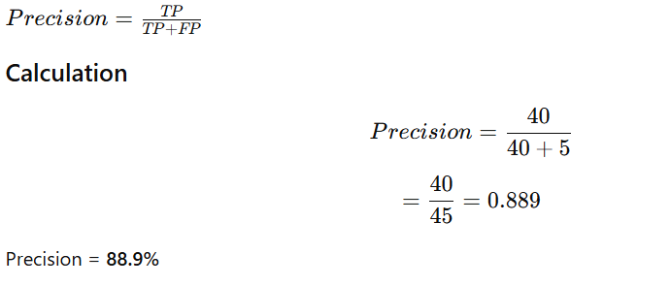
3. Precision
Meaning of Precision
When model says: “This email is Spam”
How often is it correct?
When to Use Precision?
Use Precision when:
False Positives are dangerous
Fraud Detection
If innocent people are flagged as fraud:
Accounts may freeze unnecessarily
Need high precision.
Precision tells:
Out of all predicted positive cases, how many were actually positive?
Notes:
For unhealthy case it will be 0/0+0=0

Slide 8
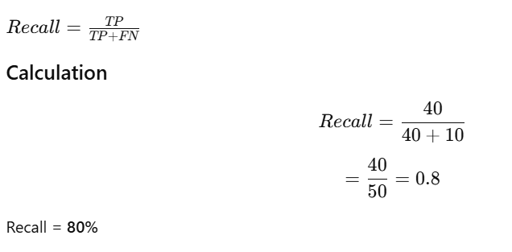
4.Recall
Recall tells:
Out of all actual positive cases, how many did the model correctly find?
Meaning:
Out of all spam emails:
How many did we actually detect?
Use Recall when:
Missing positive cases is dangerous
Disease Detection
Missing cancer patient is very risky.
Need high recall.
Notes:
For unhealthy case it will be 0/0+5=0

Slide 9
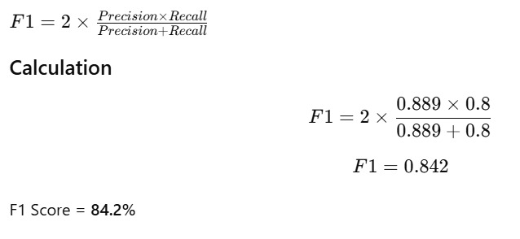
5. F1 Score
Sometimes:
Precision is high
Recall is low
OR
Recall is high
Precision is low
F1 gives a balanced value.
Use F1 when:
Dataset is imbalanced
Need balance between Precision and Recall
F1 Score balances both:
Precision
Recall

Slide 10
Multi-Class Confusion Matrix
Binary confusion matrix has:
2 classes
Multi-class confusion matrix has:
3 or more classes
Suppose we have a model that classifies fruits into:
Class A = Apple
Class B = Banana
Class C = Cherry
We test it on 30 samples.

Slide 11
Multi-Class Confusion Matrix
Actual \ Predicted | Apple (A) | Banana (B) | Cherry (C)
Apple (A) | 8 | 1 | 1
Banana (B) | 2 | 6 | 2
Cherry (C) | 1 | 1 | 8
Class A (Apple)
True Positives (TP) = 8
False Positives (FP) = predicted Apple but wrong
= 2 (Banana→Apple) + 1 (Cherry→Apple) = 3
False Negatives (FN) = actual Apple but missed
= 1 (Apple→Banana) + 1 (Apple→Cherry) = 2

Slide 12
Multi-Class Confusion Matrix
Class B (Banana)
TP = 6
FP = 1 (Apple→Banana) + 1 (Cherry→Banana) = 2
FN = 2 (Banana→Apple) + 2 (Banana→Cherry) = 4
Class C (Cherry)
TP = 8
FP = 1 (Apple→Cherry) + 2 (Banana→Cherry) = 3
FN = 1 (Cherry→Apple) + 1 (Cherry→Banana) = 2
Find the other terms as well.

Slide 13
Exercise : Disease Prediction
A model predicts whether a patient has a disease.
40 sick patients were correctly predicted as sick.
15 sick patients were predicted healthy.
10 healthy patients were predicted sick.
135 healthy patients were correctly predicted healthy.
Task
Construct the confusion matrix.

Slide 14
 | Predicted Sick | Predicted Healthy
Actual Sick | 40 (TP) | 15 (FN)
Actual Healthy | 10 (FP) | 135 (TN)

Slide 15
Exercise : Student Pass/Fail Prediction
A model predicts whether students will pass.
60 students actually passed and were predicted pass.
20 students actually passed but were predicted fail.
15 students actually failed but were predicted pass.
105 students actually failed and were predicted fail.
Task
Draw the confusion matrix.
Notes:
TP = 60 FN = 20 FP = 15 TN = 105

Slide 16
A face-recognition system checks whether a person is authorized.
Results:
Authorized and predicted authorized = 70
Authorized but predicted unauthorized = 12
Unauthorized but predicted authorized = 8
Unauthorized and predicted unauthorized = 110
Task
1. Create the confusion matrix.
2. Identify TP, TN, FP, FN.
3. Calculate accuracy.
Notes:
TP = 70 FN = 12 FP = 8 TN = 110

Slide 17
Class participation
A disease test was performed on 200 people.
50 people actually had the disease.
Out of these 50, the test correctly identified 40.
Out of the remaining 150 healthy people, the test incorrectly identified 30 as diseased.
Find:
1. TP, TN, FP, FN
2. Confusion Matrix
3. Accuracy

