Slide 1
Cyber Security
Week-1
Semester- Spring 2026

Slide 2
Instructor Contact Details
Name: Muhammad Bilal Khan
Course Instructor: Cyber Security
Credit Hours: 3
Designation : Senior Lecturer
Office Location: Cabin 38, Gym Building
Email: Muhammad.bilalkhan@ucp.edu.pk
Visiting Hours: TBA

Slide 3
Course Objectives
This course offers an introduction to key cybersecurity concepts, focusing on common threats, vulnerabilities, and risks across web applications, networks, software, and mobile platforms. Students will learn essential terminology and concepts in the cybersecurity field, while also gaining the ability to identify various types of malwares and understand their impact on computers and networks. This course provides a strong foundation for understanding cybersecurity fundamentals..

Slide 4
Security Motivation Factors
Three important motives of students to support security at organization level are:
You can not be an IT expert without knowing IT security
vulnerable IT systems
“Security by design” is a requirement
Information security is a political issue
Notes:
Would you hire a civil engineer who doesn’t know earthquake safety?”
Then say:
Every software system can be attacked.
If you don’t understand security, your system can be hacked.
A programmer who ignores security writes incomplete software.
Why do hackers still succeed if companies spend millions?”
Because:
Weak passwords
Unpatched software
Misconfigured servers
Human mistakes
🔹 Simple Analogy:
A house with:
Strong walls
But unlocked door
👉 That’s a vulnerable system.
Tell them:
“Most attacks exploit mistakes, not magic.”
Security affects:
National security
Elections
Military systems
Citizen data privacy
International relations
🔹 Real Examples:
Election hacking
Cyber warfare
Data privacy laws
Social media misinformation
Tell them:
“Cyber security is not only technical — it is about power and control.”

Slide 5
Introduction to Cyber Security
“Cyber security refers to the protection of information systems (hardware, software and associated infrastructure), the data on them, and the services they provide, from unauthorised access, harm or misuse. This includes harm caused intentionally by the operator of the system, or accidentally, as a result of failing to follow security procedures.” - UK National Cyber Security Strategy

Slide 6
Introduction to Cyber Security
“Cyber Security focuses specifically on protecting digital systems, networks, and cyberspace from cyber attacks.”
It protects:
Networks
Computers
Servers
Cloud systems
IoT devices
Applications

Slide 7
Importance of Cyber Security
Cyber security is essential for ensuring the confidentiality, integrity, and availability of digital assets, protecting critical infrastructure, maintaining economic stability, and enabling trustworthy digital transformation.

Slide 8
The History of Information Security
Began immediately following development first mainframes
  Developed for code-breaking computations
  During World War II
  Multiple levels of security were implemented
Physical controls
  Defending against physical theft, espionage, and sabotage

Slide 9
What is Security?
“The quality or state of being secure—to be free from danger”
A successful organization should have multiple layers of security in place:
  Physical security
  Personal security
  Operations security
  Communications security
  Network security
  Information security
Notes:
Security is not just about installing antivirus software. A strong organization protects its buildings, its people, its operations, its communications, its networks, and its data. If one layer fails, other layers still protect the system. This is called layered security or defense in depth.”

Slide 10
What is Security? (cont’d.)‏
The protection of information and its critical elements, including systems and hardware that use, store, and transmit that information
Necessary tools: policy, awareness, training, education, technology
C.I.A. triangle
  Was standard based on confidentiality, integrity, and availability
  Now expanded into list of critical characteristics of information

Slide 11

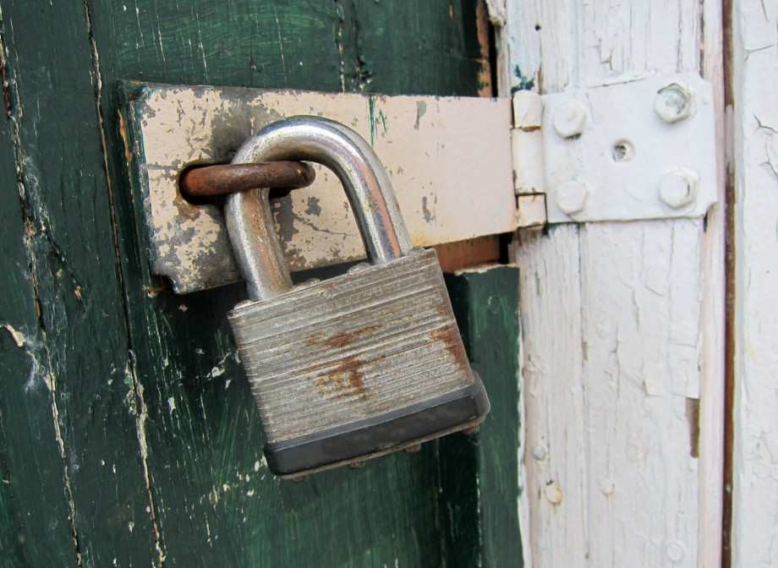
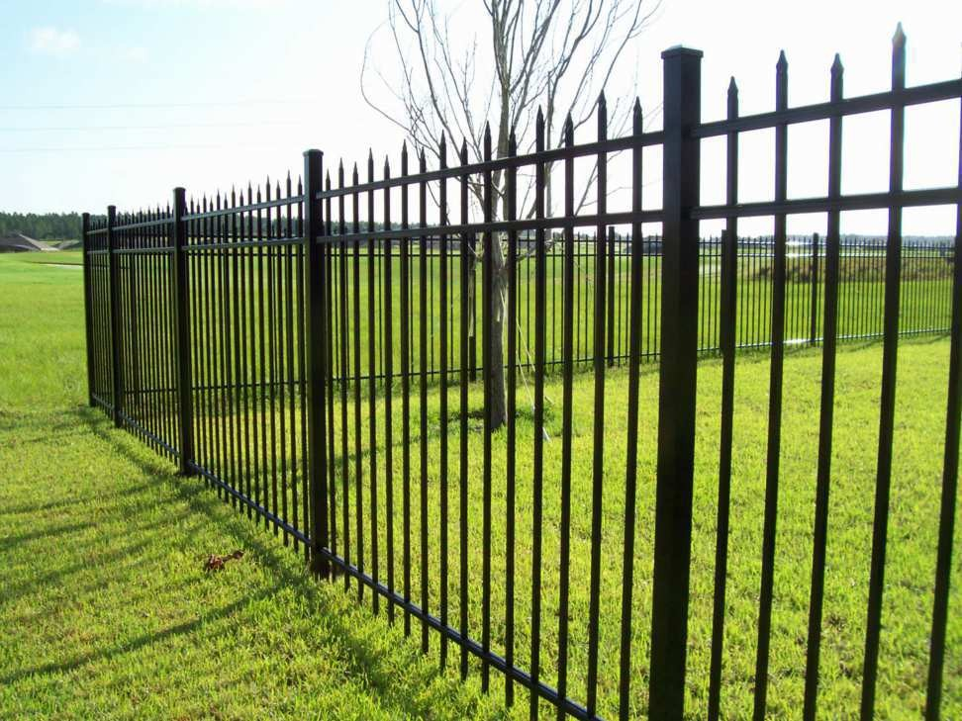
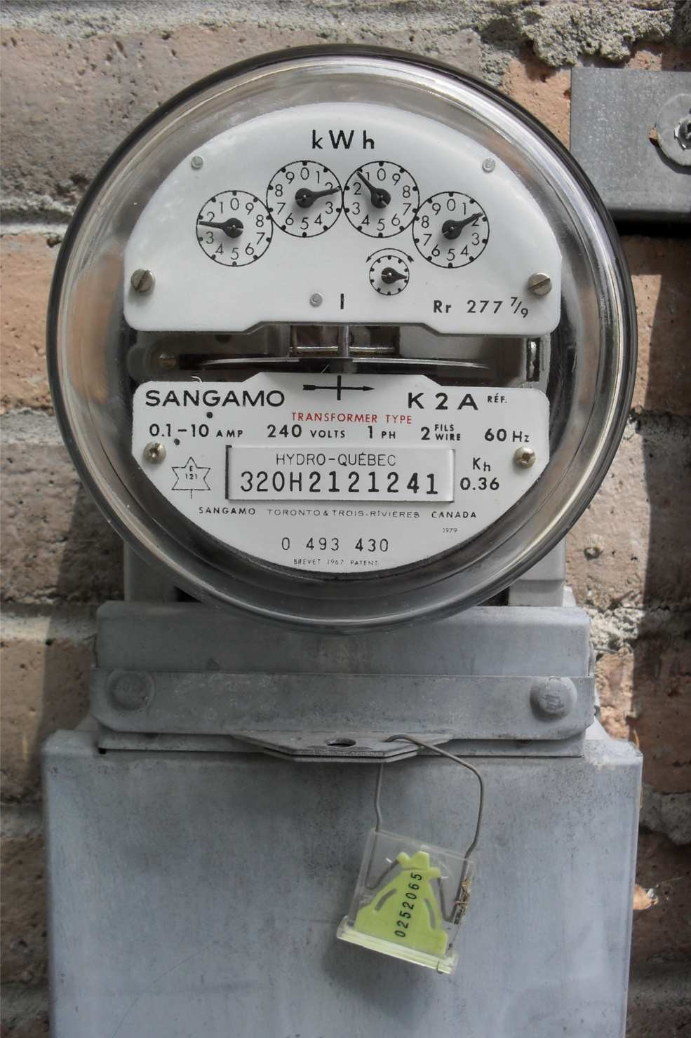


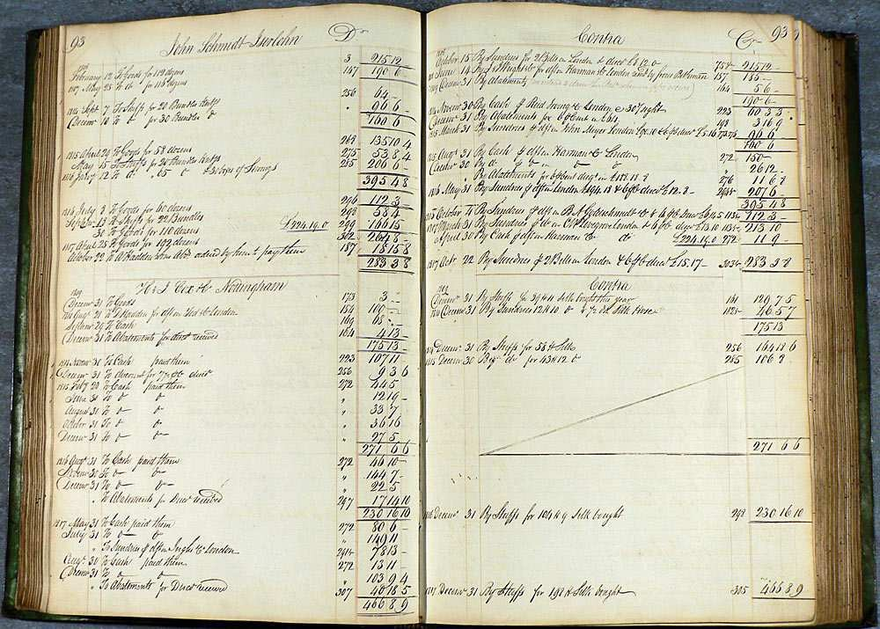
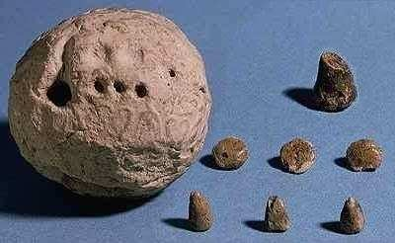
Motivation
People have always tried to protect their property

Slide 12
Basics of Information Security
CIA Model
Basic Terminologies
Security Attacks, Mechanisms & Services
Models for Network Security

Slide 13
What is Information Security?
Protection from unauthorized access
Protection against disclosure, modification, destruction
Applies to data at rest, in transit, and in use

Slide 14
Goals of Information Security
Protect organizational assets
Maintain trust
Prevent cyber attacks
Ensure business continuity

Slide 15
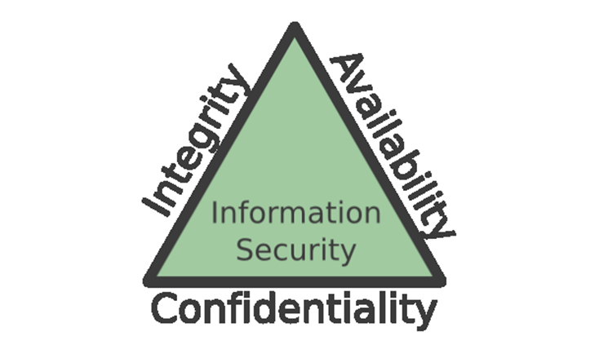
CIA Triad Overview
Confidentiality
Integrity
Availability
Notes:
Ensuring that information is accessible only to authorized users.
🔎 Goal:
Prevent unauthorized disclosure of data.
🛠 How it is achieved:
Encryption
Passwords
Multi-Factor Authentication (MFA)
Access control policies
Role-based access control (RBAC)
🎓 Example for Students:
Student grades should only be seen by the student and authorized faculty.
Bank account details should not be accessible to strangers.
If confidentiality is broken → Data breach

Slide 16

Confidentiality
Accessible only to authorized users
Methods:
  Encryption
  Passwords
  Access control
  Two-factor authentication

Slide 17
Integrity
Ensures accuracy and consistency
Methods:
  Hash functions
  Digital signatures
  Checksums
Notes:
Ensuring that data is accurate, complete, and not altered without authorization.
🔎 Goal:
Prevent unauthorized modification.
🛠 How it is achieved:
Hash functions
Digital signatures
Checksums
Version control
Database constraints
🎓 Example:
Exam marks should not be changed by unauthorized users.
Financial records must not be modified illegally.
If integrity is broken → Data tampering

Slide 18
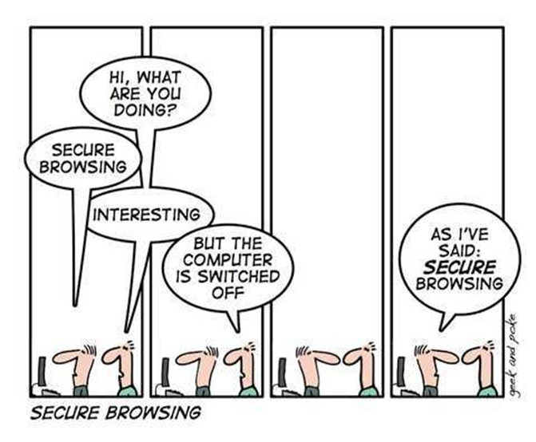
Availability
Ensures systems are available when needed
Methods:
  Backups
  Redundancy
  Disaster recovery
Notes:
Ensuring that systems and data are available when needed.
🔎 Goal:
Prevent service disruption.
🛠 How it is achieved:
Backup systems
Redundant servers
Load balancing
Disaster recovery plans
Protection against DDoS attacks
🎓 Example:
University portal should work during result day.
ATM machines must be operational.
If availability is broken → Denial of Service

Slide 19
Components of an Information System
Information system (IS) is entire set of components necessary to use information as a resource in the organization
  Software
  Hardware
  Data
  People
  Procedures
  Networks

Slide 20
Basic Terminologies (Part 1)
Attack
Threat
Vulnerability
Malware

Slide 21

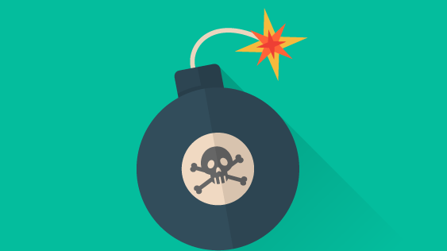
Threats
A threat is a person or an entity that can harm you A threat can be malicious or malignant
Malicious: intending to hurt you
Malignant: harmful, but no intent to hurt you
Notes:
A threat that causes harm without intent.
There is no deliberate plan to damage the system.
🎯 Examples:
Power failure
Natural disasters (flood, earthquake)
Employee accidentally deleting important files
Hardware failure
These are accidental or environmental threats.

Slide 22
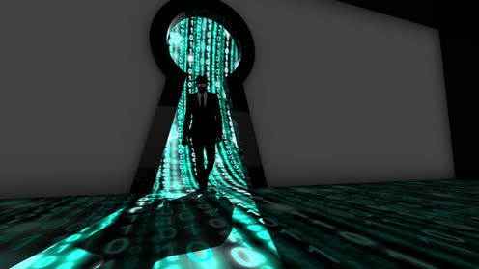
Vulnerabilities
A vulnerability is a weakness that allows a threat to exploit you
Notes:
eak password → Vulnerability
2️⃣ Outdated software → Vulnerability
3️⃣ Misconfigured firewall → Vulnerability
4️⃣ No data backup → Vulnerability

Slide 23
Types of Security Attacks
• Passive Attacks
• Active Attacks

Slide 24
Passive Attacks
No data alteration
Eavesdropping
Traffic analysis

Slide 25
Active Attacks
Data modification
Masquerade
Replay
Denial of Service

Slide 26
Malware
Malware (short for malicious software) is any software intentionally designed to infiltrate, damage, disrupt, or gain unauthorized access to computer systems, networks, or data.
It is one of the primary threats addressed in Cyber Security.

Slide 27
Malware
Malware can:
  Steal sensitive information
  Encrypt files for ransom
  Spy on users
  Disrupt operations
  Take control of entire networks

Slide 28
Types of Malware
Virus
Attaches to legitimate files
Spreads when the infected file runs
Requires human action
Worm
Self-replicating
Spreads automatically across networks
Does not require user interaction

Slide 29
Types of Malware
Trojan Horse
Disguised as legitimate software
Creates backdoors for attackers
Ransomware
Encrypts files
Demands payment for decryption

Slide 30
Types of Malware
Spyware
Monitors user activity
Steals passwords and financial data
Adware
Displays unwanted advertisements
May track user behavior
Rootkit
Hides malicious activity
Provides stealth access to attackers

Slide 31
How Malware Spread
Phishing emails
Infected USB drives
Malicious websites
Software vulnerabilities
Drive-by downloads

Slide 32
Protection Mechanism
Antivirus and Endpoint Detection & Response(EDR)
Firewalls
Intrusion Detection Systems (IDS)
Regular patching
Secure coding practices
AI-based anomaly detection

Slide 33
Summary
CIA is foundation
Understand threats & vulnerabilities
Services protect communication

Slide 34
Acknowledgement
Slides prepared by Ms. Mahek Kausar

