Slide 1
General Knowledge
A XOR B = C
Where:
A = Message B = Key
C = Ciphertext
Receiver will get C, B C XOR B = A
C XOR A = B

Slide 2
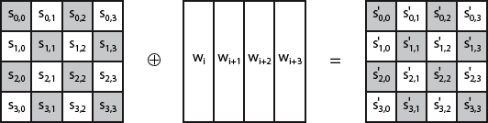
Add Round Key

Slide 3
AES Key Scheduling
The AES key expansion algorithm takes as input a 4-word (16-byte) key.
Algorithm produces a linear array of words, providing a 4- word round key for the initial AddRoundKey stage and each of the 10/12/14 rounds of the cipher.
It involves copying the key into the first group of 4 words, and then constructing subsequent groups of 4 based on the values of the previous & 4th back words.
The first word in each group of 4 gets “special treatment” with Rotate + S-box + XOR constant on the previous word before XOR’ing the one from 4 back.
In the 256-bit key/14 round version, there’s also an extra
step on the middle word.

Slide 4
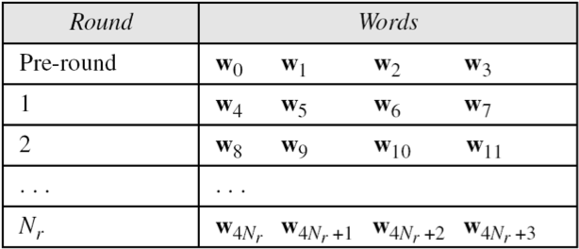
AES Key Scheduling

Slide 5
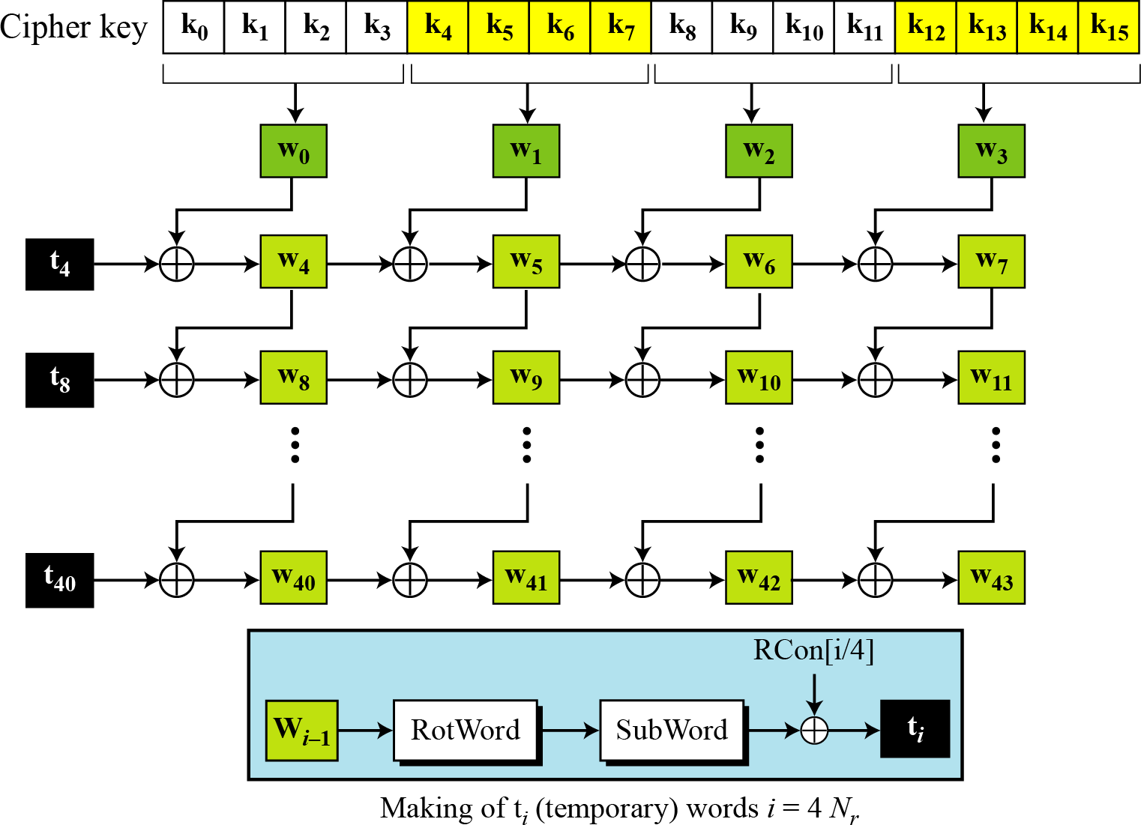
Key Expansion Scheme

Slide 6
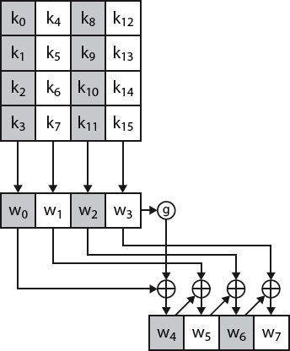
Key Expansion Scheme

Slide 7
Key Expansion submodule
RotWord performs a one byte circular left shift on a word For example:
RotWord[b0,b1,b2,b3] = [b1,b2,b3,b0]
SubWord performs a byte substitution on each byte of input word using the S-box
SubWord(RotWord(temp)) is XORed with RCon[j] – the round constant

Slide 8
Round Constant (RCon)
RCON is a word (32 bits or 4 bytes).
In RCON, three rightmost bytes are zero.
It is different for each round and defined as: RCon[ j ] = ( RCon[ j ], 0, 0, 0 )
where:
RCon[ 1 ] =1 = 01 = 0000 0001
RCon[ j ] = 2 * RCon[ j -1 ]
Multiplication is defined over GF(2^8)

Slide 9
Round Constant (RCon)
Round # | Round Constant (RCON)
1 | ( 01 00 00 00 )₁₆
2 | ( 02 00 00 00 )₁₆
3 | ( 04 00 00 00 )₁₆
4 | ( 08 00 00 00 )₁₆
5 | ( 10 00 00 00 )₁₆
6 | ( 20 00 00 00 )₁₆
7 | ( 40 00 00 00 )₁₆
4 Bytes = 32 Bits = 0000 0000 |  | 0000 0000 |  | 0000 0000 0000 0000
In Hexa 00 |  | 00 |  | 00 |  | 00
RC1 (in Hexa) | 01 |  | 00 |  | 00 | 00
In Binary | 0000 0001 |  | 00000000 |  | 00000000 | 00000000
In Bytes | 1 |  | 0 |  | 0 | 0
8 ( 80 00 00 00 )₁₆
9 ( 1B 00 00 00 )₁₆
10 ( 36 00 00 00 )₁₆

Slide 10
01 00 00 00 2 * (01 00 00 00) 01 = 0000 0001 (in Binary) 2 = 10 X 00000000 00000001x -------------------------- 0 0000 0010 (9 bits) 9 bits can’t be in 1 byte Left most bit is 0, discard it = 0000 0010 = 0 2 | Round Constant (RCON)
 | ( 01 00 00 00 )₁₆
 | ( 02 00 00 00 )₁₆
 | ( 04 00 00 00 )₁₆
 | ( 08 00 00 00 )₁₆
 | ( 10 00 00 00 )₁₆
 | ( 20 00 00 00 )₁₆
 | ( 40 00 00 00 )₁₆
 | ( 80 00 00 00 )₁₆
 | ( 1B 00 00 00 )₁₆
 | ( 36 00 00 00 )₁₆

Slide 11
Round Constant (RCon)
Round # | Round Constant (RCON)
1 | ( 01 00 00 00 )₁₆
2 | ( 02 00 00 00 )₁₆
3 | ( 04 00 00 00 )₁₆
4 | ( 08 00 00 00 )₁₆
5 | ( 10 00 00 00 )₁₆
6 | ( 20 00 00 00 )₁₆
7 | ( 40 00 00 00 )₁₆
8 | ( 80 00 00 00 )₁₆
9 | ( 1B 00 00 00 )₁₆
10 | ( 36 00 00 00 )₁₆

Slide 12
08 00 00 00
2 * (08
Round Constant (RCON)
( 01 00 00 00 )₁₆
( 02 00 00 00 )₁₆
( 04 00 00 00 )₁₆
( 08 00 00 00 )₁₆
( 10 00 00 00 )₁₆
( 20 00 00 00 )₁₆
( 40 00 00 00 )₁₆
( 80 00 00 00 )₁₆
( 1B 00 00 00 )₁₆
( 36 00 00 00 )₁₆
00 00 00)
2* 80 = 10 ?
08 = 0000 1000
10 X
2 =
00000000
0 0001000x
--------------------------
0 00010000 9 bits
9 bits can’t be in 1 byte
= 0001 0000
= 0001 0000
= 1 0

Slide 13
80 00
2 * (80
00 00
00 00 00)
Round Constant (RCON)
( 01 00 00 00 )₁₆
( 02 00 00 00 )₁₆
( 04 00 00 00 )₁₆
( 08 00 00 00 )₁₆
( 10 00 00 00 )₁₆
( 20 00 00 00 )₁₆
( 40 00 00 00 )₁₆
( 80 00 00 00 )₁₆
( 1B 00 00 00 )₁₆
( 36 00 00 00 )₁₆
2* 80 = 1B ?
80 = 1000 0000
10 X
2 =
---------------------------
00000000
10000000x
---------------------------
1 0000 0000 = 9 bits
9 bits can’t be in 1 byte
= x8
x⁸ + x⁴ + x³ + x +1
--------------------------------------
x⁴ + x³ + x + 1
= 0 0 0 1 1 0 1 1
= 1 B

Slide 14

Key Expansion Example (1st Round)
Example of expansion of a 128-bit cipher key
Cipher key = 2b7e151628aed2a6abf7158809cf4f3c
w0=2b7e1516 w1=28aed2a6 w2=abf71588 w3=09cf4f3c
i | ^{w}i-1 | RotWord | SubWord | Rcon[i/4] | t_{i} | w[i-4] | w_{i}
4 | 09cf4f3c | cf4f3c09 | 8a84eb01 | 01000000 | 8b84eb01 | 2b7e1516 | a0fafe17
5 | a0fafe17 | - | - | - | - | 28aed2a6 | 88542cb1
6 | 88542cb1 | - | - | - | - | Abf71588 | 23a33939
7 | 23a33939 | - | - | - | - | 09cf4f3c | 2a6c7605

Slide 15
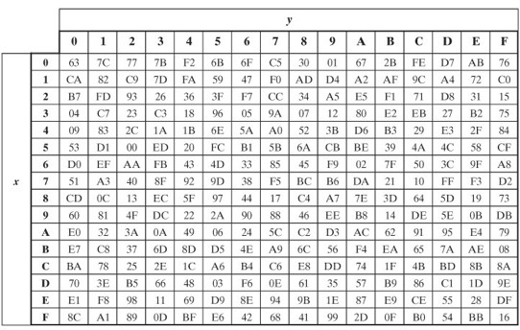
AES S-BOX

Slide 16
Key Expansion Example 2

Slide 17
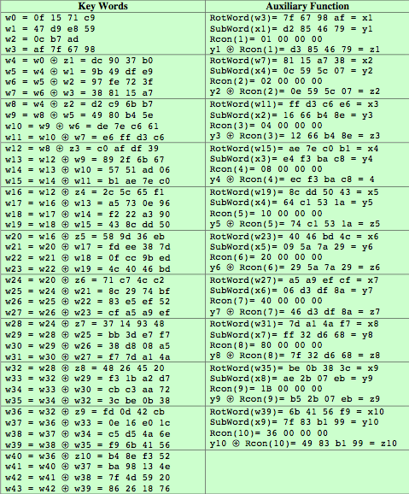
=t₄
=t₈
AES
Example Key Expansion

Slide 18
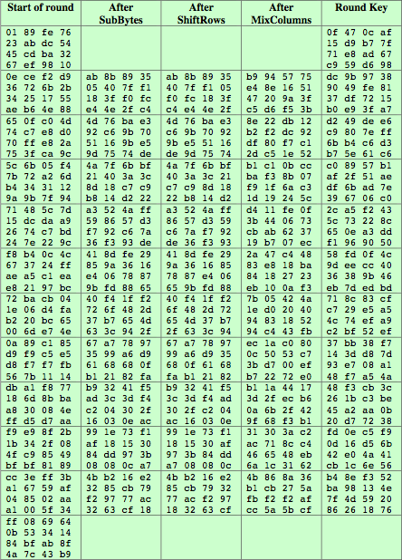
AES
Example Encryption

