Slide 1
Home Display Project
Sharjil Khan

Slide 2
Overview
Project Objectives
High Level Architecture
Capabilities implemented
Advanced Python Concepts Used
Quick Demo

Slide 3
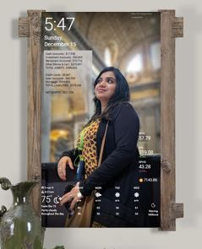
Project Objective
Use APIs provided by different data sources (Banks, Fitness apps, Social Media etc.) collect and aggregate relevant personal data.
Store the data in a database as it is collected.
Use analytics to make decisions. And provide custom notifications to the user.
Put everything together and connect to DakBoard API to display the relevant information to a user using DakBoard.

Slide 4
High level Architecture
Wall Display
Bank Accounts
Credit Card Accounts
Luigi Tasks to interact with the APIs and load the data.
Used Django to create database and store data .
Analytics to make decisions based on the data and put information on the wall display.
Personal Capital API
Stock Accounts
Work in Progress: Not included in this project
Retirement Accounts
Withing's Fitness API
Fitness Watch
Wi-Fi Weight Scale

Slide 5
Capabilities Implemented
Read Financial Data from Personal Capital
Aggregate Financial data and give the user a summary of Financial status:
- All the user’s assets (cash, stocks, bonds, retirement funds etc combined)
- All the user’s liabilities ( credit card balance, loans, mortgages)
- The users net worth
Custom messages that alert the users using analytics on the Django database

Slide 6
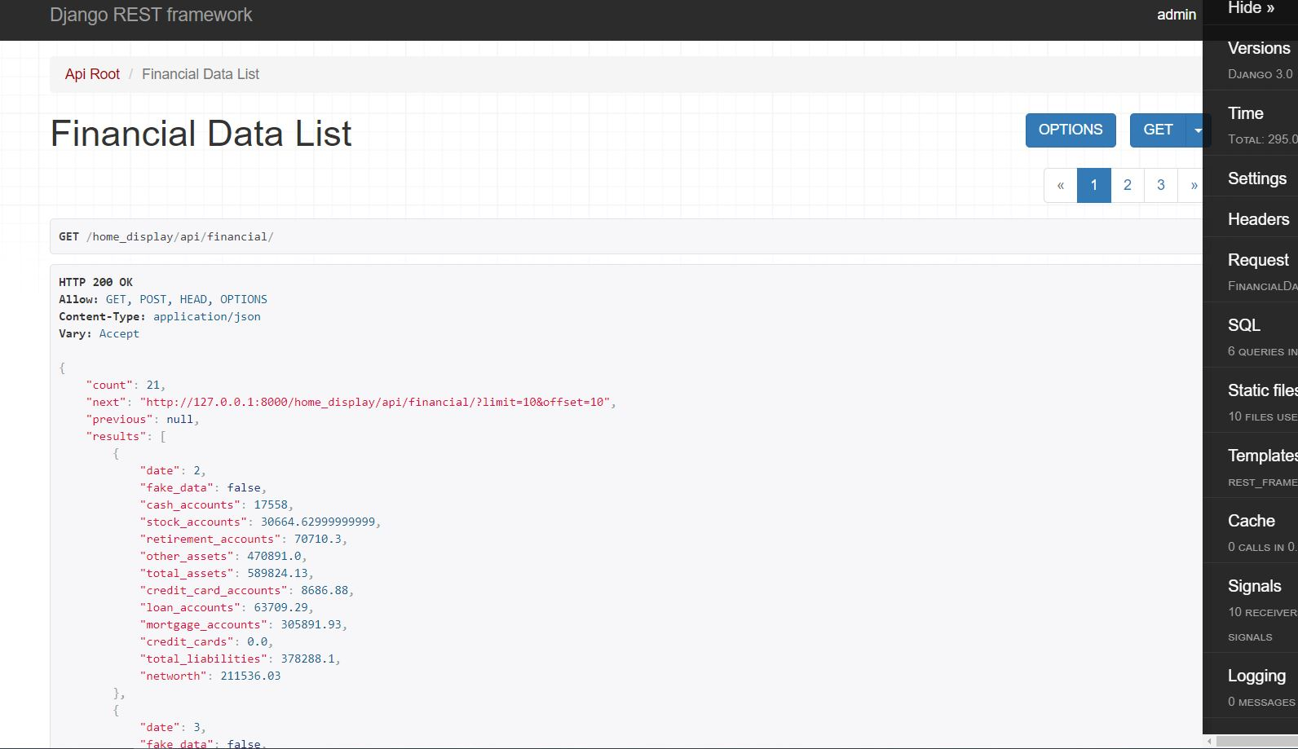
A view of the Django Server

Slide 7
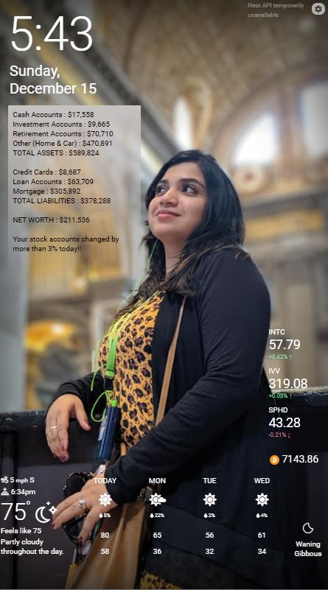
All Assets combined from different accounts
All liabilities combined from different accounts
Net Worth
Custom Alerts

Slide 8
Advanced Python Concepts Used.
Used Luigi to retrieve data and process them in two atomic steps.
Django to store data in the app’s database to be able to run data analytics on it.
Composition to create objects of another class within the classes.
Travis CI to continuously test changes and test build on a different system

