Slide 1
CS 82 Final Project: Dog Breed Detection USING CNN AND TRANSFER LEARNING
Sharjil Khan

Slide 2
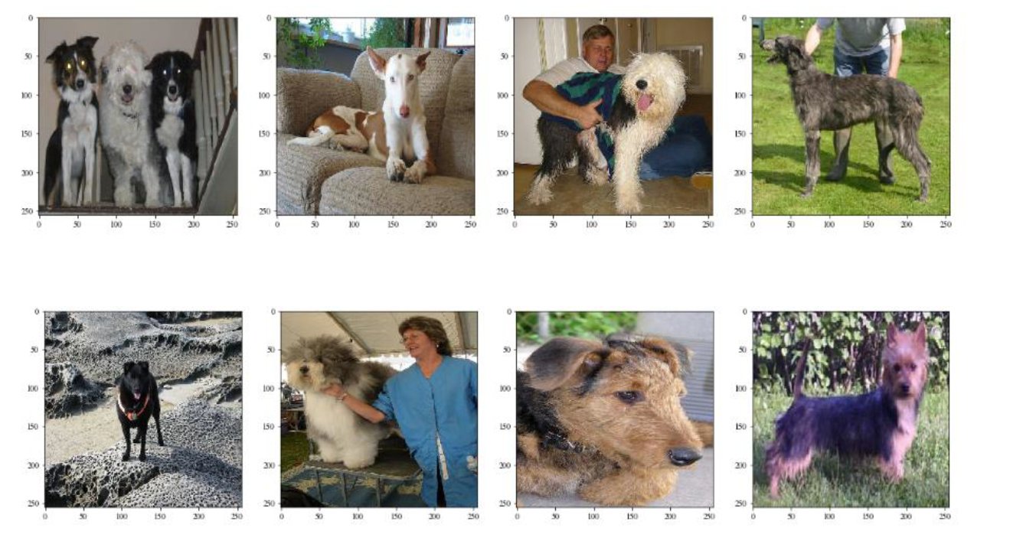
The PROBLEM AND DATA SET
Data Set : http://vision.stanford.edu/aditya86/ImageNetDogs/main.html.
20,580 dog images with over 100 breeds represented.

Slide 3
General Approach TO SOLVE THE PROBLEM
Use Convolutional Neural Networks
Start with easier problems such as classifying between 8 dog breeds
Then move on to more difficult problems of classifying between 16 or 32 breeds
Use partially pre-trained weights (Transfer Learning) with newly trained layers to classy between 100s of breeds

Slide 4
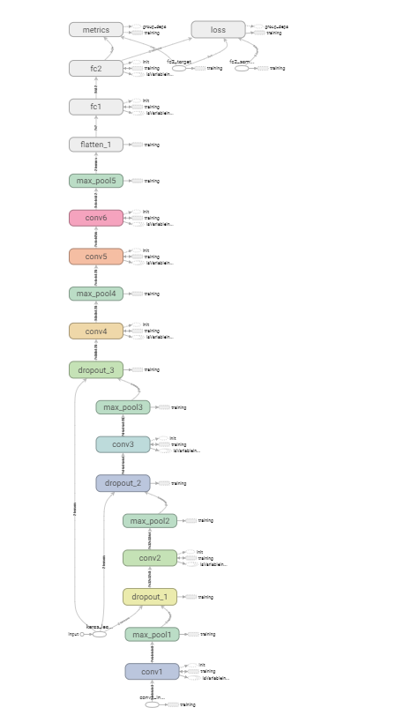
CNN Model Used

Slide 5
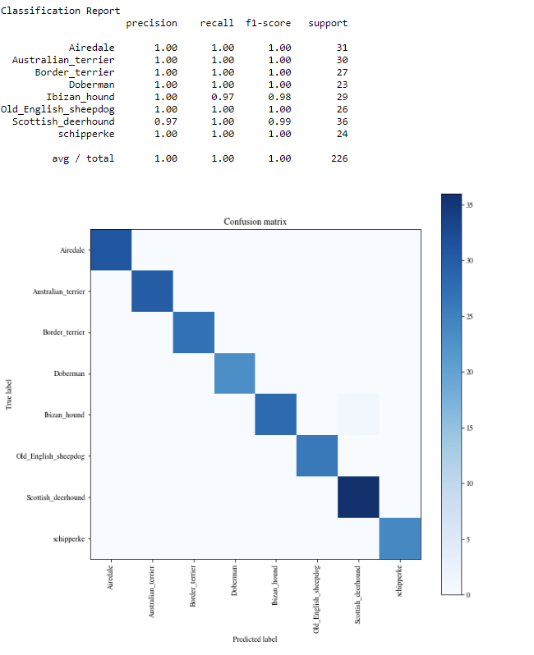

Results with Just 8 dog Breeds
99.6 % Accuracy

Slide 6
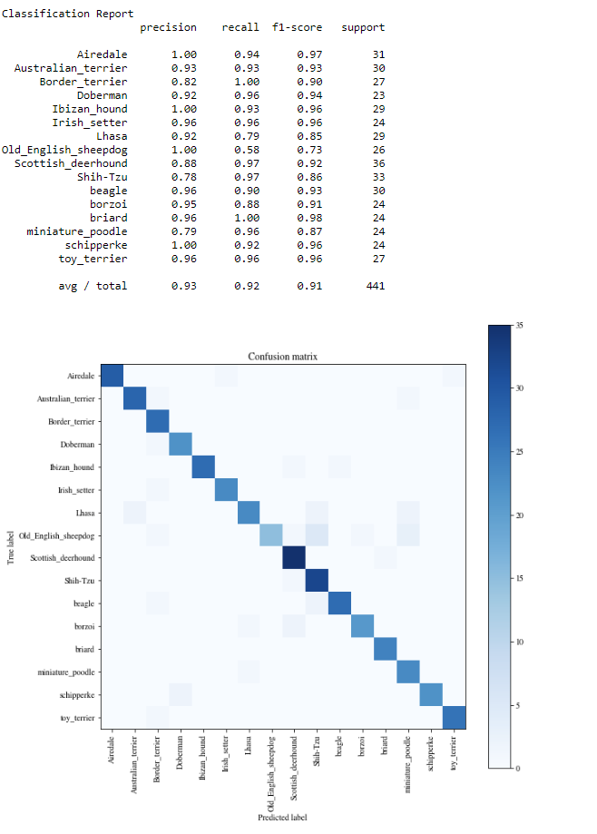
Results with 16 dog Breeds
91.7 % Accuracy

Slide 7
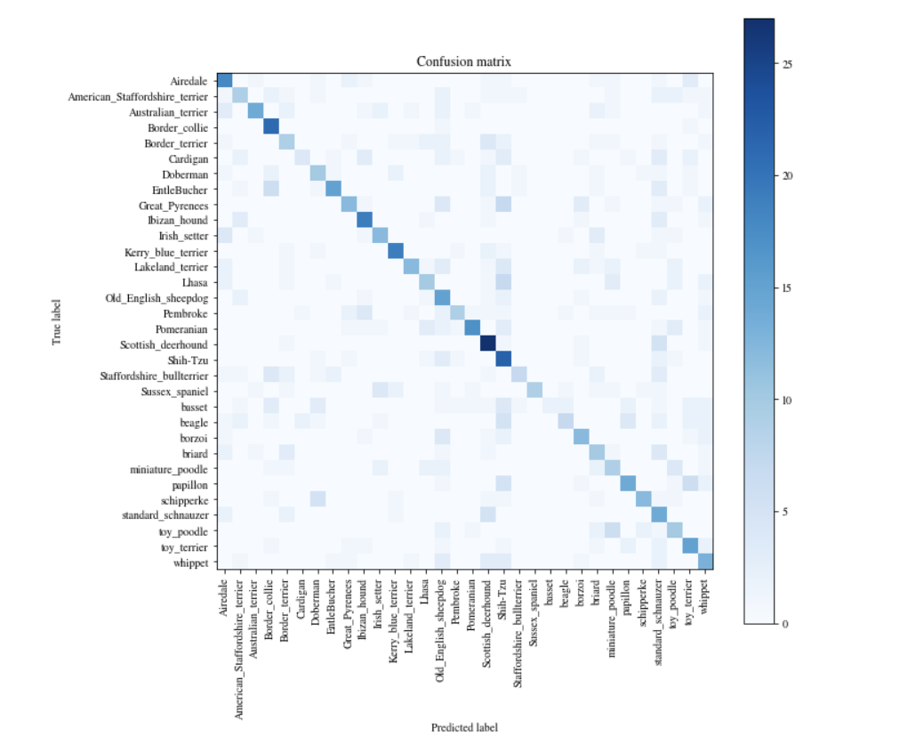
Results with 32 dog Breeds
46.12 % Accuracy

Slide 8
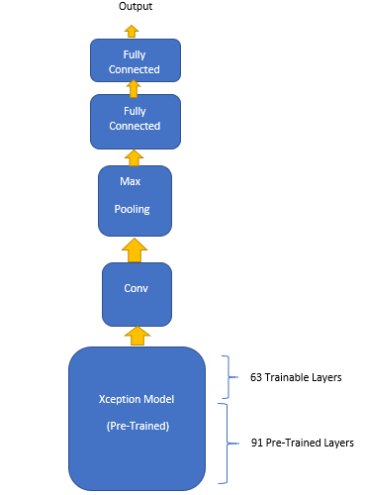
PRE-Trained (XcEPTION) MODEL with LAYERS ADDED AT THE END
Other Options:
ResNETV40
INCEPTION RESNETV2

Slide 9
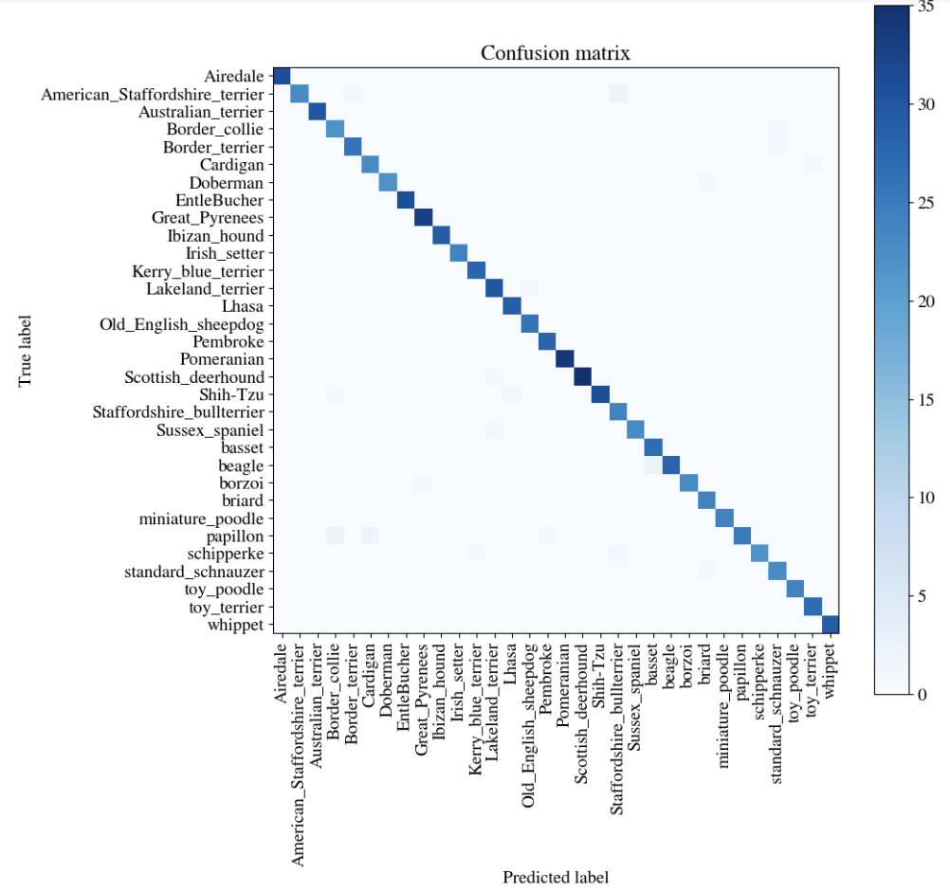
Partially Pre-trained MODEL WITH 32 DOG BREEDS
97.12 % Accuracy

Slide 10
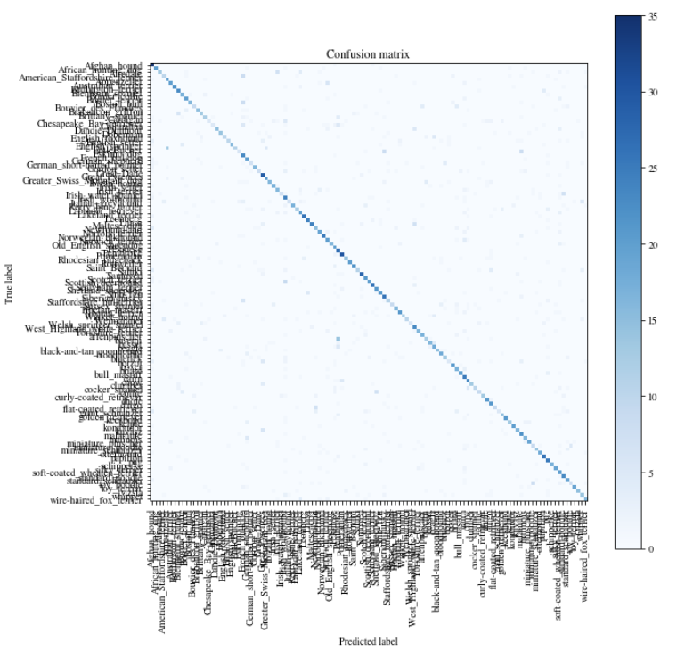
115 DOG BREEDS WITH PARTIALLY PRE-TRAINED MODEL
58.75 % Accuracy

Slide 11
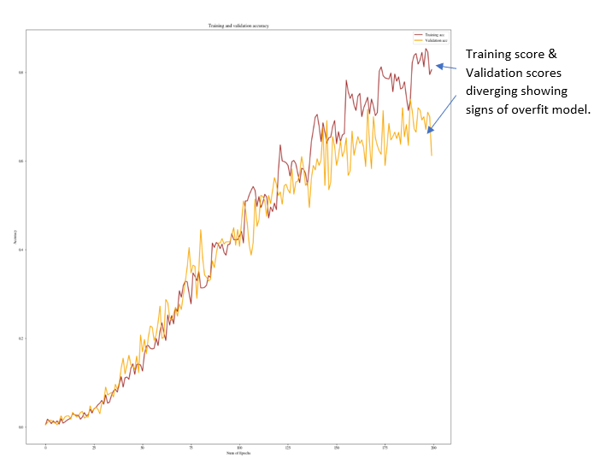
MODEL BEGINS TO OVERFIT DURING TRAINING

Slide 12
115 DOG BREEDS WITH PARTIALLY PRE-TRAINED MODEL
77.87 % Accuracy

Slide 13
SUMMARY OF RESULTS
Convolutional Neural Network :
8 Dog Breeds : 99.6 %
16 Dog Breeds: 91.17 %
32 Dog Breeds: 46.12 %
Pre-Trained Xception Model with some modifications (Transfer Learning):
32 Dog Breeds: 97.12 %
115 Dog Breeds: 77.87%

