Slide 1
SharkyData
Data visualization

Slide 2
Methodology
Load full dataset (with selected columns) of the week
Take a random sample of n visits for each day, keeping all logs of the sampled visits for the week
Conduct EDA on the ≅7*n visits sampled from that day

Slide 3
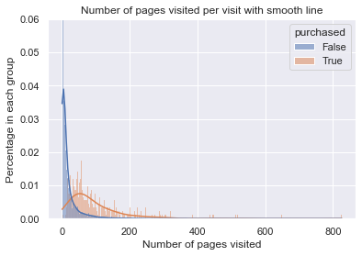
Mean:
False 17.22
True 93.61

Slide 4
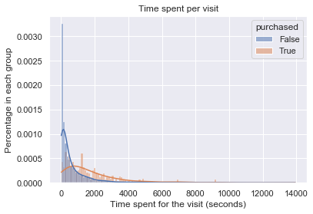
After removing visits that lasted < 10s
Mean:
False 650.47
True 1787.36

Slide 5
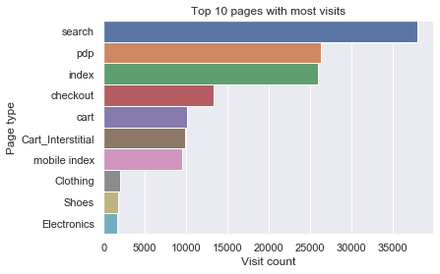

Slide 6
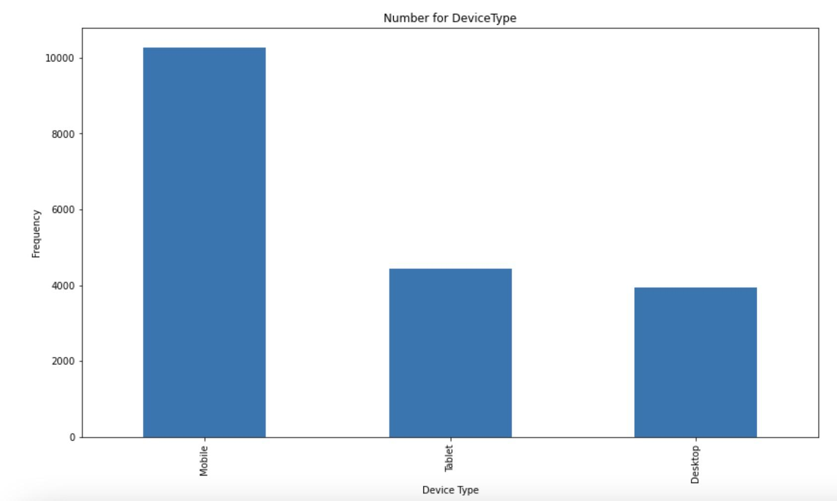
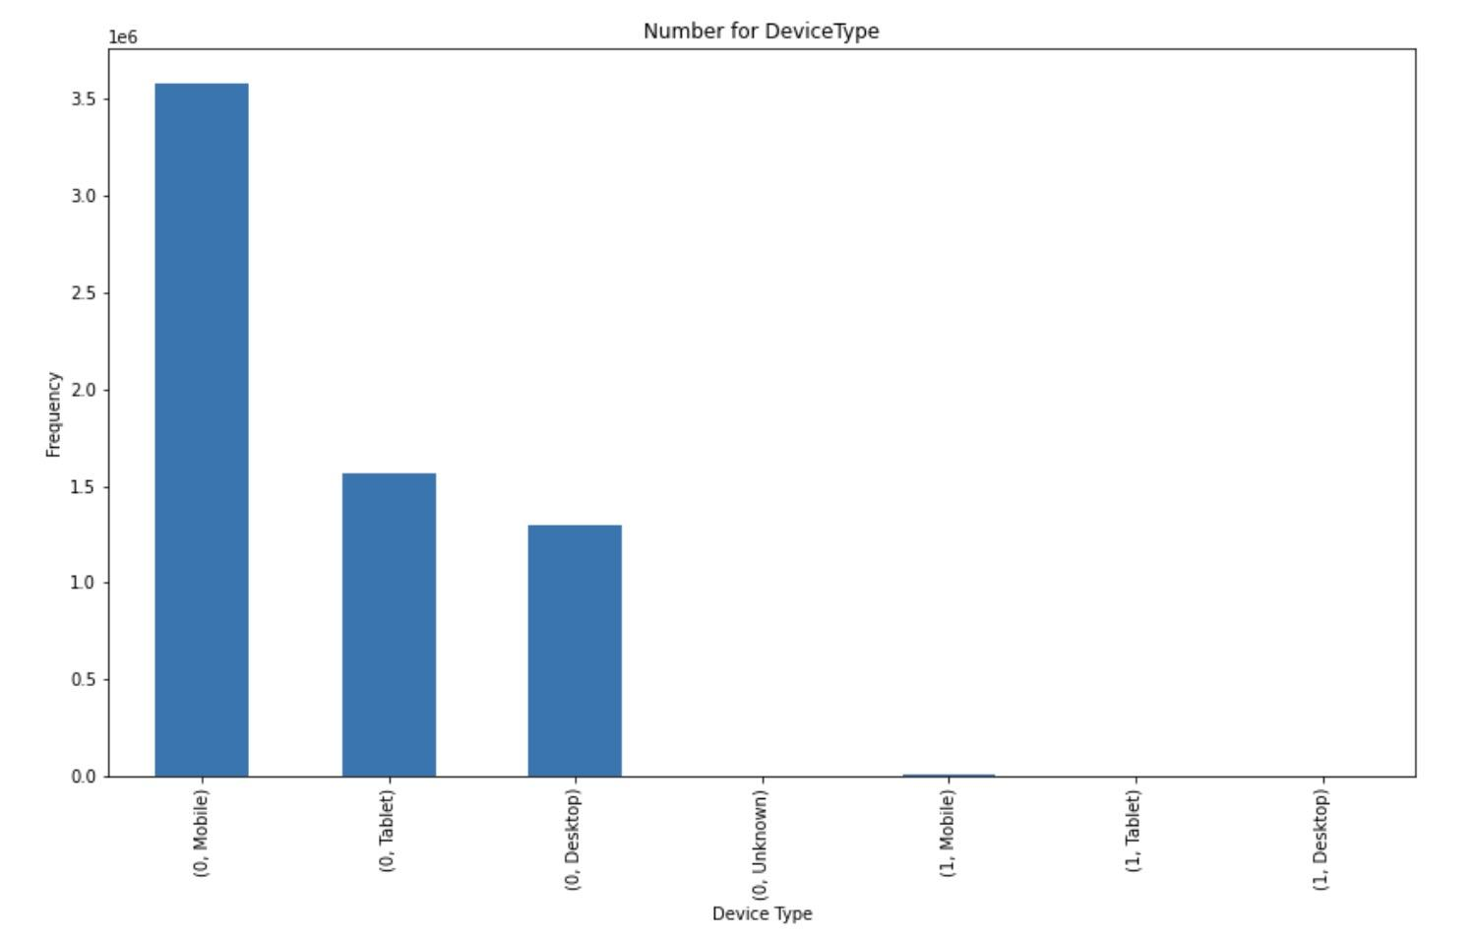
Purchased with different device
1: purchased 0: not purchased

Slide 7
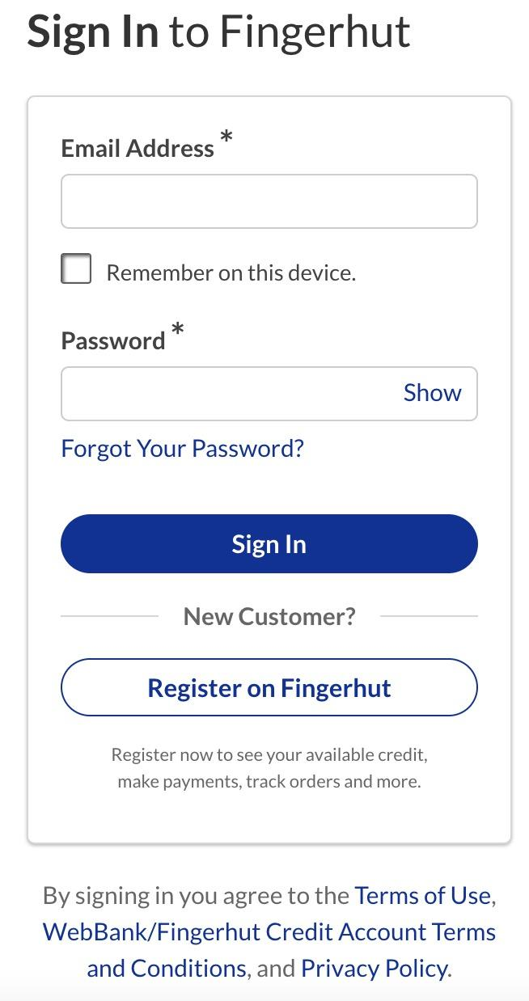
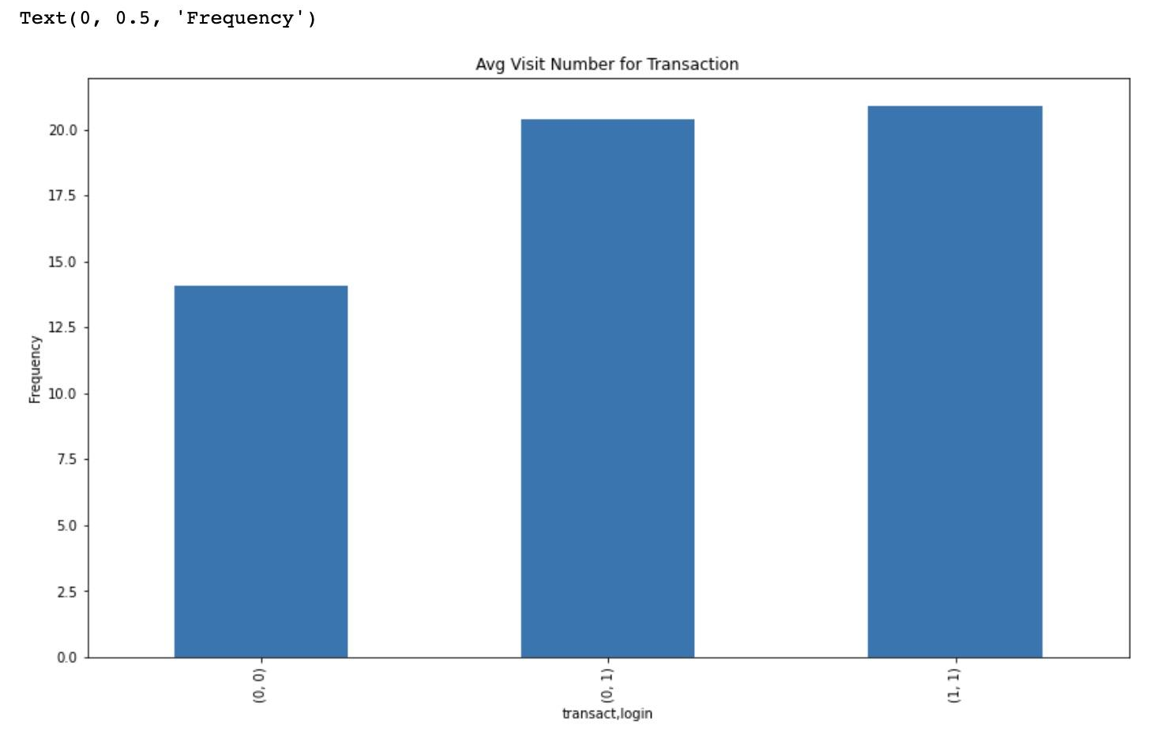
Transaction w Login
(0: not login, 0: not purchased)
(1: login, 0: purchased)

Slide 8
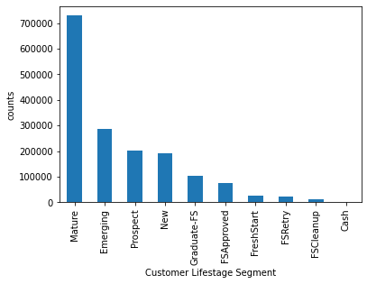
Customer Lifestage Distribution

Slide 9
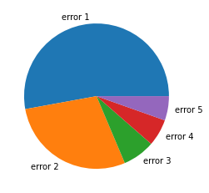
Error Message Frequency
error1: no longer available
error2: out of stock
error3: down payment pending on a previous order
error4: refresh the page
error5: total order less than 50$

Slide 10
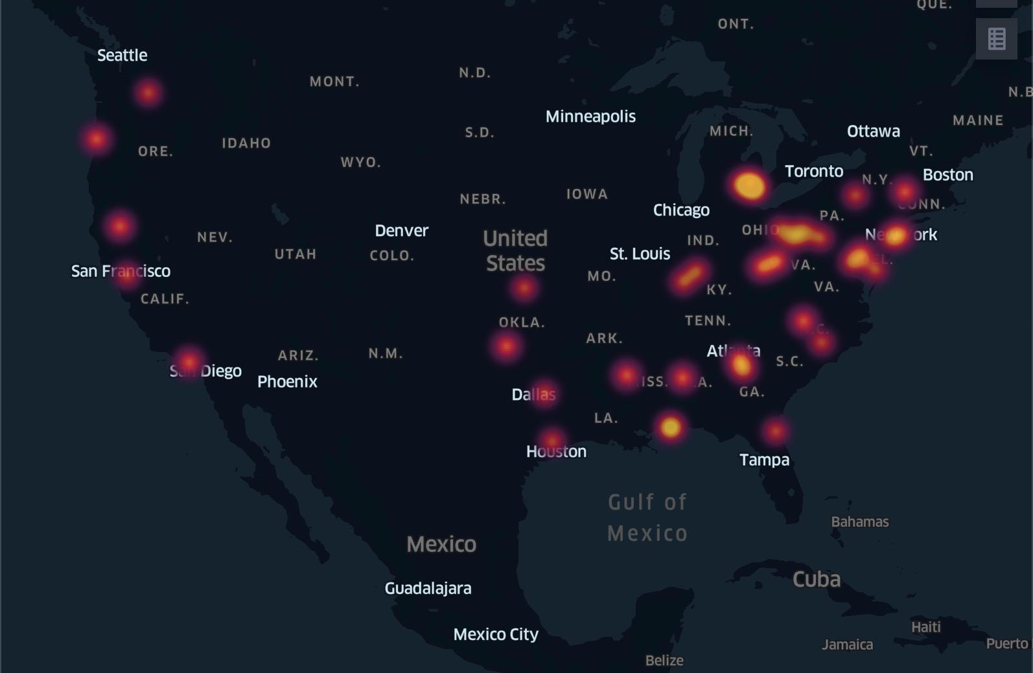
Heatmap of consumer distribution

Slide 11

Search Word Cloud
-noted: removed men, women
The men, women shown is like
break down word from men_shoes

