Slide 1
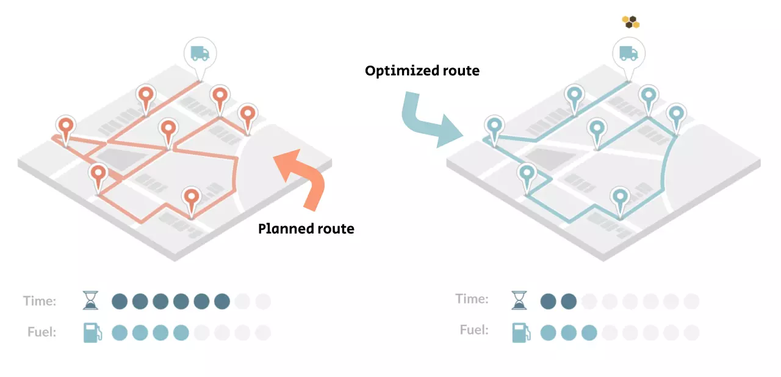
Trajectory Optimization with Multiple Initial Motion Plans
Comp 550
Speaker: Vincent Chang - Mohamad Kreidieh
Dec 04, 2025

Slide 2
Problem Statement & Motivation
The state of a manipulator can be described by a vector q of joint angles. We rely on motors to apply torques to exert acceleration on joints to move and achieve collision-free paths under robot physical constraints.
We aim to get smoother motion such as continuous velocity q’ and acceleration q’’ after performing trajectory optimization within a limited time to boost the quality of the path.
Notes:
One way to achieve this is goal to generate multiple candidate paths during planning, and then find out which one is better after performing optimization.

Slide 3
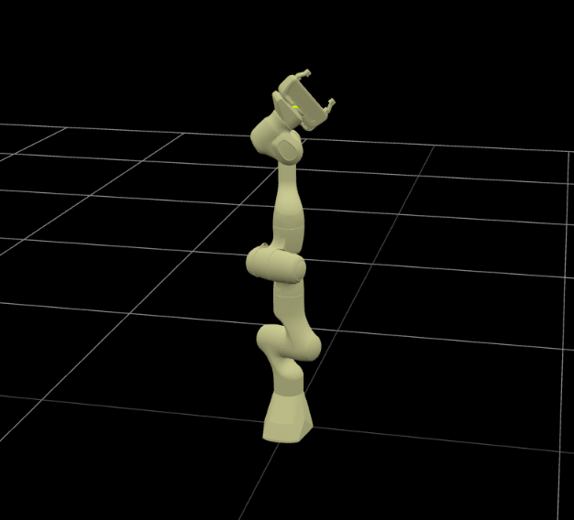
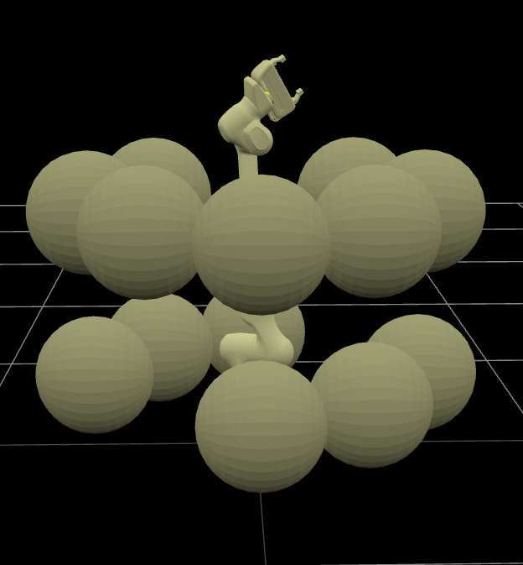
Robot & Environment - Panda with 7 DOF
Notes:
The robot is Panda with 7 joints, and we have two environments, one is empty and the other one with spheres.

Slide 4
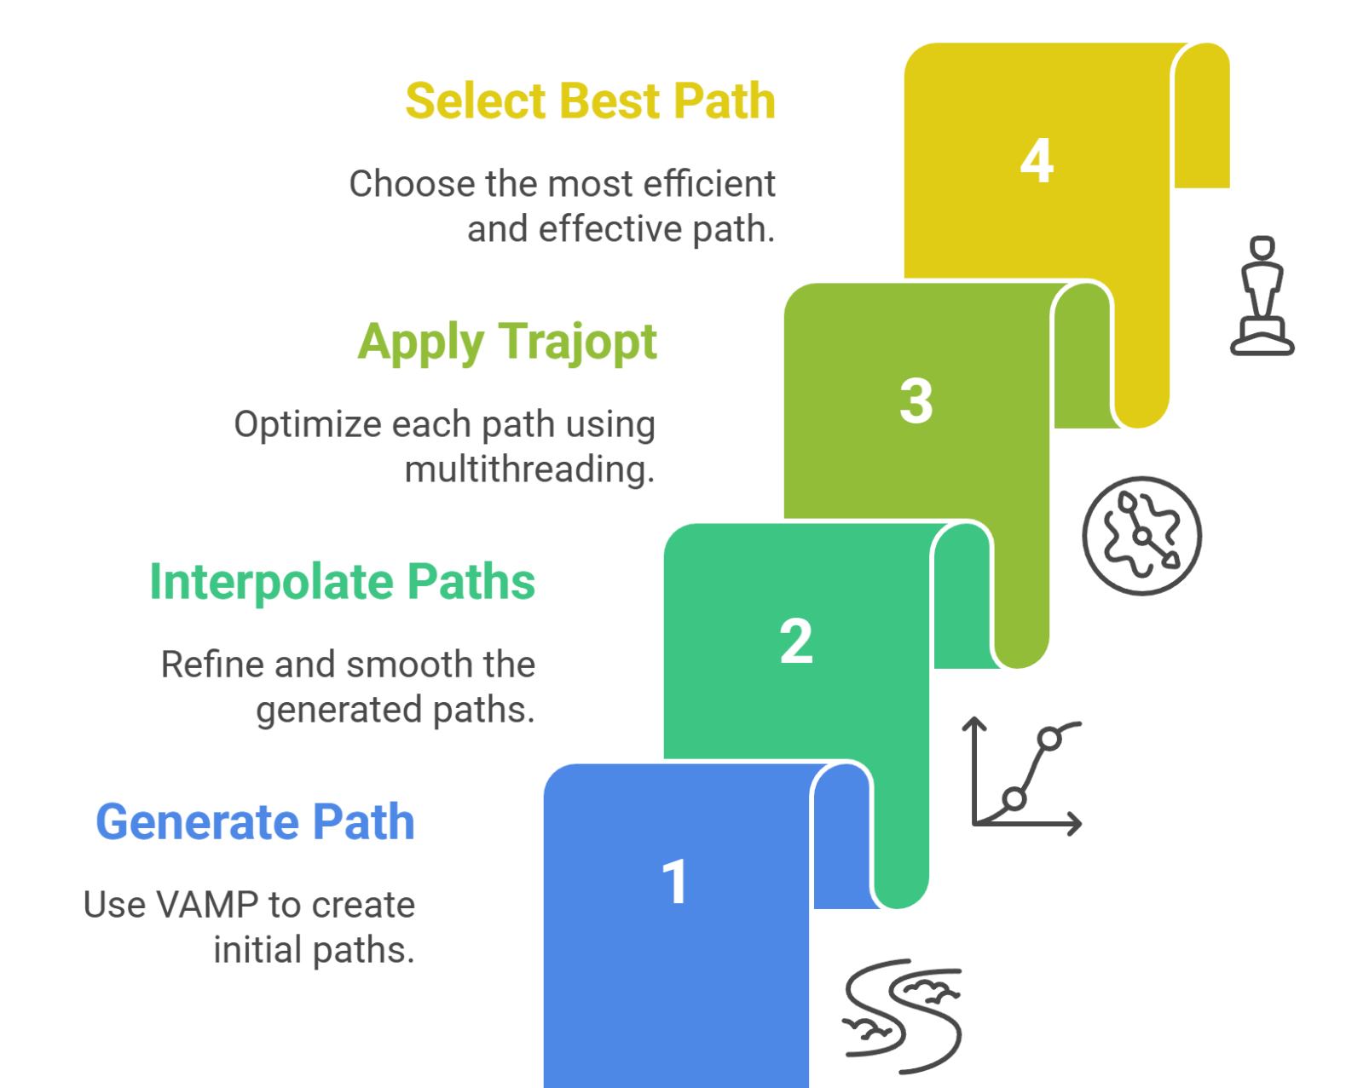
System Overview

Slide 5
Experimentation
Planning time and Path length
with and without obstacles

Slide 6
Optimizing in an environment with obstacles takes more time
Task1 | Free Env1 | Obs Env1
Average Path Length (m) | 1.555 | 1.533
Average Planning Time (s) | 0.236 | 1.021

Slide 7
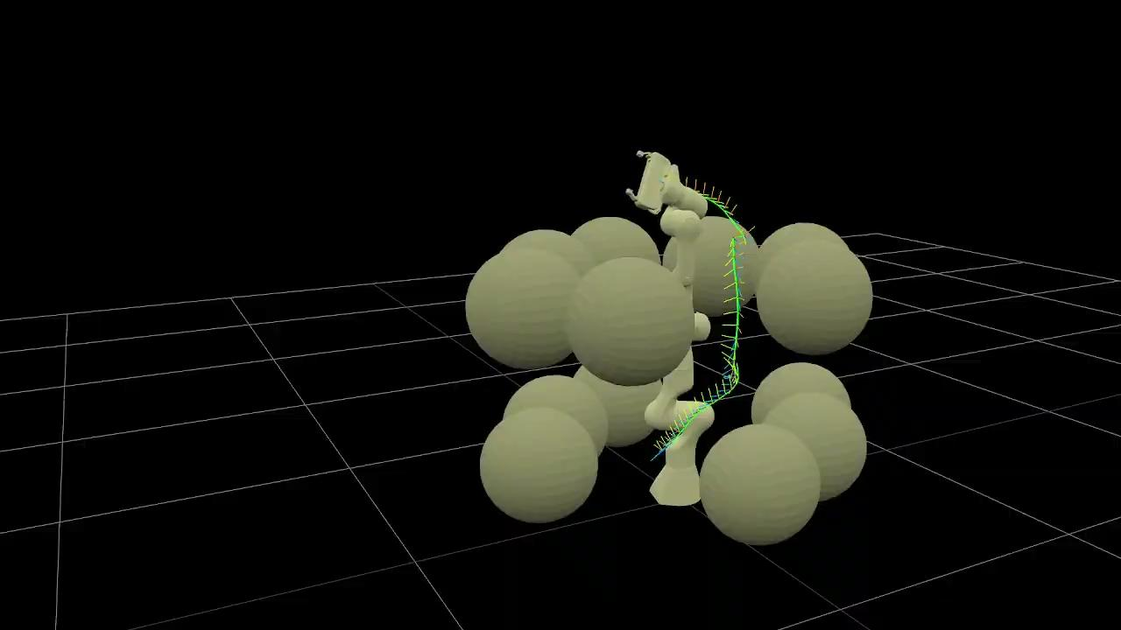

Slide 8
Optimizing in an environment with obstacles takes more time
Task2 | Free Env2 | Obs Env2
Average Path Length (m) | 0.362 | 0.496
Average Planning Time (s) | 5.364 | 69.011

Slide 9
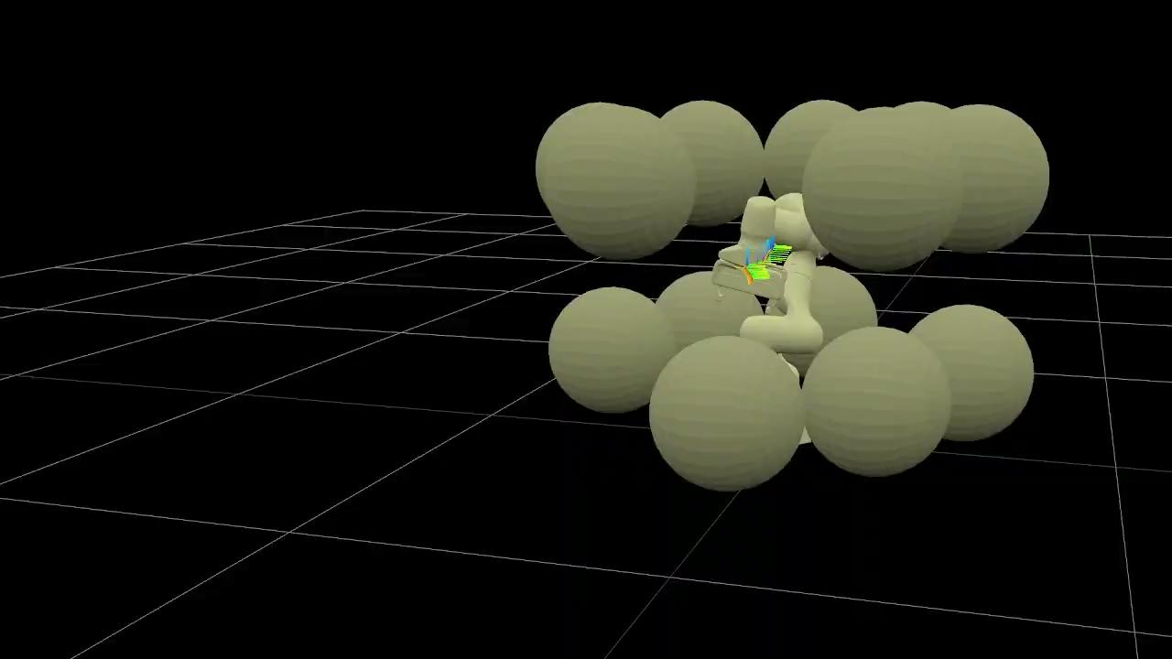

Slide 10
Experimentation
VAMP Without Simplifier + TrajOpt

Slide 11
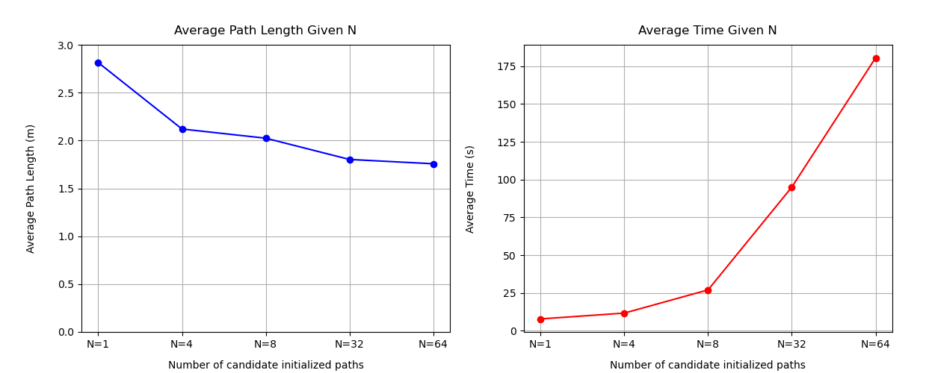
Better performance may not always be worth the extra effort!

Slide 12
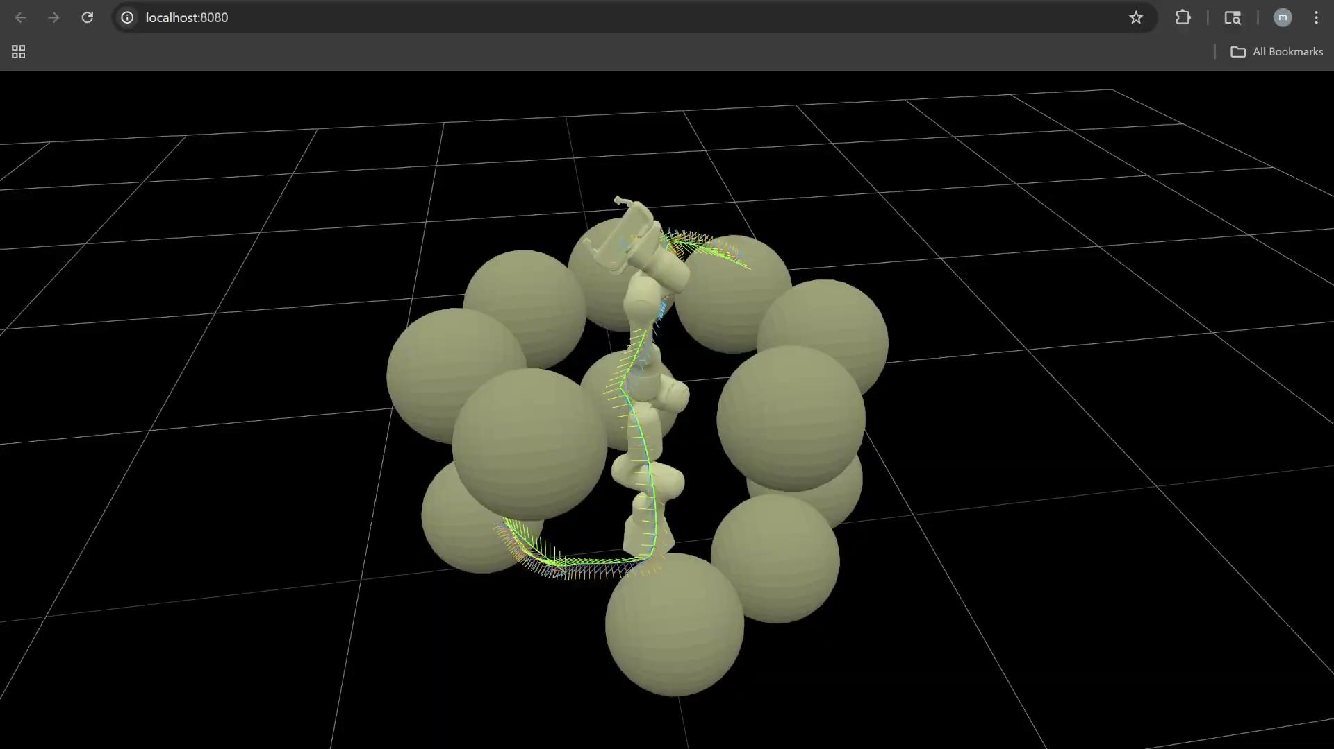

Slide 13
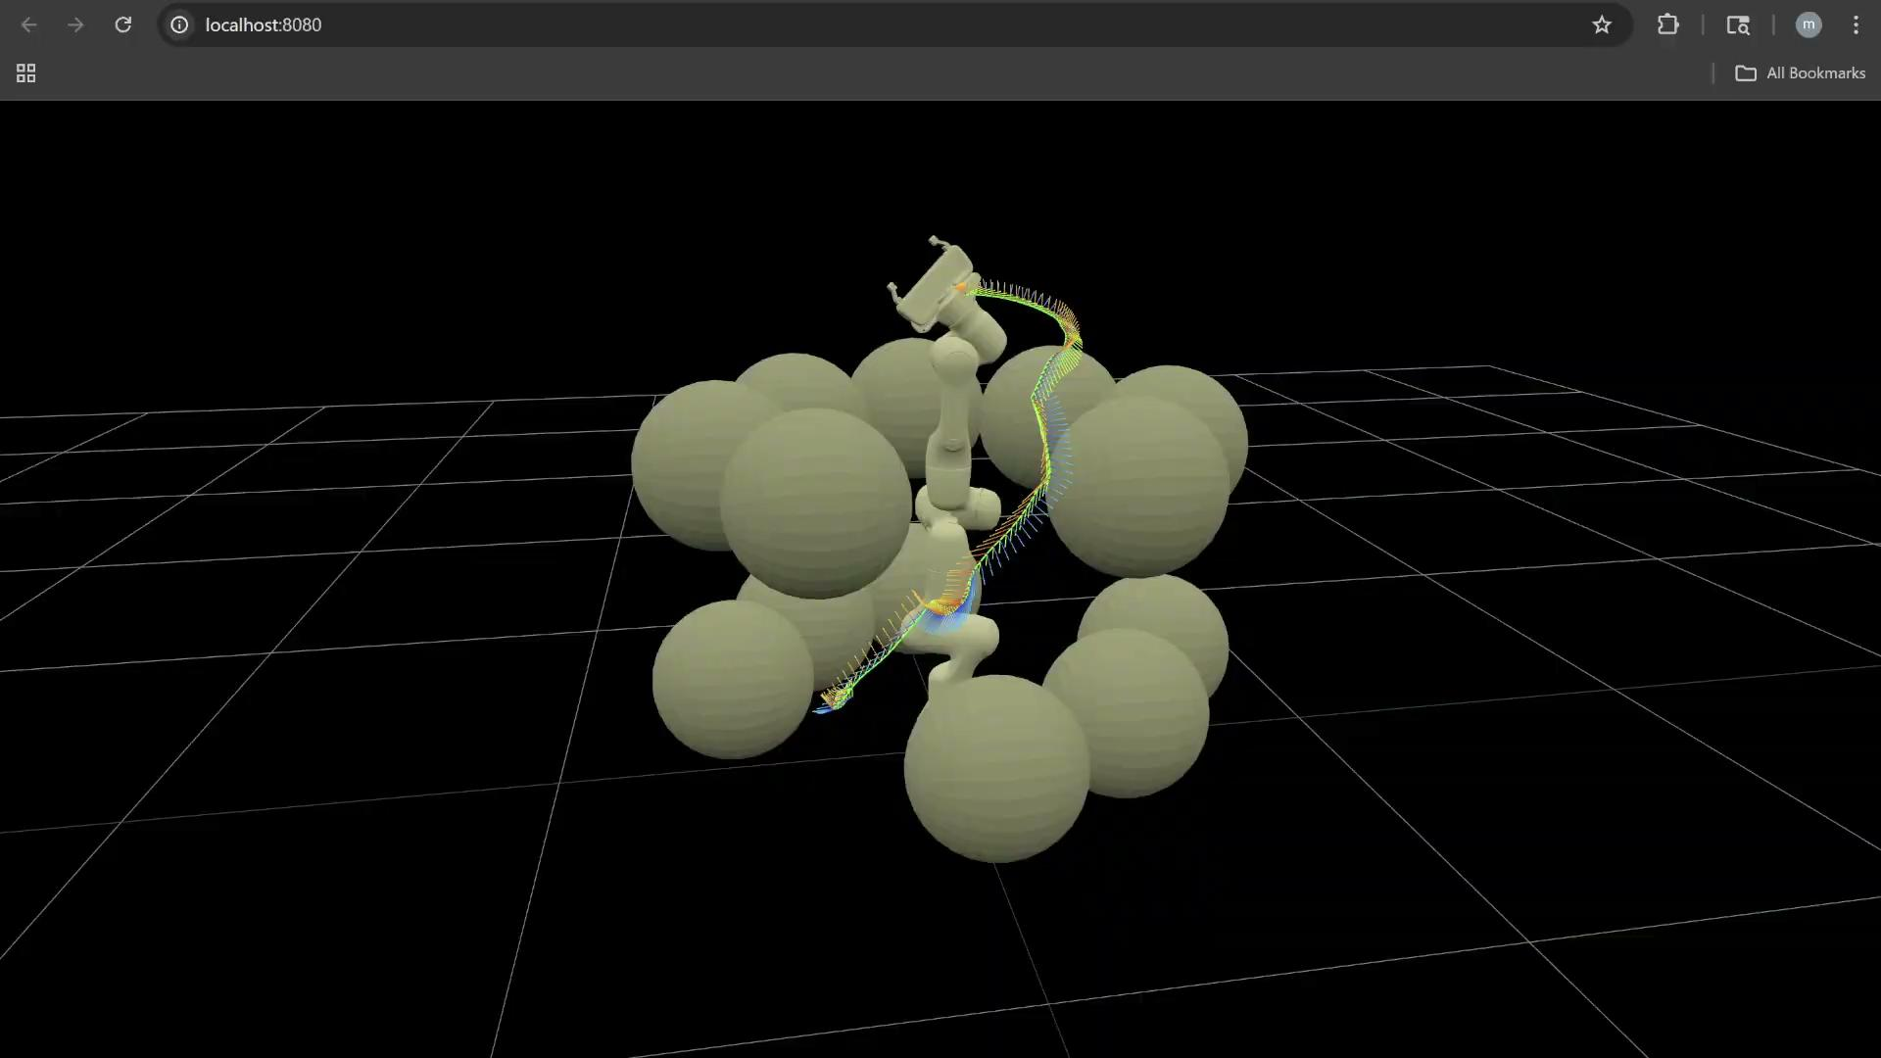

Slide 14
Experimentation
VAMP With Simplifier + TrajOpt

Slide 15
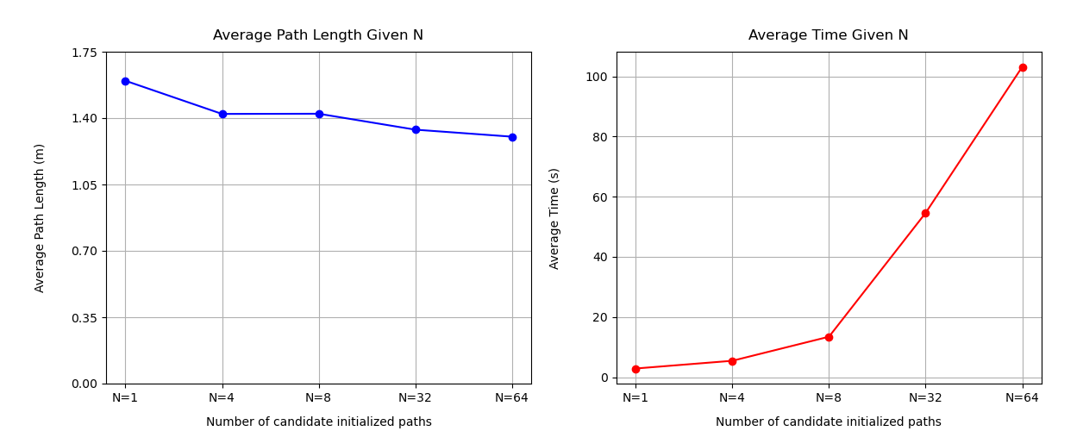
Performance is almost always optimal!

Slide 16
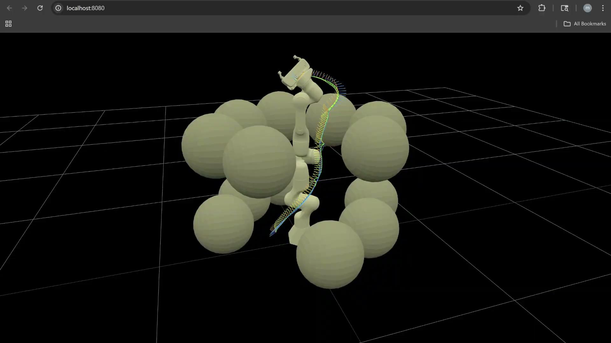

Slide 17
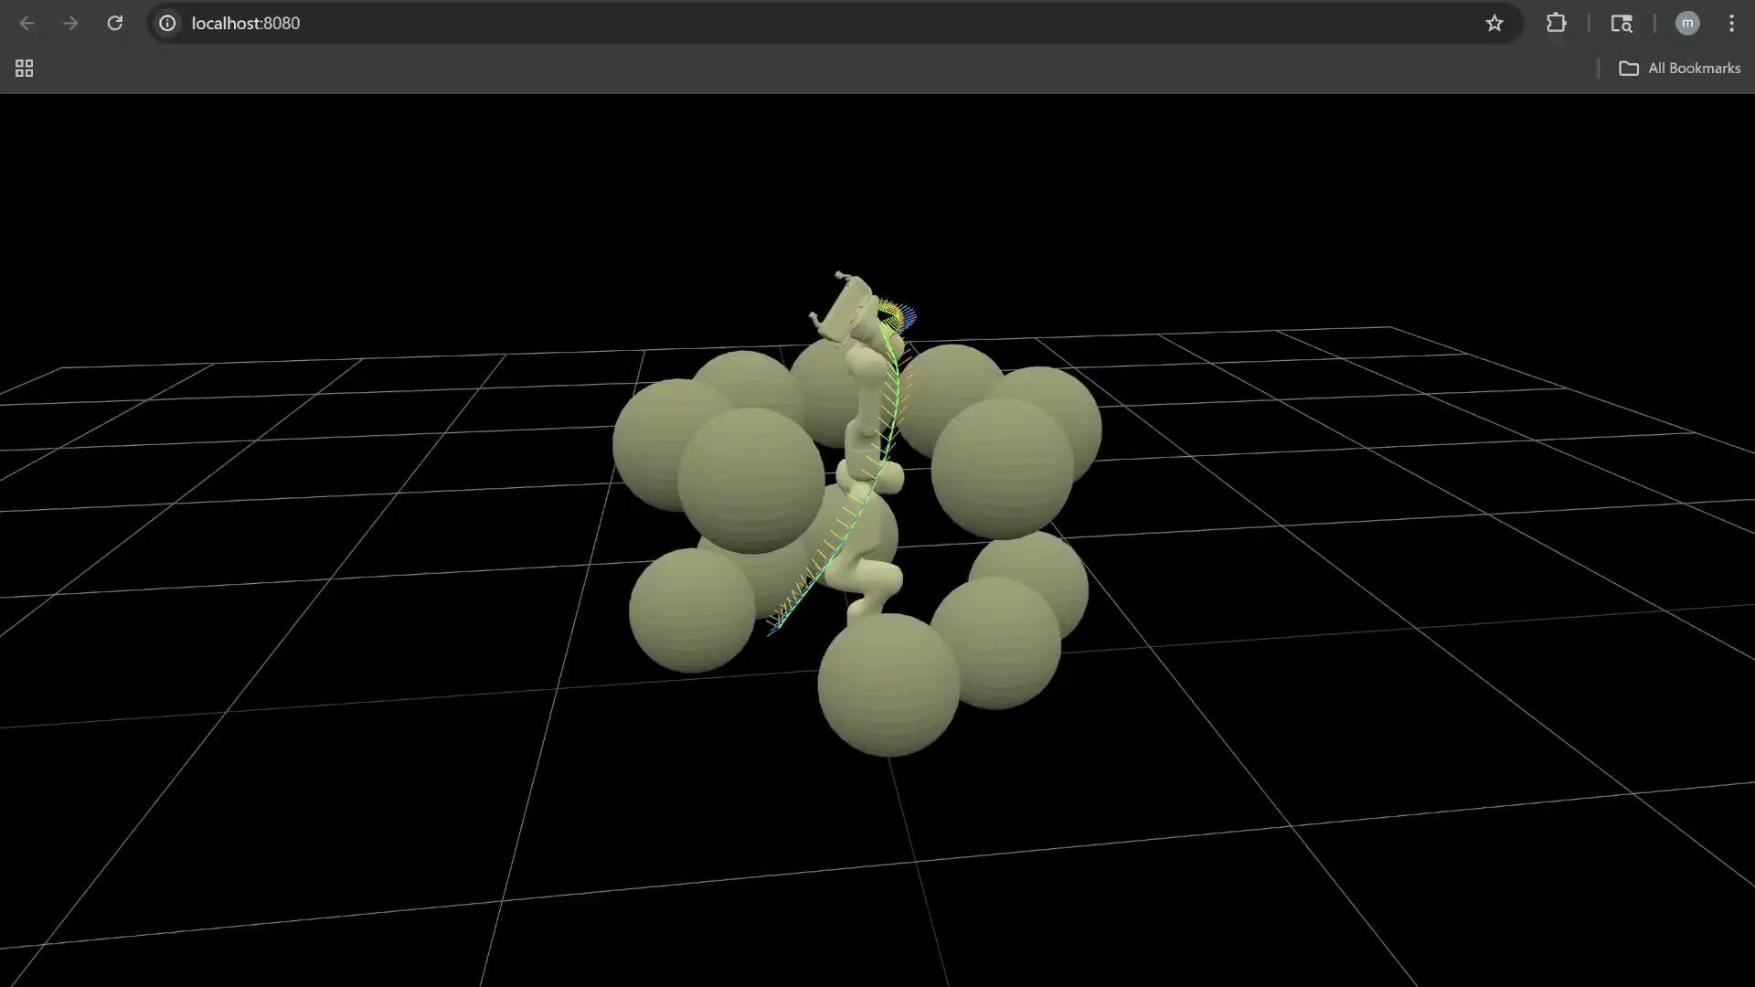

Slide 18
Experimentation
Effect of Multithreading

Slide 19
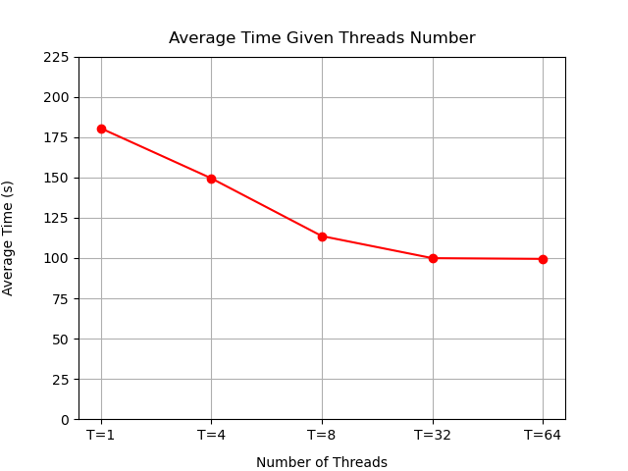
Multithreading saves lots of time

Slide 20
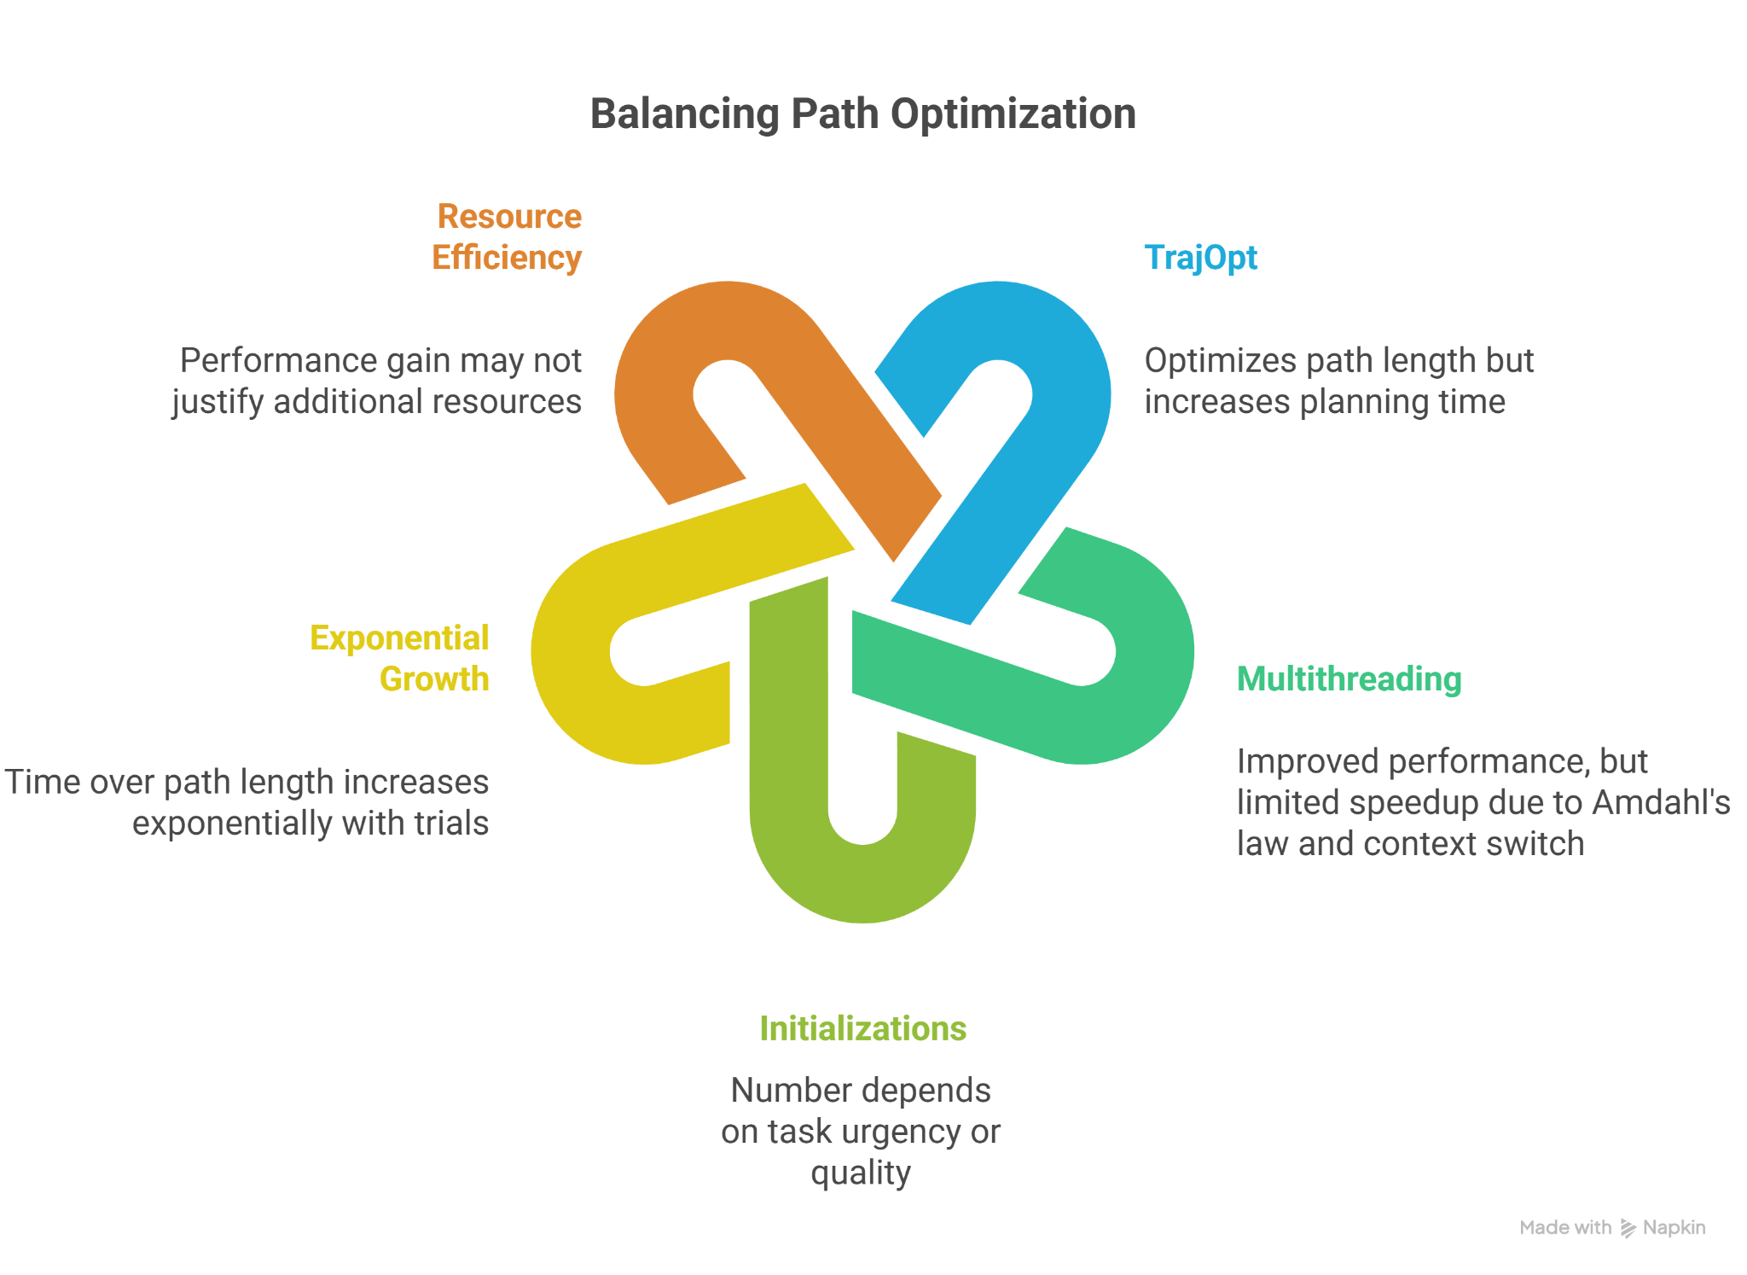
Conclusion

