Slide 1
EEG Clustering Project

Slide 2
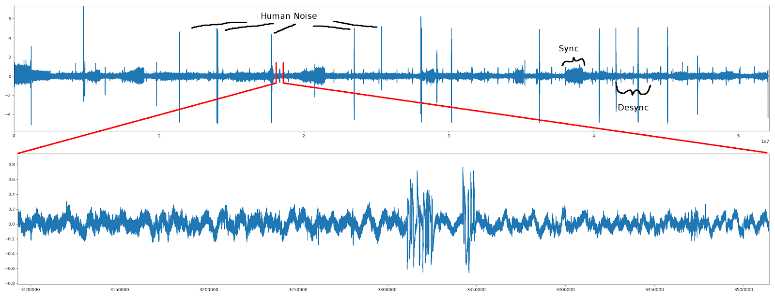
The Dataset
5207 EEG signals
1KHz sample rate
10 seconds each

Slide 3
Data Preparation
Signals greater than 1.4 V amplitude, removed
Line noise removal (60 Hz, harmonics)
Windowed FFT with Hanning window
2-D Gaussian filter across power spectra
Pxx: Power Spectra
  0 – 40 Hz
  Shape: 401 x 5138

Slide 4
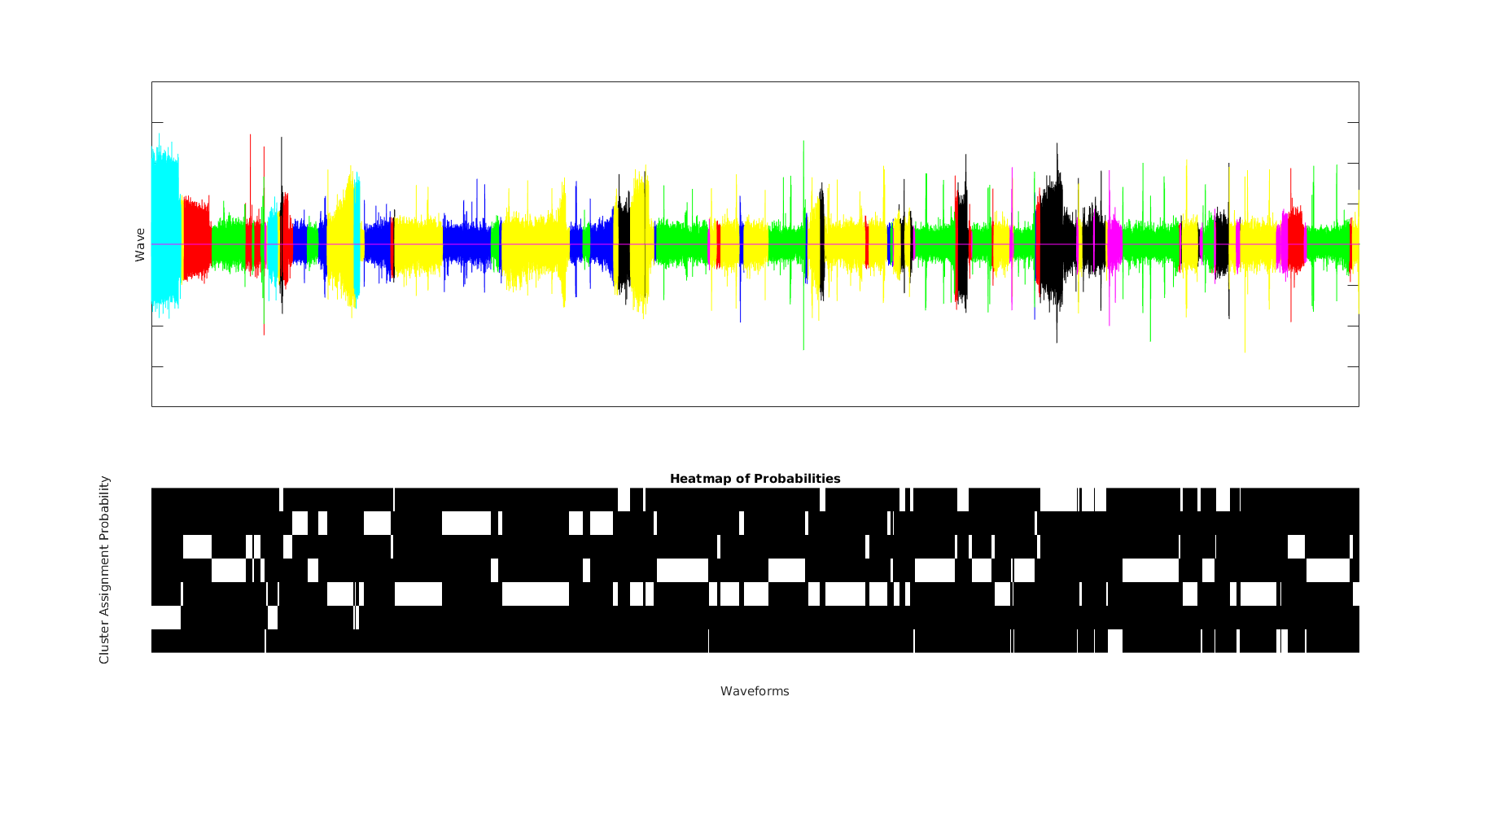
Clustering
K-Means
GMM
  AIC, BIC, Covariance Structure, number of modes
  Problems in high dimensions

Slide 5
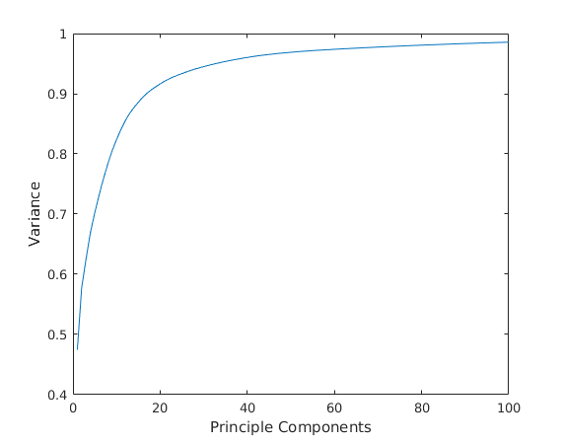
Current Work
Dimensionality Reduction
  PCA
  NLPCA

Slide 6
Current Work
Bias:
  AIC, BIC Score
Variance:
  Hungarian Algorithm Score

Slide 7
Current Analysis Pipeline
De-Noising | Transform and Filtering | Dimensionality Reduction | Clustering | Model Analysis
Line Noise Removal High Frequency Removal Animal Noise, Respiration | Windowed FFT 2-D Gaussian Filter | PCA NLPCA Determining optimal number of components | K-Means GMM Optimal Parameters | Hungarian Algorithm AIC BIC tSNE

