Slide 1
Do signal-peptide features predict collagen secretion in B. subtilis?
DDLS project · data-driven life science
32 peptides, three Western blots, one collagen construct — and the question of whether any of it supports a predictive model.
Baris Akar · bakar@dtu.dk · 4 November 2026
Data owner: Alexiou et al., thesis chapter 2
Notes:
Headline: a negative result with one qualified positive lead. Say so up front so the audience is not waiting for a reveal.

Slide 2
Three questions from the data owner
The question
1
Do sequence, nucleotide or physicochemical features relate to secretion?
What the owner asked for
A well-supported negative result would be informative — and do not analyse only the best performers. That was the exact flaw they had seen in the published literature.
2
If so, can they identify or design high-secretion candidates?
3
Is it worth training a model?
Both cautions are built into every analysis that follows.

Slide 3
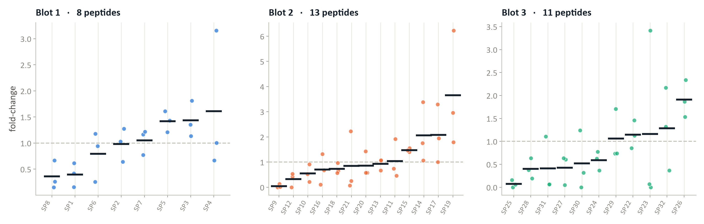
Effective n is 8, 13 and 11 — not 32
The data
8 / 13 / 11
3
96 → 32
peptides per blot
separately normalised blots
replicate rows collapsed
Each blot was divided by the mean of a different peptide subset, so the three panels share no numeric scale.
Notes:
Point at the three separate y-axes. This is the owner's own warning, implemented.

Slide 4
Four rules — three of them the owner's own cautions
Method
Never pool the blots
One value per peptide
Combine the three per-blot effect estimates by meta-analysis — never the blot-normalised values themselves.
96 replicate rows collapsed to 32 observations before any test. Otherwise the sample size triples on paper.
All 32 candidates
Split at peptide level
Never only the top performers — the selection bias the owner specifically warned about.
Scaling fitted inside training folds only, so no peptide informs its own prediction.
34 descriptors were computed before any outcome was consulted, so feature choice could not be steered by results.

Slide 5
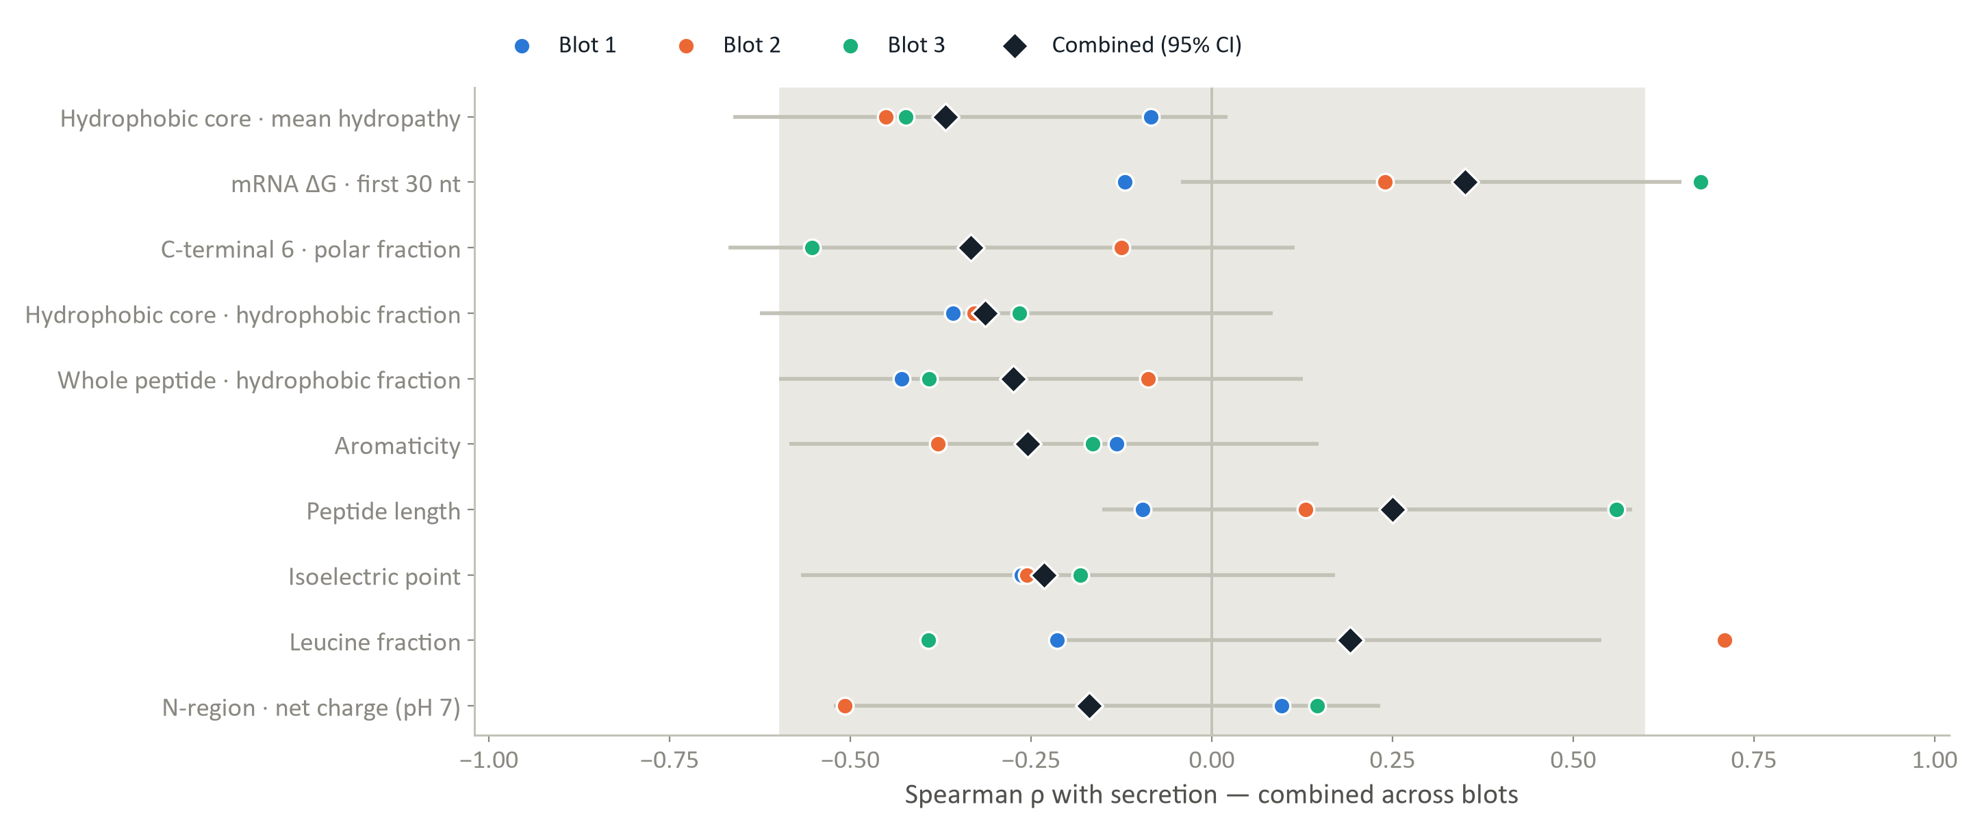
No feature survives the screen
Result 1
Top 10 of 34 descriptors, each tested within each blot separately. Every confidence interval crosses zero; the grey band is what chance alone produces.

Slide 6
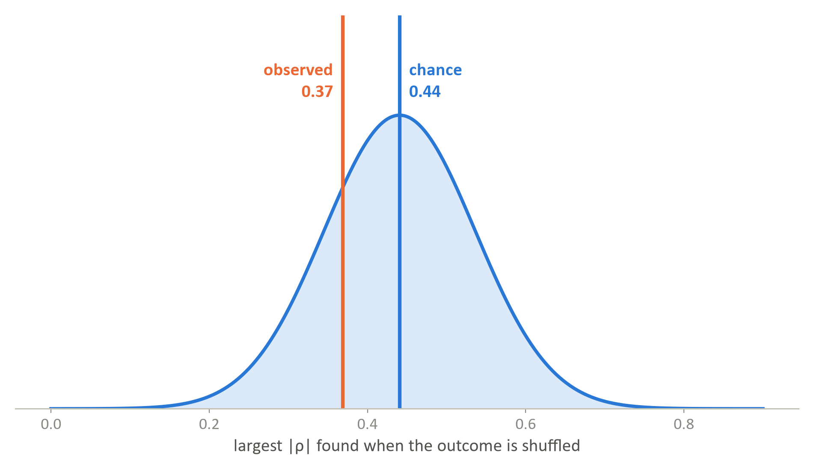
0.37 looks fine — until you calibrate it
The trap
0.369
best real feature, of 34 screened
0.441
median best-of-panel on shuffled outcomes
p = 0.81
family-wise, 5,000 permutations
The outcome was permuted within each blot and the whole 34-feature screen re-run each time. The best real feature is weaker than chance.
Notes:
This is the decisive slide for the negative result. If they push back anywhere, it is here — the reliability ceiling on the next slide is the answer.

Slide 7
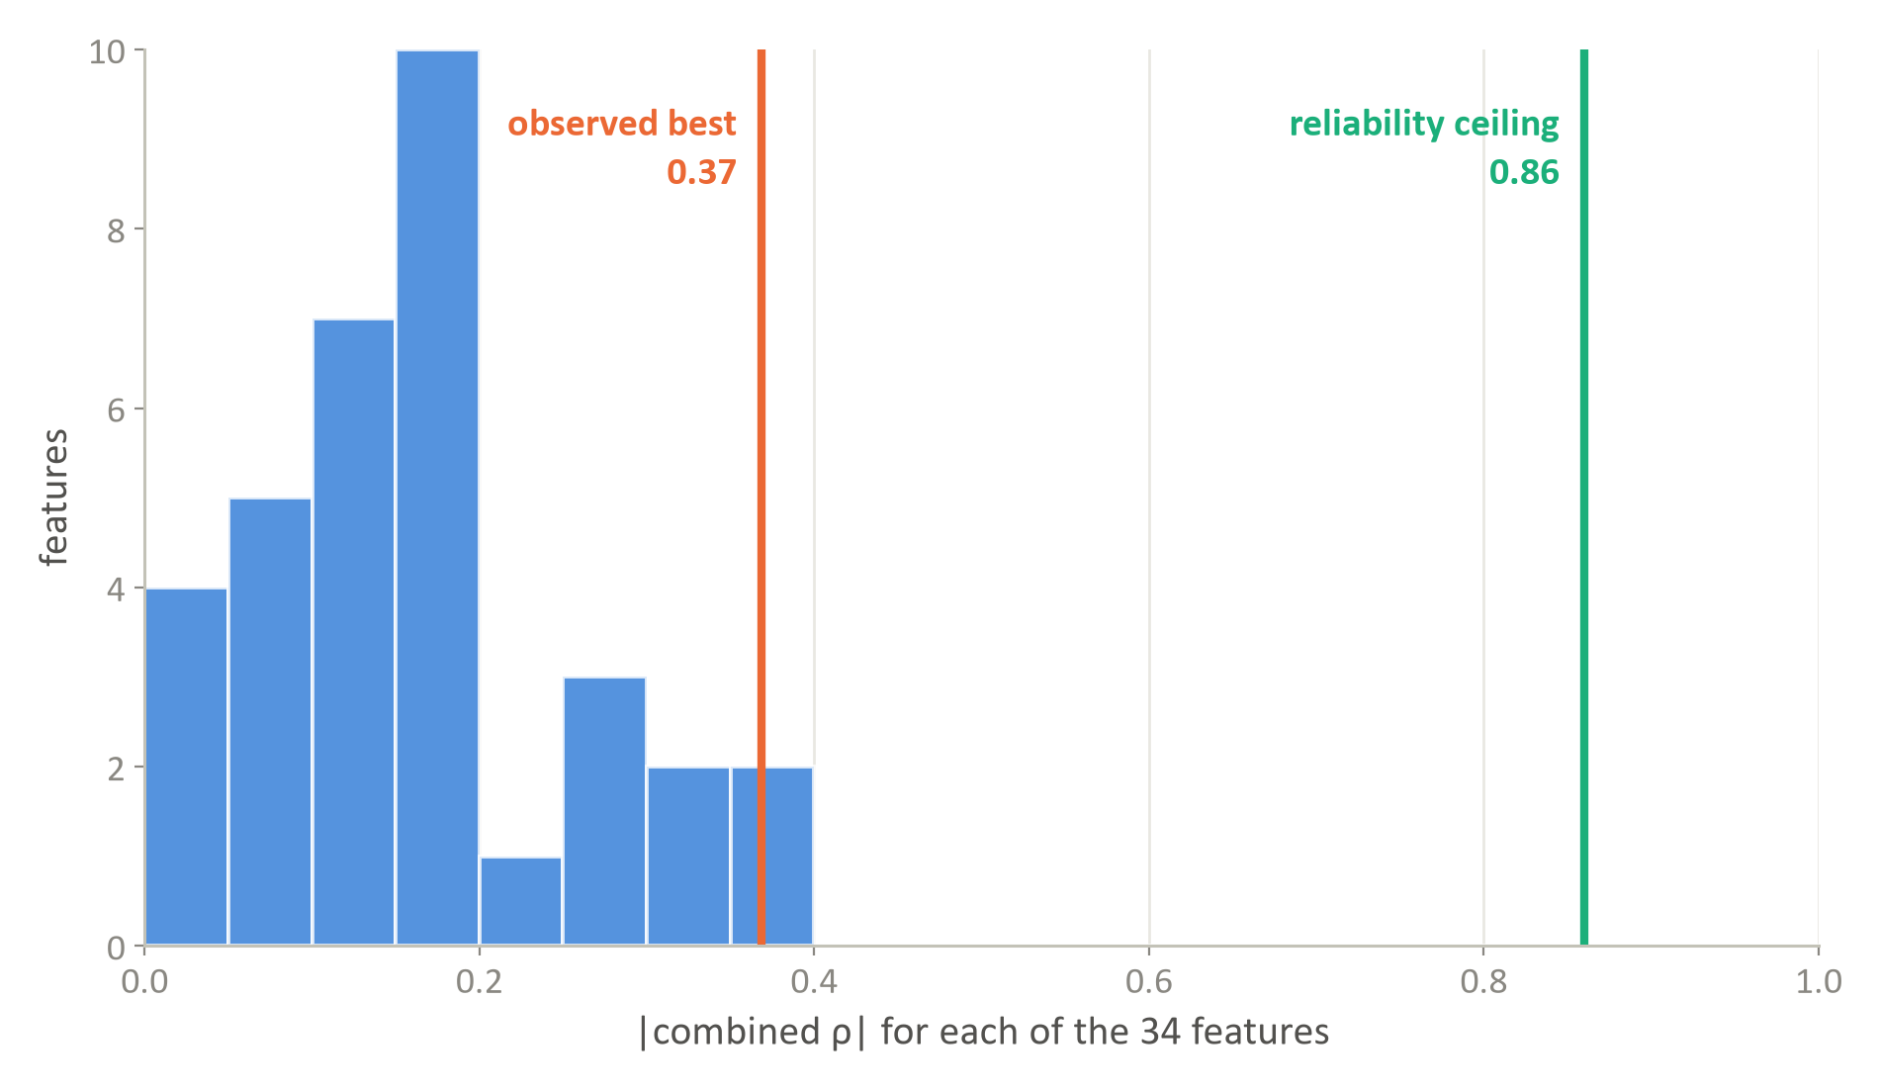
The null is informative, not underpowered
Result 2
Measurement reliability
Blot | Inter-rep ρ | Max ρ
Blot 1 | 0.476 | 0.855
Blot 2 | 0.581 | 0.898
Blot 3 | 0.418 | 0.827
A feature perfectly predicting true secretion could still only correlate at about 0.86 against these measurements.
There was room to detect a moderate effect. None appeared — so this is a genuine negative, not a noisy assay.

Slide 8
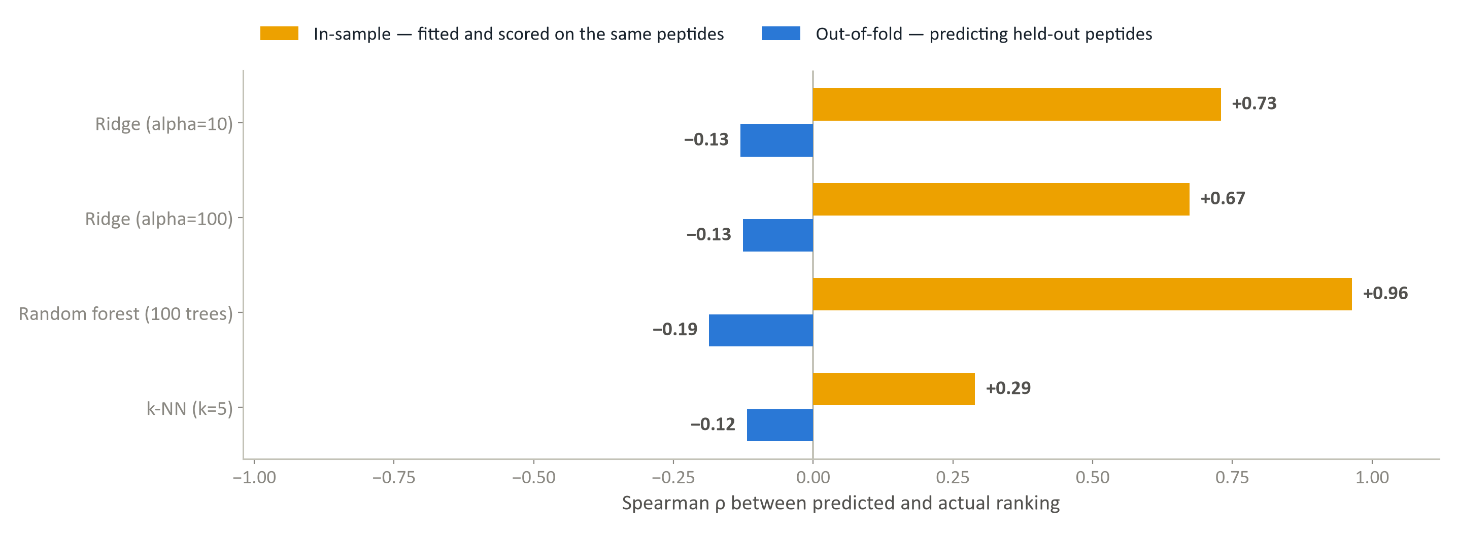
In-sample fit is not performance
Result 3
34 features against 32 observations: the model memorises the set and learns nothing transferable. Every out-of-fold score is negative under both validation schemes, including leave-one-blot-out.
Notes:
The single most persuasive exhibit. Random forest: 0.96 in-sample, −0.19 out-of-fold. Same model, same data, two ways of scoring it.

Slide 9
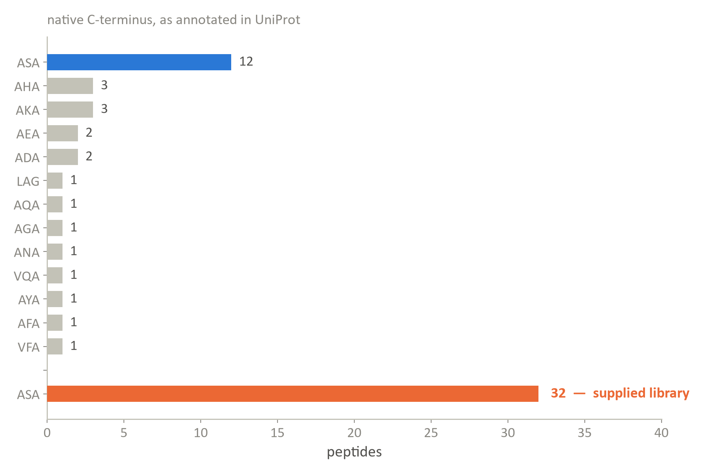
The library suppresses its own variation
Why it could not work
Engineered, not inherited
Native C-termini span 13 motifs. All 32 supplied peptides end A-S-A. Only 8 of 32 match their native sequence exactly.
So the motif explains nothing
The A-x-A motif Fu et al. link to good performers is a constant here, not a variable — it could never explain a difference.
SP1/AmyE, the classic B. subtilis secretion tag, ranks 7th of 8 — and is among the most heavily modified peptides in the set.

Slide 10
Four reasons, in order
Why it could not work
1
No signal to learn. Best feature 0.369; shuffled data gives 0.441. Nothing for a model to combine.
2
Effective n is 8 / 13 / 11 against 34 features — memorisation, not learning.
3
Not a noise problem. The reliability ceiling is 0.86, so there was room to see an effect.
4
Design holds key features fixed. Constant cleavage region, constant mature-protein start, restricted hydrophobicity range.
A negative result about this dataset's shape — not about the biology, and not a criticism of the experiment.

Slide 11
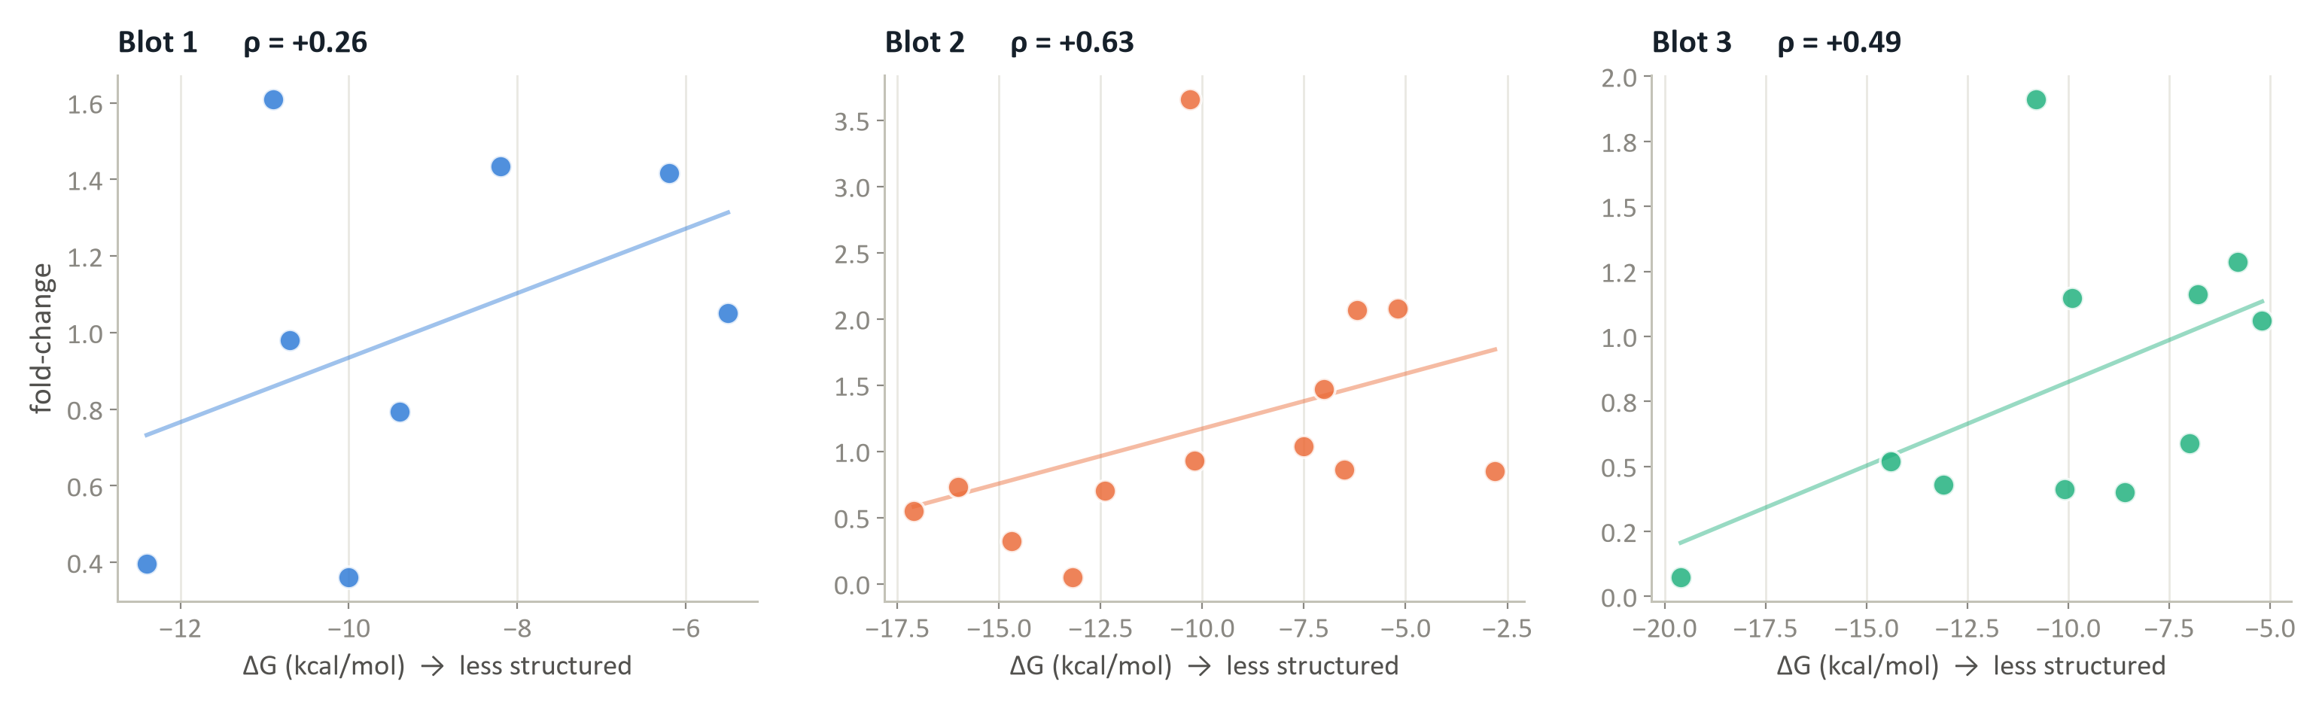
mRNA accessibility at the initiation region
The one honest positive
What was found
What it is not
Positive in all three blots, in the direction Fu et al. predicted. Combined ρ = +0.515, one-sided permutation p = 0.0042.
A coding-only version of this family was already in the 34-feature screen — a refinement, not clean out-of-sample confirmation. No mechanism established.
Notes:
State the caveats yourself before they are asked for. If this lead later fails to replicate, how it was described now is what will matter.

Slide 12
What the owner can and cannot act on
Recommendation
Can
Cannot
Prioritise SP5 (CV 0.14) and SP26 (CV 0.21) — high and reproducible within their own blots
Treat SP4 with caution — 1st by mean, 5th by median, plus the unresolved secondary band
Test the mRNA-accessibility hypothesis
Build a cross-blot ranking
Train a predictive model or propose synthetic designs
Claim a mechanism
Assume transfer to another protein target — five peptides shared with Fu et al. give ρ = −0.20
This is a negative result about the dataset's shape — not about the biology, and not a criticism of the experiment. The screen produced reproducible candidates, data that could be tested rigorously, and one testable lead.

Slide 13
What would make the question answerable
Next steps
1
A shared reference lane on every gel. The single largest fix — it turns three incomparable blots into one dataset.
2
More peptides on that common scale. Grasso et al. needed about 4,400 informative peptides.
3
Raw densitometry — to audit the normalisation, resolve the SP9 zero and assess SP4's secondary band.
4
Transcription start site and 5′UTR — to test the one lead against its published definition.
5
Confirm two anomalies: SP31's V versus M, and whether the uniform A-S-A was intentional.
Nothing analytical substitutes for the first item.

Slide 14
Who did what
AI-use disclosure
Agent A — data owner
Agent B — Claude
Person — me
Experimental data, project goal, assay account, and the domain constraints the whole analysis runs under.
Essentially all computational work: QC, features, statistics, machine learning, literature, dashboard, drafting. Generated and altered no measurement; flagged anomalies rather than patching them.
Research question, interviews, constraints, challenging AI interpretations, and verification — re-running every script and tracing each number to its source.
Verification caught a real defect: a stale background process had overwritten the modelling outputs with a different random-forest configuration than the committed script specified. Re-run, and recorded rather than quietly fixed. A Pi agent independently built its own feature set and models, and reached the same negative conclusion.

