Slide 1
TKINTER
Lesson 1 – Introduction to Tkinter..

Slide 2
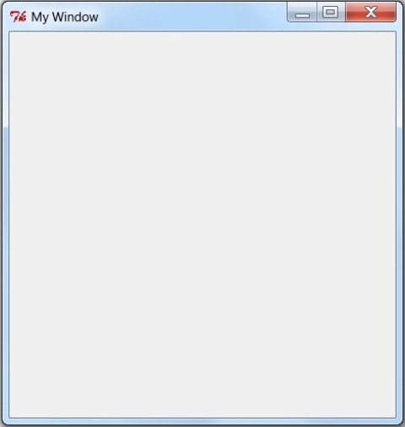
tkinter
Toolkit Interface
A Graphical User interface
for Python

Slide 3
Open Python
Then go File > New window
In the new untitled window
Go File > Save As
Save the file tkwindow.py in your area

Slide 4
import sys # these lines import the module tkinter
from tkinter import *

Slide 5
import sys # these lines import the module tkinter
from tkinter import *
mGui = Tk() # mGui is the name of the window within the # program

Slide 6
import sys # these lines import the module tkinter
from tkinter import *
mGui = Tk() # mGui is the name of the window within the # program
mGui.mainloop() # this line must go at the end of the code

Slide 7
import sys # these lines import the module tkinter
from tkinter import *
mGui = Tk() # mGui is the name of the window within the # program
mGui.geometry (‘400 x400’) # this is the window size in pixels note there are no spaces in 400x400
mGui.mainloop() # this line must go at the end of the code

Slide 8
import sys # these lines import the module tkinter
from tkinter import *
mGui = Tk() # mGui is the name of the window within the # program
mGui.geometry (‘400 x400’) # this is the window size in pixels note there are no spaces in 400x400
mGui.title(‘My Window’) # this line creates a title to the top bar of the window.
mGui.mainloop() # this line must go at the end of the code

Slide 9
import sys # these lines import the module tkinter
from tkinter import *
mGui = Tk() # mGui is the name of the window within the # program
mGui.geometry (‘400 x400’) # this is the window size in pixels note there are no spaces in 400x400
mGui.title(‘My Window’) # this line creates a title to the top bar of the window.
mlabel=Label(text=‘Testwood School’).pack() # makes the label and names it.
mGui.mainloop() # this line must go at the end of the code

Slide 10
import sys # these lines import the module tkinter
from tkinter import *
mGui = Tk() # mGui is the name of the window within the # program
mGui.geometry (‘400 x400’) # this is the window size in pixels note there are no spaces in 400x400
mGui.title(‘My Window’) # this line creates a title to the top bar of the window.
mlabel=Label(text=‘Testwood School’).pack() # makes the label and names it.
mbutton=Button(mGui,text=“OK”).pack() # makes a button and names it.
mGui.mainloop() # this line must go at the end of the code

Slide 11
import sys # these lines import the module tkinter
from tkinter import *
mGui = Tk() # mGui is the name of the window within the # program
mGui.geometry (‘400 x400’) # this is the window size in pixels note there are no spaces in 400x400
mGui.title(‘My Window’) # this line creates a title to the top bar of the window.
mlabel=Label(text=‘Testwood School’).place(x=50,y=50) # places the label
mbutton=Button(mGui,text=“OK”).place(x=100,y=100) # places the button
mGui.mainloop() # this line must go at the end of the code

Slide 12
Placing your object.
My Window
Y axis 1-400
X axis 1-400

Slide 13
import sys # these lines import the module tkinter
from tkinter import *
mGui = Tk() # mGui is the name of the window within the # program
mGui.geometry (‘400 x400’) # this is the window size in pixels note there are no spaces in 400x400
mGui.configure(bg=“red”) # creates a red background
mGui.title(‘My Window’) # this line creates a title to the top bar of the window.
mlabel=Label(text=‘Testwood School’).place(x=50,y=50) # places the label
mbutton=Button(mGui,text=“OK”).place(x=100,y=100) # places the button
mGui.mainloop() # this line must go at the end of the code

Slide 14
Next week we will make the button do something !

