Slide 1

How the COVID-19 Pandemic Affected Drug Overdose Cases?
Apoorv Sharma
Notes:
Hello Everyone,
Today I will be talking about how the COVID-19 pandemic has affected drug overdose cases in Philadelphia, Penn.
According to a report by the CDC, drug overdose cases have steadily increased over the past decade in all of United States
Moreover, with the macroenvironmental changes that began during the COVID-19 pandemic, such as increased physical isolation and economic insecurity, I predict that the number of overdose cases have increased throughout the pandemic

Slide 2


Notes:
Moreover, with the macroenvironmental changes that began during the COVID-19 pandemic, such as increased physical isolation and economic insecurity, I predict that the number of overdose cases have increased throughout the pandemic
Upon further research, I was able to find a dataset that contained reported cases of drug overdose as well as data associated to these cases
However the dataset had some challenges associated to it

Slide 3

Notes:
The dataset contained data from all counties included Penn and just had a lat/long coordinate for the county
As a result, I had to spend a significant amount of time using geographic libraries to map the coordinates to counties
The rest of the cleaning involved
Normalizing some quantitative variables (such as dosage of drugs administered)
Once the data was cleaned, I was able to do some EDA and come with different hypothesis

Slide 4

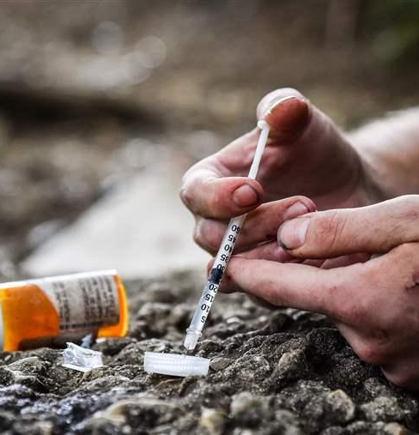
Notes:
The first hypothesis was The number of drug overdoses cases during the COVID-19 pandemic is significantly higher than before the start of the pandemic
To test this hypothesis, I created 2 different graphs and ran an ANNOVA test with a significance level of 0.05

Slide 5
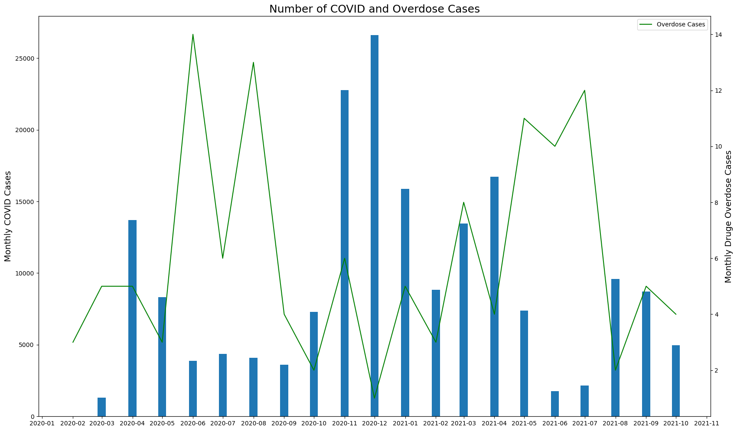

Slide 6
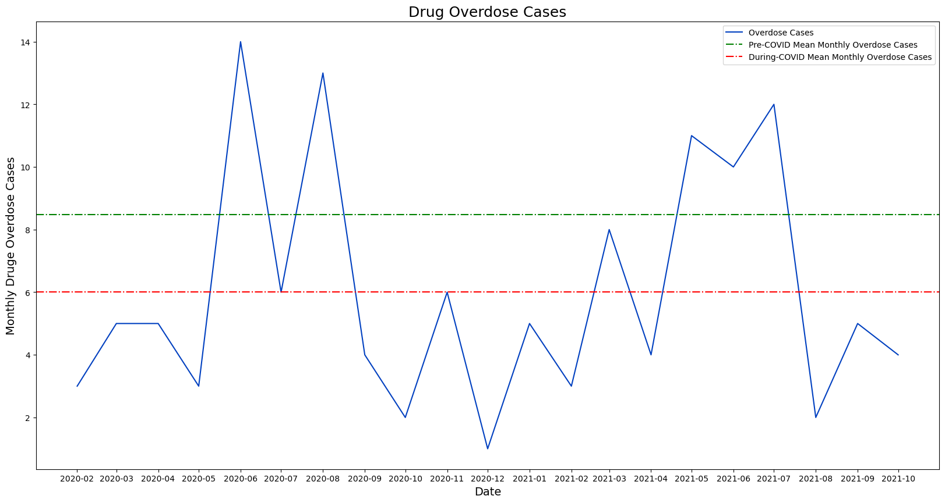
H0: There is no difference between the number of drug overdose cases before and during the COVID-19 pandemic

Slide 7
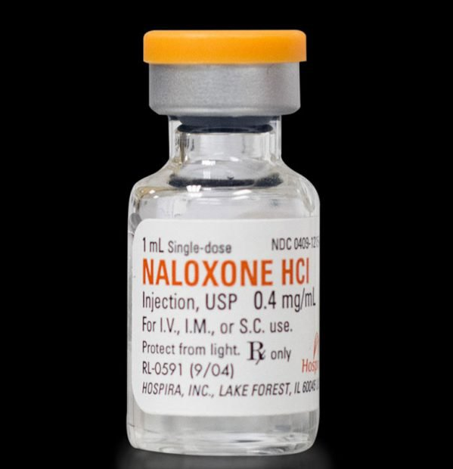
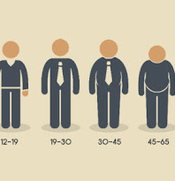

Slide 8
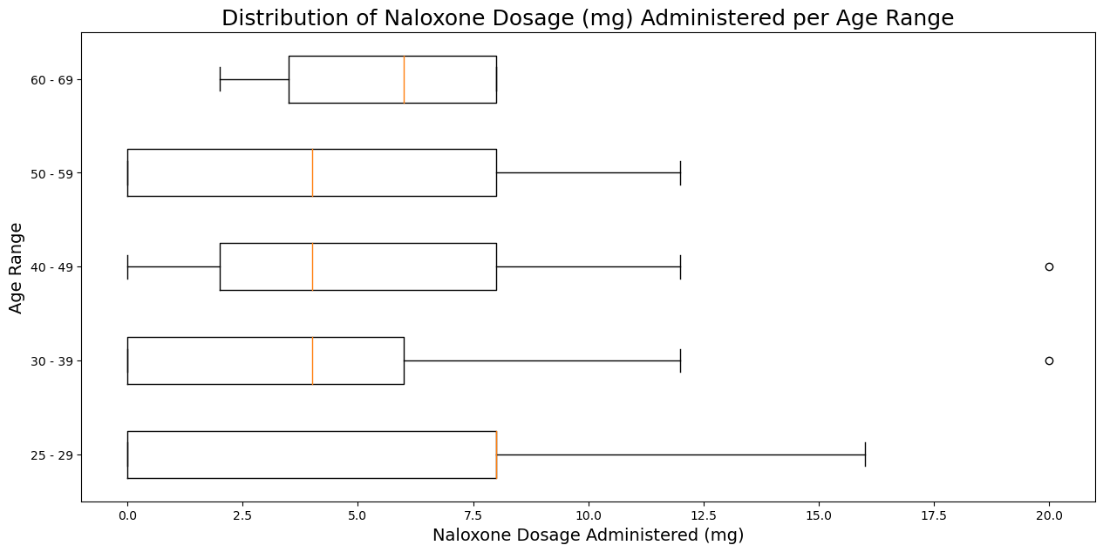
H0: The dosage of Naloxone is not associated to the age of a person

Slide 9
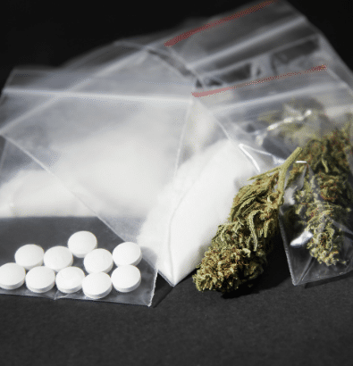

Slide 10
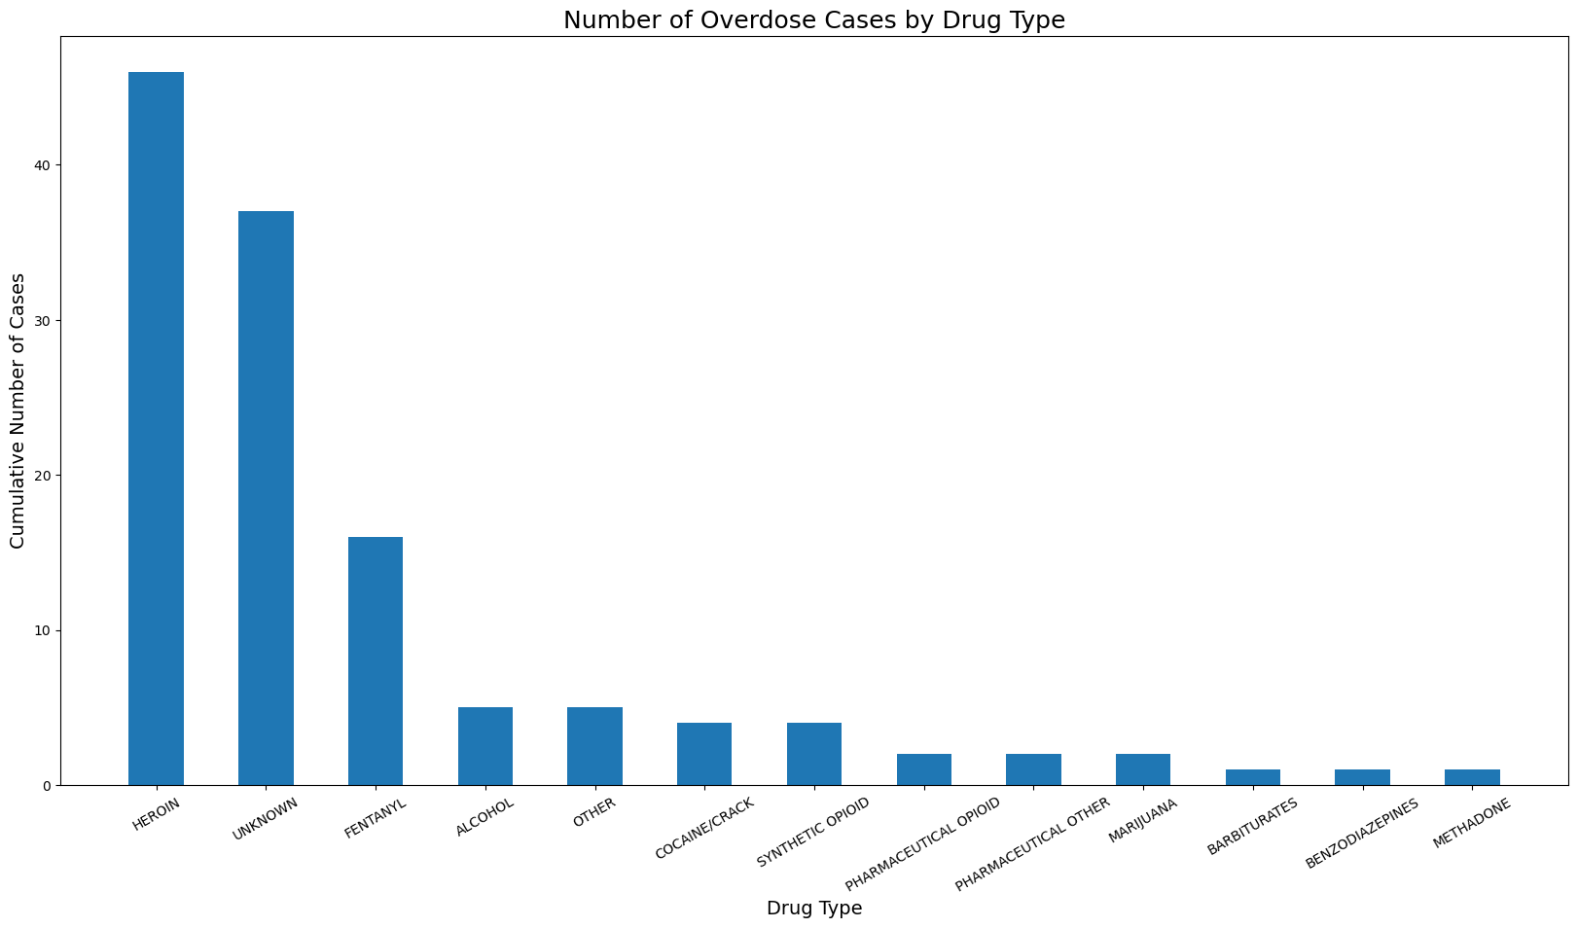

Slide 11
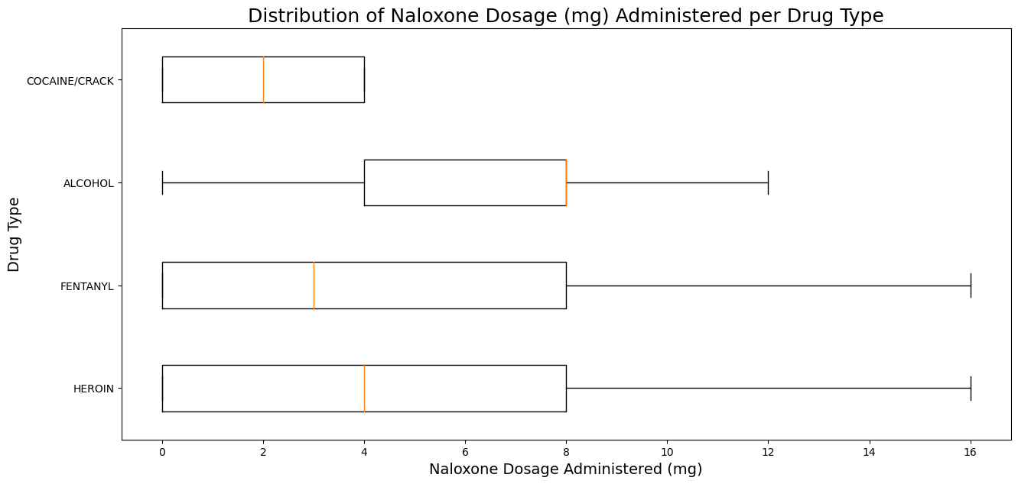
H0: The dosage of Naloxone is not associated with the drug type

Slide 12



