Slide 1


CareConnect: Your Healthcare Companion
CareConnect is an all-in-one healthcare assistance platform providing tailored medical information to users. It helps users easily find hospitals, labs, and understand medical results. By combining accessibility with personalized health services, CareConnect empowers informed health decisions anytime, anywhere.

Slide 2

Team:- The Learning Loop
Himanshu Kumar Sharma
Ashish Gupta

Slide 3


Hospital Agent Overview
1
Data Collection & Storage
We gather extensive hospital data, including names, addresses, and services offered, stored in an SQL database within Databricks Unity Catalog.
2
Brochure Parsing & Vectorization
We extract detailed information from hospitals' brochures, such as bed count, doctor specializations, and fees, using NLP techniques.
3
Functionality & Use Cases
Users can search for hospitals based on location or specialization, guiding users to appropriate facilities.

Slide 4



Lab & Pathology Agent Overview
Location & Time-Aware Suggestions
The agent recommends nearby labs based on user location and current time, checking lab availability for services.
Data Collection & Storage
2
This agent gathers data from labs and pathology centers, including names, addresses, hours, and Google Map links.
1
User Interaction
3
Users receive filtered options in an organized way, enhancing their experience in finding healthcare services quickly.

Slide 5


Lab Report Summarizer Overview
Core Idea
File Ingestion & Extraction
Simplifies complex medical terms, making reports accessible.
Utilizes OCR and PDF parsing to extract data accurately.
Medical Interpretation
User-Friendly Summary
Compares extracted values against standard medical ranges.
Generates a clear summary of significant parameters.

Slide 6




Medication Advisor Agent Overview
Data Collection & Preparation
User Context Analysis
A comprehensive dataset of medicines, including names and dosages, is curated to support user queries.
The agent retrieves user-specific information for personalized medication suggestions.
1
2
Personalized Recommendations
Semantic Retrieval
4
3
The agent performs semantic searches to find suitable medications based on user symptoms.
The agent communicates tailored advice and emphasizes consultation with healthcare professionals.

Slide 7

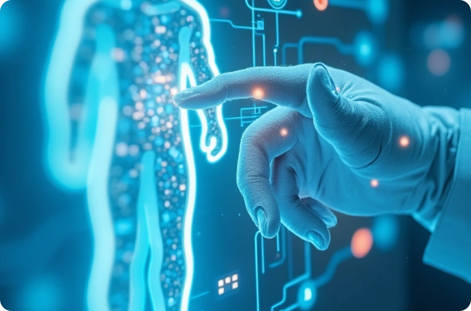

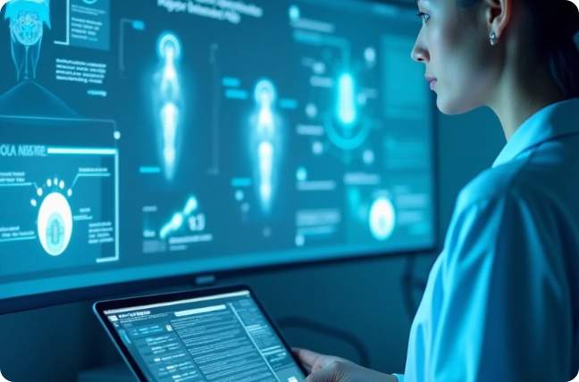

Conclusion & Future Development
Empowering Healthcare Access
User-Centric Design
CareConnect aims to bridge the gap in healthcare accessibility.
The platform focuses on user experience, tailoring responses based on individual needs.
Future Integration Plans
Call to Action
Plans to integrate telemedicine services and AI-driven health tracking tools.
We encourage collaboration in developing CareConnect’s features.

