Slide 1







MonkeyKraft Coders
Presentation 2023
Presented By:
Karishma Gawali
Rithik Shetty
Pranali Chipkar
Mittul Sharma

Slide 2


Introduction
Welcome to MonkeyKraft Coders, your all-encompassing platform dedicated to honing your coding skills.
Our mission is to provide a rich variety of coding challenges that cater to all skill levels, ensuring a dynamic and effective learning experience.

Slide 3
Languages & Framework
Typescript
Javascript
Css
Python
Html
Mongoose
MongoDB
PostMan
Express
React
BCrypt
Acorn

Slide 4
Features
Problem Sets
Coding Playground
Submission and Evaluation
User Profiles

Slide 5
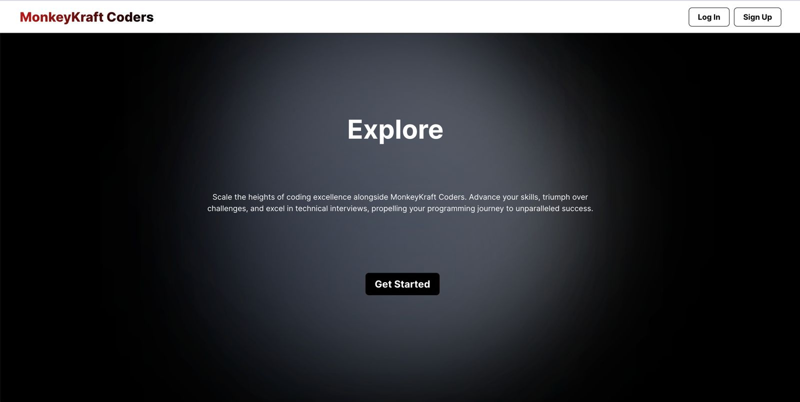
Home Page

Slide 6
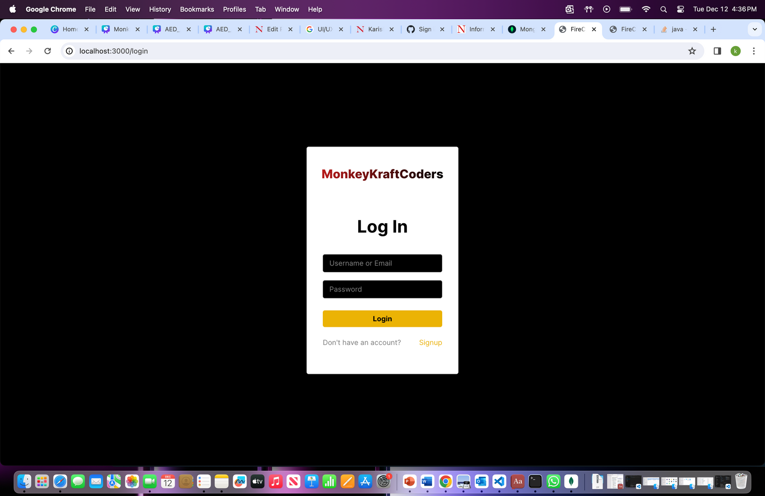
Login Page

Slide 7
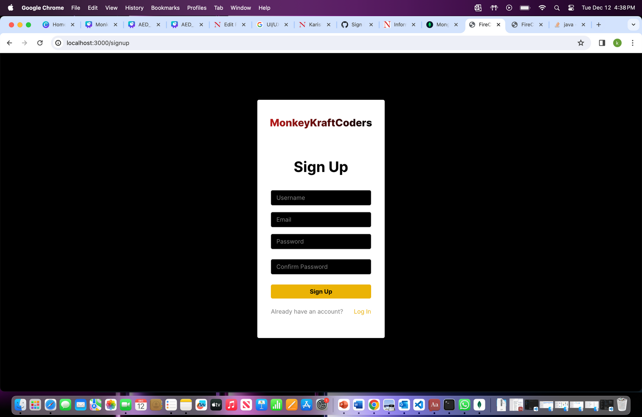
Signup Page

Slide 8
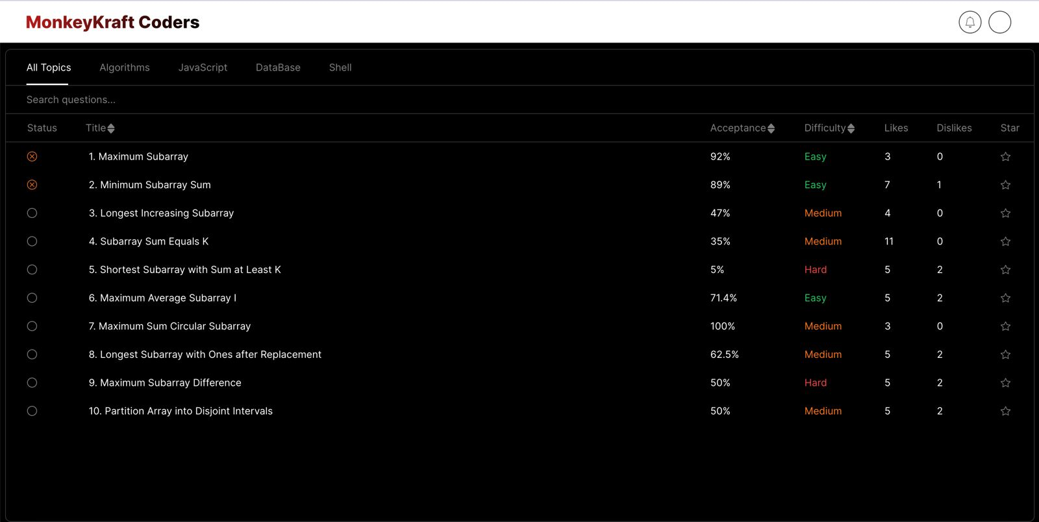
Problemset Page

Slide 9
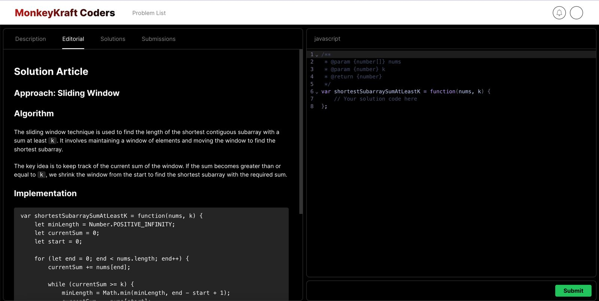
Solution Article

Slide 10
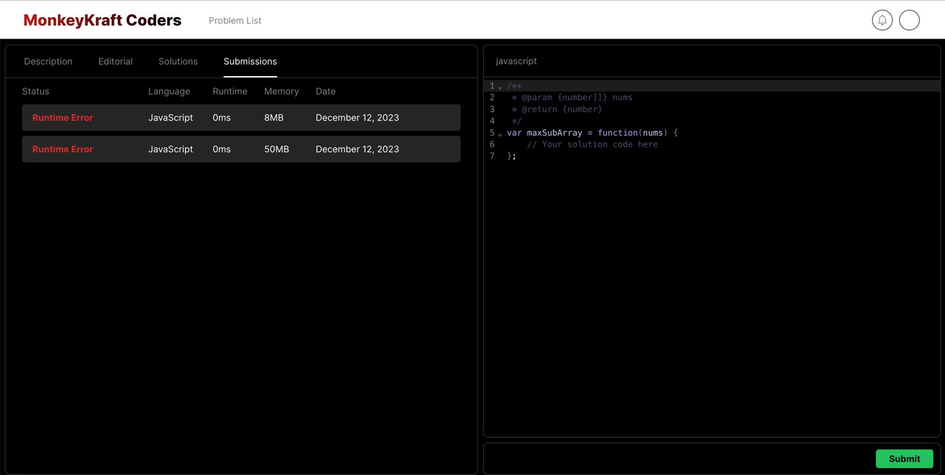
Submission Page

Slide 11
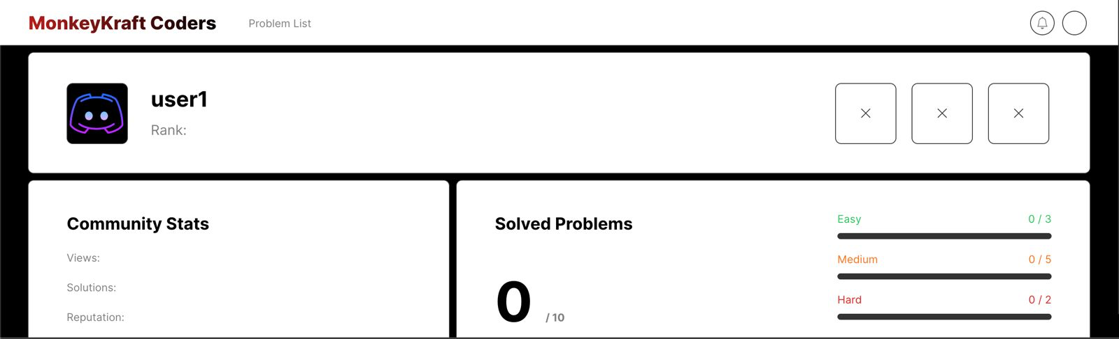
User

Slide 12
Thank You!

