Slide 1
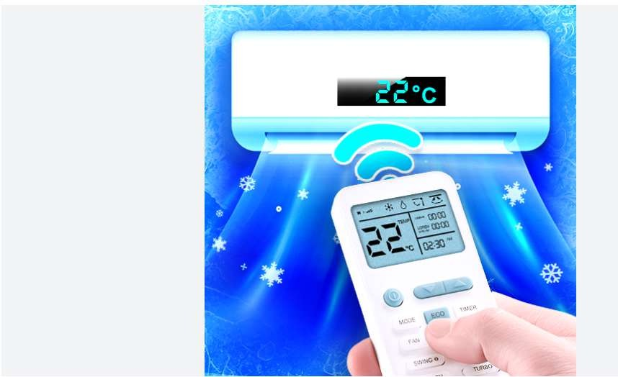
Smart AC Remote Convenience, Customization, and Smart Control
21BCS6325 – Nikhil Sharma
21BCS6301 – Pravesh Sharma

Slide 2
Introduction
Traditional air conditioning remotes often come with limited functionality, offering only basic temperature and fan controls without any real-time feedback. In a world where smart appliances are becoming the norm, these conventional systems fall short in terms of user convenience, data tracking, and energy efficiency. Our proposed Smart AC Remote addresses these gaps by introducing automation, real-time system insights, multilingual support, and voice interaction, thereby enhancing the overall user experience and contributing to smarter, more sustainable homes.

Slide 3
Why Smart AC Remote?
Personalized User Profiles: Users can set their preferred modes, fan speeds, and temperatures, ensuring a tailor-made cooling experience.
Real-time Monitoring: The system provides up-to-the-minute information on AC settings, operational status, and battery level, displayed clearly on the screen.
Voice Assistant Integration: The Smart AC Remote uses speech synthesis to announce actions, improving accessibility and ensuring users are constantly aware of system changes.
Multilingual Support: Language options including English, Spanish, and French make the device usable by a broader demographic, enhancing inclusivity.

Slide 4
Smart System vs Existing AC Remote
Existing Systems
Manual Operation Only
Limited customization
No feedback or monitoring
Static user interface
Proposed Smart System
Remote control, App Access, and Voice Commands
Personalized settings for different users
Real-time display of setting and battery life
Dynamic Design with dark mode and accessibility options
Voice assistant integration

Slide 5
Target User Groups
Remote Enthusiasts: Aged 25-45, tech-savvy individuals who seek precise control and customization.
Busy Professionals: Aged 30-55, prioritize convenience and efficiency; appreciate quick, automated solutions.
Tech-Savvy Homeowners: Aged 35-60, early adopters of smart technologies, looking to integrate devices into their smart homes.
Elderly Users: Aged 65+, require simple, large interfaces with clear language and voice support to ease interaction.

Slide 6
User Interface (UI) Features
Large and Intuitive Buttons: Easy to operate even for users with motor impairments.
Dark Mode Option: Enhances visibility and reduces eye strain, especially in low-light environments.
Multilingual Interface: Instantly switch between English, Spanish, and French.
Voice Announcements: Each action, like temperature change or mode switch, is audibly confirmed, assisting users with visual impairments.

Slide 7
Key Functionalities
Power Control: Turn the AC unit ON or OFF with a single tap.
Temperature Adjustment: Increase or decrease the room temperature within a customizable range (16°C to 30°C).
Mode Selection: Choose between Cool, Heat, Fan, Auto, and Dry modes, depending on the user's needs.
Fan Speed Adjustment: Select from Low, Medium, High, or Auto fan speeds for optimal air distribution.
Preset Modes:
Cool 22°C: Standard comfortable cooling.
Sleep Mode: Temperature regulation for a restful sleep.
Eco Mode: Energy-efficient operation to save power.

Slide 8
Accessibility Features
Voice Synthesis Feedback: Real-time announcements provide auditory feedback for all remote operations.
High Contrast and Dark Mode: Helps visually impaired users to navigate the interface easily.
Large Control Elements: Reduces precision requirements, aiding users with limited motor skills.
Simplified Interface Language: Minimizes cognitive load for elderly and cognitively impaired users.

Slide 9
Future Improvements
Mobile App Integration: Develop apps for Android and iOS to allow remote operation from smartphones.
AI-driven Climate Control: Intelligent algorithms to adjust settings based on user behavior and room conditions.
Expanded Language Options: Adding more regional languages to broaden accessibility.
Smart Home Ecosystem Integration: Compatibility with platforms like Amazon Alexa, Google Home, and Apple HomeKit.

Slide 10
Conclusion
The Super Smart AC Remote reimagines the traditional air conditioning experience, blending convenience, customization, accessibility, and efficiency into one compact device. It not only addresses the limitations of existing remotes but also pushes the boundaries by integrating smart technologies like voice control and multilingual support. As we move toward smarter living spaces, innovations like this remote are essential to enhancing comfort and energy conservation. With future expansions into AI and smart home systems, the Smart AC Remote sets the foundation for a truly intelligent and user-friendly cooling solution.

