Slide 1
SOFTWARE ENGINEERING PROJECT PRESENTATION
Advanced Encryption Standard
SUBMITTED BY: BHAGVATI KAIWARTYA
PRERNA SHARMA
SNEHAL PATRA
WILSON EKKA

Slide 2
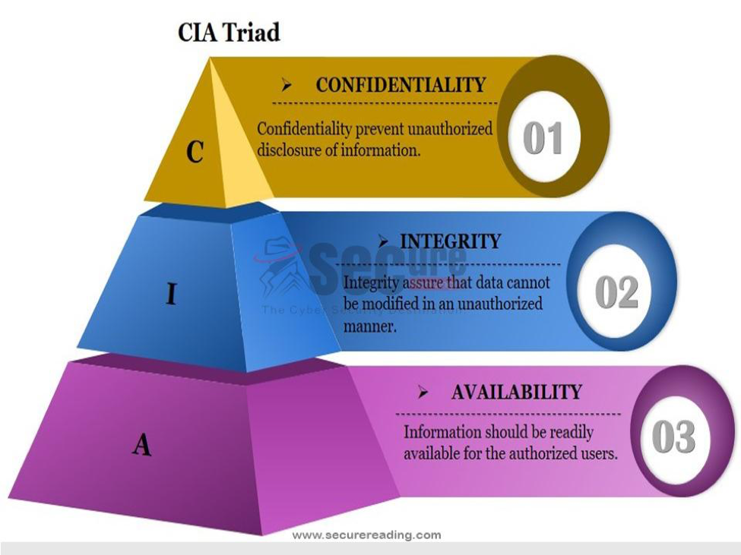
INFORMATION SECURITY; Protection of information systems against unauthorized access to or modification of information, whether in storage, processing or transit, and against the denial of service to authorized users or the provision of service to unauthorized users, including those measures necessary to detect, document, and counter such threats is called information security.
PROBLEM: There are several types of threats and vulnerabilities to the information now a days. Examples: System hacking, Backdoors, Fraud, Poor documentation, Letter bombs, Viruses, Denial of service, Corruption of data, Malicious code, introduction System, bugs etc.
Unauthorized access (malware, spyware) limits our ability to protect the confidentiality of the data
Malicious programs can alter the data values, destroying the integrity of the data
Denial of Service (DoS) attacks can shut down a server and/or network, making the system unavailable.
Results: Reputation loss, Financial loss, Intellectual property loss, Legislative Breaches leading to legal actions (Cyber Law), Loss of customer confidence, Business interruption costs
To protect Information from these threats we need cryptography.
Solution: Cryptography

Slide 3
CRYPTOGRAPHY
ADVANCED ENCRYPTION STANDARD
jhwaedgshgfjqwgehfehfhehghgcccgg

Slide 4
INTRODUCTION
The more popular and widely adopted symmetric encryption algorithm likely to be encountered nowadays is the Advanced Encryption Standard (AES). It is found to be at least six time faster than the triple DES.
The features of AES are as follows:
Symmetric key symmetric block cipher
128-bit data, 128/192/256-bit keys
Stronger and faster than Triple-DES
Provide full specification and design details
Software implementable in C and Java

Slide 5
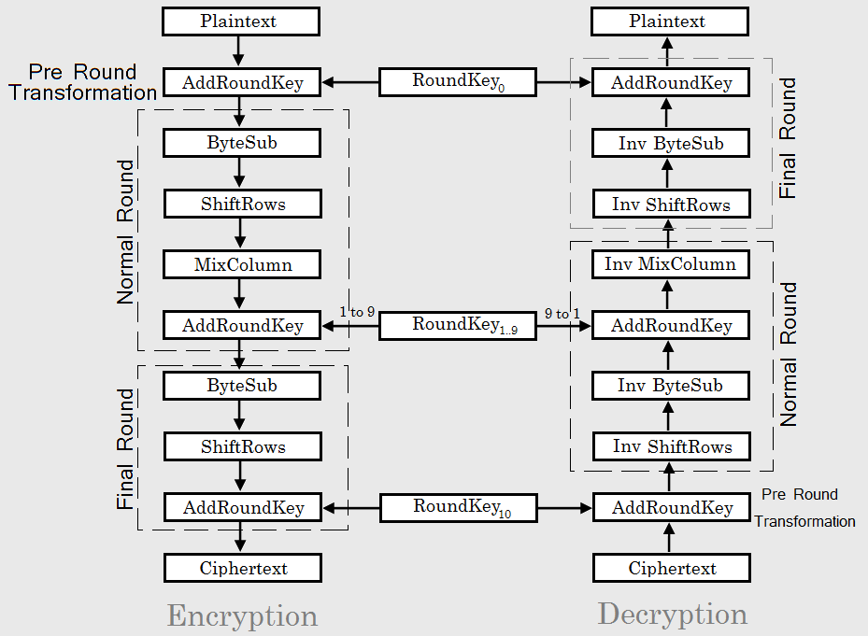
WORKING
Number of Rounds Key Size
10 128
12 192
14 256
Block Diagram of AES for 128 bit key (10 Rounds)

Slide 6
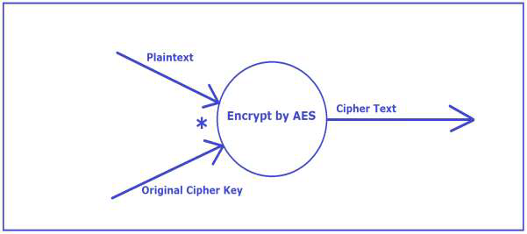
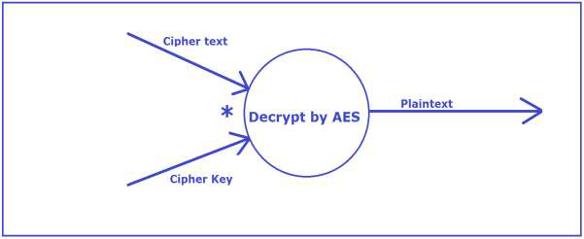
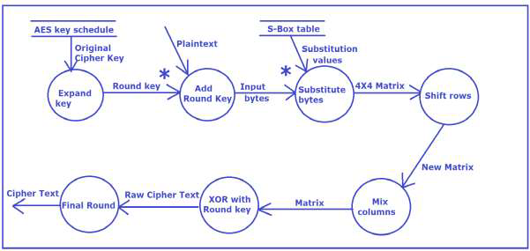
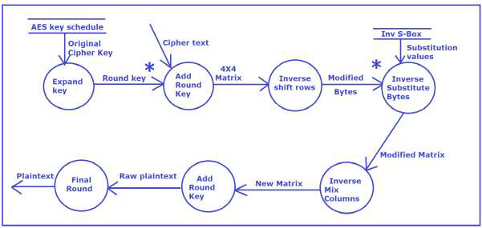
DATA FLOW DIAGRAM
ENCRYPTION DECRYPTION
Level 0 DFD
Level 0 DFD
Level 1 DFD
Level 1 DFD

Slide 7
PROCESS SPECIFICATION
(1) Structured English
FUNCTION: encryption
RECEIVE plaintext
Input key
Invoke method extension_of_key()
Execute process Add Round Key
LET k=1
DO-WHILE (k<10)
LET i=0
DO-WHILE (i<4)
Execute process Substitute Bytes
i=i+1
END DO
PRINT input
Execute process Shift Rows
Execute process Mix Columns
Execute process Add Round Key
k=k+1
END DO
Execute Process Encryption Final Round
// end of function
FUNCTION: decryption
RECEIVE cipher_text
Input key
Execute Process Expand key
Execute Process Add Round Key
LET k=1
DO-WHILE (k<10)
Execute Process Inverse Shift Rows
LET i=0
DO-WHILE (i<4)
Execute Process Inverse Substitute Bytes
i=i+1
END DO
Execute Process Inverse Mix Columns
Execute Process Add Round Key
k=k+1
END DO
Execute Process Decryption Final Round
// end of function

Slide 8
(2) PRE/POST Conditions
The Pre/Post conditions for the processes that build up the algorithms of
encryption are detailed below:
Process: Expand Key
Pre-Condition 1: 2-dimensional array key[][] and extended_key[][] must be
declared.
Post-Condition 1: Array extended_key[][] is filled with calculated values and
made ready for further operation.
Process: Add Round Key
Pre-Condition 1: Array input[][] and Array extended_key[][] are filled with
appropriate values from the previously executing processes.
Post-Condition 1: Array input[][] is modified as each element of the array is
XOR-ed with each element of the array extended_key[][].
Process: Substitute Bytes
Pre-Condition 1: Array input[][] is modified by previous process and array
sbox[][] is declared and filled with appropriate values.
Post-Condition 1: Array input[][] is modified by specific values from sbox[][].
Process: Shift Rows
Pre-Condition 1: Array input[][] is modified by previous processes.
Post-Condition 1: Array input[][] is further modified as the rows of the matrix
are shifted and rearranged as per the algorithm‟s specifications.
Process: Mix Columns
Pre-Condition 1: 1-dimensional array word[] is declared and the modified array
input[][] is received as modified by the previous processes.
Post-Condition 1: Array word[] is filled with appropriate values as per the
specifications of the algorithm and specific elements of array input[][] are
replaced with elements of array word[].
Process: XOR with Round Key
Pre-Condition 1: Array input[][] and extended_key[][] are received as modified
by previous processes.
Post-Condition 1: Array input[][] is modified as each element of the array is
XOR-ed with each element of the array extended_key[][].
Process: Final Round
Pre-Condition 1: All previously mentioned processes have successfully executed.
Post-Condition 1: The cipher text is generated and made ready to be passed on
to the processes involved in decryption.
The Pre/Post conditions for the processes that build up the algorithms of
decryption are detailed below:
Process: Expand Key
Pre-Condition 1: 2-dimensional array key[][] and extended_key[][] must be
declared.
Post-Condition 1: Array extended_key[][] is filled with calculated values and
made ready for further operation.
Process: Add Round Key
Pre-Condition 1: Array input[][] and Array extended_key[][] are filled with
appropriate values from the previously executing processes.
Post-Condition 1: Array input[][] is modified as each element of the array is
XOR-ed with each element of the array extended_key[][].
Process: Inverse Shift Rows
Pre-Condition 1: Array input[][] is modified by XOR operation of each element
with each element of Array extended_key[][] in the previous process.
Post-Condition 1: Array input[][] is further modified by shifting of rows.
Process: Inverse Substitute Bytes
Pre-Condition 1: 2-dimensional array Invsbox[][] should be declared.
Post-Condition 1: 1-dimensional array inp[] is filled with specific elements of
array Invsbox[][].
Process: Inverse Mix Columns
Pre-Condition 1: 1-dimensional array word[] is declared and 2-dimensional array
input[][] is available for operations.
Post-Condition 1: Array word[] is filled with appropriate values and specific
elements of array input[][] are replaced with elements of array word[].
Process: Final Round
Pre-Condition 1: All previously mentioned processes have successfully executed.
Post-Condition 1: The plaintext is generated.

Slide 9
DATA DICTIONARY
The data dictionary for the entire system (metadata) has been depicted in the following table:
Data Item Data Type Bytes of storage Size for display(bytes)
key uint8_t 1 X size of array 1 X size of array
input uint8_t 1 X 4 X 4 = 16 1 X 4 X 4 = 16
extended_key uint8_t 1 X 4 X 44 = 176 1 X 4 X 44 = 176
Invsbox uint8_t 1 X 16 X 16= 256 1 X 16 X 16= 256
Sbox uint8_t 1 X 16 X 16= 256 1 X 16 X 16= 256
Table 2: Metadata
The above table represents the metadata of the entire system. The relation AES Key Schedule is as follows:
AES_Key_Schedule (key, Type)
AES_Key_Schedule = @key + Type
key = alpha + numeric * Key Field *
Type = [string | integer]
alpha = 0 { }
numeric = 1 { }

Slide 10
SOFTWARE REQUIREMENT SPECIFICATIONS DOCUMENT(SRS)
Purpose:
The purpose of the project is to build an encryption-decryption algorithm using Advanced Encryption Standard (AES) so that it can be used to exchange confidential data and information over a platform or network. The project ensures data protection using AES algorithm.
Project Scope:
The project can be extended for encryption of text into images and used in steganography with the help of powerful IDEs and tools like MATLAB. It can be used in practical applications for exchange of data over a local network.
Requirements:
.
Correctness: The plaintext as received by the receiver should be the same as the one sent by the sender. There should be no variation between the sent item and the received item. The correctness of the system is to be maintained.
Maintainability: The AES key schedule should maintain a proper list of keys in order to serve the purpose of a sufficient number of customers. The provision and supply of keys for the purpose is up to the developers.
Usability: The system should satisfy a maximum number of customer needs.
Reliability: The system performs its intended task of encrypting the original file on the sender’s side and decrypting the cipher text on the receiver’s side. The system needs to maintain the integrity of the original file that is encrypted and sent by the sender to the receiver.
Modularity: The system has been designed using the modular approach of software development. Hence it can be decomposed into modules in order to study the system.
Reusability: The software can be used with changes made to it in order to expand it to implement larger projects such as image and audio encryption projects.
Functional requirements
Arrays have been used to contain the key and the plaintext.
2-dimensional array has been used to store key, extended key, plaintext and Ciphertext.
The data members have been passed on to functions as formal parameters in most of the cases.
However, global data members have also been used.
Modular approach has been followed.
Non-functional requirements
Performance Requirements: The steps involved to perform the implementation of the system include command-based interface and the modules for encryption and decryption. It also requires the proper declaration and use of data structures for the implementation of the same.
Software Quality Attributes:
Availability: A list of keys should be available to serve the purpose of encryption-decryption operations by multiple users.

Slide 11
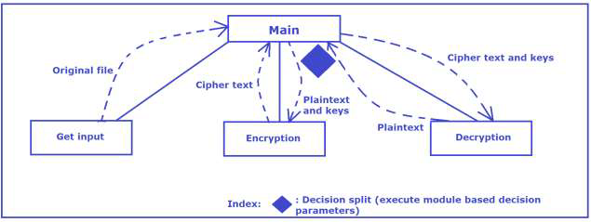
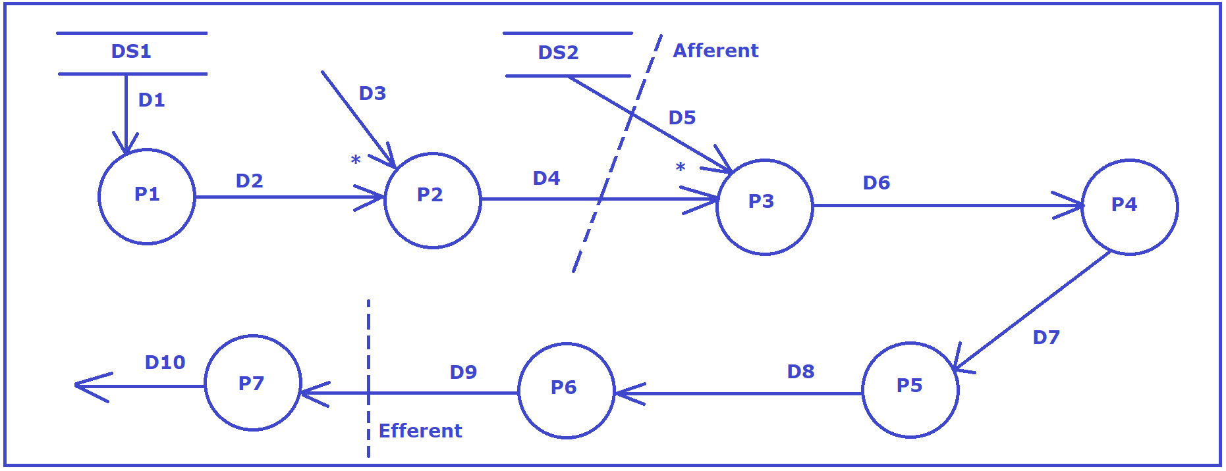
Mapping DFD into Structure Charts
Main Module
DS1: AES Key schedule
DS2: S-Box table
D1: Original Cipher Key
D2: Round Key
D3: Plaintext
P2: Add round key
D4: Input Keys
D5: Substitution values
P3: Substitution bytes
D6: 4*4 Matrix
P4:Shift rows
D7: New matrix
P5: Mix columns
D8: Matrix
P6: XOR with round key
D9: raw Ciphertext
P7: Final round
D10: Ciphertext

Slide 12
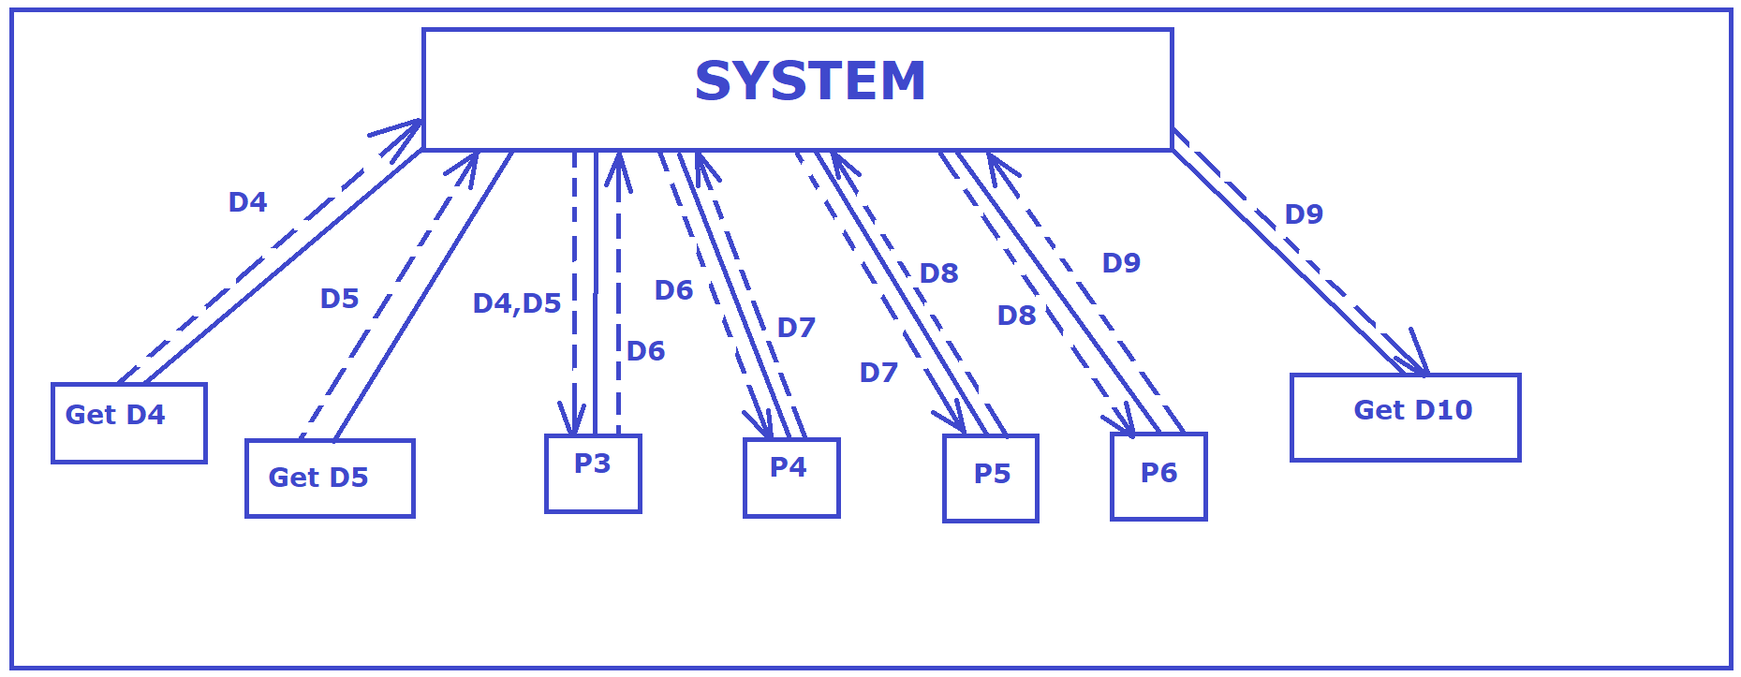
ENCRYPTION MODULE
First Cut Factor of Encryption
DATA FLOW DIAGRAM OF ENCRYPTION KODULE IS ALREADY GIVEN IN SLIDE SIX

Slide 13
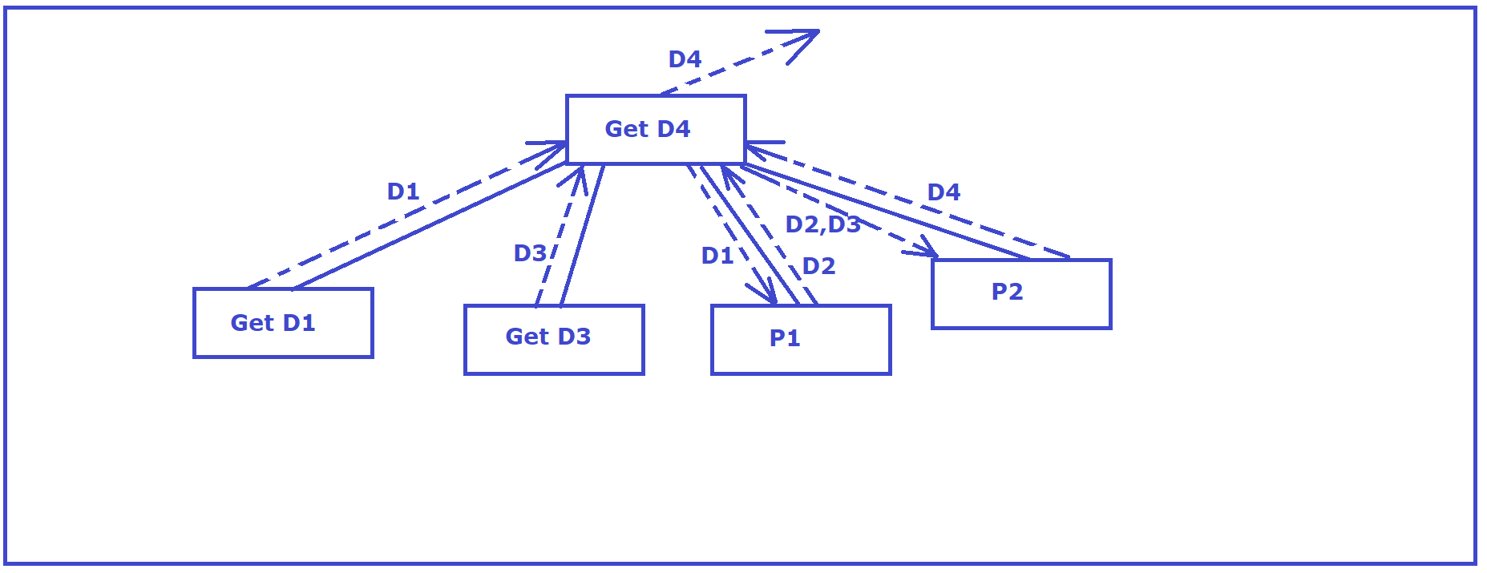

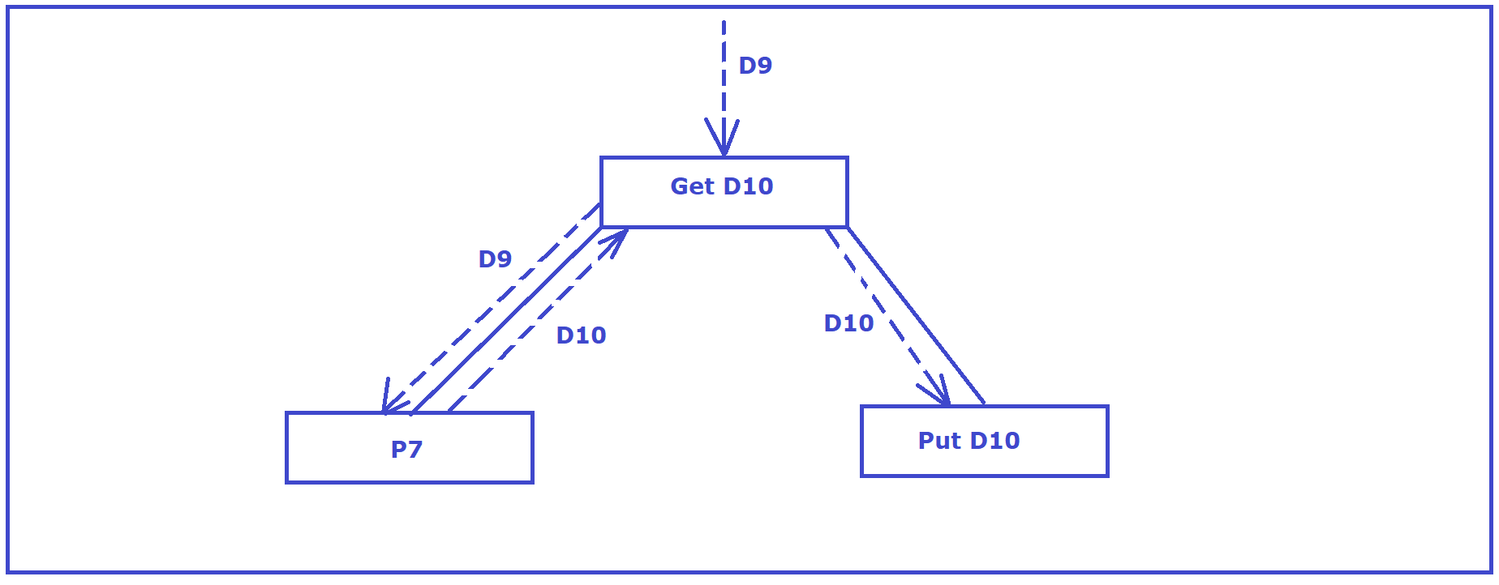
ENCRYPTION MODULE
Factor Afferent and Factor Efferent
Factoring Afferent(1) Factoring Afferent(2) Factoring Efferent
NOTE: Same for decryption module.

Slide 14
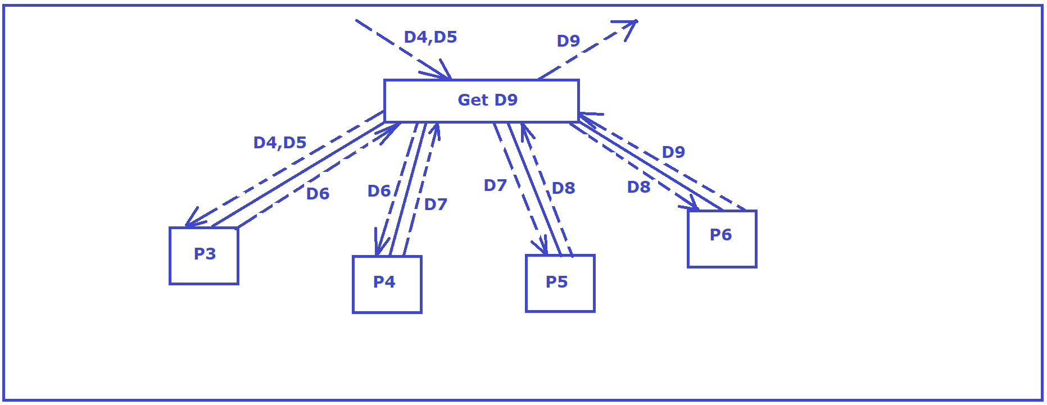
ENCRYPTION MODULE
Central Transform of Encryption

Slide 15
MODULES AND THEIR SPECIFICATIONS
The Main Module consists of the following modules:
Get Input
Encryption
Decryption
The module Get Input is an atomic module whereas the other two modules further consist of the following sub-modules:
Module Encryption is implemented with the help of the following sub-modules:
Expand Key
Add Round Key
Substitute Bytes
Shift Rows
Mix columns
XOR with Round Key
Encryption Final Round
Module Decryption is implemented with the help of the following sub-modules:
Expand Key
Add Round Key
Inverse Shift Rows
Inverse Substitute Bytes
Inverse Mix Columns
Decryption Final Round

Slide 16
COHESION AND COUPLING
COUPLING
Our software design implements data coupling and common coupling.
Data coupling in the current project:
The modules of Encryption and Decryption along with their subordinate modules operate on homogeneous data elements. The key and the arrays that the modules work on are of homogeneous data type. Further details have been disclosed in the Design Document in Section 11.
Common coupling in the current project: The following global 2-D arrays are used by the modules: extended_key[4][44], sbox[16][16], Invsbox[16][16].
This contributes to common coupling in the software design.
COHESION
The current project makes use of functional cohesion and sequential cohesion and hence ensure the most desirable cohesion in the system.
Functional cohesion in the current project:
The subordinate modules of Encryption and Decryption each achieves a single goal and ensures functional cohesion within its module.

Slide 17
SOFTWARE TESTING_

Slide 18
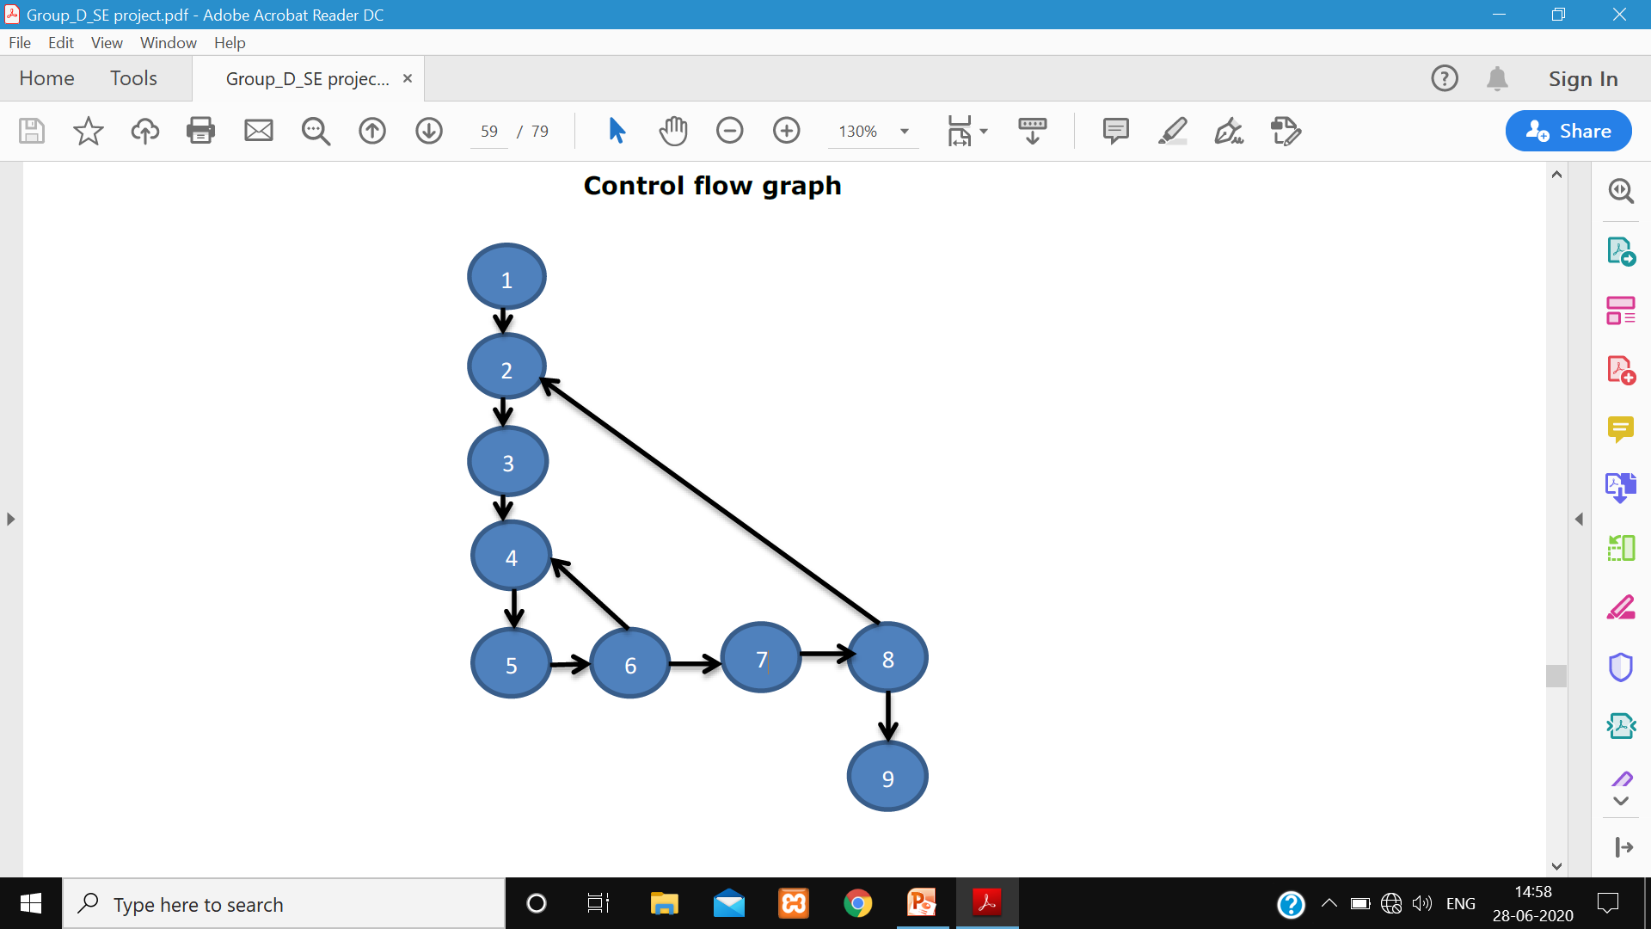
STRUCTURAL TESTING
(1) Unit Testing
Algorithm get_input (inp[][])
{
Declare Array st[100]: character
1 Input st
k=0
2 do{
3 j=0
4 do{ inp[j][i]=hex_to_deci(st,k);
5 k=k+2;
j=j+1;
}while(j<4) 6
7 i=i+1
}while(i<4) 8
} // end of Algorithm 9
No of bounded regions: 2
No of edges: 10
No of vertices: 9
Cyclomatic complexity:
V(G)= E– V+2 = 3
V(G)= 2+1 = 3
Basis set of linearly independent path:
Path 1: 1->2->3->4->5->6->7->8->9
Path 2: 1->2->3->4->5->6->7->8->2
Path 3: 1->2->3->4->5->6->4

Slide 19
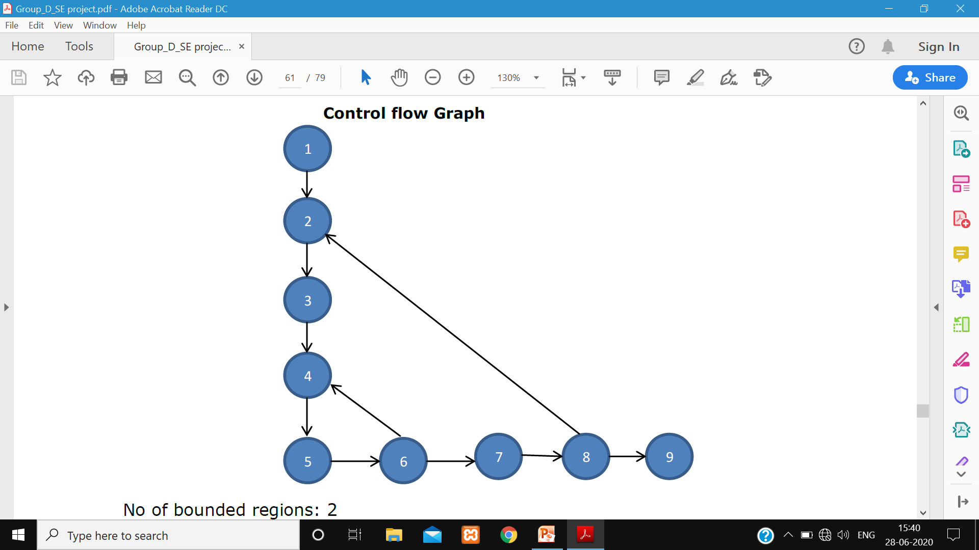
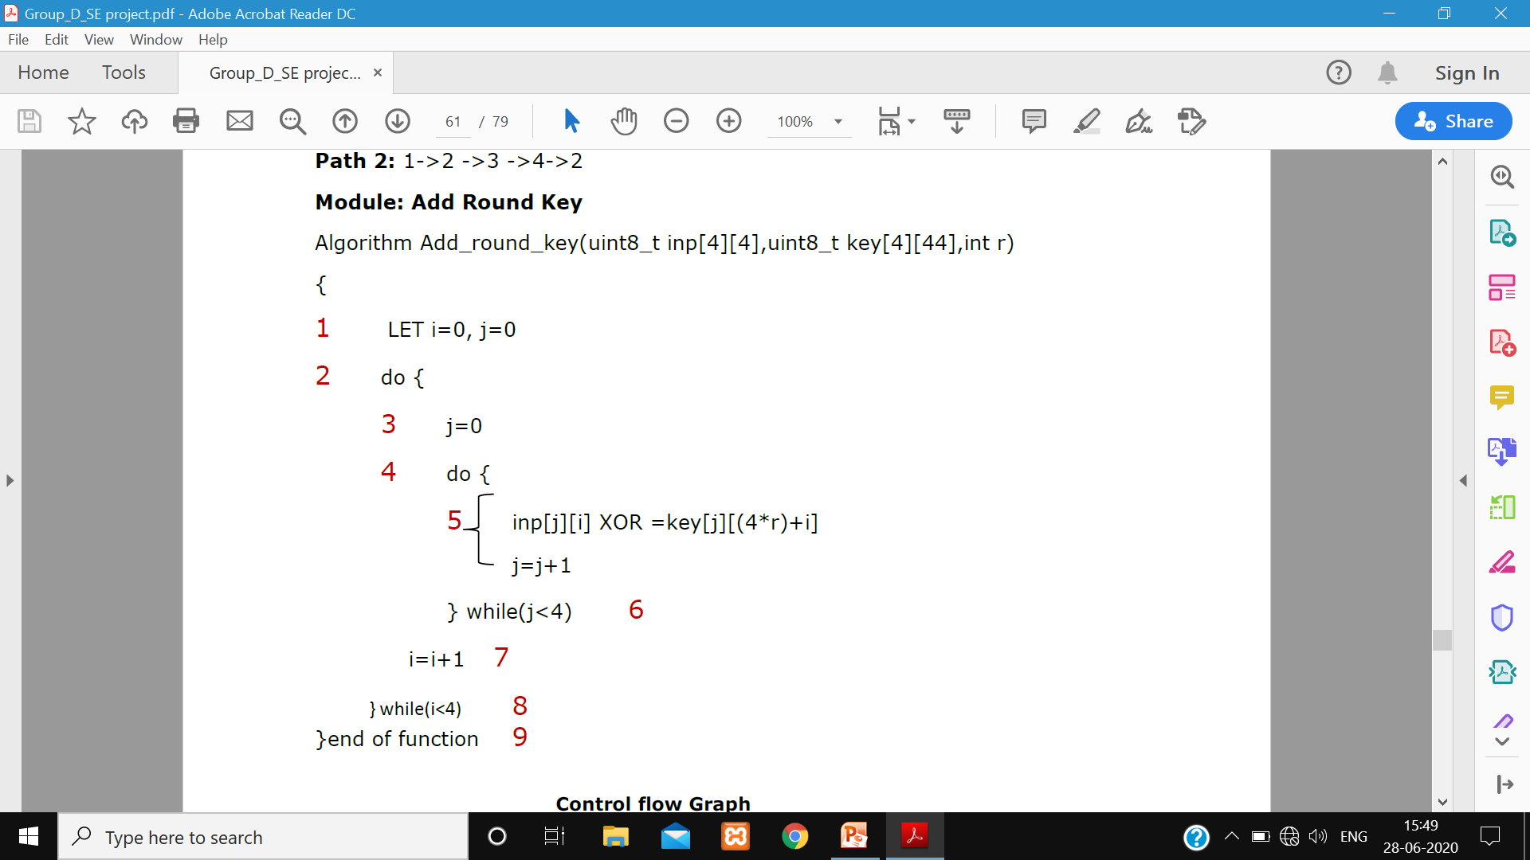
STRUCTURAL TESTING
(1) Unit Testing
No of bounded regions: 2
No of edges: 10
No of vertices: 9
Control flow Graph
Cyclomatic complexity: V(G)= E– V+2 = 3
V(G)= 2+1 = 3
Basis set of linearly independent path:
Path 1: 1->2->3->4->5->6->7->8->9
Path 2: 1->2->3->4->5->6->7->8->2
Path 3: 1->2->3->4->5->6->4

Slide 20
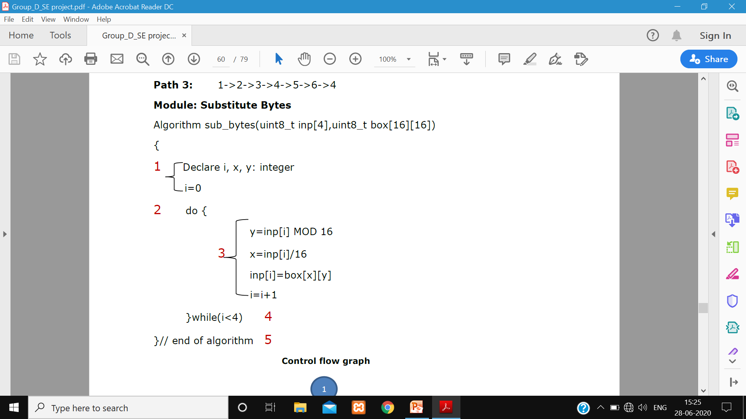
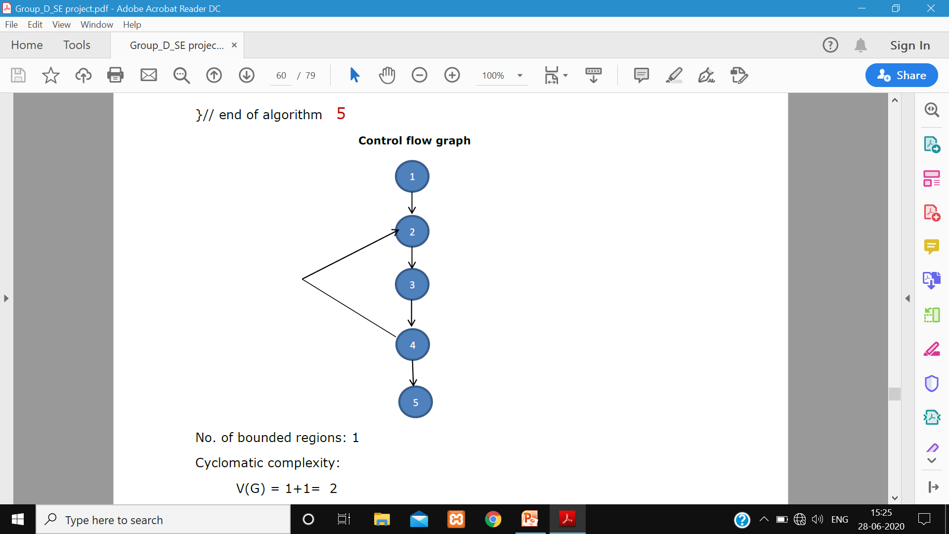
STRUCTURAL TESTING
(1) Unit Testing
No. of bounded regions: 1
Cyclomatic complexity:
V(G) = 1+1= 2
Basis set of linearly independent path:
Control flow graph
Path 1: 1->2->3->4->5
Path 2: 1->2 ->3 ->4->2

Slide 21
STRUCTURAL TESTING
(1) Unit Testing
Module: Shift Rows
Algorithm shift_rows(input[][])
{
1 Declare i, j, temp, k: integer
i=1
2 do {
3 rotate_l(input[i],i)
i=i+1
} while(i<4) 4
}//end of function 5
Number of bounded regions: 1
No. of edges: 5
No. of vertices: 5
Cyclomatic complexity:
E- V + 2 = V(G)= 2
Basis set of linearly independent paths:
Path 1: 1->2->3->4->5
Path 2: 1->2->3->4->2

Slide 22
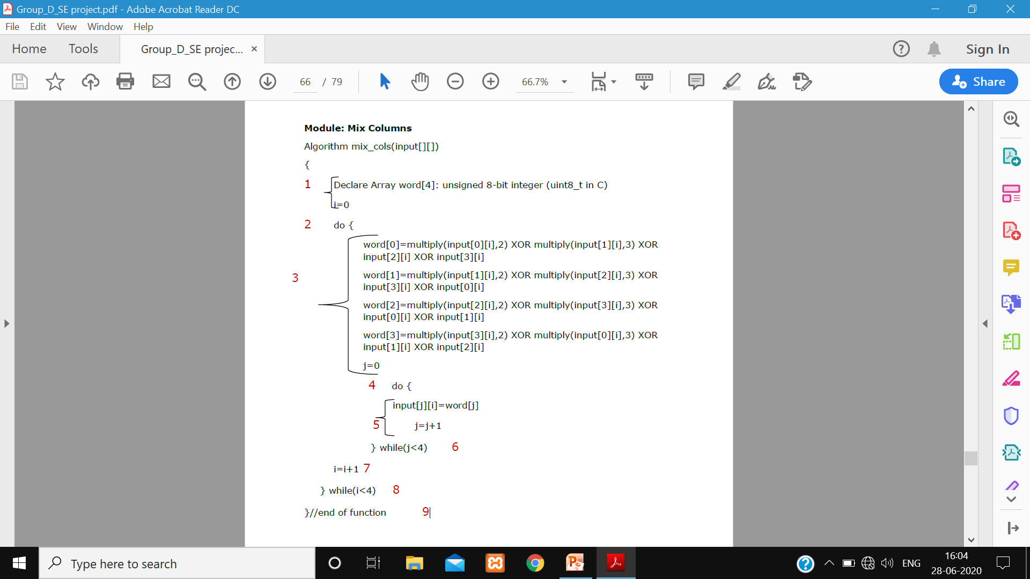
STRUCTURAL TESTING
(1) Unit Testing
No. of bounded regions: 2
No. of edges: 10
No. of vertices: 9
Cyclomatic complexity is:
E – V+2 = 10-9+2 = 3
Basis of linearly independent paths:
Path 1: 1->2->3->4->5->6->4
Path 2: 1->2->3->4->5->6->7->8->2
Path 3: 1->2->3->4->5->6->7->8->9

Slide 23
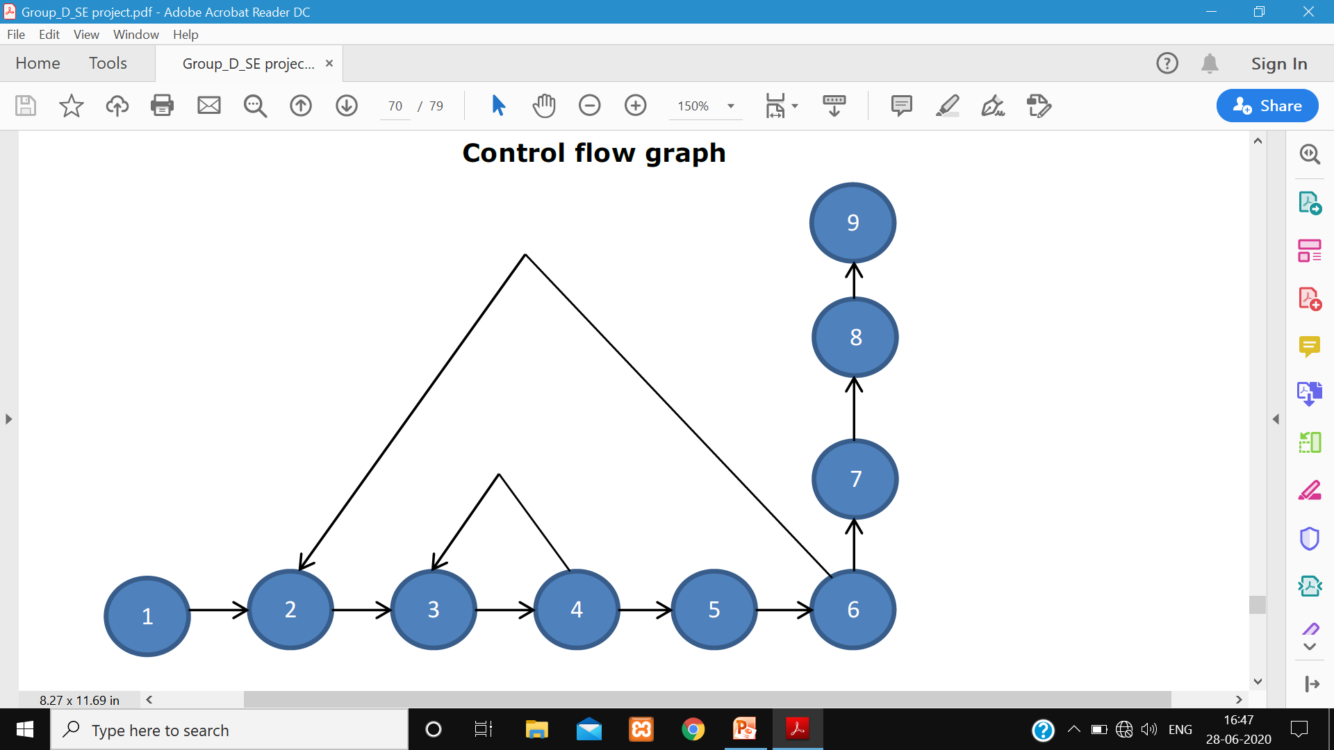
STRUCTURAL TESTING
(1) Integration Testing
Module Encryption:
Algorithm encryption (input[][], key[][], sbox[][])
{
extension_of_key(key,extended_key,sbox);
Add_round_key(input,extended_key,0);
printf("AFTER ADDING KEY :\t");
print(input);
2 for(k=1;k<10;k++)
{
PRINT ("ROUND %d \n\n",k)
3 for(i=0;i<4;i++)
4 sub_bytes(input[i],sbox);
} end of for 5
PRINT ("AFTER SUBSTITUTION :\t")
PRINT (input)
shift_rows(input);
PRINT ("AFTER SHIFTING ROWS :\t")
6 PRINT (input)
mix_cols(input);
PRINT ("AFTER MIXING COLS :\t")
PRINT (input)
Add_round_key(input,extended_key,k);
PRINT ("AFTER ADDING KEY :\t")
PRINT (input)
}end of for 7
8 PRINT ("\n ROUND %d \n",k)
Execute Module Encryption Final Round
} // END OF Algorithm 9

Slide 24
STRUCTURAL TESTING
(1) Integration Testing
No. of bounded regions: 2
No. of edges = 9
No. of vertices = 8
Cyclomatic complexity = E – V + 2
= 9- 8+2
= 3
Basis of linearly independent Path:
Path 1: 1->2->3->4->3
Path 2: 1->2->3->4->5->6->2
Path 3: 1->2->3->4->6->7->8->9
Test cases are:
cipher text: 50 67 246 168 136 90 48 141 49 49 152 162 224 55 7 52
Key: 43 126 21 22 40 174 210 166 171 247 21 136 9 207 79 60
NOTE: Decryption process is also same as Encryption.

Slide 25
STRUCTURAL TESTING
System Testing
Module: Main module
Algorithm Main {
Declare Array input[][],
key[][]: unsigned 8-bit integer (uint8_t in C) 1
Invoke Method s_box(sbox)
do { 2
Print (“ENTER E OR e TO ENCRYPT AND D or d TO DECRYPT”)
Input dec 3
4 5
If (dec=='E' OR dec=='e')
{
PRINT ("Enter input of 128 bits \n")
Input input[][] // taking input 6
PRINT ("Enter the key of 128 bits \n")
Input key //taking input of key
encryption(input,key,sbox)
} end if
7 8
else if (dec=='D' OR dec=='d')
{
PRINT ("Enter input of 128 bits \n");
Input input[][] 9
PRINT ("Enter the key of 128 bits \n")
Input key
decryption(input,key,sbox,Invsbox)
}
else
PRINT ("\n PLEASE! ENTER THE CORRECT INPUT \n") 10
PRINT ("\n ENTER 0 TO CONITNUE \n")
Input con 11
} while(con==0) 12
} // end of main 13

Slide 26
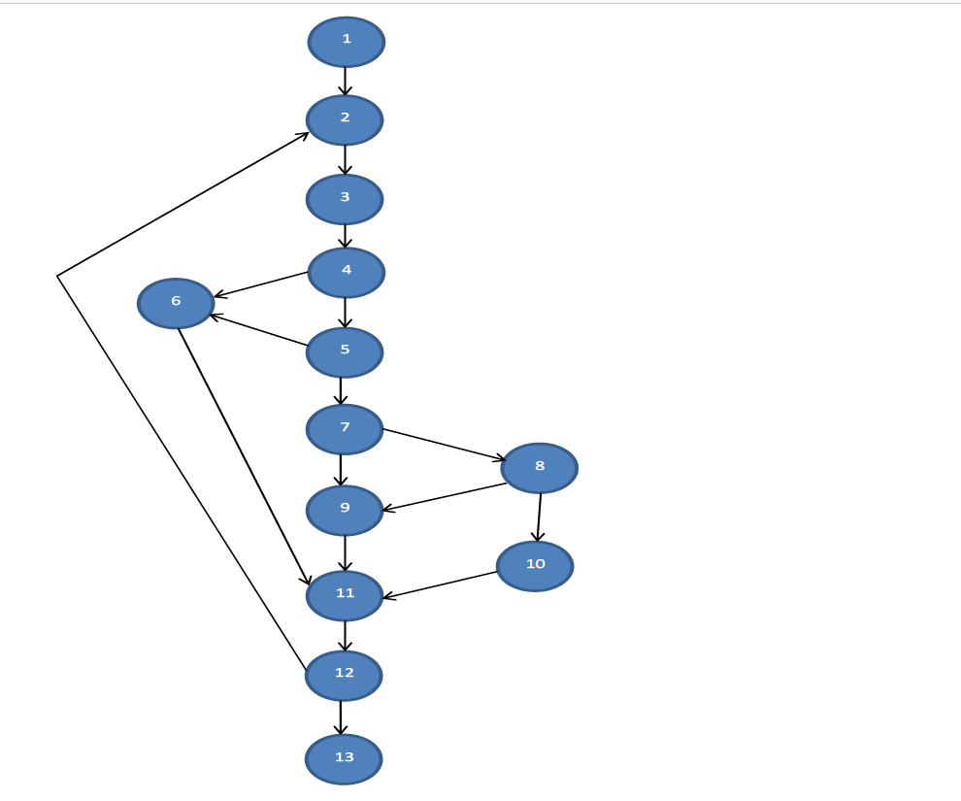
STRUCTURAL TESTING
System Testing
No. of bounded regions: 6
No. of edges: 17
No. of vertices: 13
Cyclomatic complexity:
E- V+ 2
17-13+2 = 6
Basis set of linearly independent paths:
Path 1: 1->2->3->4->6
Path 2: 1->2->3->4->5->6
Path 3: 1->2->3->4->5->6->11->12->13
Path 4: 1->2->3->4->5->7->9->11->2
Path 5: 1->2->3->4->5->7->8->9->11->12->13
Path 6: 1->2->3->4->5->7->8->10->11->12->13
Test cases are:
1. <inp = E >
2. <inp=e>
3. <inp = D>
4. <inp = d>
5. <inp p or any alphabet other than above>

Slide 27
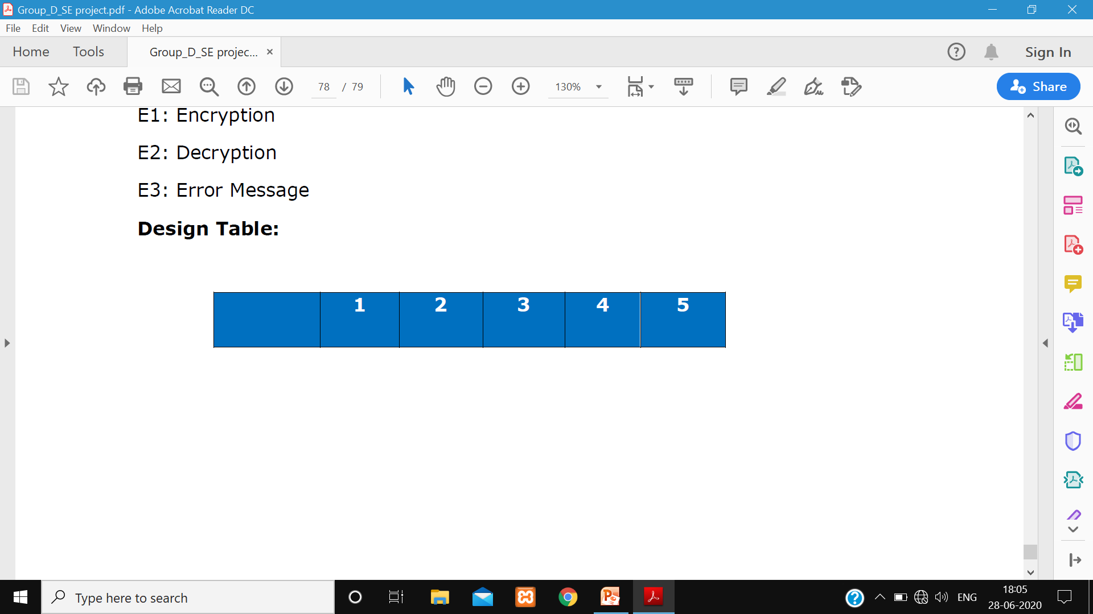
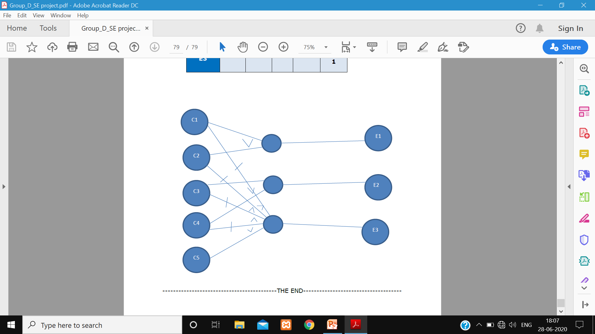
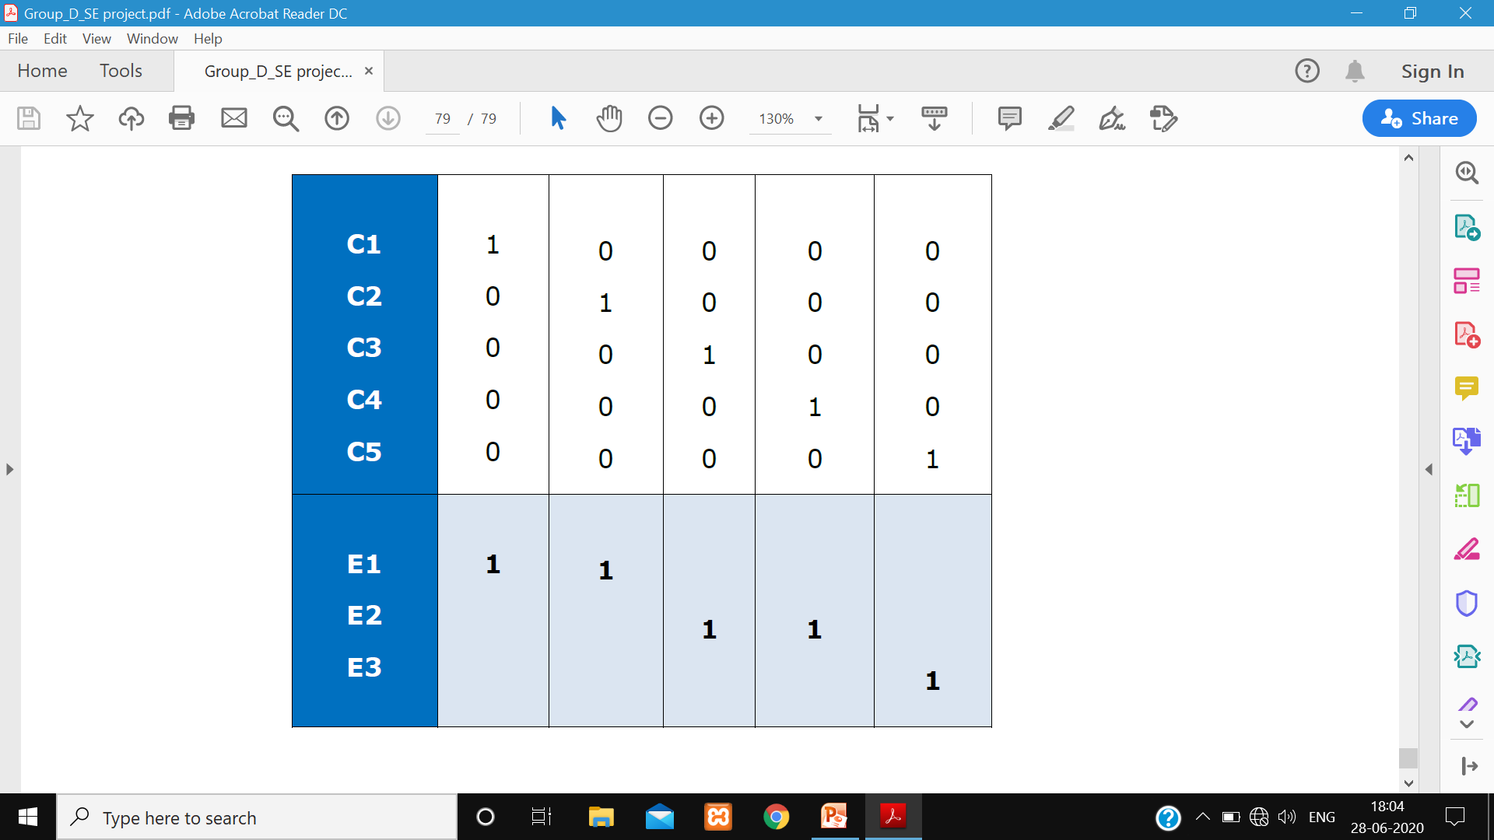
FUCNTIONAL TESTING
Cause Effect Graphic Technique
Module: Main Module
Causes:
C1: Input E
C2: Input e
C3: Input D
C4: Input d
C5: Input Other than above
Effects:
E1: Encryption
E2: Decryption
E3: Error Message

Slide 28
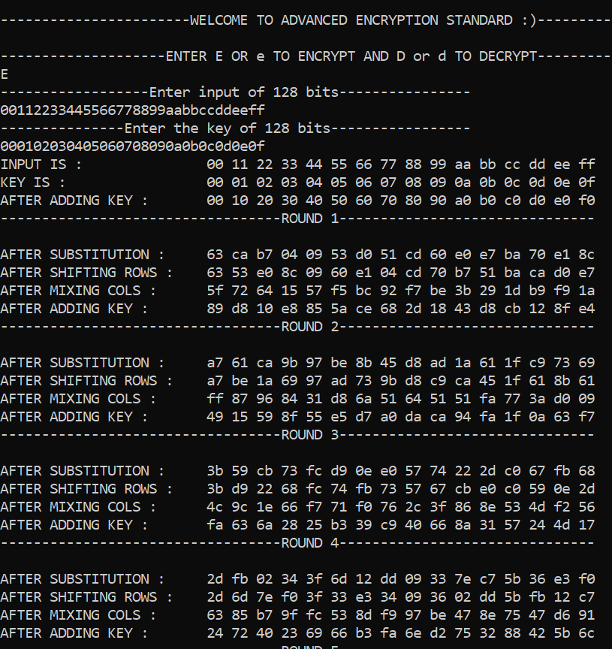
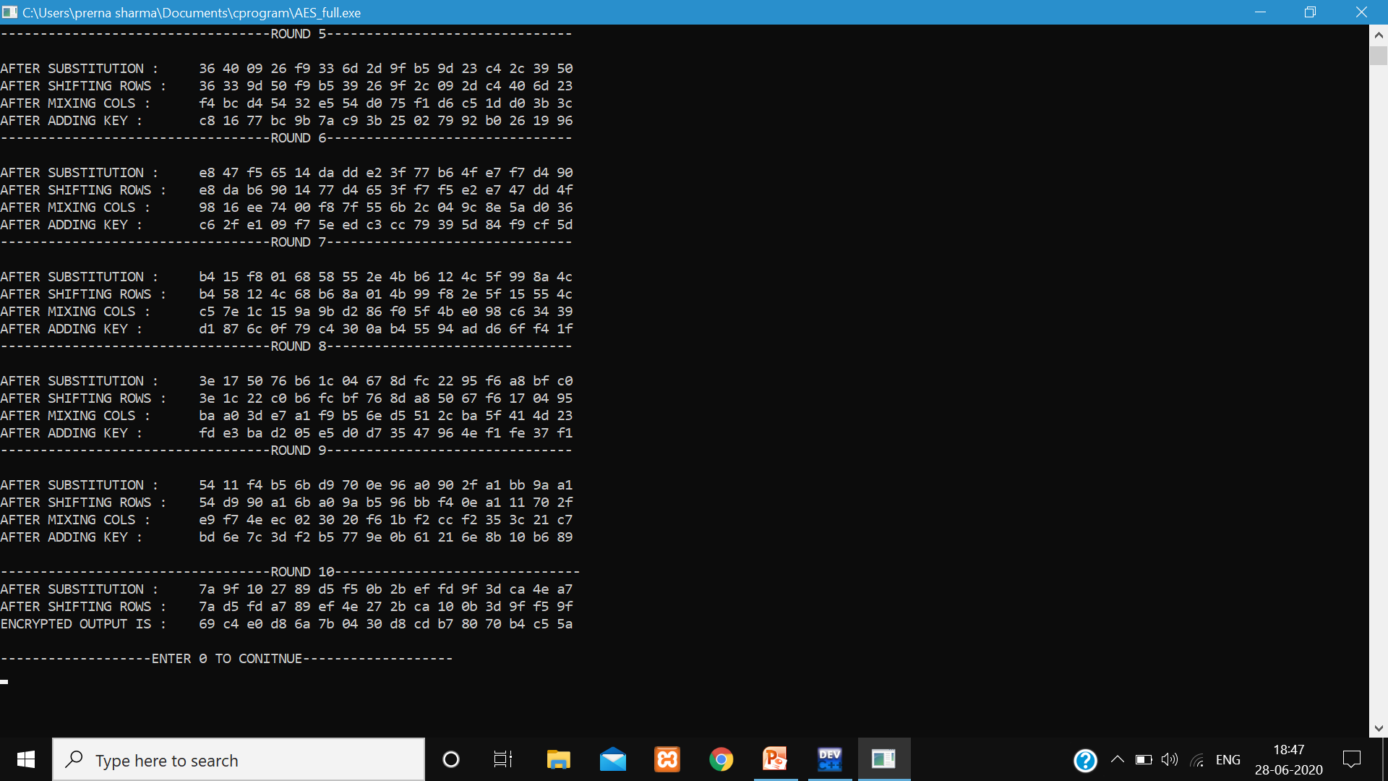

Slide 29

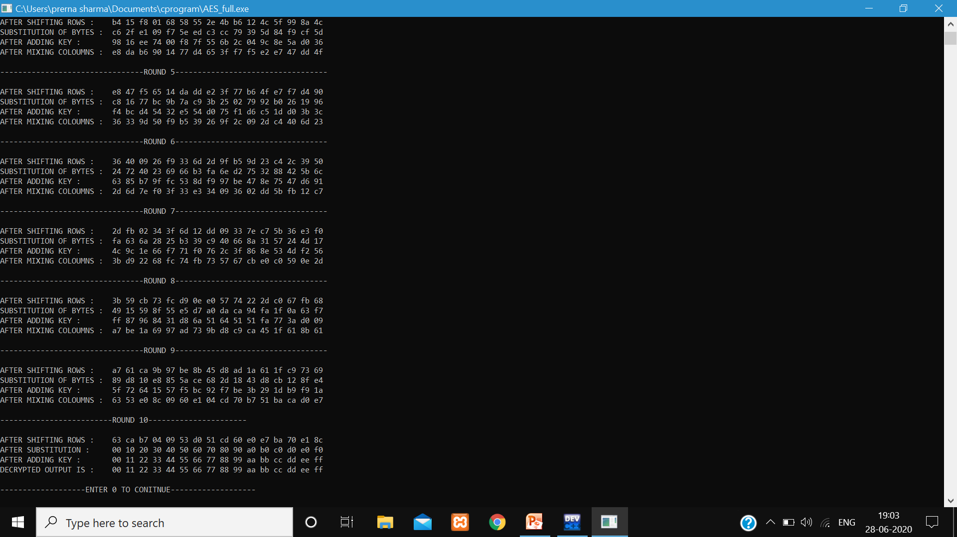

Slide 30
THE END

