Slide 1
MORPHOLOGICAL CLASSIFICATION OF GALAXIES
Presented
By
PRERNA SHARMA

Slide 2
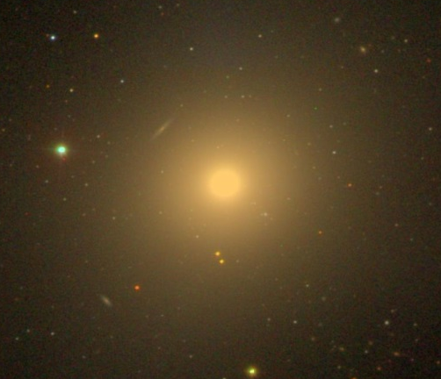
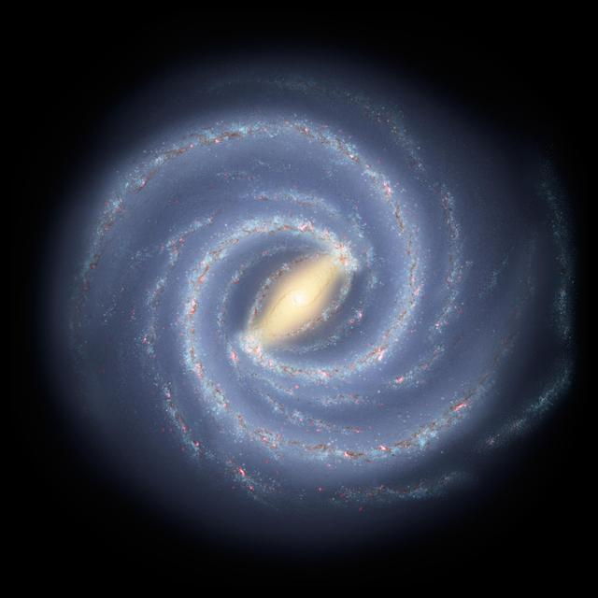
INTRODUCTION
OBJECTIVE: Implement a machine learning model that can classify galaxies.
Why Galaxy Classification is important?
It helps to unveil the evolution of galaxies after big bang.
It helps to detect gravitational lensing effect which in turn can be a huge sign of existence of dark matter.
Fundamental Classification of galaxy
Name: Messier-89
Class: Elliptical
Name: Milky Way
Class: Spiral

Slide 3
DATASET
Dataset Used
The dataset is drawn from Galaxy Zoo 2 .
GZ2 is one of the most successful crowdsourcing projects in astronomy .
Large-scale morphological classification with more than 16 million objects, classified in 304,122 co-added images of galaxies.
from both DR7 Legacy survey having apparent magnitude (m > 17), and SDSS Stripe 82 [4].
gri color composite images, each of size (424 × 424) pixels.

Slide 4
Task | Question | Response | Next
01 | Is the galaxy simply smooth and rounded, with no sign of features or a disk? | smooth disk star or artifact | 07 02 end
02 | Could this be a disk viewed edge-on? | Yes No | 09 03
03 | Is there a sign of a bar feature through the centre of the galaxy? | Yes No | 04 04
04 | Is there any sign of a spiral arm pattern? | Yes No | 10 05
05 | How prominent is the central bulge, compared with the rest of the galaxy? | no bulge just noticeable obvious dominant | 06 06 06 06
06 | Is there anything odd? | yes no | 08 end
07 | How rounded is it? | completely round in between cigar-shaped | 06 06 06
08 | Is the odd feature a ring, or is the galaxy disturbed or irregular? | ring lens or arc disturbed irregular other merger dust lane | end end end end end end
09 | Does the galaxy have a bulge at its centre? If so, what shape? | rounded boxy | 06 06
10 | How tightly wound do the Spiral arms appear? | tight medium loose | 11 11 11
11 | How many spiral arms are there? | 1 2 3 4 more than four 05 can't tell 05 | 05 05 05 05 05 05
Task | Previous Task
01 | -
02 | 01
03 | 01,02
04 | 01,02
05 | 01,02
06 | -
07 | 01
08 | 06
09 | 01,02
10 | 01,02,04
11 | 01,02,04

Slide 5
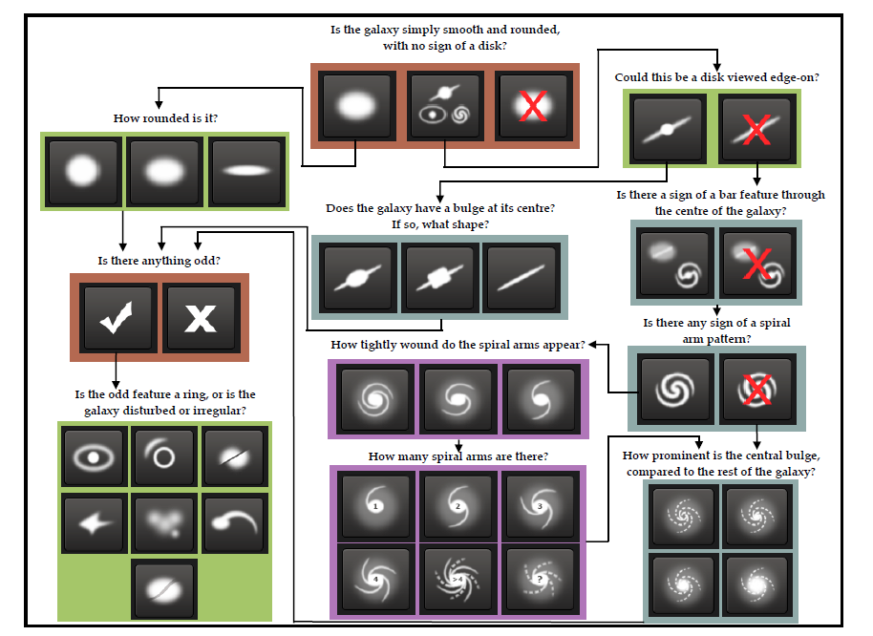

Slide 6
APPROACH USED
1. Model Architectures: ResNet50, Multilayer Perceptron with following Variations
MLP: Without and With Image Augmentation (each with RGB & Grayscale Images)
ResNet50: With and Without Image Augmentation
2. Data Preprocessing: By applying transformations on each image (61578 images)
Crop
Resize
Rescale
3. Image Augmentation: To reduce overfitting
1. Horizontal Flip
Vertical Flip
Random Rotation within provided range
Zoom
Increased Brightness
4. Training Models ( 6*61578 = 369468 images )
5. Testing (79975)

Slide 7
MODEL ARCHITECTURE: MLP
Input Layer
Neurons = Image shape
16384
or,
49512
Hidden layer 1
4096 Neurons
Activation
‘Relu’
Hidden layer 2
512
Neurons
Activation
‘Relu’
Hidden layer 3 with dropout rate 0.5
256
Neurons
Activation
‘Relu’
Hidden layer 4
37
Neurons
Activation
‘Relu’
Custom Output Layer
37
Neurons

Slide 8
MODEL ARCHITECTURE: ResNet-50
ResNet-50 without top layers
Pooling: Average
Last layer: 2048 neurons with dropout rate 0.5
Weights: Imagenet
Hidden layer 4
37
Neurons
Activation
‘Relu’
Custom Output Layer
37
Neurons
&
Custom activation

Slide 9
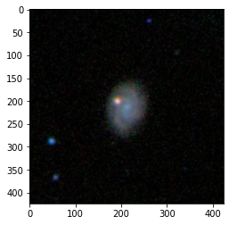
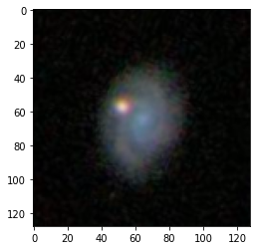
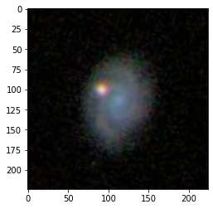
DATA PREPROCESSING
Crop
Resize

Slide 10
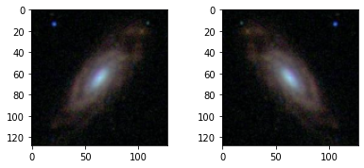
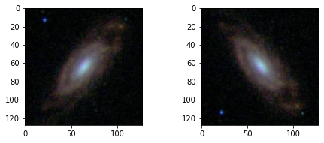
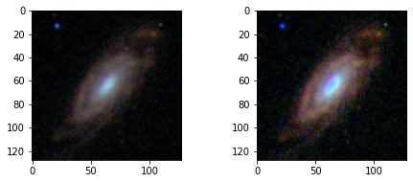
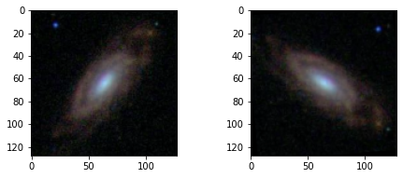
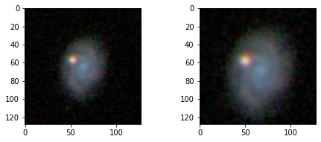
IMAGE AUGMENTATION
Horizontal Flip
Vertical Flip
Brightness Enhancement
Random Rotation
Zoom-In

Slide 11
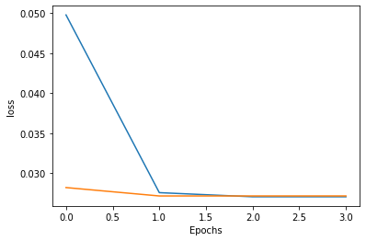
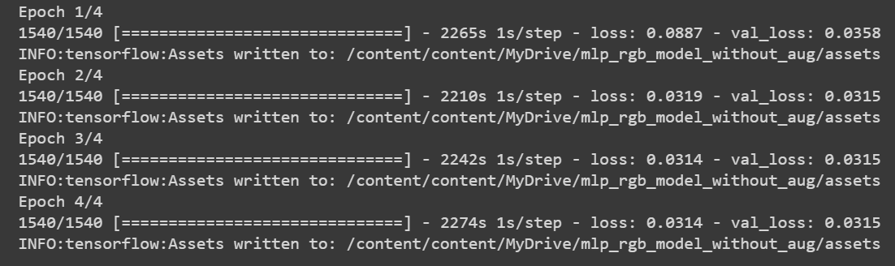
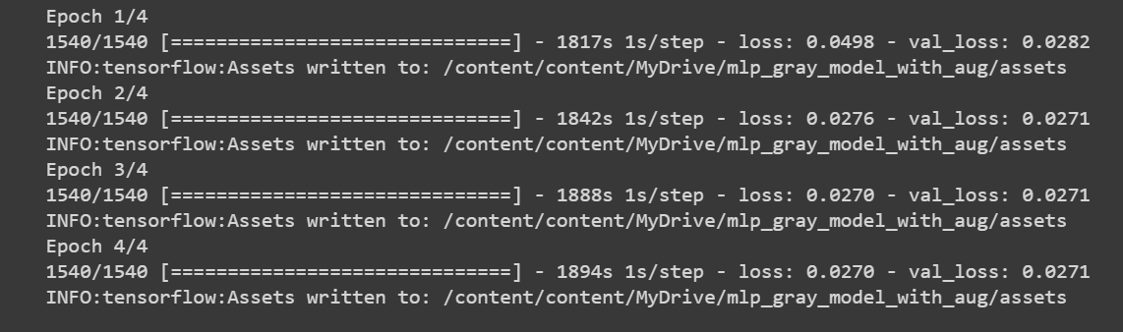
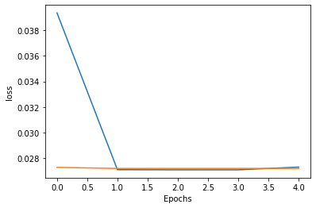
TRAINING: PROGRESS SUMMARY
1. ResNet without data augmentation
2. ResNet with data augmentation

Slide 12
TESTING: RMSE SCORE
Model | Data Augmentation | Image Color Mode | RMSE (Root Mean Square Error)
MLP | No | Grayscale | 0.0897
MLP | Yes | Grayscale | 0.0555
MLP | No | RGB | 0.0756
MLP | Yes | RGB | 0.0498
Resnet50 | No | RGB | 0.0450
Resnet50 | Yes | RGB | 0.0289

Slide 13
FUTURE SCOPE & CONCLUSION
ResNet-50 performed well with data augmentation
This project can be extended to distinguishes galaxies in DES DR2
It can also be extended to classify large number of classes as shown in Hubble Turing Fork Diagram.

Slide 14
Thank you

