Slide 1
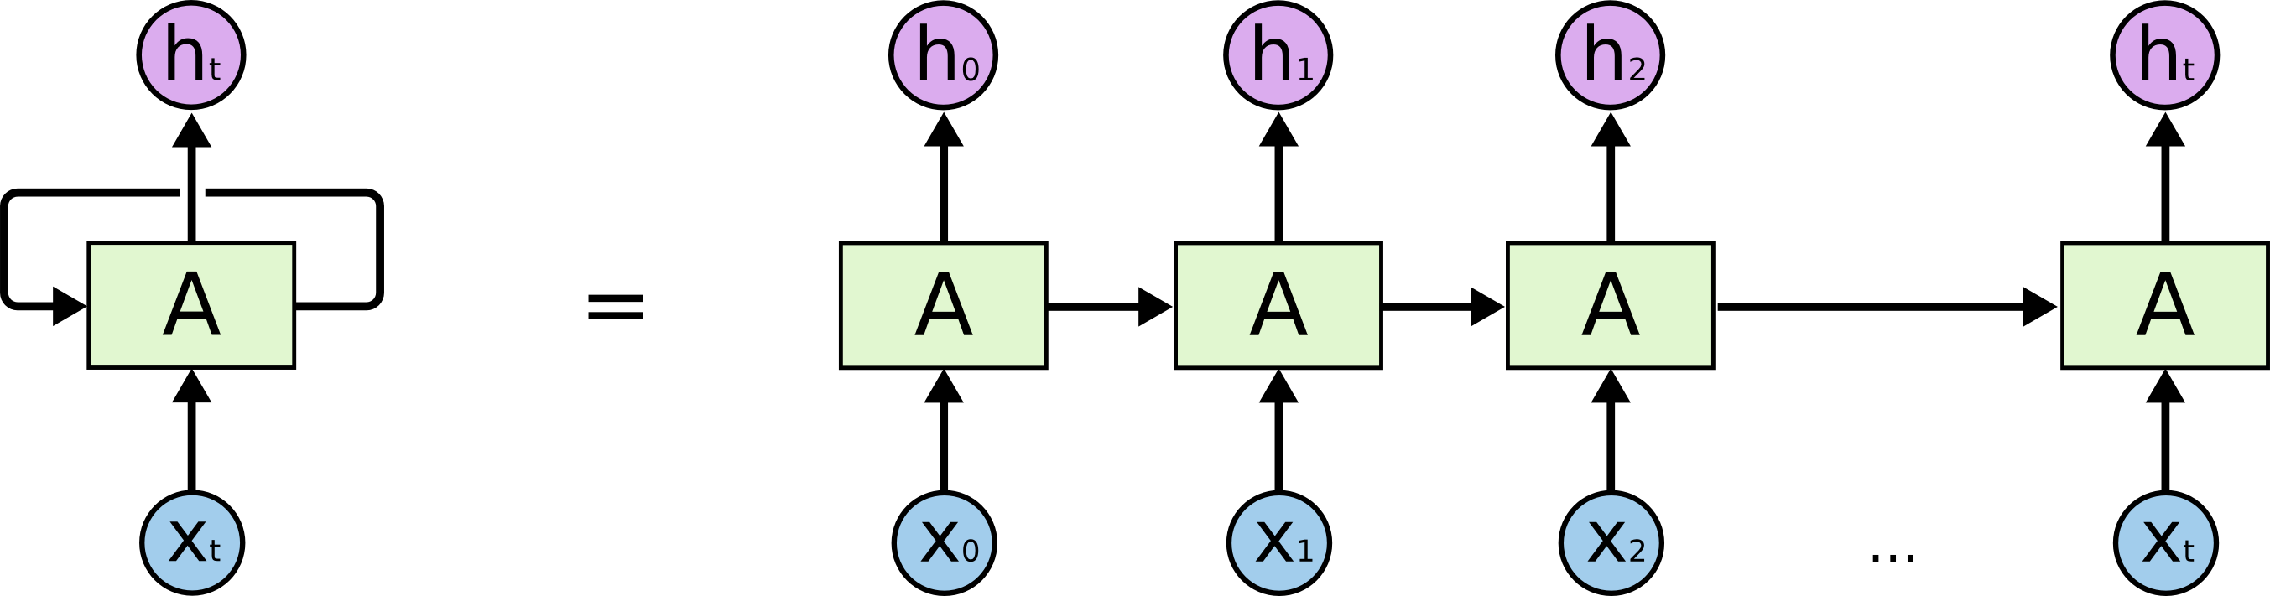
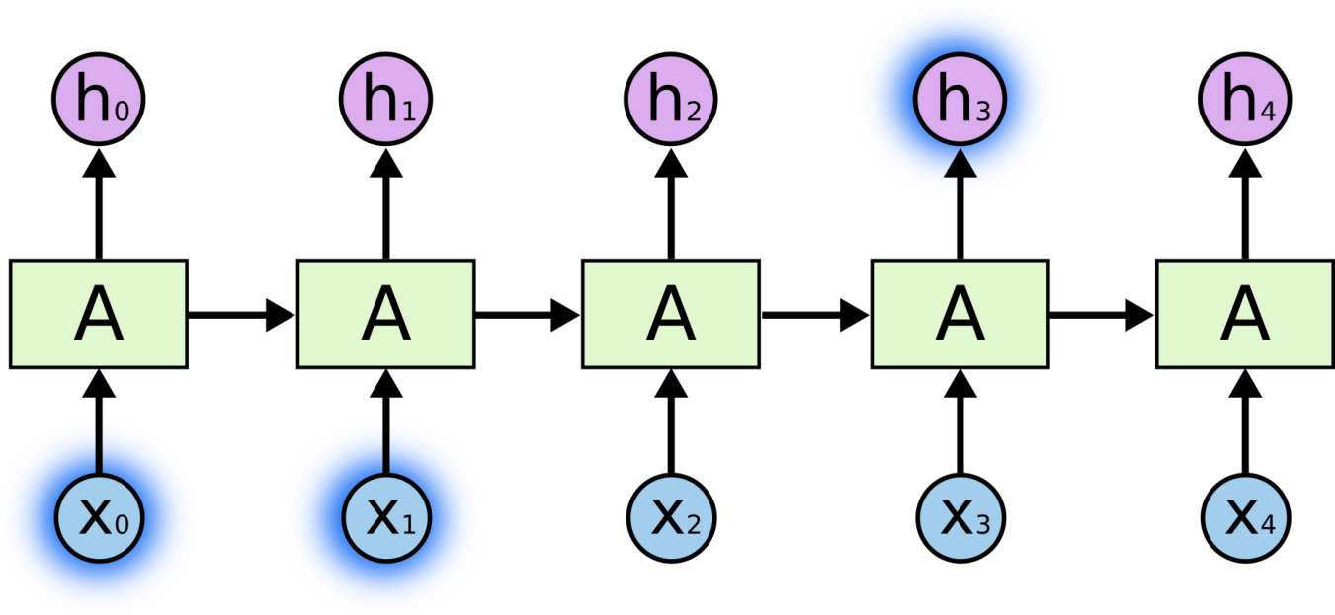
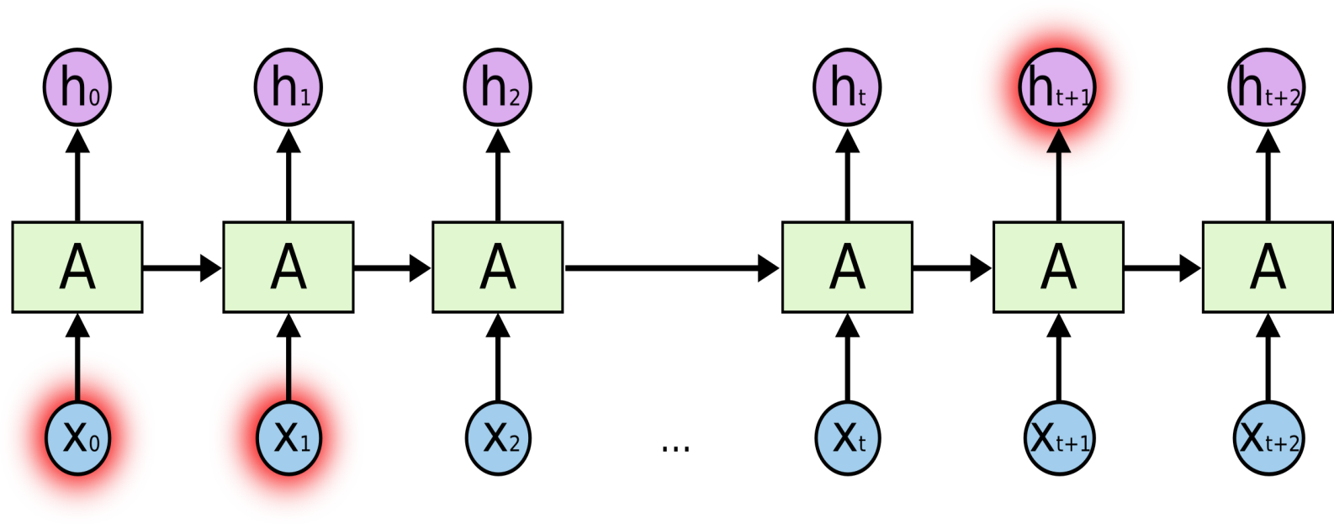
Why not a standard network?
Traditional feed forward neural networks do not share features across different positions of the network. In other words, these models assume that all inputs (and outputs) are independent of each other. This model would not work in sequence prediction since the previous inputs are inherently important in predicting the next output. For example, if you were predicting the next word in a stream of text, you would want to know at least a couple of words before the target word.
Traditional neural networks require the input and output sequence lengths to be constant across all predictions
How do language models and sequence generation work:
Language models make predictions by estimating the probability of the next word given the words that precede it. After you’ve trained a language model, the conditional distributions you’ve estimated may be used to sample novel sequences.
there are various other applications in other fields. In finance, for example, you may use this type of model to generate sample stock paths. You could train the network on various 3 minute tick-by-tick intervals for a single name and then use the network to generate sample paths.
Recurrent Neural Network (RNN)
Problem of Vanishing gradients with RNNs:
RNNs may have gradients that vanish exponentially fast making it difficult for the network to learn long-term dependencies. Exploding gradients are less of the problem since you could easily apply a simple gradient clipping algorithm.
Problem of long term dependencies:
as that gap grows, RNNs become unable to learn to connect the information.
Example:
The clouds are in the sky
Example:
I grew up in India… I speak fluent Hindi.

Slide 2

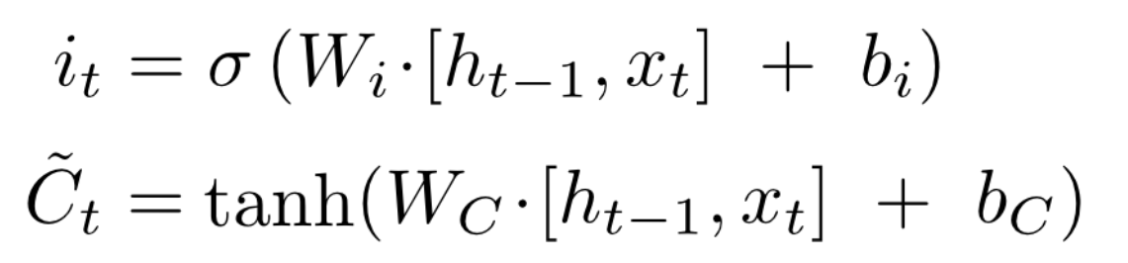
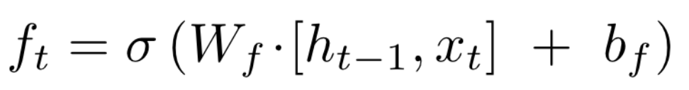
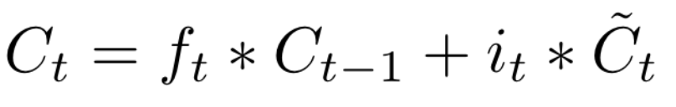
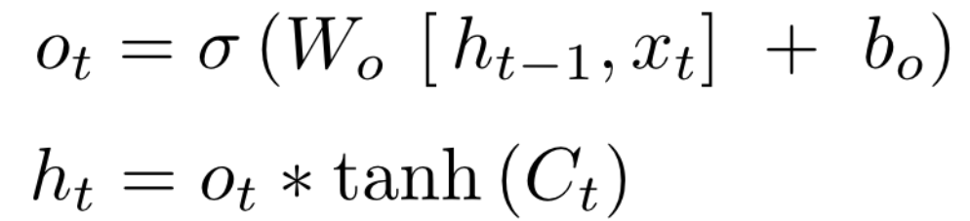
Long-short term memory (LSTM)
An LSTM has three of these gates, to protect and control the cell state, an input and an output.
LSTM Networks
Long Short Term Memory networks – usually just called “LSTMs” – are a special kind of RNN, capable of learning long-term dependencies.
LSTMs are explicitly designed to avoid the long-term dependency problem. Remembering information for long periods of time is practically their default behaviour, not something they struggle to learn!

Slide 3
Image Captioning Generator
Image caption Generator is a popular research area of Artificial Intelligence that deals with image understanding and a language description for that image. Generating well-formed sentences requires both syntactic and semantic understanding of the language. Being able to describe the content of an image using accurately formed sentences is a very challenging task, but it could also have a great impact, by helping visually impaired people better understand the content of images.
This task is significantly harder in comparison to the image classification or object recognition tasks that have been well researched.
The biggest challenge is most definitely being able to create a description that must capture not only the objects contained in an image, but also express how these objects relate to each other
Approach to the problem statement
We will tackle this problem using an Encoder-Decoder model. Here our encoder model will combine both the encoded form of the image and the encoded form of the text caption and feed to the decoder.
Our model will treat CNN as the ‘image model’ and the RNN/LSTM as the ‘language model’ to encode the text sequences of varying length. The vectors resulting from both the encodings are then merged and processed by a Dense layer to make a final prediction.
We will create a merge architecture in order to keep the image out of the RNN/LSTM and thus be able to train the part of the neural network that handles images and the part that handles language separately, using images and sentences from separate training sets.

Slide 4
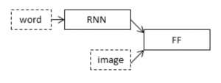
The
In our merge model, a different representation of the image can be combined with the final RNN state before each prediction.
The above diagram is a visual representation of our approach. The merging of image features with text encodings to a later stage in the architecture is advantageous and can generate better quality captions with smaller layers than the traditional inject architecture (CNN as encoder and RNN as a decoder).
To encode our image features we will make use of transfer learning. There are a lot of models that we can use like VGG-16, InceptionV3, ResNet, etc. We will make use of the inceptionV3 model which has the least number of training parameters in comparison to the others and also outperforms them. To encode our text sequence we will map every word to a 200-dimensional vector. For this will use a pre-trained Glove model. This mapping will be done in a separate layer after the input layer called the embedding layer. To generate the caption we will be using two popular methods which are Greedy Search and Beam Search. These methods will help us in picking the best words to accurately define the image.
Dataset Used: Flickr8k Image dataset
Our dataset structure is as follows:-
Images : contains the 8000 images
Flickr8k.token.txt:- contains the image id along with the 5 captions
Flickr8k.trainImages.txt:- contains the training image id’s
Flickr8k.testImages.txt:- contains the test image id’s

Slide 5
THE END

