Slide 1
Predicting death In the Hospital

Slide 2
Problem Identification
Context:
Ten percent of all healthcare spending in the U.S. goes toward end-of-life care. Palliative care consultations lead to an average reduction in direct hospital costs of around $3,000 per admission.
Identifying which patients are at high risk of mortality will allow for better allocation of resources for the patient and allow for a reduced number of unplanned cardiac arrests and rapid responses.
Criteria for Success:
Identifying which patients are at high risk for inpatient mortality will allow for the palliative care team to intervene and start a discussion with the family to asses goals of care. This discussion will help with the treatment team to determine care plan that aligns with the goals of the patient and family.
Scope of Solution:
Identify patients on admission who are at high risk for dying.
Constraints:
Obtaining enough data on expired and non-expired patients. Getting enough data to get a good representation from the general population.

Slide 3
Recommendation and key findings
Based on our analysis we found the following features that have the highest correlation with inpatient mortality:
Age > 70 y.o
High number of medical problems
High number of medications
Cancer Diagnosis
Length of Stay > 3 days
Recommendations:
I would recommend a screening patients for palliative care based on an age > 75 years, with a Past Medical History of greater than 7 diagnoses and greater than 6 medications and diagnosis of either Lung, Colon, or Pancreatic Cancer.

Slide 4
Modeling results and analysis
Based on feature importance of the Logistic and Random Forest Models, we can arrive at the following conclusions of predicting inpatient mortality:
Increased age is one of the most important factors and was the most important on both models.
Increased number of medications and number of medical problems is another strong indicator of morbidity.
A diagnoses related to malignancy is a high predicator of death.
These patients should be alerted to the palliative care team. Prospective studies should show a decrease in the number of unplanned cardiac arrests and rapid responses based on goals of care discussions regarding CPR status and hospice care.

Slide 5
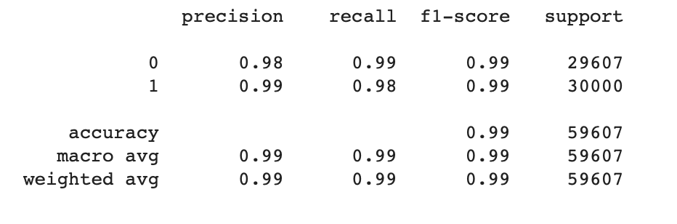
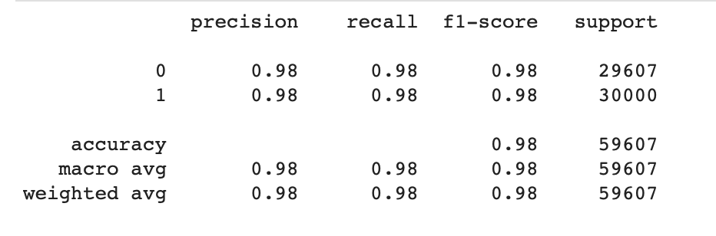
Modeling results and analysis
Logistic Regression
Random Forest

Slide 6
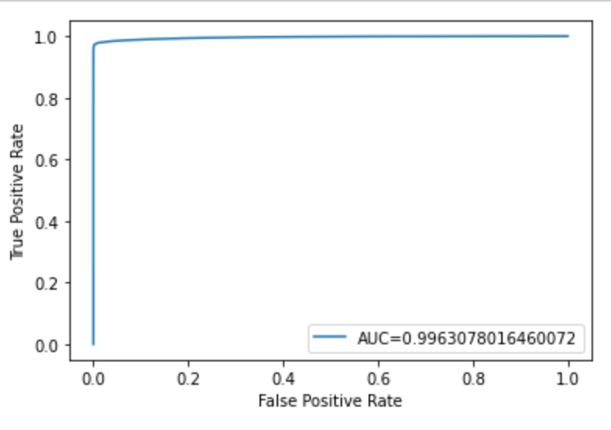
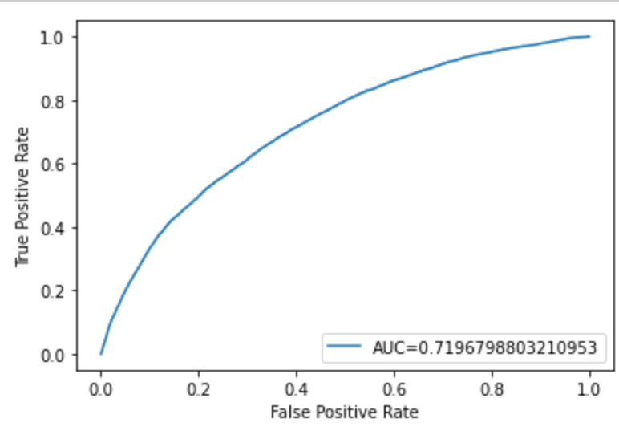
Modeling results and analysis
Random Forest
Logistic Regression

Slide 7
Summary and conclusion
In conclusion, palliative screening for elderly patients with numerous medical problems and increased number of medications as well as a malignancy diagnosis will result in decreased spending on end of life care, unplanned cardiac arrests and rapid responses.
Using data that is not strictly due to chronic illness such a diabetes may help improve model accuracy.
Next steps, would be due to get more expired patients records to get a more balanced data set.

