Slide 1
Big Mountain Resort

Slide 2
Problem Identification
Context:
Big Mountain Resort, a ski resort located in Montana. Every year about 350,000 people ski or snowboard at Big Mountain Due to increased competition from different ski resorts it is necessary to increase value and revenue for the ski resort. This is going to be done by increasing revenue and decreasing costs.
Criteria for Success:
Increase revenue by 10%
Scope of Solution:
Increase adult ticket prices by 5% and increase number of days the resort is open by 10%.
Constraints:
Increase adult ticket prices not to exceed market rate but to be in alignment with them. Increase number of days the resort is open per year to maximize revenue.

Slide 3
Recommendation and key findings
Based on our analysis we found the following features that have the highest correlation with ticket price:
vertical drops
FastQuads
Snow making area
night skiing capacity
Runs
Total number of Chairs
Recommendations:
I would recommend a Run and increasing vertical drop by 150ft and installing an additional chair lift and adding adding 2 acres snow making.

Slide 4
Modeling results and analysis
Closing up to 6 runs would decrease ticket price. This price would have to be weighed against the cost savings of closing the runs.
Increasing a Run and increasing vertical drop by 150ft and installing an additional chair lift. This would increase ticket price by $1.6 and increase revenue by $2.8M.
This scenario would be the same as #2 above but with adding 2 acres snow making. This would increase revenue close to the same amount above.
This scenario calls for increasing the longest run by .2 miles and guaranteeing its snow coverage by adding 4 acres of snow making capability. This did affect price of ticket and did not bring in any additional ROI.

Slide 5
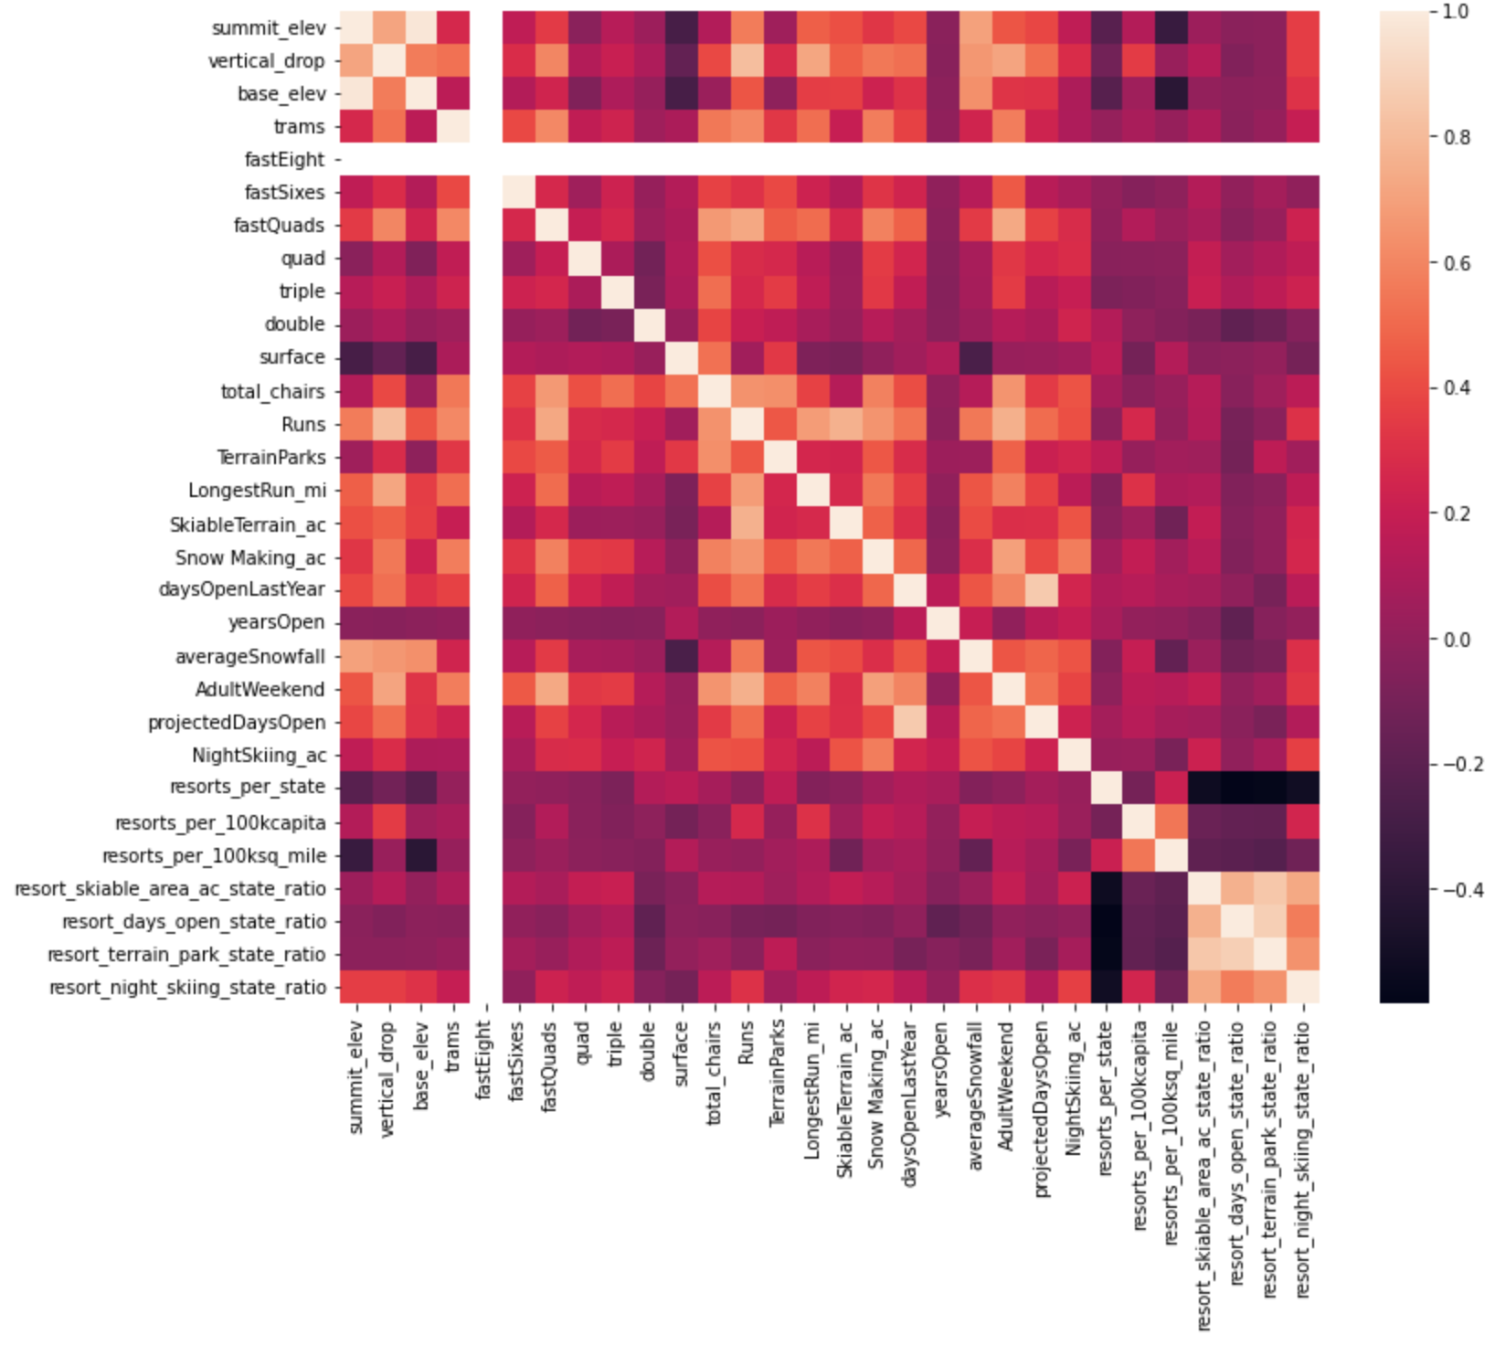
Modeling results and analysis

Slide 6
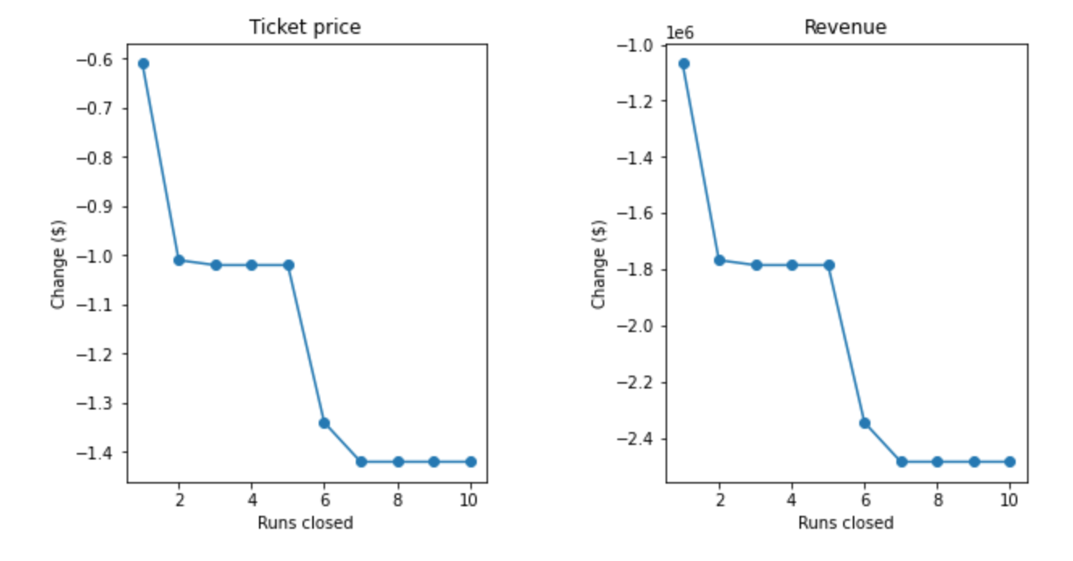
Modeling results and analysis

Slide 7
Summary and conclusion
In conclusion, increasing a Run and increasing vertical drop by 150ft and installing an additional chair lift. This would increase ticket price by $1.6 and increase revenue by $2.8M.
Adding 2 acres of additional snow will increase revenue further when combined with above.
Looking at more visitor data and possible demographics may help in predicting the elasticity of the ticket price.

