Slide 1
Predicting heart attack Complications In the Hospital

Slide 2
Problem Identification
Context:
It is estimated that there are close to 600,000 new myocardial infarctions in the United States every year. Estimating which of these patients will have an acute complication will improve patient care and reduce health care spending.
Identifying which patients are at high risk of mortality will allow for better allocation of resources for the patient and allow for a reduced number of unplanned cardiac arrests and rapid responses.
Criteria for Success:
Develop a model that has high recall and precision at identifying which patients will have cardiac complication.
Scope of Solution:
Identify patients on admission who are at high risk for arrythmia, pulmonary edema, or death.
Constraints:
Obtaining enough data on those patients that have a complication vs. those that do not.
Key Stakeholders:
Hospitalist physicians in the Mid Atlantic Regional Health Center.

Slide 3
Recommendation and key findings
Based on our analysis we found the following features that have the highest correlation with cardiac complication:
Evidence of arrythmia on EKG
History of Heat Failure
Having Recurrent Chest Pain after MI
Number of Prior Myocardial Infarctions
History of Diabetes
Recommendations:
I would recommend a screening patients for all patients admitted for myocardial infarction with history of arrythmia, heart failure, history of prior MIs, and recurrent chest pain.

Slide 4
Modeling results and analysis
Based on feature importance of the Logistic, Random Forest Models, and Xgboost we can arrive at the following conclusions of predicting which patients will have a cardiac complication:
History of any EKG abnormality with emphasis on arrythmia.
History of Heart Failure.
Recurrent Chest pain.
These patients should be alerted to the cardiac icu team. Prospective studies should show a decrease in cardiac complications by identifying these patients early so the treatment team can be aggressive with cardiac interventions.

Slide 5
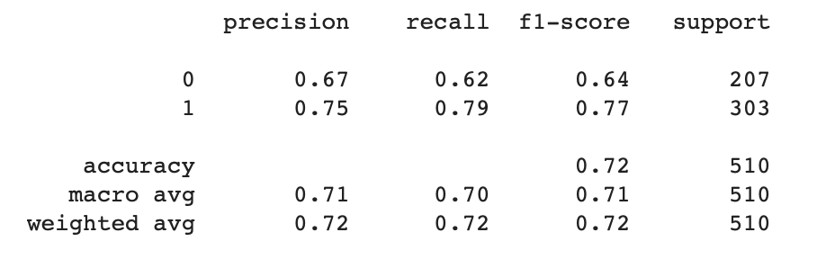
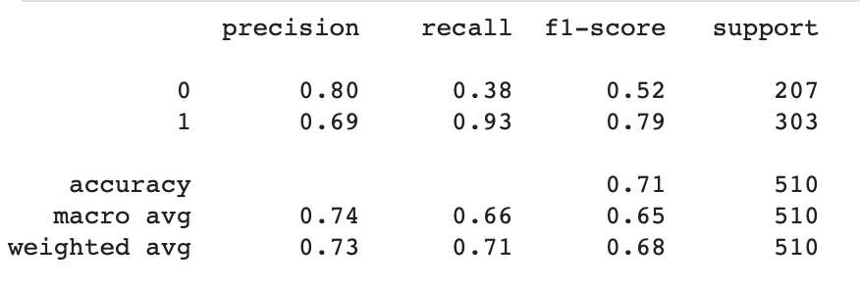
Modeling results and analysis
Logistic Regression
Random Forest

Slide 6
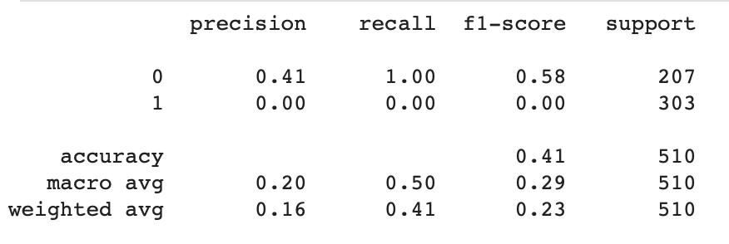
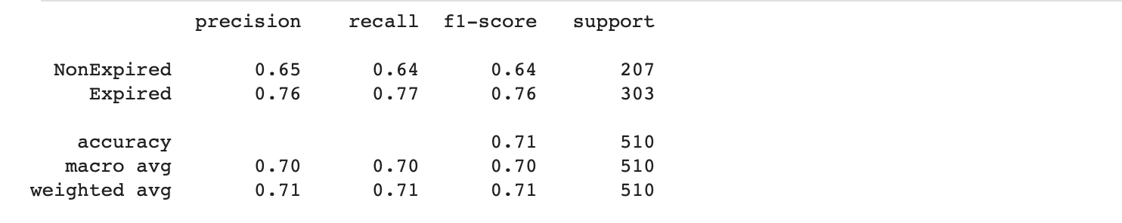
Modeling results and analysis
Deep Learning
XgBoost

Slide 7
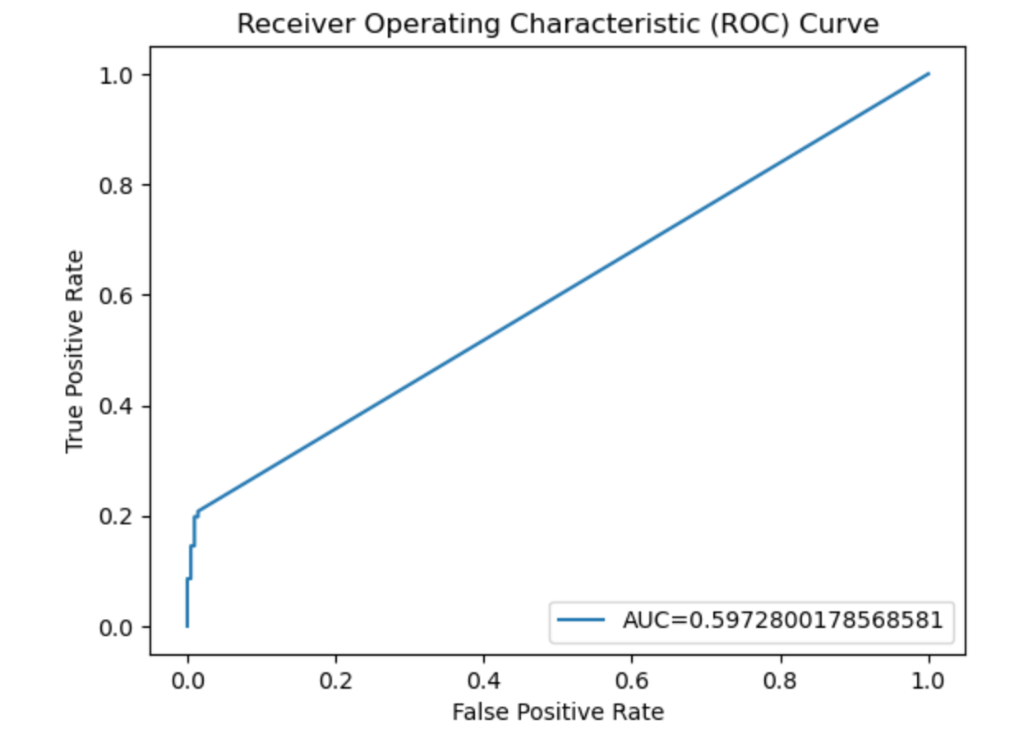
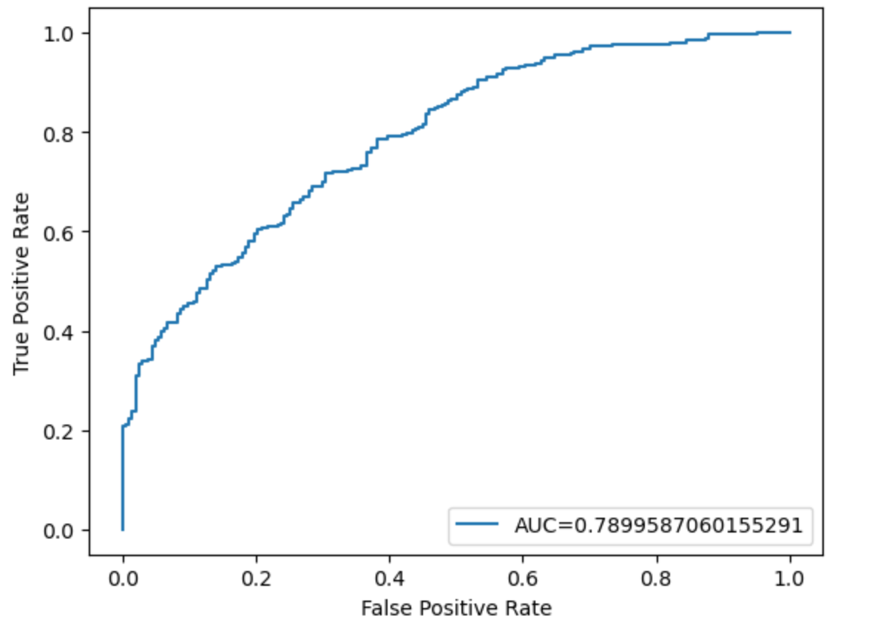
Modeling results and analysis
Deep Learning
Random Forest

Slide 8
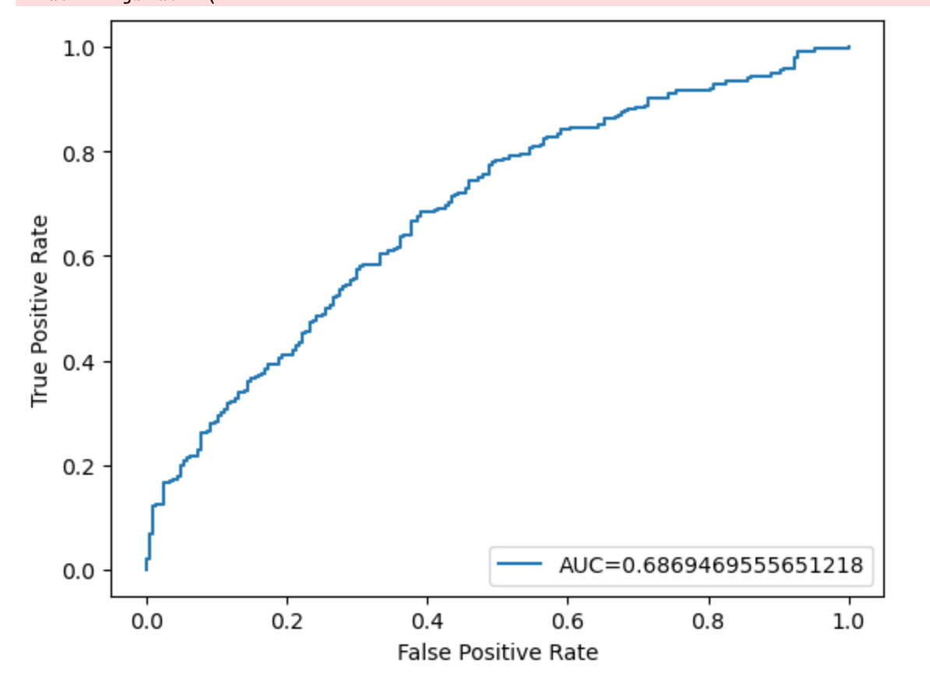
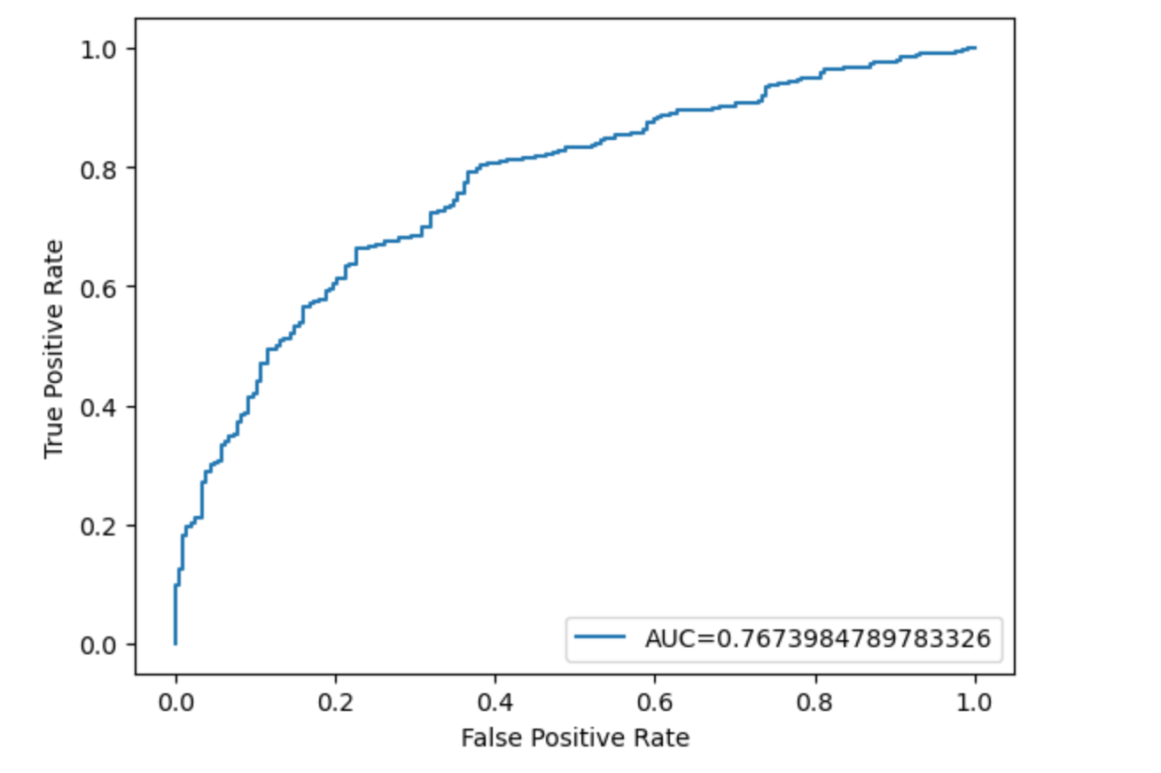
Modeling results and analysis
Logistic Regression
XgBoost

Slide 9
Summary and conclusion
In conclusion, cardiac screening for myocardial infarctions in patients with history of heart disease, arrythmias, and recurrent chest pain will result in decrease in cardiac complications, unplanned cardiac arrests and rapid responses.
Broadening the patient pool of data will help extract insights from patients that will allow predictions to the general population.
Next steps, would be due to get more data on cardiac complication patients to get a more balanced data set.

