Slide 1
Inpatient Hospital Data
Sachin Sharma
Springboard Data Science

Slide 2
Data
The Dataset was downloaded from UCI Machine Learning Repository. The dataset represents 10 years (1999-2008) of clinical care at 130 US hospitals and integrated delivery networks.
Includes over 50 features representing patient healthcare data.
Data contains such attributes as patient number, race, gender, age, admission type, time in hospital, medical specialty of admitting physician, number of lab test performed, HbA1c test result, diagnosis, number of medications, diabetic medications, number of outpatient, inpatient, and emergency visits in the year before the hospitalization
We will divide up data set between Expired and Non-Expired. We will then calculate p-value to determine significance between the two populations.
Significance will be determined if p value is less than .05.

Slide 3
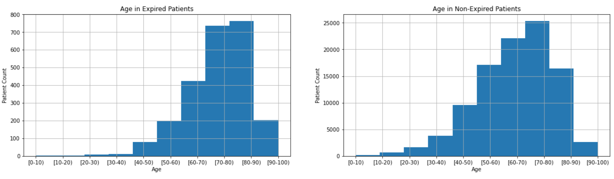
Difference in Age in the two populations
Here we look at Age feature. P value = 0.0023

Slide 4
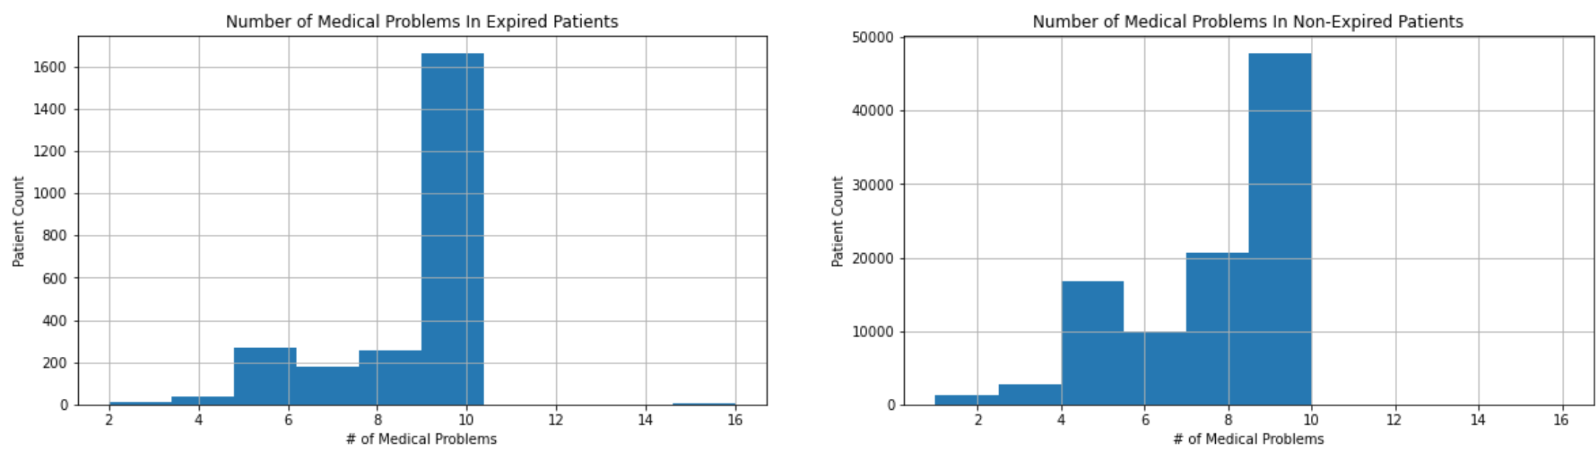
Number of Medical Problems
P-value = 0.

Slide 5
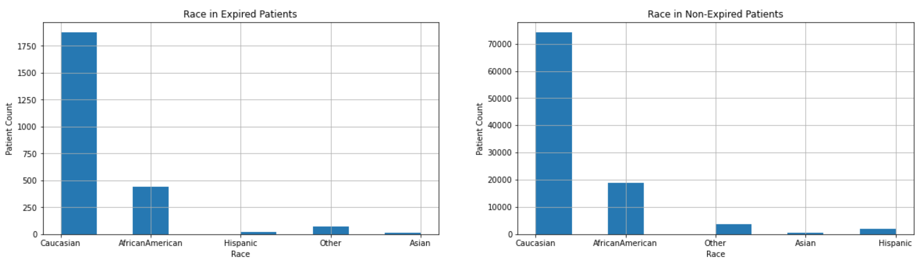
Race
P-value = 0.5287
Race does not seem to be a factor of the total dataset compared to expired patients.

Slide 6
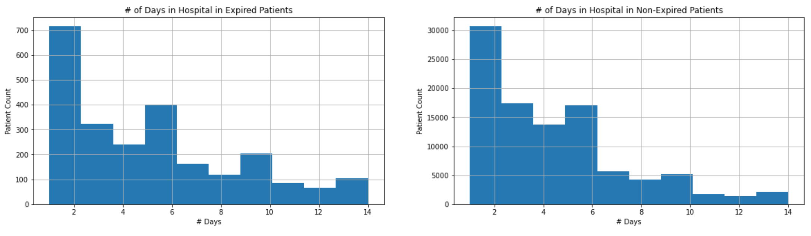
Length of Stay in the Hospital
Length of Hospital stay has a p-value = 0.00.

Slide 7
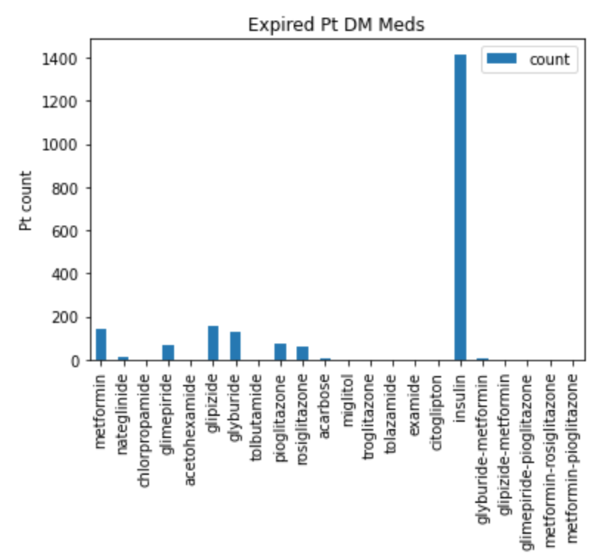
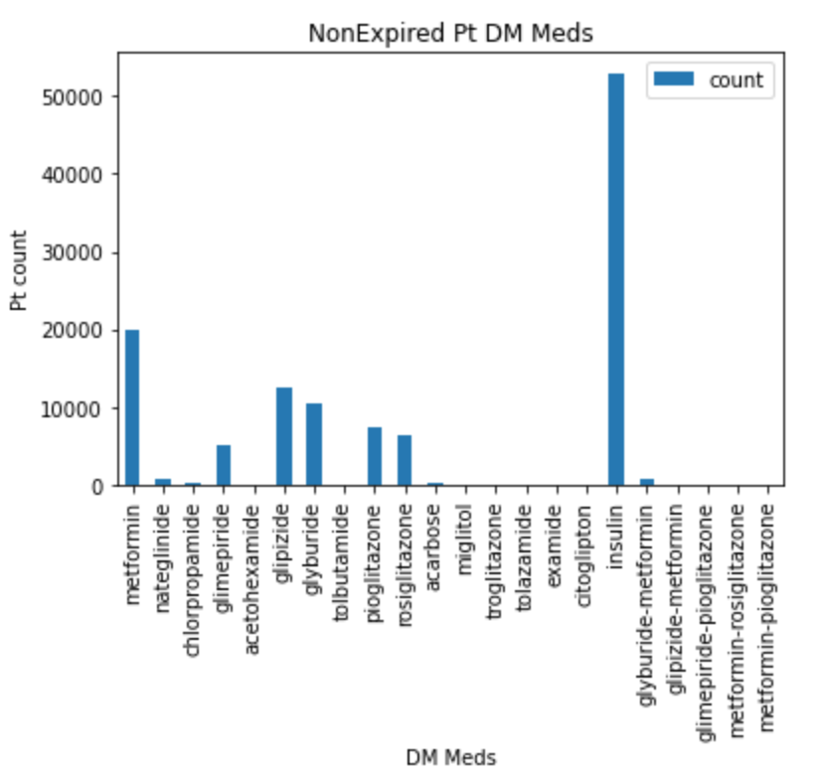
Comparing different Diabetic Medications
P-Value is 0. There is a significant difference between the two populations.

Slide 8
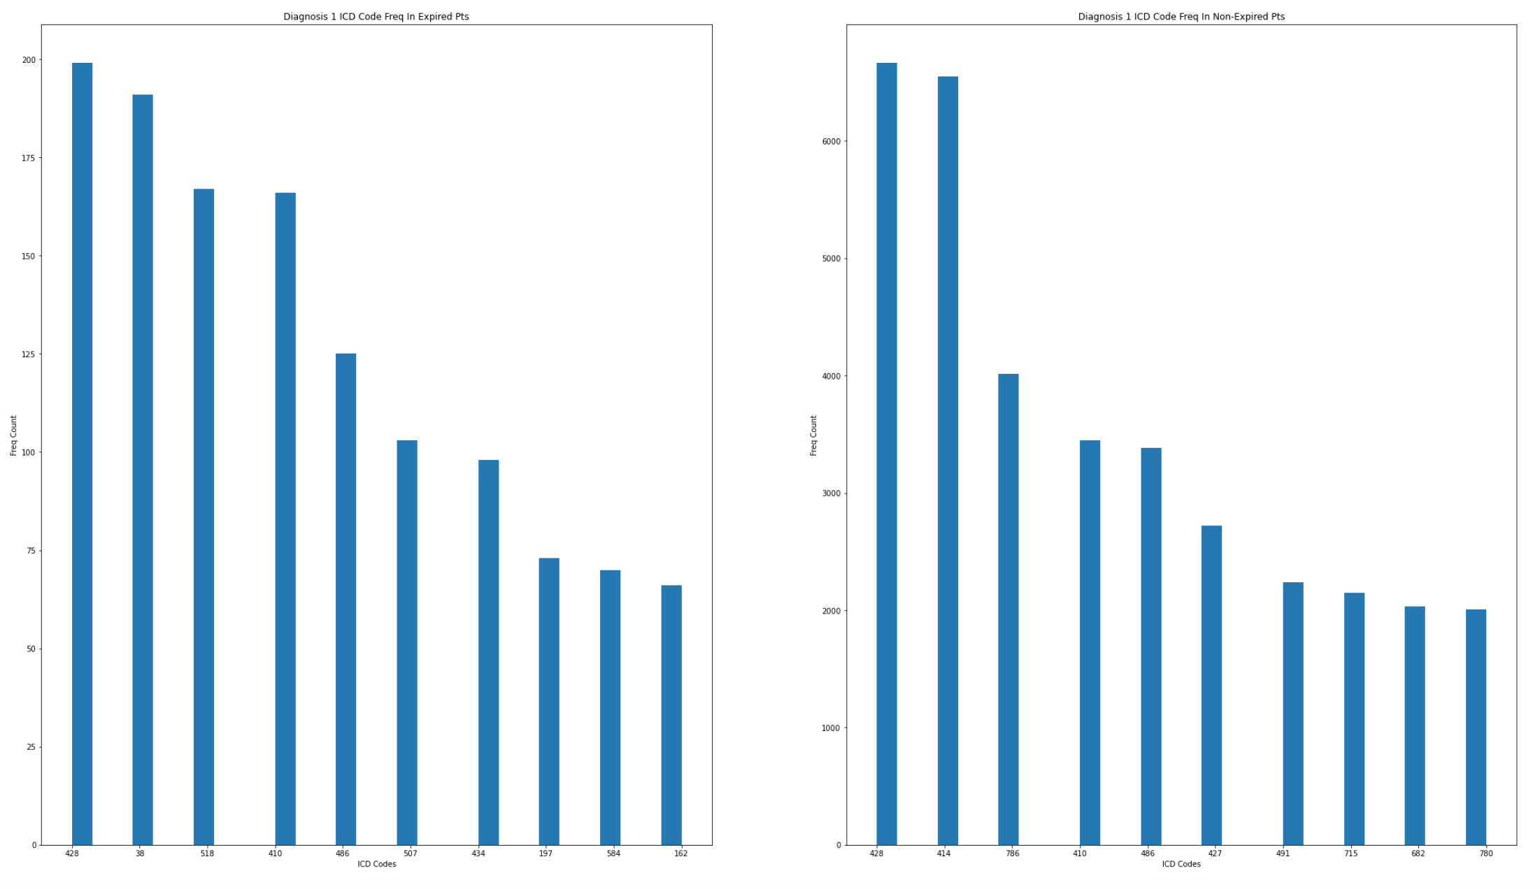
Primary Diagnosis Feature
Diagnosis codes are different between the two populations.

Slide 9
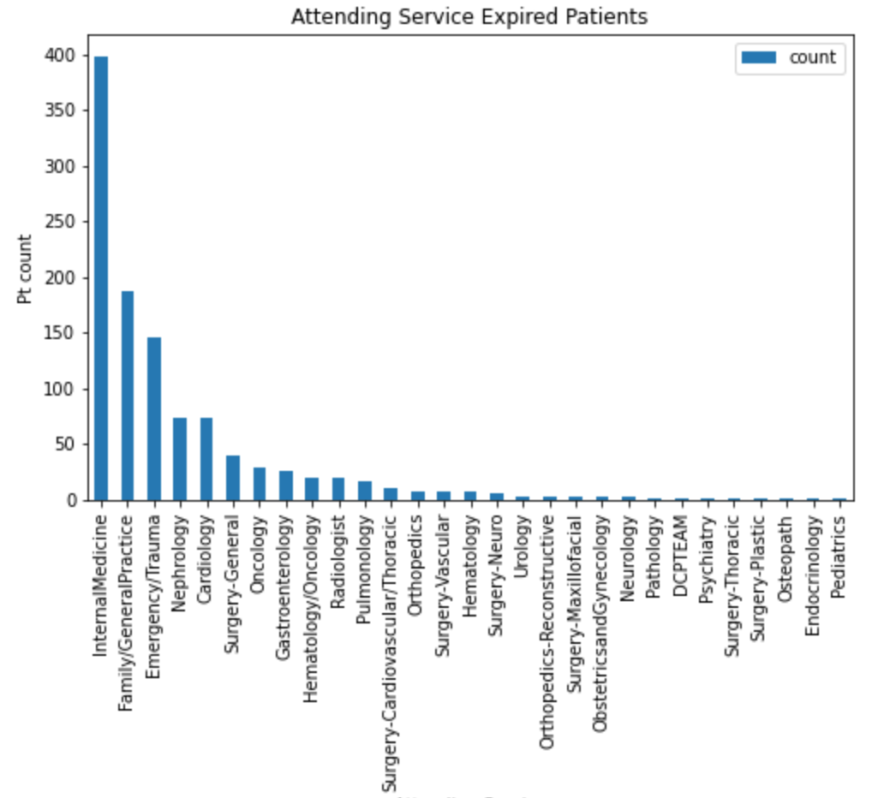
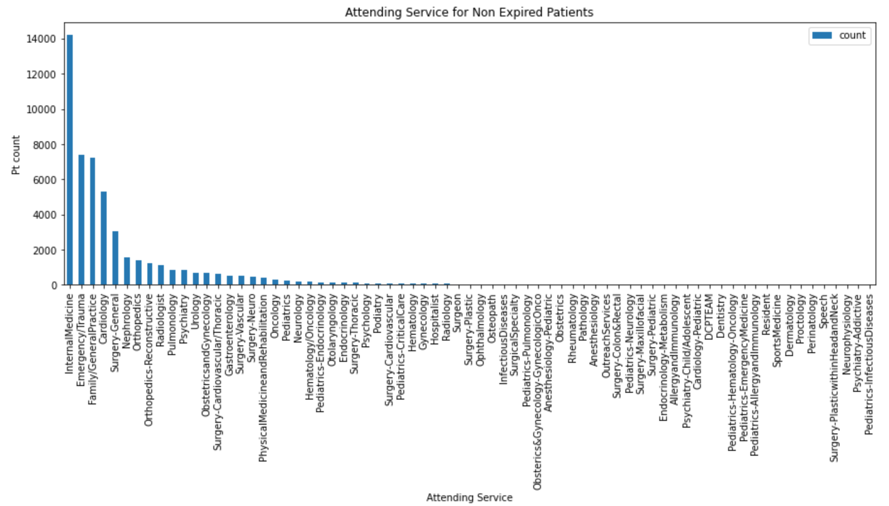
Difference in the Attending Service.
P value [0.] Medical Specialty does differ between the two populations.

Slide 10
Conclusions
It can be seen that out of the 50 features there are a roughly over 50% do demonstrate a significant difference between the expired and non-expired patient populations.
It can easily be hypothesized that given the p-value of less than 0.05 in many of the features that there are significant differences between the two patient populations.
Further investigations can be done to demonstrate predictive ability in demonstrating which new patient will be an expired or non expired patient.

