Slide 1
Sentimental Analysis using DEEP LEARNING of Amazon Product Reviews
Kiran Talreja
Chandni Sharma
Bashaer Alkhathlan
Abhijit Shinde

Slide 2
Problem Statement
Applying sentiment analysis to scraped reviews from the web using R
Label positive/negative words from each review of scraped corpus
Vectorize each review in corpus using Doc2Vec and apply both DBN/RBM and SVM to compare performances

Slide 3
Web Scraping
SITE: http://www.amazon.com/product-reviews/
For Product page: https://www.amazon.com/dp/
prod_code = "B015ZG997I"
Created a url for the web page needed to be accessed, with the product code and the base url
To extract data from a web page, first need to know which CSS Selector matches the data we want. Used SelectorGadget tool for that.
Extracted the data page by page of reviews using html_node() and html_text() of the rvest library
The data being product title, author of the review, ratings, etc

Slide 4
Sentiment analysis
Score.sentiment function takes each sentence, positive words, and negative words from each product review then calculates and returns Scores data frame
The function splits sentences into words using the function str_split() and then compares and matches with pos/neg dictionaries
To calculate the scores of all reviews, we applied this formula:
score = sum(pos.matches) - sum(neg.matches)

Slide 5
Continued..
To calculate emotion within reviews, we used classify_emotion function from the Sentiment package that uses a naive Bayes classifier trained on Carlo Strapparava and Alessandro Valitutti’s emotions lexicon
To calculate polarity within reviews, we used classify_polarity function from the Sentiment package that uses the algorithm “bayes”

Slide 6
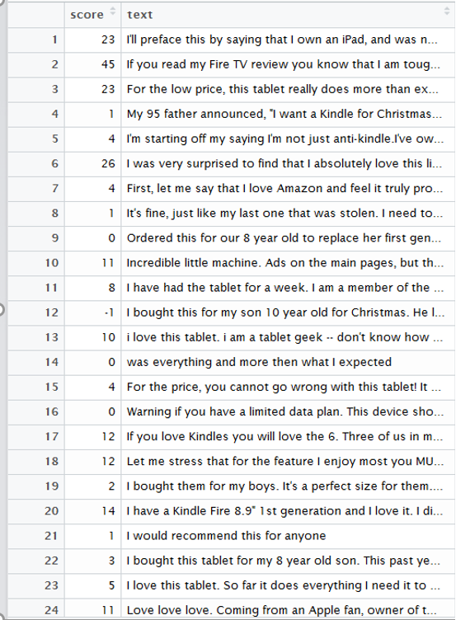
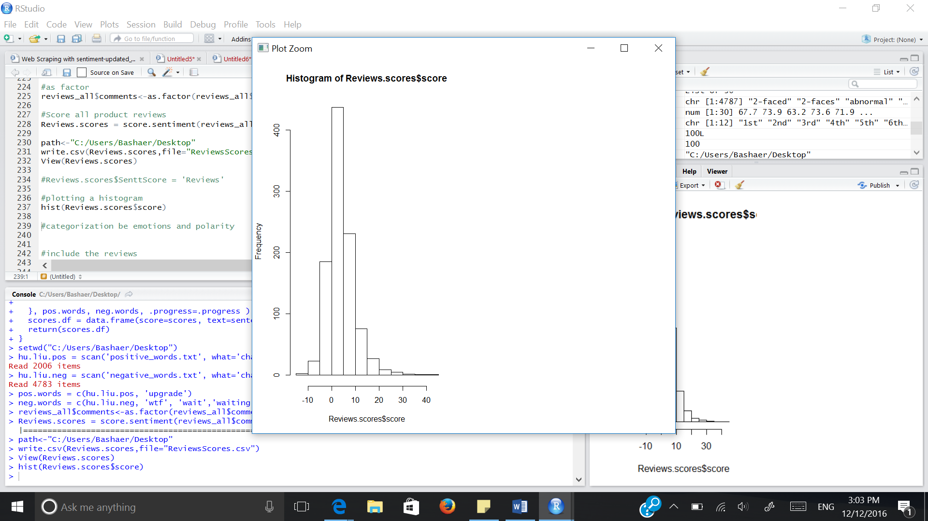
Plots and tables

Slide 7
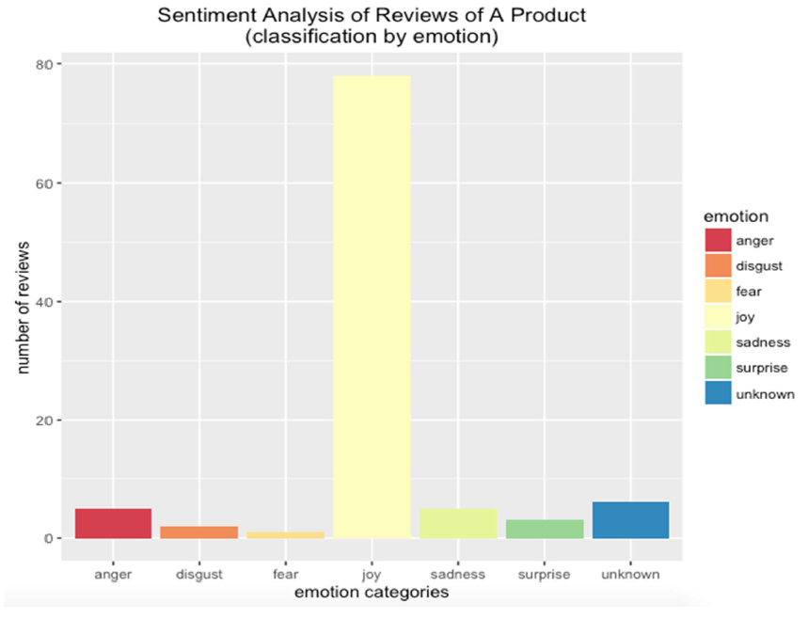
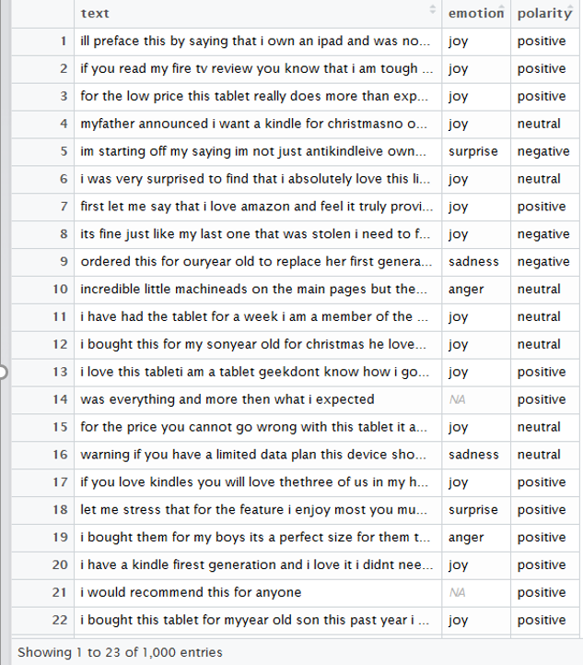
Continued..

Slide 8
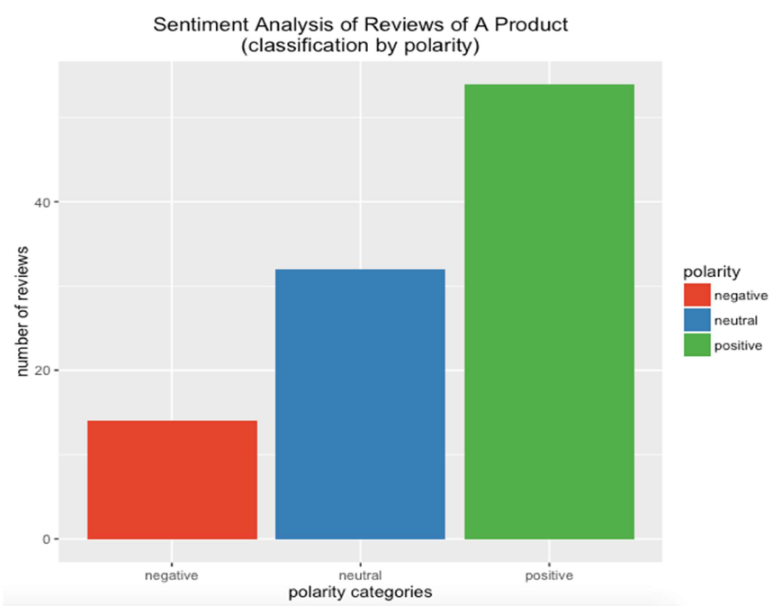
Continued..

Slide 9
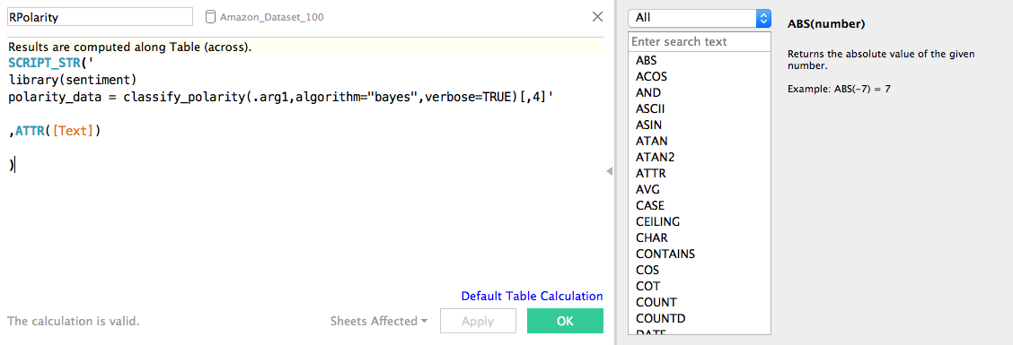
Tableau with R integration
Using Rserve in R and then connecting to that Server from Tableau enabled scripting in Tableau possible.

Slide 10
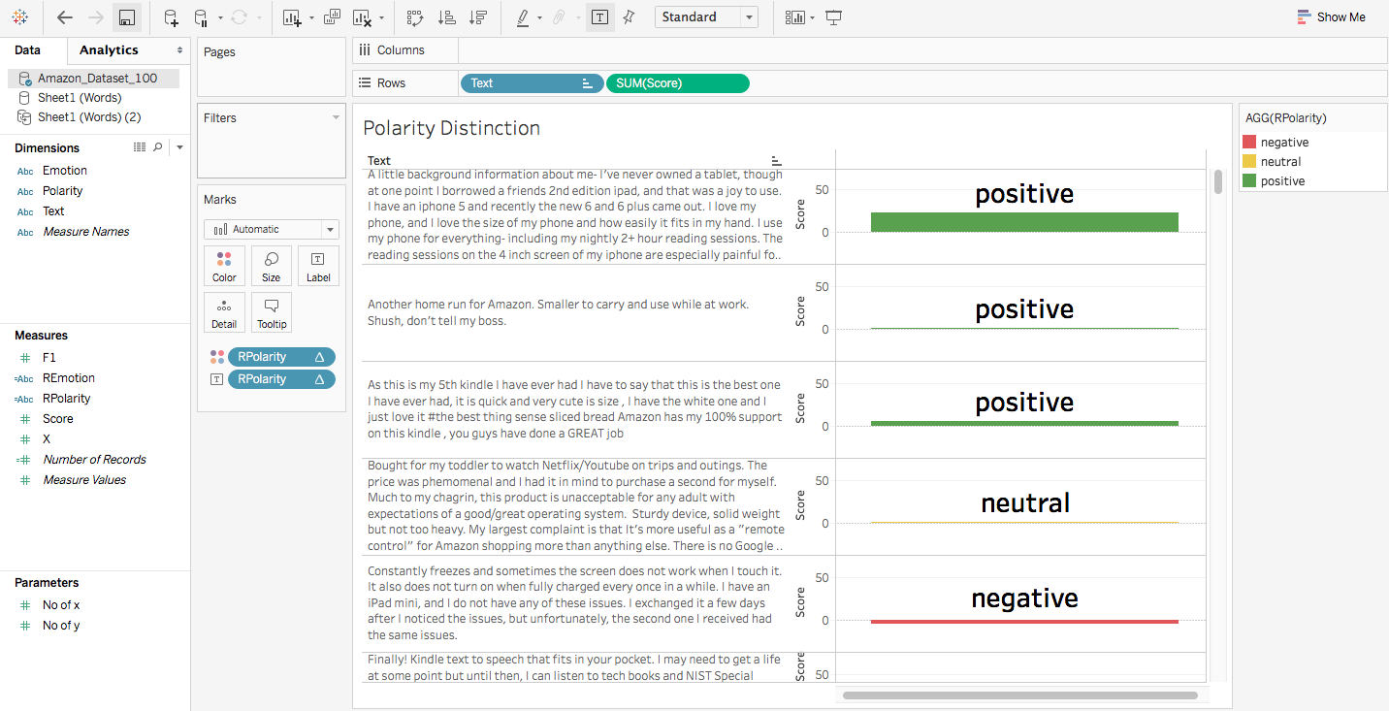
Tableau with R integration
Using Rpolarity Calculated Field which we generated using SCRIPT_STR(), created this graph showing
Polarity of the reviews and their relative scoring.

Slide 11
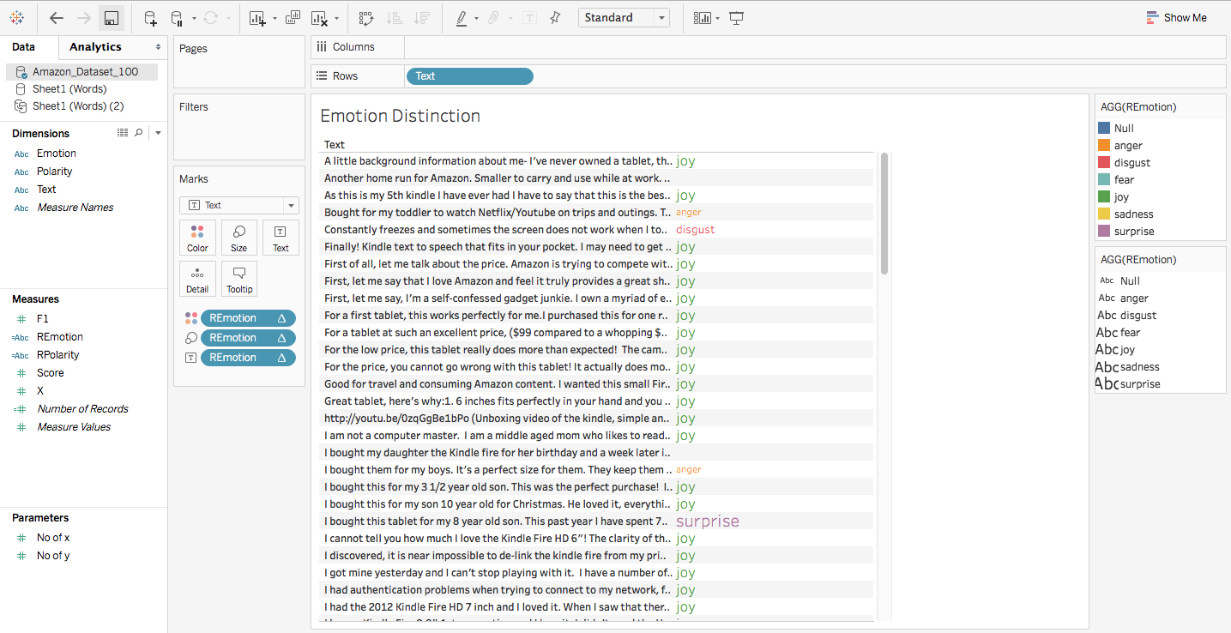
Tableau with r integration
Remotion and text used with SCRIPT_STR containing the script to classify_emotion() of the reviews.

Slide 12
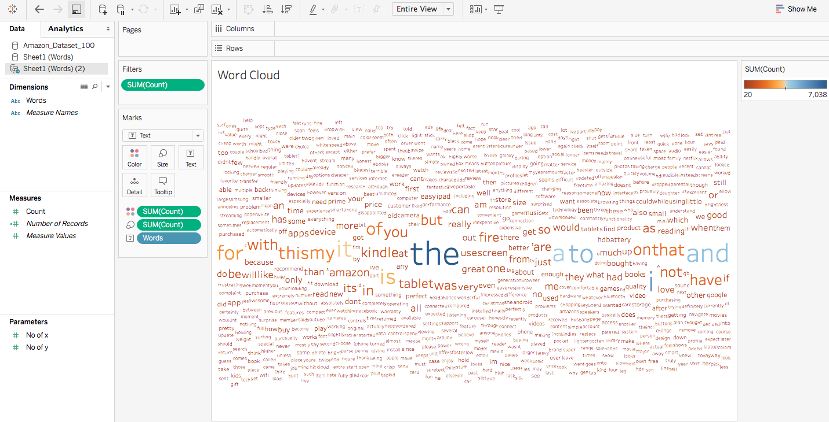
Tableau Sentimental analysis
Generated Word Cloud using the list the words used in the reviews.
Set the filter to show only those having Count greater than 20.

Slide 13
Doc2Vec
Why Doc2Vec?
- Despite their simplicity in Dataset, models involves technical challenges for classifications and categorization.
vectorize text i.e constructing a document-term matrix (DTM) using text2vec
- A document-term matrix is a mathematical matrix that describes the frequency of terms that occur in a collection of documents.
- In a document-term matrix, rows correspond to documents in the collection and columns correspond to terms(words)
Eg Sentences : D1 = "I like databases“ D2 = "I hate databases“
 | I | like | hate | databases
D1 | 1 | 1 | 0 | 1
D2 | 1 | 0 | 1 | 1

Slide 14
Steps for Doc2Vec
Accept Input and divide input as train and test
Take text column of input to perform vectorization i.e represent document in vector plain (vocabulary- based vectorization)
Create Document Term Matrix
Pruning Matrix, removing stop words and white spaces (reducing dimensions)
Perform above steps for both Train and Test
Creating separate data frame for both Train and Test along with Response variable.

Slide 15
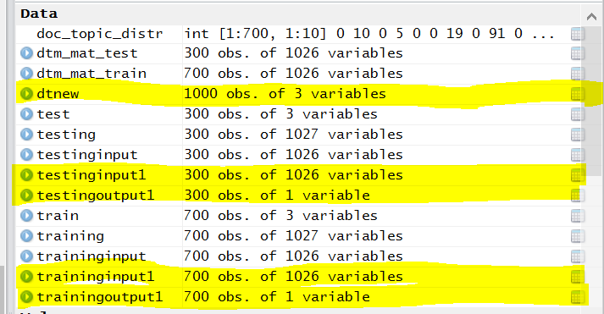
Different Data frame during Doc2vec

Slide 16
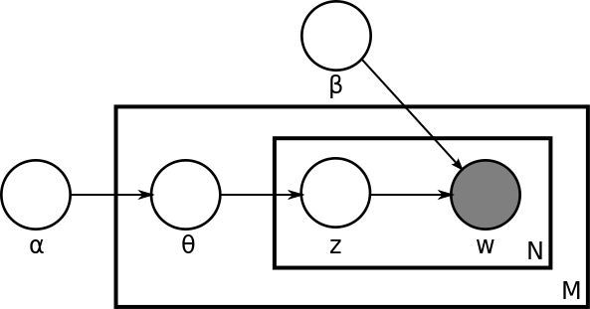
LDA - Latent Dirichlet Allocation (TOPIC MODELLING)
LDA is a bag-of-words model.
In LDA, each document may be viewed as a mixture of various topics. Where each document is considered to have a set of topics that are assigned to it via LDA.
With plate notation, the dependencies among the many variables can be captured concisely. The boxes are “plates” representing replicates.
The outer plate represents documents, while the inner plate represents the repeated choice of topics and words within a document. M denotes the number of documents, N the number of words in a document.

Slide 17
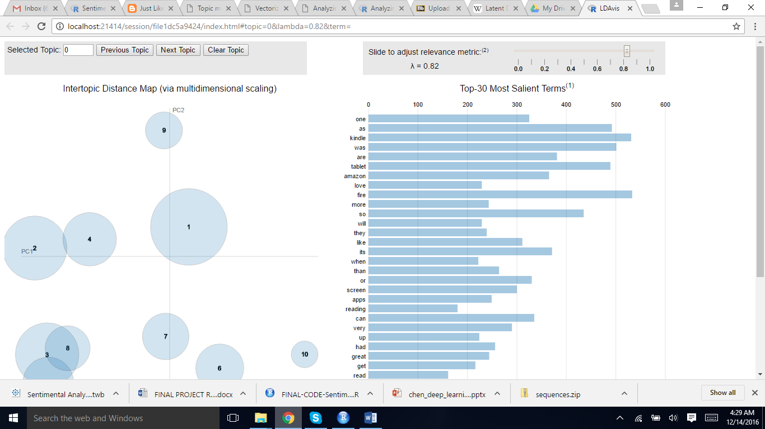
LDA is a statistical model which helps in telling the observations of the words like Salient terms (most noticeable or important words – which is w)
The plot runs on the Web browser (localhost://21414/session) locally connected from the Rserver and shows the Top 30 Most Salient Terms in the dataset with an adjustable relevance metric (Lambda)

Slide 18
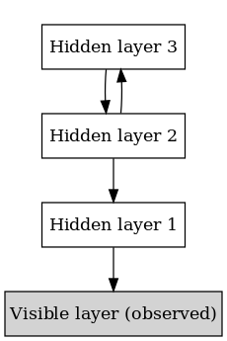
DBN/DNN (DEEP BELIEF NEURAL NETWORKS)
A deep-belief network can be defined as a stack of restricted Boltzmann machines, explained here, in which each RBM layer communicates with both the previous and subsequent layers. The nodes of any single layer don’t communicate with each other laterally.

Slide 19
DBN (Continued..)
A fast learning algorithm for deep belief nets
Reducing the dimensionality of data with neural networks
The darch-package implements Deep-Architecture-Networks and Restricted-Bolzmann-Machines.
Darch method includes a pre training with the contrastive divergence method and a fine tuning with backpropagation or conjugate gradient.

Slide 20
Steps FOR DNN
Following are the steps:
1. Divided Input and output variables
2. Using darch function, we created the DBN/DNN model
3. The parameters for above function has layers with 1026 inputs and 1 outputs and 4 layers
4. Following are the steps which are performed in Darch
· Create and configure a Darch instance.
· Pre-train the network.
· Fine-tune the network.
· Back-propagate further data through the network to create predictions and Retuning.

Slide 21
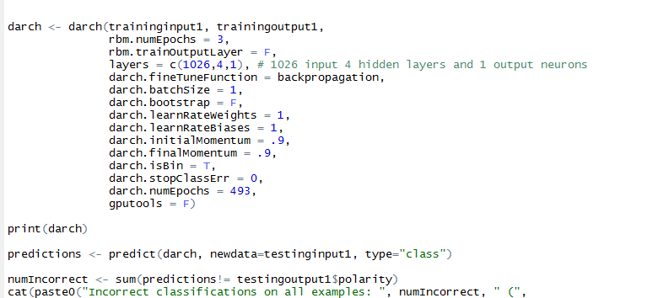

Slide 22
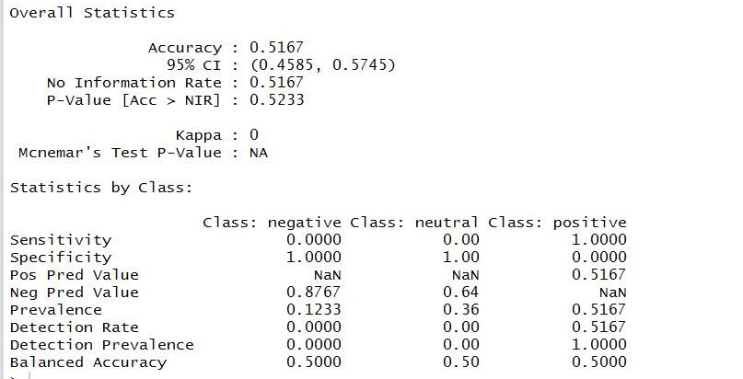

DBN/DNN PERFORMANCE (RESULTS)

Slide 23
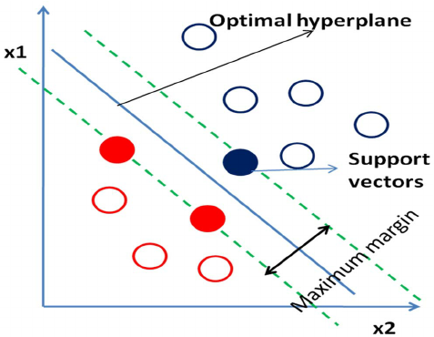
SVM (Support Vector Machines)
SVM is a classiﬁcation technique that seeks to ﬁnd a hyperplane that partitions the data by their class labels. We calculated the Best Parameters for tuning the SVM
SVMs are useful in Text & Hypertext Classification.
SVM is known to significantly reduce the need for labels in the training instances.

Slide 24
Advantages of svm
Effective in high dimensional spaces.
It avoids over-ﬁtting the data by maximizing the margin of the separating hyperplane.
Still effective in cases where number of dimensions is greater
than the number of samples.
Uses a subset of training points in the decision function
(called support vectors), so it is also memory efficient.
Versatile: different Kernel functions can be specified for
the decision function. Common kernels are provided
but it is also possible to specify custom kernels.

Slide 25
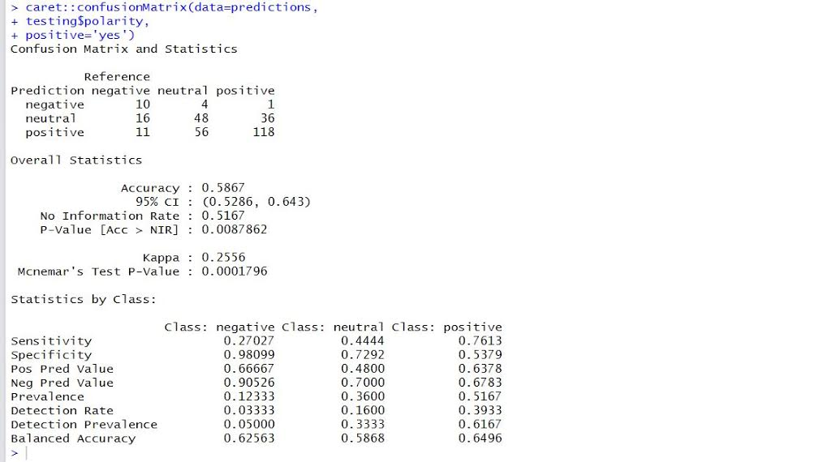
SVM PERFORMANCE (RESULTS)

Slide 26
COMPARISON
We have evaluated the accuracy of the models based on the Confusion Matrix.
Interestingly, the tuned SVM model performed better as compared to the Deep Belief Network.

