Slide 1
Minesweeper
Abhineet, Ashwin, Shubham

Slide 2
Agenda
Walkthrough Various Tasks
Problem Description
Tools Used
Design Overview
Demo

Slide 3
Tasks
Design of Minesweeper
Game
Agent
Test Possibility of Using Prolog as Logic Engine
Try out various Interfaces with Java
Test Possibility of Using a CSP Solver
Try out available Tools
Implementing Minesweeper Problem Generator
Implement Minesweeper UI
Implement a solver agent

Slide 4
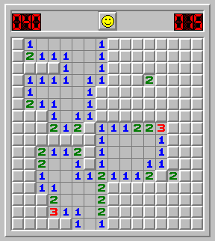
Minesweeper
A simple one player computer game
A 2-D rectangular playing field divided in various clickable blocks
Some of the blocks contains mines which are hidden to player
Clicking a block, which don’t have a mine, will show the number of surrounding mines
Winner is declared once all the non-mine blocks are opened
The player loses if any block with mine clicked

Slide 5
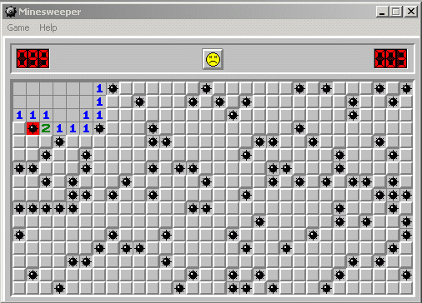
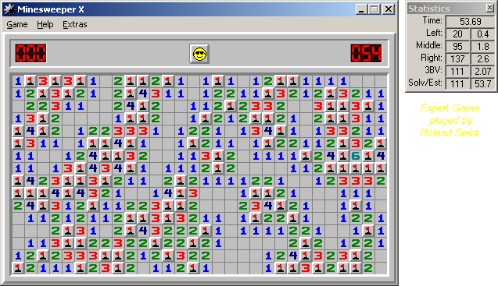
Two End States

Slide 6
Tools Explored
Logic Based
JPL : A Java Interface to Prolog
GNU Prolog
InterProlog
Constraint Satisfaction
JaCoP : Java Constraint Programming Solver

Slide 7
PrologWrapper
Load a .pl File : loadFile(String fileName)
Assert a new fact : assertNewFact(String predicateString)
Query : getAllSolutions(Term goal)

Slide 8
Constraint Satisfaction Problems
CSP –
Finite set of variables V, { V₁, V₂, …, V_{n}}
Nonempty domain of possible values D, for each variable, {D₁, D₂, … D_{m}}
Finite set of constraints C, {C₁, C₂, …, C_{k}}
C_{i} limits the values that variables can take, e.g.V₁ > V₂
System state –
An assignment of values to some or all variables.
Consistent assignment –
An assignment that does not violate any constraint, C.
Complete assignment –
An assignment is which every variable is mentioned, and does not violate any constraints.

Slide 9
Minesweeper as CSP
0 | 0 | E
1 | 1 | D
A | B | C
A + B = 1
A + B + C+ D+ E = 1
Possible Solutions :
A = 0 , B = 1, C = D = E = 0
A = 1 , B = 0, C = D = E = 0

Slide 10
Issues
Main Issue : How to identify a solution
Approach :
Fix the variable with one consistent value in all the solutions
Val = 0 ➔ Not a mine
Val = 1 ➔ Mine
Keep all other ambiguous variables in the equation

Slide 11
Algorithm
Identify explored square, S_{exp}
Identify all the unexplored neighbours of S_{exp}
Form Variables of CSP with Domain [0,1]
No of mines defines the constraint
Solve using JaCoP
Squares with consistent value = 0 ➔ SAFE
Squares with consistent value = 1 ➔ MINE

Slide 12
Design Overview
User Interface
Problem Manager
Minesweeping Agent

Slide 13
Design Overview - Timeline
ProblemManager.GenerateProblem()
UserInterface.display()
Agent.solve()
ProblemManager.updateModel()
UI.repaint()

Slide 14
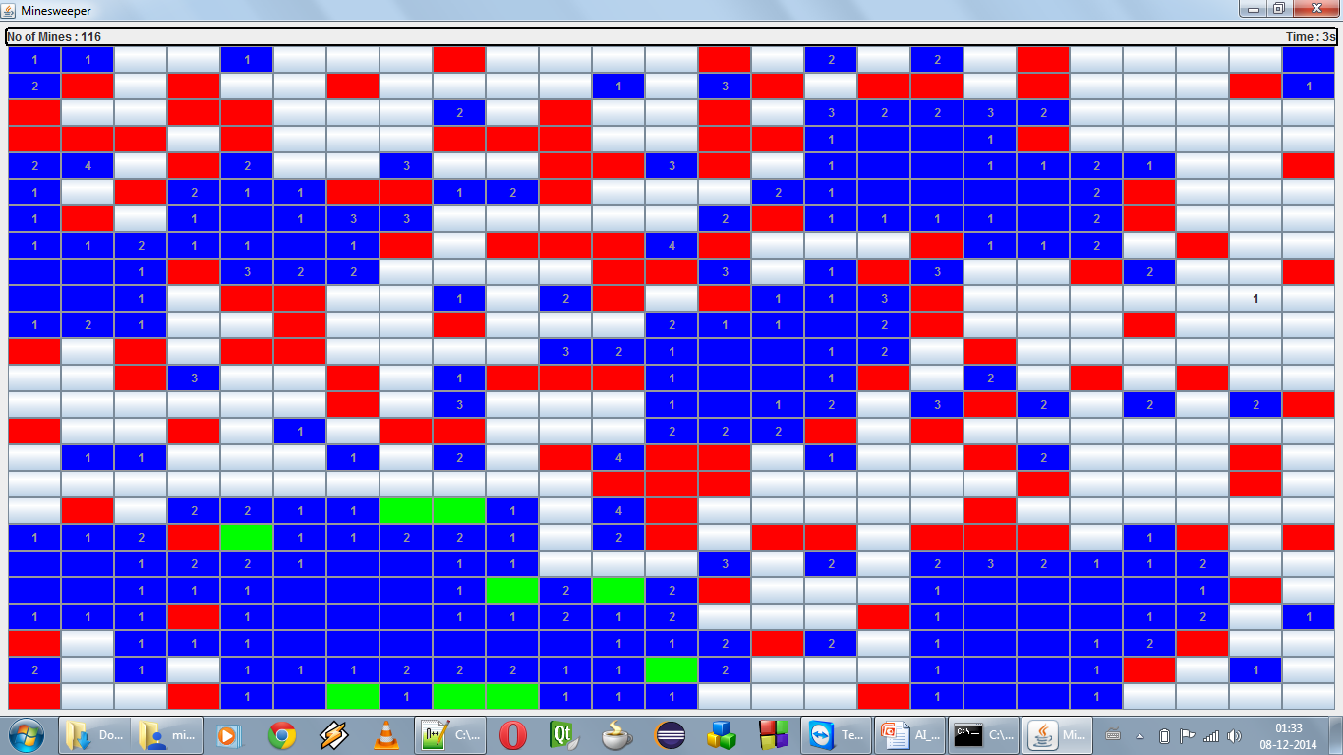
Minesweeper In Action

Slide 15
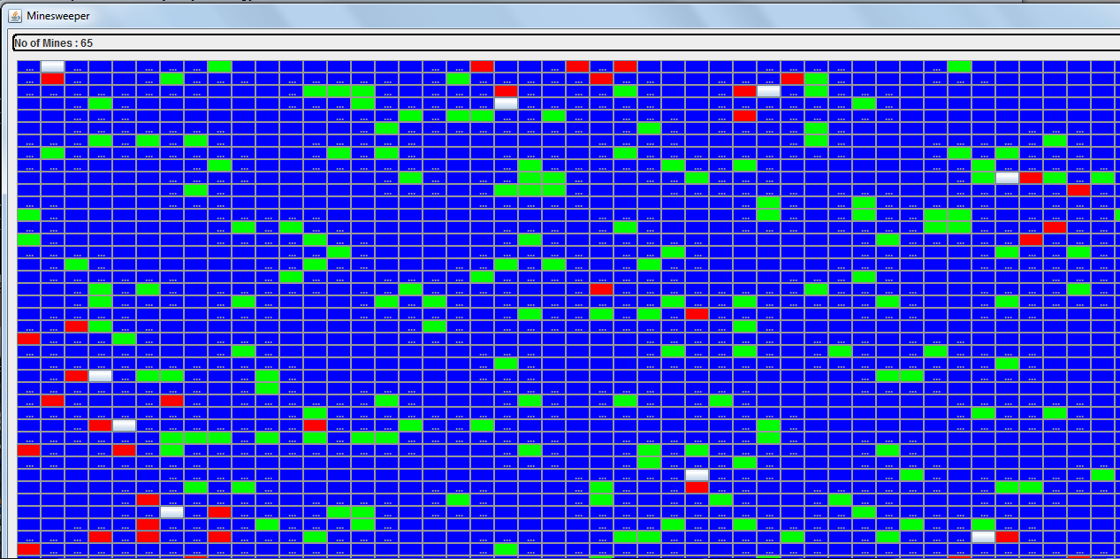
Minesweeper in Action

Slide 16
Runtime Data

Slide 17
Runtime Data

Slide 18
Known Issues
Work In Progress for Probabilistic Inference
Currently Agent makes a random guess
Wrong Move
Do not end the game
Store the wrong move count as a statistic

Slide 19
Demo

Slide 20

Thank You!!!

