Slide 1
MAJOR PROJECT
QuMail
Quantum-secure email for everyday mail accounts
Anika Sharma · Amit Chouhan · Umang Goswami

Slide 2
Why QuMail?
1
2
3
Today
The gap
Our answer
Email encryption relies on RSA / ECC.
A large quantum computer breaks both.
QKD gives keys that are secure by physics.
No common mail client can use them.
A desktop client for Gmail / Yahoo.
Pick a security level per mail, keys come from a Key Manager.

Slide 3
How it works
Sender
Key Manager
Encrypt
Mail server
Receiver
Compose mail
Choose level
Issues quantum key
Returns key ID
AES-GCM / OTP
Envelope + header
Sees only
ciphertext
Reads key ID
Fetches key, decrypts
X-QuMail-Level: 3 X-QuMail-KeyID: QK0003
Only the key ID travels with the mail. Both sides fetch the same key from the Key Manager; the key is consumed afterwards.

Slide 4
Four security levels
1
2
3
4
Plain
AES-256-GCM
One-Time Pad
Post-quantum
No encryption
Quantum key via HKDF
Key as long as the message
Hybrid scheme
Done
Done
Done
Next

Slide 5
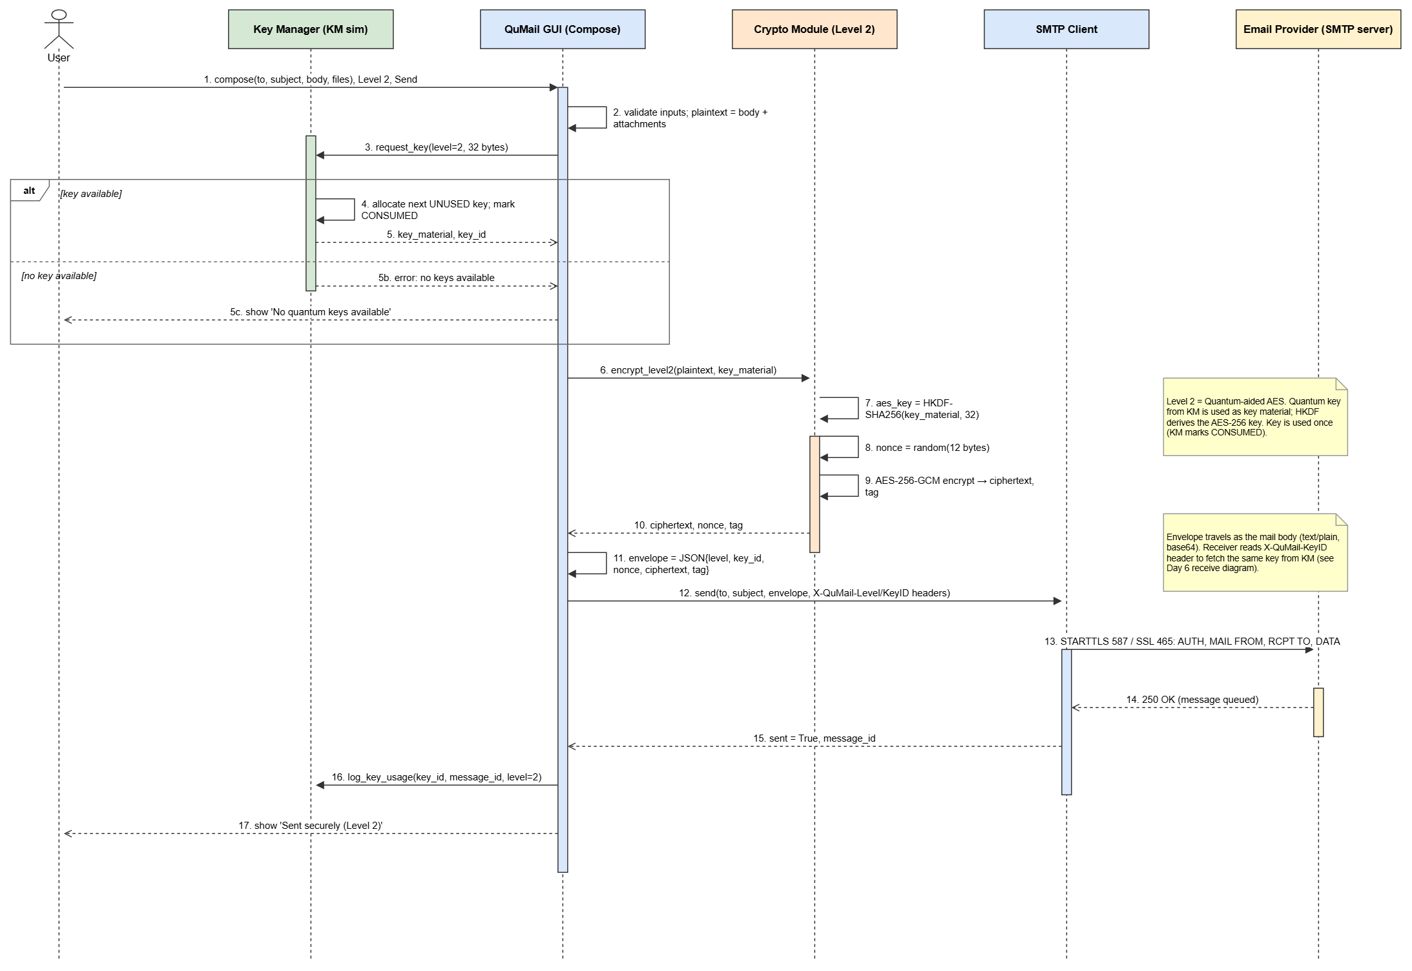
Week 1 — foundation
Jira board, 30-day plan, 6 sprints
GitHub repo with branch strategy
UML: use case, activity, sequence
Key Manager simulator
Login screen + Level 1 mail over Gmail

Slide 6
Week 2 — encrypted mail, end to end
Attachments
Level 2
Level 3
send · receive · preview
AES-256-GCM with quantum key
One-Time Pad + integrity check
Key bank
CI pipeline
Test docs
empty / offline states, safe fallback
41 tests on every push
plan + coverage report

Slide 7
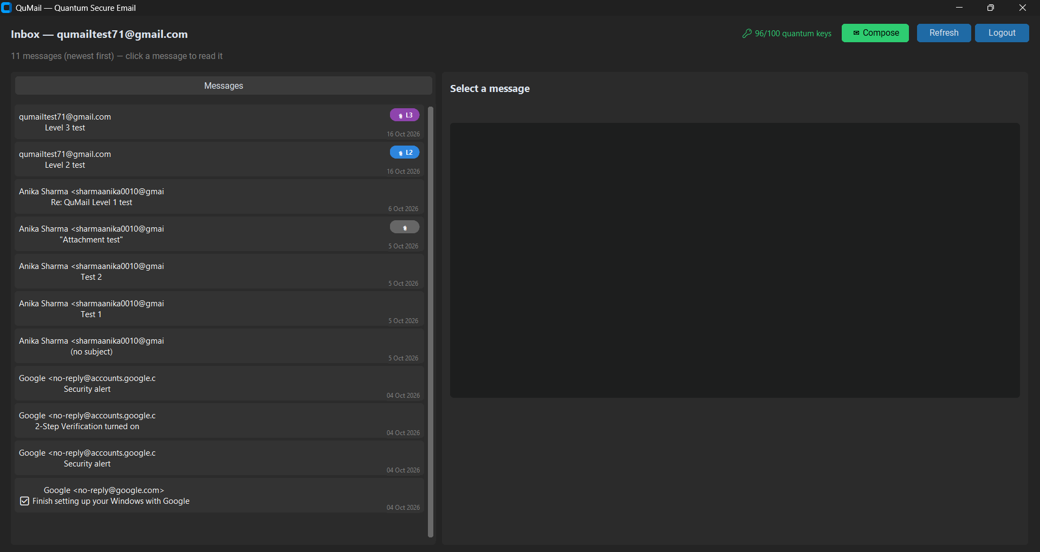
Inbox & live key count
Key Manager status is always visible — green, low, empty or offline.
DEMO

Slide 8
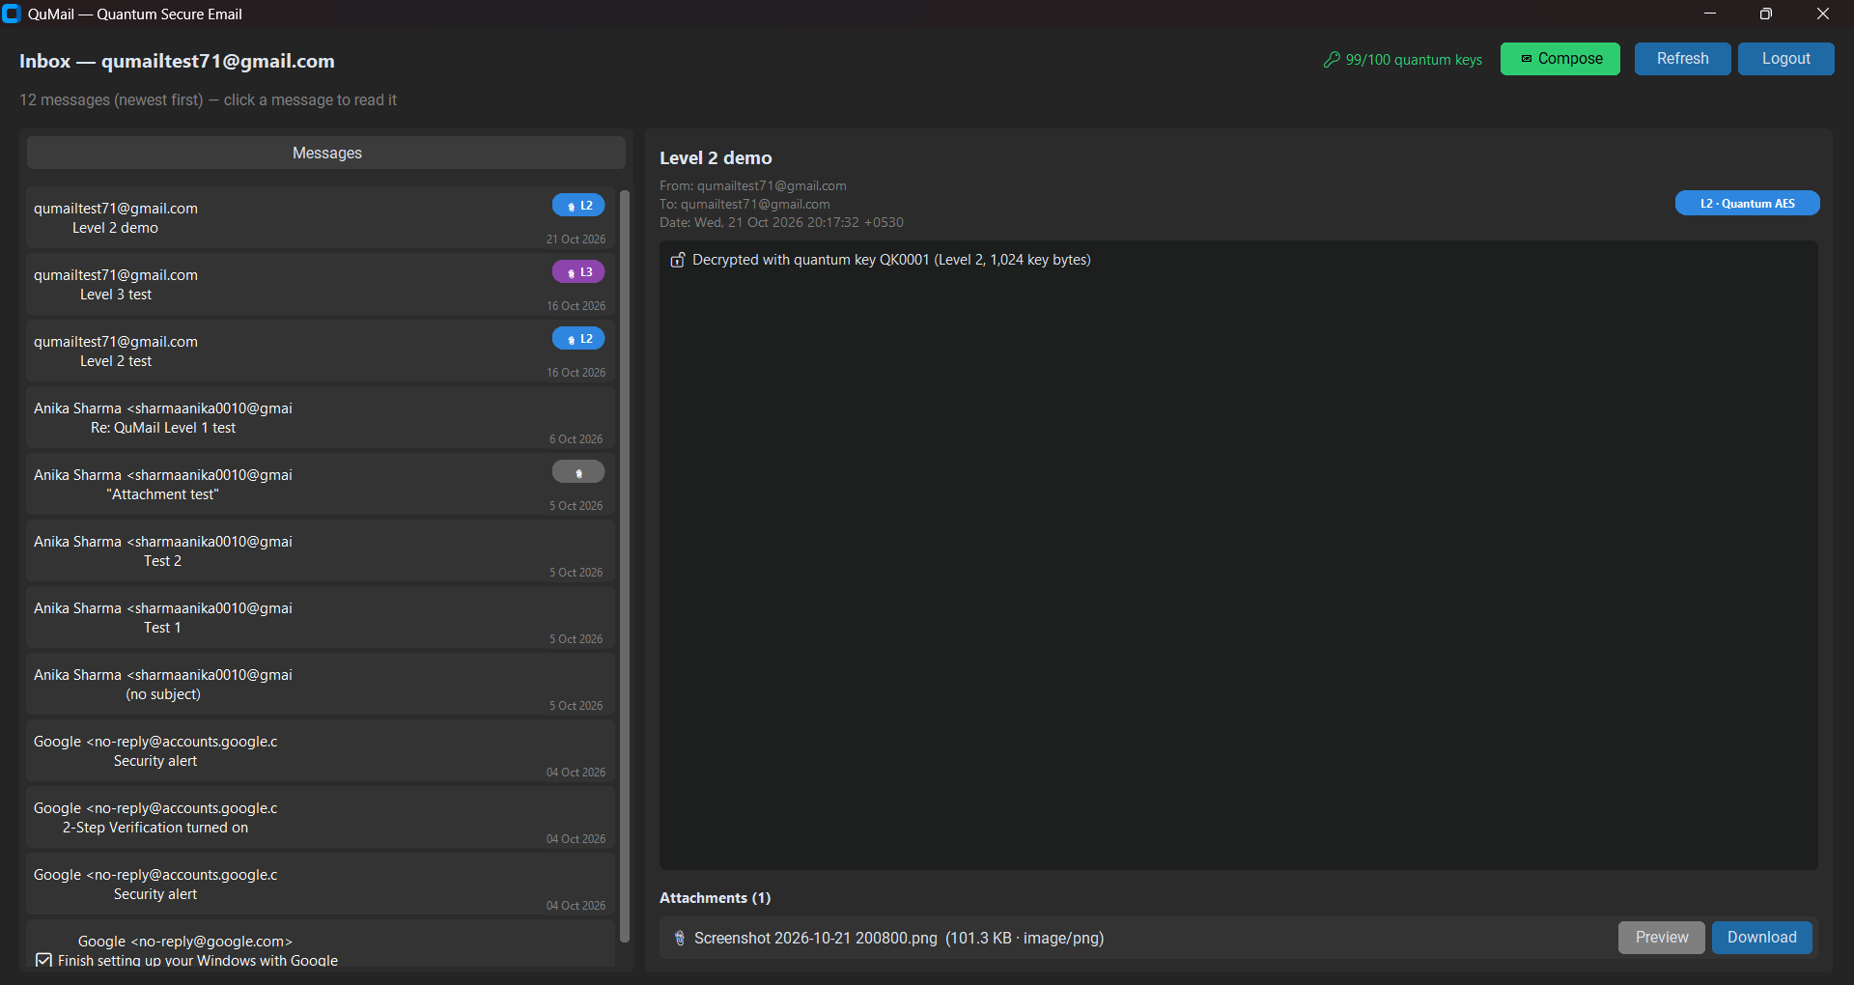
Level 2 — what Gmail sees vs what QuMail shows
Ciphertext envelope and .qenc attachment in Gmail; decrypted image in QuMail.
screenshot
DEMO

Slide 9
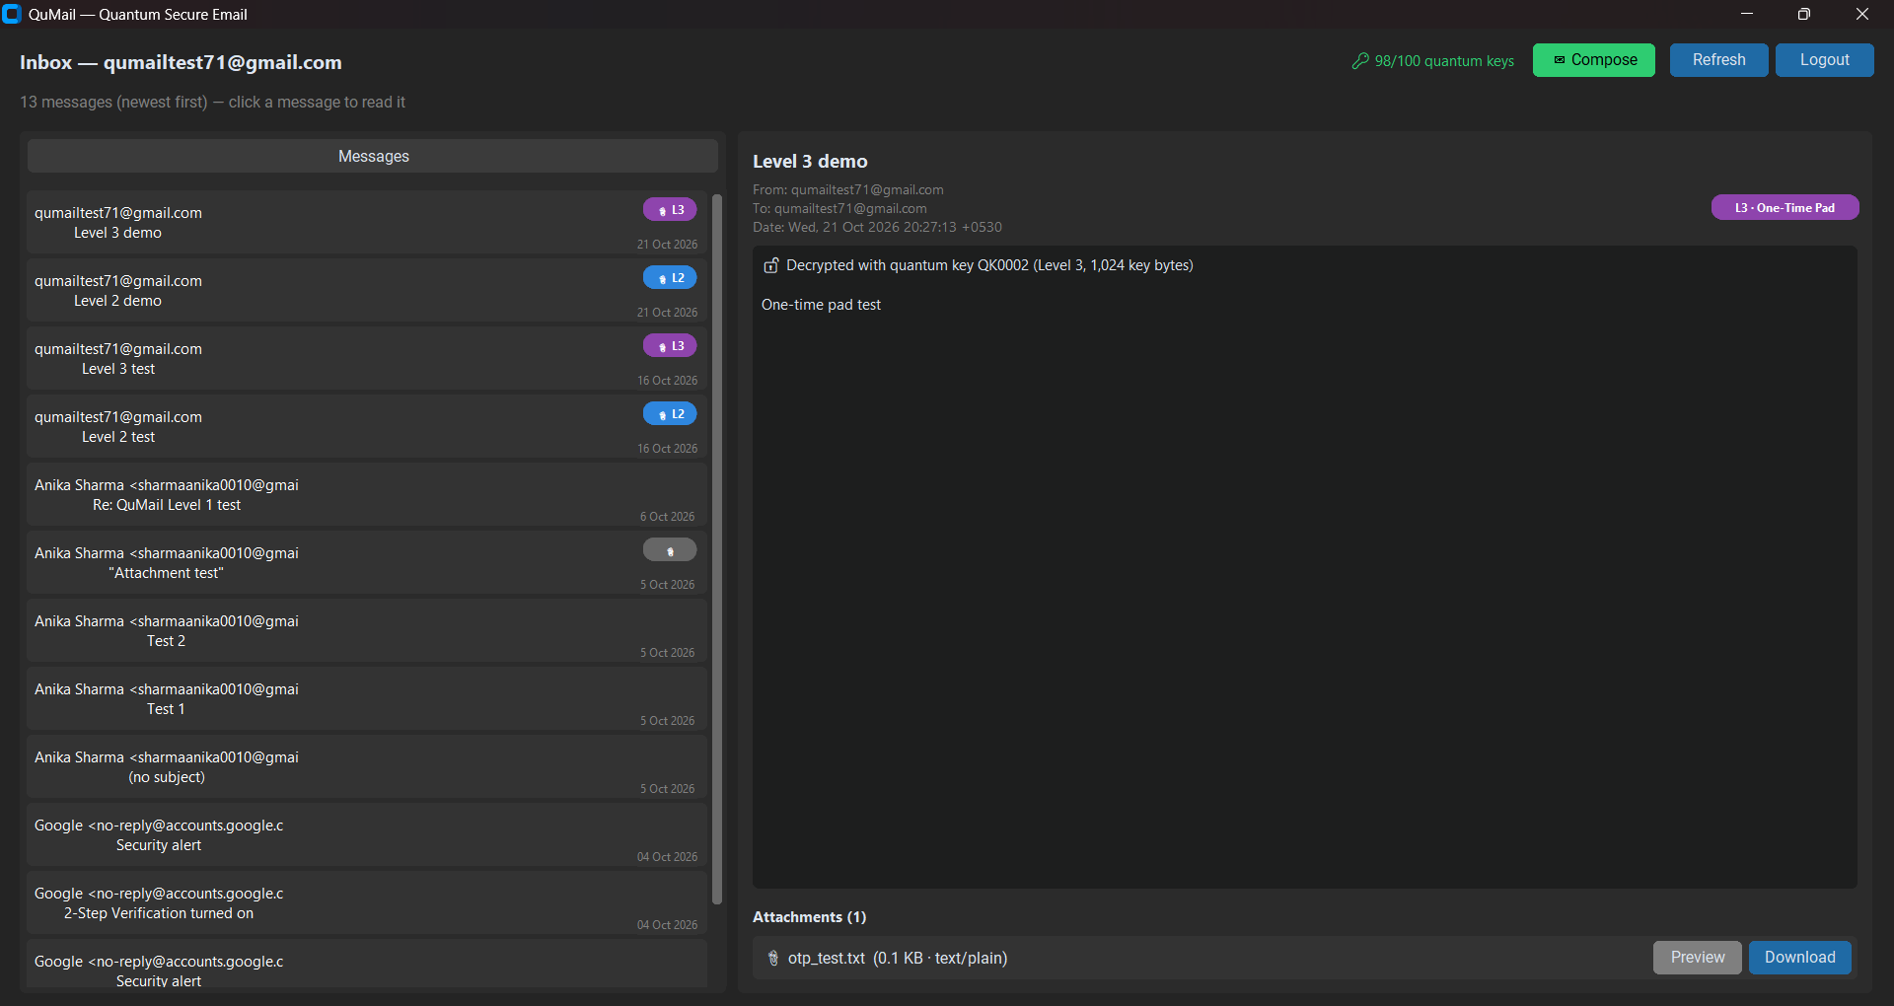
Level 3 — One-Time Pad
Small file decrypts; a 5.7 MB file is stopped before sending because the key bank is too small.
screenshot
DEMO

Slide 10
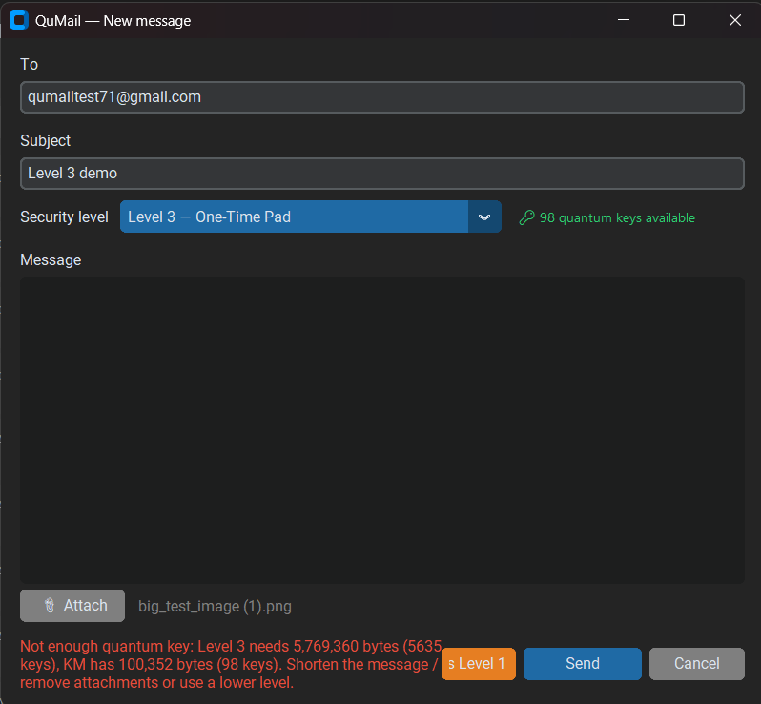
When keys run out
Bank empty → only Level 1 offered. KM offline → clear message, nothing breaks.
screenshot
DEMO

Slide 11
Built with discipline
13
41
91%
3/4
pull requests, all reviewed
automated tests
crypto & KM coverage
levels working
Jira ticket
feature branch
pull request
CI green
review
merge
develop branch is protected — nothing merges without passing tests.

Slide 12
What we learned
Real mail is messy
OTP is expensive
Keys need a lifecycle
Antivirus tools rewrite mails and drop big uploads — the parser and the IMAP client had to become tolerant.
A 100-key bank covers 100 KB. The client now tells you before sending, instead of failing midway.
Reserve → use → consume. A failed send must burn its key, or it is reused by accident.

Slide 13
What's next
Yahoo & multi-account
Security review
Level 4 (post-quantum)
UI polish & settings
Clean-machine test & final demo
Week 3: Level 4 + accounts · Week 4: hardening, docs, demo

Slide 14
Thank you
Questions?
github.com/sharmaanika0010-droid/Major-Project---Quantum-Secure-Email-Client-Application

