Slide 1
Contents
Introduction
Problem Statement
Problem Solution
Requirements( Services/Framework/Tools/Platform Used )
Solution Architecture
Working of Model
Understanding Model Working/code/scripts/frameworks
Working Business case

Slide 2
Introduction/ Understanding the Problem statement
We need to automate the email responding system intelligently, whenever a user send an email, then system should identify the language in which the mail is sent and afterward convert it to the English language if required.
Assign a token (issue or service request) whether the mail is about service/issue related. Then generate a mail of required solution of service/issue encountered and convert the language to the original language in which mail was received if solution is available in KB.
If solution is not available in the KB, then assigns to concerned resolving group. A mail is sent to costumer consisting name of resolving group and estimate time to resolve the problem in language in which mail was received.

Slide 3
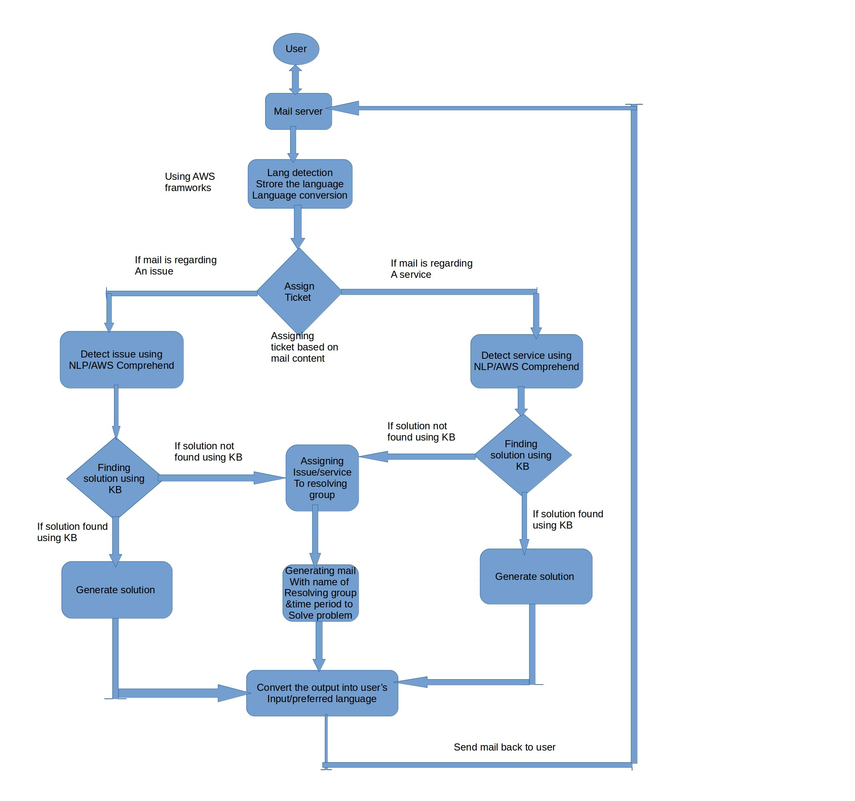

Slide 4







Problem Architecture
User
YES
solution
Language Detection and Conversion
Detect Problem
Check KB for solution
Language Detection and Conversion
NO
User
Resolving group

Slide 5
Introduction/ Solution statement
After receiving mail event from service management tool we will detect the language of the email using AWS comprehend. Then, the mail is translated(using translator tool) in English if required.
Then, token is assigned using the content of mail using Classifier by locating Key Phrases and Topic modeling.
Categorizing the issue/service using trained model of different categories.
Solving the issue/service using trained model of our KB. If solution not found, then assign the problem to appropriate resolving group according to category defined by our model.
Preparing the mail content according to solution/resolving group details.Translating the generated mail content in user language and sending the mail to user.
And when resolving group have the solution to the query asked by the user, send the mail back to mail received address with the appropriate tag and it also train the classifier on the new problem and save the solution to KB .

Slide 6


Services/Framework/Tools/Platform Used
AWS Comprehend
AWS translate
Email Server
AWS DynamoDB
AWS Lambda
AWS S3 Bucket
Classification Model(algorithm: SVM)

Slide 7



Architecture-(Classification)
Mail parser
Language Detection and Conversion
User
Mail server
Amazon S3
DynamoDB
Data
Problem Classifier

Slide 8

Architecture-(Reply)
DynamoDB
User
Problem Classifier
KB
User data
Mail server
Language Detection and Conversion
Resolving group info
Resolving group

Slide 9

Architecture-(Training)
Resolving group
Mail server
Mail parser
Language Detection and Conversion
Amazon S3
User
DynamoDB
Data
Training Data
Training Data
Training Classifier

Slide 10
Conclusion
Scope of Automation
Automation is the requirement of this generation to do the things smartly. This type of automation can be used efficiently and can be improved timely. Due to modularity of solution this automation technique can not be obsolete in future. The use of cloud can save cost as well as manpower for maintenance.
Achieved cost saving
Usually if a dedicated hardware is maintained for processing the data require a lot of initial and maintenance cost. Cloud services like AWS offer shared based required hardware using network according to the load of the client. Such cloud services impose cost based on the processing and use of resources. This reduces the initial setup cost and also save the maintenance cost of the client. Cloud services also offer well trained machine learning frameworks which save time as well as cost. Hence, use of such cloud services can reduce the cost a lot.
Conclusion
Using the available resources on cloud like AWS and different frameworks we can develop a smart automation which can respond more smartly than the existing automation tools.

