Slide 1
ChainSight
Reported wallet
From a reported scam wallet to a ready-to-send freeze request, in one automated investigator report
Exchange deposit
Team [Team name] | Powered by TinyFish web agents
Notes:
ChainSight traces scam money to the exchange that can freeze it, then uses TinyFish web agents to do the web research investigators do by hand today.

Slide 2




Team details
Team name: [Team name] Institution / organisation: [Name] Contact: [Email / phone]
[Member 1 name]
[Member 2 name]
[Member 3 name]
[Member 4 name]
Team lead, product and pitch
On-chain tracing and risk engine
TinyFish agents and backend
UI/UX and investigator report
[College / year / LinkedIn]
[College / year / LinkedIn]
[College / year / LinkedIn]
[College / year / LinkedIn]
Roles are suggestions that match the work split; edit to fit your team.

Slide 3



Scam money moves in hours; tracing it takes days
Cyber-fraud victims report the wallet addresses scammers used. Those are usually burner or intermediary wallets that hide the trail (layering).
Which exchange received it?
Only exchanges (VASPs) can freeze funds and hand over identity. Finding them needs rare blockchain skills, across chains, mixers and bridges.
Investment scams
Task-based fraud
Sextortion
Phishing
Ransomware
Who do we contact, and how?
Even once the exchange is known, finding its compliance contact and request process is manual web research.
How the money disappears
Every hour counts
Victim pays
Burner wallet
Layering hops
Exchange deposit
Cash-out
Funds move on within hours. Delay means the money is lost for good.
Meanwhile, the investigator is still researching
Why existing tools don't fully solve it: commercial tracing tools (Chainalysis, TRM and similar) are expensive and built for large firms, and even they don't automate the web research around a wallet or VASP contact discovery.

Slide 4
The gap: tracing tools stop at the web research
 | Manual investigation | Commercial tracing tools | ChainSight
Cost | Low tooling cost, very labour-heavy | Expensive enterprise licences | Low: public blockchain APIs + TinyFish
Expertise needed | Rare blockchain experts | Trained analysts | Guided report any investigator can use
Finding the exchange | Hours to days | Fast | Automated, down to the deposit address
Web research on the wallet | Manual searching | Not automated | Automated (TinyFish Search + Fetch)
Exchange's law-enforcement contact | Manual web research | Not automated | Automated (TinyFish Web Agent)
Evidence for the case | Ad-hoc screenshots | Tool exports | Timestamped, hashed page snapshots
Comparison reflects the problem framing; ChainSight complements, not replaces, commercial tools for large firms.

Slide 5






Our solution: one wallet in, one investigator report out
Input
1. On-chain tracing
2. Off-chain intel
3. VASP contact discovery
4. Evidence capture
5. Report
Reported wallet + chain, via dashboard or API (later: pulled from complaint systems)
Follow funds hop by hop; detect pass-through, fan-out / fan-in and peel chains; match known exchange wallets
Scam-report sites, forums and social pages; sanctions and abuse lists; P2P seller profiles
Agent finds the exchange's law-enforcement request page, process and contact
Timestamped, hashed snapshots of every page used
Fund-flow graph, risk category, nearest VASP, next action, evidence trail
TinyFish
TinyFish
TinyFish
A human investigator always reviews. The risk score is a lead, not proof of guilt. Every point in the score is explained, and every finding links to its evidence.

Slide 6




What the investigator gets: a case-ready report
Fund-flow graph
Nearest VASP + deposit address
Key insight
Every hop, amount and timestamp, with the path to the exchange highlighted
Which exchange, how many hops, how much arrived, and when
We find the deposit address, not just the exchange name
Risk lead score + category
Contact + draft freeze request
An unlabelled address that sweeps its funds into an exchange's hot wallet is that exchange's customer deposit address. That identifies the exact account the exchange can freeze and run KYC on.
Rule-based, with the reason for every point (ML later)
Portal, process, required documents, pre-filled request letter
Evidence trail
PDF / JSON export
UTC timestamp and SHA-256 hash for each page relied on
Standardised output for case files and other systems
scam wallet > hops > deposit > exchange

Slide 7





Built for the people who have to freeze the money
Primary
Secondary
Secondary
State cyber cells and police units
Exchange and VASP compliance teams
Banks' fraud units
Teams working on national cybercrime complaints (NCRP) and SAHYOG
Screen incoming deposits against reported fraud flows
Link crypto cash-outs to the fiat accounts they control
Value to them
Faster freezing
Less dependence on rare experts
Standardised evidence
Exchange and contact identified in one run instead of days of manual work
Any trained investigator can act on the guided report
Same report format, hashed snapshots, audit log for every case

Slide 8
Technical architecture
Input layer
Dashboard form | REST API | later: complaint systems (NCRP)
Orchestrator
Job queue (Redis + worker). Runs tracing and agents in parallel, then merges results
Off-chain intelligence engine
TinyFish Search, Fetch, Web Agent, Browser
Risk engine
Rule-based scoring now, ML later
On-chain engine
Explorer / node APIs > transaction graph (NetworkX), exchange-cluster matching, pattern detection
Tracing and web agents run concurrently, so a slow agent never blocks the on-chain result.
PostgreSQL
Cases, results, audit log, VASP contact cache
Output layer
Dashboard | fund-flow graph | PDF / JSON report | freeze-request draft
Blockchain data sources
Etherscan / Alchemy / Infura (Ethereum) | TronGrid / Tronscan (Tron) | public exchange-label datasets

Slide 9



Technology stack and MVP scope
Backend
Async jobs
Data
MVP scope
Ethereum and Tron only
Single-wallet tracing
Direct exchange identification
Exchange contact discovery
Everything else is roadmap
Python + FastAPI
Redis + worker (Celery or similar)
PostgreSQL for cases and results; NetworkX for the transaction graph
Frontend
Reports
Web intelligence
React with a graph visualisation library for fund flow
PDF generation from case data, plus JSON
TinyFish Search, Fetch, Web Agent, Browser (one API key)
Why Tron: USDT on Tron is heavily used in Indian scam flows.
Blockchain data: Etherscan-style explorer APIs or Alchemy / Infura (Ethereum), TronGrid / Tronscan (Tron), Bitcoin explorers later. Free-tier limits and terms to be verified. Public exchange-label datasets are limited, and we say so.

Slide 10

How we integrate the TinyFish API
TINYFISH PIECE
WHAT IT DOES
WHERE CHAINSIGHT USES IT
Search
Structured live web results
Find mentions of the wallet on scam-report sites, forums and social pages
Fetch
Renders pages into clean text, JSON or HTML
Read those pages and confirm the address is really there; read exchange policy and contact pages
Web Agent
Natural-language goal in, multi-step task done, structured JSON out
Navigate exchange sites to the law-enforcement process and contact; pull P2P seller profiles
Browser
Cloud browser session we control
Timestamped evidence snapshots (stretch goal)
Why agents, not scrapers: these sites are all different, change often, have no APIs, and the tasks take several steps. One agent adapts to many exchanges without a script per site.
Honest limits: agents are slower than APIs and can fail on odd sites, so we use them only where no API exists, with retries and a manual fallback.

Slide 11




TinyFish in action: exchange contact discovery
1. We send the Web Agent a URL and a goal
2. It navigates the site and returns structured fields
"On this exchange's website, find the official process for law-enforcement agencies to request user information or freeze funds. Navigate legal, help-centre or compliance pages as needed. Do not log in or submit any form. Return the portal URL, process steps, contact email, required documents, response time and the pages you used."
Portal
Law-enforcement request page / form
Process
Official email domain > submit via portal > attach legal notice
Required documents
Signed notice on letterhead, officer ID, FIR / complaint ref.
Contact
Email if published, else portal only
Sources
Pages visited, each captured as hashed evidence
Retries with backoff
Contacts cached per exchange
Failures flagged for manual review
Simple HTTP API, one key (MCP also available)

Slide 12



Scalability and feasibility
Feasible now
Scales by configuration
Parallel by design
Built on existing blockchain APIs and TinyFish. No custom blockchain indexer needed for the MVP.
A new chain or exchange is a config entry, not a new scraper. The agent finds each exchange's current page itself.
Tracing jobs and agents run concurrently through the queue; contact results are reused across cases.
Risks and mitigations
Risk | Mitigation
Agent failures on unusual sites | Retries, cached results, fallback contact, flagged for manual review
False positives | Human validation; explained score; risk score is a lead, not proof
Legal and ethical limits | Authorised use only, audit logs, respect site terms; agents never log in or submit forms
Limited public exchange labels | Deposit-address inference from sweep behaviour; plug in richer label datasets

Slide 13
Use case: a task-scam victim's report, start to finish
1
2
3
4
Victim reports a wallet
Funds traced to an exchange
TinyFish agents work the web
Investigator acts
A victim of a task-based job scam reports the USDT (Tron) wallet they paid.
Money collected from several victims is split across mules and reaches an exchange deposit address within a few hops.
They find outside reports of the wallet, the exchange's law-enforcement process and contact, and capture evidence.
One report with a ready-to-send freeze and KYC request, reviewed and sent by the officer.
Result: hours or days of manual tracing and web research become one automated report. We will replace this with measured timings from live runs on real reported wallets.

Slide 14
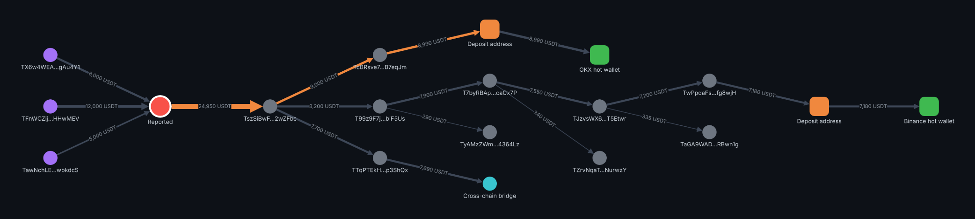
Prototype: the investigator's case view
UI prototype shown on a sample scenario with synthetic wallet data.
Reported wallet
Victim-side senders
Intermediaries
Exchange deposit address
Exchange wallet
Bridge
Highlighted path: funds from the reported wallet reach an exchange deposit address in 3 hops. Patterns detected: fan-in, pass-through, fan-out and a peel chain.

Slide 15
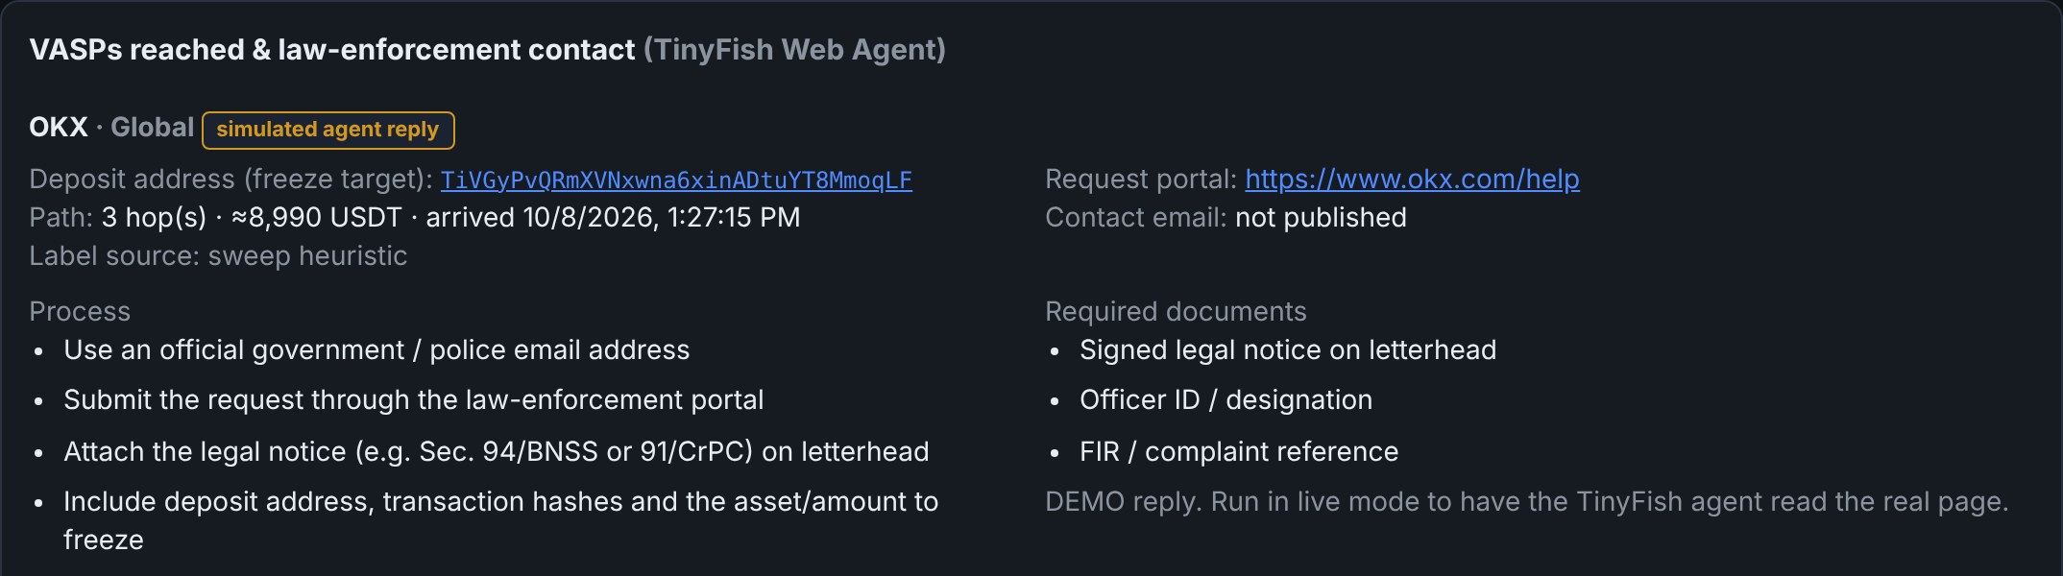
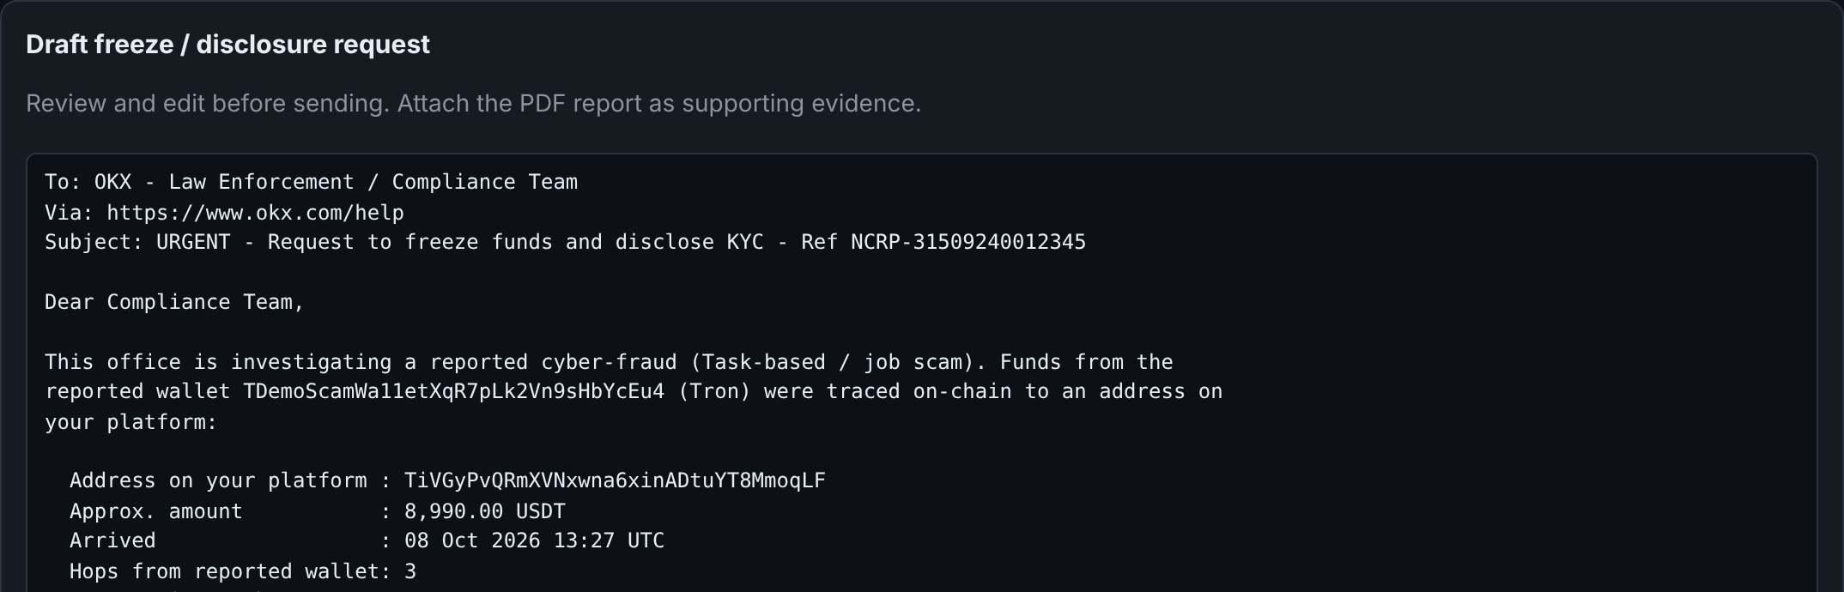
Prototype: exchange contact and freeze request
UI prototype on the same sample scenario; contact details are illustrative until the live agent runs.
Exchange contact card
Deposit address to freeze, path and amount, request portal, process steps and required documents found by the TinyFish agent.
Draft freeze and KYC request
Pre-filled with the complaint reference, deposit address, amount and transaction hashes. The officer reviews, edits and sends it.
Also in the prototype: confirmed wallet mentions, an evidence table with UTC timestamps and SHA-256 hashes, an itemised risk score and a PDF report.

Slide 16
Faster freezes, fewer losses
ROADMAP
More chains (Bitcoin and others)
Bridge and cross-chain tracing
P2P seller intelligence module
ChainSight turns a reported wallet into the exchange, the contact and the evidence an investigator needs to act while the money is still there.
Address-poisoning guard
ML-based risk scoring
Team [Team name] | [Contact email]
NCRP and SAHYOG integration

