Slide 1

CAR: PRICE PREDICTION

Slide 2
Problem Statement
Cars are one of the necessary need of each and every person around the globe and therefore car market is the market which is one of the major contributors in the world’s economy. It is a very large market and there are various companies working in the domain.
Data science comes as a very important tool to solve problems in the domain to help the companies increase their overall revenue, profits, improving their marketing strategies and focusing on changing trends in car sales and purchases. Predictive modelling, Market mix modelling, recommendation systems are some of the machine learning techniques used for achieving the business goals for car selling companies. Our problem is related to one such car-selling client.
We are required to model the price of cars with the available independent variables. This model will then be used by the management to understand how exactly the prices vary with the variables. They can accordingly manipulate the strategy of the firm and concentrate on areas that will yield high returns. Further, the model will be a good way for the management to understand the pricing dynamics of a new market.
With the covid 19 impact in the market, we have seen lot of changes in the car market. Now some cars are in demand hence making them costly and some are not in demand hence cheaper. One of the clients works with small traders, who sell used cars. With the change in market due to covid 19 impact, client is facing problems with their previous car price valuation machine learning models. So, they are looking for new machine learning models from new data.

Slide 3
For this client wants to know:
Which variables are important to predict the price of variable?
How do these variables describe the price of the cars?
Business Goal:
We are required to model the price of cars with the available independent variables. This model will then be used by the management to understand how exactly the prices vary with the variables. They can accordingly manipulate the strategy of the firm and concentrate on areas that will yield high returns. Further, the model will be a good way for the management to understand the pricing dynamics of a new market

Slide 4
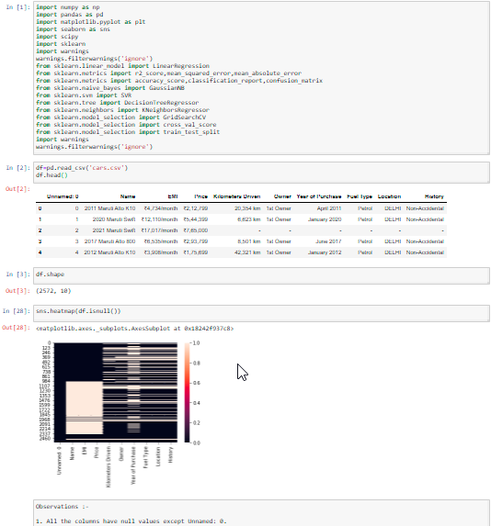
Exploratory Data Analysis
The sample data is extracted by using web scraping from selenium. It is stored in csv format and hence we import it using pandas. Then we further checked more about data using info, checked data types using dtypes, shapes using .shape, columns using .columns, null values using .isnull.sum, and further visualize it through heatmap as follows:

Slide 5
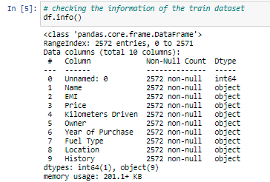

Then we further checked more about data using info, checked datatypes using dtypes, shapes using .shape, columns using .columns, null values using .isnull.sum and further visualize it through heatmap as follows:

Slide 6

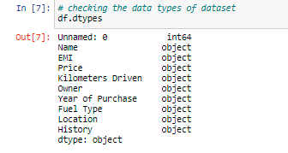
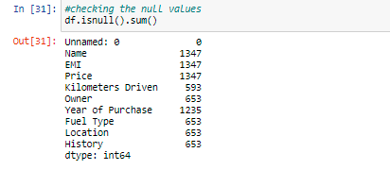

Slide 7
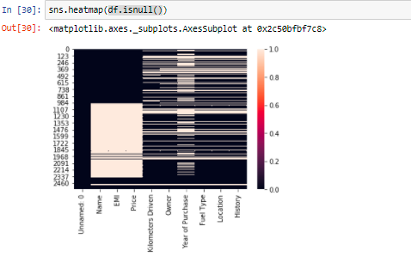

Slide 8
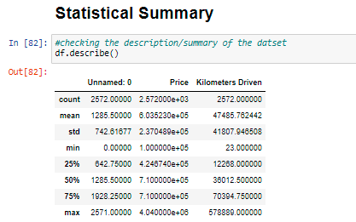
Then we will check the statistical summary of the dataset using .describe from which we have observed that:
Total entries:2572
outliers are there in :
EMI, Price, Kilometers Driven, Owner and Location
Mean is greater than median in : Kilometers Driven.

Slide 9
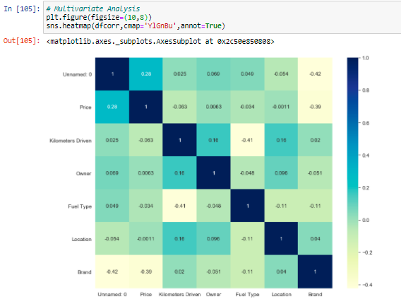
Next we will be checking the correlation using .corr and visualize the same using a heatmap. Also we can check the correlation of all the attributes with the target variable. From this we observe that:
Price is highly positively correlated to Owner.
Owner is highly negatively correlated to Brand.
Owner is highly positively correlated to Kilometers Driven.
Kilometers Driven is highly negatively correlated to Price.

Slide 10
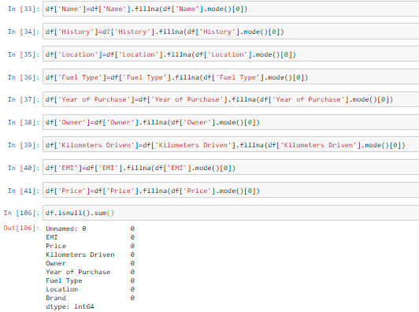
We will be imputing the columns with int data types having null values with mode and using mean of that particular column and check again if there are any null values left.

Slide 11
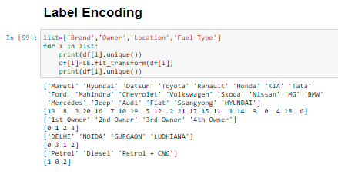
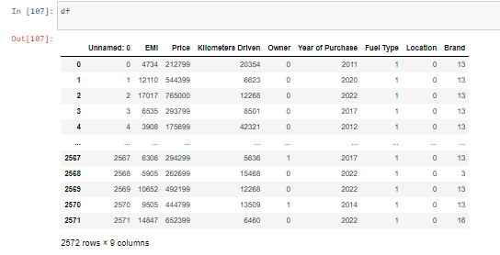
Encoding the columns with object data type using label encoder
It can be observed that all the columns with object data type has been converted to int/float

Slide 12
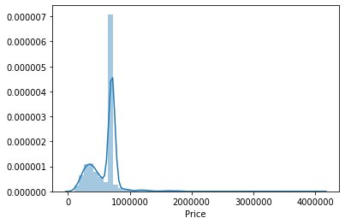
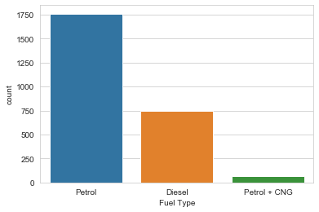
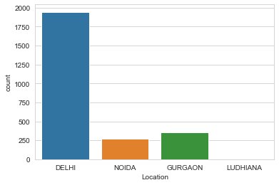
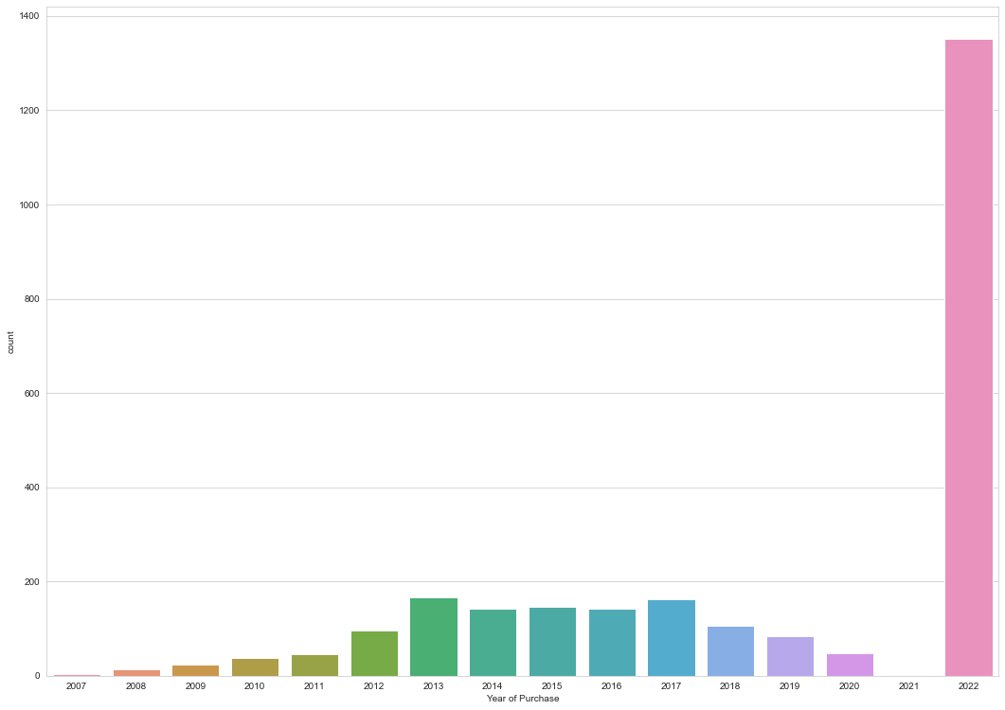
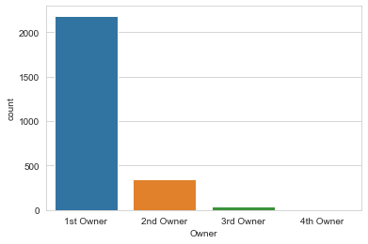
Data Visualization
we'll be checking the impact of each attribute on the 'Price' using distplot and barplot.

Slide 13
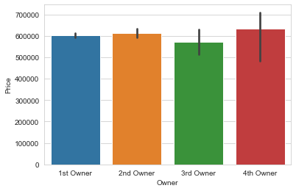
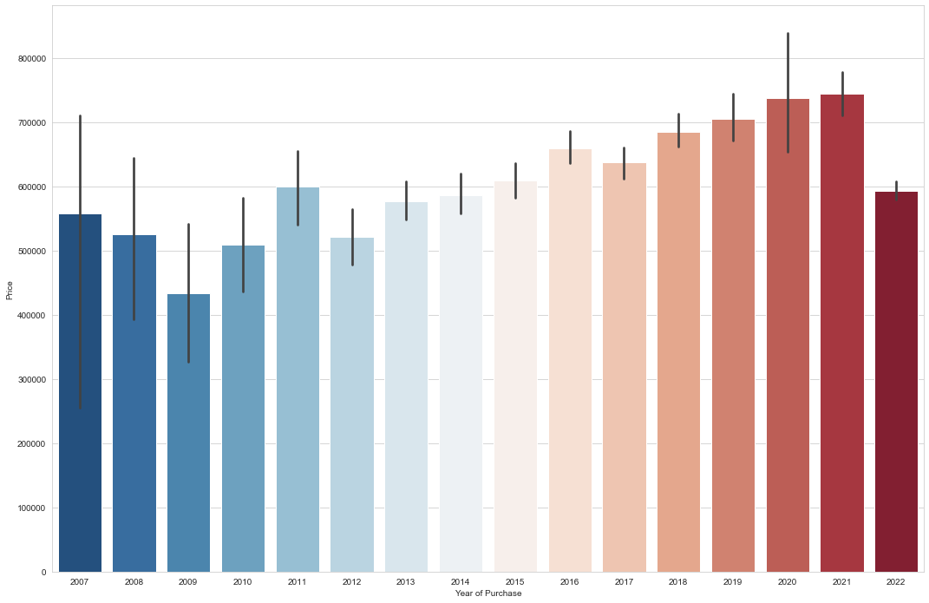
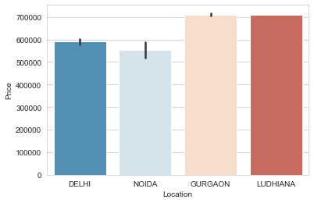
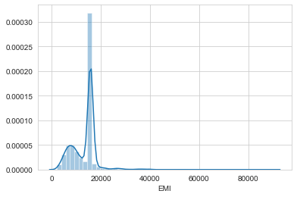
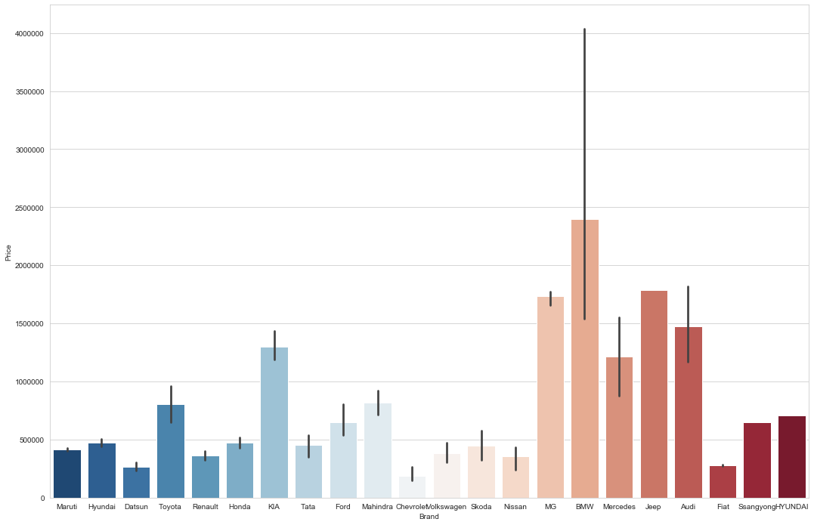

Slide 14
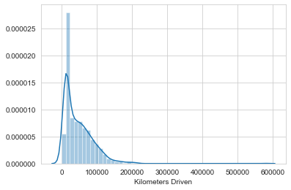

Slide 15

Checking Distribution/skewness
It can be observed that there is skewness present in : Kilometers Driven, Owner, Location, Year of Purchase and Brand.

Slide 16
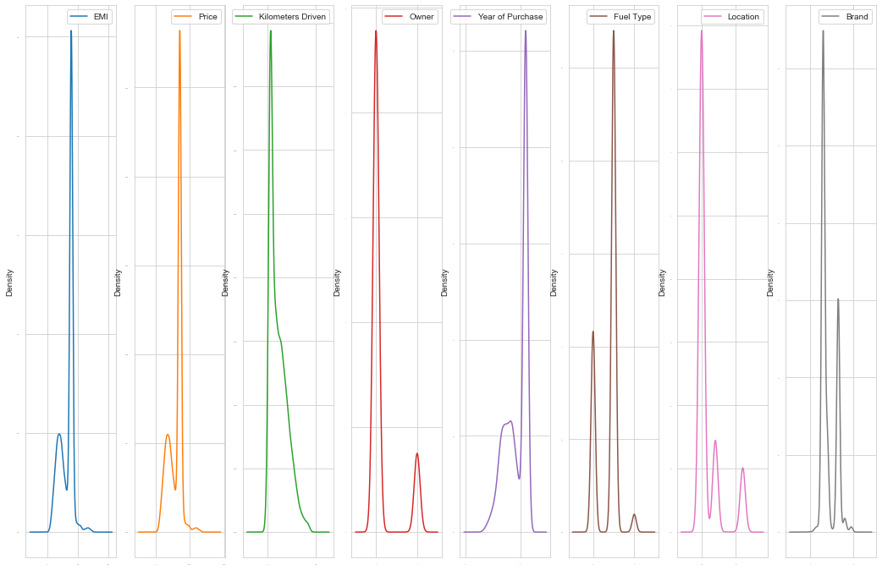

Slide 17
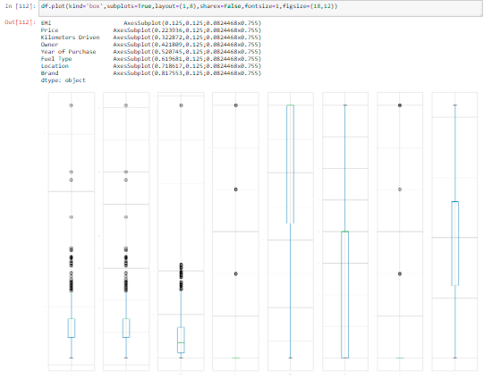
Plotting the outliers using boxplot

Slide 18
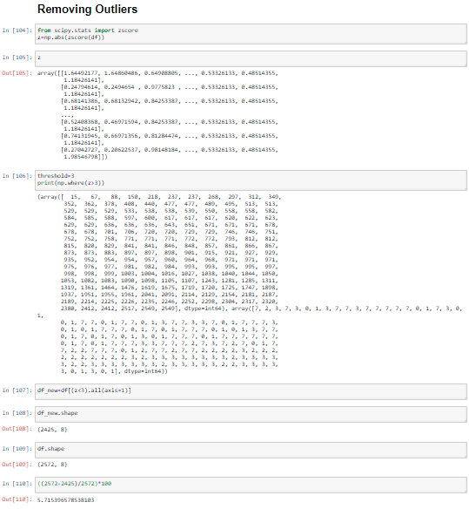
Removing the Outliers using Z-score

Slide 19
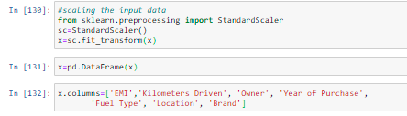
Model Training
Firstly, we will be splitting our dataset into input and output variable as x and y respectively.
Then, we will be scaling all our input variables using standard scalar.

Slide 20
Lastly, to develop the model we have used various libraries and metrics from sklearn such as train_test_split, LinearRegression,Lasso,Ridge,ElasticNet, SVR, DecisionTreeRegressor, KNeighborsRegressor, RandomForestRegressor, AdaBoostRegressor, mean_squared_error, mean_absolute_error and r2_score
Next, we will be splitting our data into training and testing with random_state=11 and test_size=0.22. Then we will be checking the shape of train and test data as follows:

Slide 21
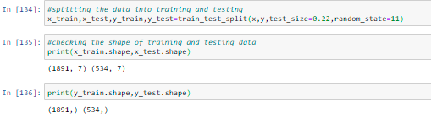
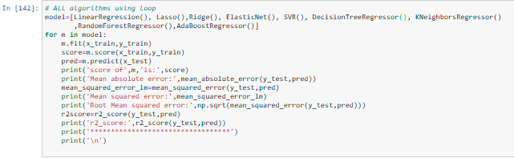
Now we will be using a loop where all the algorithms will be used one by one and their corresponding Score, Mean Absolute Error, Mean Squared Error, RMSE and r2_score will be evaluated.

Slide 22
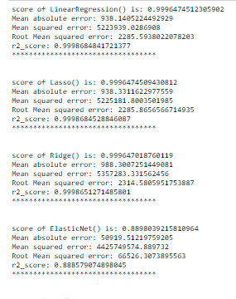
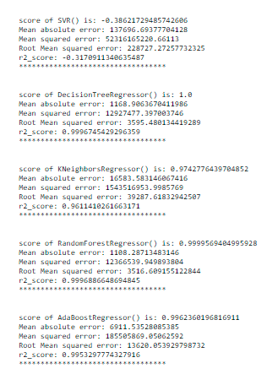
I am choosing DecisionTreeRegressor as our best model since it's giving us best score and it's performing well. It's r2_score is also satisfactory and it shows that our model is neither underfitting/overfitting.
We are not performing hyperparamter tuning using GridSearchCV on DecisionTreeRegressor as it is already giving 100% accuracy.

Slide 23
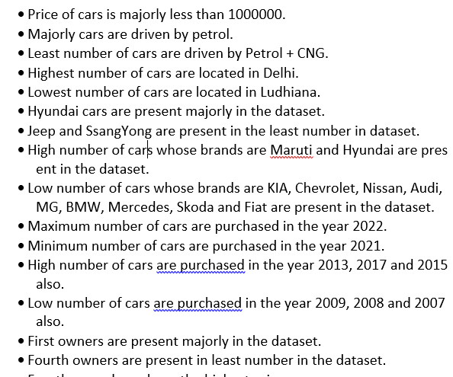
Conclusion

Slide 24
