Slide 1

FLIGHT: PRICE PREDICTION

Slide 2
Problem Statement
Flights are one of the necessary need of each and every person around the globe and therefore flight tickets market is the market which is one of the major contributors in the world’s economy. It is a very large market and there are various companies working in the domain.
Data science comes as a very important tool to solve problems in the domain to help the companies increase their overall revenue, profits, improving their marketing strategies and focusing on changing trends in flight tickets sales and purchases. Predictive modelling, Market mix modelling, recommendation systems are some of the machine learning techniques used for achieving the business goals for flight tickets selling companies. Our problem is related to one such flight-tickets selling client.
We are required to model the price of tickets with the available independent variables. This model will then be used by the management to understand how exactly the prices vary with the variables. They can accordingly manipulate the strategy of the firm and concentrate on areas that will yield high returns. Further, the model will be a good way for the management to understand the pricing dynamics of a new market.
With the covid 19 impact in the market, we have seen lot of changes in the flight tickets market. Now some flights are in demand hence making them costly and some are not in demand hence cheaper. One of the clients works with small traders, who sell flight tickets. With the change in market due to covid 19 impact, client is facing problems with their previous flight tickets price valuation machine learning models. So, they are looking for new machine learning models from new data.
For this client wants to know:
Do airfares change frequently? Do they move in small increments or in large jumps? Do they tend to go up or down over time?

Slide 3
What is the best time to buy so that the consumer can save the most by taking the least risk?
Does price increase as we get near to departure date? Is Indigo cheaper than Jet Airways? Are morning flights expensive?
Business Goal:
We are required to model the price of flight tickets with the available independent variables. This model will then be used by the management to understand how exactly the prices vary with the variables. They can accordingly manipulate the strategy of the firm and concentrate on areas that will yield high returns. Further, the model will be a good way for the management to understand the pricing dynamics of a new market.

Slide 4
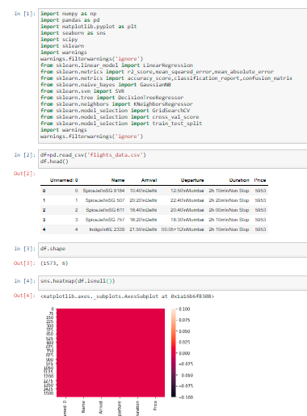
Exploratory Data Analysis
The sample data is extracted by using web scraping from selenium. It is stored in csv format and hence we import it using pandas. Then we further checked more about data using info, checked data types using dtypes, shapes using .shape, columns using .columns, null values using .isnull.sum, and further visualize it through heatmap as follows:

Slide 5
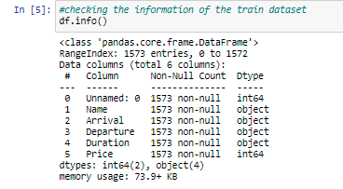

Then we further checked more about data using info, checked datatypes using dtypes, shapes using .shape, columns using .columns, null values using .isnull.sum and further visualize it through heatmap as follows:

Slide 6

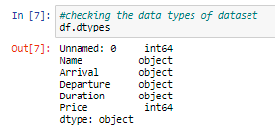
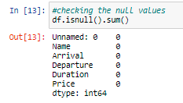

Slide 7
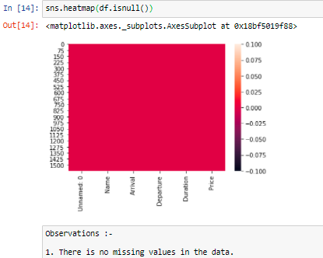

Slide 8
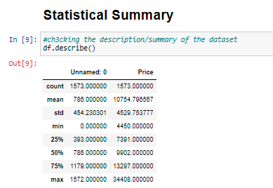
Then we will check the statistical summary of the dataset using .describe from which we have observed that:
Total entries: 1573
outliers are there in :
Price, Number of Stops and Departure Hours
Mean is greater than median in : Price.

Slide 9
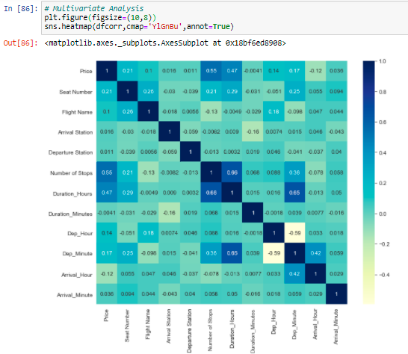
Next we will be checking the correlation using .corr and visualize the same using a heatmap. Also we can check the correlation of all the attributes with the target variable. From this we observe that:
Price is highly positively correlated to Number of stops.
Number of stops is highly negatively correlated to Flight Name.
Flight Name is highly positively correlated to Seat Number.
Arrival_Hour is highly negatively correlated to Price.

Slide 10
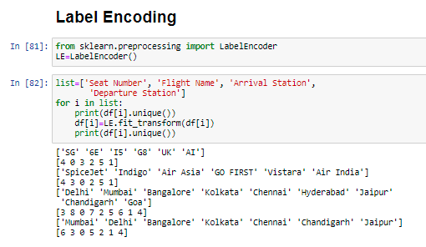
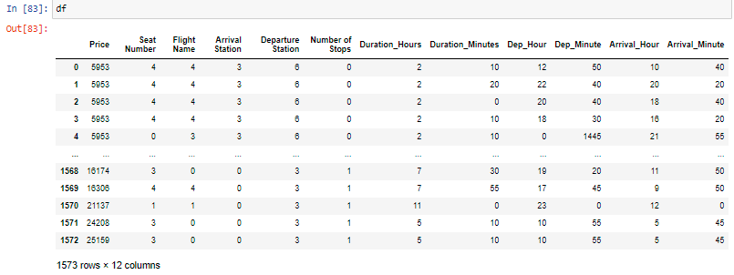
Encoding the columns with object data type using label encoder
It can be observed that all the columns with object data type has been converted to int/float

Slide 11
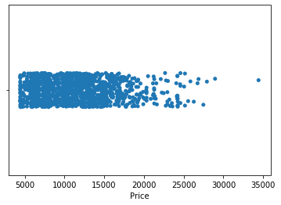
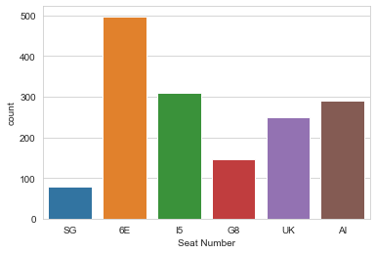

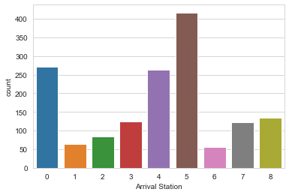
Data Visualization
we'll be checking the impact of each attribute on the 'Price' using distplot, countplot and barplot.

Slide 12
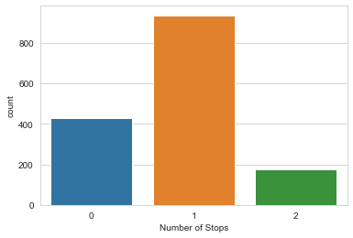
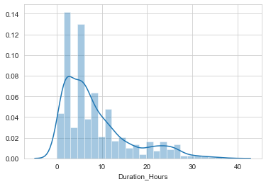
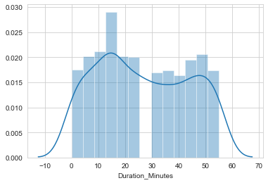
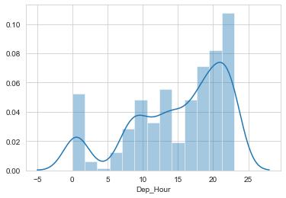
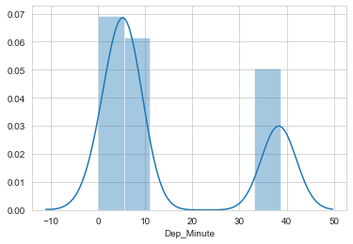
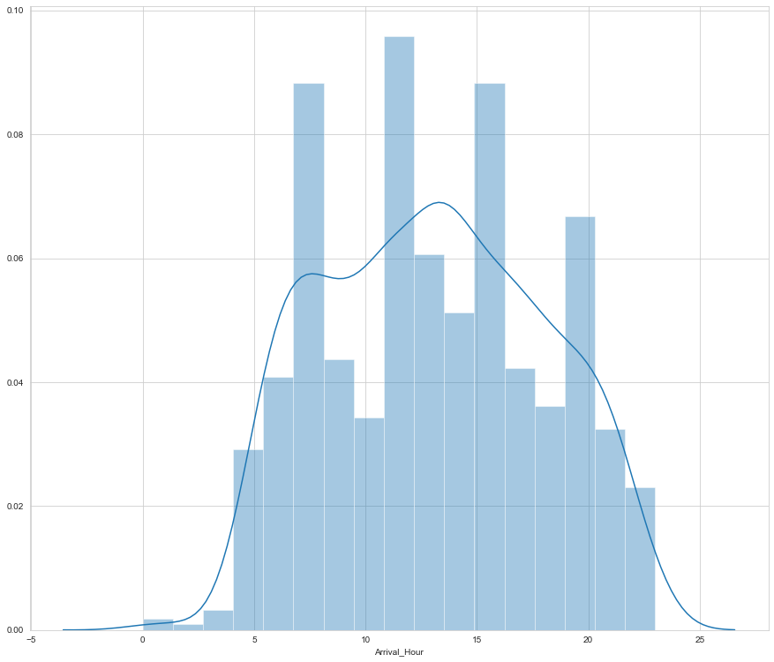

Slide 13
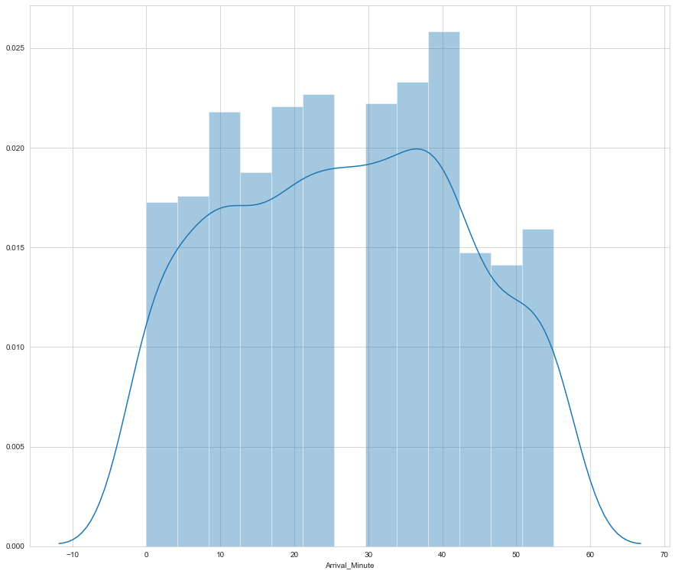
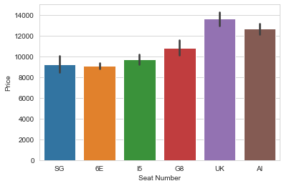

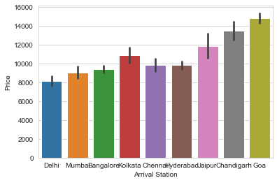
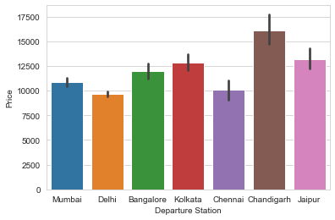
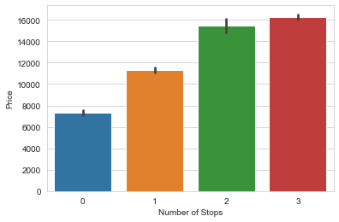

Slide 14
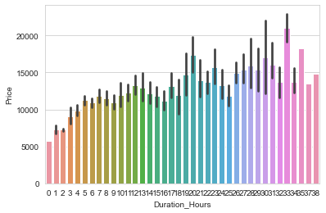
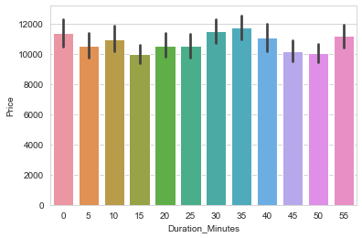
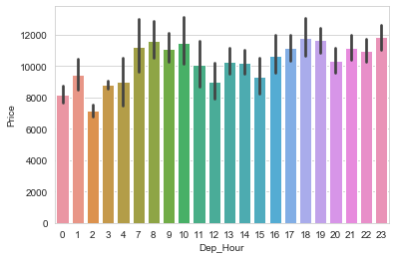
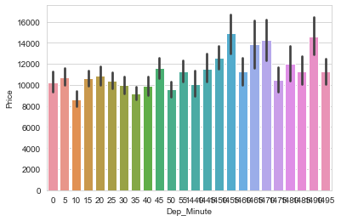
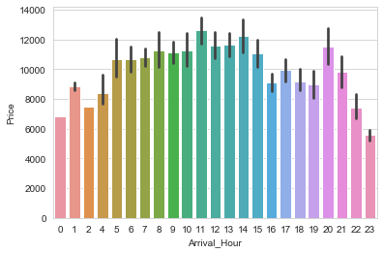
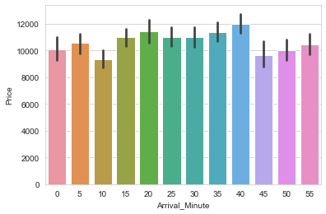

Slide 15

Checking Distribution/skewness
It can be observed that there is skewness present in : Duration_Hours , Dep_Minute
and Dep_Hour columns.

Slide 16
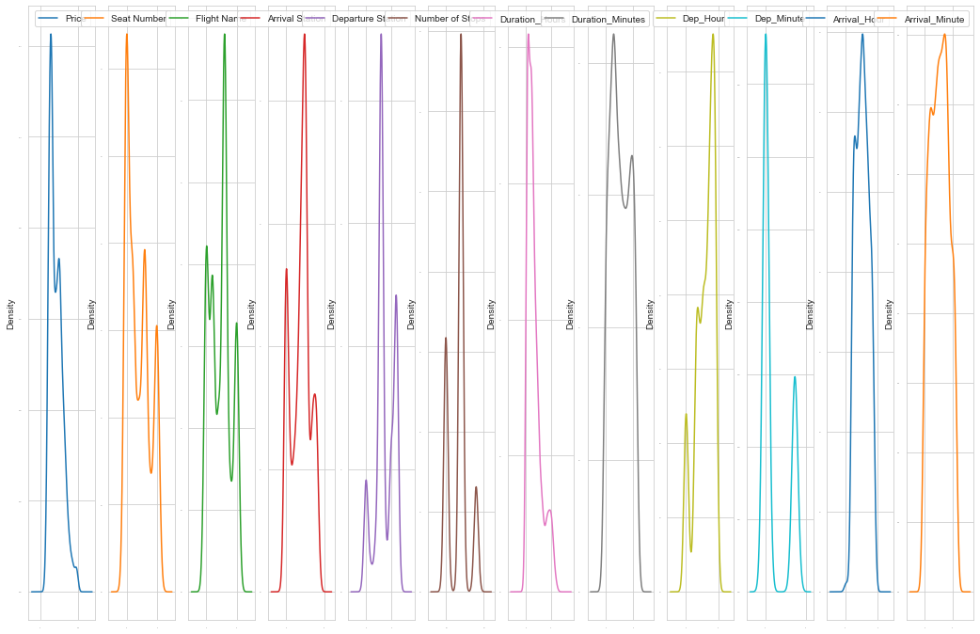

Slide 17
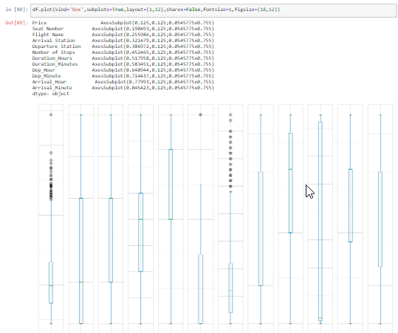
Plotting the outliers using boxplot

Slide 18
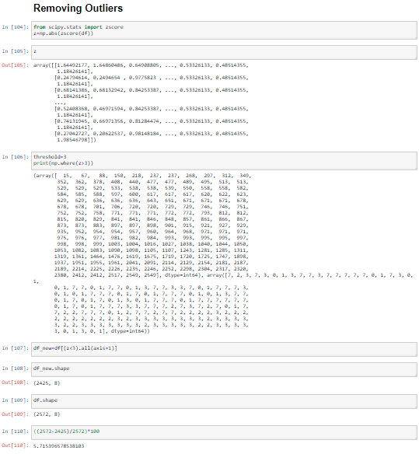
Removing the Outliers using Z-score

Slide 19
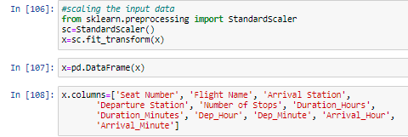
Model Training
Firstly, we will be splitting our dataset into input and output variable as x and y respectively.
Then, we will be scaling all our input variables using standard scalar.

Slide 20
Lastly, to develop the model we have used various libraries and metrics from sklearn such as train_test_split, LinearRegression,Lasso,Ridge,ElasticNet, SVR, DecisionTreeRegressor, KNeighborsRegressor, RandomForestRegressor, AdaBoostRegressor, mean_squared_error, mean_absolute_error and r2_score
Next, we will be splitting our data into training and testing with random_state=21 and test_size=0.22. Then we will be checking the shape of train and test data as follows:

Slide 21
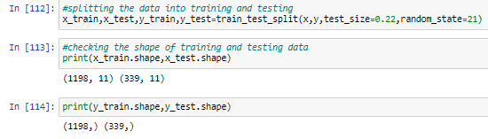
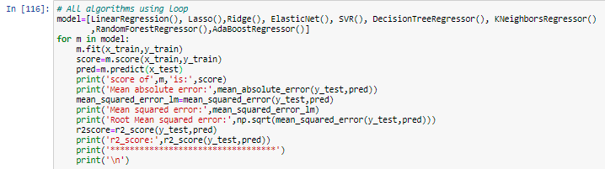
Now we will be using a loop where all the algorithms will be used one by one and their corresponding Score, Mean Absolute Error, Mean Squared Error, RMSE and r2_score will be evaluated.

Slide 22
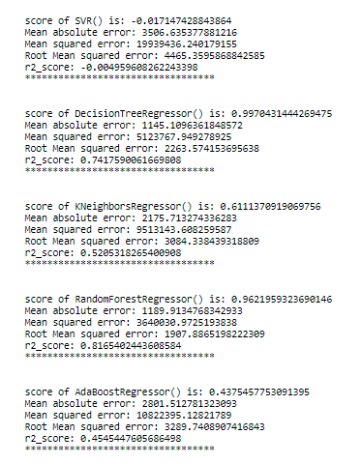
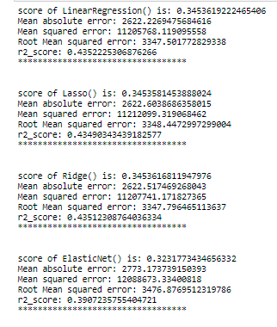
I am choosing DecisionTreeRegressor as our best model since it's giving us best score and it's performing well. It's r2_score is also satisfactory and it shows that our model is neither underfitting/overfitting.

Slide 23
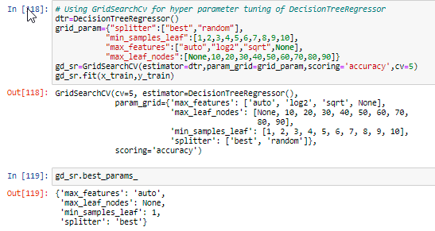
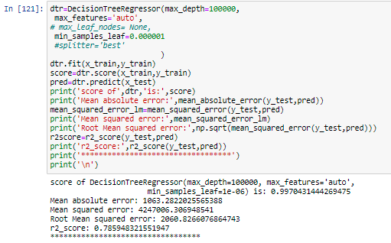

We have got 'max_features': 'auto', 'max_leaf_nodes': None, 'min_samples_leaf': 1 and 'splitter': 'best' as best parameters.
We are getting score 0.9970431444269475 after performing hyperparameter tuning and earlier it was 0.9970431444269475 Its r2_score is also satisfactory and after hyperparameter tuning mean squared error, mean absolute error and root mean squared error has also reduced.
Hence we will be saving DecisionTreeRegressor as our final model using joblib.

Slide 24
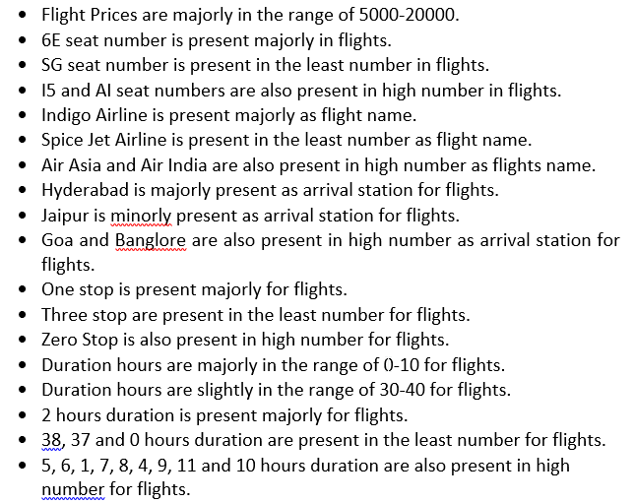
Conclusion

Slide 25
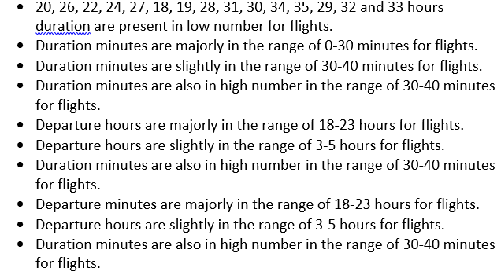

Slide 26
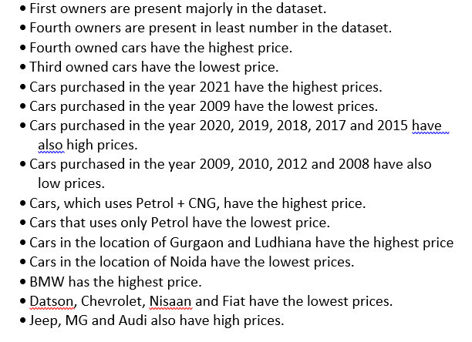
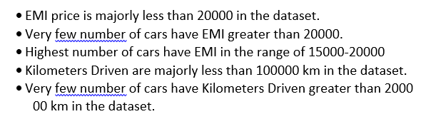

Slide 27
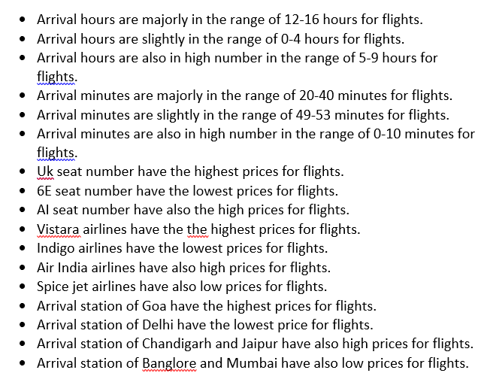

Slide 28
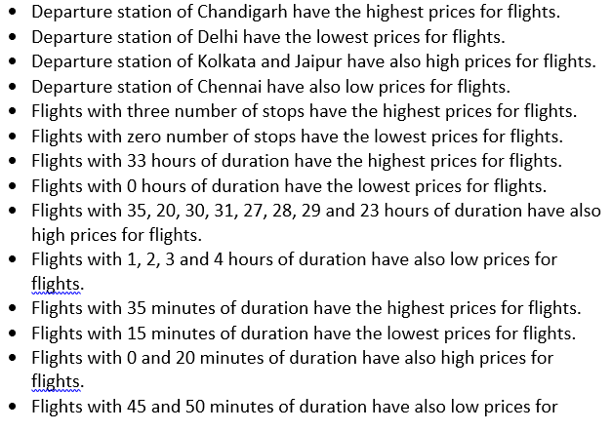

Slide 29
