Slide 1
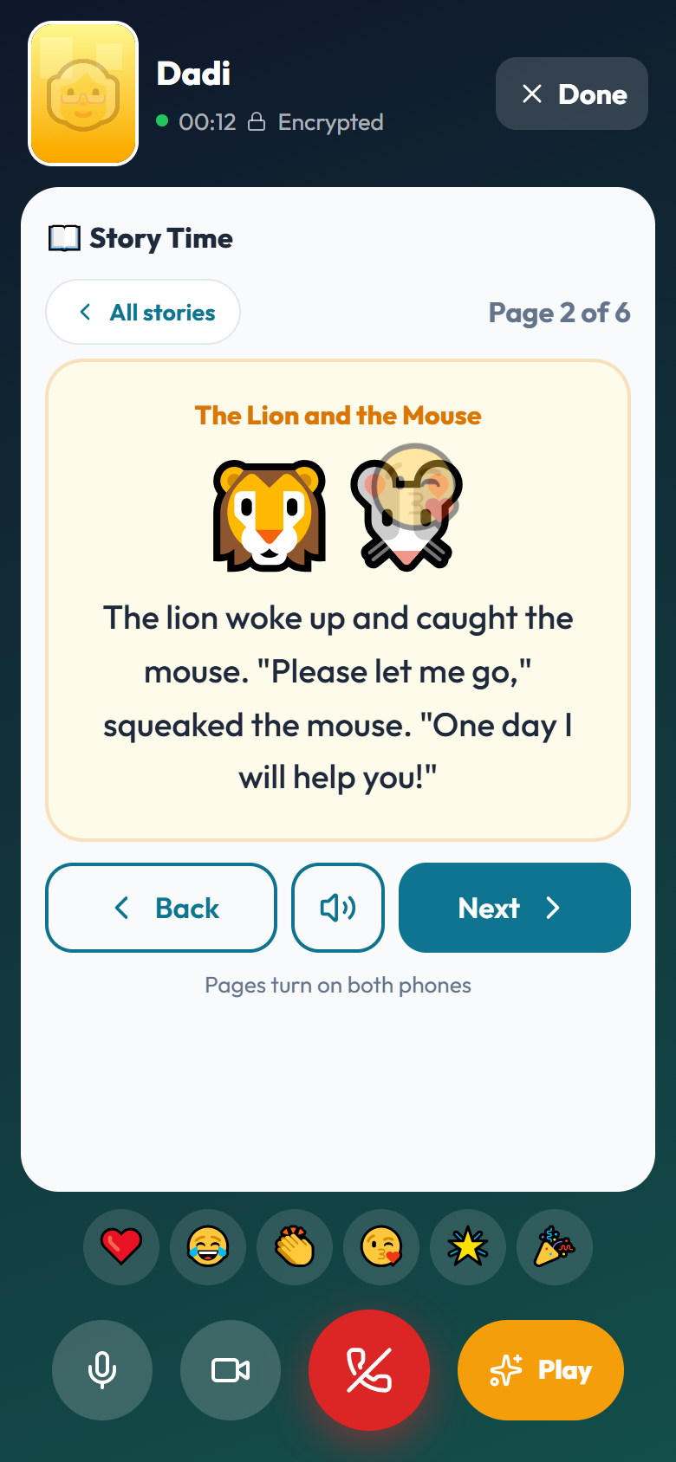
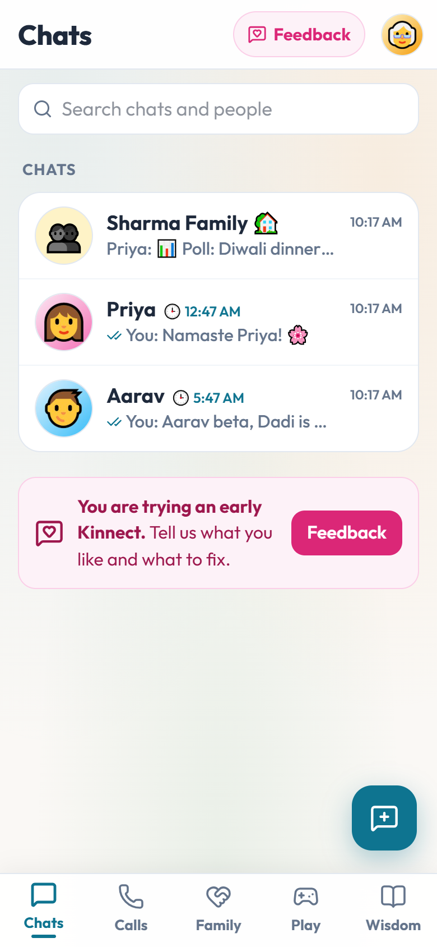
Kinnect
Bringing generations closer, across countries
A private family app where grandparents and grandchildren play, care and stay in touch — in their own language and their own time zone.
What makes us different · Beta 1.3
Notes:
Kinnect is a family app built around one idea: keeping grandparents and grandchildren close when the family is spread across countries. Everything shown in this deck is running in the current beta.

Slide 2



Families are spread across the world
Chat apps connect people. They were not designed to keep generations close.
Distance and time zones
Kids won't just talk on the phone
Apps are hard, and risky, for elders
It's 6 PM for Dadi and 1 AM for her son in Toronto. Families guess the right time to call, or give up.
A 7-year-old loses interest in a video call in two minutes. There is nothing to do together.
Small text, crowded screens and scam messages asking for OTPs and bank details.
Notes:
Three problems we heard from families: time zones make calling awkward, children need something to do on a call, and elderly parents find apps hard and are targets for scams.

Slide 3




Other apps connect people.
Kinnect connects generations.
Play together
Care for each other
Simple for every age
Private by design
Stories, drawing and games on the video call, on both screens.
Daily I'm OK, medicine reminders and SOS, shared with family.
Simple mode, big text, voice and read-aloud, in Indian languages.
End-to-end encrypted. No ads. Contacts never uploaded.
Notes:
Our positioning in one line. The four pillars are what the rest of the deck shows, feature by feature.

Slide 4
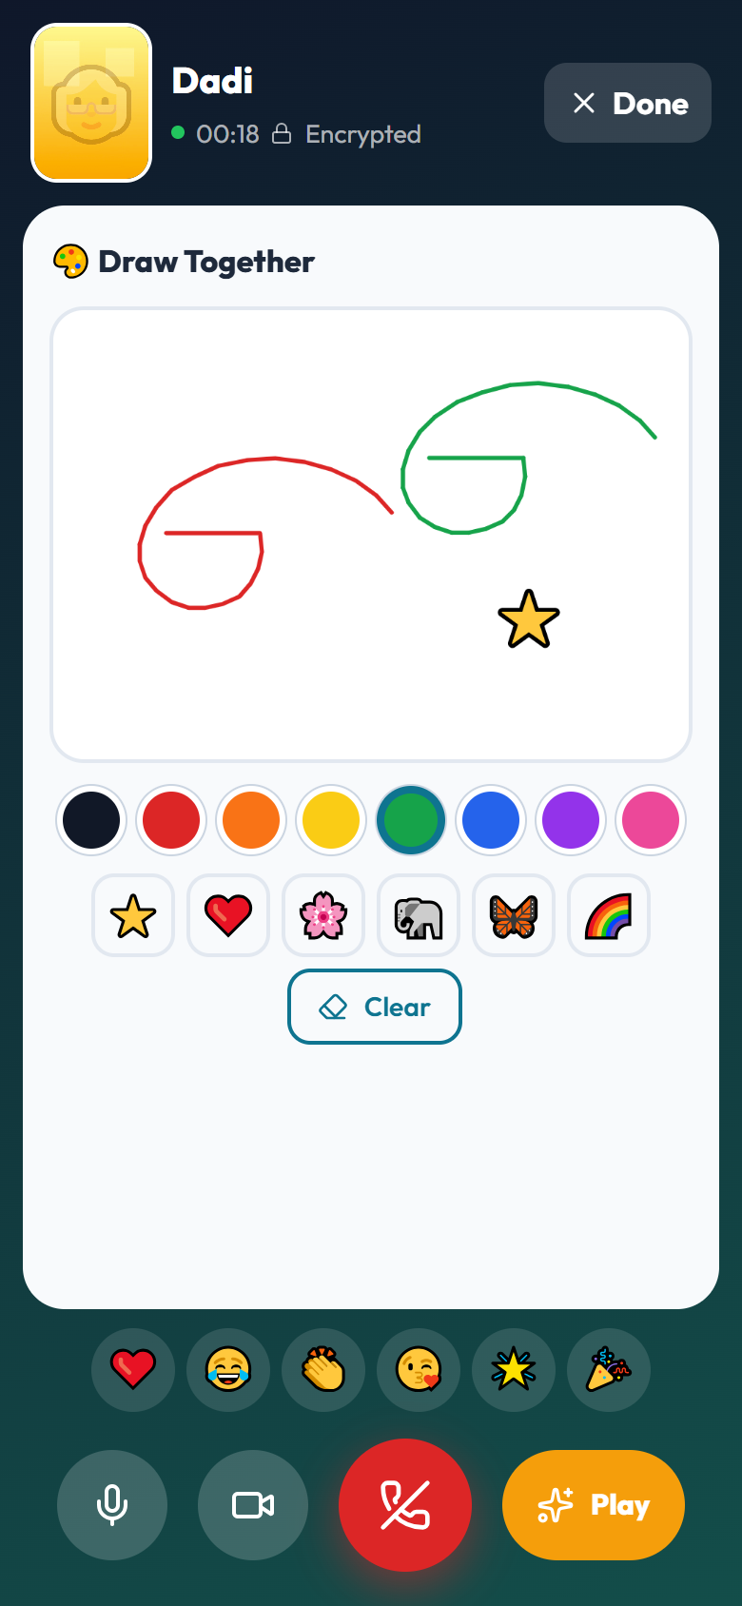


Play together on calls
Grandparents and grandchildren share the same story, drawing or game — on both screens, while they talk.
Story Time
Five illustrated tales. Either person turns the page; both screens follow. Read-aloud built in.
Draw, guess and play
Draw Together with stickers, Draw & Guess, Tic-Tac-Toe, Memory Match, Snakes & Ladders.
Watch together & festivals
A YouTube video in sync, and Light the Diyas for Diwali. Face stays visible the whole time.
Story Time on a call
Draw Together
Notes:
This is the heart of Kinnect. During a video call either person taps Play. Whatever they open appears on the other phone too, and every page turn, stroke or move is synced and encrypted. The grandparent stays on screen in a small video window.

Slide 5
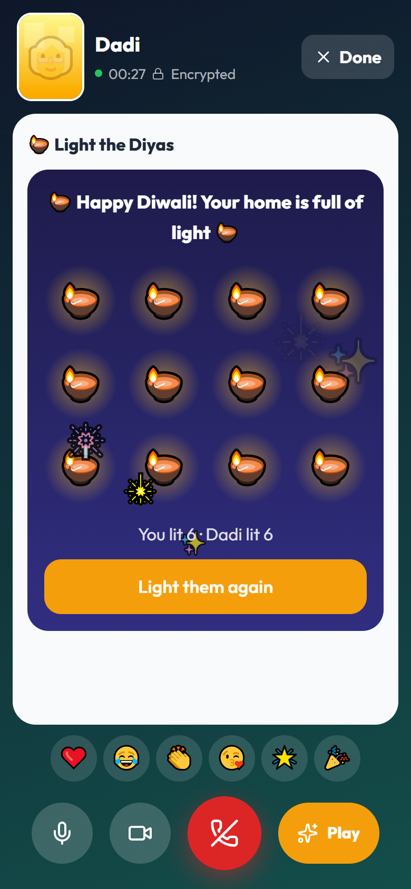
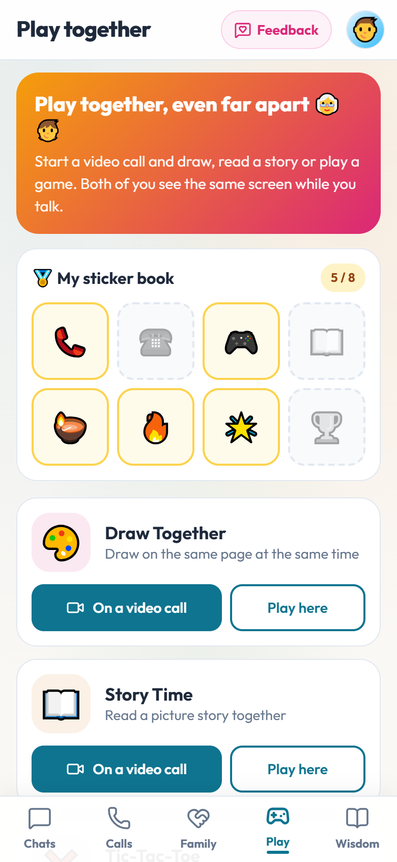


Kids want to call back
Small rewards turn "call Dadi" into something children ask for.
Sticker book
Stickers for the first call, playing together, listening to a story, lighting diyas.
Weekly call streaks
"4 weeks in a row with Dadi" shows next to each name on the Calls tab.
Grandma's voice, any time
Grandparents record bedtime stories; kids play them from the Story library.
Light the Diyas
Play tab & sticker book
Notes:
Engagement for children comes from play and small rewards: stickers, streaks, and hearing a grandparent read a story in their own voice even when they are asleep in another country.

Slide 6
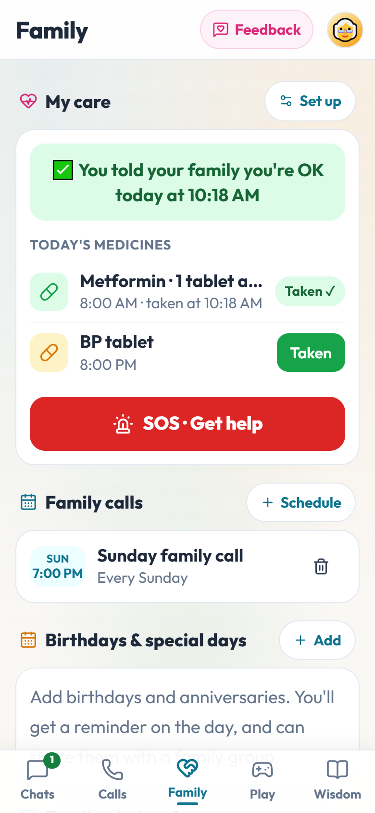
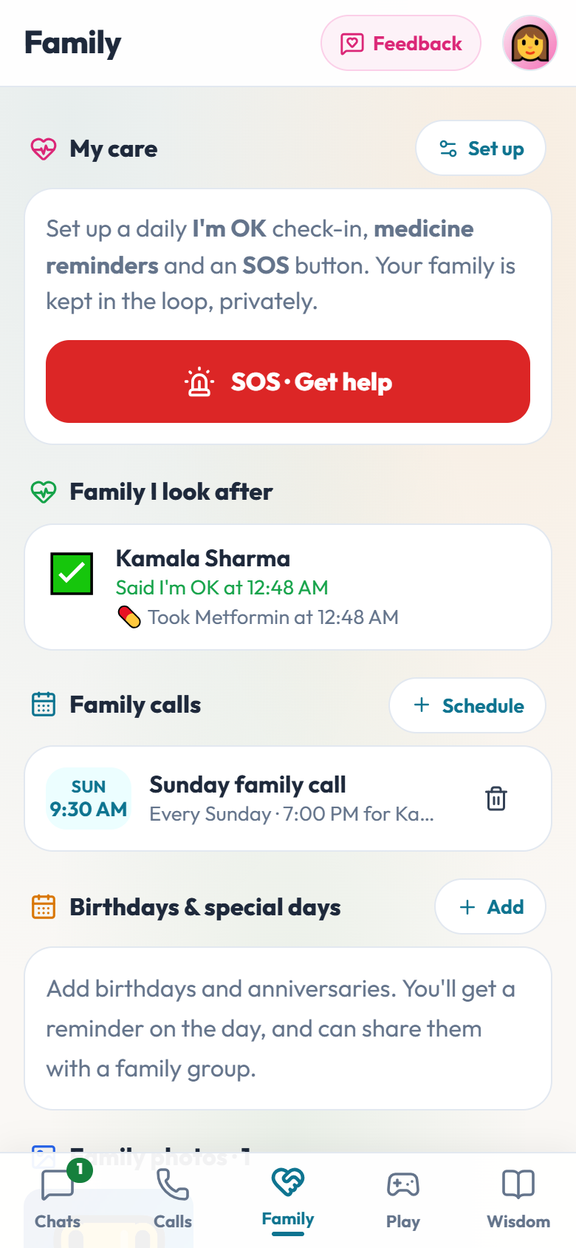
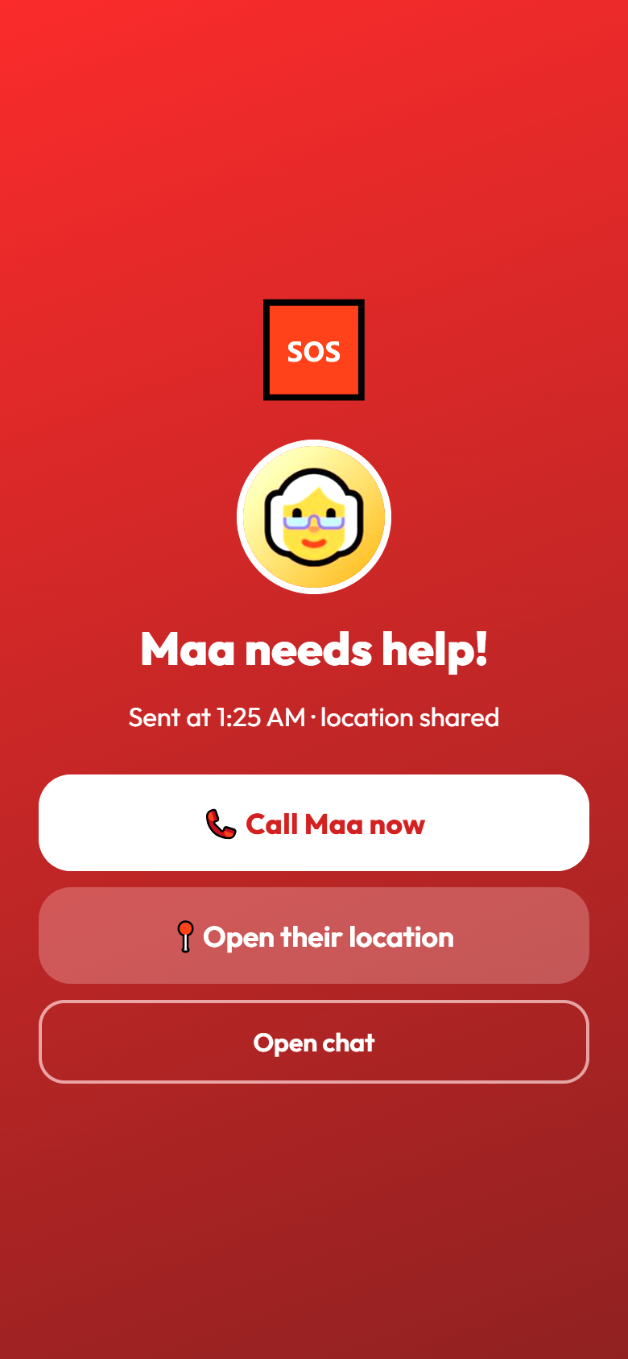

Care that works across oceans
Family can look after elders from anywhere — privately, without constant calls.
Daily I'm OK
Medicine reminders
SOS
One tap each morning. Chosen family sees it.
Reminders on the phone; the taken log is shared.
Sends location to family and calls the first contact.
Dadi: I'm OK + medicines
Priya sees it in Toronto
SOS with location
Notes:
Daily I'm OK check-in: one tap, and the chosen family members see it. If there is no check-in, caregivers are nudged. Medicine reminders run on the phone and the taken log is shared. SOS sends the location to chosen family and automatically calls the first contact; the alert steps aside while they talk.

Slide 7
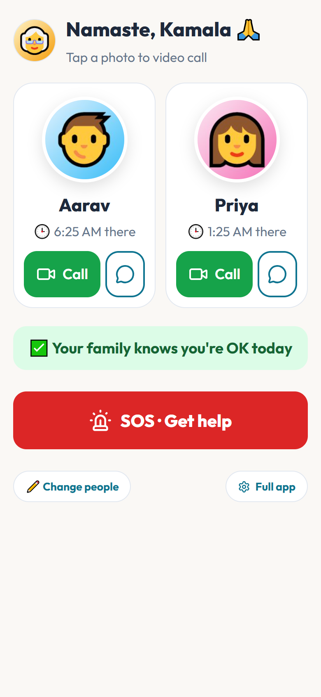
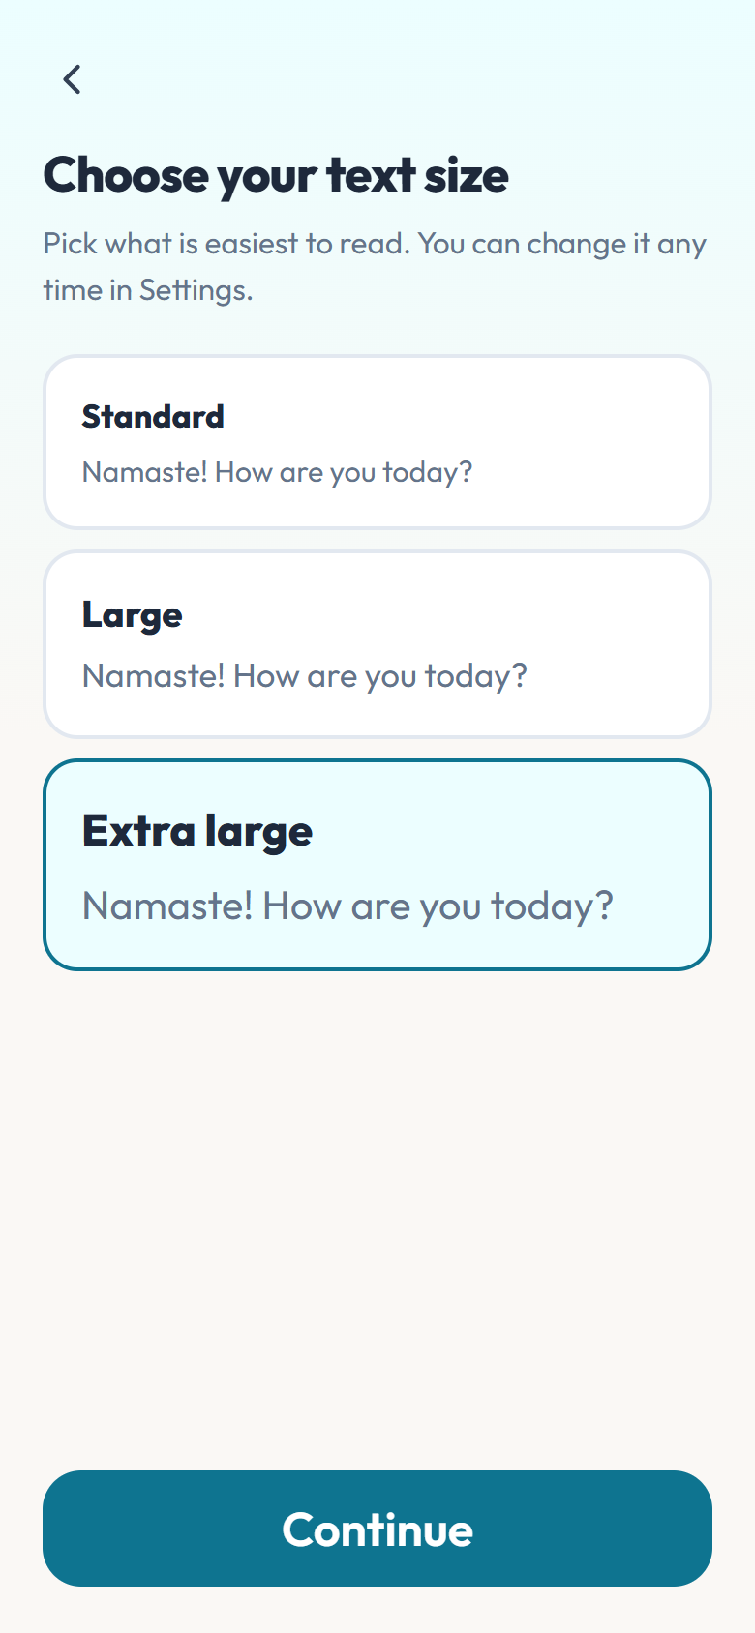
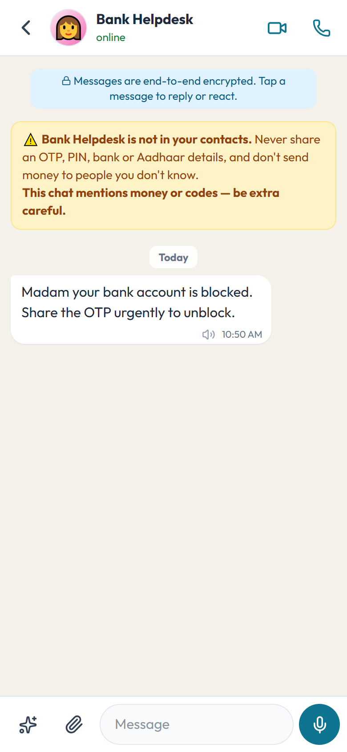



Built for grandparents
Every screen was designed for the oldest person in the family, not the youngest.
Simple mode
Big photos of favourite people. One tap to video call.
Voice first
Voice messages, read-aloud, Indian-language keyboard.
Their language
On-device translation: Hindi, Telugu, Tamil, Kannada and more.
Scam protection
Strangers asking for OTP or bank details trigger a warning.
Simple mode
Text size at sign-up
Scam warning
Notes:
Simple mode replaces the whole app with big photos and one-tap calls. Text size is chosen at sign-up with a live preview. Messages can be read aloud, voice messages replace typing, and translation runs on the phone so chats stay encrypted. Messages from strangers mentioning OTPs, banks or money show a warning.

Slide 8
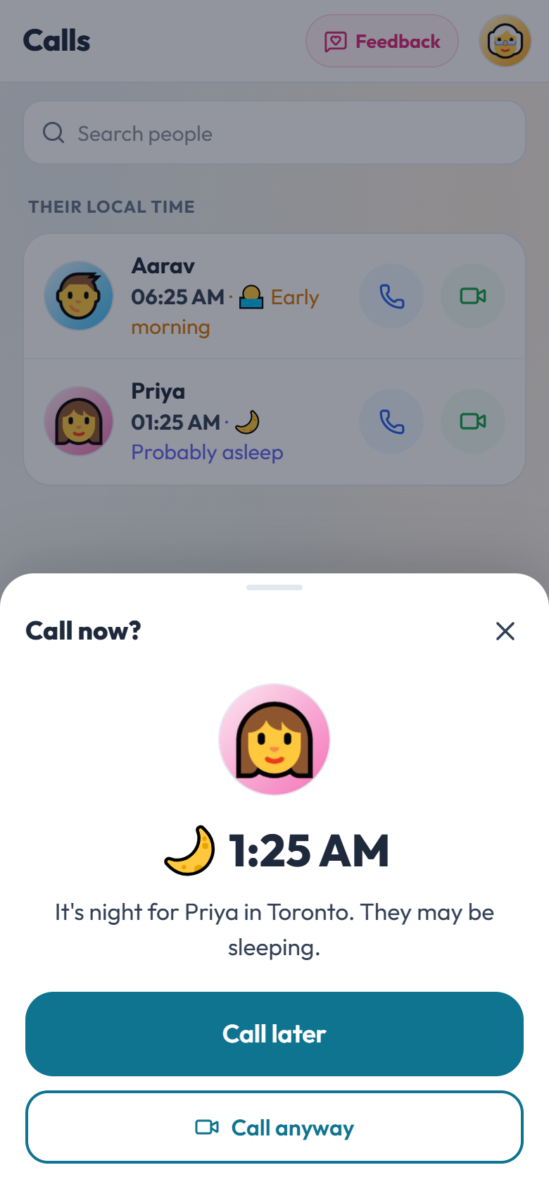
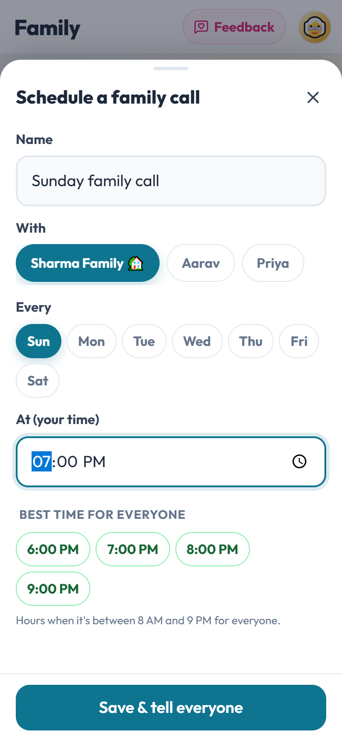


Time zones, handled
Nobody should need a world clock to call their mother.
Their time, right where you need it
Shown next to their name in chats and calls.
Late-night check
"It's 1:25 AM for Priya in Toronto" before the phone rings.
Scheduled family calls
Everyone is reminded in their own time; best hour suggested.
Late-night check
Best time for everyone
Notes:
Kinnect knows each person’s time zone. It shows their local time in the chat header and list, warns before calling someone at night, and schedules recurring family calls so each person is reminded in their own time. When scheduling, it suggests the hours when everyone is awake.

Slide 9
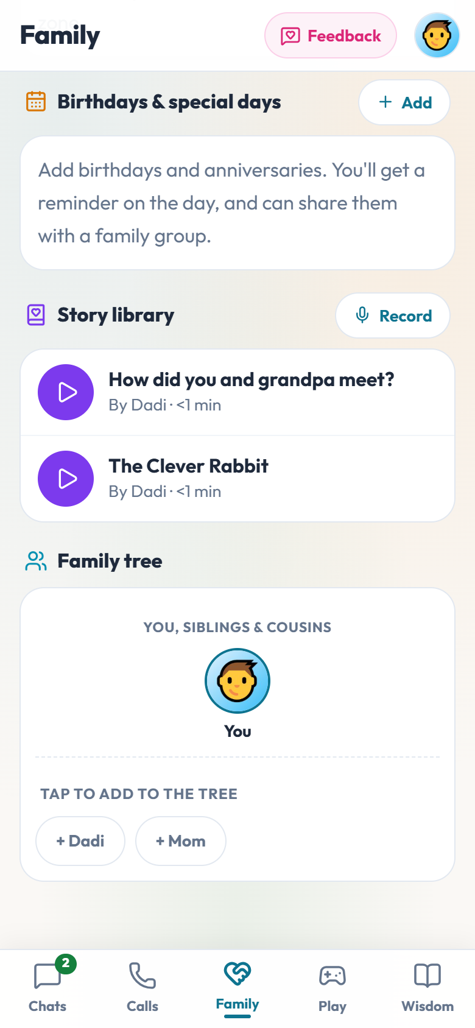
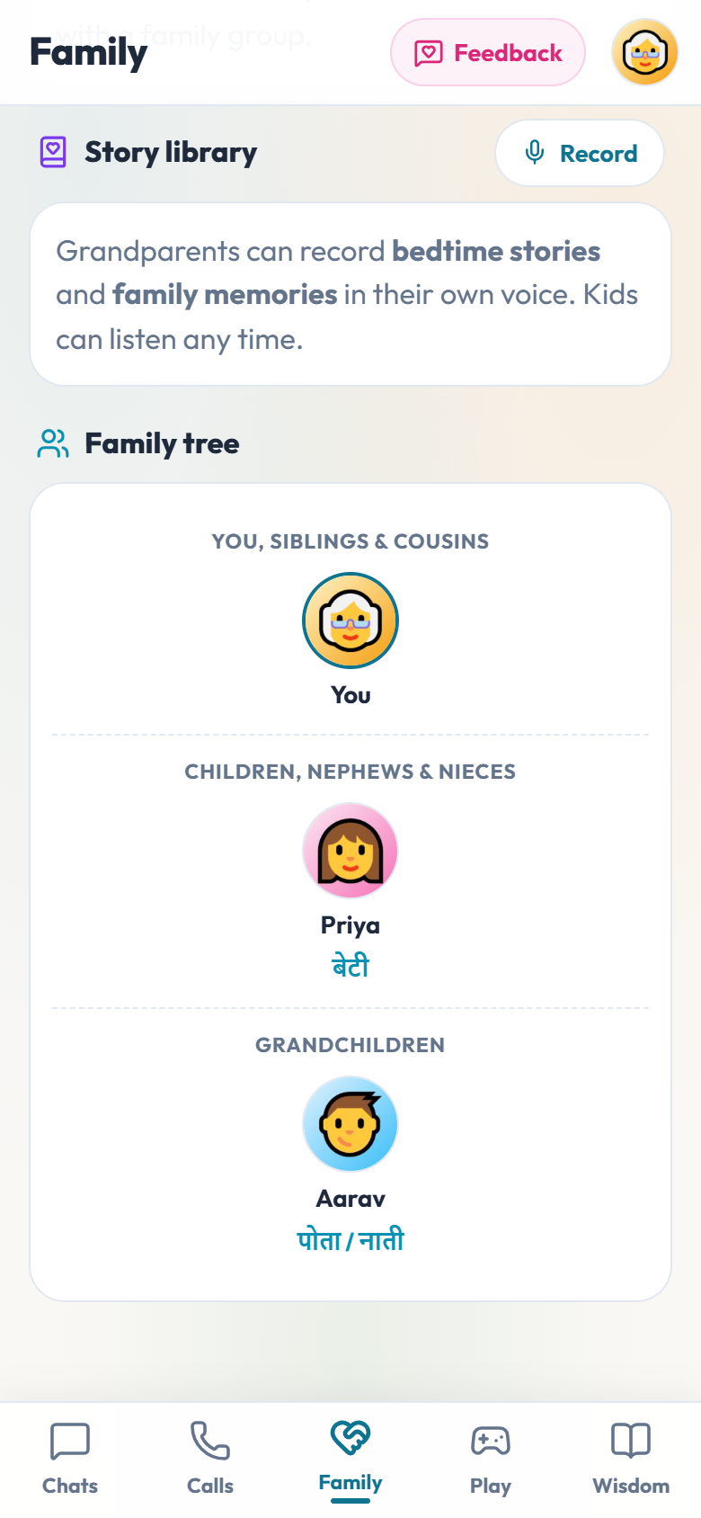

Family memories
Voices, stories and relationships that outlast any single chat.
Story library
Recorded bedtime stories and memory answers ("How did you meet grandpa?").
Family tree in our languages
दादी · నానమ్మ — children learn what to call every relative.
Photos, birthdays, anniversaries
Shared album with "On this day", reminders on the day.
Story library
Family tree
Notes:
Grandparents record stories and family memories with ready-made questions. The family tree labels each relative with Hindi and Telugu relation names, so children learn Dadi, Nani, Mama and Bua. Photos from all chats are gathered with On this day memories.

Slide 10
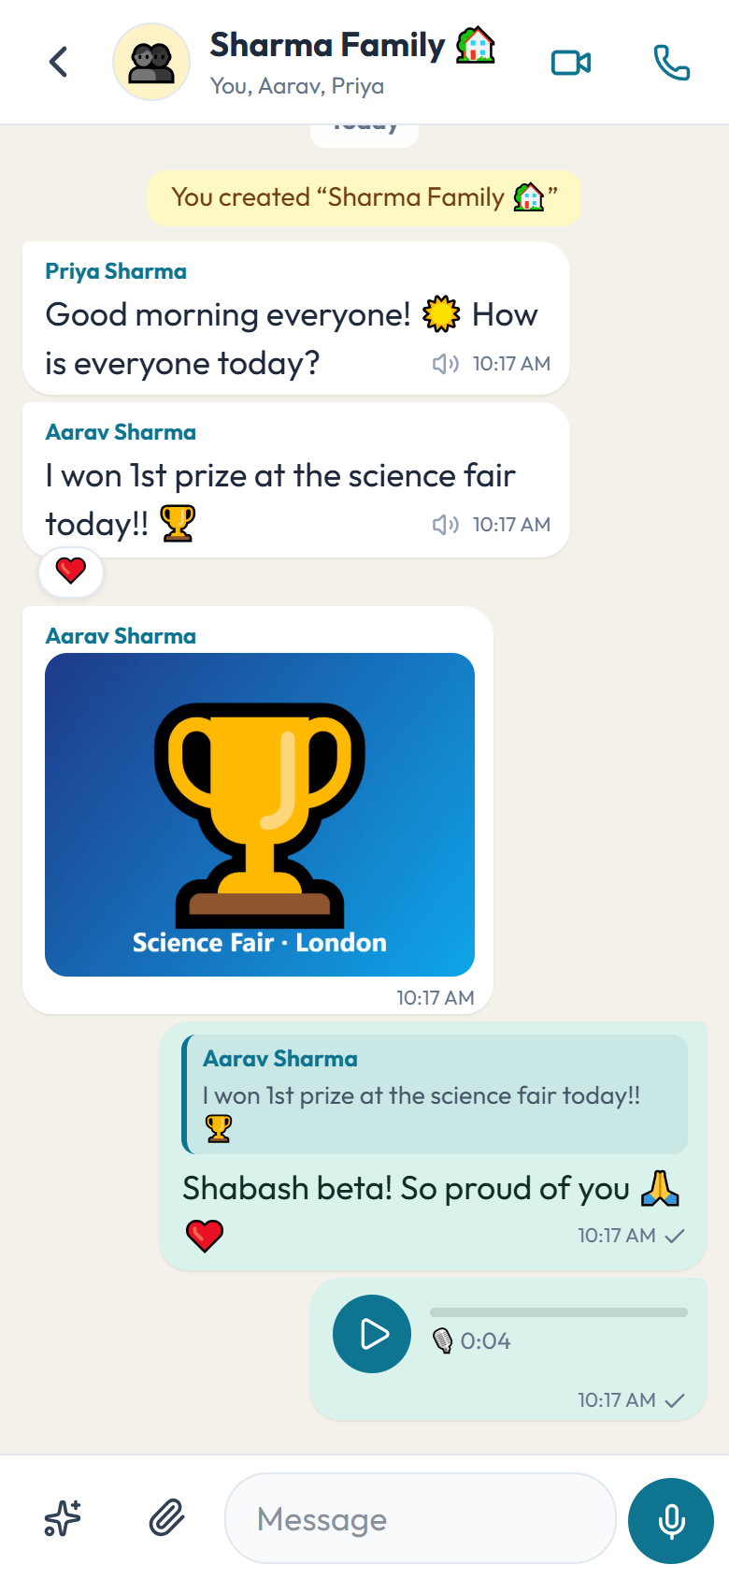
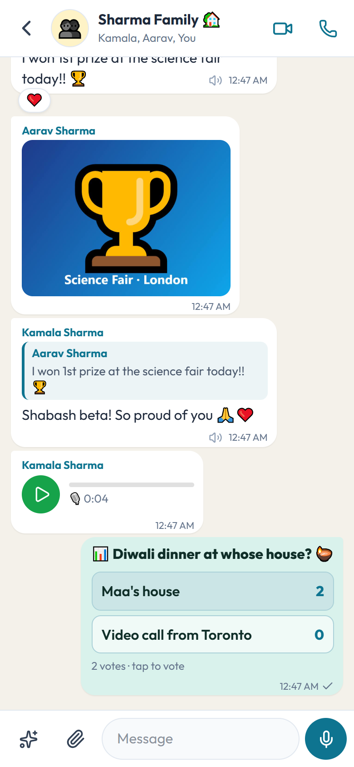
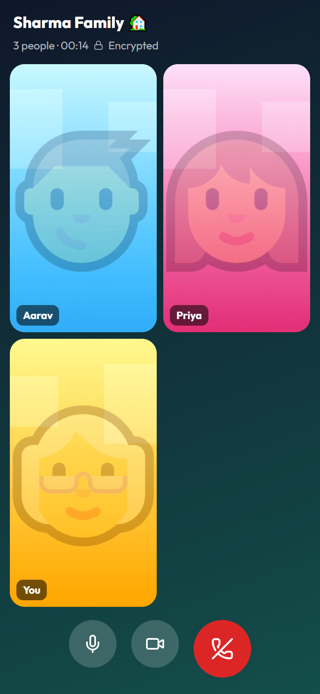
Everything families expect from a chat app
So nobody has to keep a second app for everyday messaging.
Chats, groups, photos, voice messages
Replies, reactions, delete for everyone
Typing, online and last seen (optional)
Group video calls for up to 4
Polls, shared lists, live location
Find family from your contacts or by QR
Encrypted backup to move to a new phone
Dark theme and save-data mode
Group chat
Polls & lists
Group video call
Notes:
Families will only move if everyday messaging is covered. Kinnect has the full set of chat basics, including group video calls, polls, shared lists, live location and encrypted backup.

Slide 11
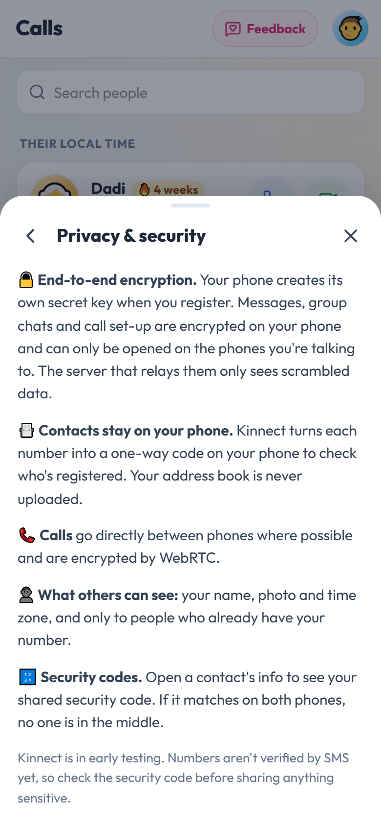


Private by design
Family conversations belong to the family.
End-to-end encrypted
Messages, photos, group chats and call set-up are encrypted on the phone. The relay only sees scrambled data.
Contacts stay on your phone
Numbers are turned into one-way codes on the phone to find family. Nothing is uploaded.
Security codes
Compare a code on both phones to be sure nobody is in the middle.
No ads, no data selling
Kinnect runs without paid servers, so there is nothing to sell.
Notes:
Every phone creates its own key. Chats are encrypted with ECDH and AES-GCM before leaving the phone; tests confirmed no readable message text on the relay. Phone contacts are hashed on the device. Honest caveat for the beta: phone numbers are not yet verified by SMS, so security codes are the safeguard.

Slide 12
What you only get with Kinnect
Built into the app, for families — not add-ons.
Feature | Kinnect | Typical chat apps
Chats, groups, photos, voice, video calls | ✓ | ✓
End-to-end encryption | ✓ | Most
Stories, drawing and games together on a call | ✓ | —
Daily I'm OK check-in and medicine reminders for family | ✓ | —
SOS that alerts family with location and calls them | ✓ | —
Local time + late-night warning before calling | ✓ | —
Simple mode for grandparents | ✓ | —
Recorded bedtime stories and a family tree in Indian languages | ✓ | —
Notes:
A deliberately conservative comparison: typical chat apps already do the basics well, and many are encrypted. What Kinnect adds is the family layer — playing together on calls, care, time zones and features for elders.

Slide 13


Built to run for free
No paid services — so it can stay free for families.
₹0
4
110+
monthly running cost today
people per group video call
automated checks across 2–4 test phones
On the phone
Android + web
Encryption, translation (Google ML Kit), reminders, backup — all on the device.
One code base: Android app and a browser version for any computer.
Direct calls
Tested end to end
Video goes phone-to-phone (WebRTC); a free public relay passes encrypted messages.
Every feature exercised between simulated phones before release.
Notes:
Running cost is effectively zero: encryption, translation, reminders and backup all run on the phone; calls are peer to peer; the relay is a free public service. The numbers: group calls up to four people, and over 110 automated checks run across two to four simulated phones.

Slide 14
What's next
Guided by feedback from our first testers.
1
2
3
4
Tester feedback
Notifications when closed
Kids' profile
Live subtitles on calls
Share the beta, collect feedback in the app, fix what matters most.
Free push notifications (Firebase) so messages arrive even when the app is shut.
A child account on a parent's tablet, with parent-approved contacts.
Translated captions, only if it can run free and on the phone.
Held back on purpose: Play Store listing ($25 once) and an iPhone app ($99 a year) wait until the no-paid-services rule is revisited. Until then: Android APK + web.
Notes:
Next steps in order. Feedback first; then push notifications when the app is closed (needs a small free sender); a kids profile; and live translated subtitles if it can be done on the phone for free. Play Store and iPhone releases are on hold because they cost money.

Slide 15
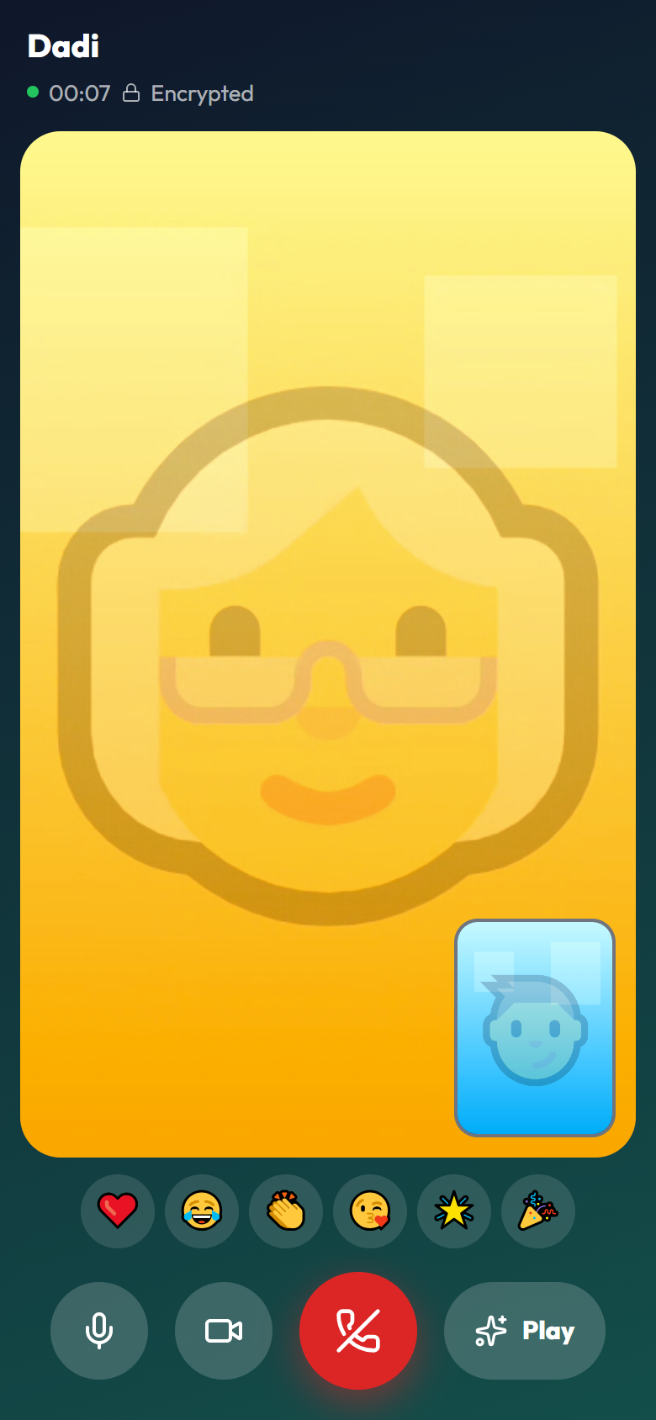
Every generation.
One family.
Try the Kinnect beta and tell us what you think — the Feedback button is on every screen.
Notes:
Close with the invitation: install the beta, use it with family for a week, and send feedback from the Feedback button.

