Slide 1
Artificial Intelligence

Slide 2
What is AI?
Intelligence:
“ability to learn, understand and think”
AI is the study of how to make computers make things which at the moment people do better.
Examples: Speech recognition, Smell, Face, Object, Intuition, Inferencing, Learning new skills, Decision making, Abstract thinking

Slide 3
AI Definitions
What is AI ?
A broad field and means different things to different people
Concerned with getting computers to do tasks that require
human intelligence
There are many tasks which we might reasonably think require intelligence which computers do without even thinking
However
There are many tasks that people do without thinking which are extremely difficult to automate
Complex Arithmetic
Recognizing a Face

Slide 4
AI Definitions
What is AI ?
Definitions organized into four categories
Think like human
The exciting new effort to make computers think … machines with minds, in the full and literal sense. [Haugeland 85].
Think Rationally
The study of the computations that make it possible to perceive, reason, and act. [Winston, 1992]
Act humanly
The study of how to make computers do things at which, at the moment, people are better. [Rich & Knight, 1991]
Act rationally
The branch of computer science that is concerned with the automation of intelligent behavior. [Luger and Stubblefield, 1993]

Slide 5
Think Like Human
The Cognitive Modeling approach
To develop a program that think like human , the way the human think should be known.
    Knowing the precise theory of mind ( how human think?) → expressing the theory as a computer program.
    GPS (General Problem Solver) [ by Newell & Simon, 1961]
      Were concerned with comparing the trace of its reasoning steps to traces of human subjects solving the same problem rather that correctly solve problems
Cognitive Science
Computer models from AI + Experimental techniques from psychology
→ Construction of human mind working theories

Slide 6
Act Like Human
The TURING Test Approach:
Alan Turing [1950] designed a test for intelligent behavior.
Ability to achieve human-level performance in all cognitive tasks,
sufficient to FOOL an interrogator.
A human (interrogator) interrogates (without seeing) two candidates
A and B (one is a human and the other is a machine).
Computer would need:
    Natural Language Processing → Communication.
    Knowledge Representation→store info before and during interrogation.
    Automated Reasoning→ answer questions and draw new conclusions.
    Machine learning→ adapt to new circumstances.

Slide 7
Think Rationally
The Law of Thought Approach
Aristotle and his syllogism ( right thinking) :
  always gave correct conclusions given correct premises
Socrates is a Man. %Fact
All men are Mortal. % Rule : if X is a Man then X is Mortal.
Therefore Socrates is Mortal. % Inference
These laws of thoughts initiated the field of LOGIC.
Two main obstacles
  Not easy to translate an informal knowledge into a formal logic.
  It is usually the case that (say medium-size) problems
  can exhaust the computational power of any computer.
  Thus the need for heuristics.

Slide 8
Act Rationally
The Rational Agent Approach
An agent is something that perceives and acts
Laws of thought → correct inference
Making correct inferences is part of being rational agent
Act rationally = reason logically to the conclusion
act on that conclusion
Correct inference is not always == rationality
e.g. reflex actions ( acting rationally without involving inference)
Two main advantages
  More general than “the laws of thought”( a mechanism to achieve rationality)
  More amenable to scientific development than approaches based on [human] behavior/thought.

Slide 9
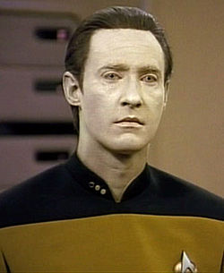
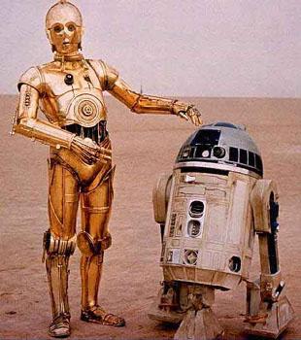
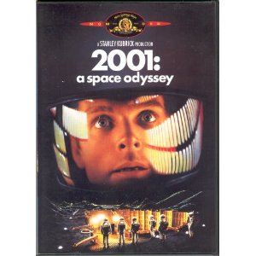


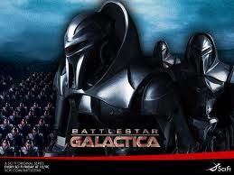
Artificial Intelligence in the Movies

Slide 10
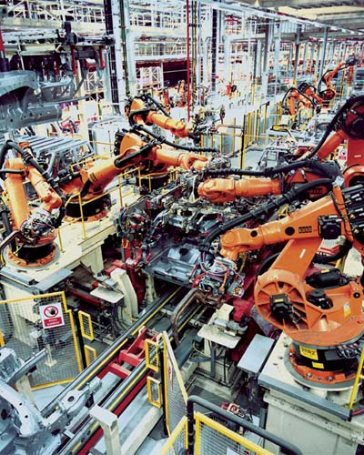
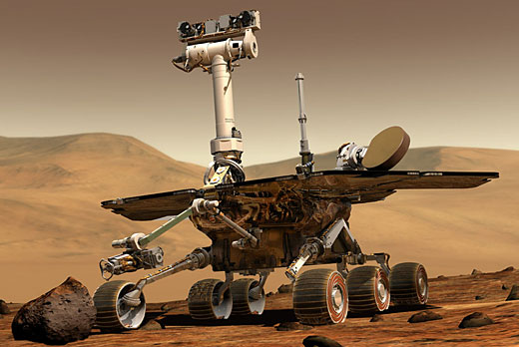
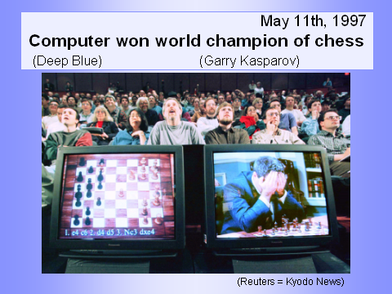
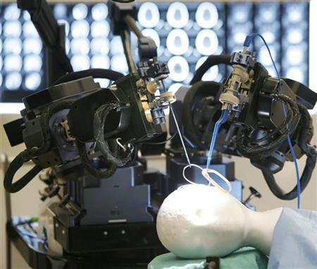
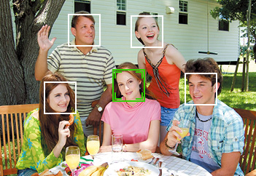
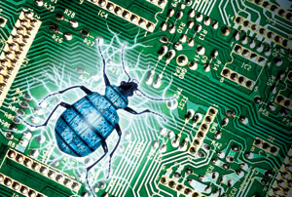
Artificial Intelligence in Real Life
  Exciting and dynamic field, lots of uncharted territory left
  Impressive success stories
  “Intelligent” in specialized domains
  Many application areas
Face detection
Formal verification

Slide 11
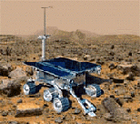

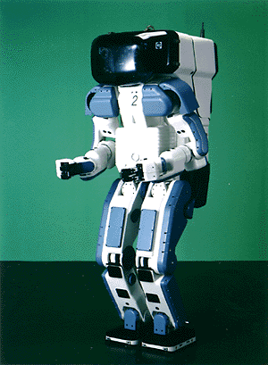

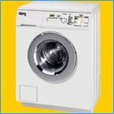
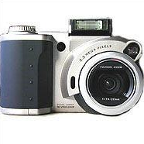

Why the interest in AI?
Search engines
Science
Medicine/
Diagnosis
Labor
Appliances
What else?

Slide 12
Typical AI Problems
Mundane tasks which people can do
very easily ( understanding language)
AI tasks involve both :
Expert tasks that require specialist
knowledge ( medical diagnosis)

Slide 13
Task Domains of AI
Mundane Tasks:
  Perception
    Vision
    Speech
  Natural Languages
    Understanding
    Generation
    Translation
  Common sense reasoning
  Robot Control
Formal Tasks
  Games : chess, checkers etc
  Mathematics: Geometry, logic, Proving properties of programs
Expert Tasks:
  Engineering ( Design, Fault finding, Manufacturing planning)
  Scientific Analysis
  Medical Diagnosis
  Financial Analysis

Slide 14
Typical AI Problems
Mundane tasks correspond to the following AI problems areas:
Planning : The ability to decide on a good sequence of actions to achieve our goals
Vision : The ability to make sense of what we see
Robotics: The ability to move and act in the world, possibly responding to new perceptions
Natural Language: The ability to communicate with others in any human language

Slide 15
Typical AI Problems
Experts tasks (require specialized skills and training) include :
Medical diagnosis
Equipment repair
Computer configuration
Financial planning
Mundane tasks are generally much harder to automate
AI is concerned with automating both mundane and expert tasks.

Slide 16
The Foundations of AI
Philosophy (423 BC − present):
− Logic, methods of reasoning.
− Mind as a physical system.
− Foundations of learning, language, and rationality.
Mathematics (c.800 − present):
− Formal representation and proof.
− Algorithms, computation, decidability, tractability.
− Probability.

Slide 17
The Foundations of AI
Psychology (1879 − present):
− Adaptation.
− Phenomena of perception and motor control.
− Experimental techniques.
Linguistics (1957 − present):
− Knowledge representation.
− Grammar.

Slide 18
A Brief History of AI
The gestation of AI (1943 − 1956):
− 1943: McCulloch & Pitts: Boolean circuit model of brain.
− 1950: Turing’s “Computing Machinery and Intelligence”.
− 1956: McCarthy’s name “Artificial Intelligence” adopted.
Early enthusiasm, great expectations (1952 − 1969):
− Early successful AI programs:
Newell & Simon’s Logic Theorist, Gelernter’s Geometry
Theorem Prover.
− Robinson’s complete algorithm for logical reasoning.


Slide 19
A Brief History of AI
A dose of reality (1966 − 1974):
− AI discovered computational complexity.
− Neural network research almost disappeared after
Minsky & Papert’s book in 1969.
Knowledge-based systems (1969 − 1979):
− 1969: DENDRAL by Buchanan
− 1976: MYCIN by Shortliffle.
− 1979: PROSPECTOR by Duda



Slide 20
A Brief History of AI
AI becomes an industry (1980 − 1988):
− Expert systems industry booms.
− 1981: Japan’s 10-year Fifth Generation project.
The return of NNs and novel AI (1986 − present):
− Mid 80’s: Back-propagation learning algorithm reinvented.
− Expert systems industry busts.
− 1988: Resurgence of probability.
− 1988: Novel AI (ALife, GAs, Soft Computing)
− 1995: Agents everywhere.
− 2003: Human-level AI back on the agenda.

Slide 21
AI Technique
Intelligence requires Knowledge
Knowledge possesses less desirable properties such as:
  Voluminous
  Hard to characterize accurately
  Constantly changing
  Differs from data that can be used
AI technique is a method that exploits knowledge that should be represented in such a way that:
  Knowledge captures generalization
  It can be understood by people who must provide it
  It can be easily modified to correct errors.
  It can be used in variety of situations

Slide 22
Overview of AI application areas

Slide 23
AI application areas
Game Playing
  Much of the early research in state space search was done using common board games such as checkers, chess, and the 15-puzzle
  Games can generate extremely large search spaces. Theses are large and complex enough to require powerful techniques for determining what alternative to explore

Slide 24
AI application areas
Automated reasoning and Theorem Proving
  Theorem-proving is one of the most fruitful branches of the field
  Theorem-proving research was responsible in formalizing search algorithms and developing formal representation languages such as predicate calculus and the logic programming language

Slide 25
AI application areas
Expert System
  One major insight gained from early work in problem solving was the importance of domain-specific knowledge
  Expert knowledge is a combination of a theoretical understanding of the problem and a collection of heuristic problem-solving rules

Slide 26
AI application areas
Expert System
  Current deficiencies:
    Lack of flexibility; if human cannot answer a question immediately, he can return to an examination of first principle and come up something
    Inability to provide deep explanations
    Little learning from experience

Slide 27
AI application areas
Natural Language Understanding and Semantics
  One of the long-standing goals of AI is the creation of programming that are capable of understanding and generating human language

Slide 28
AI application areas
Modeling Human Performance
  Capture the human mind (knowledge representation)

Slide 29
AI application areas
Robotics
  A robot that blindly performs a sequence of actions without responding to changes or being able to detect and correct errors could hardly considered intelligent
  It should have some degree of sensors and algorithms to guild it

Slide 30
AI application areas
Machine Learning
  Learning has remained a challenging area in AI
  An expert system may perform extensive and costly computation to solve a problem; unlike human, it usually don’t remember the solution

Slide 31
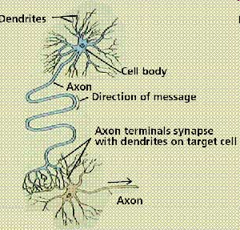
AI application areas
Alternative representations
  Neural Networks
  Genetic Algorithm

