Slide 1
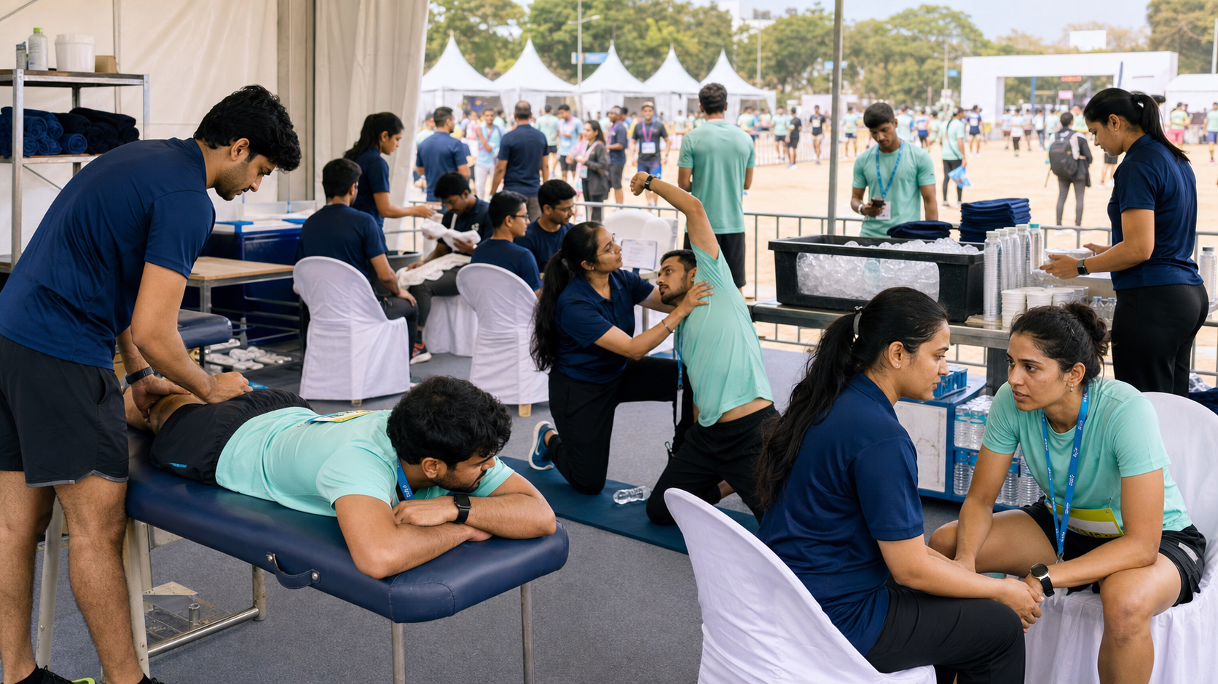

PROPOSED
01
GETYOURPHYSIO.IN × HYROX MUMBAI
H Y R O X
PHYSIOTHERAPY & ATHLETE RECOVERY
M U M B A I
DEPLOYMENT PLAN
17–20 SEPT 2026
NESCO CENTRE
Healing at your doorstep.
PROPOSED TEAM
TEAM COMPOSITION & DEPLOYMENT
✓
10–14 Sports Physiotherapists deployed across the event
ROLE
DEPLOYMENT
Senior Physiotherapy Leads
2
✓
2 Senior Physiotherapy Leads for clinical supervision & coordination
Sports Physiotherapists
10–14
✓
Dedicated Operations Coordinator for smooth execution
Event Operations Coordinator
1
✓
Deployment across active shifts and operating hours
TOTAL PROPOSED TEAM
13–17
✓
Uniformed, professional and athlete-focused recovery team
* Final strength aligned with athlete footfall, recovery-zone capacity and operating hours.
EVENT EXPERIENCE
FF
MR
RZ
SP
OP
Functional
Fitness
Marathons &
Endurance
Athlete
Recovery Zones
Sports
Physiotherapy
Organised Team
Proven Execution
Structured deployment for efficient athlete flow, clinical supervision and seamless event coordination.

Slide 2
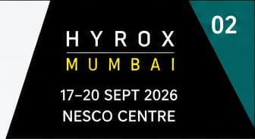

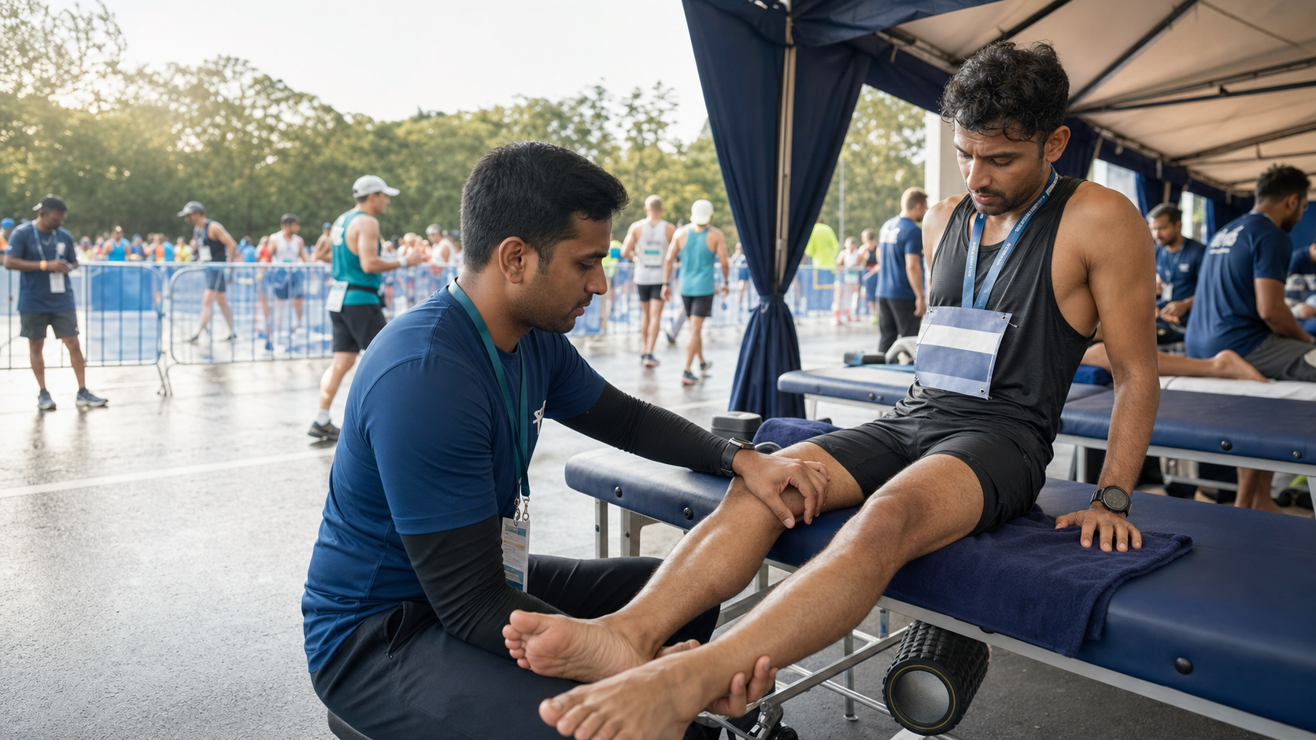
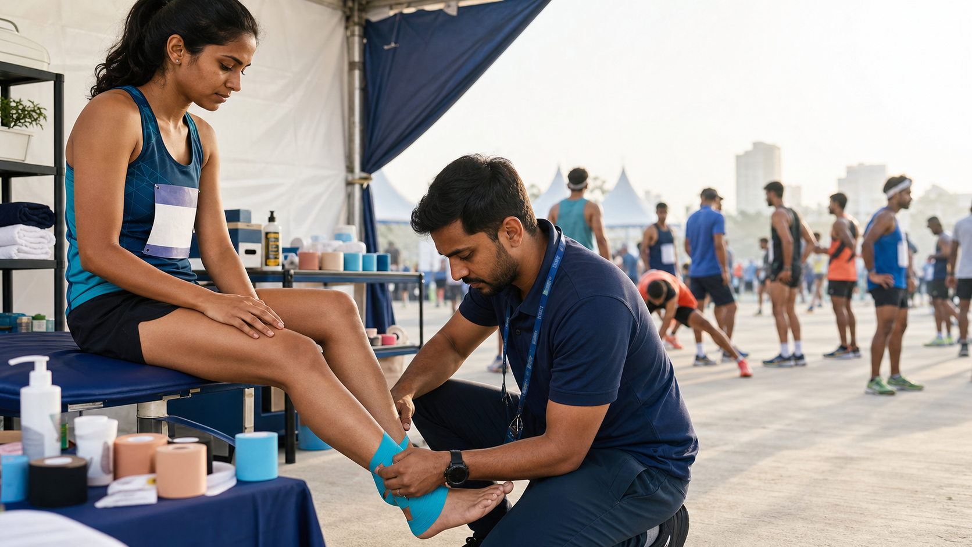
PROPOSED
02
PROPOSED
GETYOURPHYSIO.IN × HYROX MUMBAI
PHYSIOTHERAPY & ATHLETE RECOVERY
GetYourPhysio.in
Healing at your doorstep.
ATHLETE RECOVERY EXPERIENCE
1
→
2
→
3
→
4
→
5
ARRIVAL
QUICK ASSESSMENT
RECOVERY
REASSESSMENT
EXIT / REFERRAL
Athlete check-in
& guidance
Rapid screening &
needs assessment
Targeted recovery
interventions
Post-treatment review
& guidance
Safe exit or escalation
when required
SERVICES WE PROVIDE
EQUIPMENT & RECOVERY SETUP
01
PRE / POST-RACE SUPPORT
TT
MG
CUP
DN
• Rapid screening & mobility assessment
• Assisted stretching & dynamic recovery
Treatment
Tables
Massage
Guns
Cupping
Equipment
Dry Needling
Equipment
• Mobility guidance
RECOVERY INTERVENTIONS
ASSESS • TRIAGE • SUPPORT
RB
MT
FR
TB
02
• Manual / soft-tissue techniques
Resistance
Bands
Mobility
Tools
Foam
Rollers
Therapy
Balls
• Joint and muscle mobility
• Cupping / dry needling when indicated
CLINICAL SUPPORT
H/C
SAN
CON
DOC
03
• Identify athletes needing medical attention
Hot / Cold
Supplies
Sanitisation
Supplies
Clinical
Consumables
Assessment
Material
• Appropriate escalation / referral
RECOVER • MOBILISE • RETURN
• Hygiene, safety & clear communication
SAFE, EFFICIENT AND PROFESSIONAL ATHLETE SUPPORT — FROM ARRIVAL TO RECOVERY OR REFERRAL.
✓
✓
✓
✓
SAFE
PROFESSIONAL
ATHLETE-FIRST
EFFICIENT
GETYOURPHYSIO.IN • HYROX MUMBAI • PROPOSED RECOVERY ZONE

Slide 3
PROPOSED
03
GETYOURPHYSIO.IN × HYROX MUMBAI
H Y R O X
PHYSIOTHERAPY & ATHLETE RECOVERY
M U M B A I
PLAN OF ACTION
17–20 SEPT 2026
NESCO CENTRE
Healing at your doorstep.
01
STAGE
02
STAGE
03
STAGE
04
STAGE
BEFORE THE EVENT
DURING THE EVENT
ATHLETE EXPERIENCE
AFTER THE EVENT
Team selection & briefing
Dedicated recovery stations
Efficient athlete movement
Team debrief
Role and shift allocation
Athlete assessment & triage
Minimised waiting time
Recovery-zone utilisation summary
Equipment / consumables checklist
Efficient treatment workflow
Consistent recovery support
Athlete feedback where available
Recovery-zone setup planning
Team-lead supervision
Clear athlete communication
Operational observations
Coordination with HYROX team
Event-management coordination
Athlete-first approach
Recommendations for future events
Clinical & escalation protocols
Hygiene & equipment control
Referral when required
Basic documentation
OUR OBJECTIVE
Deliver a professionally managed athlete recovery experience that integrates seamlessly into the HYROX event environment.
GetYourPhysio.in • Expert Physiotherapy • Sports Recovery • Event Support

