Slide 1
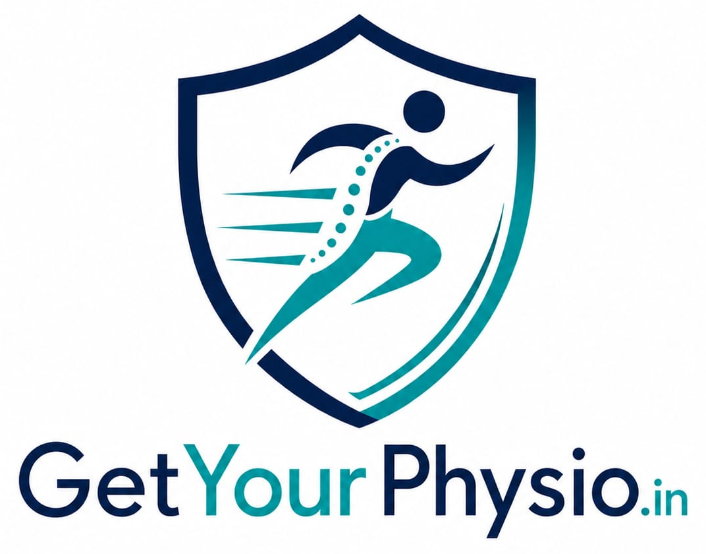
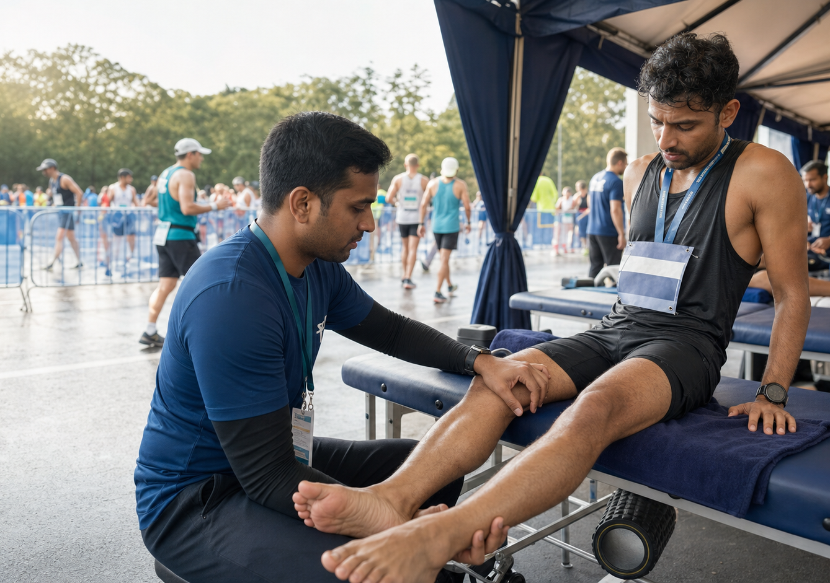
OFFICIAL PARTNER PROPOSAL
Official Recovery
Partner Proposal
PREPARED FOR
HYROX
Presented by Dr. Kandarp Sharma (PT)
Sports Physiotherapist
HEALING AT YOUR DOORSTEP
PRE-EVENT PREPARATION • RACE-DAY RECOVERY • REHABILITATION
GetYourPhysio.in • Gurugram

Slide 2
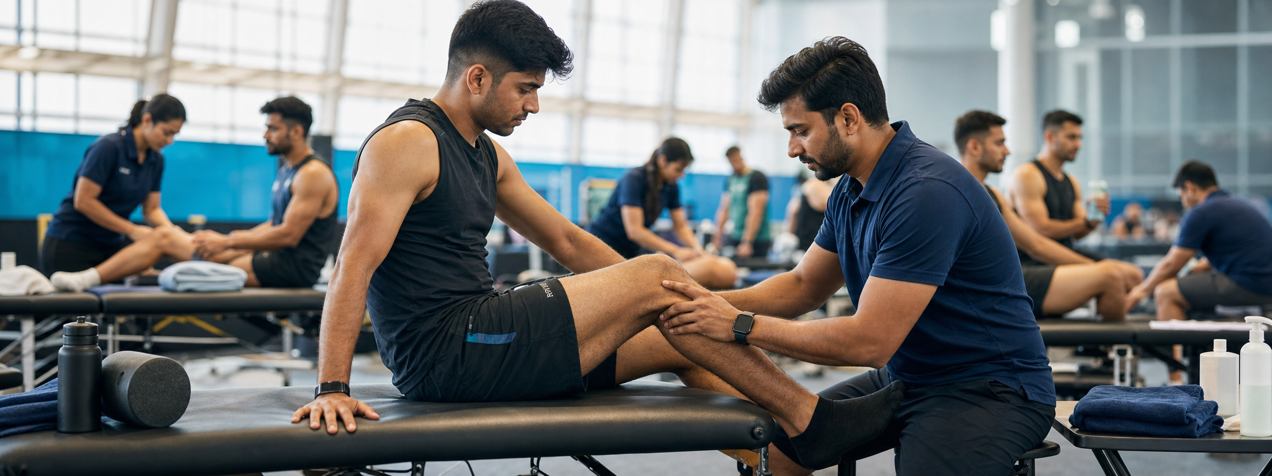
ABOUT GETYOURPHYSIO.IN
More than physiotherapy
A professionally managed recovery ecosystem built for athletes, events and sustained performance.
OUR EXPERTISE
GetYourPhysio.in is building a reliable, professionally managed recovery ecosystem for athletes—from pre-event preparation and on-ground recovery to post-event rehabilitation and performance support.
Sports Injury Rehabilitation
Orthopedic Physiotherapy
We are actively expanding our network of qualified sports physiotherapists across India to deliver consistent clinical standards, coordinated operations, and a high-quality athlete experience at scale.
Athlete Recovery & Performance
Event Medical & Recovery Support
ATHLETE-FIRST • EVIDENCE-BASED • EVENT-READY
Post-event Rehabilitation Continuity

Slide 3
OUR SERVICES
Comprehensive recovery support
Professional physiotherapy before, during and after competition—supporting readiness, safe recovery and confident performance.
01
Pre-race taping and injury prevention
02
On-site injury assessment
03
Muscle cramp management
04
Sports massage and soft tissue release
05
Manual therapy and joint mobilization
06
Recovery stretching and mobility work
07
Dry needling—when clinically appropriate
08
Post-race recovery guidance and rehabilitation advice
CARE AT THE POINT
OF NEED

Slide 4
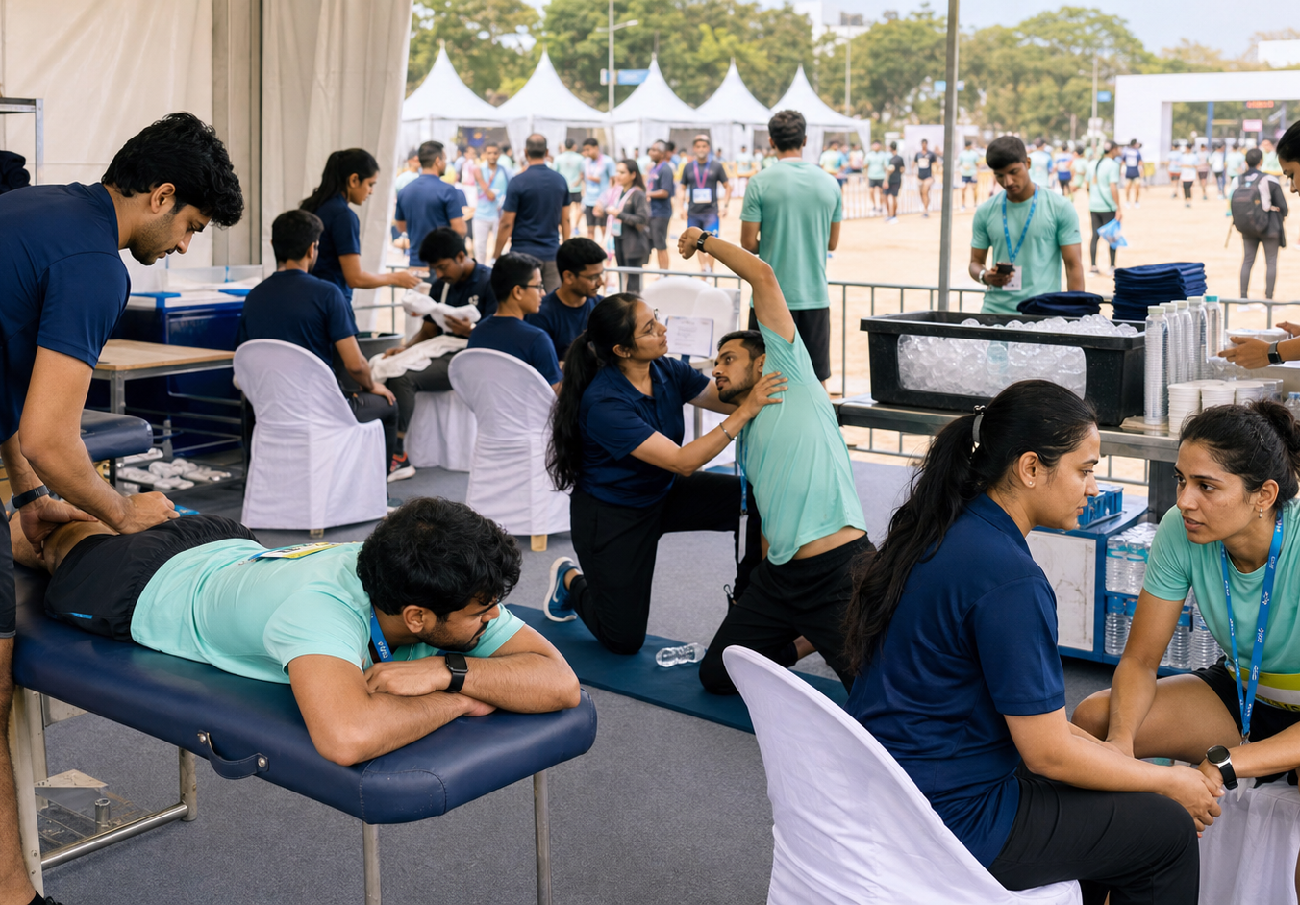
HYROX RECOVERY ZONE
Built for race-day intensity
Designed for efficient athlete flow, rapid clinical assessment and consistent care at every touchpoint.
SETUP INCLUDES
✓
Treatment tables
✓
Recovery beds
✓
Sports taping station
✓
Ice therapy station
✓
Manual therapy area
✓
Athlete waiting & assessment area
✓
Recovery equipment & consumables
ILLUSTRATIVE EVENT-DAY RECOVERY ZONE
CUSTOMISED TO PARTICIPANT NUMBERS & EVENT REQUIREMENTS

Slide 5
NATIONAL DELIVERY CAPABILITY
A trained, scalable physiotherapy network
A central clinical and operational model supported by qualified sports physiotherapists across India.
LEAD SPORTS PHYSIOTHERAPIST
Clinical lead • escalation • team oversight
SPORTS PHYSIOTHERAPISTS
PHYSIOTHERAPY INTERNS
Assessment • treatment • athlete guidance
Flow support • supervised recovery assistance
EVENT COORDINATOR
SUPPORT STAFF & VOLUNTEERS
Operations • organiser liaison • reporting
Check-in • supplies • participant movement
TEAM SIZE SCALES WITH EVENT SIZE & EXPECTED TURNOUT

Slide 6
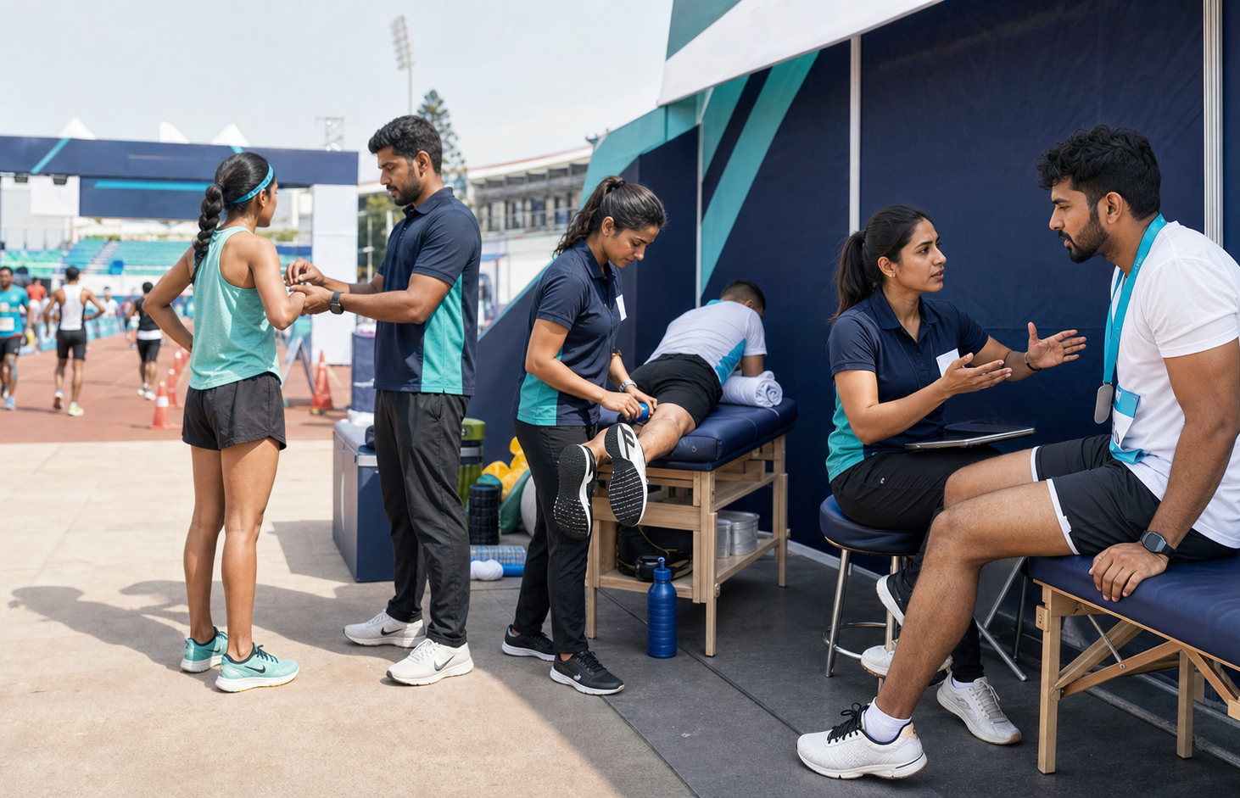
RELEVANT CAPABILITY
Built for hybrid fitness and endurance
Supporting athletes across high-performance, strength, fitness and endurance environments.
✓
Athlete rehabilitation
✓
Gym collaborations
✓
Sports injury management
✓
Marathon and endurance event support
✓
Strength & conditioning recovery
✓
Individual athlete performance care
Event photographs can be incorporated when supplied.
ILLUSTRATIVE SPORTS-EVENT COLLABORATION

Slide 7
EVENT-DAY WORKFLOW
Structured athlete care
A clear pathway ensures timely care, appropriate escalation and useful recovery guidance.
01
REPORT
02
ASSESS
03
EVALUATE
04
TREAT
Athlete arrives at Recovery Zone
Initial Physiotherapy assessment
Clinical evaluation and diagnosis
Immediate recovery intervention
05
REFER
06
GUIDE
07
DOCUMENT
Medical-team referral if required
Recovery and return-to-activity advice
Post-event recommendations
LISTEN • ASSESS • ACT • ESCALATE • GUIDE

Slide 8
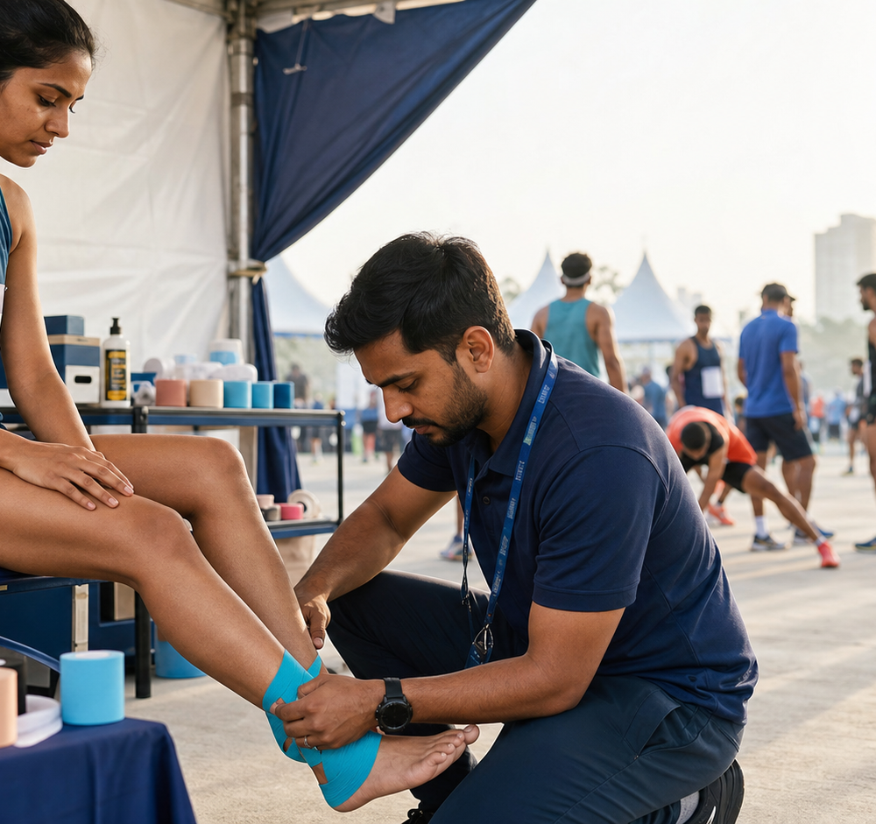
PROPOSED HYROX PARTNERSHIP
One recovery standard across the athlete journey
A coordinated recovery programme designed around HYROX participants, venues and event operations.
01
Complete Recovery Zone setup
02
Qualified Physiotherapy team
03
Recovery equipment and treatment supplies
04
Sports taping and manual therapy
05
Athlete recovery and injury-prevention education
06
Event-day operational support
07
Post-event reporting, rehabilitation pathways and follow-up
PRE-RACE PREPARATION & TAPING

Slide 9
WHY GETYOURPHYSIO.IN × HYROX
A stronger recovery layer for every participant
Professional recovery support can strengthen athlete trust, operational consistency and the overall HYROX experience.
✓
Professional on-site Physiotherapy support
✓
Faster injury management and recovery
✓
Enhanced athlete safety
✓
Improved participant satisfaction
✓
Consistent standards across Indian events
✓
A credible, athlete-first brand association
✓
Seamless Recovery Zone operations
OUR GOAL
Help every participant recover safely, perform confidently, and leave with a positive event experience.

Slide 10
THANK YOU
Let’s build the recovery standard
HYROX athletes can rely on.
Dr. Kandarp Sharma (PT)
Founder — GetYourPhysio.in • Sports Physiotherapist
WEBSITE
EMAIL
PHONE
www.getyourphysio.in
getyourphysio.in@gmail.com
+91 99193 87585
From race preparation to recovery and return to performance.
GetYourPhysio.in • Gurugram

