Slide 2
Crop Yield Prediction System
Submitted to:
Department of Computer Science and Engineering

Slide 3
Supervised by: Prof. Krupi Saraf
Team Members
1.Kanak Sharma (0827CS201111)
2.Gourav Sharma (0827CS201083)
3.Harsh Dad (0827CS201089)
4.Harsh Jaiswal (0827CS201091)

Slide 4
Project Presentation Outline
Abstract
Introduction
Problem Statement
Survey of Existing Systems
Project Objectives
Solution Proposed
The Outcome Discussion
Conclusions

Slide 5
Abstract
This project predicts crop yields through data-driven analysis of weather and crop history.
Using machine learning, the system provides farmers with actionable insights for informed decision-making.
By anticipating yield fluctuations, farmers can optimize resource allocation and adapt to changing conditions, ensuring more efficient and resilient crop management.

Slide 6
Introduction
In today's dynamic agricultural landscape, achieving optimal crop yields is not only a matter of traditional expertise but also of harnessing data-driven insights.
The intricate interplay between various factors such as weather patterns, soil quality, and crop history significantly influences agricultural outcomes.
This project aims to revolutionize crop management by employing advanced data analysis techniques to predict yields accurately.

Slide 7
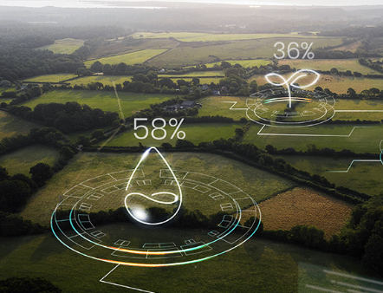

The Problem Statement
Crop prediction System:
Analyze data such as weather pattern and crop history to predict crop yields. This can help farmers plan their harvests and make informed decisions about their crops.

Slide 8

Survey of Existing Systems
Climate FieldView: It is a digital farming platform that uses data analytics and machine learning to help farmers manage their fields. It provides real-time insights into crop performance, field conditions, and weather forecasts, which can assist in making informed decisions.
Advantages:
Climate FieldView provides real-time data and insights about field conditions, weather forecasts, and crop performance. This data-driven approach helps farmers make informed decisions for better crop management.
Farmers can remotely monitor their fields, reducing the need for constant physical presence. This is particularly useful for large farms or farms spread over different geographic locations.
Disadvantages:
Cost: Subscribing to and using Climate FieldView may incur costs, including equipment, software, and subscription fees. This can be a barrier for small-scale or resource-constrained farmers.
Technical Requirements: Using Climate FieldView requires access to technology such as smart phones, tablets, and reliable internet connectivity. Farmers lacking these resources might face challenges in adopting the platform.

Slide 9

Survey of Existing Systems
IBM AgroPad: AgroPad is a mobile-based system developed by IBM that uses computer vision and machine learning to analyze water and soil quality. It helps farmers understand the conditions of their fields and make informed decisions about irrigation and fertilization.
Advantages:
AgroPad is designed to be user-friendly and accessible, making it suitable for farmers with varying levels of technological expertise.
By providing precise information about soil and water conditions, AgroPad can help farmers optimize the use of irrigation and fertilizers, potentially leading to cost savings.
Disadvantages:
Acquiring the necessary equipment, such as the AgroPad device and compatible technology (smartphones or tablets), involves an initial cost that might be a barrier for some farmers.
Like any technology, the accuracy of AgroPad's predictions and recommendations depends on the quality of input data and the underlying algorithms.

Slide 10
Objectives
Enhanced Harvest Planning: Develop predictive models that empower farmers to anticipate crop yields based on weather patterns, soil quality, and historical data, aiding in effective harvest planning and reducing uncertainties.
Informed Decision-Making: Provide farmers with accurate yield predictions, enabling them to make informed decisions about resource allocation, market planning, and distribution strategies.
Risk Mitigation: Help farmers proactively address risks associated with adverse weather events, pests, and diseases by suggesting precautionary measures and response strategies.

Slide 11
Solution Proposed
In response to the need for an effective crop yield prediction system, we propose a comprehensive solution that leverages advanced data science and machine learning techniques.
Our solution aims to assist farmers in making informed decisions by providing accurate crop yield predictions based on location, weather data, and historical information.
Solution will use machine learning algorithms to develop predictive model. These models will consider factors such as temperature, humidity, rainfall, and crop-specific data to forecast crop yields.
User-Friendly Interface: We will design an intuitive interface that allows farmers to input their location and crop preferences easily. The software will provide user-friendly visualizations and predictions.

Slide 12
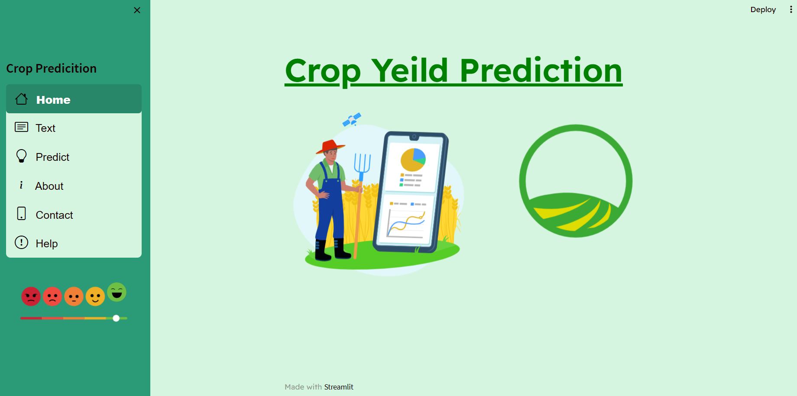
Screen Shot of Project

Slide 13
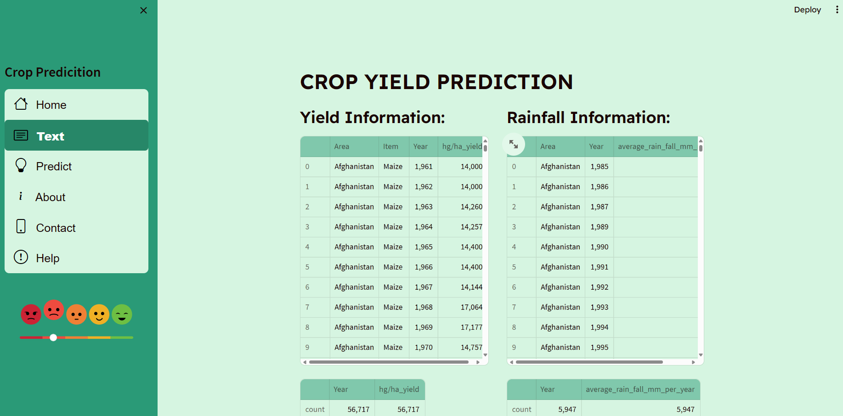
Screen Shot of Project

Slide 14
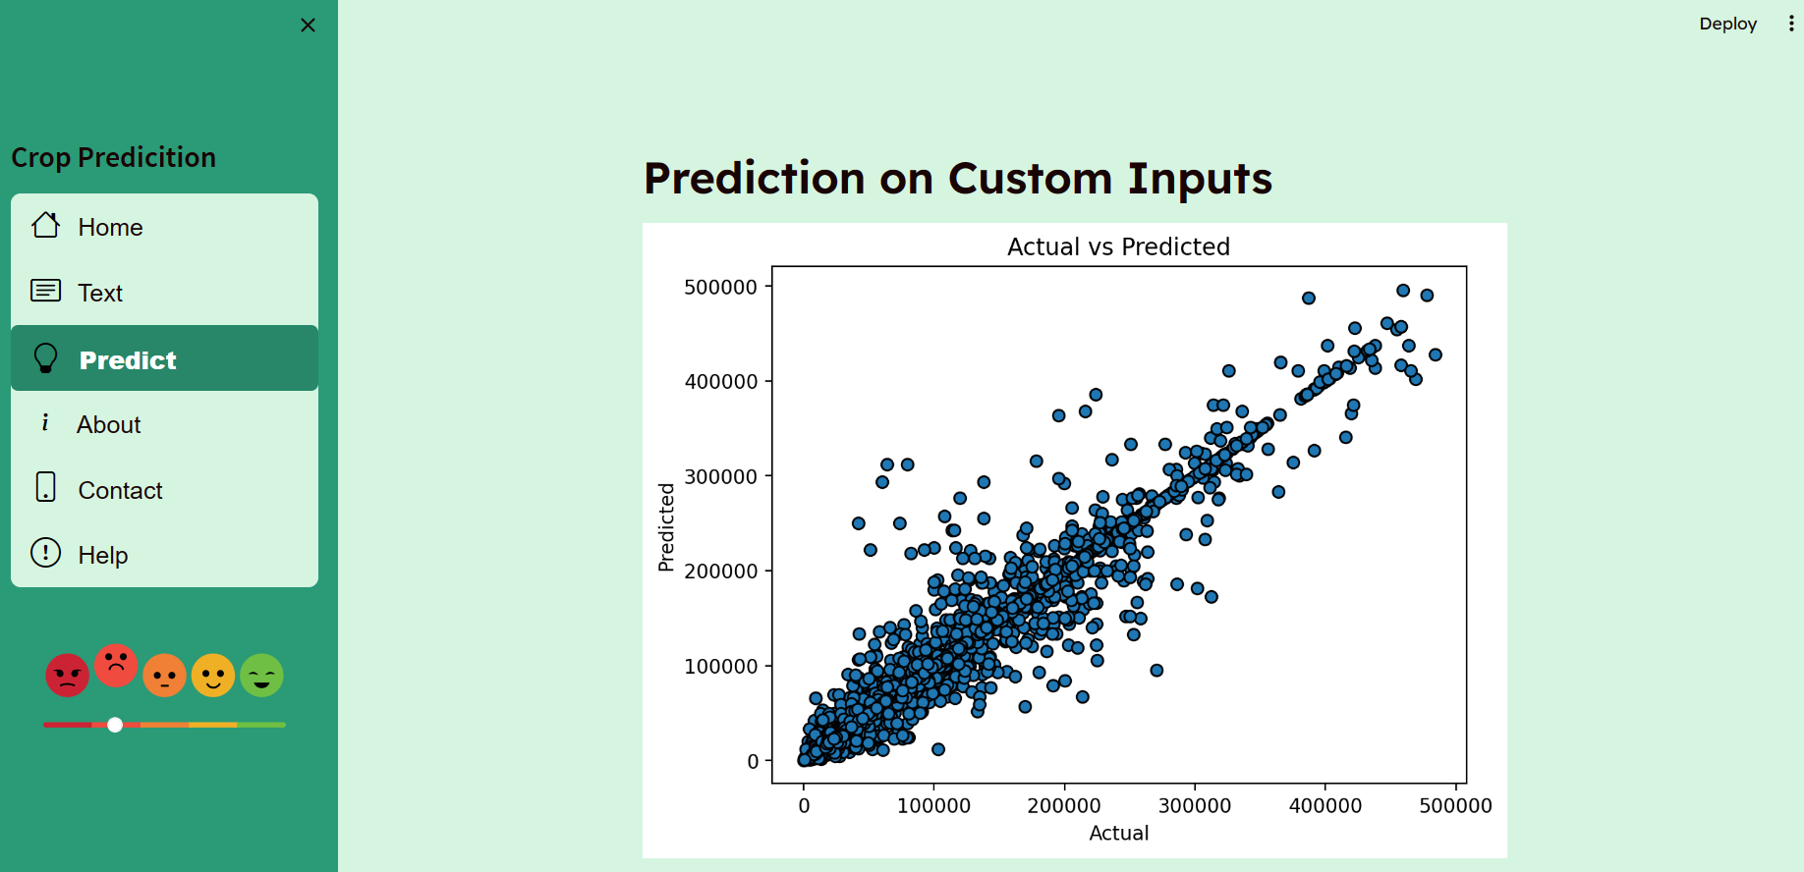
Screen Shot of Project

Slide 15
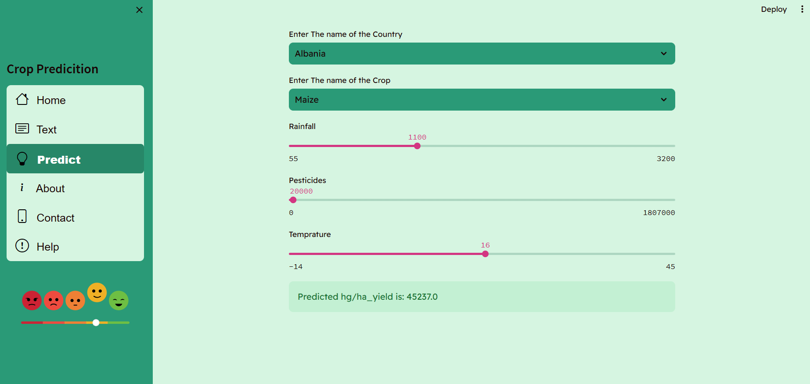
Screen Shot of Project

Slide 16
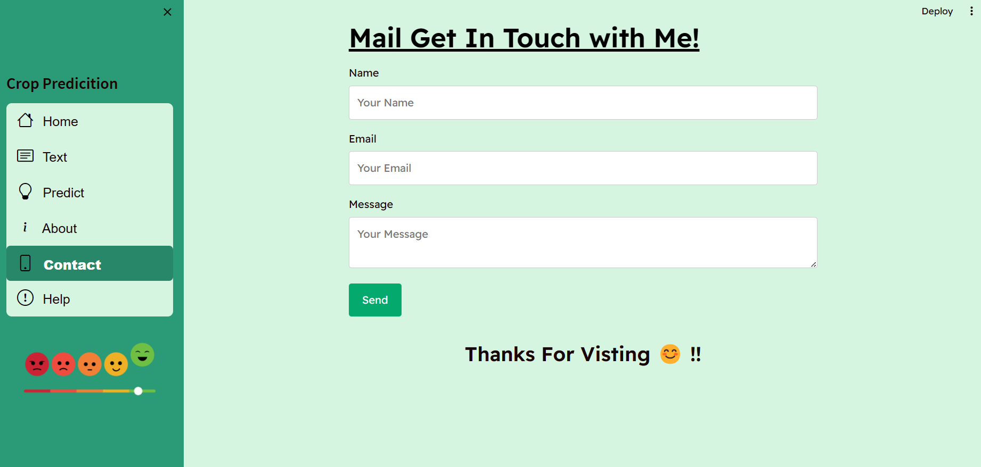
Screen Shot of Project

Slide 17
The Outcome
Accurate Yield Predictions: Farmers can expect reliable predictions of crop yields based on weather patterns, soil quality, and historical data. This accuracy empowers them to make more informed decisions regarding harvest planning and resource allocation.
Reduced Uncertainty: Farmers gain confidence in their decisions due to the reduced uncertainty associated with crop management. This increased confidence can lead to more proactive planning and risk management.
Time Savings: Farmers save time by having access to readily available predictions and recommendations in one platform, streamlining their decision-making processes.

Slide 18
Conclusion
The Crop Yield Prediction and Recommendation represents a significant step forward in modernizing agriculture.
By providing farmers with accurate predictions, informed recommendations, and the tools to thrive in a dynamic agricultural landscape, the project paves the way for improved productivity, increased resilience, and a more sustainable approach to feeding the world's growing population.
As the agricultural sector embraces data-driven insights, this project stands as a beacon of innovation and a testament to the positive impact technology can have on the lives of farmers

Slide 19
Q&A

Slide 20
THANKS

