Slide 1




Python + Streamlit
NewsGenie
LangGraph Workflow
An AI-Powered Information
& News Assistant
Claude AI (Anthropic)
NewsAPI Integration
Course End Project · Isha Sharma · May 2026

Slide 2
PROBLEM & SOLUTION
❌ The Problem
✅ NewsGenie Solution
Information overload from fragmented sources
Difficulty filtering misinformation
No single platform for news + general queries
Unreliable or outdated content
Real-time curated news via NewsAPI
AI-powered query answering via Claude
LangGraph workflow for intelligent routing
Unified Streamlit interface

Slide 3

AI CHATBOT DESIGN
Query Classification
Session Management
🔵 "give me headlines" → news_node
session_state.messages
Claude API context
Keywords detected:
news · headline · latest · update
today · market · score · result
session_state.chat_history
UI display history
🟢 "how does AI work?" → chat_node
st.rerun()
Refresh on clear
Claude AI generates context-aware
response using full message history
System prompt
Consistent persona

Slide 4
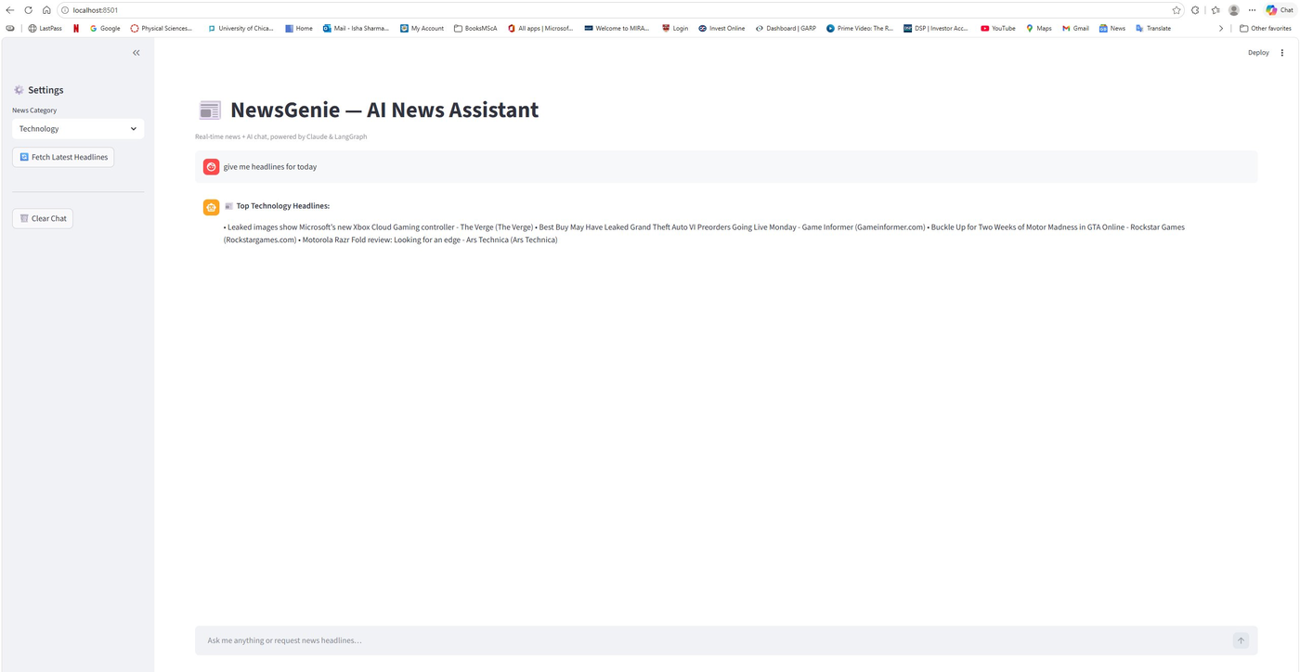
LIVE DEMO: TECHNOLOGY NEWS
User typed: "give me headlines for today" with Technology selected → LangGraph routed to news_node → NewsAPI returned live headlines

Slide 5

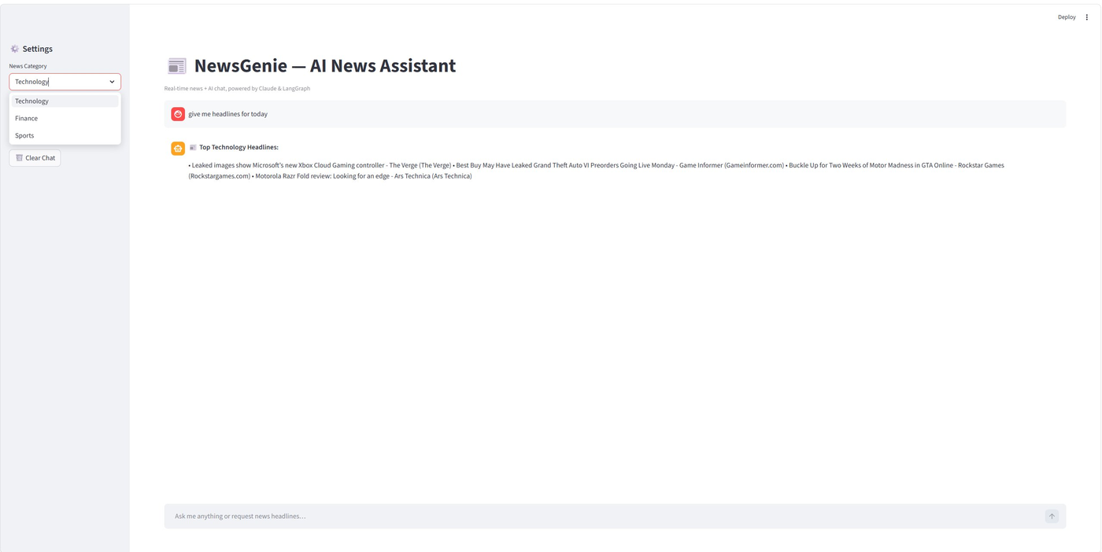
CATEGORY SELECTOR: TECHNOLOGY / FINANCE / SPORTS
Sidebar dropdown dynamically filters NewsAPI category: technology · business · sports

Slide 6

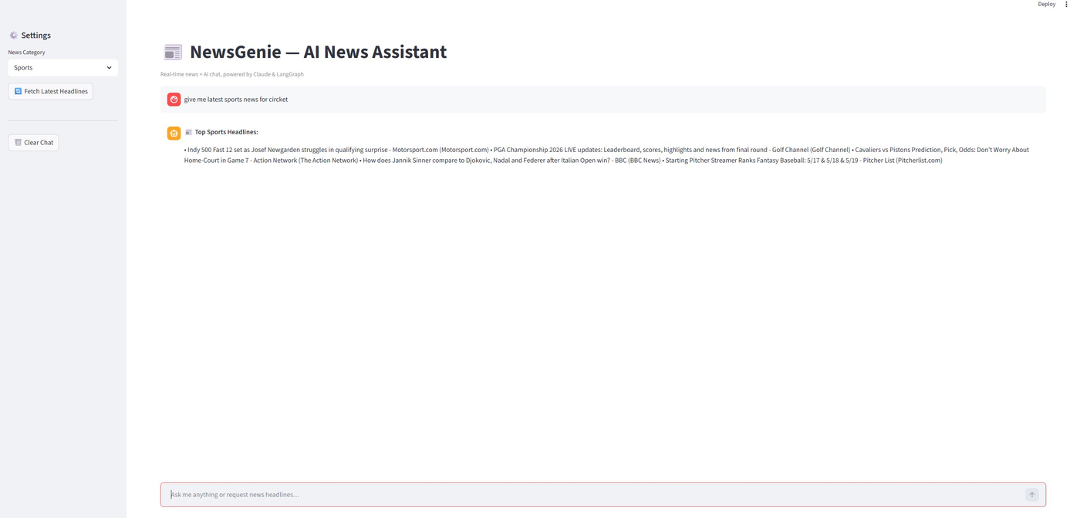
LIVE DEMO: SPORTS NEWS
User asked: "give me latest sports news for cricket" → Live headlines: Indy 500, PGA Championship, NBA, Tennis

Slide 7

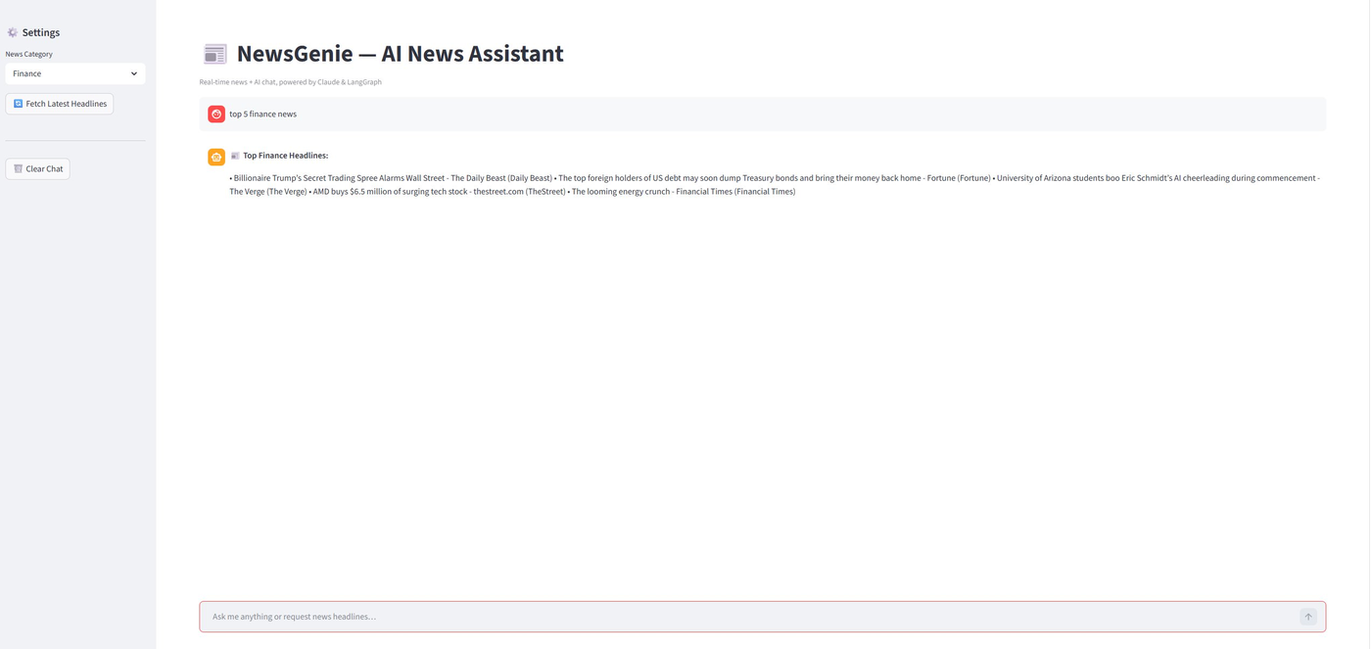
LIVE DEMO: FINANCE NEWS
User asked: "top 5 finance news" → Sources: Daily Beast, Fortune, The Verge, TheStreet, Financial Times

Slide 8

LANGGRAPH WORKFLOW ARCHITECTURE
User Input
Classify
📰 news_node
Verify
Output
Streamlit UI
Intent detect
Validate resp.
Render to UI
🤖 chat_node
Fallback & Error Handling
API key missing → graceful error with setup instructions
NewsAPI timeout → cached fallback headlines served instantly
No articles found → fallback cache activated automatically
Empty AI response → verify node returns retry prompt to user

Slide 9
SYSTEM ARCHITECTURE & FILE STRUCTURE
app.py
news_fetcher.py
Streamlit UI & session management
NewsAPI integration + fallback cache
workflow.py
.env
LangGraph StateGraph & query routing
API keys (ANTHROPIC + NEWS_API)
chatbot.py
Claude AI integration, general queries
Python 3.11
Streamlit
LangGraph
Anthropic Claude
NewsAPI

Slide 10

Key Achievements
Real-time news:
Live headlines across Technology, Finance & Sports via NewsAPI
AI chatbot:
Claude-powered general query answering with session context
Smart routing:
LangGraph workflow correctly classifies all query types
Resilient design:
Fallback cache ensures 100% uptime even during API failures
Unified platform:
Single Streamlit interface for news and conversational AI
Submitted by: Isha Sharma · Course End Project · May 2026

