Slide 1
Smart City Healthcare System

Slide 2
Contributors
# TEAM_ASV
Seemin Vasaikar: 1565151 vasaikar.s@northeastern.edu
Aaradhy Sharma: 1040799 sharma.aara@northeastern.edu
Jatin Sharma: 1524467 sharma.jat@northeastern.edu

Slide 3
Proposed Solution
The Smart city healthcare system is an ecosystem which bridges the gap between the population and the essential sectors of healthcare and incident response under one centralized framework.
The key highlight of this system is that it puts an end to the malpractice of prescription duplicity by connecting the doctors directly with the medical services.
Also, users can report emergencies and seek immediate response to the calamities using the "Emergency Services" feature.

Slide 4
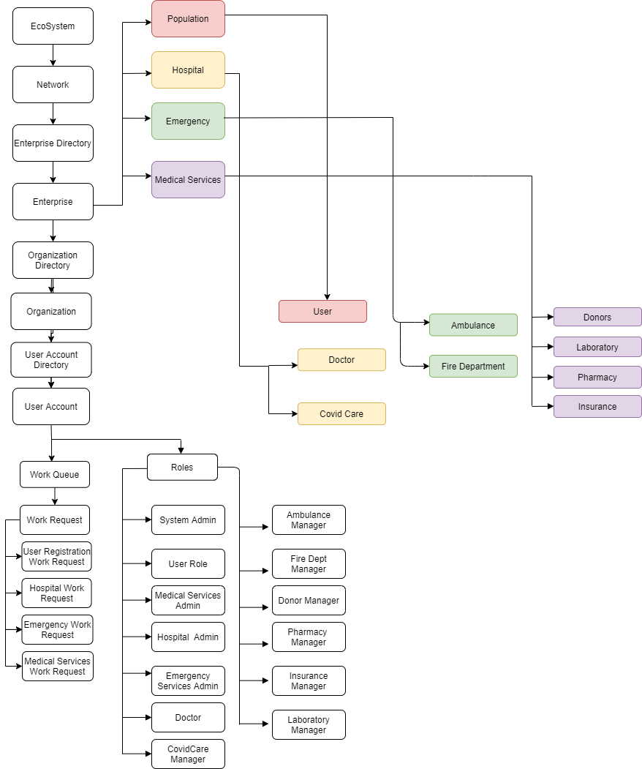
System Architecture

Slide 5
Salient Features
User Centric Healthcare System
Regulate Organization requests like doctor appointment, labs, etc. centrally by network
User can send request to multiple organizations at a time
User can check status for all of their requests
User will receive Email Notifications for their requests
PDF can be generated for prescription given by doctor

Slide 6
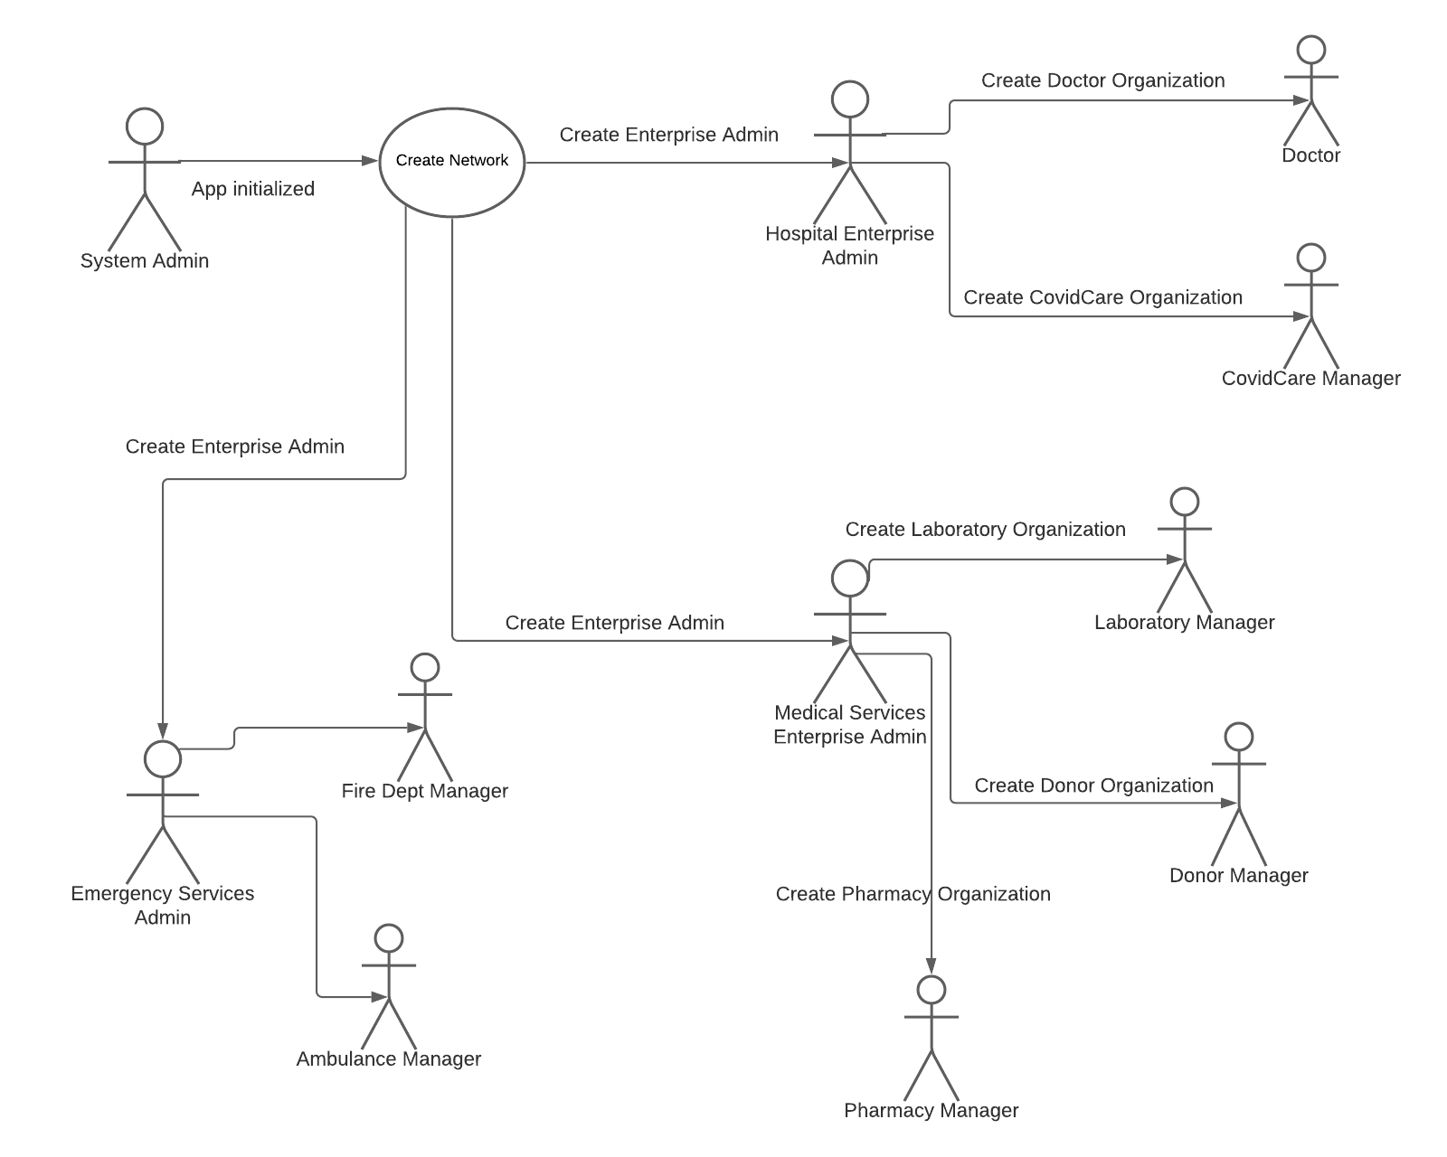
System Admin Sequence Diagram

Slide 7
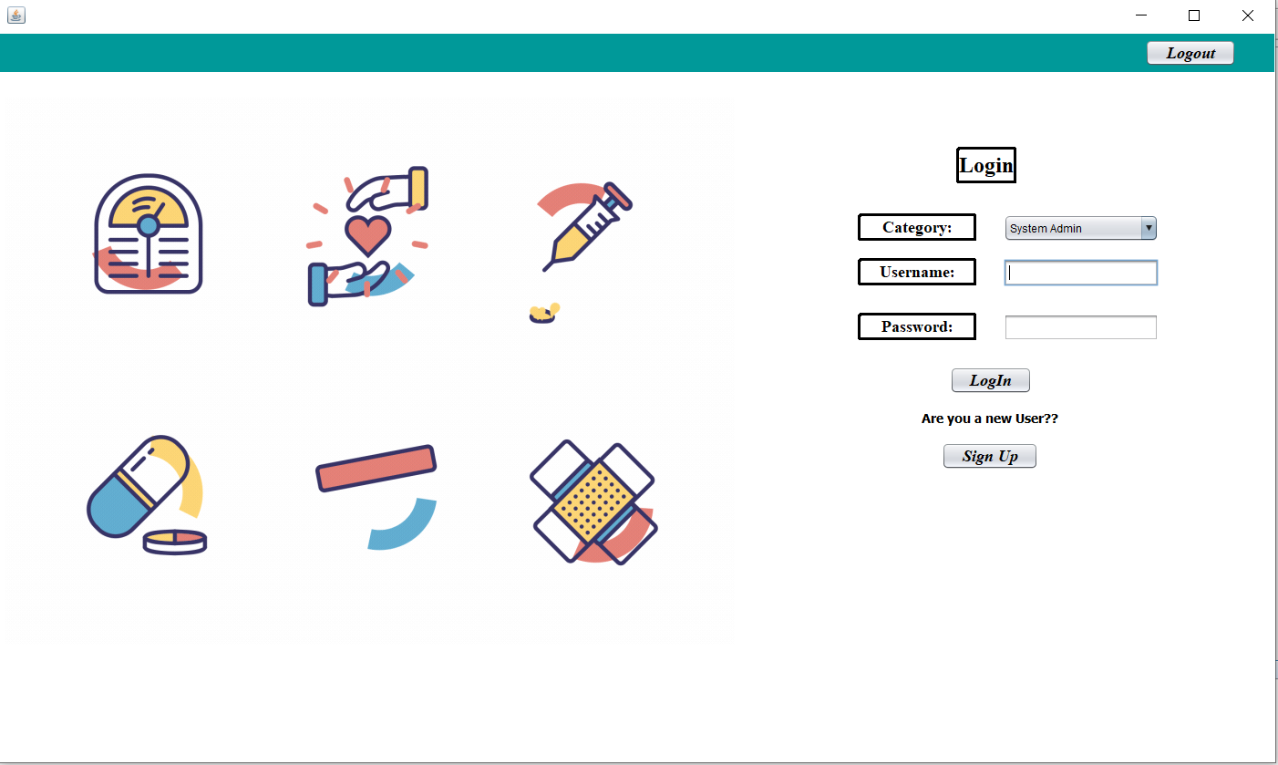
Login Page

Slide 8
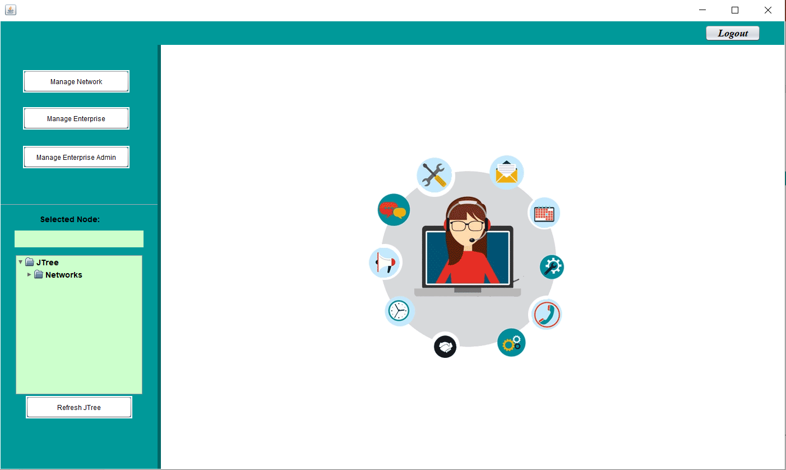
System Admin Work Area

Slide 9
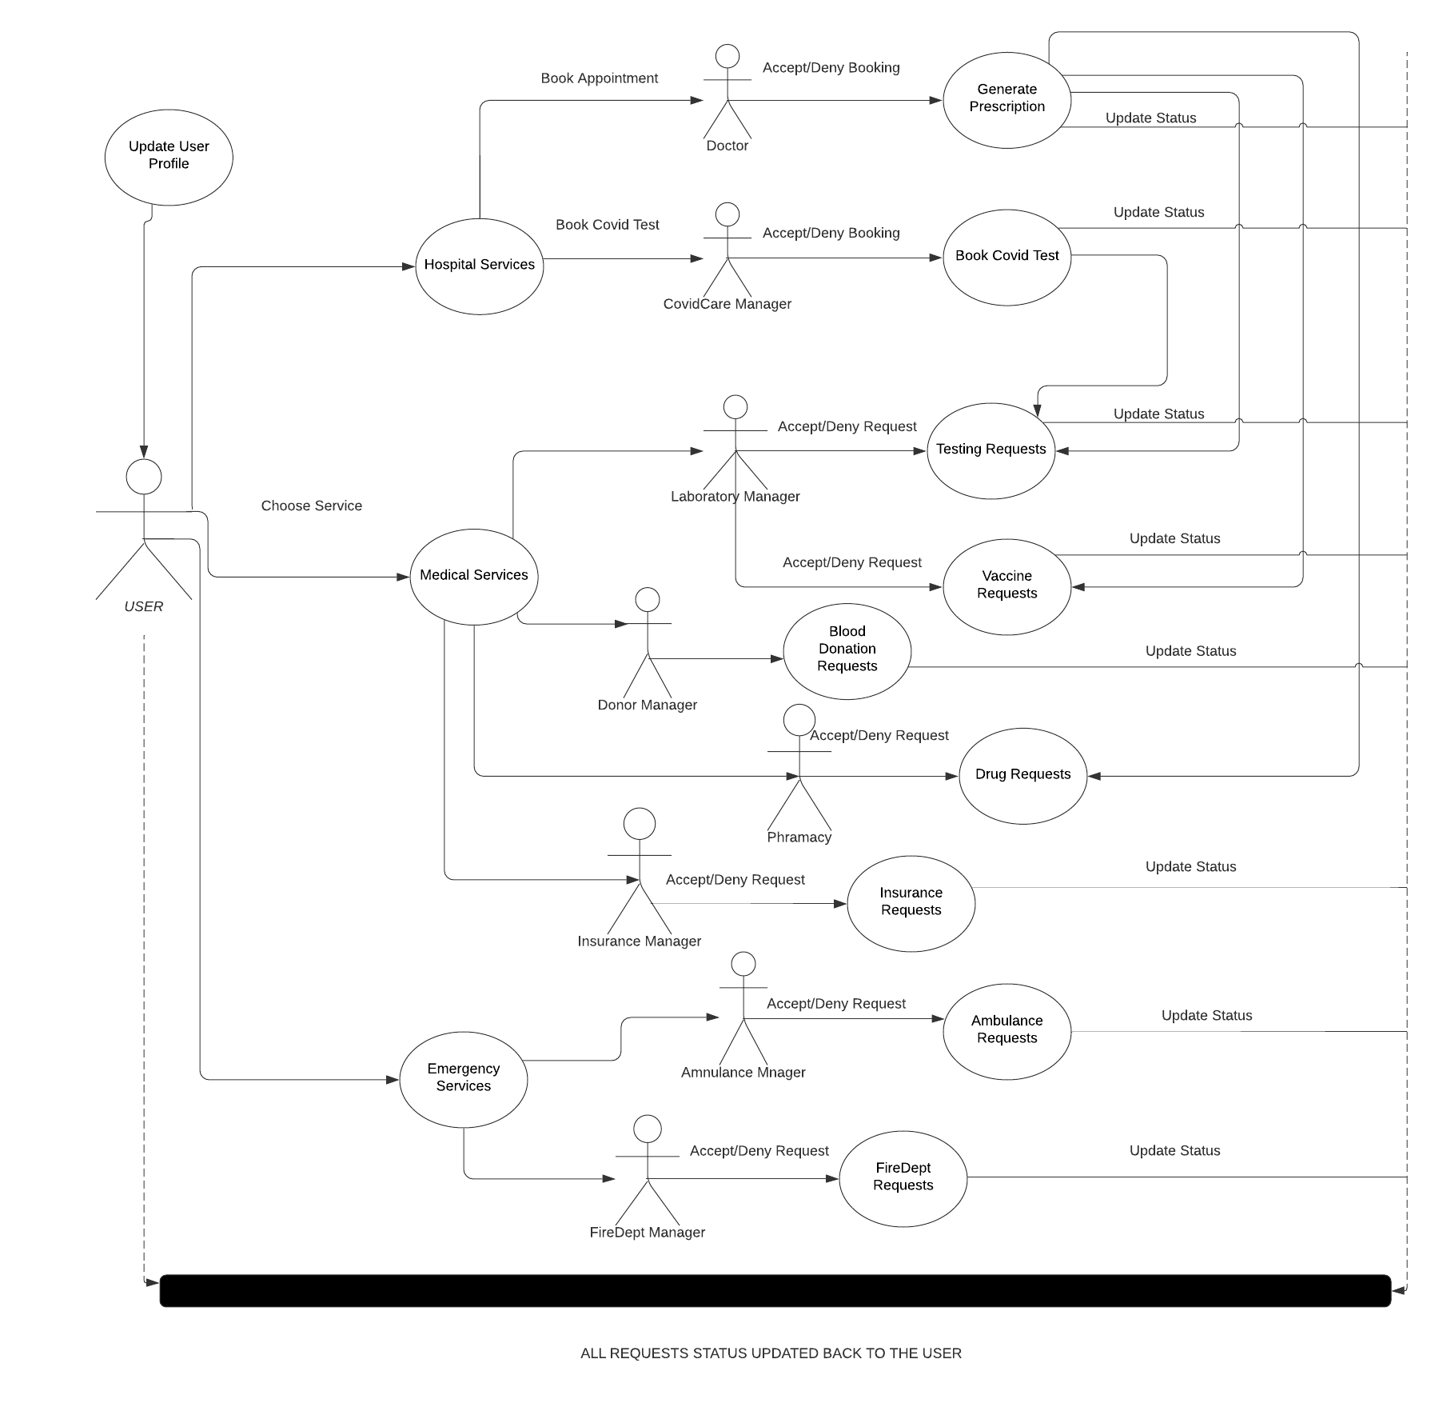
User Work Requests Sequence Diagram

Slide 10
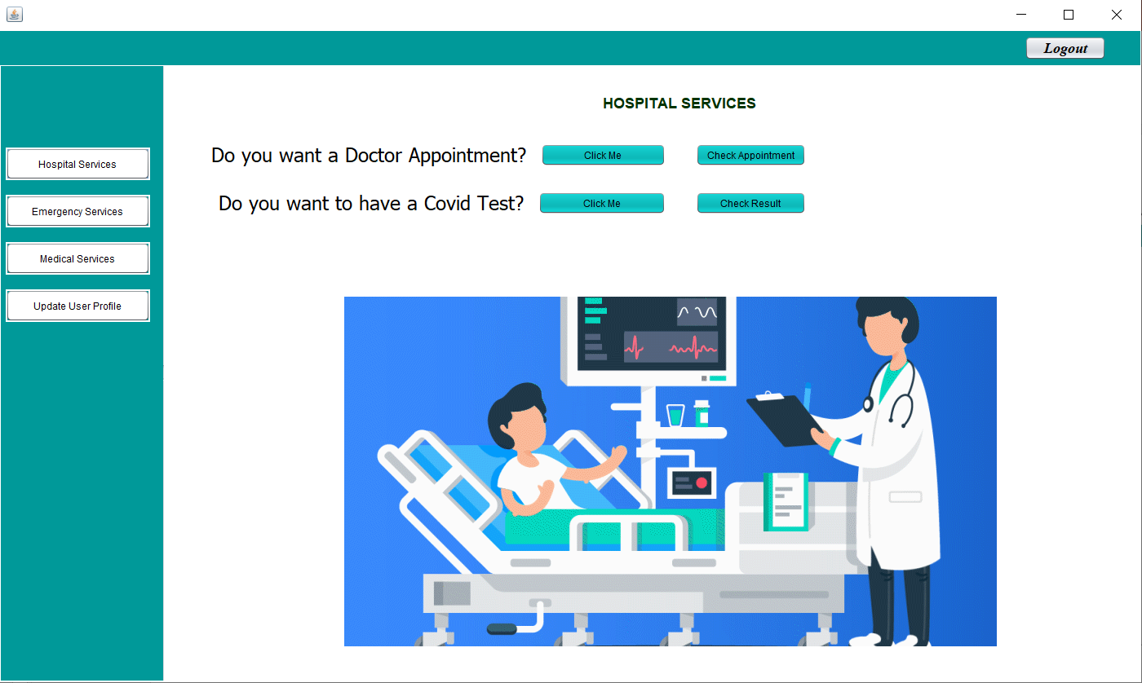
User Login Work Area

Slide 11
Thank you
Git Hub Link : https://github.com/vasaikarSimii/HealthCareSystem/tree/main
Please feel free to email your queries if any

