Slide 1

Project 1
Kendrick g. Morales Ortiz
Sandesh Sharma
Daniel O. Audi

Slide 2
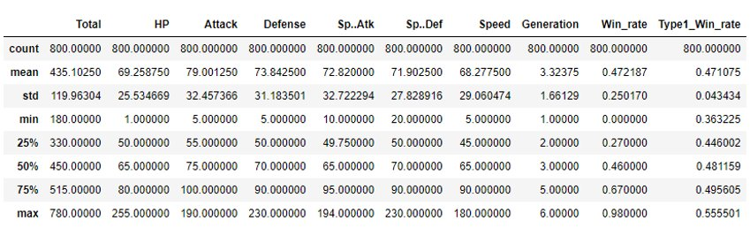
Descriptive statistics of the dataset
Categorical Data: Name ,Type 1 and Type 2, Generation, Legendary
Quantitative Data: HP, Attack, Defense, Sp.Atk , Sp.Def, Speed, Win_rate, Type1_Win_rate

Slide 3
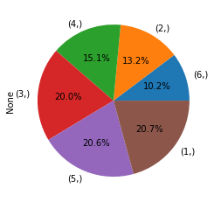
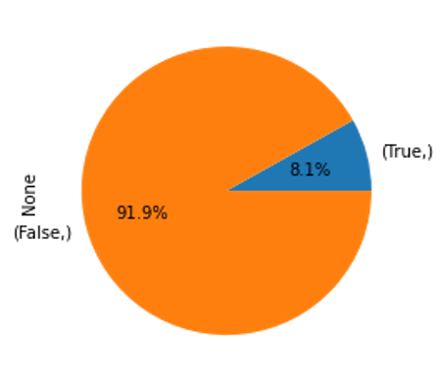
DESCRIPTIVE STATISTICS OF THE DATASET
Generation ratio
Legendary Ratio

Slide 4
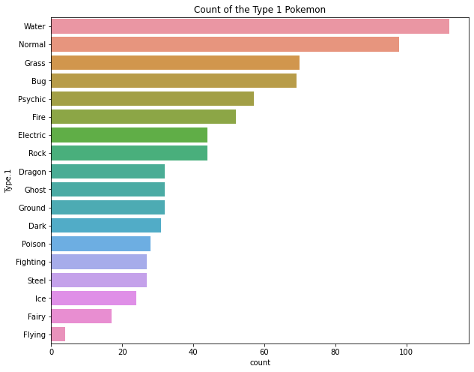
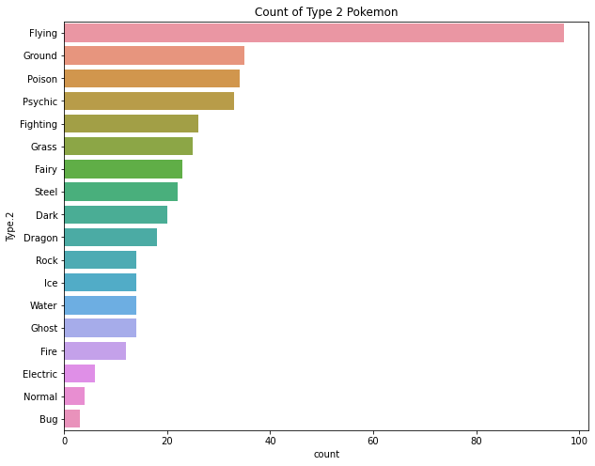
DESCRIPTIVE STATISTICS OF THE DATASET
Type 1 and Type 2 Amounts

Slide 5
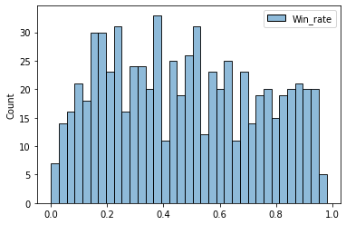
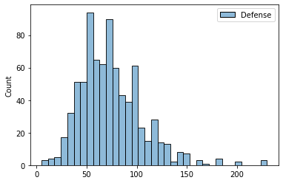
DESCRIPTIVE STATISTICS OF THE DATASET
We used histograms to visualize the distributions of the quantitative values to notice any particular patterns.​

Slide 6
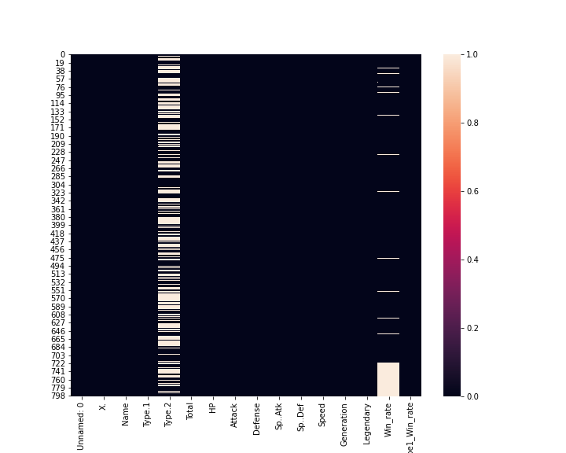
Handling the Missing Value
‘Win_Rate’ and ‘Type.2’ columns have 94 & 386 missing data points respectively.
Replaced the missing value with the median value for the ‘Win_rate’ column.
‘Type.2’ is a nominal data so, it is wise to remove the missing value or keep it like depending upon use case.

Slide 7
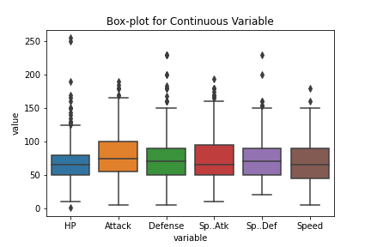
Outliers
All the quantitative variables have outliers as seen in the graph.
HP variable seems to have couple of data points which are on extreme ends.
We would remove the outlier however; no further analysis was required we kept the outlier as it is.

Slide 8
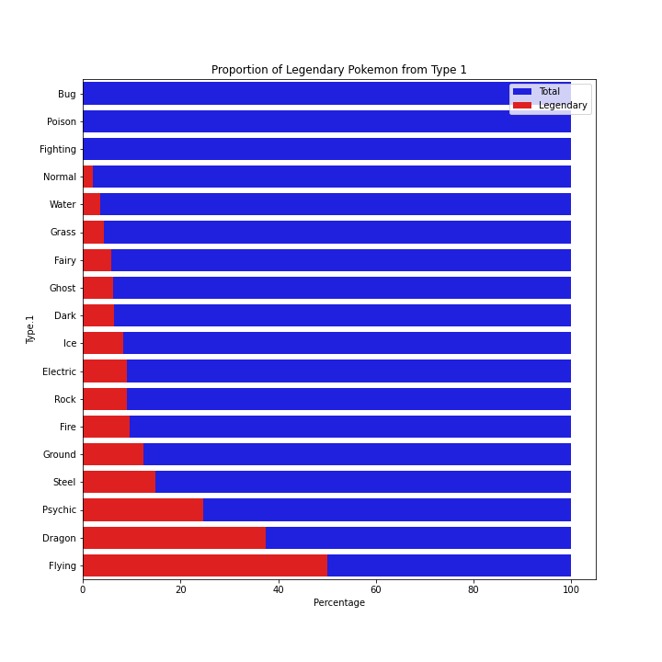
Comparing Categorical Variable
Proportion of the ‘Legendary’ Pokémon presented in different ‘Type 1’.
Bug, Poison & Fighting doesn’t have any kind of Legendary Pokémon.
Flying has highest proportion of Legendary Pokémon followed by Dragon, Psychic, Steel.

Slide 9
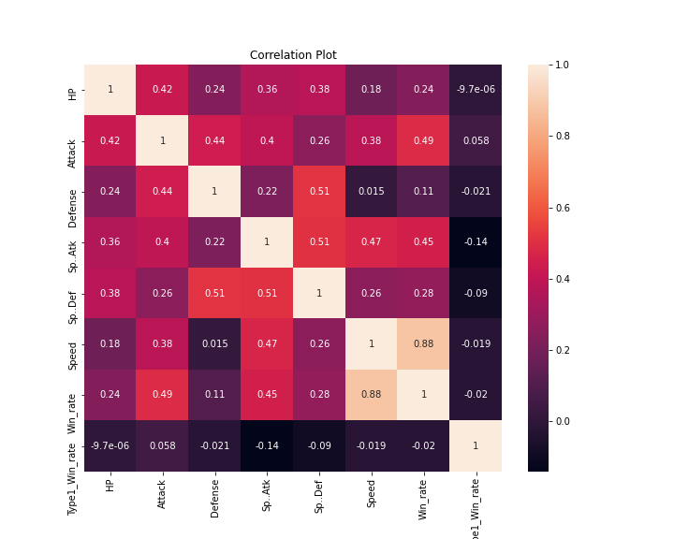
Correlation Summary
Variables | Correlation
Speed → Win_Rate | 0.88
Sp.Attack → Sp.Defense | 0.51
Attack → Win_Rate | 0.49
Attack → Defense | 0.44
Speed → Defense | 0.015

Slide 10
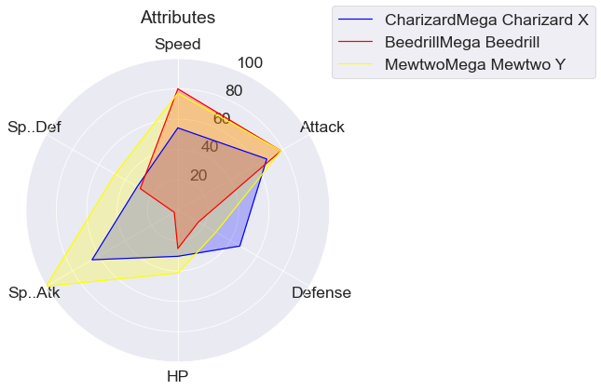
RADAR CHART
The radar chart allows us to compare the attributes of different Pokemon
From this radar chart we can see that MewTwoMega and BeedrillMega have about the same speed.
CharizardMega has the best Defense stats of the three Pokemon.
MewTwoMega is as good as or better than the other 2 Pokemon in 5 of the 6 attributes, losing out on Defense alone.

Slide 11

Conclusion
We were able to visualize components of the data to get a better understanding of patters.
Utilize all tools learn on the course so far
Have a better analytical understanding of Pokemons from generation 1-6

Slide 12

Questions

