Slide 1
Comparison of energy efficiency between macro and micro cells using energy saving schemes
Koustubh Sharma

Slide 2

Lund University, Sweden
Education, research and innovation since 1666
Comparison of energy efficiency between macro and micro cells using energy saving schemes
Koustubh Sharma
Supervisors:
Zhi Zhang
Examiner:
Maria Kihl

Slide 3
Agenda
Introduction
Theory
Power Model
Energy Saving Schemes
Simulation Setup
Results
Conclusions
Future Work

Slide 4
Save Energy !!
ICT industry is responsible for 10% of world’s total energy consumption and is doubling in every 10 years. Cellular networks are among the main energy consumers in the ICT industry.
In Germany, last year mobile network operators spent more than 200 million Euros on electricity bills.
With IoT and connected cars, cellular networks are likely to densify furthermore.

Slide 5
Problem Formulation
Need to study; comparison between macro centric and micro centric deployment.
The results presented in this thesis will contribute to the understanding of how these cells behave in a realistic traffic scenario and how much gain we can achieve by implementing the energy-saving schemes.

Slide 6
Theory
Macro and Micro cell
MACROCELL
MICROCELL
Microcells cover areas less than a kilometer in diameter and can often be seen mounted on signs, traffic lights, etc.
Macrocells are traditional cell towers that cover from a few hundreds of meters to a few kilometers.

Slide 7
Components of base station
P
P
in
out
R
F
PA
B
B
feeder
R
F
P
A

Slide 8
Power distribution in different cells

Slide 9


EARTH Power Model
BS type | N_{TRX} | P_{max}[W] | P₀[W] | Δ_{p} | P_{sleep}[W]
Macro | 2 | 40 | 130.0 | 4.7 | 75.0
Micro | 2 | 10 | 56.0 | 2.6 | 39.0
P : Power consumed in the BS
P₀ : Power consumed at no load
P_{out} : RF output power
P_{max}: RF output power at maximum load
u: utilization
Δp: Slope of load dependent power consumption
$$P(u)=P_{0}+{Δ_{P}P}_{max}u$$

Slide 10






EARTH Power Model
BS type | N_{TRX} | P_{max}[W] | P₀[W] | Δ_{p} | P_{sleep}[W]
Macro | 2 | 40 | 130.0 | 4.7 | 75.0
Micro | 2 | 10 | 56.0 | 2.6 | 39.0
Power Consumed $P$
$$Δ_{P}$$
Load dependent part
$$P(u)=P_{0}+{Δ_{P}P}_{max}u$$
$$P_{0}$$
$$P_{sleep}$$
Fixed constant part
0
utilization [%]
100
$$u$$

Slide 11
Energy Saving schemes
Micro TX sleep
MBSFN
Lean carrier

Slide 12
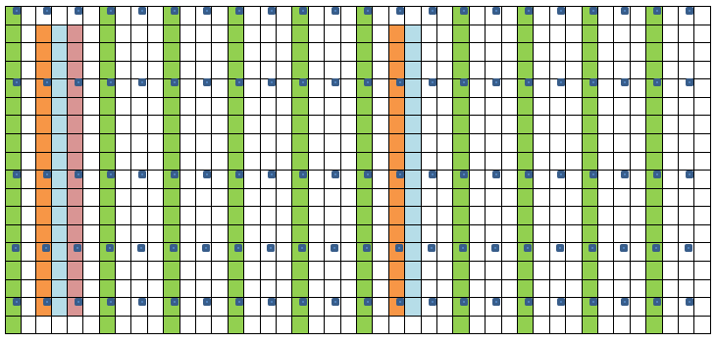
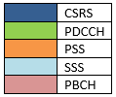
Micro TX Sleep
Radio Frame, 10ms
Notes:
5.6ms sleep time.

Slide 13
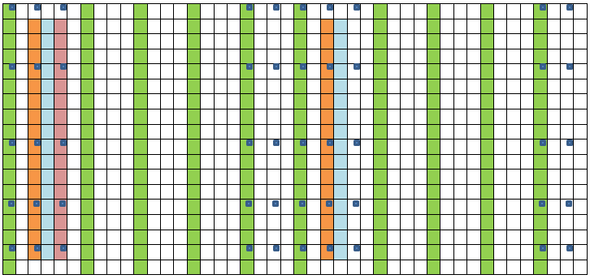
MBSFN Sub-Frame
MBSFN Sub-Frames

Slide 14

Lean Carrier

Slide 15
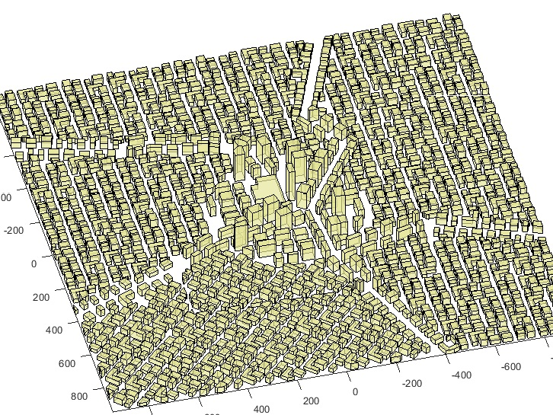
Simulation Setup
Parameters | Value
Carrier frequency | 2.0 GHz
Bandwidth | 20 MHz
Modulation scheme | 64 QAM
Packet traffic model | Equal buffer model
Macro TX Power | 40 W per sector
Micro TX Power | 10 W
Macro cells in central grid | 21
Micro cells in central grid | 28
Feeder loss | 10 dB

Slide 16
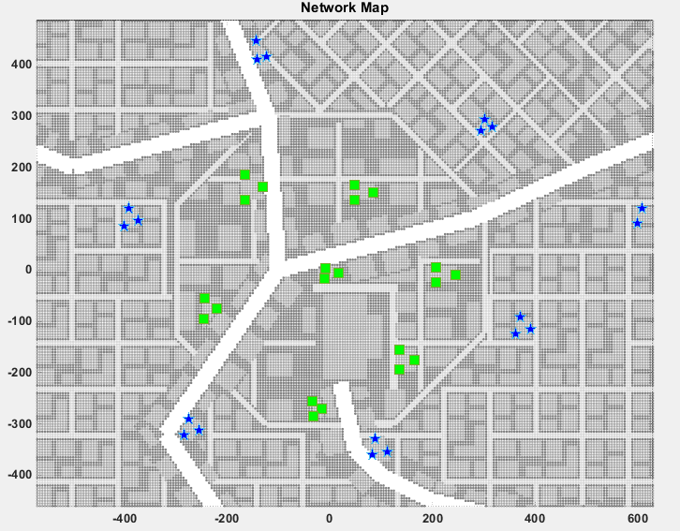
Macro Deployment

Slide 17
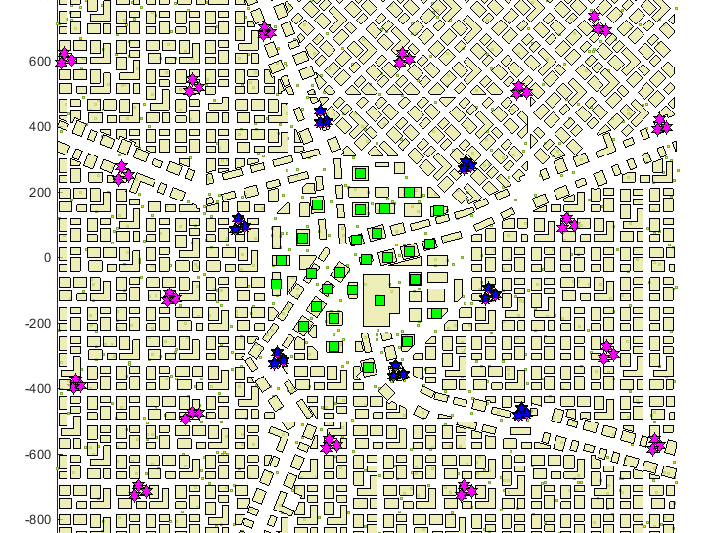
Micro Deployment

Slide 18
Results
Macro versus micro without energy saving schemes.
Macro with and without energy saving schemes.
Micro with and without energy saving schemes.
Macro versus micro with energy saving schemes.
Daily power consumption.

Slide 19
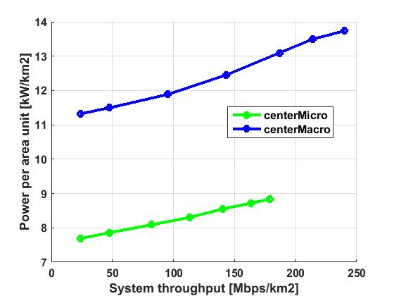
Results
Comparison macro versus micro without energy saving schemes :
Comparison of Power per area unit versus System throughput
Power per unit area difference at 100 Mbps/km2
31%

Slide 20
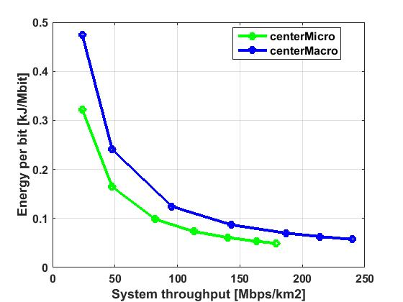
Results
Comparison of Energy per bit versus System throughput for central deployment of macro cells and micro cells.

Slide 21
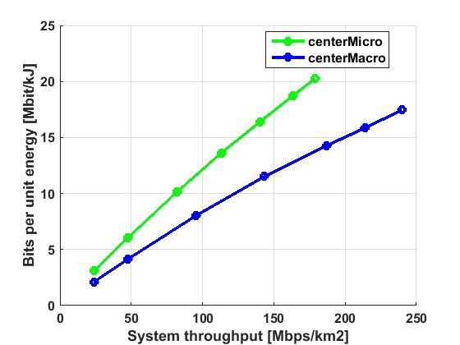
Results
Comparison of bits per unit energy versus system throughput for central deployment of macro cells and micro cells.

Slide 22
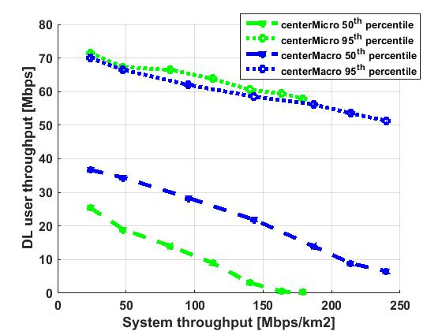
Results
Comparison of DL user throughput for 50th and 95th percentile versus system throughput.

Slide 23
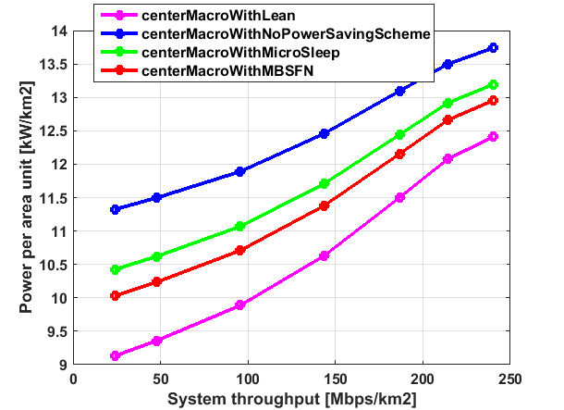
Results
Comparison macro with and without energy saving schemes
Comparison of Power per area unit versus System throughput for central deployment of macro cells.
Scheme | Power per unit area difference at 100 Mbps/km2
Micro sleep | 7%
MBSFN | 10%
Lean | 17%

Slide 24
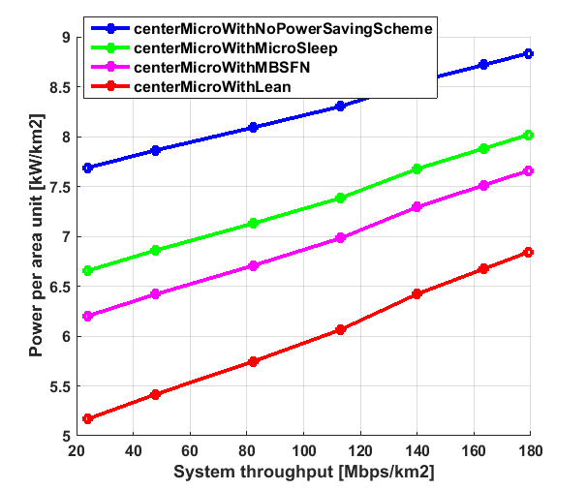
Results
Comparison micro with and without energy saving schemes
Comparison of power per area unit versus system throughput for central deployment of micro cells.
Scheme | Power per unit area difference at 100 Mbps/km2
Micro sleep | 10%
MBSFN | 16%
Lean | 27%

Slide 25
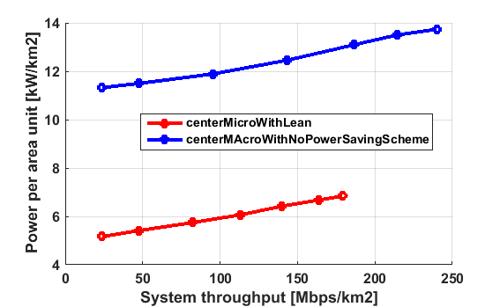
Results
Comparison macro versus micro with energy saving schemes
Comparison of Power per area unit versus System throughput for central deployment of macro cells versus micro cells.
Power per unit area difference at 100 Mbps/km2
50%

Slide 26
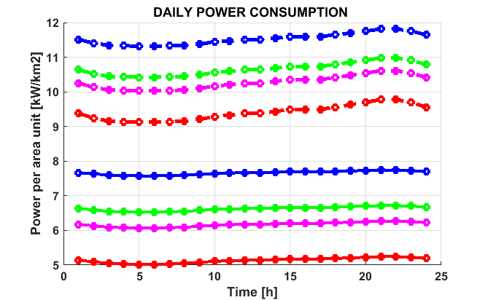
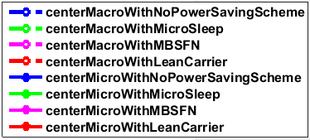
Results
Daily power consumption

Slide 27
Comparative Chart
Deploy-ment | Scheme | Daily power consumption (kWhr/km²) | Yearly power consumption (kWhr/km²) | Difference at 10 Mbps edge cell DL user throughput
Macro | No scheme | 283.44 | 103,455.6
 | Micro sleep | 263.52 | 96,184.8 | 7%
 | MBSFN | 254.64 | 92,943.6 | 10%
 | Lean | 234.62 | 85,637.7 | 17%
Micro | No scheme | 185.80 | 67,819.9
 | Micro sleep | 161.23 | 58,849.6 | 13%
 | MBSFN | 150.24 | 54,837.6 | 19%
 | Lean | 125.85 | 45,937.4 | 33%

Slide 28
Conclusions
31% of the energy could be saved by using micro cells instead of macro cells with no energy saving scheme.
The energy saving schemes saved up to 17% of energy in macros and 33% of energy in micros.
55% of the energy could be saved over a year by using micro cells with Lean Carrier instead of macro cells with no energy saving scheme.
Macros have better coverage than micro cells.

Slide 29
Conclusions
Quite efficient to deploy heterogeneous networks with macro cells with micro cells with energy saving schemes; especially for densified 5G deployments.
Applying energy saving schemes in thousands of sites will save tens of millions of kilowatt hours (kWh) annually.

Slide 30
Future Work
Energy efficiency could be studied in other scenarios as well such as sub-urban and rural.
There could be different sort of deployment of the cells to analyze the energy and throughput efficiencies.
One could make use of dynamic simulators to analyze the dynamic traffic.

Slide 32
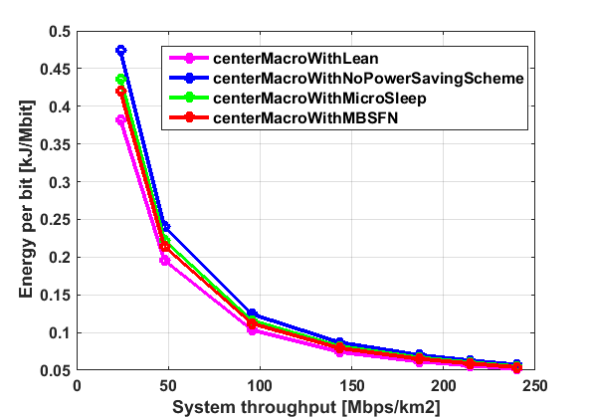
Results
Comparison of energy per bit unit versus system throughput for central deployment of macro cells.

Slide 33
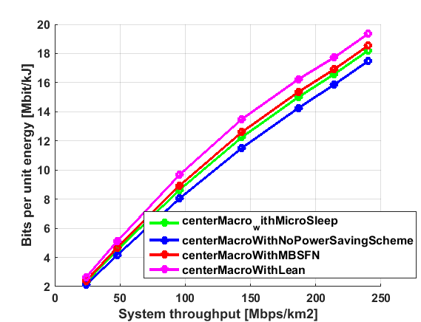
Results
Comparison of bits per unit energy versus system throughput for central deployment of macro cells.

Slide 34
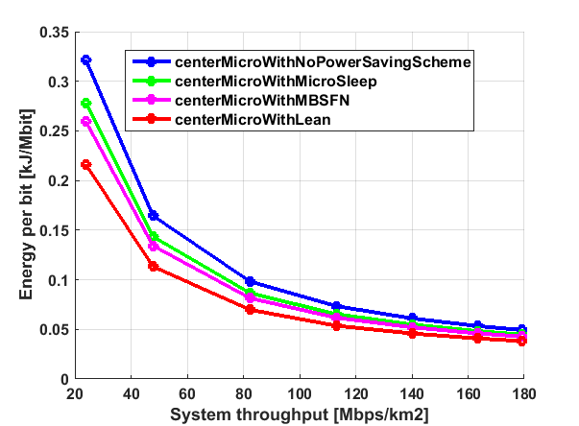
Results
Comparison of energy per bit unit versus system throughput for central deployment of micro cells.

Slide 35
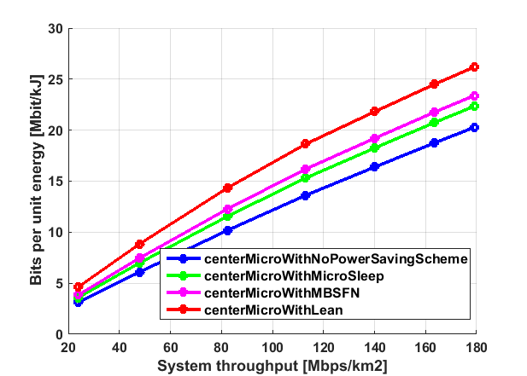
Results
Comparison of bits per unit energy versus system throughput for central deployment of micro cells.

Slide 36
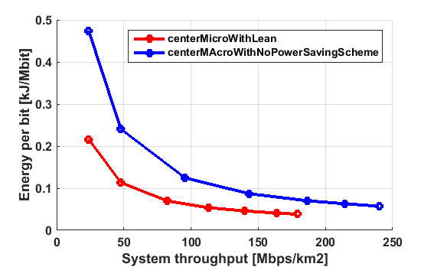
Results
Comparison of energy per bit unit versus system throughput for central deployment of micro cells versus macro cells.

Slide 37
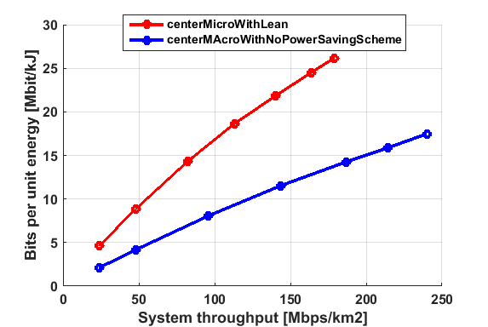
Results
Comparison of bits per unit energy versus system throughput for central deployment of micro cells versus macro cells.

Slide 38
Calculation of Mbps per km2 for Seoul with 2GB data per user per month
>> 9000000/605
ans = 1.4876e+04
>> 1.4876e+04*2000000000/(30*24*60*60) = 1.1478e+07 =11Mbps per km2
>> 1.4876e+04*5000000000/(30*24*60*60) = 2.8696e+07
=28 Mbps per km2

