Slide 2
Introduction
ICT industry in total is responsible for as much carbon emissions as aviation industry. And, cellular networks are among the main energy consumers in the ICT industry.
Last year in Germany alone mobile network operators spent more than 200 million Euros on electricity bills and 80% of that cost was from cellular networks. And, as per the EU regulations the cost of electricity is likely to increase more in coming years.
In the new era of internet of things and connected cars these cellular networks are likely to densify furthermore so, there is a pressing need to focus on energy consumption by these networks.

Slide 3
There are various approaches for densifying the present network that we have; in this project we have made comparison between macro cells versus micro cells centric deployment the approaches to cater to the traffic demands with macro cells versus micro cells deployments.

Slide 4
Problem formulation
According to the power model and previous studies the power of femto and pico cells does not vary with varying load or traffic. So, the power consumption in the Power amplifier remains the same.
In connected cars micro cells will be extensively used across both the sides of the roads in 5G.
Need to study the comparison between the macro centric and micro centric deployment.

Slide 5
We will setup a dense urban real like scenario in our simulator and compare the energy efficiencies between macro cells centric deployment versus a micro cells centric deployment.
We will make use of energy- saving schemes like micro DTX, lean carrier and MBSFN to cut the power consumed in the network. We will compare between the deployments with the units like energy per bit, power per unit area and power consumed over a day.
With results presented in this thesis, we will contribute to the understanding of how these cells behave in a realistic traffic scenario and how much gains can we achieve by implementing the above-mentioned energy-saving schemes.

Slide 6
To keep the results more generic and not specific to any particular set of radio base stations we will carry out EARTH power model.

Slide 7
Theory
SMALL CELL BASICS
MICROCELL
MACROCELL
Microcells cover areas less than a mile in diameter and can often be seen mounted on signs, traffic lights, etc. They can be used temporarily during large events for additional coverage.
Comparatively, the traditional cell towers you are used to seeing cover about 20 miles.
Notes:
Macro Cells
These cells are the base stations that provide coverage to a large area with Inter Site Distance (ISD) from hundreds of meters to several kilometers. depending upon the density. They fulfill the baseline coverage for any LTE network, providing connectivity and up all the time. The power consumption varies from 100W to 300W ; they have sectored antennas normally covering 120 degrees per sector.
Micro Cells
Micro cells have lower transmit power than macro BSs, they are smaller base stations with full features that are used to cover both indoor and outdoor crowded areas. It can typically cover a range of few meters to one or two kilometers. The power consumption ranges from 10W to 40W. They are generally used for indoor purposes as well as outdoor such as hot-spots. [11]
I made S and D in capitals. As it is an abbreviation
W in caps after 100 and no full stop after 300W.
No… can be… made active voice

Slide 8
Power distribution in base station
Notes:
The PA connects to the antennas of the base station after providing the required power gain The PA has poor power efficiency as it is made to work in non-saturated region which is to avoid nonlinear distortion from channel interference. In macro BS digital pre-distortion is used to improve the PA efficiency [7].
Radio Frequency module is used to convert analog signals to digital signals. Base Band module serves as digital signal processor for digital up and down conversion of signals, it also does OFDM modulation of the signal. Typical functionalities for BB are filtering, FFT for OFDM modulation and IFFT for OFDM demodulation, signal detection, channel estimation, it acts as the brain of transceiver [13].

Slide 9
Power distribution in different cells
Notes:
Figure shows the breakdown of power consumption in various base stations [15]. We can see over here that the macro base station consumes the most energy in PA in macro cells; whereas base band becomes the major component in small cells.

Slide 10
Variable load power consumption of BS.
BS type | N_{TRX} | P_{max}[W] | P₀[W] | Δ_{p} | P_{sleep}[W]
Macro | 6 | 20 | 130.0 | 4.7 | 75.0
RRH | 6 | 20 | 84.0 | 2.8 | 56.0
Micro | 2 | 6.3 | 56.0 | 2.6 | 39.0
Pico | 2 | 0.13 | 6.8 | 4.0 | 4.3
Femto | 2 | 0.05 | 4.8 | 8.0 | 2.9
P : power consumed in the BS
P_{out} :RF output power
P_{max} : maximum load the output power
Notes:
The relation between the RF output power and the power consumed by base stations are roughly linear in nature [14]. The mathematical equation of this relation could be represented as:
This represents the linear approximation of the power model. Here P would represent the power consumed in the BS and P_{out} is the RF output power, at maximum load the output power would be P_{max}. Power consumption at zero load is given by P₀, Δ_{p} represents the slope of the curve. P_{sleep} represents the sleep mode power consumption in the BS when the load is low and N_{TRX} is the number of transceiver chains. Table 3 provides parameters of power model for different BSs [15].

Slide 11

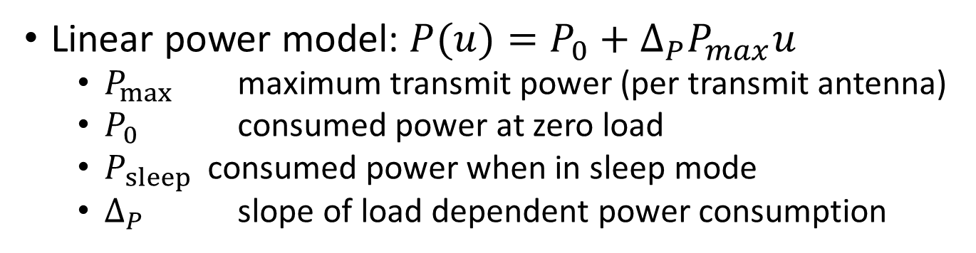




How Much Power Does a Base Station Consume?
Linear power model: $P(u)=P_{0}+{Δ_{P}P}_{max}u$
$P_{max}$ maximum transmit power (per transmit antenna)
$P_{0 }$ consumed power at zero load
$P_{sleep }$ consumed power when in sleep mode
$Δ_{P}$ slope of load dependent power consumption
Consumed power $P$
$$Δ_{P}$$
Load dependent part
$$P_{0}$$
$$P_{sleep}$$
Fixed constant part
0
Resource utilization [%]
100
$$u$$

Slide 12
Average power consumption over a day
Notes:
To get an idea of the power consumption over the entire day, we need to average the power consumed over a day. The simulator which we have uses statistical tools to model the traffic. It measures the networks parameters for a small period of time while keeping the total traffic to be constant. Therefore, to know the network performance over a varied load, we sweep the total traffic value over a sufficient range.
In real scenario the traffic values change over the day in a pattern which is given in [15]. By taking the traffic profile as described in [15] we can estimate the traffic for every hour as a fraction of the peak throughput. Here we take the case of an urban traffic scenario which shows the average pattern of traffic over a day on hourly scale.
Instead of whole; I used entire

Slide 13
Energy Saving schemes
Lean carrier
Micro DTX sleep
MBSFN

Slide 14
Lean carrier
The Lean carrier make use the sleep modes and switching off the cell when there is no transmission of data. It makes use of different features like transmitting the signal only when required, transmitting faster with higher modulation scheme, effectively utilizing the carrier aggregation to have large spectrum and making use of beam forming antennas. These features reduce extraneous signaling and interference.
Minimizing the overhead cell specific reference signaling and using the spectrum flexibility it reduces energy consumption. With lean carrier design, it is possible to achieve fraction of sleep at no load condition to 100%. More details about lean carrier can be found in [16].

Slide 15
Micro DTX sleep
The radio’s RRU component does not transmit all the time. There are time slots when the radio can be put to sleep mode depending upon the traffic handled and the scheduled transmissions. At this point the biasing of the final stage amplifiers is turned off, which can be achieved by sending a strobe signal based on the information of the data that DU needs to send. This information is sent in a message that gives the symbols which will be sent over the radio during the transmission time interval [17].
The LTE RRU transmits 140 OFDM symbols per radio frame consisting of cell-specific radio signal (CSRS) and physical downlink control channel (PDCCH). Assuming a no-load situation when there are no scheduled users; out of 140 OFDM symbols, power amplifier could be put in sleep mode for 73 of them with 37 wake up events. This equals to 4.1ms of sleep time during each radio frame or 41% of time.

Slide 16
MBSFN
In a LTE radio frame six out of ten sub-frames can be Multicast and Broadcast Single-Frequency Network (MBSFN) for FDD system [18]. The MBSFN sub-frames are used to predict the future traffic load for a base station. Using MBSFN a base station could calculate the load it needs to handle in subsequent frames and the resources required to cater to the traffic. This load prediction is made based upon the previously served load information exchanged between the base stations over X2 interface. Load prediction is used to turn off the idle resources and setup the switch off intervals. Moreover, the MBSFN sub-frames have less number of reference signals than normal sub-frames, which gives an opportunity to turn off these sub-frames when there is no data available. [19]
Using MBSFN scheme in no load condition we get 91 OFDM symbols with 19 wake up events per radio frame. This gives a window of 5.9ms or 59% with sleep mode enabled.

Slide 17
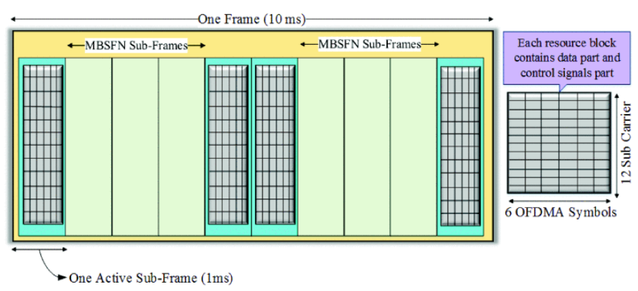
LTE radio frame

Slide 18


Discontinuous Transmission
Consumed power $P$
Power
saving
$$P_{sleep}$$
Resource utilization [%]
Center resource blocks
1.4 MHz
On
Sleep
Time
Radio-frame 10ms

Slide 19
Discontinuous Transmission
Micro DTX
MBSFN DTX
Lean Carrier DTX
Radio-frame 10ms
MBSFN sub-frames

Slide 20
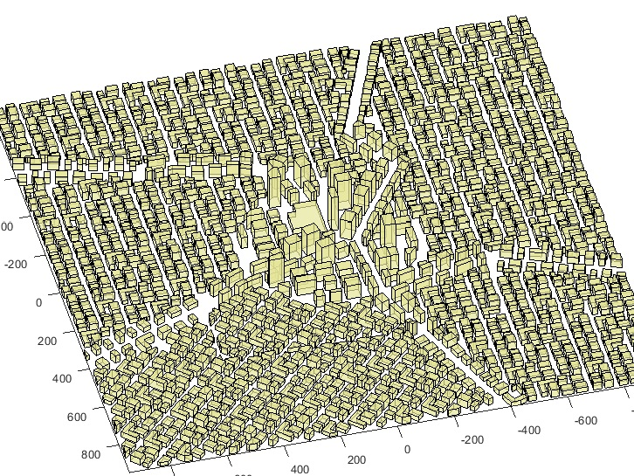
Simulation Scenario
Notes:
The simulator used is Ericsson’s internal network simulator. It is a time static system level simulator implemented in MATLAB. It provides various propagation models from statistical models to ray-tracing based models [12]. The model used in our thesis makes use of statistical model that determines the utilization of the base stations running on a particular load. The utilization values are used to calculate of the power being consumed by the whole network.
Setup
We setup a “real like” dense city scenario, in which we are deploying the city with streets, buildings, base stations and users. The deployment is made keeping in mind of a typical dense urban network with high-rise buildings in the center and lesser dense and low height buildings outer wards. This sort of setup is very close to a realistic scenario than just being a statistical propagation analysis.
We are simulating with ray-tracing propagation model called BEZT. It makes use of multipath propagation model that calculates the path gain between the user and the base station. The channel gains over these paths are stored in a huge gain matrix which are used to estimate the throughput for every user, in the central part of the map

Slide 21
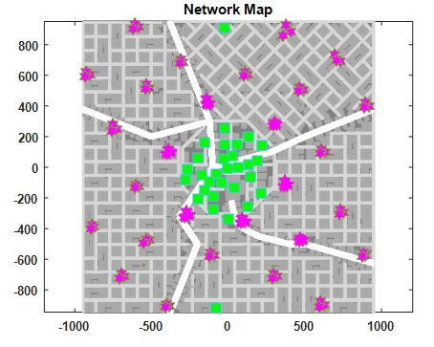
Simulation Scenario
Notes:
We are deploying a real like city scenario in which the outer layer of macro grid will provide baseline coverage, we will refer to it as surrounding macro layer. In first scenario, we deploy macro cells in the city center complemented by the surrounding macro grid and in second scenario we deploy small micro cells in the city center complemented by the surrounding macro grid.
In the first scenario setup, we have taken 21 macro cells deployed in the central grid of the city with inter-site distance of 200m surrounded by a base layer of macro cells with inter-site distance of 400m.
In the second scenario setup, we have taken 28 micro cells deployed in the central grid of the city with a base layer of macro cells inter-site distance of 400m.
The system under consideration is a LTE network with carrier frequency of 2 GHz, highest modulation scheme is 64 QAM, each site has three-sectors. The central grid area is 1000x1000m.
For macro cells; the max Output Power out per antenna in DL is 40 W, P₀ = 130W, Δ_{p} = 4.7 and P_{sleep} = 75.0.
For micro cells; the max Output Power out per antenna in DL from the micros is 10 W, P₀ = 56W, Δ_{p} = 2.6 and P_{sleep} = 39.0.

Slide 22
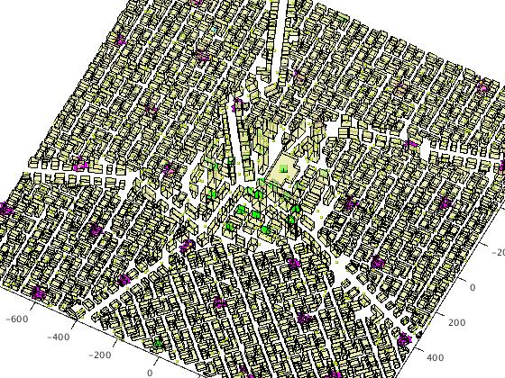
Simulation Scenario

Slide 23
Simulation parameters
Parameter | Value
Carrier frequency | 2.0 GHz
Bandwidth | 20 MHz
Modulation scheme | 64 QAM
Packet traffic model | Equal buffer model
Macro TX Power | 40 W per sector
Micro TX Power | 10 W
Macro cells in central grid | 21
Micro cells in central grid | 28
Feeder loss | 10 dB
Notes:
We deploy buildings, streets, base stations and users in the simulator. The simulator calculates the SINR between each user and node deployed on macro or micro layer. Using the propagation model, the interference, gain or the propagation loss is calculated for each link. To simulate the dynamic network where the download sessions by users happens at random; equal buffer traffic model is utilized. Each session is of fixed file size where the request comes as per the Poisson distribution. The users fully utilize the link bit rate during the file download. The total air traffic could be given by offered traffic per m². Because of the capacity limitations the served traffic is lower than offered traffic. In the simulations, we sweep through varying loads of offered traffic and make use of the served traffic to compare performances.

Slide 24
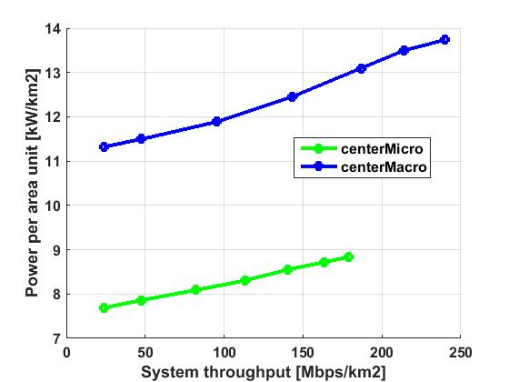
Results and conclusions
Comparison macro versus micro without energy saving schemes
Comparison of Power per area unit versus System throughput
Notes:
Here we will compare the energy performance and the network performance of deploying the large cells of macro grid in the city center versus small cells of micro grid without any energy saving schemes.
The Power per unit area is measured for power per 1 km² around the central area of the map. We calculate the utilization of each node which taken as a factor for calculating the total power consumed by that node in the network. As we can see in Figure 13, the power per unit area for micro cells is lesser than the macro cells. Here we are sweeping the simulation for various loads to test the system for varying units of system throughput. We can see that the Power per area unit increases as the throughput increases as we predicted by the earth power model.

Slide 25
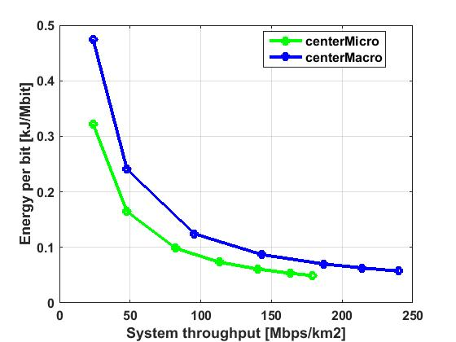
Results and conclusions
Comparison of Energy per bit versus System throughput for central deployment of macro cells and micro cells.
Notes:
we compare the energy performance with respect to the energy per bit. For calculating the energy per bit, we divide the total energy consumed by the serving nodes by the total traffic served by them. Energy per bit tells us that how much energy is needed in the system to deliver a single bit. As we can observe that the deployment of micro cells proves out to take lesser energy per bit as the power amplifier in the micro cells do not ramp up the energy consumption with the load as much in macro units. The energy per bit is higher for lower load because the system throughput increases faster than the power consumption in the serving nodes.

Slide 26
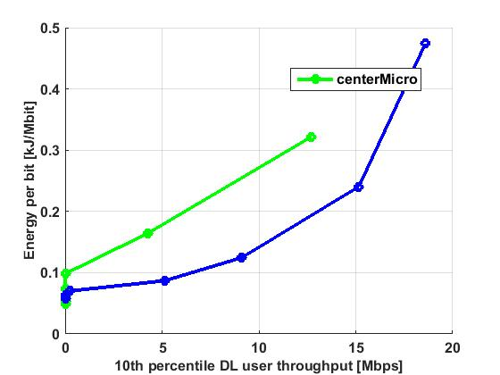
Results and conclusions
Comparison of Energy per bit versus 10th percentile DL user throughput for central deployment of macro cells and micro cells.
Notes:
we do a critical analysis of quality of service down to the 10th percentiles of users, these users have the worst downlink throughput and they could be considered as edge cell users. To deliver a good throughput to the edge cell users say, 11 Mbps we can see the macro cells need something around 1.8 kJ/Mbit while micro cells need 0.3 kJ/Mbit. Here the macro cells come out to as winner because of they can handle a higher load than micro cells as well as the increased load compensates for the increased power consumption in macro cells.

Slide 27
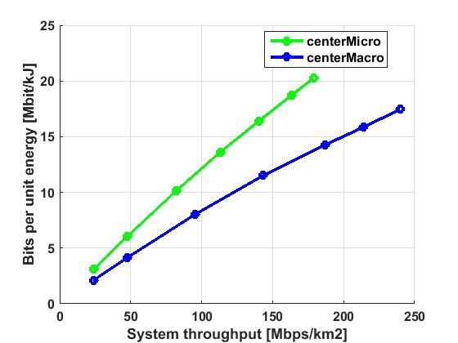
Results and conclusions
Comparison of bits per unit energy versus system throughput for central deployment of macro cells and micro cells.
Notes:
Bits per unit energy is the inverse of energy per bit, to calculate this, we divide the total traffic by total power consumption. In Figure 16, we can see that the micro cells can transfer more bits per unit energy than the macro cells and as the power consumption in micro cells increases less with served traffic load, the number of bits transferred in unit energy (Mbit/kJ) is higher for smaller cells than the large macro cells.

Slide 28
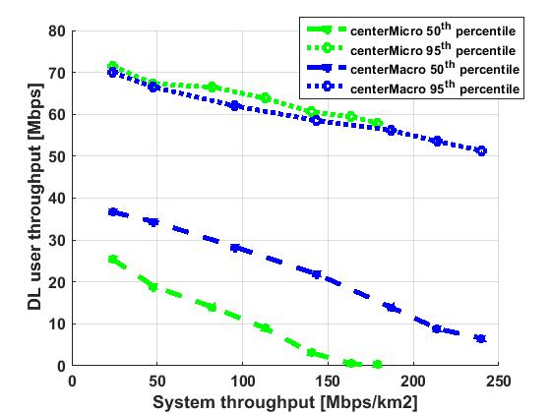
Results and conclusions
Comparison of DL user throughput for 50th and 95th percentile versus system throughput.
Notes:
The DL user throughput is calculated for 10th, 50th and 95th percentile. The 10th percentile refers to the edge cell users, the 50th percentile is the median user data rate for the served traffic, the 95th percentile users are the best-case users with top 5% data rates. In figure 16 the 95th percentile users have similar data rates in macros and micros. The 50th percentile users experience difference in data rates because the data rates at the user side increases with transmit power.
We can also observe that the DL data rate decreases with the increasing traffic load, this is because at lower load there are enough of resources available for the cells to serve the users with high data rates, but as the traffic load increases the bandwidth and the available resources reduces and hence it leads to lowered data rates.

Slide 29
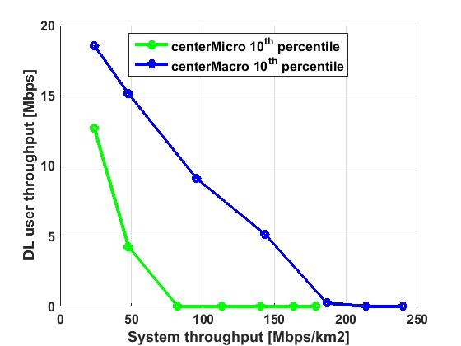
Results and conclusions
Comparison of DL user throughput for 10th percentile versus system throughput.
Notes:
The 10th percentile users represents the edge cell users; the figure 17 compares the data rates for the cell edge users between the micro grid and the macro grid. When the data throughput drops to zero then it represents that the total traffic in the area is so high that the cell edge user could not be served. The data rates for these users decreases rapidly for micro case which proves that it is not the best choice for coverage purpose. This clearly shows that the coverage of macro cells is more than micro cells.

Slide 30
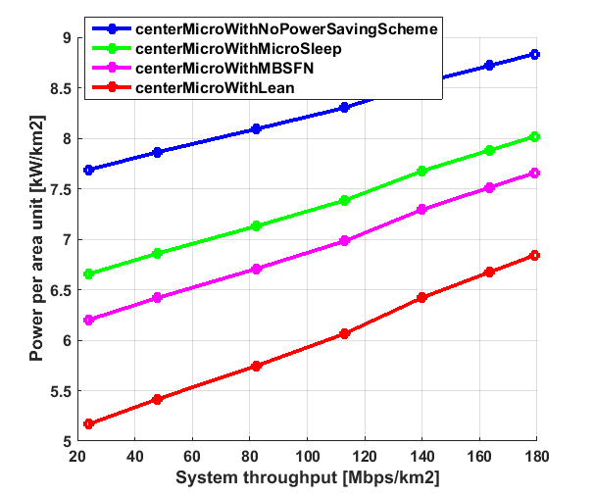
Results and conclusions
Comparison micro with and without energy saving schemes
Comparison of Power per area unit versus System throughput for central deployment of macro cells.
Notes:
the Power per area unit variation for micro cells also follows the similar pattern as in the power per unit area for macro cells. The energy saving schemes can save up to 2 kW/km² than micro cells without energy saving schemes. Here we can see that as the traffic load increases the power required to serve that traffic also goes up. The Lean energy saving scheme seems to be more energy efficient than MBSFN and micro DTX sleep. We can see that the deployment with lean power saving scheme can save 23.5% energy compared to deployment without any energy saving scheme.

Slide 31
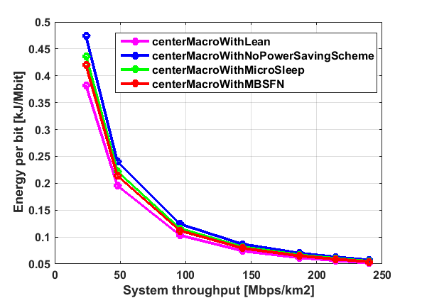
Comparison of energy per bit unit versus system throughput for central deployment of macro cells.
Notes:
we can derive that there is some difference in energy needed to transmit a bit for lower traffic load in different schemes, but as we gradually move towards higher loads this difference comes close together because at higher traffic loads there will be less idle time for the cells to save energy.

Slide 32
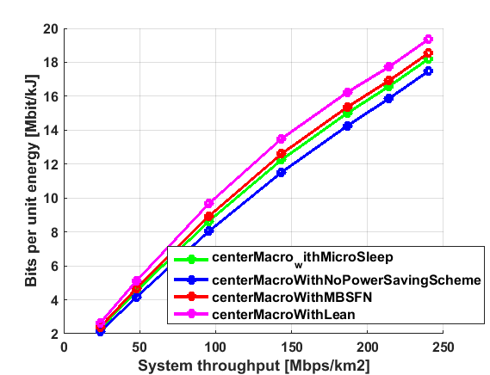
Comparison of bits per unit energy versus system throughput for central deployment of macro cells.
Notes:
In continuation to figure 19 we plot the bits per unit energy versus traffic demand in figure 20, we encounter that there are more number of bits which could be transferred per unit energy when we make use of energy saving schemes.

Slide 33
Results and conclusions
Comparison micro with and without energy saving schemes
Comparison of power per area unit versus system throughput for central deployment of macro cells.
Notes:
Here we will compare the energy performance and the network performance of deploying small cells of micro grid with and without energy saving schemes.
the Power per area unit variation for micro cells also follows the similar pattern as in the power per unit area for macro cells. The energy saving schemes can save up to 2 kW/km² than micro cells without energy saving schemes. Here we can see that as the traffic load increases the power required to serve that traffic also goes up. The Lean energy saving scheme seems to be more energy efficient than MBSFN and micro DTX sleep. We can see that the deployment with lean power saving scheme can save 23.5% energy compared to deployment without any energy saving scheme.

Slide 34
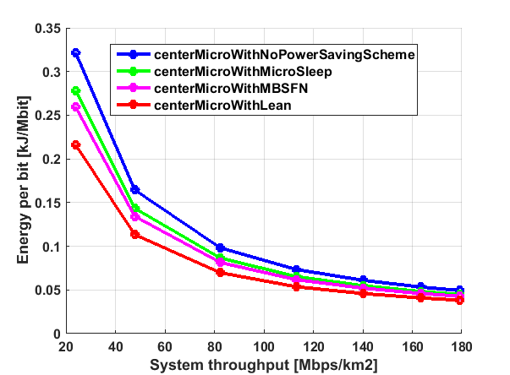
Comparison of energy per bit unit versus system throughput for central deployment of micro cells.
Notes:
the same pattern as the one we saw in central macro deployment case however the energy per bit needed in micro is lesser than that of macros. The energy schemes can save upto 25% on energy per bit for micro deployment.

Slide 35
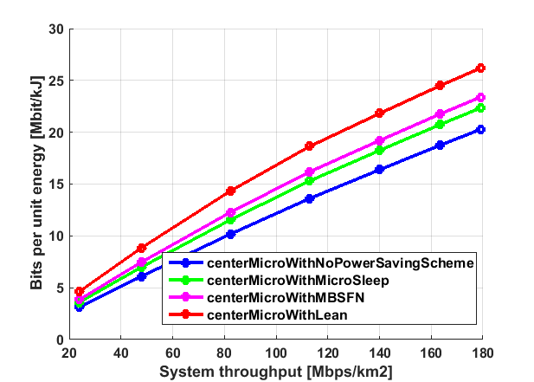
Comparison of bits per unit energy versus system throughput for central deployment of macro cells.
Notes:
we see the behavior as expected, deployment with enegy saving schemes have potential to fit in upto 30% more bits per unit energy than deployments without energy saving schemes.

Slide 36
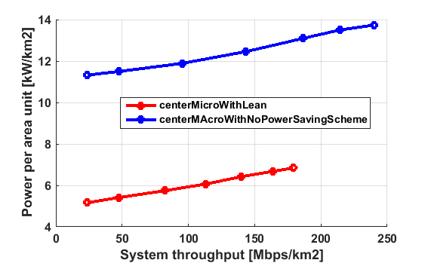
Results and conclusions
Comparison macro versus micro with energy saving schemes
Comparison of Power per area unit versus System throughput for central deployment of macro cells versus micro cells.
Notes:
we can compare the amount of energy savings we can achieve by having a micro cell with lean carrier energy saving scheme against a macro cell with no energy saving schemes. For 100 Mbps/km² of system throughput the micro cells consume 6 kW//km² whereas, macro cells consume double than that 12 kW//km² . Implementing a scheme like this one can reduce the power consumption to half.

Slide 37
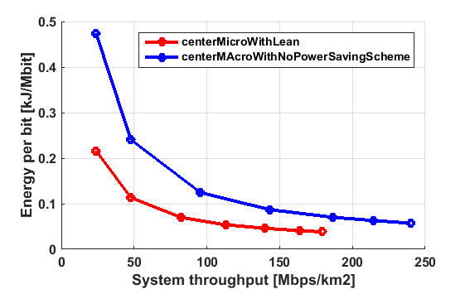
Comparison of energy per bit unit versus system throughput for central deployment of micro cells versus macro cells.
Notes:
Now let’s consider the energy per bit, we can see in figure 25, the energy per bit requirement for micro cells with energy saving scheme is much less than that of macro counterpart. The energy per bit is high for low traffic load because the total served traffic is low for less load and hence, the energy per bit increases.

Slide 38
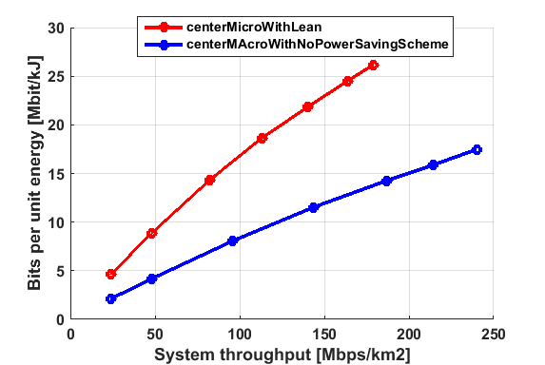
Comparison of bits per unit energy versus system throughput for central deployment of micro cells versus macro cells.
Notes:
The bits per unit energy for micro cells with lean carrier energy saving scheme is almost double than that of the macro cells without energy saving schemes as seen in figure

Slide 39
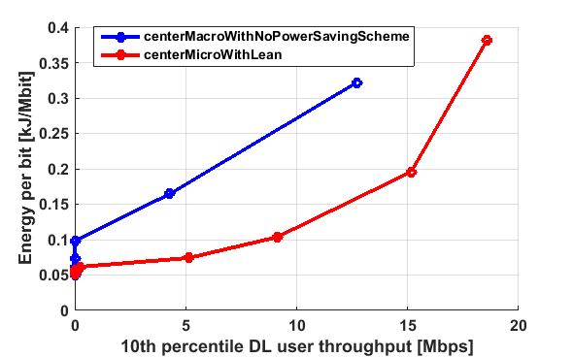
Comparison of energy per bit unit versus system throughput for central deployment of micro cells versus macro cells.
Notes:
When it comes to reaching the last mile of user throughput, the micros could not provide as good user throughput as macros do. That’s why in figure 27, the energy per bit needed for providing high throughput for the edge cell users is high in case of micro cells. So, the macro cells are needed to provide a good coverage area and decent throughput to the bottom 10th percentile users.

Slide 40
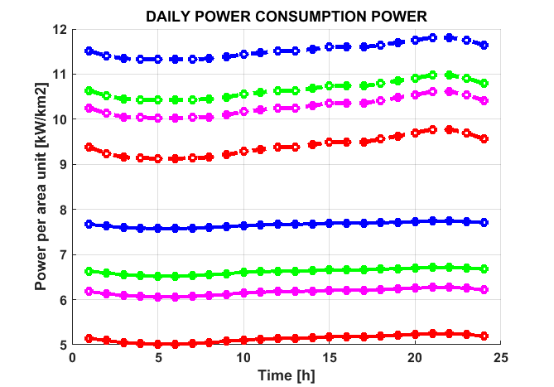
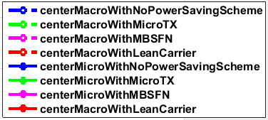
Results and conclusions
Daily power consumption
Notes:
For calculating the daily power consumption we kept a DL threshold of 10 Mbps for 10th percentile users during the peak hours. Figure 28 shows the power consumption of macros and micros with different energy saving schemes.
At peak load for macro deployment, there is a possibility of 17% saving using the lean carrier energy saving scheme and 20% energy saving could be achieved at low load.
In case of micro deployment, at peak load we can see 29% saving using the lean carrier energy saving scheme and a good 33% energy saving at low load. This is because lower utilization of nodes at lower loads gives more scope for energy saving schemes to be implemented.
Also from these patterns we can verify that the traffic demand is low during early morning hours and is high during the evening hours.

Slide 41
Conclusions
The results on the energy savings were much better by using the micro only base stations as they saved almost half of the energy required to run the network when implemented with energy saving schemes.
It was observed that using the discontinuous transmission around 20% to 30% of energy could be saved. The amount of savings from these energies saving schemes depend upon the utilization and sleep time of these nodes.
Notes:
For macro cells; as the number of resources are limited so, as the traffic load goes up the resources are needed to be shared among the UEs. This leads to reduced data rates for UE and longer time to receive a file. Therefore, It is advantageous to complement macro cells in the network with micro cells for increased quality of service and improved data rates.

Slide 42
For Macro deployment, the power consumption for a day without using any energy saving scheme was 283.44kWhr/km² which is 103455.6kWhr/km² for a year. Using micro DTX energy saving scheme it was 263.52kWhr/km² which is 96184.8kWhr/km² for a year. Using MBSFN energy saving scheme it was 254.64kWhr/km² which is 92943.6kWhr/km² for a year. Using lean carrier energy saving scheme it was 234.62kWhr/km² which is 85637.76kWhr/km² for a year.
For Micro deployment, the power consumption for a day without using any energy saving scheme was 185.80kWhr/km² which is 67819.92kWhr/km² for a year. Using micro DTX energy saving scheme it ws 161.23kWhr/km² which is 58849.68kWhr/km² for a year. Using MBSFN energy saving scheme it was 150.24kWhr/km² which is 54837.6kWhr/km² for a year. Using lean carrier energy saving scheme it was 125.85kWhr/km² which is 45937.44kWhr/km² for a year.

Slide 43
using energy saving schemes in macro cell deployment can give savings as much as 17% and 33% over a year.
comparing the macro without energy saving scheme to micro with lean carrier energy saving scheme results in 55% of energy saving.
This sort of heterogeneous cell deployment would help the network engineers in analyzing which type of cells are better suited for energy efficient deployment.
Notes:
Therefore, from an energy saving point of view, it would be much better to implement a heterogeneous network with more micro cells and small cells with energy saving schemes than with more number of macro cells.

Slide 44
Macro grid performs much better when it comes to coverage, as the performance of the big macro cells is better than micro cells for the 10th percentile users, for this reason we need to deploy the small cell networks complemented by the macro cells to provide sufficient coverage to the edge cell users.
It would be more efficient to substitute macro cells with micro cells especially in the parts of the city which require higher data rates and this will be a backbone of 5G deployments. Applying these energy saving schemes in across thousands of sites in a mobile network will accumulate to tens of millions of kilowatt hours (kWh) in power savings annually. However, it would be the responsibility of the network planners to ensure that these cells are placed in the areas where they are needed the most otherwise adding small cells on top of the macro cells will only result in higher energy consumption.

Slide 45
Future Work
As the simulations were carried out for a realistic dense urban scenario, there is scope of finding out the energy efficiency gains in other scenarios as well such as sub-urban and rural. These scenarios are equally important for instance, a huge amount of diesel energy is consumed for fueling up the cells in rural environment.
As the results are dependent over the deployment of the cells, one could might as well deploy the cells on other buildings to analyze the energy and throughput efficiencies.
Notes:
“Real-time Implementation Of Digital Cavity”, Siyuan Fu, Aohan Jin
“Frequency Tracking Using Digital Cavities”, FREDRIK ZETTERBLOM

Slide 46
The propagation model used in this study was BEZT however, there are various other propagation models like WINNER II etc. that could be used to calculate propagation losses in a real city like environment.
As the simulator which was used is a static, one can also make use of dynamic simulators to analyze the traffic and latency in each of the energy saving schemes.

Slide 47
Summary
Energy efficient schemes.
50% savings using micro with lean than macro without any scheme.
Saves _MW per year
Technique could be made use of in such a deployment.

