Slide 1
Diabetes Prediction Using LDA, QDA, and PCA: A Comprehensive Statistical Analysis
EARLY DETECTION OF DIABETES | ASDS 5303
Group 7
Members: Bikesh Adhikari • Mayanka Sharma
Md Ahnaf Tajwar Kamal • Saminas Betel Kebebe
December 5, 2025

Slide 2
537 Million
People worldwide live with diabetes
But here's the problem:
Many cases go undetected until complications arise
Source: IDF Diabetes Atlas, 10th Edition (2021)

Slide 3

The Mission: Early Detection Saves Lives
The Challenge
Diabetes is a silent killer. By the time symptoms appear, irreversible damage may have occurred. Early detection through predictive modeling can change lives.
Our Quest
Can we build a model that accurately identifies at-risk patients using simple, non-invasive measurements? We tested two powerful methods: LDA vs QDA.

Slide 4
Our Data: The Pima Indians Diabetes Study
A real-world dataset with real-world challenges
768 Women
8 Predictors
Binary Outcome
Pima Indian heritage, aged 21+
Glucose, BMI, Insulin, Age, Blood Pressure, Pregnancies, Skin Thickness, Pedigree
0 = No Diabetes = 1 = Diabetes
Real patients, real data
Clear classification goal
Simple, non-invasive measurements

Slide 5
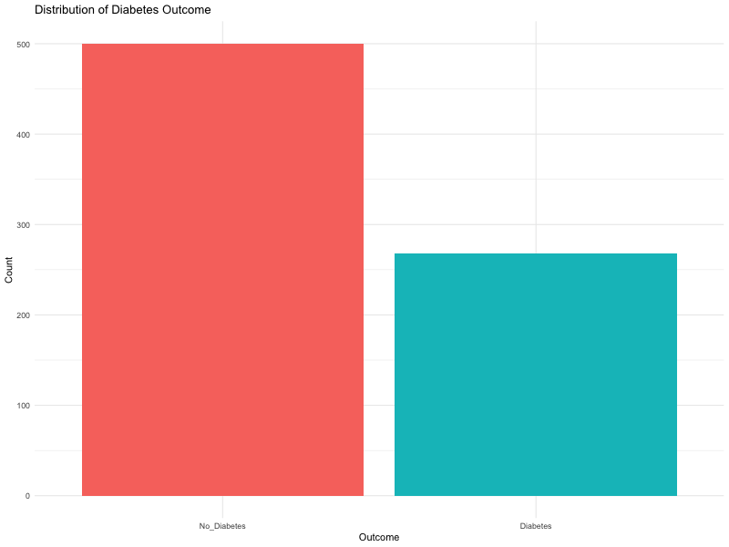
First Red Flag: Class Imbalance
Our first challenge revealed itself immediately
The Numbers
• No Diabetes: ~500 cases (65%)
• Diabetes: ~265 cases (35%)
Warning Sign:
A 2:1 imbalance means our model might favor the majority class. This will become critical later in our story.

Slide 6
Preparing for Battle: Data Preprocessing
Before we could build models, we had to clean our data
Step 1: Data Cleaning
Step 2: Train-Test Split
Replaced impossible zero values (e.g., 0 Glucose, 0 Blood Pressure) with NA and imputed using median values to preserve distribution characteristics.
70% Training / 30% Testing split, stratified to maintain the original class distribution in both sets.
Quality data = reliable results
Fair evaluation requires fair splits

Slide 7
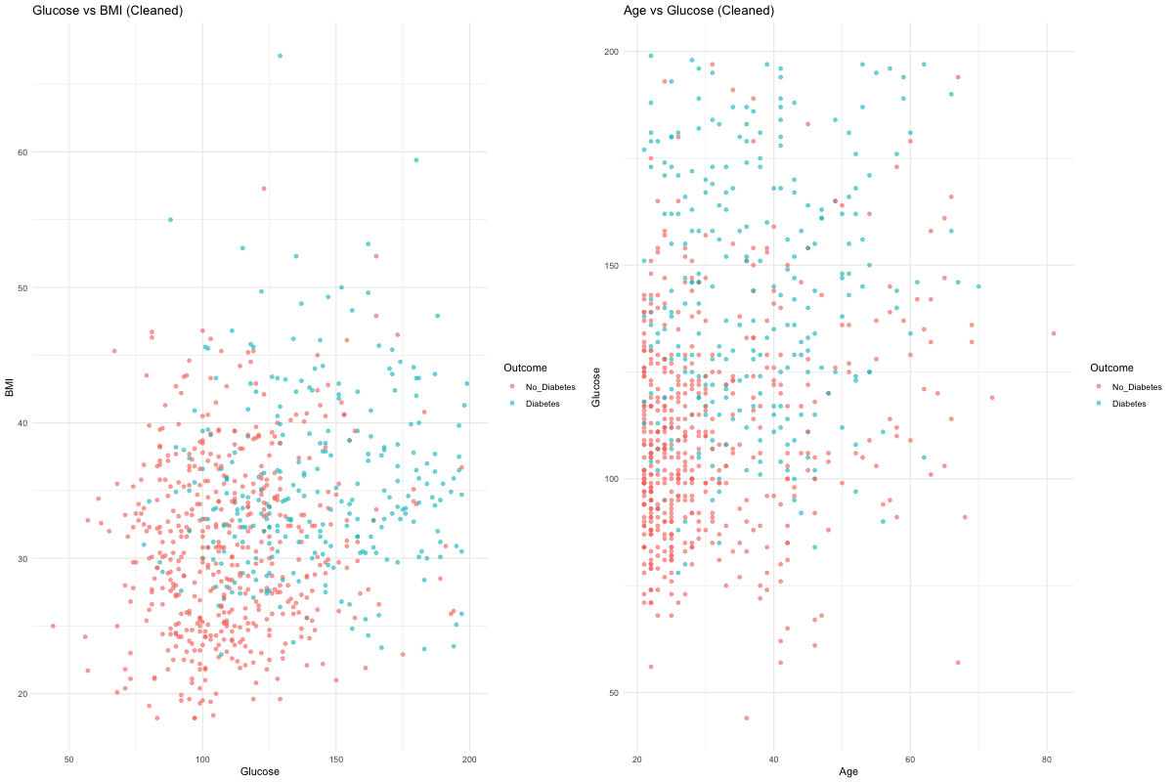
Data Visualization
Scatter Plots: Glucose vs BMI and Age vs Glucose
Key Insights:
• Glucose appears to be the strongest distinguishing factor (diabetes cases cluster at Glucose > 120-130)
• Higher BMI and Age show increased diabetes prevalence, but with significant overlap
• No clear linear separation, suggesting non-linear boundaries may be needed

Slide 8
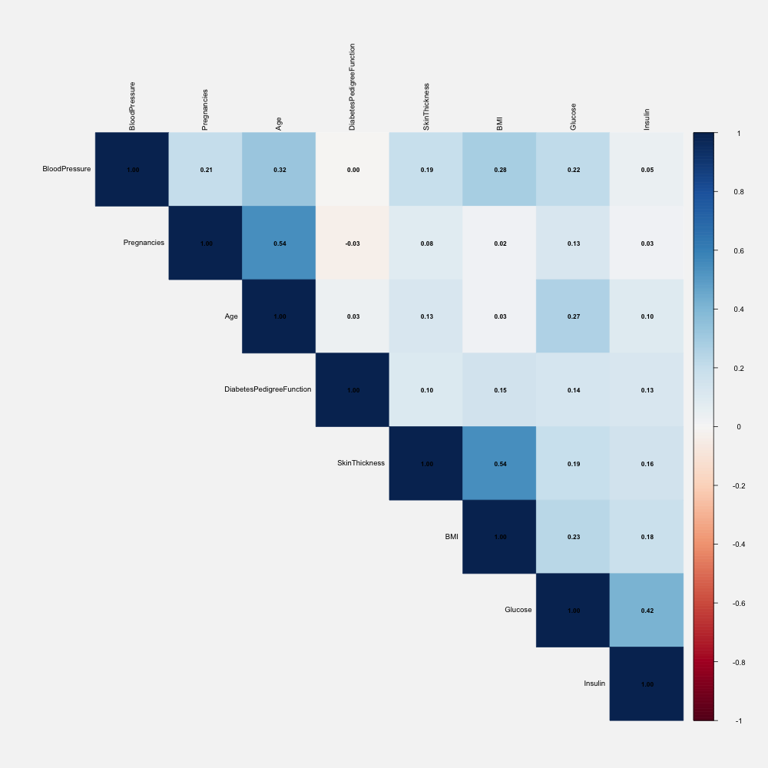
Correlation Analysis
Pairwise Correlation Matrix of Predictors

Slide 9
Key Correlations
Strong Correlations
Implications
• Age & Pregnancies (0.54): Strongest correlation; older women tend to have higher pregnancy counts.
No perfect multicollinearity: All correlations are moderate, suggesting each predictor contributes unique information. This supports the use of discriminant analysis methods.
• BMI & Skin Thickness (0.54): Expected physiological relationship - both measure body composition.
• Glucose & Insulin (0.42): Moderate positive correlation - insulin response to glucose levels.
No single dominant predictor: The outcome cannot be predicted by a single variable, necessitating multivariate approaches like LDA/QDA.
Weak Correlations
• Age & Pregnancies (0.54): Strongest correlation; older women tend to have higher pregnancy counts.
• BMI & Skin Thickness (0.54): Expected physiological relationship - both measure body composition.

Slide 10
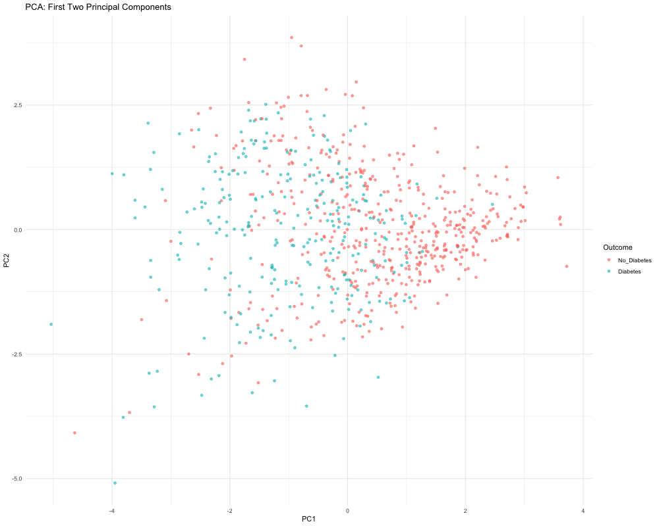
Principal Component Analysis
47.23% Variance Explained
First 2 components (PC1 + PC2) capture less than half of total variance.
5 Components Needed
Required to capture >80% of the dataset's information.
Key Observation
Heavy Overlap: The first two principal components show significant overlap between diabetes and no-diabetes groups, indicating that linear separati...
PCA: First Two Principal Components

Slide 11
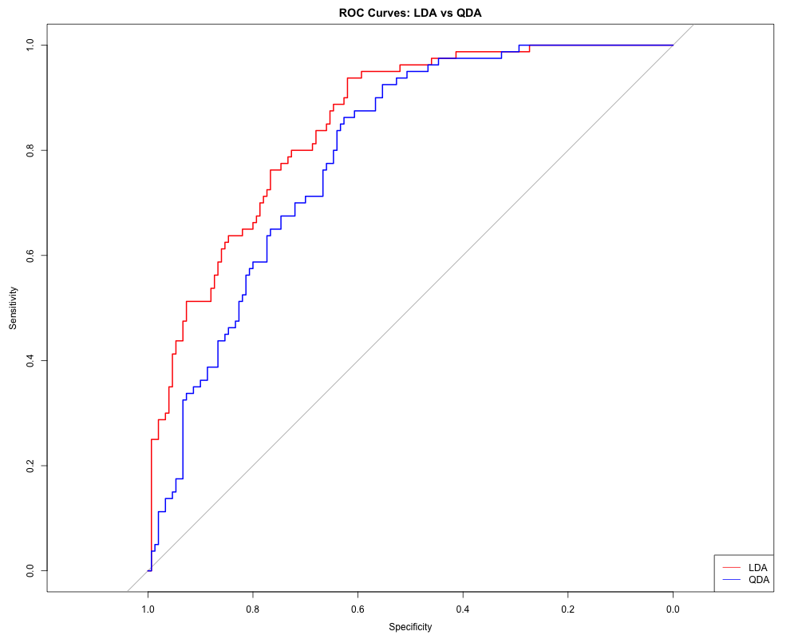
The Moment of Truth: Model Performance
After rigorous testing, the results are in...
Metric
LDA (Linear)
QDA (Quadratic)
Accuracy
76.09%
71.30%
Sensitivity (Healthy)
86.67%
82.00%
Specificity (Diabetic)
56.25%
51.25%
AUC (ROC)
0.835
0.806

Slide 12
LDA vs QDA: Detailed Results
LDA (Linear Discriminant Analysis)
QDA (Quadratic Discriminant Analysis)
Accuracy: 76.09%
Accuracy: 71.30%
Sensitivity: 86.67%
Sensitivity: 82.00%
Specificity: 56.25%
Specificity: 51.25%
AUC-ROC: 0.835
AUC-ROC: 0.806
Precision: 0.71
Precision: 0.66
F1-Score: 0.78
F1-Score: 0.73
Key Strength:
Limitation:
More robust to class imbalance, better generalization.
Overfits on smaller class, less stable with imbalanced data.
Winner: LDA - Despite theoretical preference for QDA (unequal covariance), LDA demonstrates superior performance with 4.79% higher accuracy and better stability on imbalanced data.

Slide 13
The Critical Blind Spot
A sobering reality check
56%
44%
Specificity
Missed Cases
Only 56% of diabetic cases correctly identified
44% of diabetic patients go undetected
Critical Issue:
The model is excellent at identifying healthy individuals (86.67% sensitivity), but struggles with positive cases due to class imbalance (65% No Diabetes vs 35% Diabetes). This is a significant limitation for clinical application where missing diabetic cases has serious consequences.

Slide 14
The Plot Twist: Theory vs. Reality
Sometimes the data tells a different story than the textbooks
Box's M Test: A statistical test that checks whether covariance matrices are equal across groups. H₀: Equal covariance (LDA assumption). H₁: Unequal covariance (QDA assumption).
What Theory Said
What Data Revealed
• Box's M Test: p < 0.05
• LDA Won by 4.79%
• We rejected the null hypothesis of equal covariance. This means the covariance matrices differ significantly between diabetes and no-diabetes groups.
• Despite the violation, LDA was more robust. QDA likely overfitted the noise in the smaller class.
• Statistical theory clearly suggests QDA should win (since it allows different covariances).
• ...but reality had other plans
• The textbooks were confident...
Key Insight: In real-world scenarios with imbalanced data, simpler models often outperform complex ones. Robustness beats theoretical perfection.

Slide 15
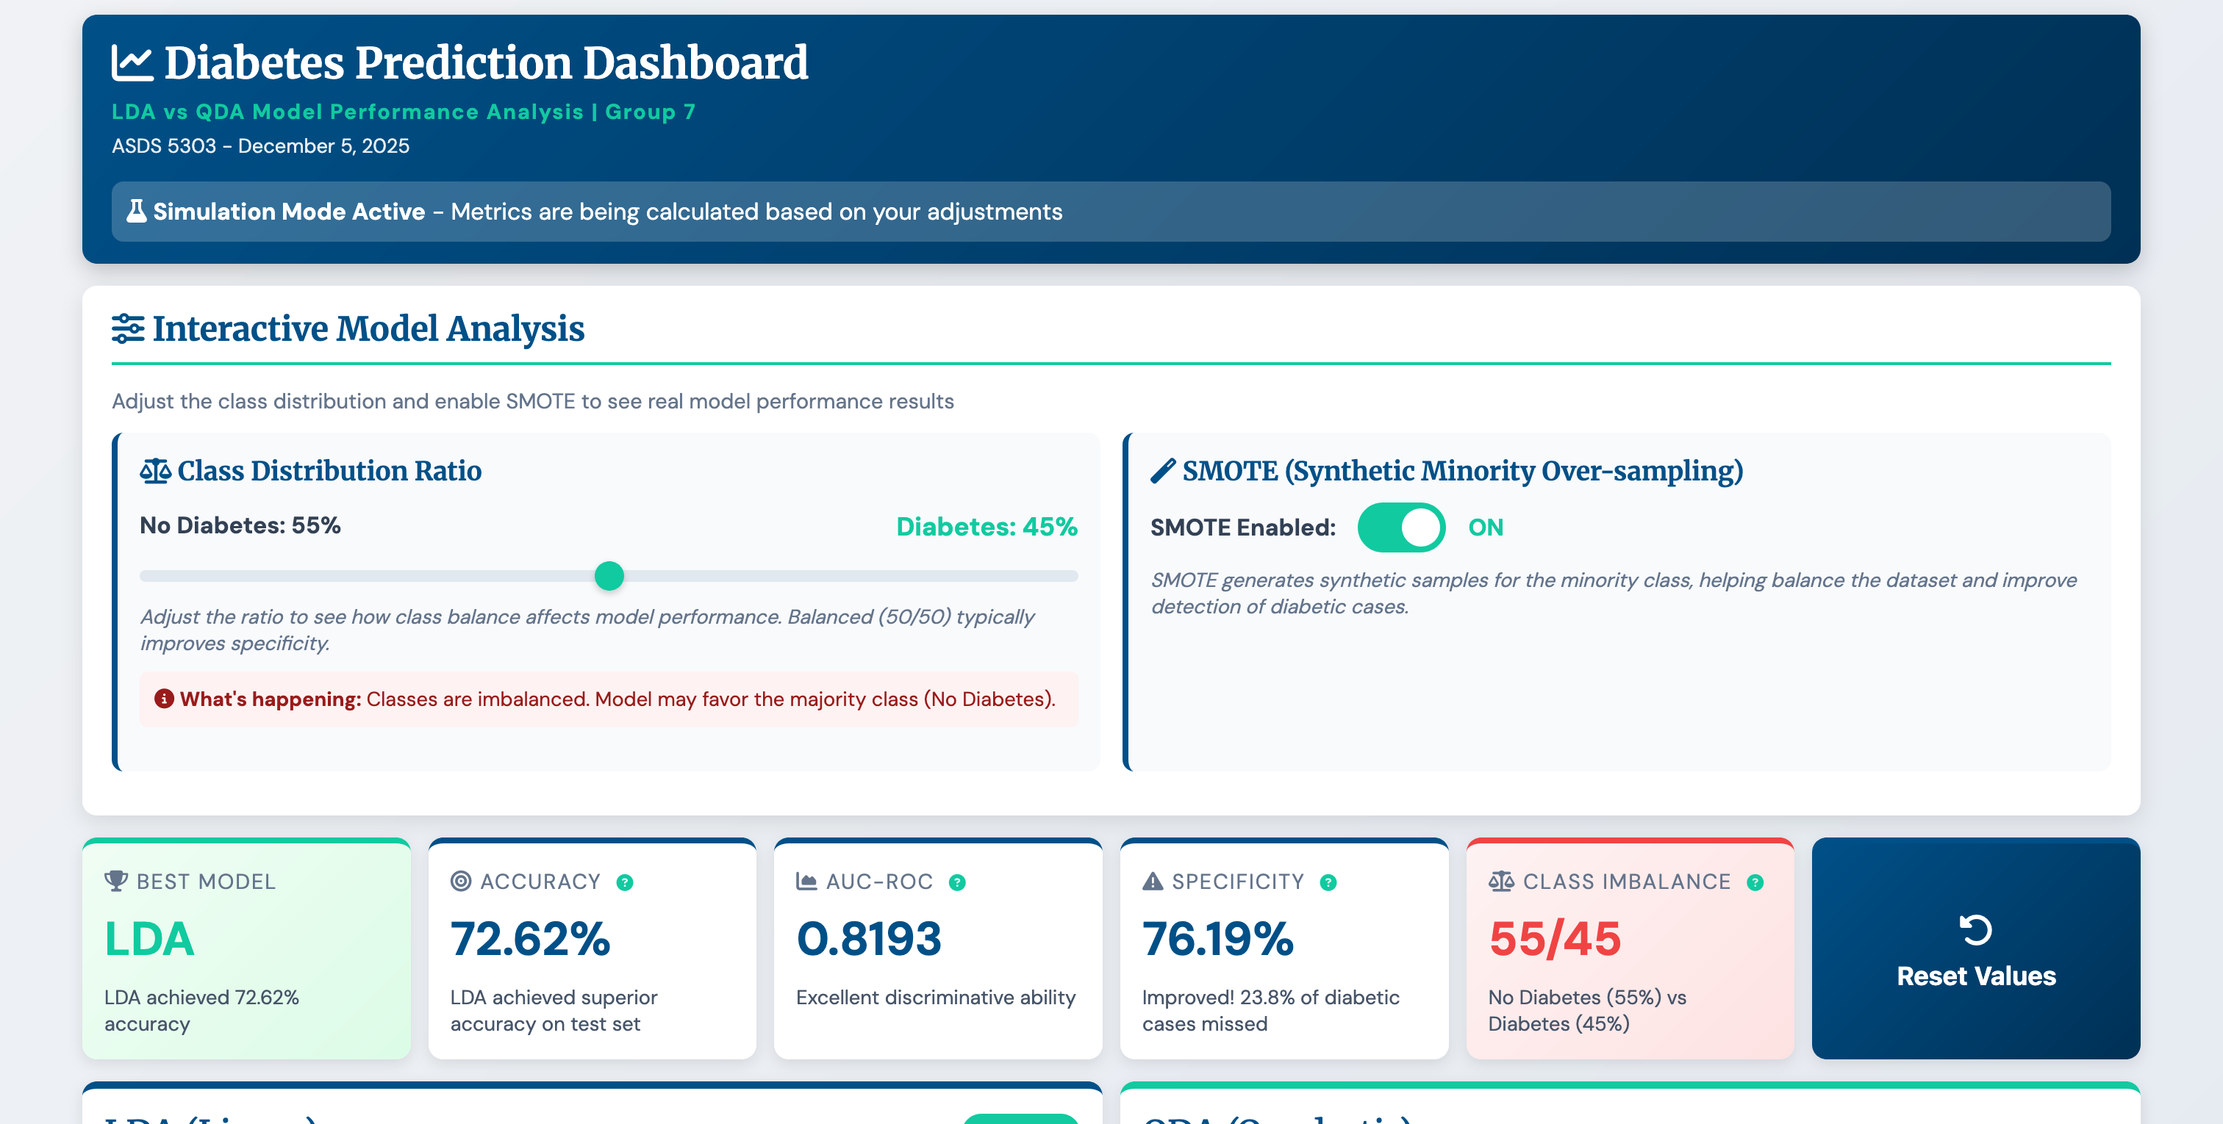
Interactive Dashboard: See It Live
Explore how class balance and SMOTE affect model performance in real-time
Interactive Features
• Class Distribution Slider: Adjust from 40% to 70% to see how balance affects performance
• SMOTE Toggle: Enable/disable synthetic oversampling
• Real-Time Updates: Metrics recalculate with actual R model training
• Live ROC Curves: Watch curves update as parameters change
What You Can Explore
• Balanced Classes (50/50): See how specificity improves
• SMOTE Impact: Compare with/without synthetic oversampling
Live Dashboard: Adjust class distribution and SMOTE to see real model results
• Model Comparison: Watch LDA vs QDA performance change
• Tooltips: Hover over metrics for explanations
Live Demo: Try the interactive dashboard yourself!
https://asds-5303-final-project-presentatio.vercel.app/dashboard.html
Adjust the slider and toggle SMOTE to see real-time model performance changes.

Slide 16
What We Learned: The Journey's End
Key Takeaways
The Path Forward
• LDA Wins: Despite theory favoring QDA, LDA achieved 76.09% accuracy with superior robustness. Sometimes simpler is better.
• SMOTE: Balance the classes to give diabetes cases a fair chance.
• Critical Gap: Missing 44% of diabetic cases is unacceptable. We must do better.
• Cost-Sensitive Learning: Prioritize catching diabetic cases—missing them costs more than false alarms.
• Ensemble Methods: Combine LDA with Random Forest, SVM for a stronger team.
• Root Cause: Class imbalance (65% vs 35%) is the villain in our story. This must be addressed.
• Feature Engineering: Uncover hidden patterns through interaction terms.
The Bottom Line: We have a good start, but we're not ready for clinical deployment yet.
Our Promise: We'll continue improving until we can confidently detect diabetes early.

Slide 17
Questions?
References:
1. International Diabetes Federation. (2021). IDF Diabetes Atlas, 10th Edition. Brussels, Belgium: International Diabetes Federation.
2. National Institute of Diabetes and Digestive and Kidney Diseases. Pima Indians Diabetes Database. UCI Machine Learning Repository.
3. James, G., Witten, D., Hastie, T., & Tibshirani, R. (2013). An Introduction to Statistical Learning: with Applications in R. New York: Springer.
4. Venables, W. N., & Ripley, B. D. (2002). Modern Applied Statistics with S (4th ed.). New York: Springer.
5. American Diabetes Association. (2023). Standards of Care in Diabetes—2023. Diabetes Care, 46(Supplement 1), S1-S291.
6. Chawla, N. V., Bowyer, K. W., Hall, L. O., & Kegelmeyer, W. P. (2002). SMOTE: Synthetic Minority Over-sampling Technique. Journal of Artificial Intelligence Research, 16, 321-357.

