Slide 1
Do we now understand convolutions?
Sources:
1D conv images from Brandon Rohrer https://e2eml.school/convolution_one_d.html
2D conv images from https://towardsdatascience.com/intuitively-understanding-convolutions-for-deep-learning-1f6f42faee1

Slide 2

Can we predict the output size?
Input size
Kernel size
Other things?
Stride
Padding
Multiple channels

Slide 3
1D Convolutions, stride > 1

Slide 4
2D Convolutions, stride=2

Slide 5
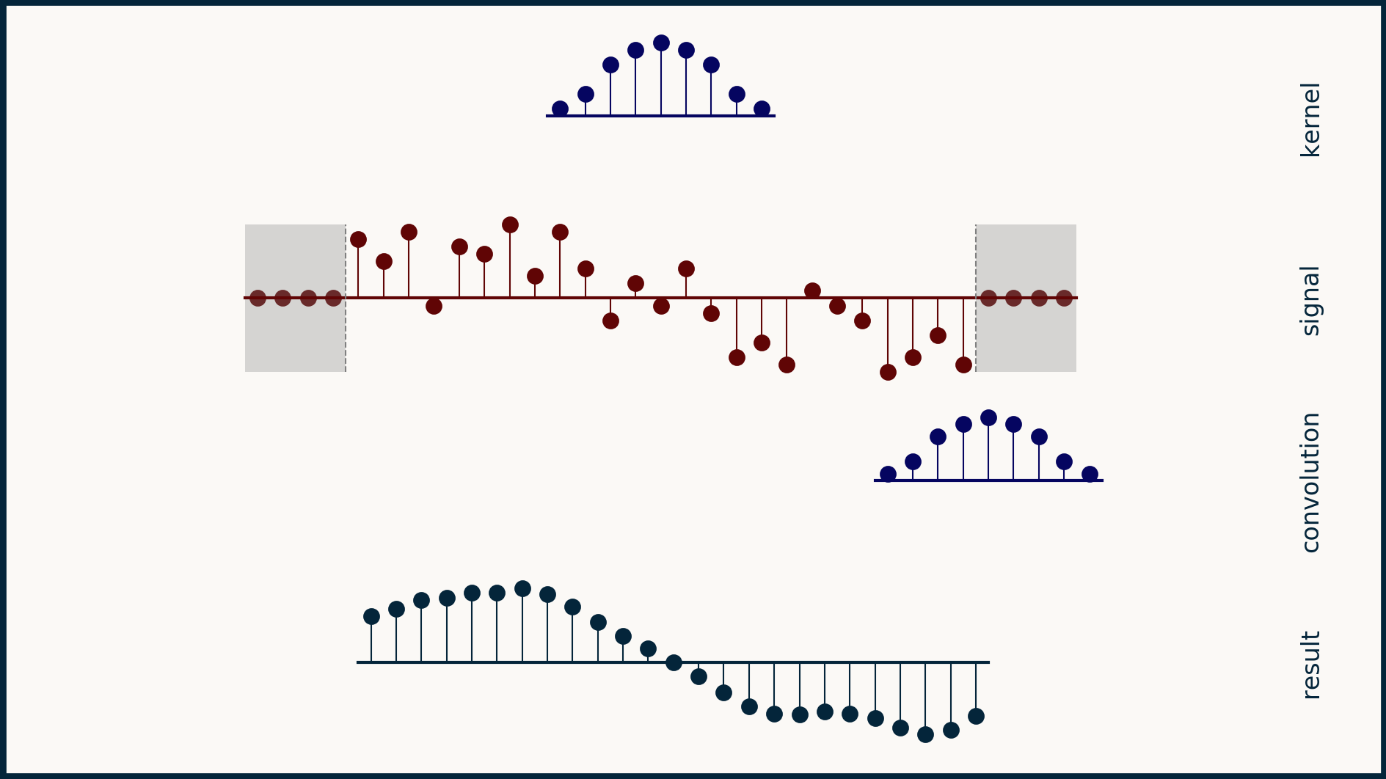
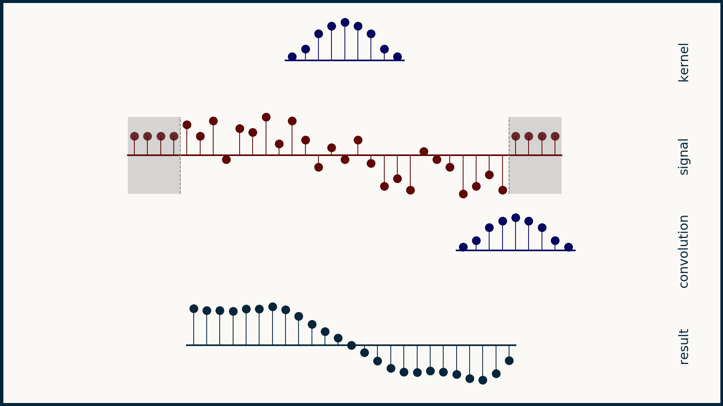
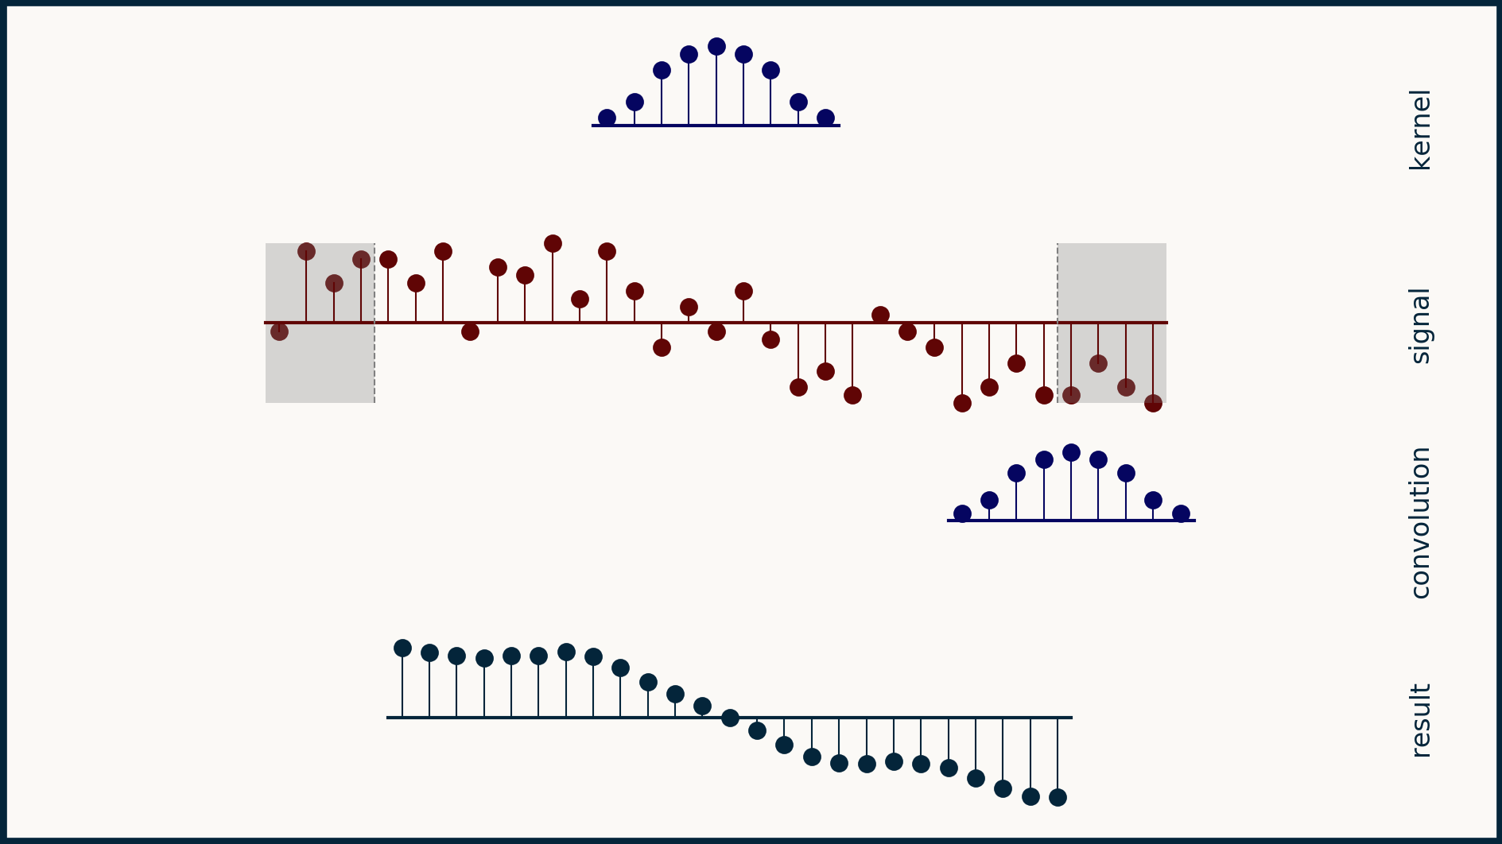
1D Convolutions, padding

Slide 6
2D Convolutions, padding=1
Quiz:
For a kernel of size K, what value of padding is necessary for output size to be equal to input? (assume stride=1)

Slide 7
1D Convolutions, multiple channels

Slide 8
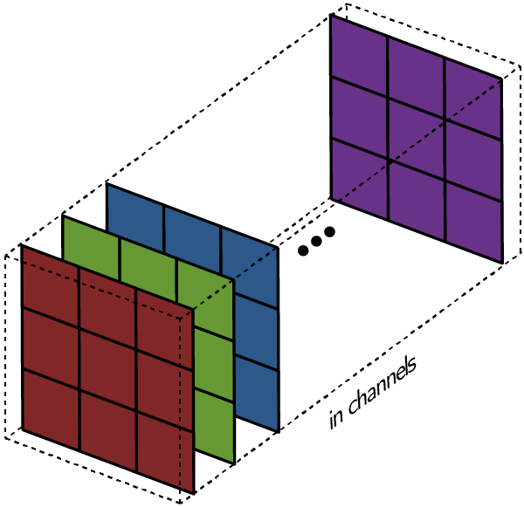
2D Convolutions, multiple channels

Slide 9
Now, can we predict the output size?
Input | Kernel | Stride | Padding | Output
15x15 | 2x2 | 1 | 0
15x15 | 3x3 | 1 | 0
15x15 | 3x3 | 1 | 1
15x15 | 5x5 | 1 | 1
15x15 | 5x5 | 2 | 1
15x15 | 5x5 | 1 | 2
15x15 | 5x5 | 2 | 2
Homework: Derive a formula to compute output size given the 4 pieces of information.
Notes:
B: 1, C_in: 1, C_out: 1, HW: (15, 15) K: 2, S: 1, P: 0, OUT: torch.Size([1, 1, 14, 14])
B: 1, C_in: 1, C_out: 1, HW: (15, 15) K: 3, S: 1, P: 0, OUT: torch.Size([1, 1, 13, 13])
B: 1, C_in: 1, C_out: 1, HW: (15, 15) K: 3, S: 1, P: 1, OUT: torch.Size([1, 1, 15, 15])
B: 1, C_in: 1, C_out: 1, HW: (15, 15) K: 5, S: 1, P: 1, OUT: torch.Size([1, 1, 13, 13])
B: 1, C_in: 1, C_out: 1, HW: (15, 15) K: 5, S: 2, P: 1, OUT: torch.Size([1, 1, 7, 7])
B: 1, C_in: 1, C_out: 1, HW: (15, 15) K: 5, S: 1, P: 2, OUT: torch.Size([1, 1, 15, 15])
B: 1, C_in: 1, C_out: 1, HW: (15, 15) K: 5, S: 2, P: 2, OUT: torch.Size([1, 1, 8, 8])

Slide 10
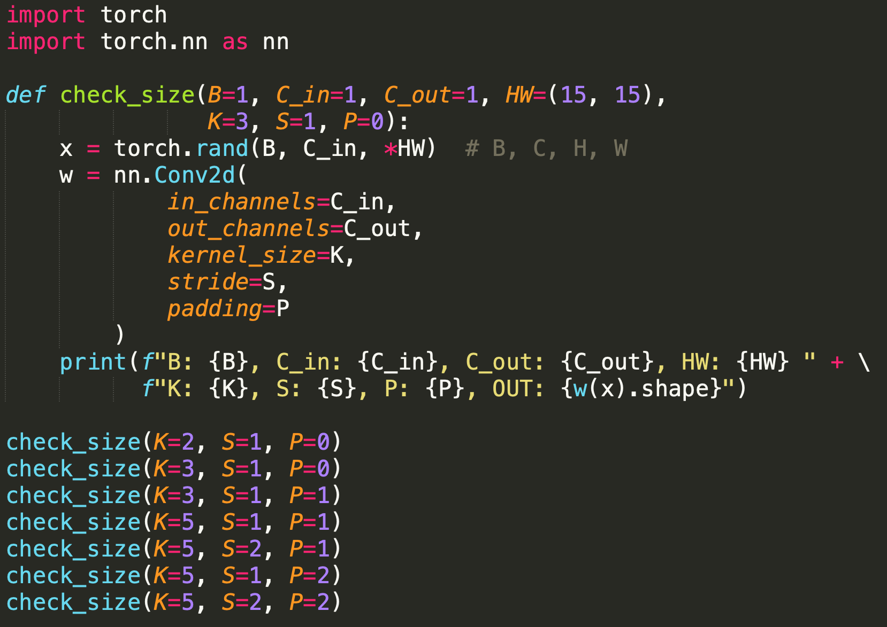
Homework: Confirm with code
Notes:
B: 1, C_in: 1, C_out: 1, HW: (15, 15) K: 2, S: 1, P: 0, OUT: torch.Size([1, 1, 14, 14])
B: 1, C_in: 1, C_out: 1, HW: (15, 15) K: 3, S: 1, P: 0, OUT: torch.Size([1, 1, 13, 13])
B: 1, C_in: 1, C_out: 1, HW: (15, 15) K: 3, S: 1, P: 1, OUT: torch.Size([1, 1, 15, 15])
B: 1, C_in: 1, C_out: 1, HW: (15, 15) K: 5, S: 1, P: 1, OUT: torch.Size([1, 1, 13, 13])
B: 1, C_in: 1, C_out: 1, HW: (15, 15) K: 5, S: 2, P: 1, OUT: torch.Size([1, 1, 7, 7])
B: 1, C_in: 1, C_out: 1, HW: (15, 15) K: 5, S: 1, P: 2, OUT: torch.Size([1, 1, 15, 15])
B: 1, C_in: 1, C_out: 1, HW: (15, 15) K: 5, S: 2, P: 2, OUT: torch.Size([1, 1, 8, 8])

Slide 11
Towards Convolutional Neural Networks

Slide 12
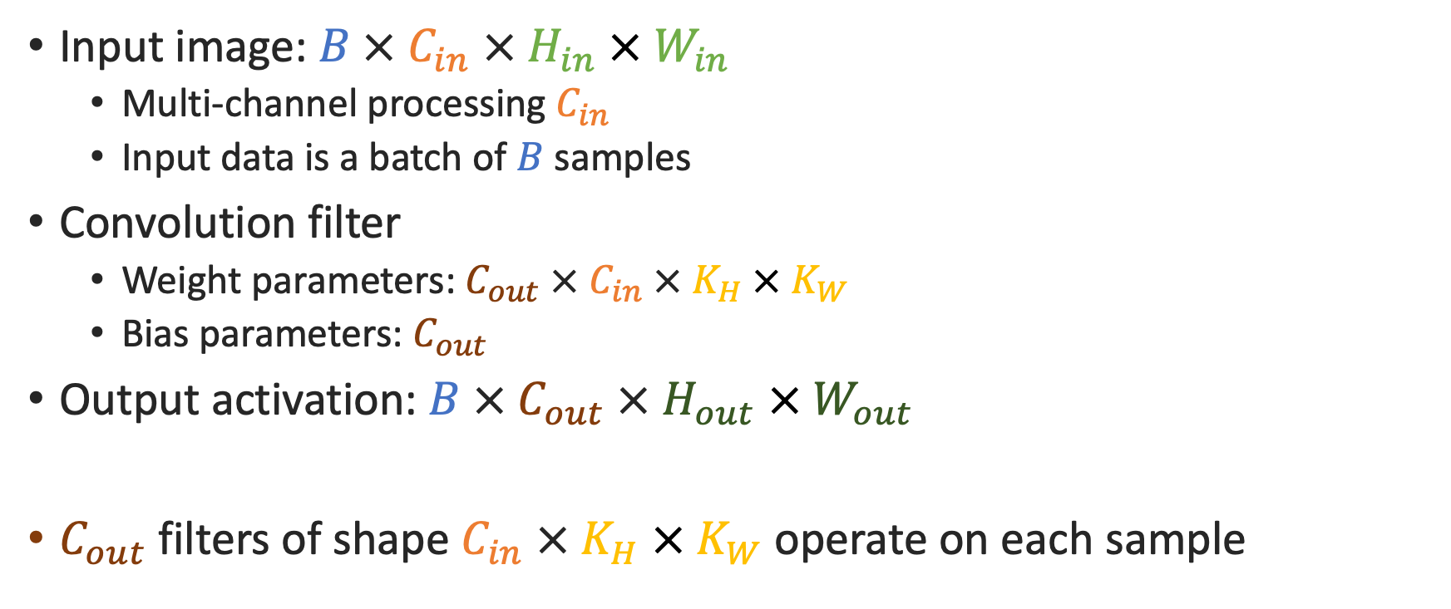
Inputs and Outputs
Input image: $B × C_{in} × H_{in} × W_{in}$
Multi-channel processing $C_{in}$
Input data is a batch of $B$ samples
Convolution filter
Weight parameters: $C_{out} × C_{in} × K_{H} × K_{W}$
Bias parameters: $C_{out}$
Output activation: $B × C_{out} × H_{out} × W_{out}$
$C_{out}$ filters of shape $C_{in} × K_{H} × K_{W}$operate on each sample

Slide 13
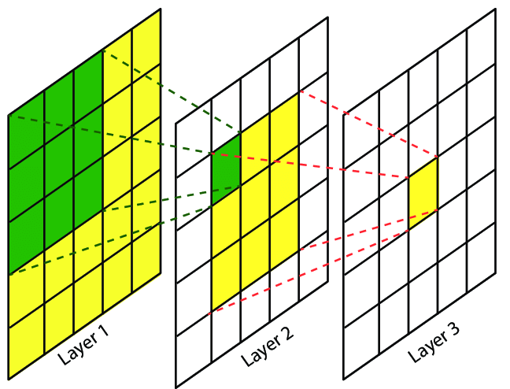
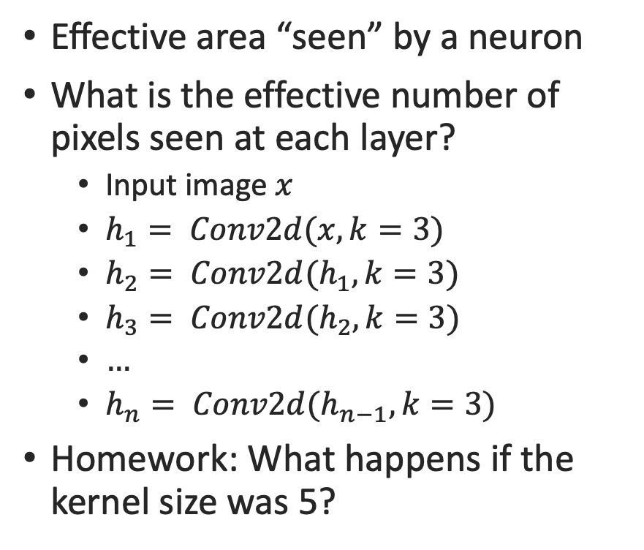
Receptive Fields
Source: (ResearchGate) Maritime Semantic Labeling of Optical Remote Sensing Images with Multi-Scale Fully Convolutional Network
Effective area “seen” by a neuron
What is the effective number of pixels seen at each layer?
Input image $x$
$h_{1}= Conv2d(x, k=3)$
$h_{2}= Conv2d(h_{1}, k=3)$
$h_{3}= Conv2d(h_{2}, k=3)$
$…$
$h_{n}= Conv2d(h_{n−1}, k=3)$
Homework: What happens if the kernel size was 5?
Notes:
1
h1: 3
h2: 5
h3: 7
…
hn: 2n+1

Slide 14
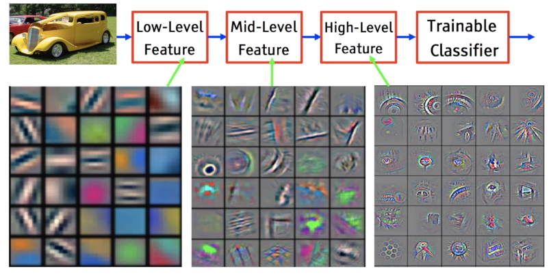
Local to Global
Source: Yann LeCun’s presentations on ConvNets

