Slide 1

IILM UNIVERSITY
School of Computer Science and Engineering • Greater Noida, U.P.
INTERNSHIP PRESENTATION
Web Testing Internship
Quality Assurance • Functional Testing • UI/UX Testing • API Validation
STUDENT NAME
Mudit Sharma
PROGRAM & SEMESTER
B.Tech CSE • Semester 3
ENROLLMENT NUMBER
25SCS1003002812
ORGANIZATION
Dikshay’s Finetune
B.Tech CSE • Batch 2025–29

Slide 2

Introduction
Web testing is the systematic process of checking a website to ensure that its functions, user interface, performance and integrations work correctly. During this 30-day internship, I gained practical exposure to software quality assurance while working on a real website project.
1
2
3
The Internship
What I Practised
The Outcome
Successfully completed a 30-day Web Testing Internship at Dikshay’s Finetune from 20 July 2026 to 20 August 2026.
Functional testing, UI testing, test-case creation and execution, defect identification and reporting, regression testing, and API testing.
Developed practical QA skills, attention to detail, debugging support experience, and an understanding of structured website testing.
Web Testing Internship • Dikshay’s Finetune
2

Slide 3

Organization Profile — Dikshay’s Finetune
Dikshay’s Finetune is the organization where I completed my Web Testing Internship. The internship provided practical exposure to website quality assurance and testing activities, including functional verification, UI/UX checks, defect tracking, regression testing and API validation.
30
Days of internship
20 Jul – 20 Aug
Internship period
My internship work focused on the Nisha Kohlani Aesthetic Website project. I worked closely on testing activities and contributed to identifying issues, validating fixes, and improving the overall quality and reliability of the website.
Web Testing Internship • Dikshay’s Finetune
3

Slide 4

Problem Statement
Websites can contain functional defects, UI inconsistencies, broken workflows, API issues and regression bugs that affect user experience. The objective of testing was to identify such issues systematically and provide clear information for correction.
1
Identify Functional Issues
2
Verify UI and UX by checking layouts, navigation, consistency, responsiveness and usability.
3
Detect, document and report defects clearly so that issues can be understood and addressed.
Web Testing Internship • Dikshay’s Finetune
4

Slide 5

Project Objectives
Understand the website requirements and expected user workflows
Create and execute structured test cases for important website functions
1
2
Verify UI, navigation, responsiveness and overall user experience
Identify, document and report defects with clear reproduction details
3
4
Perform regression testing after fixes to ensure existing features remain stable
Validate APIs and support overall quality assurance of the project
5
6
Web Testing Internship • Dikshay’s Finetune
5

Slide 6
Scope of the Internship
The internship covered end-to-end web testing activities for the Nisha Kohlani Aesthetic Website, from planning test cases and checking user interfaces to defect reporting, regression testing and API validation.
Functional testing of website features and workflows
UI testing for layout, navigation, consistency and usability
Test-case creation, execution and result documentation
Bug identification, defect tracking and clear reporting
Regression testing after changes and fixes
API testing and validation of application responses
Web Testing Internship • Dikshay’s Finetune
6

Slide 7




Technologies & Testing Concepts Used
Functional Testing
UI / UX Testing
Test Cases & Defect Tracking
Regression & API Testing
Verified whether website features and user workflows performed according to expected requirements.
Checked visual consistency, navigation, usability, responsiveness and user-facing behaviour.
Created test cases, executed them systematically, recorded results and documented defects.
Retested corrected areas and validated APIs to ensure changes did not introduce new issues.
Web Testing Internship • Dikshay’s Finetune
7

Slide 8
Testing Process Flow
From understanding requirements to delivering a more reliable and user-ready website
1
2
3
4
5
Understand Requirements
Plan & Create Test Cases
Execute Tests & Record Results
Identify & Report Defects
Regression Test & Validate Fixes
Web Testing Internship • Dikshay’s Finetune
8

Slide 9
Methodology
1
Requirement & Scenario Understanding
Studied the website project and identified the features, workflows and user-facing areas that needed verification.
2
Test Case Creation & Execution
Prepared structured test cases, executed them and recorded pass/fail results to maintain a systematic testing process.
3
Defect Identification & Reporting
Identified bugs and inconsistencies, documented them with useful details, and supported the development team during debugging.
4
Regression & API Validation
Re-tested corrected functionality and performed API checks to confirm stability and reliable application behaviour.
Web Testing Internship • Dikshay’s Finetune
9

Slide 10

Expected Outcomes & Skills Gained
Practical understanding of website quality assurance and structured testing
Ability to design, execute and document effective test cases
Improved skills in UI/UX, functional and regression testing
Experience in defect identification, tracking, reporting and debugging support
Hands-on exposure to API testing and validation
Stronger attention to detail, analytical thinking and professional QA practices
Web Testing Internship • Dikshay’s Finetune
10

Slide 11
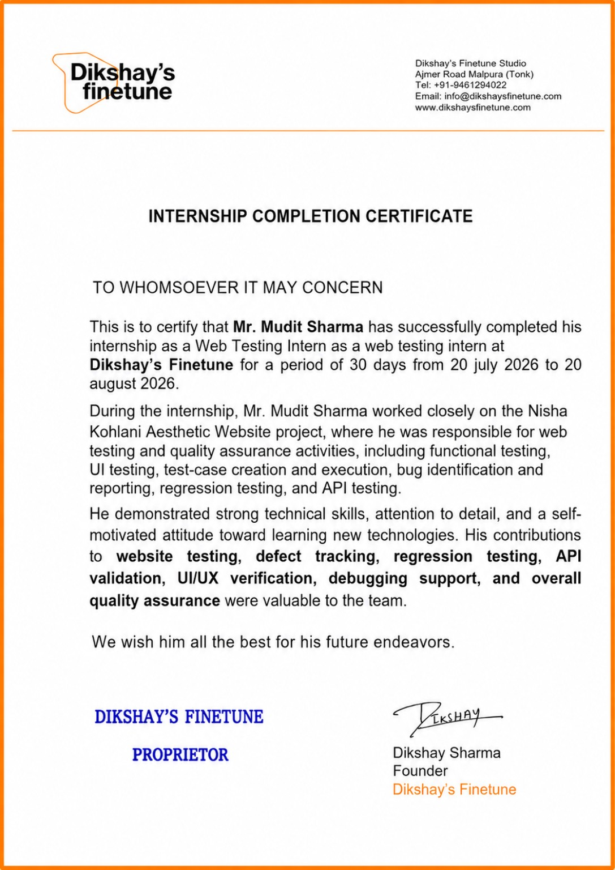
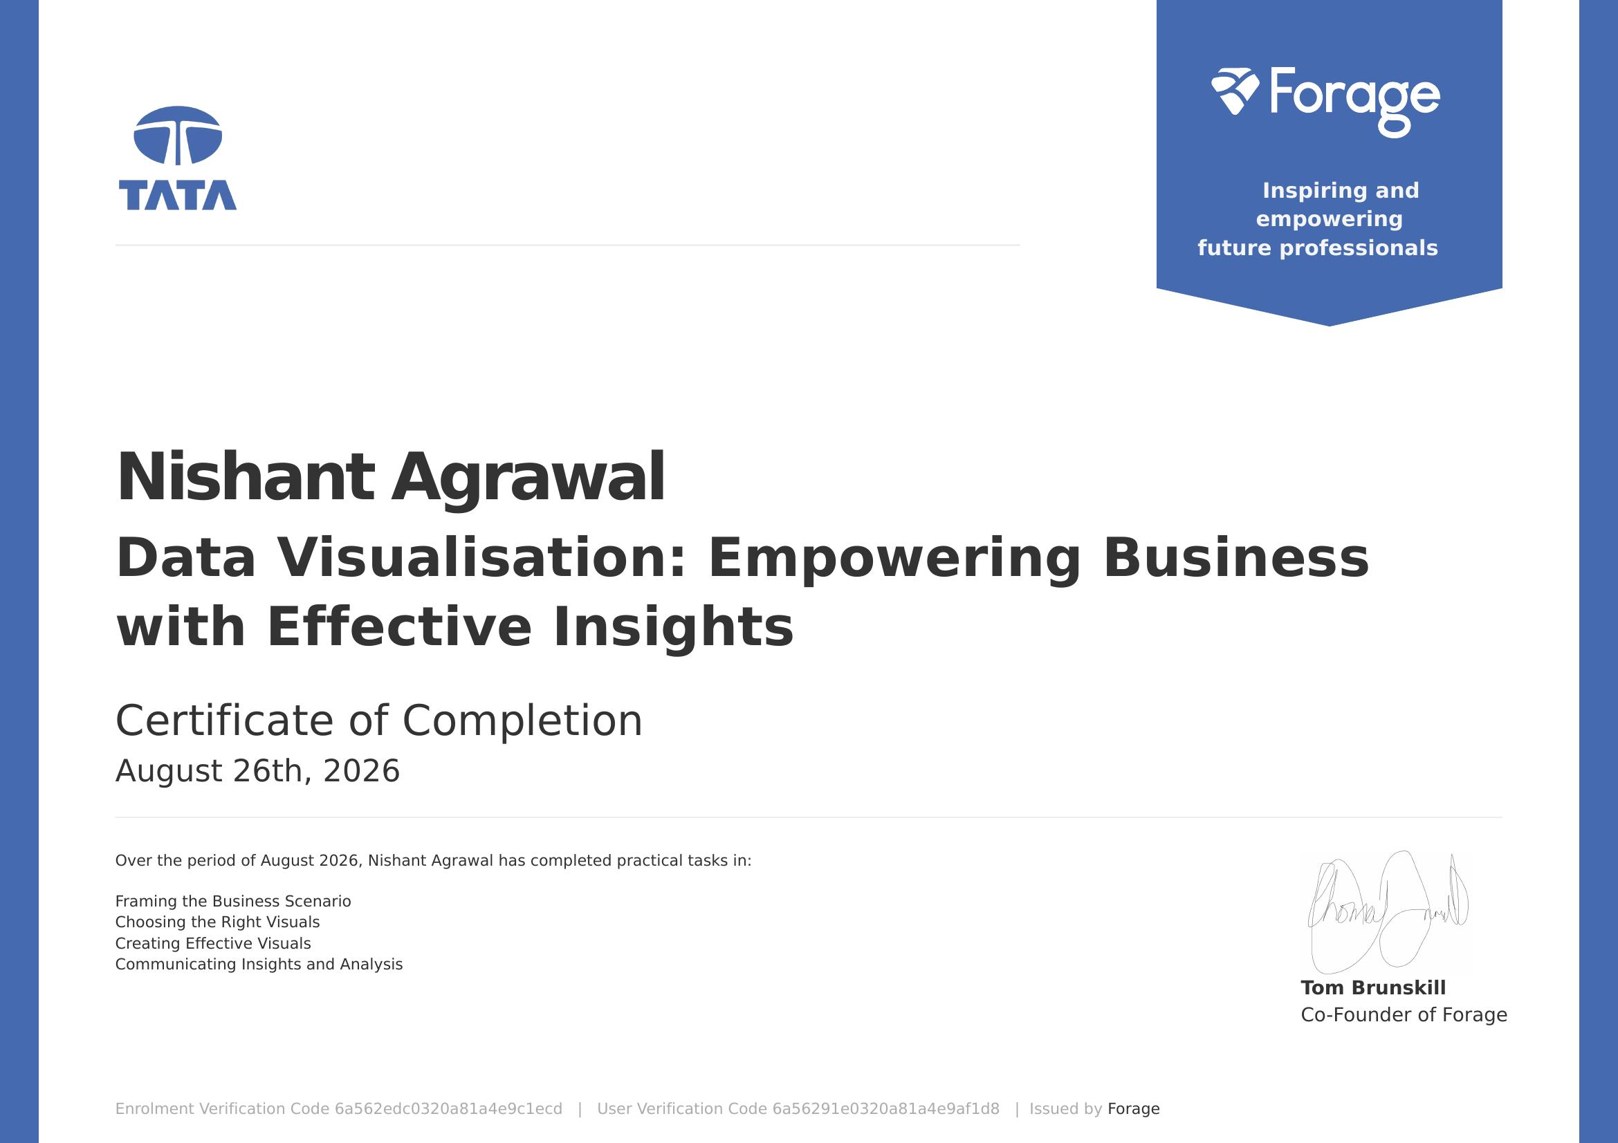
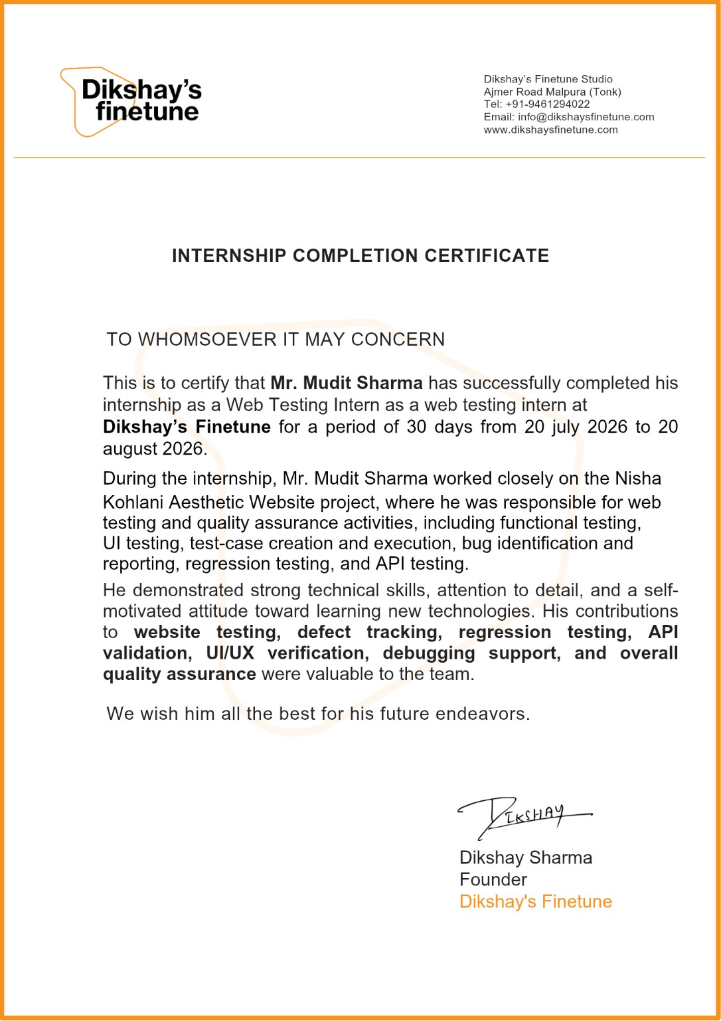
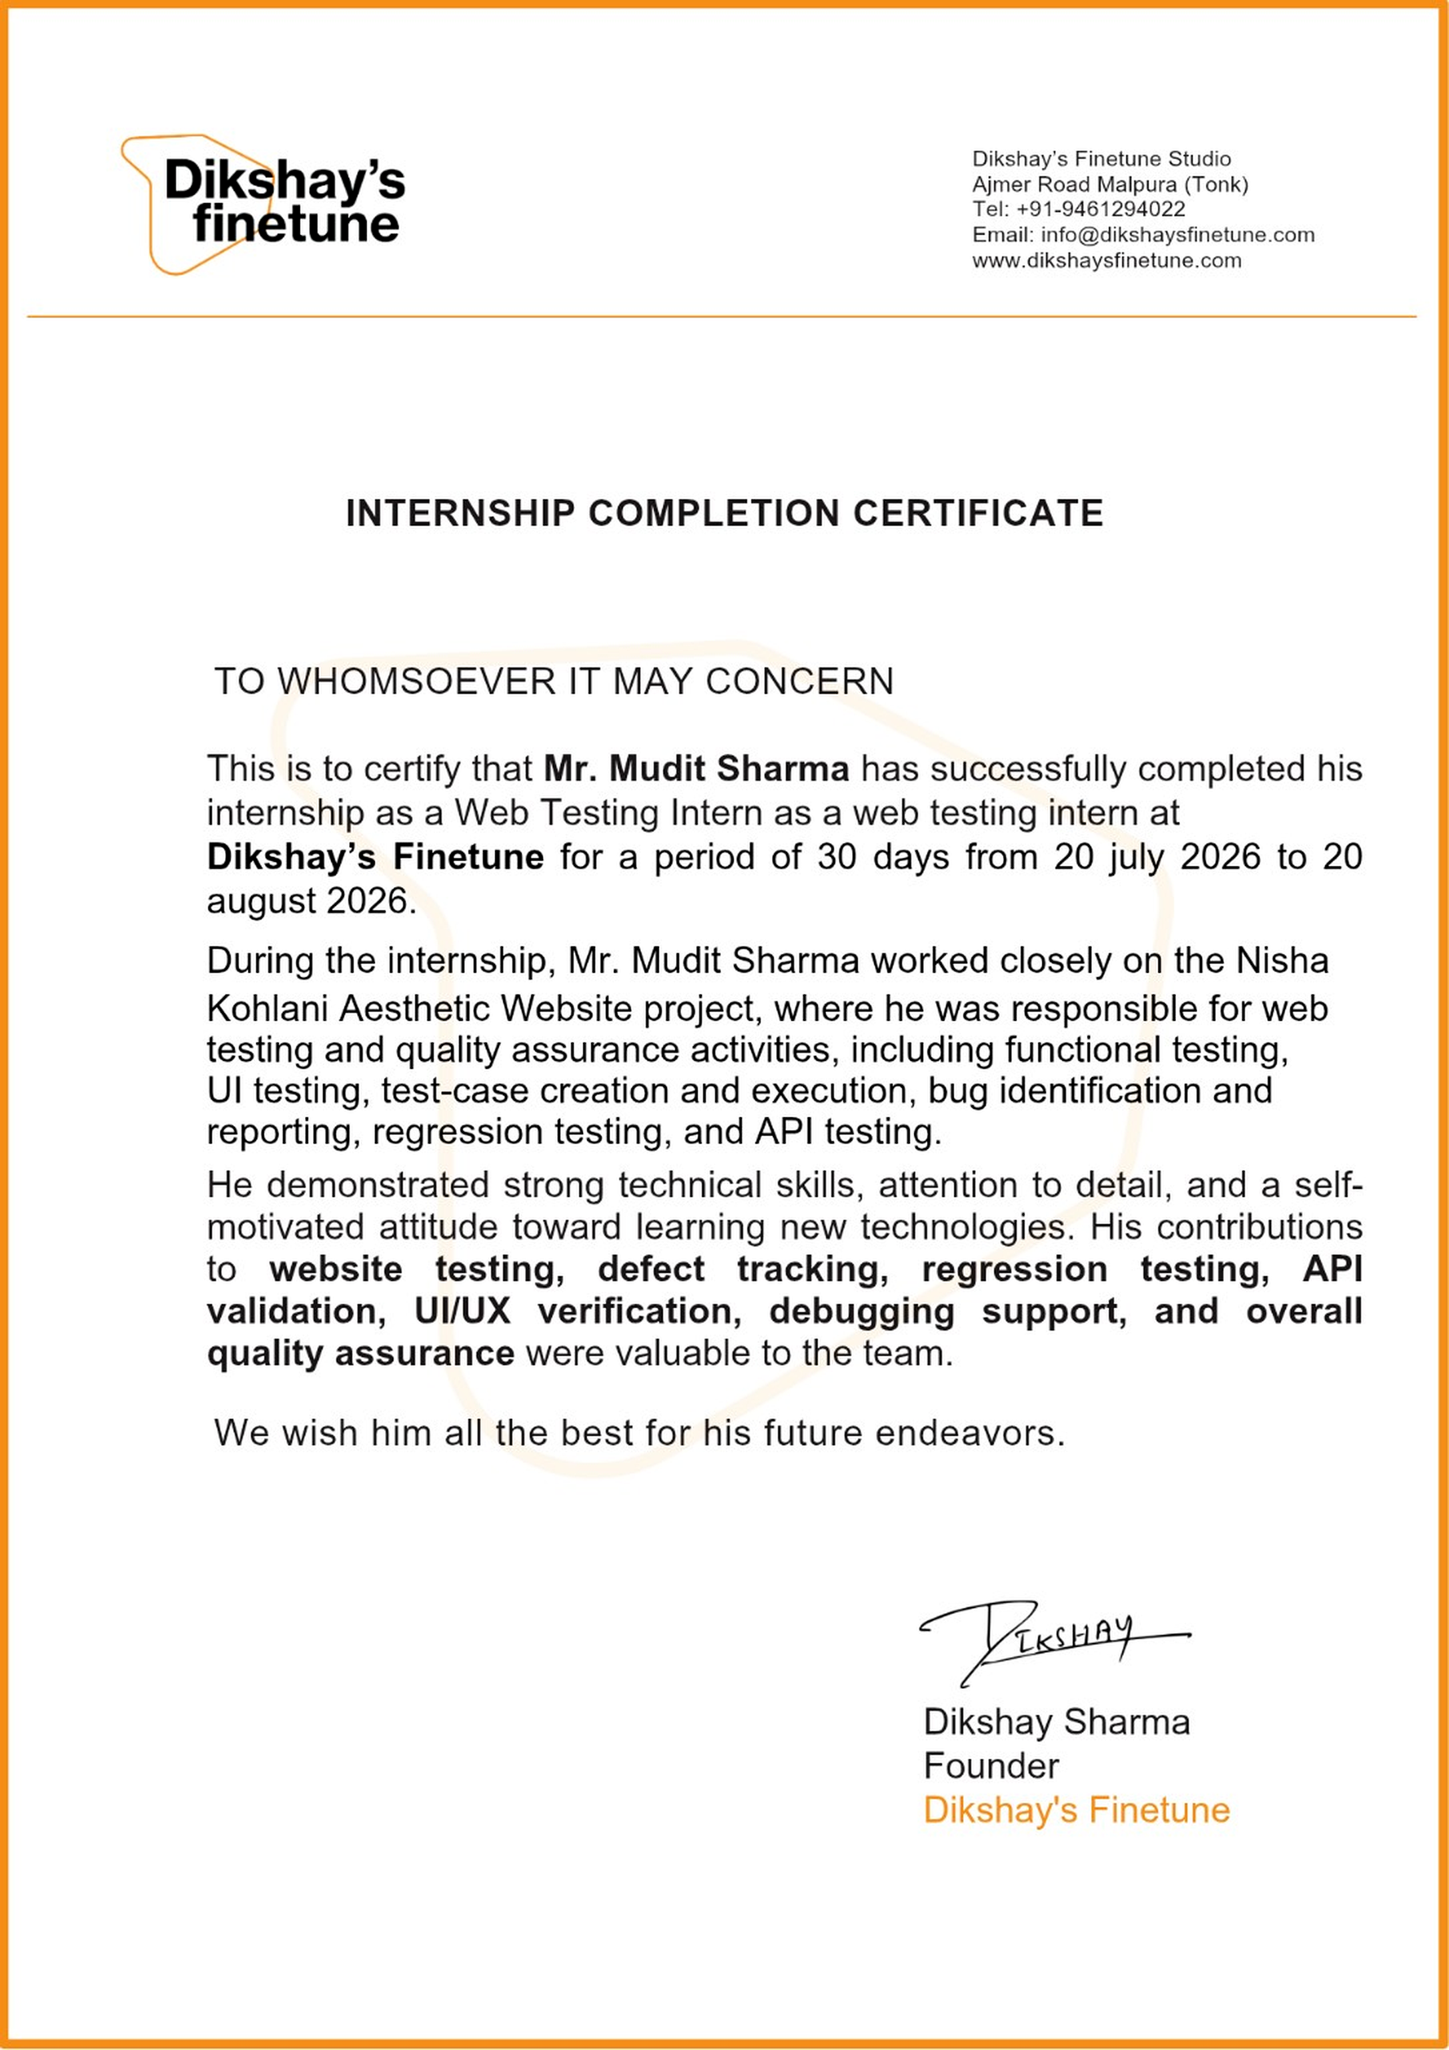

Slide 12

Thank You
Mudit Sharma | Roll No. 25SCS1003002812 | B.Tech CSE

