Slide 1

MINI CAPSTONE PROJECT PRESENTATION
By: Nikhil Kumar Sharma
(S9663)

Slide 2
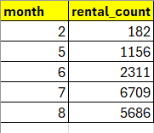
Monthly Rental Trend
select month(rental_date) as month,
count(*) as rental_count
from rental
group by month order by month;

Slide 3
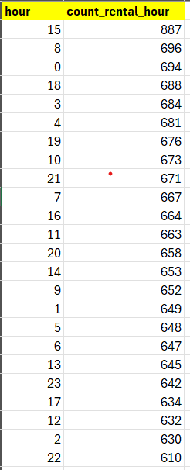
Peak Rental Hours
select hour(rental_date) as hour,
count(*) as count_rental_hour
from rental
group by hour
order by count_rental_hour desc;

Slide 4
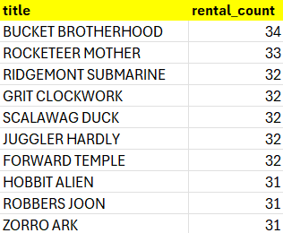
Top 10 Most Rented Films
select film.title, count(*) as rental_count
from rental inner join inventory on
rental.inventory_id = inventory.inventory_id
inner join film on inventory.film_id = film.film_id
group by film.titleorder by rental_count desc limit 10;

Slide 5
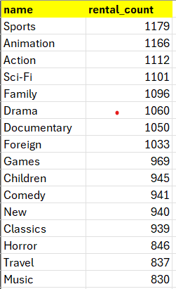
Category wise Rental Trend
select category.name,
count(*) as rental_count
from rental inner join inventory
on rental.inventory_id = inventory.inventory_id
inner join film on inventory.film_id = film.film_id
inner join film_category on film.film_id = film_category.film_id
inner join category
on film_category.category_id = category.category_id
group by category.name order by rental_count desc;

Slide 6

Store Performance
select store.store_id,
sum(payment.amount) as total_amount
from payment inner join rental
on payment.rental_id = rental.rental_id
inner join inventory on rental.inventory_id = inventory.inventory_id
inner join store on inventory.store_id = store.store_id
group by store.store_id order by total_amount desc limit 1;

Slide 7

Staff Performance
select staff.first_name as Name,
count(*) as rental_countfrom rental
inner join staff
on rental.staff_id = staff.staff_id
group by Name order by rental_count desc;

Slide 8
Mavenmovies Database Report

Slide 9
Major Findings
The 15th hour i.e., 3PM is the “peak hour” when the Rental count is highest.
Top 3 film categories having maximum rentals are: Sports, Animation and Action.
The rental count is highest for 7th and 4th month and is lowest for 1st and 2nd month.
Mike performed best with the revenue of 8040, whereas Jon’s revenue was 8004.
Store 2 performed better than Store 1.
Top 3 rented films are:
Bucket Brotherhood, Rocketeer Mother, and Ridgemonte Submarine.

Slide 10
Recommendations
Sports, Animation and Action categories are the best performing categories. Therefore, more movies should be added in these categories.
During the peak rental hours efforts should be to provide seamless and quality service to consumers.
Performance bonus should be given to motivate staff members to perform more better.
During the peak months movies with good content and high ratings should be added and promoted.

Slide 11


