Slide 1

Project Name: Customer Segmentation and its impact overall
Project Code: 10928-08
Prof: Richard Lambroff
Romil Patel 200528076 Hunny Kikaganesh 200514649 Nikhil Sharma 200524811
Group #8

Slide 2

Today’s Agenda
Project Summary
Team profile
Explanation of Project Cost
Budget data from Week 2 - Week 12
Project Results
DataBase
Dashboard & Other Progress
deliverables requested by the client

Slide 3
Project Summary
Customer segmentation aids in conducting target-specific research that increases sales and profits. In target-specific campaigns, we develop various newest frequency client segments with various plans in order to give the appropriate content and services to them while upholding our goodwill and fostering connections.
We may analyze, update, and perform activities together with fully engaged customer groups in accordance with the analysis and strategy of their categories, which will boost productivity and deliver higher results.
By effectively allocating resources, customer segmentation enables to achieve economies of scale. Economies of scale occur when we can accomplish our intended aim while also paying the least amount of money possible. Through customer segmentation, this is possible. As a result, make an effort to concentrate on a small number of resources that will aid in serving with resources.
Customer segmentation enhances the distribution route. Knowing the appropriate customer count will allow us to choose the appropriate distribution channel. This will clear up any misunderstandings among team members over who should deliver the product and when.

Slide 4
Team Profile
Nikhil Sharma (Team Leader)
Roles and Responsibilities:
-> Managing and organizing work, developing individuals and delegating day to day work and responsibility effectively.
-> Analyzing data sources and suggesting process changes where appropriate.
Hunny Kikaganesh(Developer)
Roles and Responsibilities:
-> Overseeing software programming, testing software at various phases of completion, laying out software design, building models or diagrams to communicate the end goal.
-> Review code for errors and find places where it could be improved
Romil Patel(Business Analyst)
Roles and Responsibilities:
-> Work cross-departmentally on data-driven strategies that improve business processes and decision-making
-> Support business intelligence strategies with quantitative analysis

Slide 5
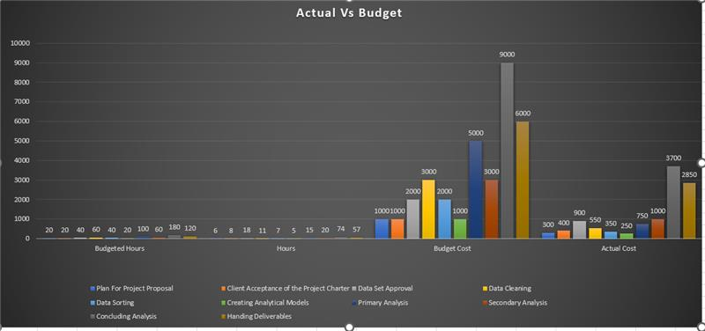
Explanation of Project Cost

Slide 6
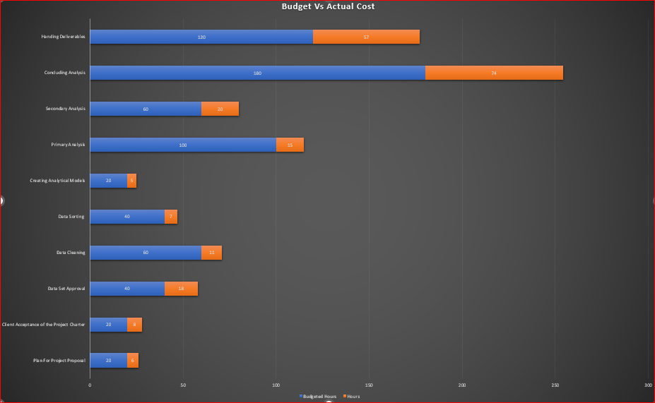
Budget data cited from Week 2 - Week 12

Slide 7
Project Results
Country with highest order amount.
Total profit generated by all product categories and what those categories were.
Shipment mode opted by the consumer and what the most common pattern was.
Most profitable category of product and the product itself.
Most sold product and who bought it.
Time series data of total sales volume to understand what time of the year was most profitable and was it constant across all years.

Slide 8
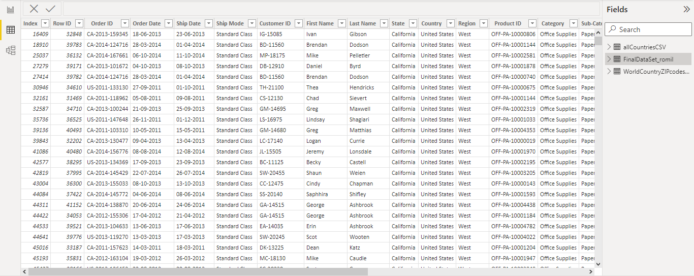
Our DataBase

Slide 9
An Overview of Our Dashboard

Slide 10
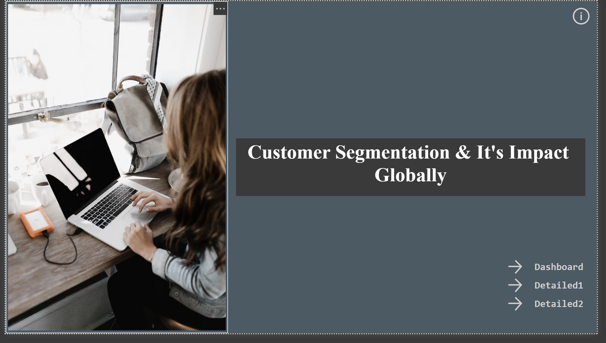

Slide 11
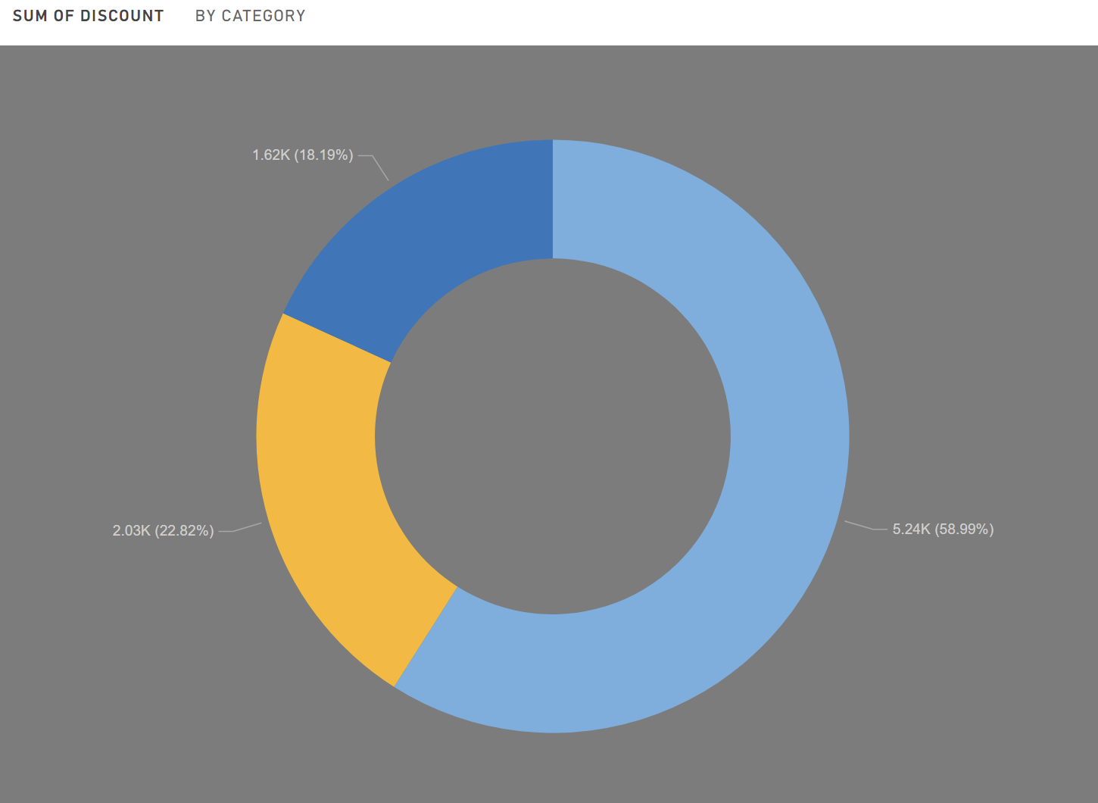
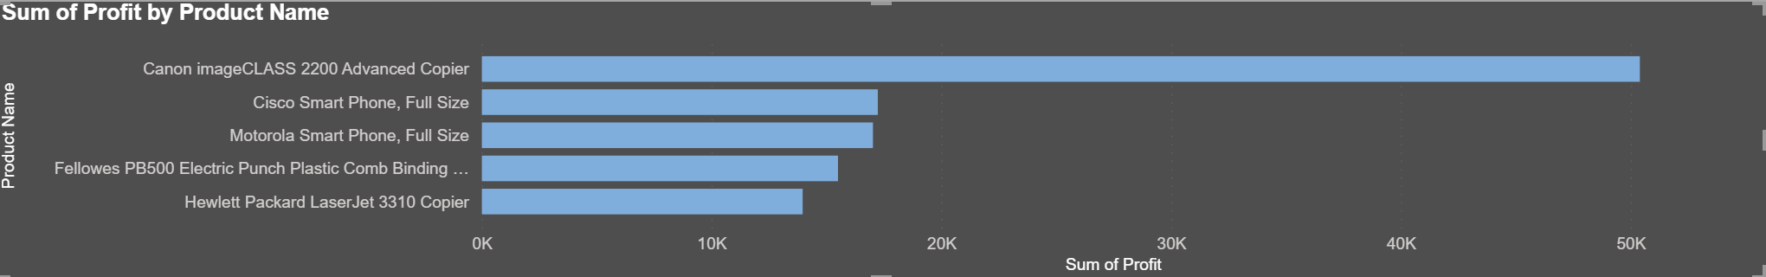

Slide 12
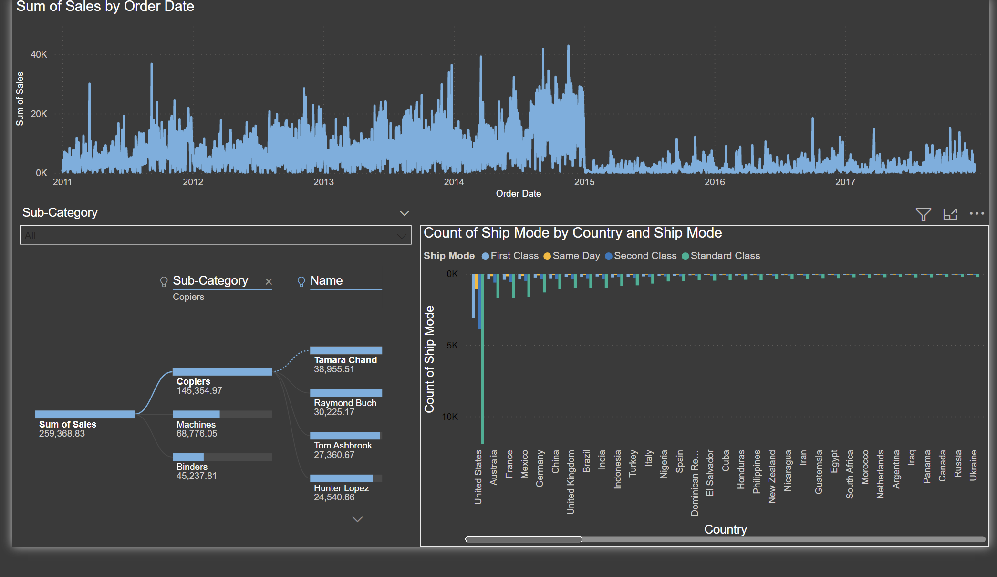

Slide 13
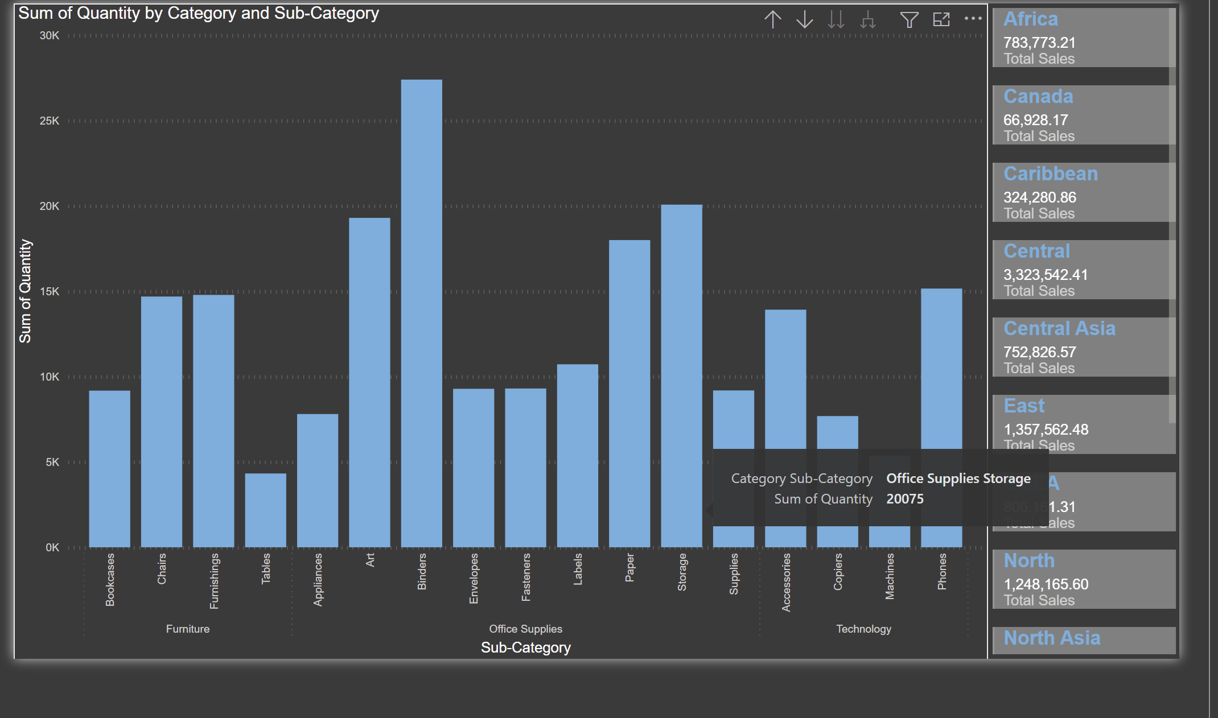

Slide 14
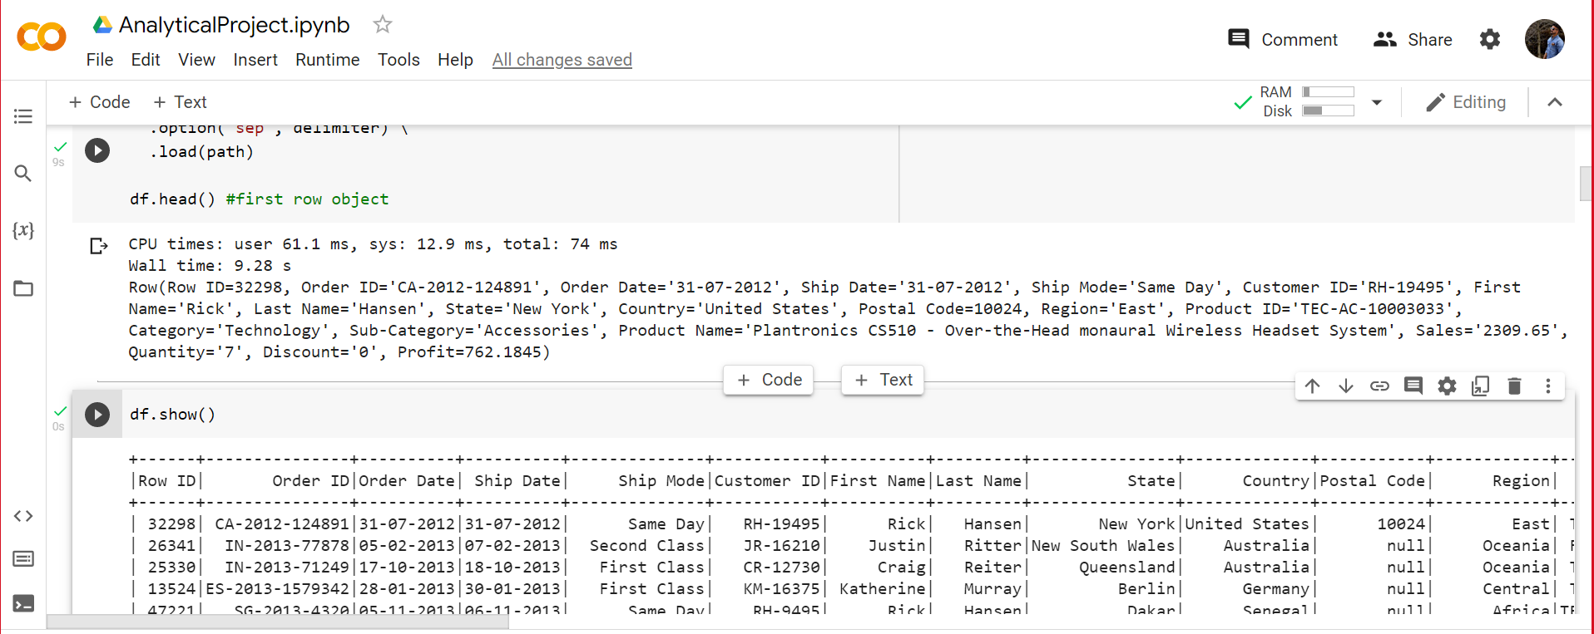
Apache SparK Processing

Slide 15

Apache SparK
We performed a few analytical steps on the data using PySpark and the major purpose was to identify and the results from Power Bi and compare it with results generated by Spark.
We did cleansing of data as well using spark as it was more convenient writing a one line query to do the actions which would have required many clicks in power bi.
Spark was way more superior in terms of processing when compared with Power Bi but the only drawback was usability and user interface, it would have been difficult to explain and display results using spark to the clients.

Slide 16
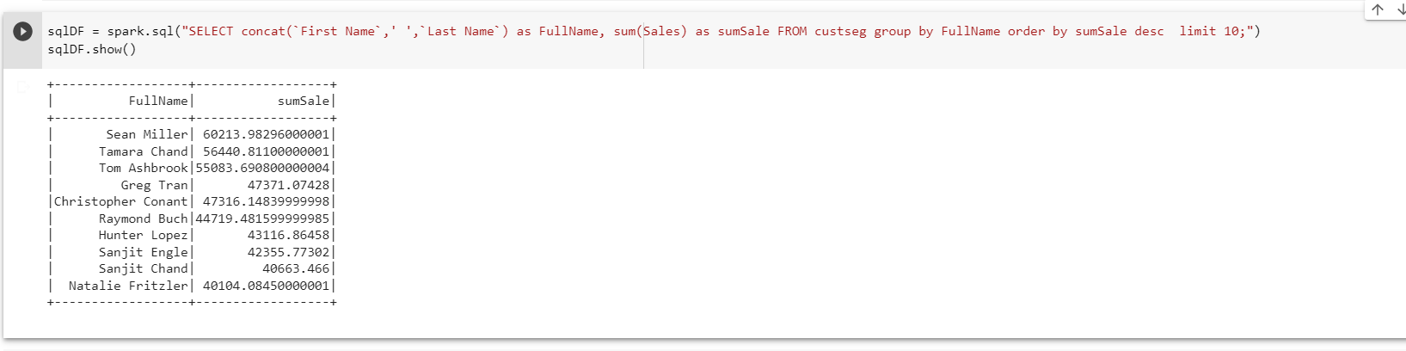
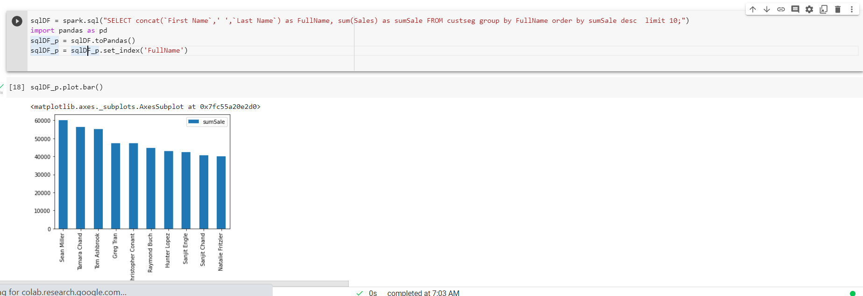
Apache SparK Processing

Slide 17
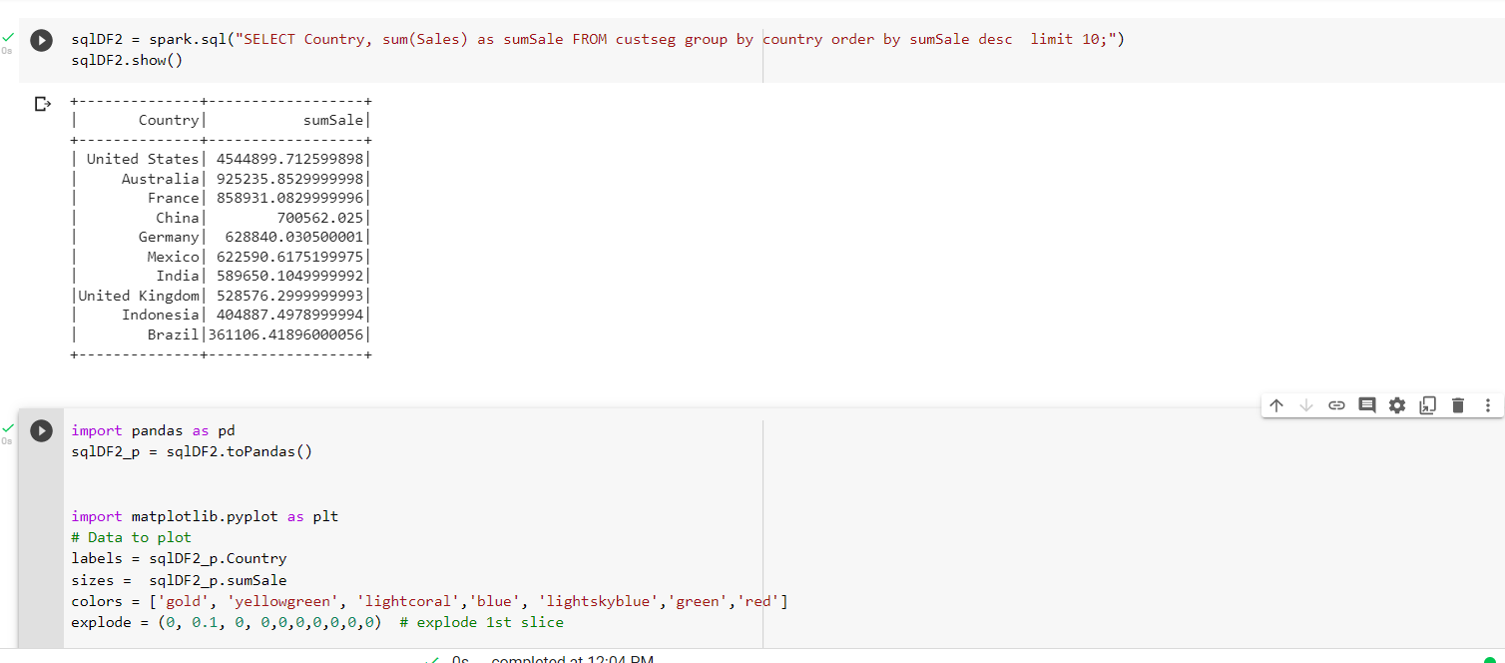
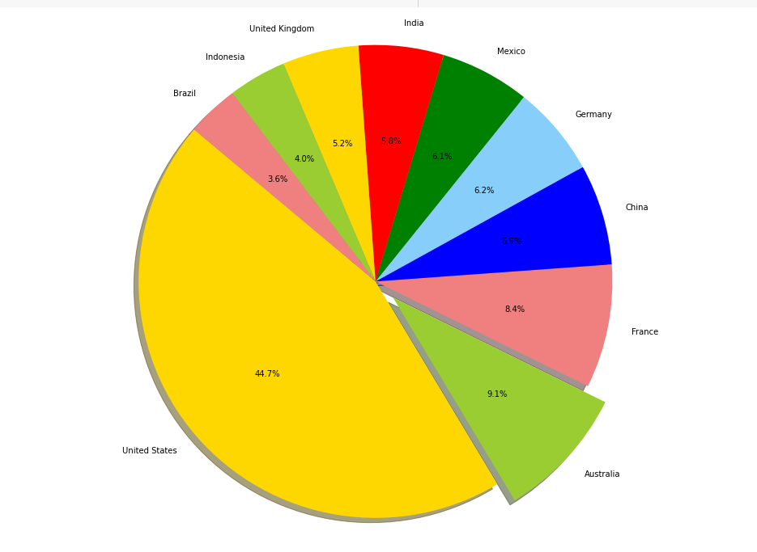
Top 10 countries by Total Sales

Slide 18
deliverables requested by the client
Client requested all dashboards to be informative and easy to read at the same time.
Code file for Apache Spark was asked to be shared to see what procedures were used to perform analytics and what the results were.
Conclusion for the project and what findings were identified by the team.

Slide 19
Thank You

