Slide 1
R PROGRAMMING PROJECT
Niraj Sharma
20220701012

Slide 2
INDEX
Aim of the project
Glimpse of the project
Dataset description
Data visualisation

Slide 3
Aim of the Project
The aim of this project is to visualize the distribution of wealth across the globe. It also states the distribution of wealth across different gender, industries, sectors and their contribution to the economy.

Slide 4
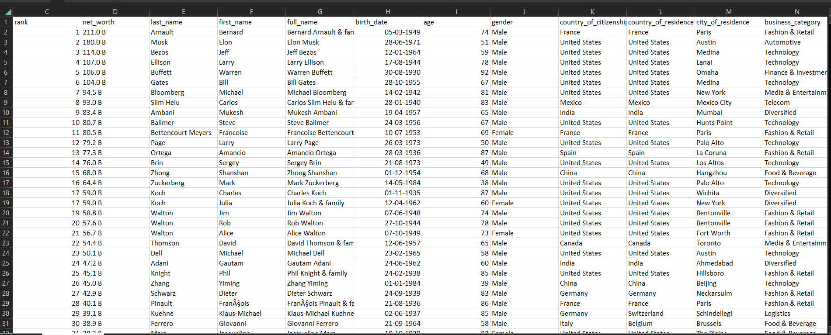
Glimpse of the dataset

Slide 5
Dataset Description
The document provides a comprehensive assessment of financial growth and the status of billionaires around the world. Meticulously records the subtle changes and major shifts in the fortunes of financial giants

Slide 6
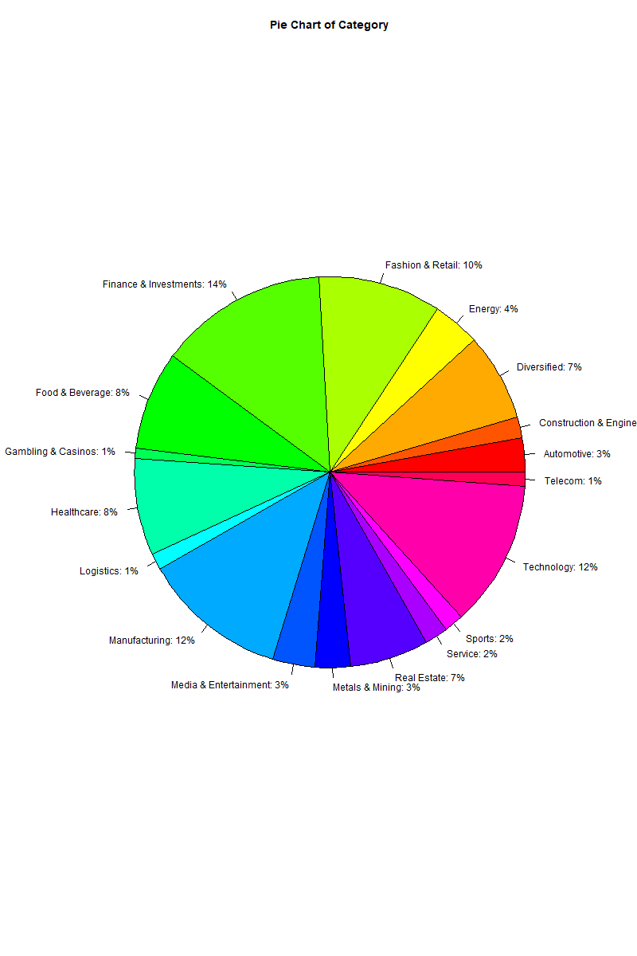
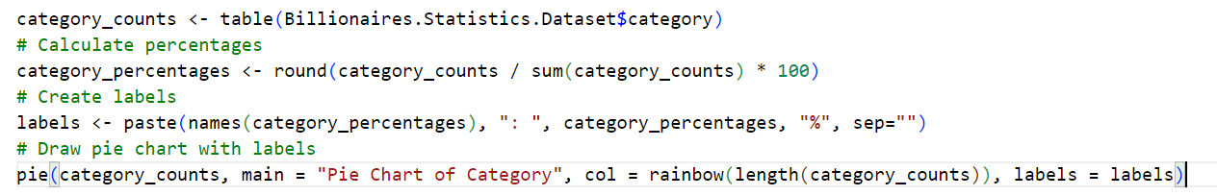
Data visualisation

Slide 7
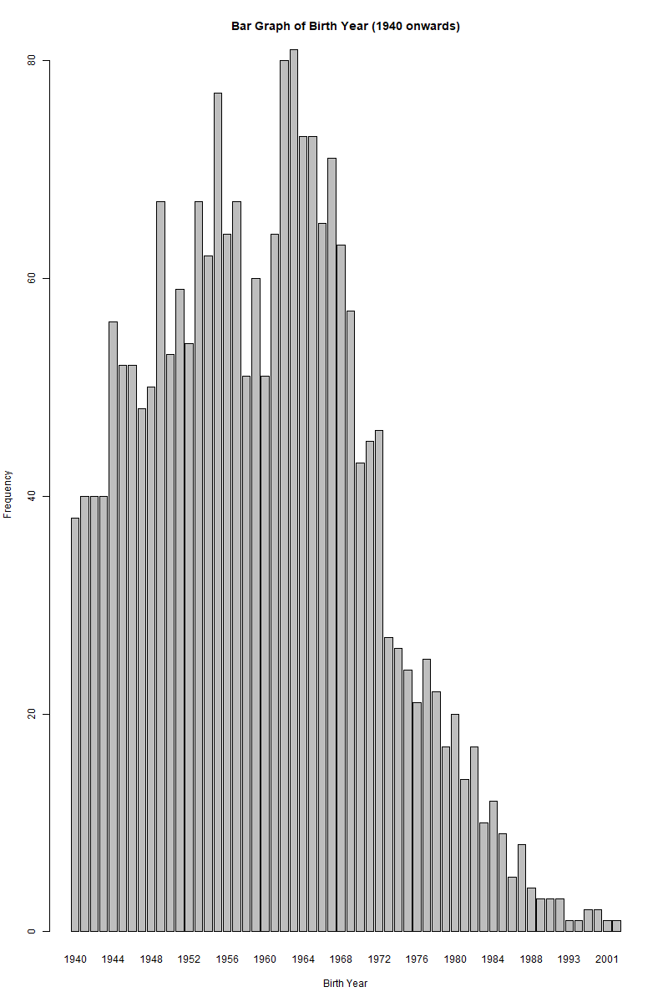
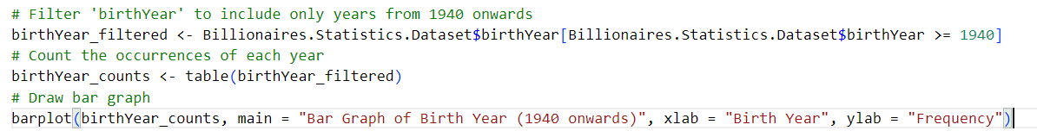
Data visualistion

Slide 8
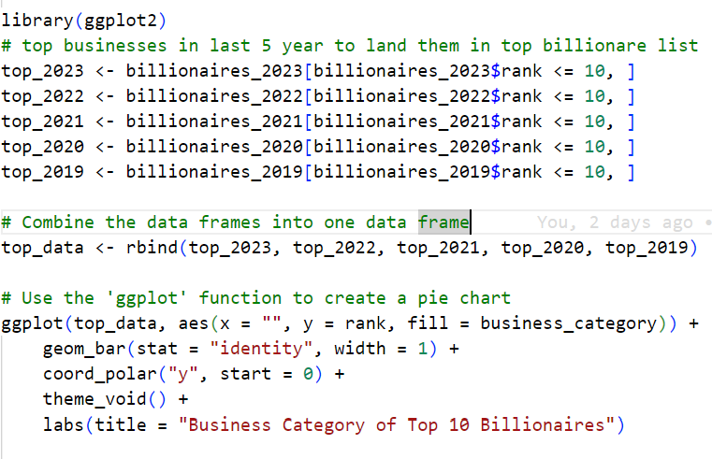
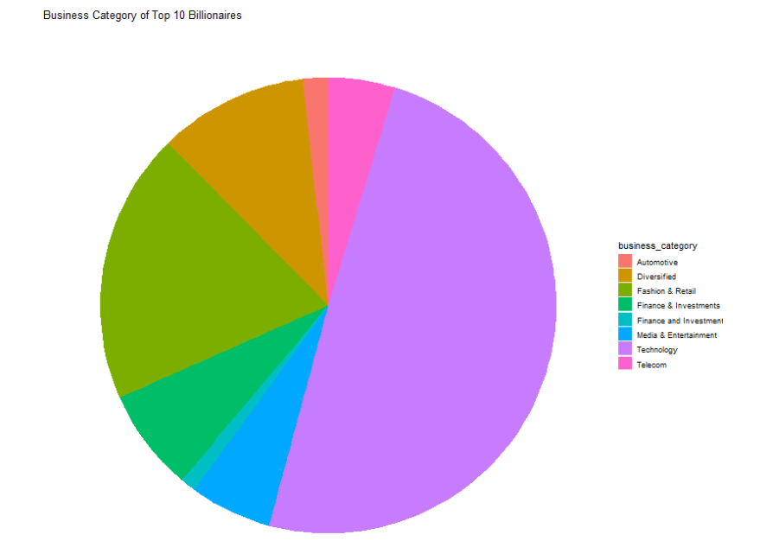
Data visualisation

Slide 9
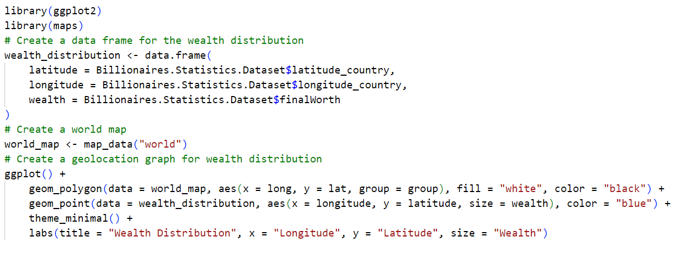
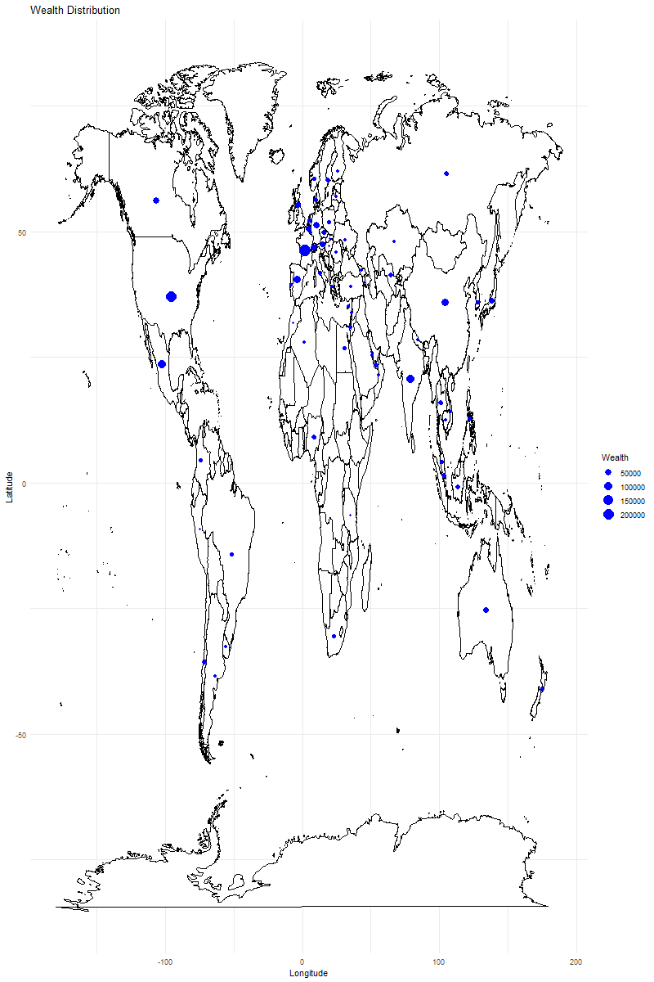
Data visualisation

Slide 10
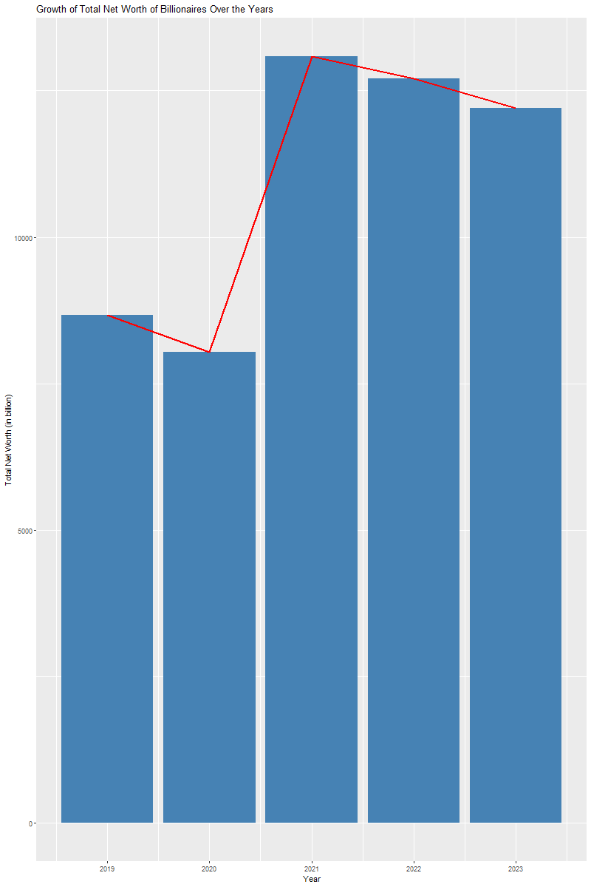
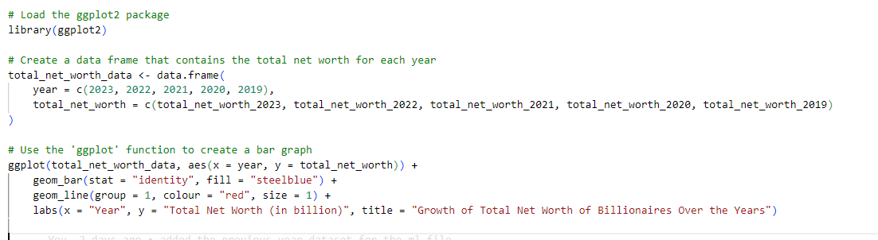

Slide 11
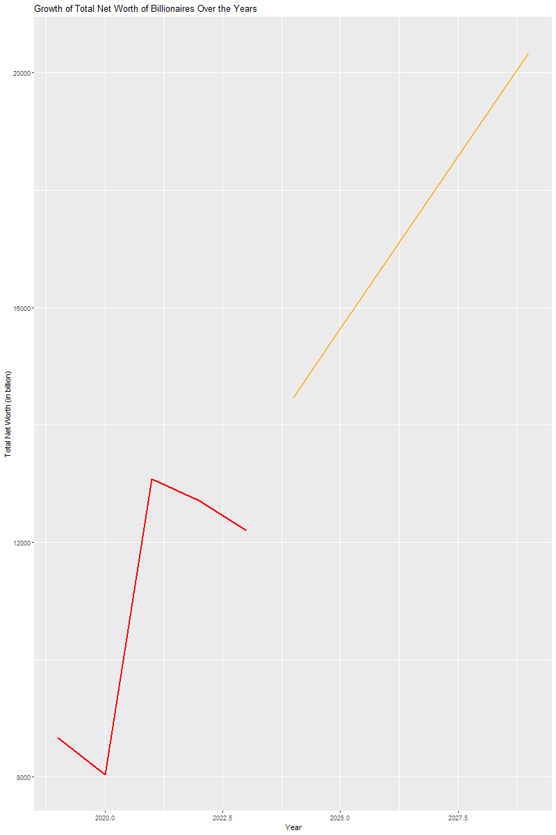
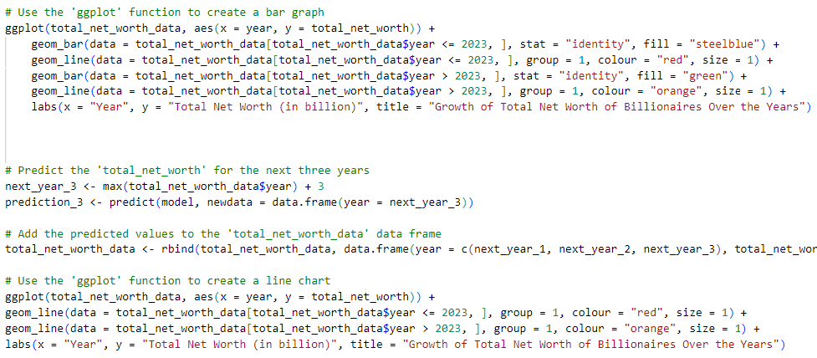
Data visualisation

