Slide 1
A DATA ANALYTICS PROJECT
Airbnb & Hotel Booking Analysis
Exploratory Data Analysis of NYC Short-Term Rental Listings
Pranjal Sharma

Slide 2
PROBLEM STATEMENT
Airbnb, Inc. — founded in 2008 in San Francisco — reshaped the hospitality industry with a commission-based online marketplace connecting hosts and guests without owning any properties.
This project analyzes the New York City Airbnb Open Dataset to understand the dynamics of the city's short-term lodging market — through data wrangling, exploratory data analysis, and visualization.
The goal is to uncover the factors that influence listing availability, pricing strategy, and host / customer behaviour, providing insights valuable to hosts, guests, and platform stakeholders.
Airbnb & Hotel Booking Analysis
1

Slide 3
PROJECT OBJECTIVE
This project aims to answer the following questions from the Airbnb Open Data:
1
What are the different property types in the dataset?
6
Are hosts with verified identities more likely to get positive reviews?
2
Which neighbourhood group has the highest number of listings?
7
Is there a correlation between listing price and service fee?
3
Which neighbourhood group has the highest average listing price?
8
Does average review rate vary by neighbourhood group and room type?
4
Is there a relationship between construction year and price?
9
Do hosts with more listings maintain higher yearly availability?
5
Who are the top 10 hosts by calculated host listing count?
Airbnb & Hotel Booking Analysis
2

Slide 4
DATASET OVERVIEW
New York City Airbnb Open Data — loaded from Excel into a pandas DataFrame.
102,599
→
83,796
541
raw rows / 26 columns
cleaned rows / 24 cols
duplicate rows removed
Key columns used in the analysis
• id, NAME, host id, host name
• room type, Construction year
• review rate number
• host_identity_verified
• price_$, service_fee_$
• calculated host listings count
• neighbourhood group, neighbourhood
• minimum nights, number of reviews
• availability 365
• lat, long, country, country code
• last review, reviews per month
• cancellation_policy, instant_bookable
Airbnb & Hotel Booking Analysis
3

Slide 5
DATA CLEANING & PREPROCESSING
Issues identified in the raw data
541 duplicate records
# Drop duplicate records
df.drop_duplicates(inplace=True)
# Drop sparse columns
df.drop(['house_rules','license'],
axis=1, inplace=True)
# Clean price & service fee
df['price'] = df['price'].astype(str)\
.str.replace('$','',regex=False)
# Drop missing values
df.dropna(inplace=True)
# Fix data types
df['price_$'] = df['price_$'].astype(float)
df['last review'] = pd.to_datetime(
df['last review'])
# Fix 'brookln' -> 'Brooklyn'
df.loc[df['neighbourhood group']==
'brookln','neighbourhood group'] = 'Brooklyn'
Insufficient data in house_rules & license columns
$ signs and commas in price / service fee
Wrong data types (price, id, dates, year)
'brookln' misspelled instead of 'Brooklyn'
Outliers in availability 365 (> 500 days)
Cleaning steps taken
Dropped duplicates & sparse columns • Stripped $ / , from price & fee • Renamed to price_$ / service_fee_$ • Dropped missing values • Fixed dtypes • Corrected 'Brooklyn' spelling • Removed availability outliers
Airbnb & Hotel Booking Analysis
4

Slide 6
TECHNOLOGY USED
1
Python
Core programming language for the analysis
2
Pandas
Data loading, wrangling & cleaning
3
NumPy
Numerical operations on the dataset
4
Matplotlib
Bar charts & line plots for EDA
5
Seaborn
Boxplots, regression plots & grouped bar charts
6
Plotly Express
Imported for interactive visualization
7
Jupyter / Google Colab Notebook
Development & analysis environment
Airbnb & Hotel Booking Analysis
5

Slide 7
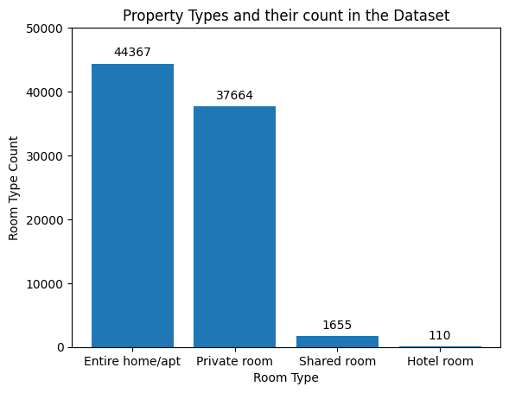
EDA – PROPERTY TYPES
WHAT'S ANALYZED
Distribution of the 4 room types listed on the platform (room type column).
WHAT IT SHOWS
A bar chart of listing counts for Entire home/apt, Private room, Shared room and Hotel room.
KEY INSIGHT
Entire home/apt dominates with 44,367 listings (53%), followed by Private room (37,664). Shared room (1,655) and Hotel room (110) are rare.
Airbnb & Hotel Booking Analysis
6

Slide 8
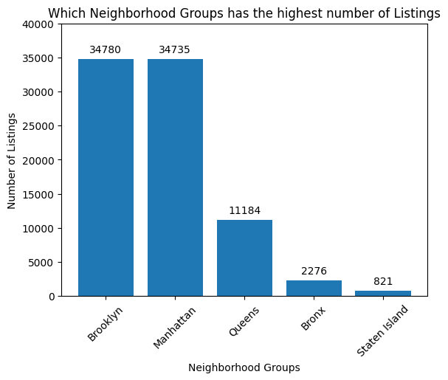
EDA – NEIGHBOURHOOD GROUPS
WHAT'S ANALYZED
Number of listings across the 5 NYC neighbourhood groups.
WHAT IT SHOWS
A bar chart comparing listing counts for Brooklyn, Manhattan, Queens, Bronx and Staten Island.
KEY INSIGHT
Brooklyn leads with 34,780 listings, closely followed by Manhattan (34,735). Bronx (2,276) and Staten Island (821) have far fewer listings.
Airbnb & Hotel Booking Analysis
7

Slide 9
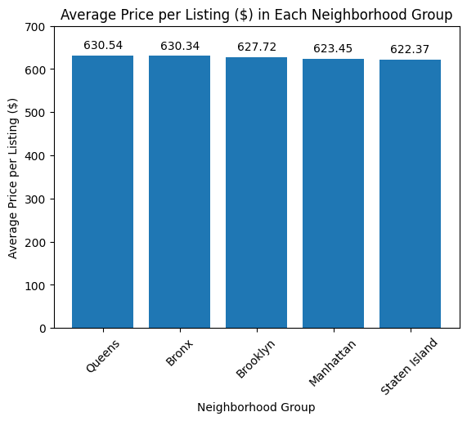
EDA – AVERAGE PRICE BY AREA
WHAT'S ANALYZED
Average listing price_$ grouped by neighbourhood group.
WHAT IT SHOWS
A bar chart of mean price per neighbourhood group, sorted descending.
KEY INSIGHT
Prices are close across groups: Queens has the highest average price ($630.54), closely followed by the Bronx ($630.34). Staten Island is lowest ($622.37).
Airbnb & Hotel Booking Analysis
8

Slide 10
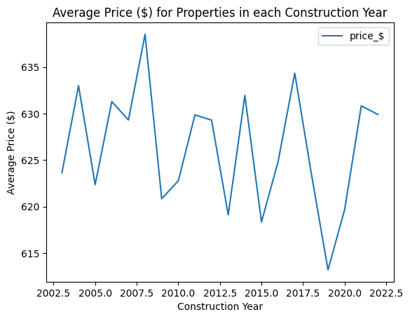
EDA – CONSTRUCTION YEAR VS PRICE
WHAT'S ANALYZED
Average price_$ of listings grouped by the property's Construction year (2003–2022).
WHAT IT SHOWS
A line plot tracking mean listing price across construction years.
KEY INSIGHT
Prices trend downward as construction year increases — newer properties (post-2015) show lower average prices than older ones.
Airbnb & Hotel Booking Analysis
9

Slide 11
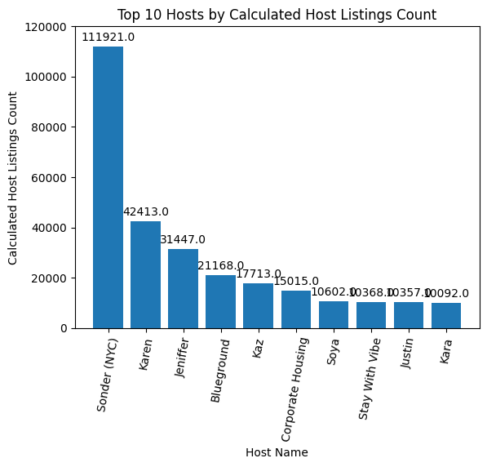
EDA – TOP 10 HOSTS
WHAT'S ANALYZED
The 10 hosts with the highest sum of calculated host listings count.
WHAT IT SHOWS
A bar chart ranking the top 10 hosts by total listings managed.
KEY INSIGHT
Sonder (NYC) leads by far with 111,921 listings, followed by Karen (42,413) and Jeniffer (31,447) — signalling a market with large professional/corporate hosts.
Airbnb & Hotel Booking Analysis
10

Slide 12
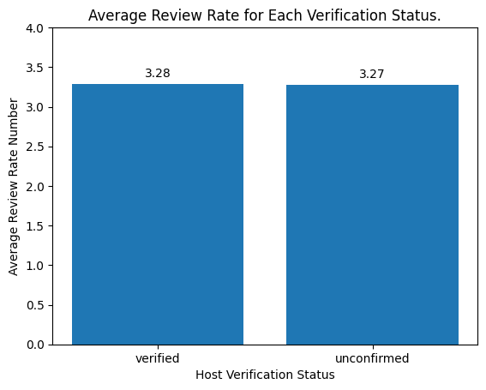
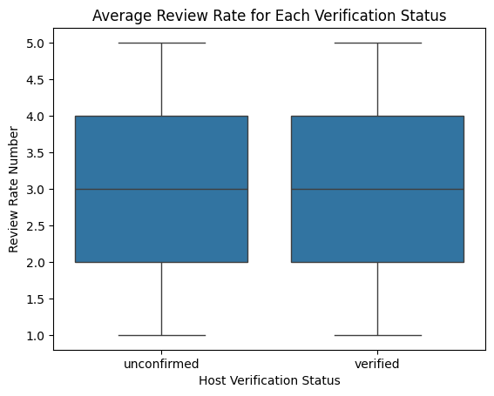
HOST VERIFICATION VS REVIEW RATE
Key Insight: Average review rate is nearly identical for verified (3.27) and unconfirmed (3.28) hosts — a marginal difference. Identity verification does not appear to drive more positive reviews.
Airbnb & Hotel Booking Analysis
11

Slide 13
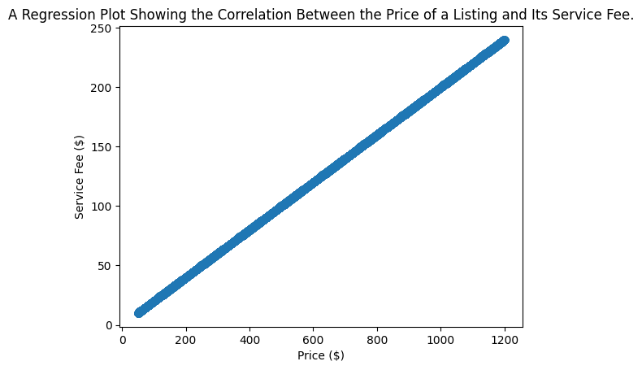
PRICE VS SERVICE FEE CORRELATION
WHAT'S ANALYZED
Correlation between price_$ and service_fee_$ across all cleaned listings.
WHAT IT SHOWS
A regression plot of price against service fee, with a fitted trend line.
KEY INSIGHT
Pearson correlation ≈ 0.99 — a near-perfect positive relationship. As listing price rises, the service fee rises proportionally.
Airbnb & Hotel Booking Analysis
12

Slide 14
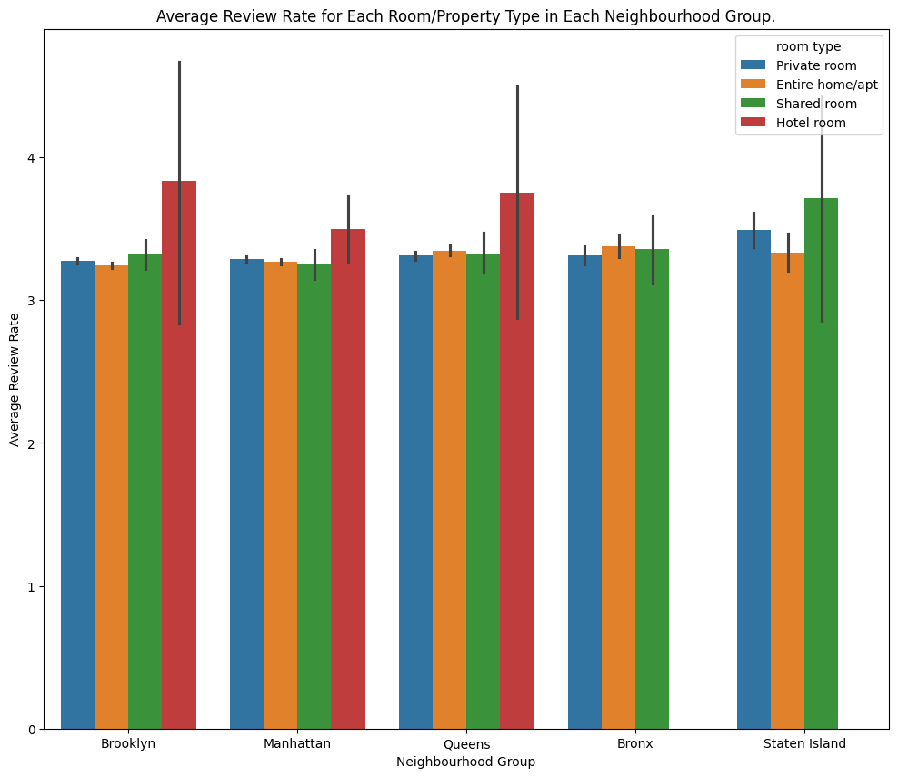
REVIEW RATE BY AREA & ROOM TYPE
WHAT'S ANALYZED
Average review rate number split by neighbourhood group and room type.
WHAT IT SHOWS
A grouped bar chart of mean review rate across every neighbourhood group / room type pair.
KEY INSIGHT
Hotel rooms score a higher average review rate than other property types in Brooklyn, Manhattan and Queens — the three groups where hotel rooms are listed.
Airbnb & Hotel Booking Analysis
13

Slide 15
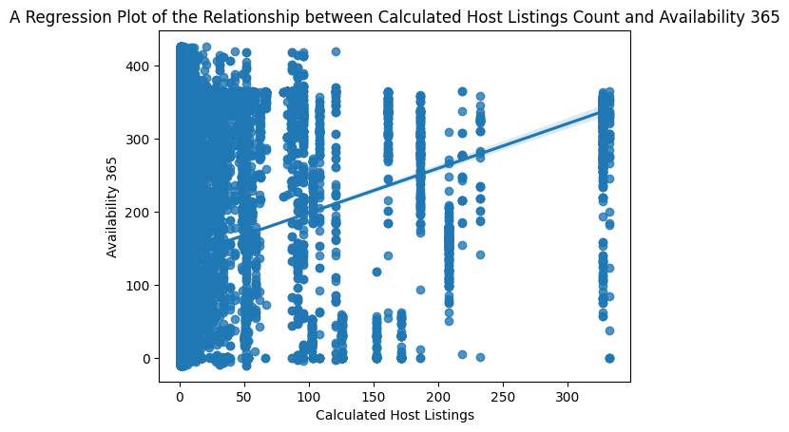
HOST LISTINGS VS AVAILABILITY
WHAT'S ANALYZED
Correlation between calculated host listings count and availability 365.
WHAT IT SHOWS
A regression plot of host listing count against yearly availability.
KEY INSIGHT
Pearson correlation ≈ 0.07 — a very weak positive relationship. Hosts with more listings are not meaningfully more (or less) available year-round.
Airbnb & Hotel Booking Analysis
14

Slide 16
RESULTS SUMMARY
53%
34,780
$630.54
of listings are Entire home/apt (44,367 of 83,796)
listings in Brooklyn — the top neighbourhood group
avg. price in Queens — the priciest neighbourhood group
0.99
3.27 vs 3.28
0.07
correlation between listing price and service fee
avg. review rate: verified vs unconfirmed hosts
correlation between host listings count and availability
Airbnb & Hotel Booking Analysis
15

Slide 17
CODE SNIPPETS
Load the dataset
Top 10 hosts by listings count
import numpy as np
import pandas as pd
import matplotlib.pyplot as plt
import seaborn as sns
df = pd.read_excel(
r"/content/P4-Airbnb Hotel
Booking Analysis.xlsx")
hosts = df.groupby("host name")\
['calculated host listings count']\
.sum().sort_values(
ascending=False).nlargest(10)
plt.bar(hosts.index, hosts.values)
Correlation – price vs service fee
Review rate by host verification
df['price_$'].corr(
df['service_fee_$'])
# -> 0.99
sns.regplot(data=df,
x='price_$', y='service_fee_$')
review = df.groupby(
"host_identity_verified")\
['review rate number'].mean()
plt.bar(review.index, review.values)
Demo Link: To be added
16

Slide 18
CONCLUSION
This project delivered a comprehensive analysis of the NYC Airbnb dataset — covering data wrangling, EDA, and interpretation of summary statistics.
Entire home/apt listings dominate the market, and listing counts vary widely across neighbourhood groups, with Brooklyn and Manhattan far ahead of the Bronx and Staten Island.
Listing price shows a downward trend against construction year, and a near-perfect correlation with service fee (0.99).
Host identity verification shows only a marginal effect on review rate, and host listing count is only weakly related to yearly availability (0.07).
Future scope: sentiment analysis on guest reviews, and predictive modelling (regression / ML) to forecast demand, pricing and customer behaviour.
Airbnb & Hotel Booking Analysis
17

Slide 19
THANK YOU
Airbnb & Hotel Booking Analysis — Pranjal Sharma

