Slide 1

M3
REGULATORY REPORTING · TECHNICAL STRATEGY
Building a Dedicated
MiFID III Environment
Leveraging our proven MiFID II (TROY) platform — reuse what works, isolate what changes.
MiFID Working Group · Prepared for senior review & sign-off

Slide 2


EXECUTIVE SUMMARY
The proposal in brief
THE ASK
WHY IT MATTERS
Approve a dedicated MiFID III reporting environment, built by copying the proven MiFID II platform. We re-use validated infrastructure, put every field — including unchanged ones — through a JIRA and a logic review, and isolate FCA / ESMA divergence to the gateway layer.
Speed Reuse over rebuild — proven logic carried forward
Control Every field traceable to a JIRA + review
Resilience ESMA changes can't regress FCA, and vice-versa
3
6
100%
5
Regulatory regimes
Component groups reused
Field-level traceability
Delivery phases
FCA · BaFin/ESMA · FinFCA
copied from MiFID II
every field → JIRA + review
controlled, staged cutover
MiFID III · Dedicated Reporting Environment
Confidential · 02

Slide 3




STRATEGIC CONTEXT
Why now — and why dedicated
Regimes are diverging
We hold a proven asset
FCA and ESMA are drifting apart under MiFID III. A shared codebase forces compromises that serve neither regime well.
TROY already runs eligibility, enrichment, multi-jurisdiction gateways and ISO 20022 submission to UnaVista.
Reuse is the fast path
Isolation de-risks both
Most plumbing carries over untouched. We copy proven infrastructure and only re-examine what genuinely changes.
A separate environment means a change for one regulator can never destabilise reporting for the other.
MiFID III · Dedicated Reporting Environment
Confidential · 03

Slide 4

01
The Approach
Copy the proven platform. Re-examine only what changes. Isolate divergence.
MiFID III · Dedicated Reporting Environment
Confidential · 04

Slide 5
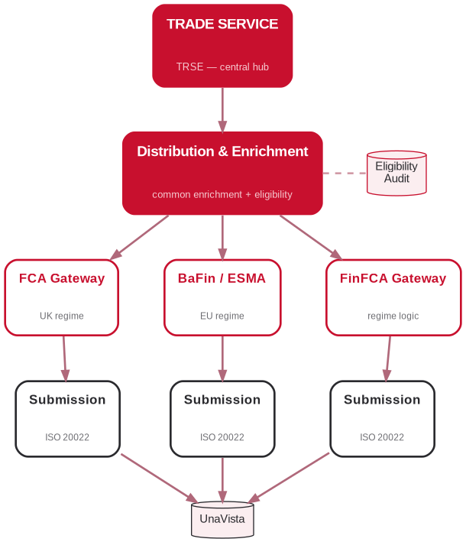



TARGET ARCHITECTURE
A mirror of the proven MiFID II flow
Distribution & Enrichment
Common field enrichment plus the eligibility decision across FCA / BaFin / FIN. Writes an audit for every trade.
Regulator Gateways
Regime-specific enrichment, overriding and any additional logic required per regulator.
Submission Engines
ISO 20022 submission — one engine per regime, all targeting UnaVista.
MiFID III · Dedicated Reporting Environment
Confidential · 05

Slide 6
STEP 1 · REUSE
Copy the proven infrastructure
Existing MiFID II components that carry into the new environment unchanged or near-unchanged.
Component | Action | Rationale
Trade ingestion from TRSE | Copy | Source feed is identical across regimes
Distribution & eligibility engine | Copy + extend | Core logic reused; rules reviewed per regime
Common field enrichment | Copy | Jurisdiction-agnostic — LEI, ISIN/UPI, UTI, counterparty
Gateway framework | Copy structure | Same shape; regime rules layered on top
ISO 20022 submission engine | Copy | Same UnaVista target and message standard
Exception handling & audit | Copy | Eligibility-audit & transaction model reused
MiFID III · Dedicated Reporting Environment
Confidential · 06

Slide 7




STEP 2 · THE GOVERNING DISCIPLINE
How we handle unchanged fields
Every field that has NOT changed still passes through a disciplined review — reuse is deliberate, never assumed.
STEP 1
STEP 2
STEP 3
STEP 4
Raise a JIRA
Review existing logic
Reuse by reference
Improve only if needed
Create a JIRA for the field even though it hasn't changed — so the work is tracked and auditable.
Review the existing MiFID II logic and confirm it still meets the MiFID III requirement.
Implement the same behaviour by referring to the existing logic — no reinvention.
Only where the review finds it lacking do we enhance — otherwise carry it over as-is.
Every reused field is traceable to a JIRA and a logic review — nothing silently inherited.
MiFID III · Dedicated Reporting Environment
Confidential · 07

Slide 8





STEP 3 · VALIDATE
Don't carry problems over
Screen before copy
Field-level logic review
Every component is reviewed before it enters the new environment — debt and defects are candidates for fixing, not cloning.
Existing logic is validated against the MiFID III rulebook, never assumed correct because it worked before.
Golden-source parity
Known-issue register
Reuse eligibility-audit & transaction datasets to prove old/new equivalence before any divergence work.
Every problematic element is logged and explicitly decided — carry, fix or drop. Never carried by default.
Regression gate
Sign-off gate
The new environment must reproduce MiFID II outputs for unchanged scenarios before divergence begins.
No field goes live without a reviewed JIRA and a validation result attached.
MiFID III · Dedicated Reporting Environment
Confidential · 08

Slide 9
STEP 4 · DIVERGENCE
Handling FCA / ESMA divergence
Shared core, regime-specific edges — divergence isolated to the gateway so neither regime destabilises the other.
SHARED CORE
Ingestion · common enrichment · eligibility engine · submission framework · audit model — identical for both regimes
FCA regime — UK
ESMA / BaFin regime — EU
UK-specific field set & validations
FCA reference data & instrument scope
UK reporting deadlines & formats
FinFCA gateway overrides
MiFIR / ESMA field set & validations
ESMA reference data & instrument scope
EU reporting deadlines & formats
BaFin / ESMA gateway overrides
MiFID III · Dedicated Reporting Environment
Confidential · 09

Slide 10
02
Delivery & Governance
A staged roadmap, explicit risk controls, and a clear decision.
MiFID III · Dedicated Reporting Environment
Confidential · 10

Slide 11


STEP 5 · ROADMAP
Implementation roadmap
PHASE 1
PHASE 2
PHASE 3
PHASE 4
PHASE 5
Stand up environment
Field review via JIRA
Validate parity
Layer divergence
Cutover & sign-off
Copy proven infra: ingestion, enrichment, gateways, submission, audit.
One JIRA per field. Review, reuse by reference, improve only where needed.
Regression against MiFID II golden data. Screen out known issues.
Implement FCA vs ESMA regime rules at the gateway layer only.
Reviewed JIRA + validation per field. Controlled go-live.
MiFID III · Dedicated Reporting Environment
Confidential · 11

Slide 12



GOVERNANCE
Key risks & how we control them
Silent reuse of flawed logic
Every field — even unchanged — gets a JIRA and a logic review before reuse.
Controlled
Cross-regime regression
Dedicated environment; divergence isolated to the gateway layer only.
Controlled
Audit & traceability gaps
100% field-to-JIRA traceability with validation results attached at sign-off.
Controlled
Carrying over known defects
Known-issue register — every problem explicitly carried, fixed or dropped.
Controlled
MiFID III · Dedicated Reporting Environment
Confidential · 12

Slide 13

STEP 6 · THE DECISION
What we're asking for
Approval to proceed with a dedicated MiFID III environment on a reuse-first basis, and endorsement of the field-level JIRA + review governance.
Immediate next step | Owner | Outcome
Confirm component copy-list from MiFID II | Architecture lead | Agreed reuse inventory
Stand up dedicated MiFID III environment | Platform / DevOps | Running skeleton environment
Raise JIRAs for all in-scope fields | BA + Tech leads | Backlog incl. unchanged fields
Define FCA vs ESMA divergence matrix | Regulatory SME | Clear regime-specific rule set
Agree validation & sign-off gate | QA lead | Parity criteria per field
MiFID III · Dedicated Reporting Environment
Confidential · 13

Slide 14

M3
THE APPROACH IN ONE LINE
Copy the proven MiFID II platform, put every field — even unchanged ones — through a JIRA and a logic review, reuse what works, and isolate FCA / ESMA divergence at the gateway.
Deliberate reuse · Traceable decisions · Isolated divergence
Discussion & sign-off

