Slide 1

JUNO
Cloud storage over LAN
Chigrupati Ved Vyas Rahul Sharma Mragank Tolwani
RIT2010074 RIT2010061 RIT2010072

Slide 2
Motivation
The explosion of digital data from individuals and organizations is one of the most significant trends of this decade.
In parallel with the fast growth in the volume of data, our society has also become critically dependent on its availability
As students we too need storage space larger than our hard disk capacity.

Slide 3
Idea
We are making use of FTP server technology and making a software which will be of great help for rising storage space problem.
Our aim is to make access storage easy and secure.

Slide 4
Project Segments
First we made FTP server for data storage
We made the database server for arranging and classifying data
We made the software for user interaction and using the storage space.

Slide 5
Tools and Techniques
We made FTP server on Ubuntu12.08
as it is secure and stable
We used Oracle11g as our database server
We used Java for Application development with Netbeans as IDE

Slide 6
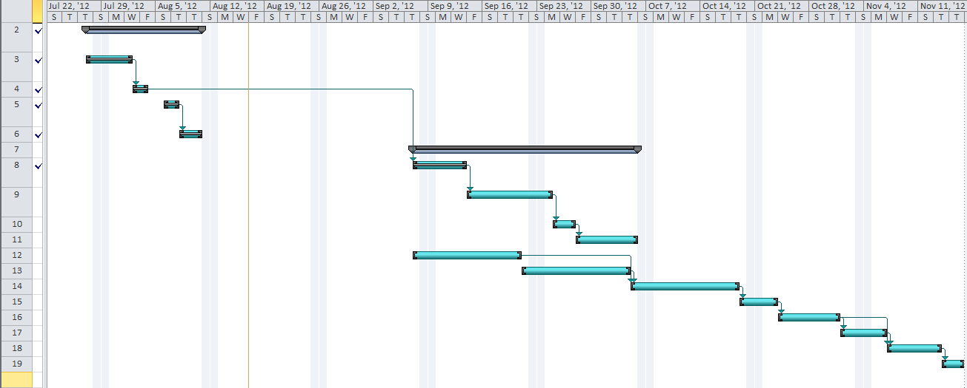
Work-Breakdown Structure

Slide 7
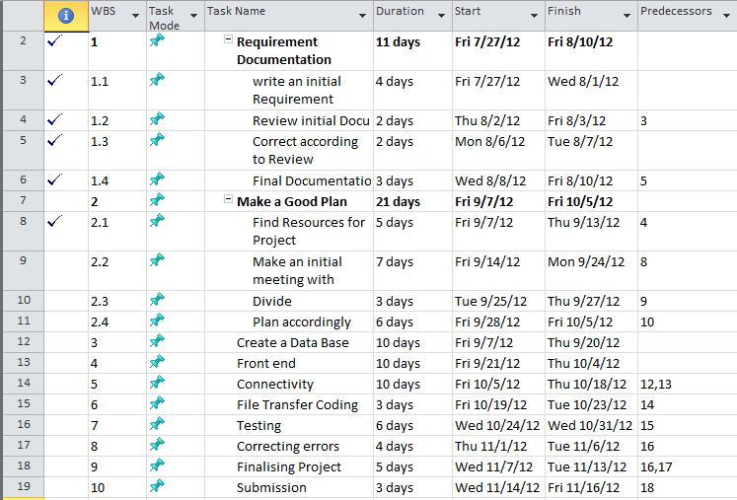


Slide 8
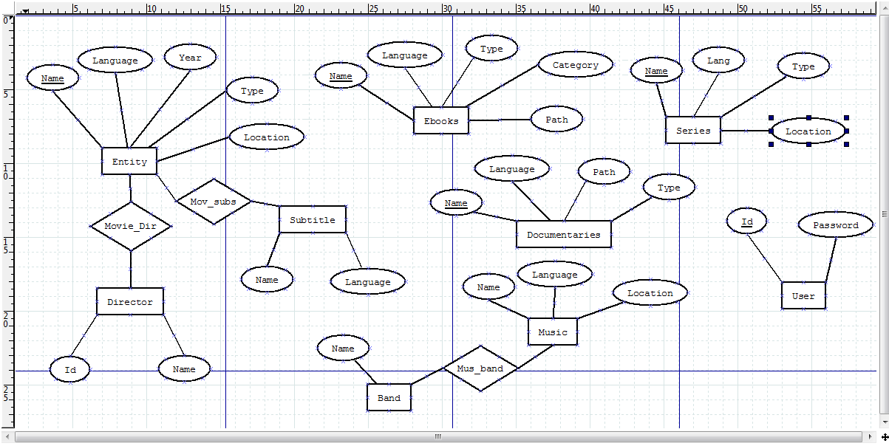
E-R Diagram

Slide 9
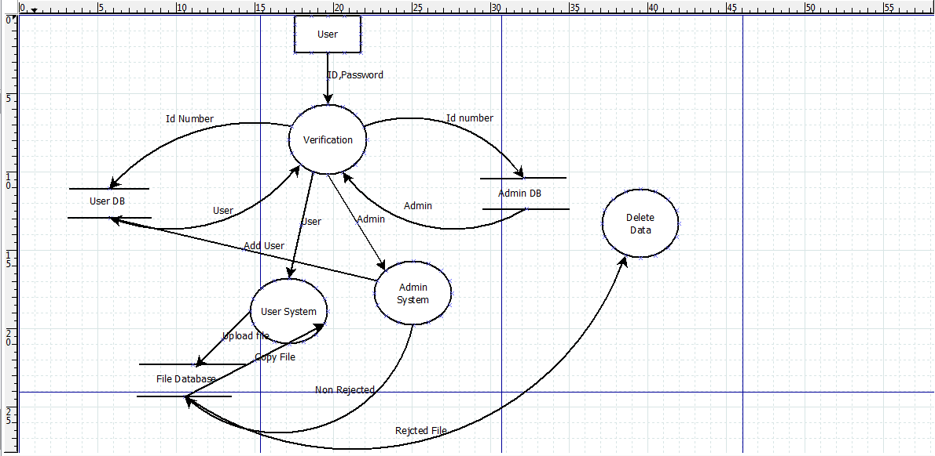
Data Flow Diagram

Slide 10
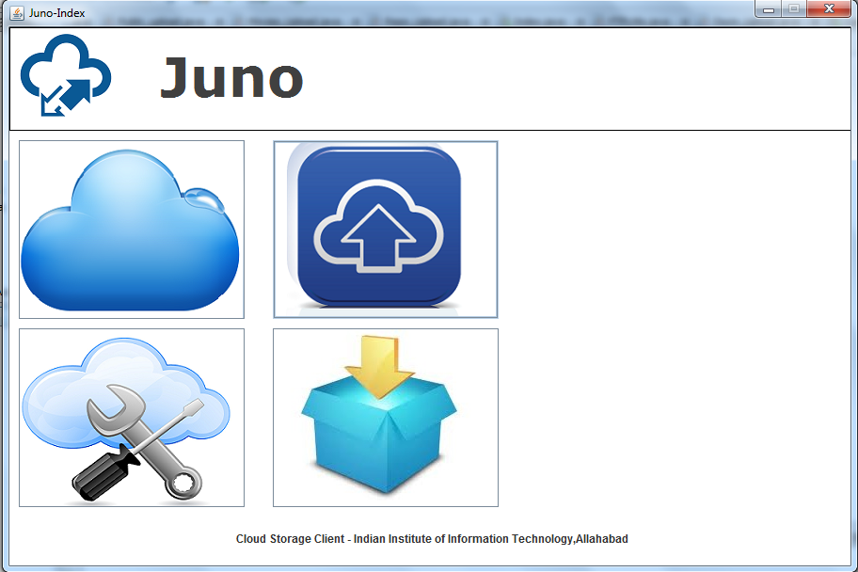
Software Homepage

Slide 11
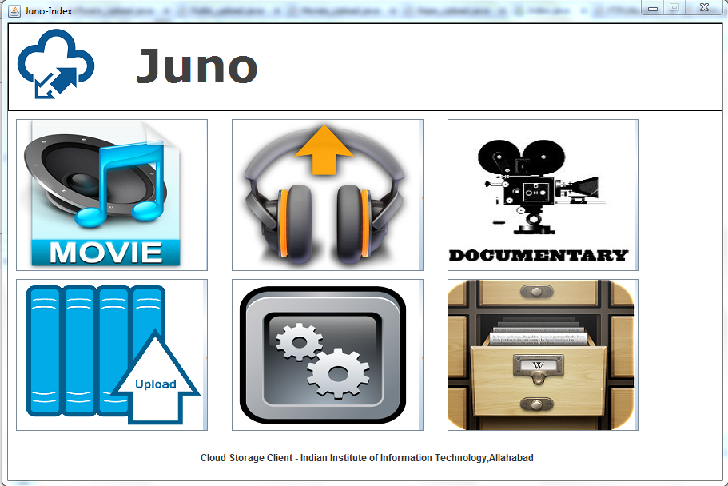
Upload

Slide 12
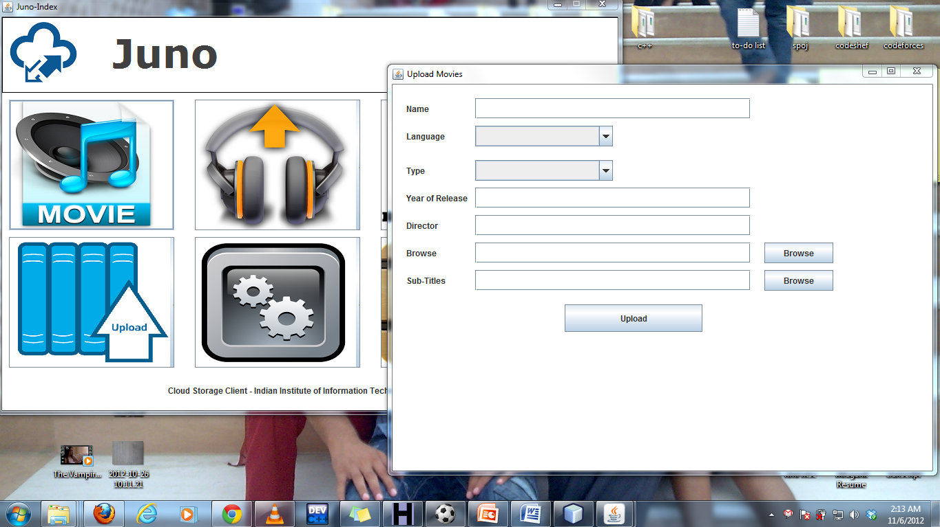
Upload Movies

Slide 13
Key Feature
Key Feature of our software is the group storage
In this Individuals can form a group as of batch and members of that only can access the data stored in space for that group
Helpful to store semester wise storage content.

Slide 14
Future Scope
We ll provide personalized space when we get server of large storage capacity.
We are looking forward to develop a similar application for mobile phones that enables to download and upload small files

Slide 15
References
http://www.emc.com/storage/atmos/atmos.htm
http://en.wikipedia.org/wiki/Cloud_storage#Cloud_storage_advantages
www.cerebrata.com

