Slide 1
Hello!
We are team Bubbles
And we are here to provide a smart solution for RCMP’s Recruitment System.

Slide 2
Smartpol
Smart Police System

Slide 3
History
Traditional Police Systems
There is several manual work for each process.
There are always chances of losing potential evidences due to lack in technology.
Police departments are sometime incapable of keeping up with innovation in crimes.
There is always chance of human errors.
Police Recruitment
There is no metrics or benchmark to evaluate right candidates.
The evaluation criteria to assess candidates are outdated.
There is still lack of diverse skill sets required to solve criminal cases.

Slide 4
Some people call this artificial intelligence, but the reality is this technology will enhance us. So instead of artificial intelligence, I think we'll augment our intelligence. - Ginni Rometty

Slide 5
Explanation
Its is a smart police recruitment system that leverages the use of Artificial intelligence and machine learning to analyse and automate existing system.

Slide 6
Recruiting with Machine learning

Slide 7
Resume Screening
Resume will be matched on the given skillset is required for the particular job description.
It also matches the relevant courses, minimum eligibility requirements will be cleared by the resume screen.a
Based on the Natural Language Processing (NLP)’s.

Slide 8
Psychological Evaluations
Pymetric Test
This test allows us to analyse the analytical and problem solving skills to determine the perfect candidate for the role .
Sourced: 3rd Party Vendor
Facial and Speech Analysis
Analyzing the micro facial expressions and speech analysis to generate the score for this analysis.
Tech: Computer Vision and NLP
Behavioural Analysis
Check the applicants digital footprint on the various social-media platform to give an insight about his/her personality.
Tech: Unsupervised Learning in NLP and data scraping

Slide 9
Data Flow Diagram

Slide 10
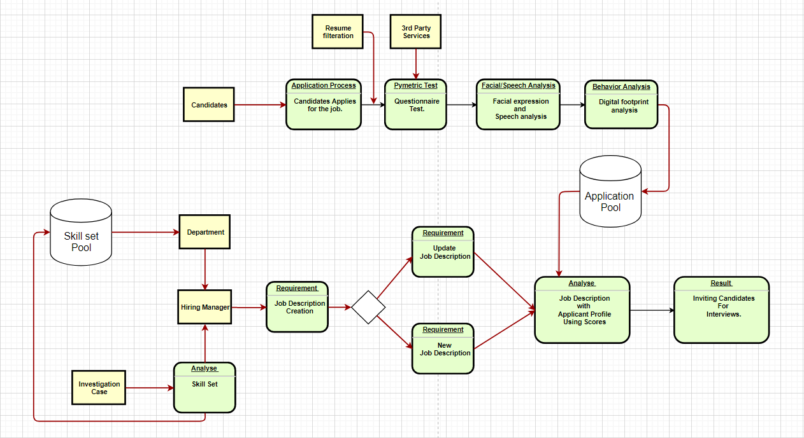

Slide 11
Samples

Slide 12
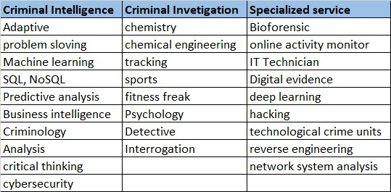
Sample skill Sets

Slide 13
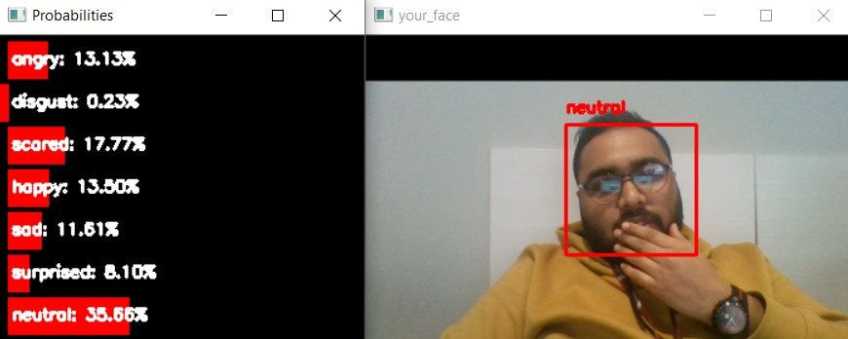
Facial Expression Assessment
Detection of the various facial expression in form of emotions.
Probabilities will be calculated.
It will help us to evaluate the applicant’s Emotional Quotient.

Slide 14
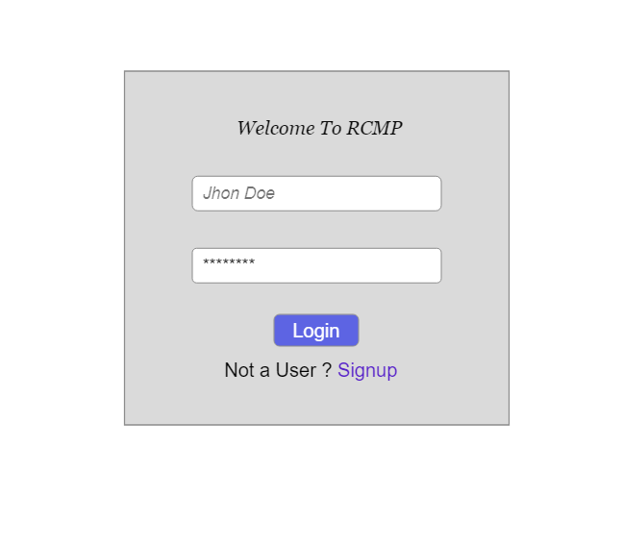
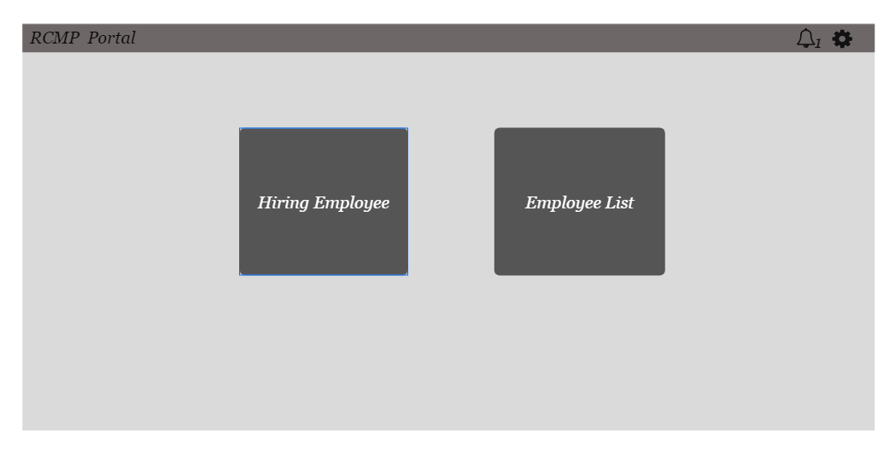

Slide 15
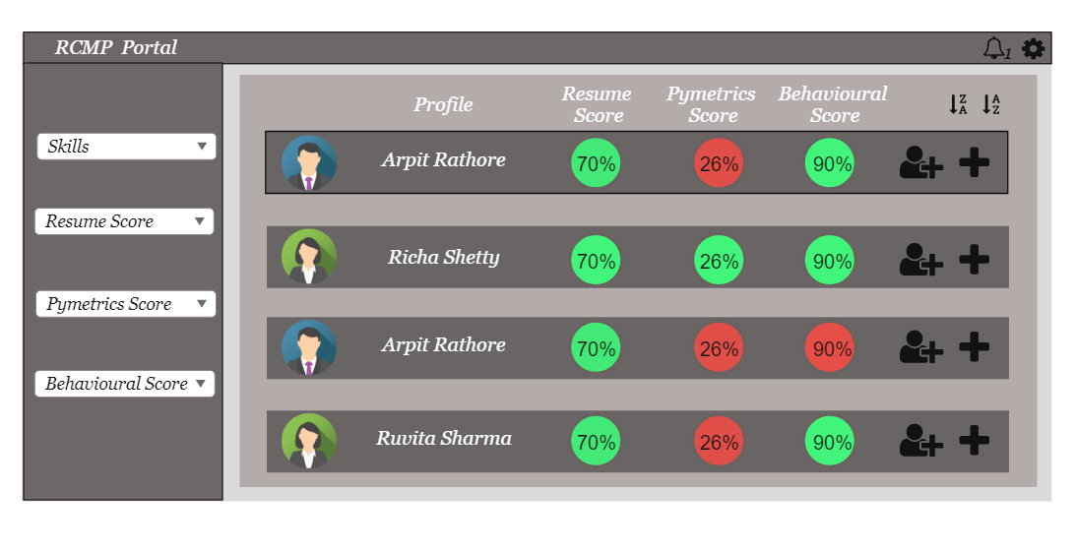

Slide 16
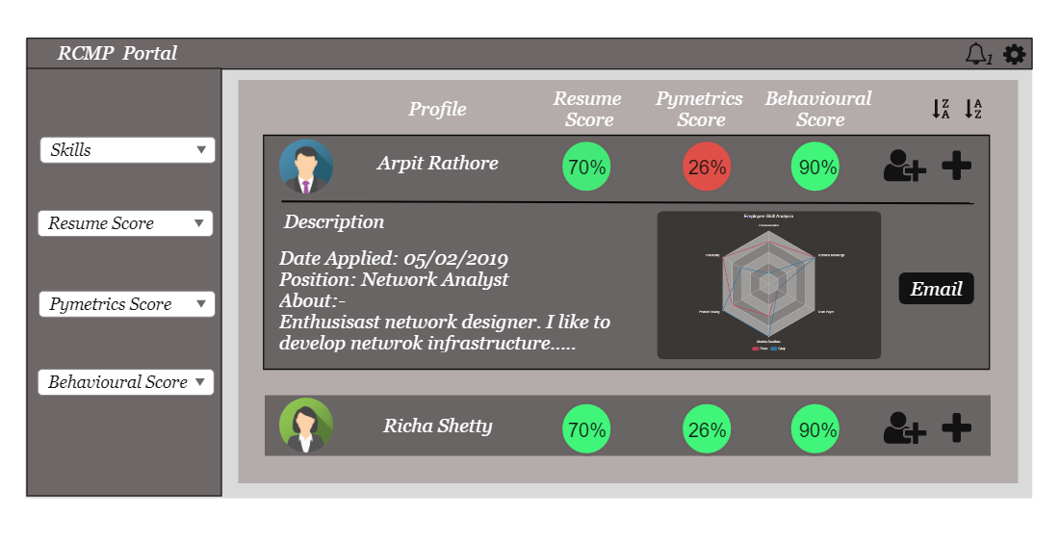

Slide 17
Thanks!
Any questions?
You can find me at:
@username
user@mail.me

