Slide 1
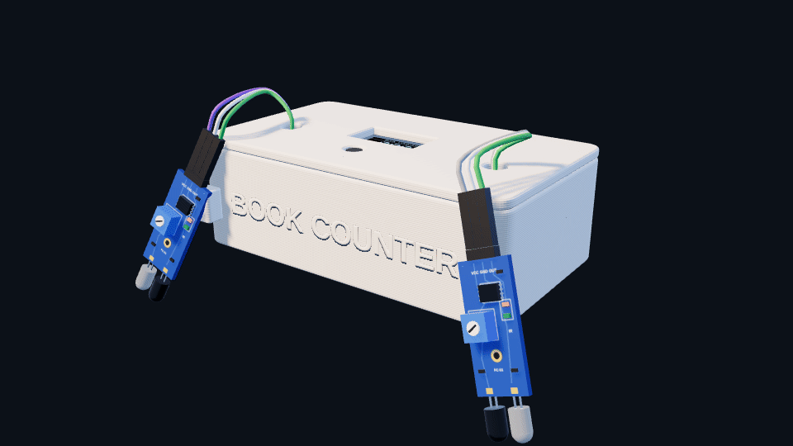
3D-PRINTED SMART BOOKMARK
BOOK
COUNTER
A bookmark that counts every page you turn and shows the total on its own screen.
2
IR sensors
0.96"
OLED screen
1
printed shell
[Presenter names · Class]
Start ►
Menu
Notes:
Hello everyone. This is Book Counter, a bookmark we designed and 3D-printed that counts the pages you turn. This presentation is interactive: the buttons work during the slide show. Click Start, or press the right arrow.

Slide 2
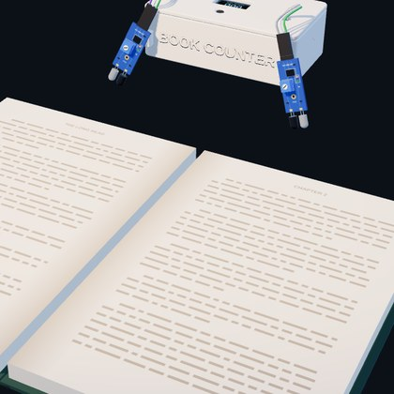
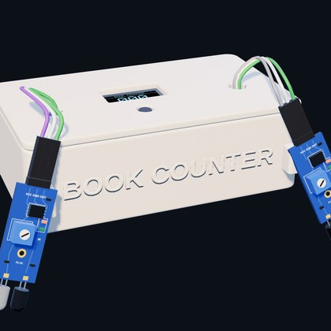
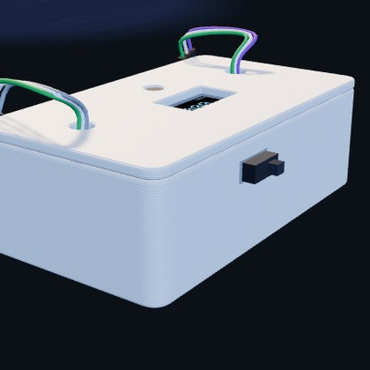
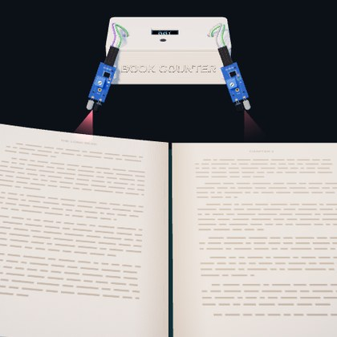
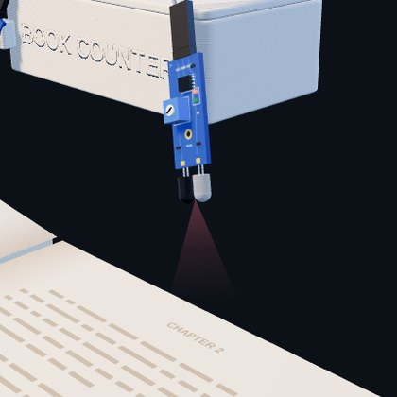
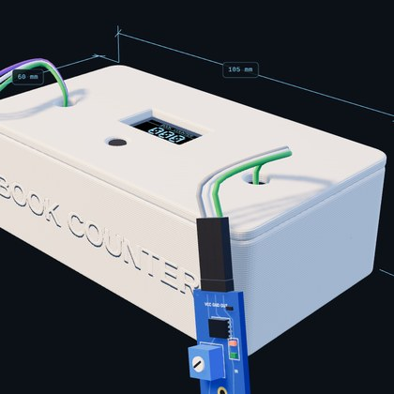
EXPLORE
Where do you want to go?
START HERE
The problem
Why paper books need a counter
CLICK THE PARTS
The device
Explore it piece by piece
REAL 3D
3D tour
A 3D model you can turn
TRY IT
Live demo
Turn pages, watch it count
AUDIENCE
Quick quiz
One question about the sensors
HOW IT IS MADE
Build
Wiring and the printed shell
Each tile is a button. Press → to go through everything in order.
Notes:
This is the menu. Every tile is a button: click one to jump straight to that part of the talk. If you just press the right arrow, the presentation goes through everything in order.

Slide 3
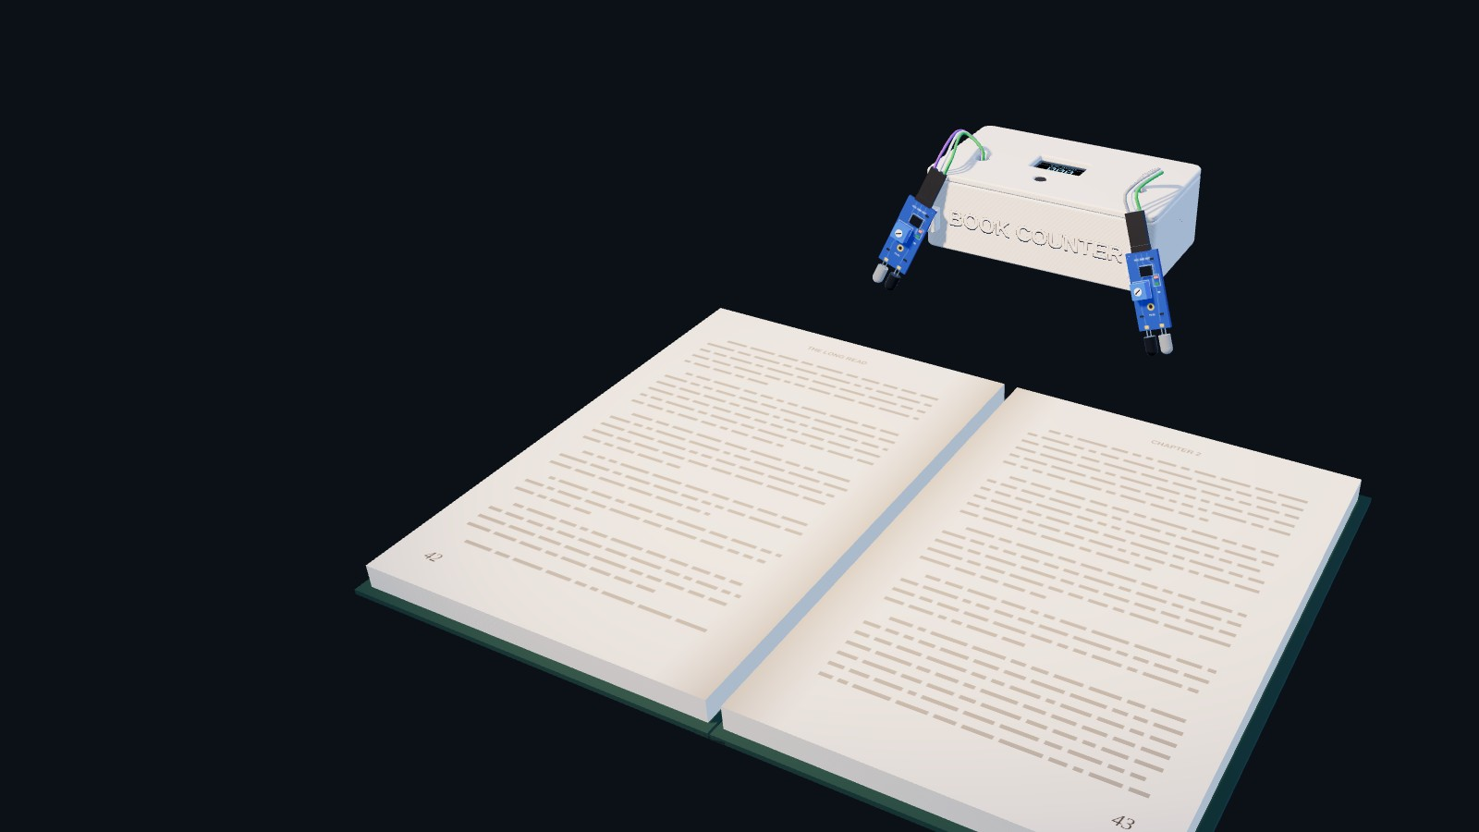
Menu
WHY WE BUILT IT
Paper books keep no score
An e-reader knows how far you got. A paper book doesn't.
• Reading goals need numbers: pages a day, pages a week.
• Page numbers written down by hand get forgotten.
• Reading apps make you type in every session.
Notes:
E-readers like a Kindle track exactly how much you read. Paper books don't. If you want a reading goal, like twenty pages a day, you have to remember where you started and do the maths yourself, and most people forget. Reading apps help, but you still have to type your pages in every time.

Slide 4
Menu
THE IDEA
What if the bookmark kept count for you?
Book Counter sits at the top of the book and counts each page as you turn it. No buttons to press, no app, nothing to write down.
Meet the device ►
Notes:
So our idea was simple: make the bookmark do the counting. You put it on your book, read normally, and it counts every page you turn by itself.

Slide 5
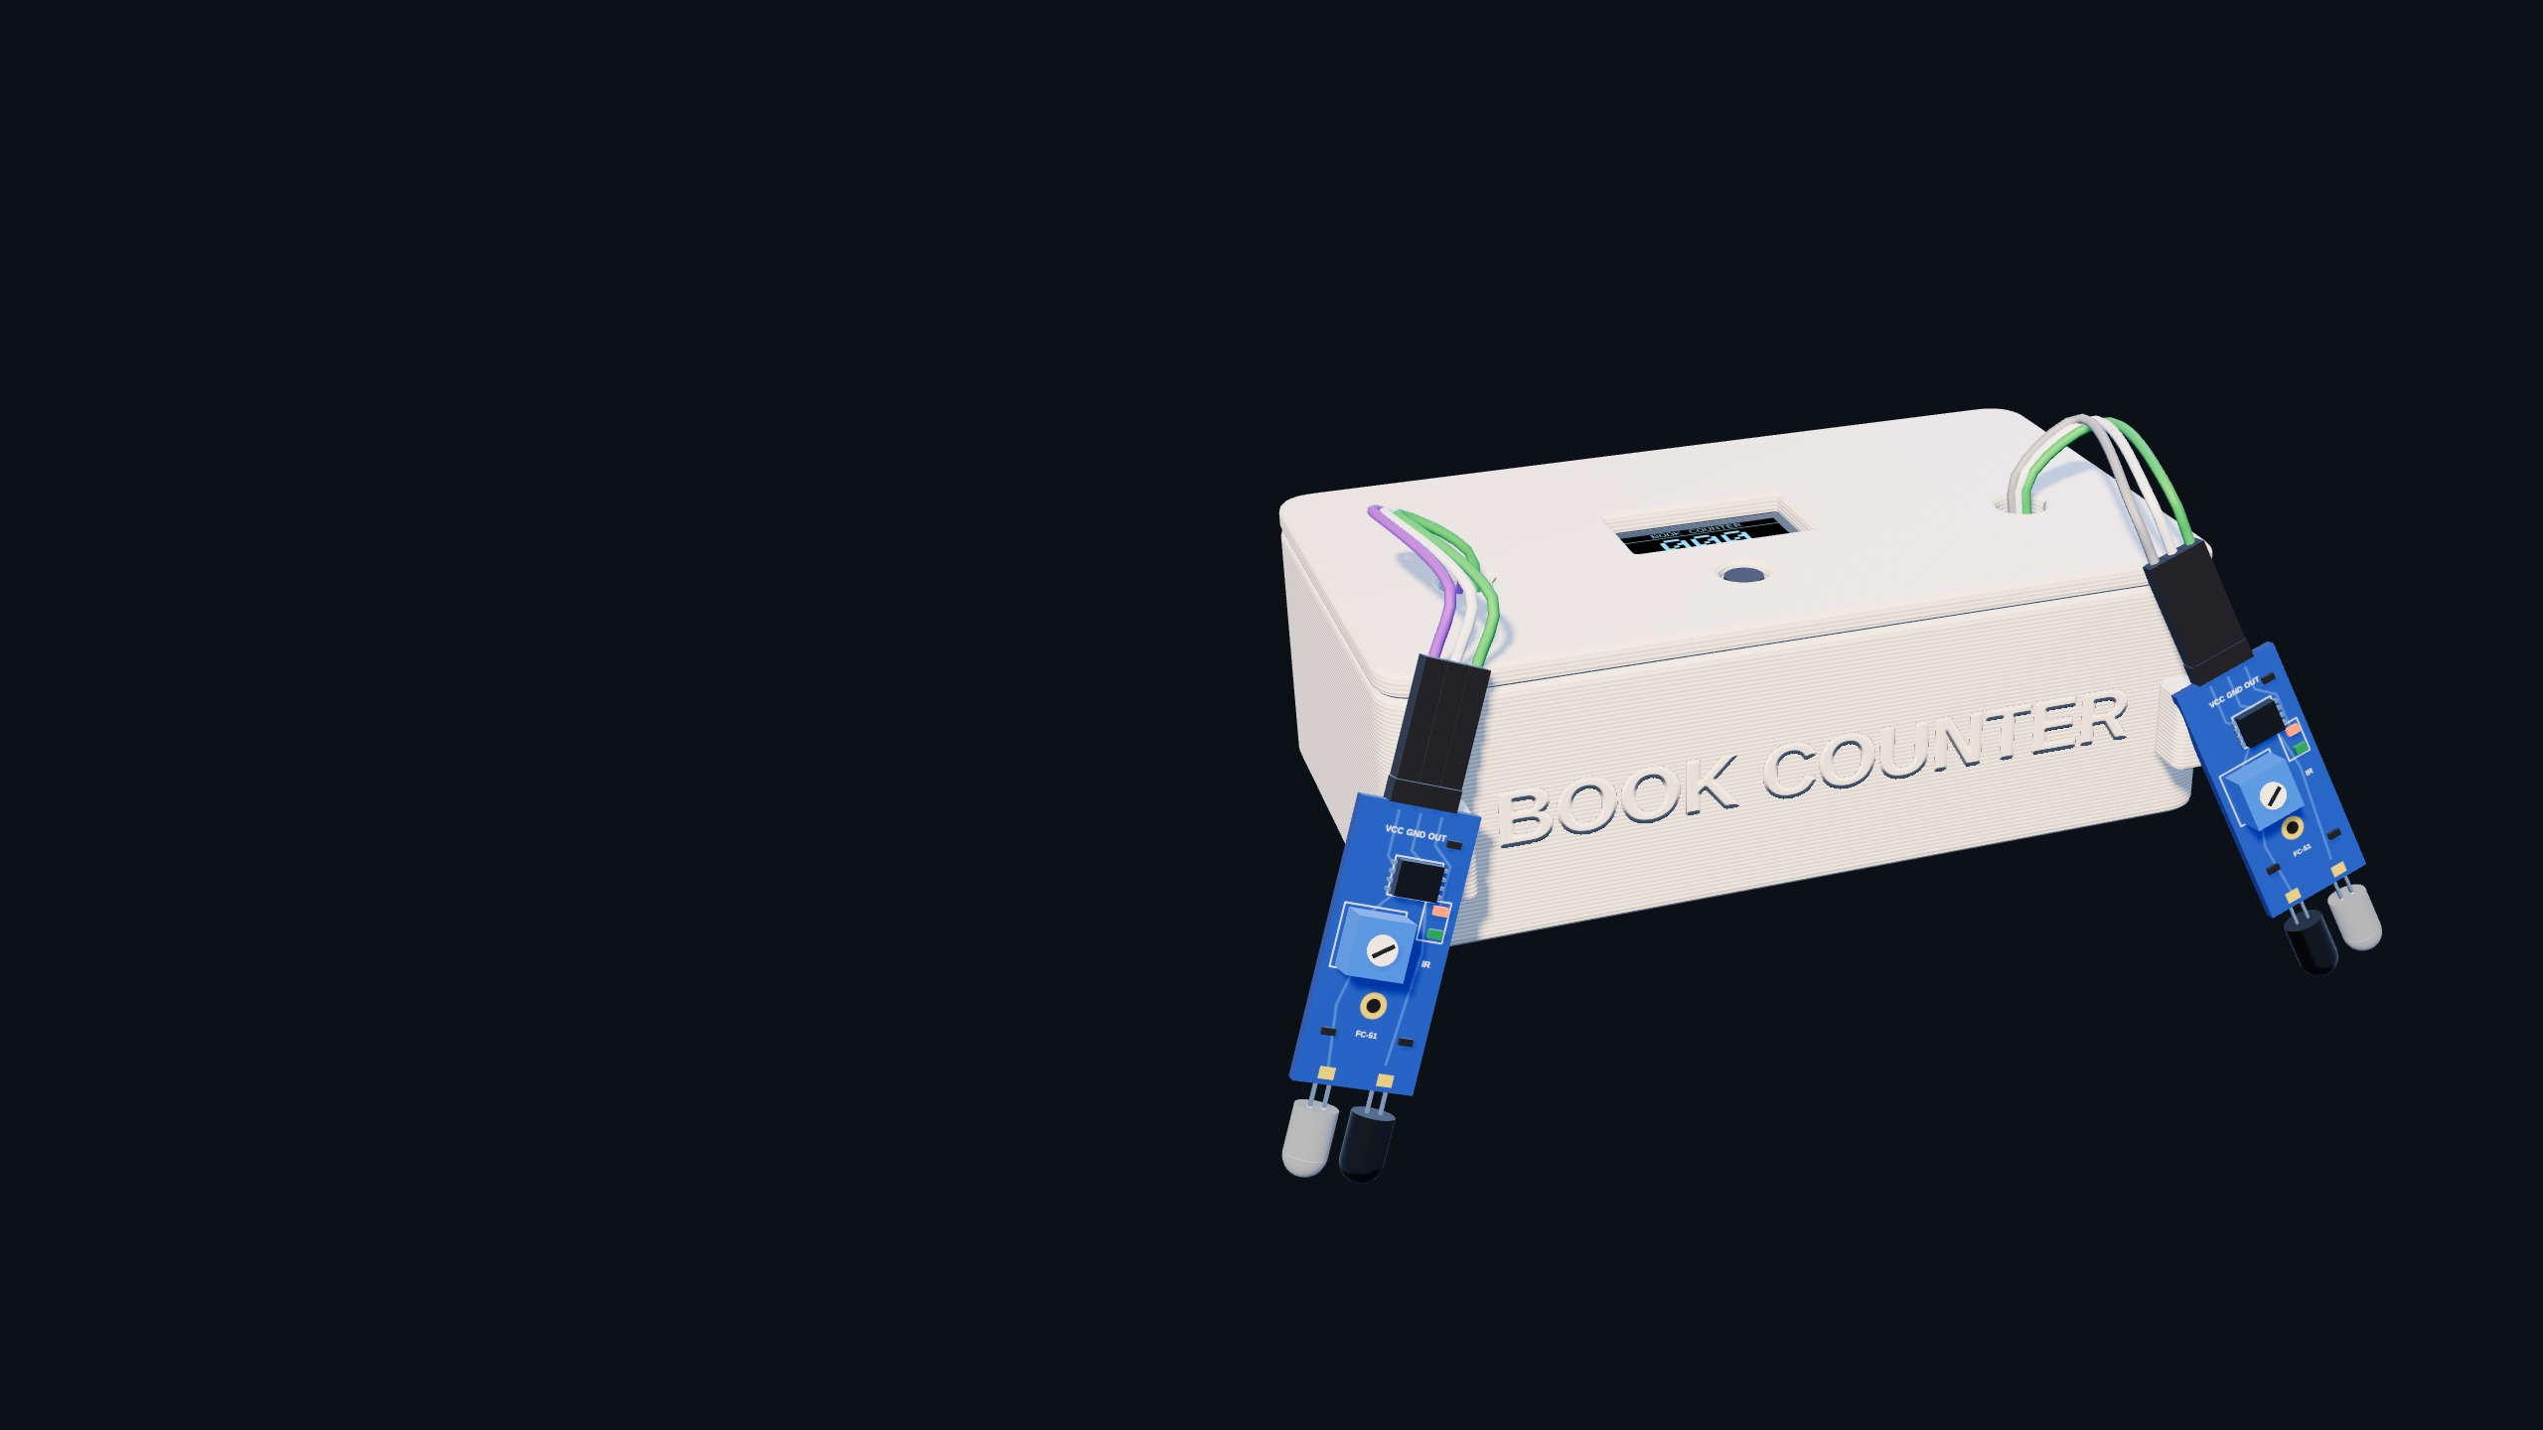
Menu
THE DEVICE
Two eyes, one screen
Reset button
OLED display
Click any part of the model to look closer.
Every label and blue dot is a button.
3D-printed shell
IR sensor, left
IR sensor, right
Notes:
Here's the device. Everything you can see from outside has one job. Click any label, or any blue dot, to zoom in on that part. Each close-up has a Back button.

Slide 6
Menu
PART 1 OF 5
OLED display
0.96" OLED · 128 × 64 px · SSD1306 · I²C
Shows the running page count. It needs only two data wires, SDA and SCL, to the microcontroller.
◄ Back to the device
Next part ►
Notes:
This is the screen. It shows the count, and it only needs two data wires to talk to the Arduino. Click Back to return to the whole device, or Next part.

Slide 7
Menu
PART 2 OF 5
Reset button
6 mm push button
Press it to set the count back to zero at the start of a reading session.
◄ Back to the device
Next part ►
Notes:
The reset button sets the count back to zero when you start a new reading session. Click Back to return to the whole device, or Next part.

Slide 8
Menu
PART 3 OF 5
3D-printed shell
PLA · 105 × 60 × 35 mm · two pieces
A base tray and a top plate with cut-outs for the screen, the button and the two sensor cables. BOOK COUNTER is embossed on the front.
◄ Back to the device
Next part ►
Notes:
We designed this shell and printed it in two pieces, with the name embossed on the front. Click Back to return to the whole device, or Next part.

Slide 9
Menu
PART 4 OF 5
IR sensor, left
IR obstacle module (FC-51) · LM393
Watches the left side of the book. When you read forward, it sees the page second, as the page lands.
◄ Back to the device
Next part ►
Notes:
The left sensor sees the page second when you turn forward, as the page lands on the left. Click Back to return to the whole device, or Next part.

Slide 10
Menu
PART 5 OF 5
IR sensor, right
IR obstacle module (FC-51) · LM393
Watches the right side of the book. When you read forward, it sees the page first, as you lift it.
◄ Back to the device
Next part ►
Notes:
The right sensor sees the page first when you turn forward, as you lift it off the right side. Click Back to return to the whole device, or Next part.

Slide 11
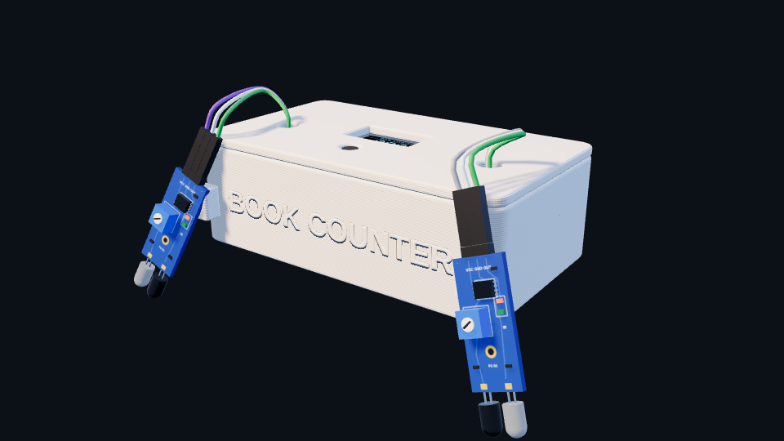
Menu
3D TOUR · 1 OF 4
A real 3D model
This is the actual 3D file of the device. Press → and PowerPoint turns it for you.
In edit mode, click the model and drag the round arrow in its middle to spin it any way you like.
Turn it ►
Notes:
This is the actual 3D file of the device. Press → and PowerPoint turns it for you. In edit mode, click the model and drag the round arrow in its middle to spin it any way you like. This model is the same 3D file we used in the live 3D version. Between these slides PowerPoint's Morph transition turns it smoothly.

Slide 12
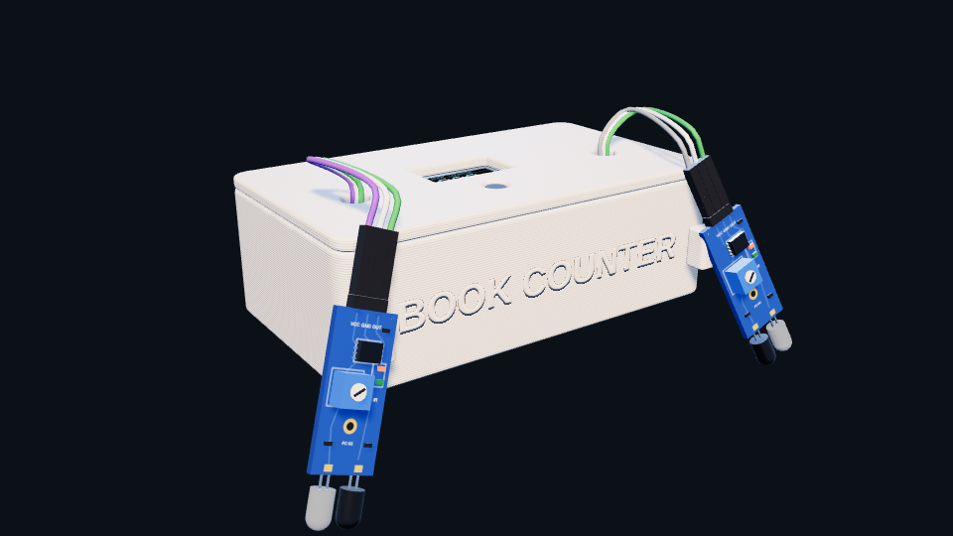
Menu
3D TOUR · 2 OF 4
The sensor arms
An IR board hangs off each front corner. Both look down towards the pages.
The jumper wires go into the shell through two ports in the top plate.
Turn it ►
◄ Back
Notes:
An IR board hangs off each front corner. Both look down towards the pages. The jumper wires go into the shell through two ports in the top plate. This model is the same 3D file we used in the live 3D version. Between these slides PowerPoint's Morph transition turns it smoothly.

Slide 13
Menu
3D TOUR · 3 OF 4
Screen on top
The OLED window and the reset button sit on the top plate, where you can see them while reading.
The screen shows the count in big pixel digits.
Turn it ►
◄ Back
Notes:
The OLED window and the reset button sit on the top plate, where you can see them while reading. The screen shows the count in big pixel digits. This model is the same 3D file we used in the live 3D version. Between these slides PowerPoint's Morph transition turns it smoothly.

Slide 14
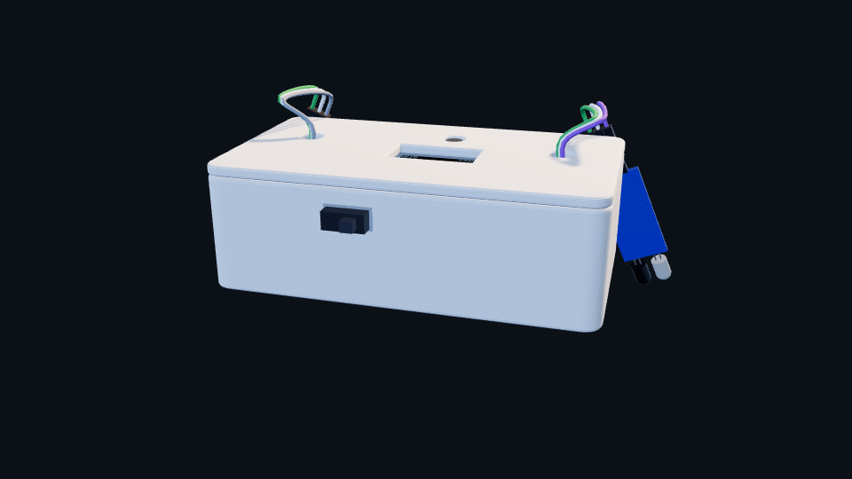
Menu
3D TOUR · 4 OF 4
All the way round
From behind you can see the power switch and the two cable ports.
Press → to continue, or click Menu to jump somewhere else.
Inside ►
◄ Back
Notes:
From behind you can see the power switch and the two cable ports. Press → to continue, or click Menu to jump somewhere else. This model is the same 3D file we used in the live 3D version. Between these slides PowerPoint's Morph transition turns it smoothly.

Slide 15
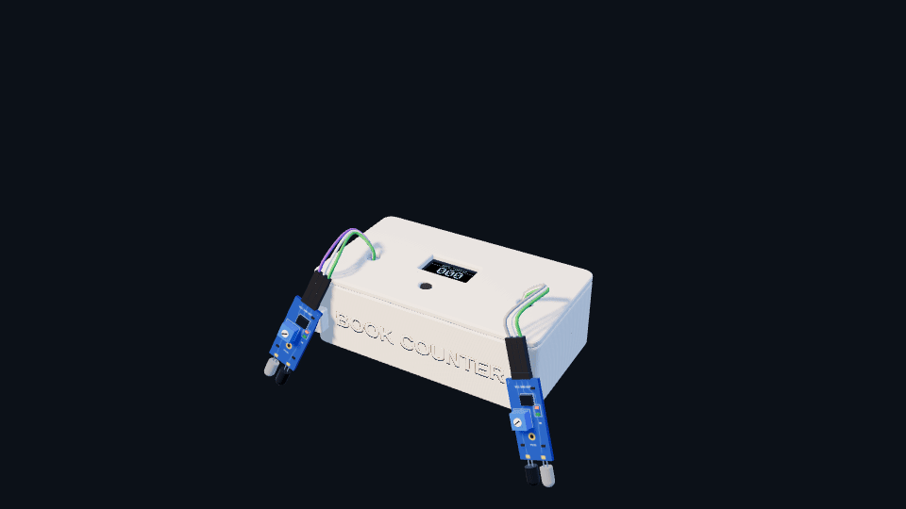
Menu
INSIDE THE SHELL
What's inside
Lift off the top plate and four parts do the real work.
Microcontroller
Arduino Nano. Reads, decides, counts.
OLED display
0.96", under the window.
Battery
9 V, with a power switch.
Jumper wires
Bring both sensor signals in.
Click the parts ►
Notes:
If we lift the top plate off, you can see the inside. The microcontroller is an Arduino Nano: it reads the sensors and keeps the count. The OLED screen is mounted under the window in the top plate. A battery powers everything, with a switch to turn it off. The sensor wires come in through two holes in the top.

Slide 16
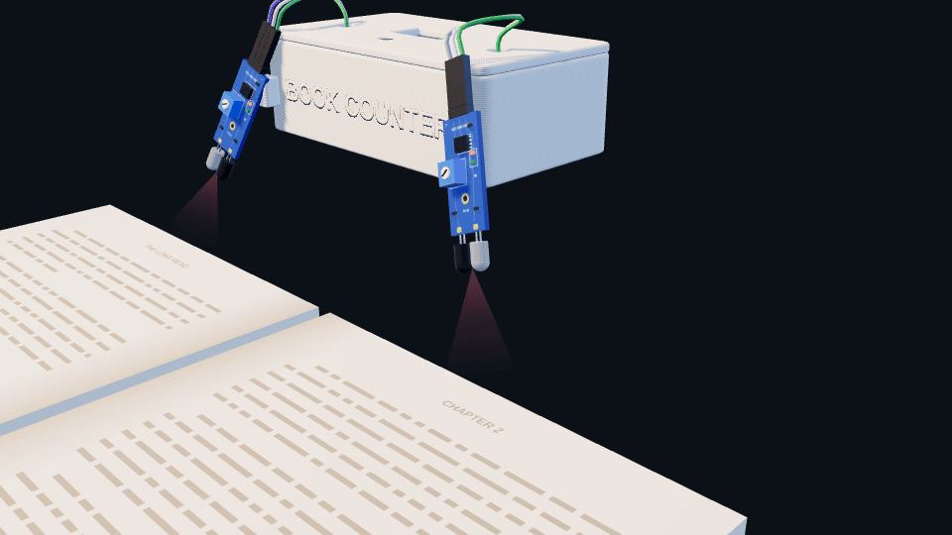
Menu
SENSING
Seeing a page
1
Send. The clear LED shines infrared light.
2
Reflect. A page in the beam bounces it back.
3
Receive. The dark photodiode picks it up.
4
Decide. The LM393 chip outputs a clean ON or OFF.
The blue trimmer sets how close a page must come. Real IR is invisible; red shows the beam.
Quick quiz ►
Notes:
Each sensor is an infrared module. The clear LED sends out infrared light, which we can't see; the red cone just shows where it goes. When a page moves into the beam, it reflects the light back to the dark photodiode. The LM393 chip turns that into a clean ON or OFF signal for the Arduino, and a small green LED lights up. The blue screw is a trimmer: we turn it to set how close a page has to be before it counts.

Slide 17
Menu
QUICK CHECK
You turn a page forward. Which sensor sees it first?
Left sensor
The board on the left corner
Right sensor
The board on the right corner
Click an answer.
Notes:
Quick question for the audience: when you turn a page forward, which sensor sees it first? Let someone answer, then click the button they chose.

Slide 18
Menu
NOT QUITE
Think about where the page starts
You read the right-hand page, then lift it from the right side. Which sensor does it pass first?
◄ Try again
Notes:
Not quite. Ask them to picture the page: it starts on the right-hand side of the open book. Then click Try again.

Slide 19
Menu
CORRECT
Right, then left
A page you turn forward lifts off the right side, so the right sensor sees it first. Then it lands on the left. Right then left means one more page read.
Try it in the live demo ►
◄ Back to the question
Notes:
Correct. The page starts on the right, so as you lift it, it passes the right sensor first and then the left one as it lands. Right then left means plus one. That order is how the bookmark knows which way you turned.

Slide 20
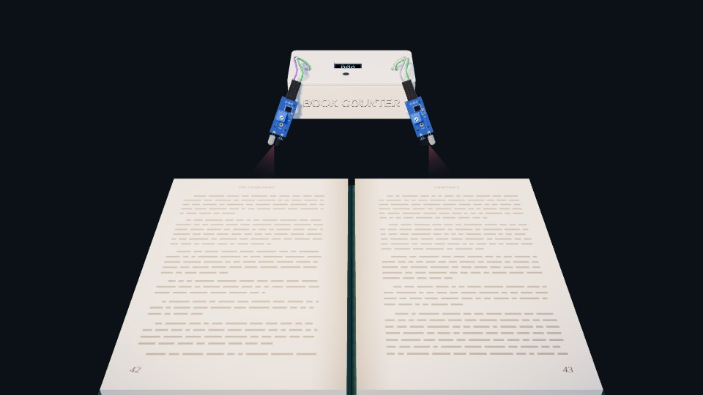
Menu
LIVE DEMO
Turn a page, watch it count
000
PAGES TURNED
Ready. Click Turn page.
Turn page ►
◄ Flip back
Reset
Continue ►
Each click plays one page turn.
Notes:
This is the live demo. Click Turn page: each click plays one page turn and the count goes up. Flip back takes it down again. Reset goes back to zero. Continue moves on.

Slide 21

Menu
LIVE DEMO
Turn a page, watch it count
001
PAGES TURNED
Right sensor, then left sensor: +1
Turn page ►
◄ Flip back
Reset
Continue ►
Each click plays one page turn.
Notes:
The page lifted off the right side first, then landed on the left. Right then left: plus one. The count is now 1.

Slide 22
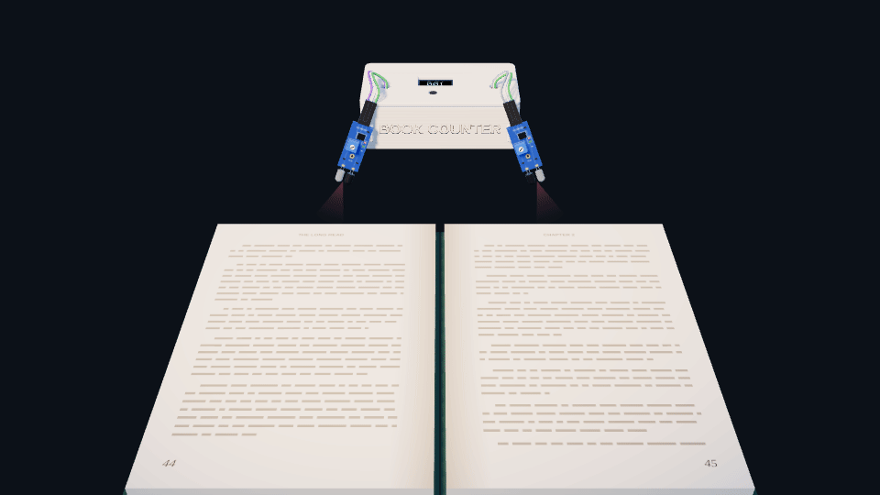
Menu
LIVE DEMO
Turn a page, watch it count
002
PAGES TURNED
Right sensor, then left sensor: +1
Turn page ►
◄ Flip back
Reset
Continue ►
Each click plays one page turn.
Notes:
The page lifted off the right side first, then landed on the left. Right then left: plus one. The count is now 2.

Slide 23
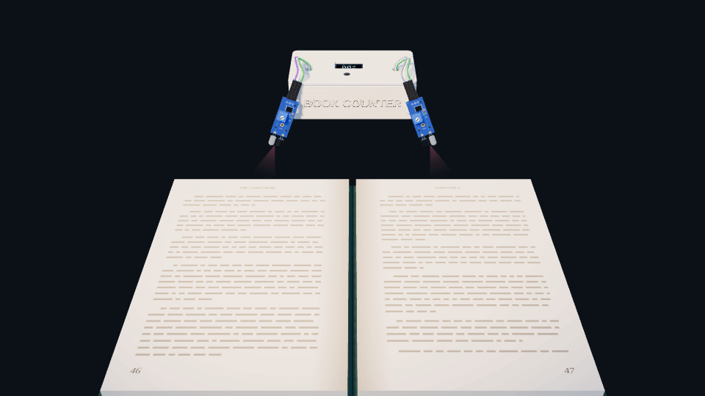
Menu
LIVE DEMO
Turn a page, watch it count
003
PAGES TURNED
Right sensor, then left sensor: +1
Turn page ►
◄ Flip back
Reset
Continue ►
Each click plays one page turn.
Notes:
The page lifted off the right side first, then landed on the left. Right then left: plus one. The count is now 3.

Slide 24
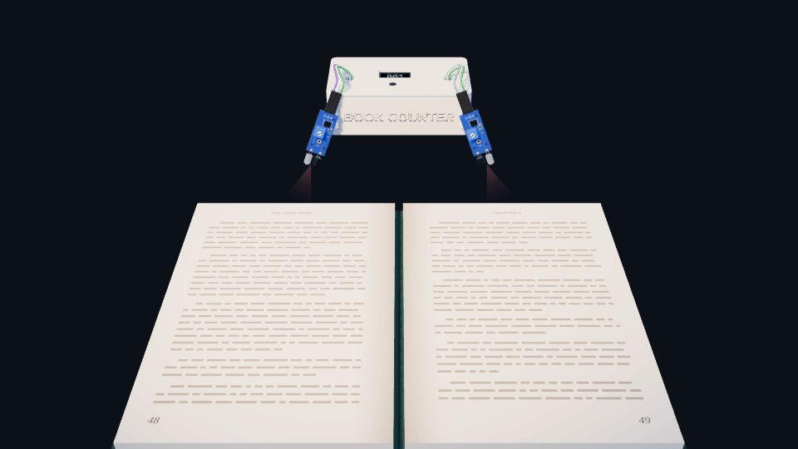
Menu
LIVE DEMO
Turn a page, watch it count
004
PAGES TURNED
Right sensor, then left sensor: +1
Turn page ►
◄ Flip back
Reset
Continue ►
Each click plays one page turn.
Notes:
The page lifted off the right side first, then landed on the left. Right then left: plus one. The count is now 4.

Slide 25
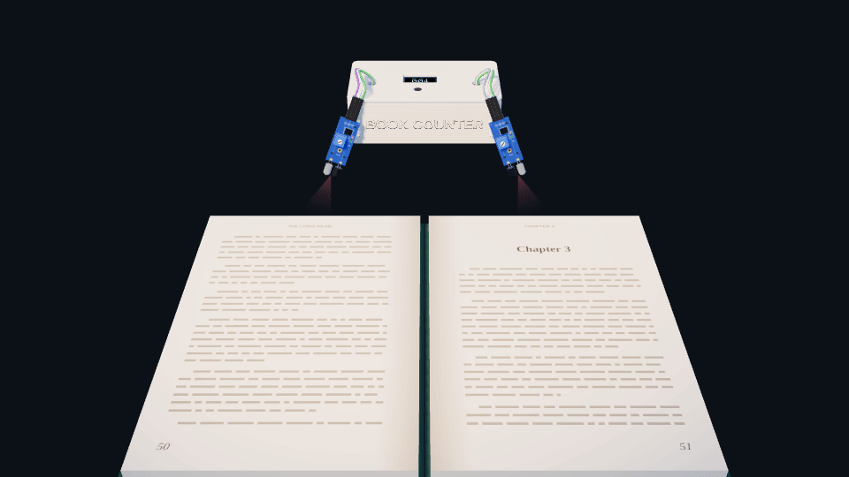
Menu
LIVE DEMO
Turn a page, watch it count
005
PAGES TURNED
Right sensor, then left sensor: +1
Turn page ►
◄ Flip back
Reset
Continue ►
Five pages. Press Reset to start again.
Notes:
The page lifted off the right side first, then landed on the left. Right then left: plus one. The count is now 5.

Slide 26
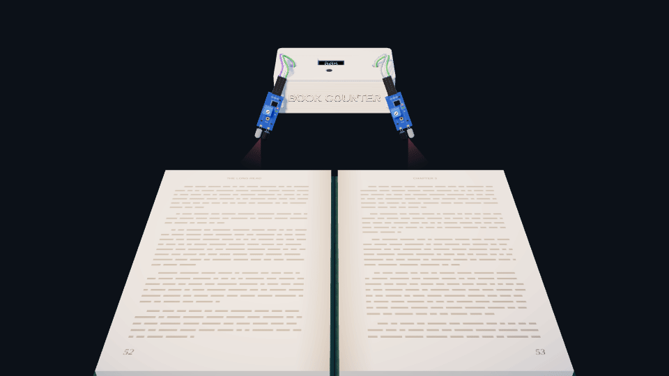
Menu
LIVE DEMO
Turn a page, watch it count
004
PAGES TURNED
Left sensor, then right sensor: −1
Turn page ►
◄ Flip back
Reset
Continue ►
Each click plays one page turn.
Notes:
This time the page went the other way: left sensor first, then right. That means minus one. The count is now 4.

Slide 27
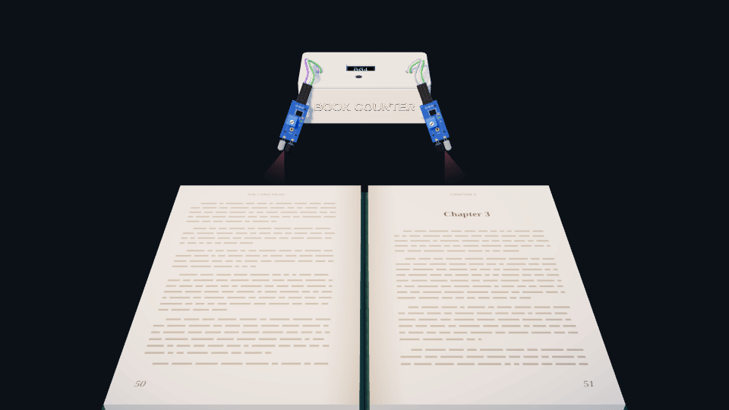
Menu
LIVE DEMO
Turn a page, watch it count
003
PAGES TURNED
Left sensor, then right sensor: −1
Turn page ►
◄ Flip back
Reset
Continue ►
Each click plays one page turn.
Notes:
This time the page went the other way: left sensor first, then right. That means minus one. The count is now 3.

Slide 28
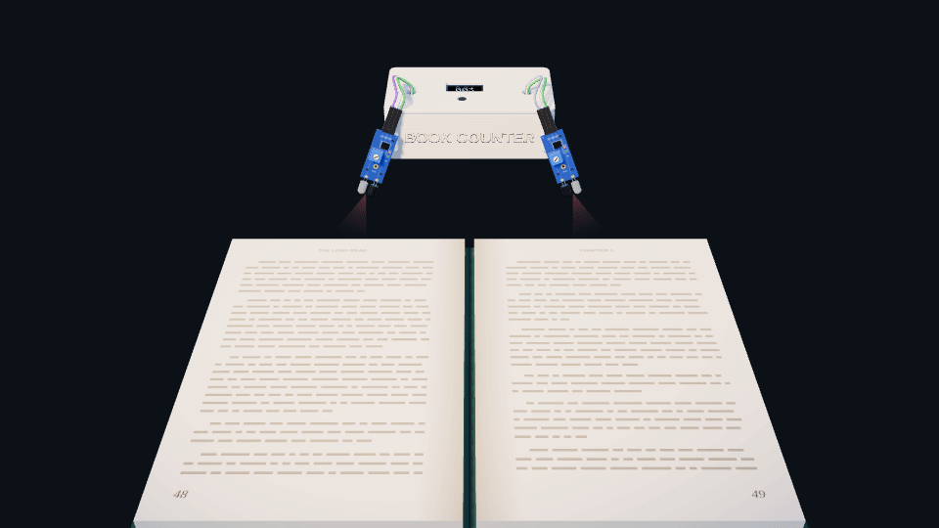
Menu
LIVE DEMO
Turn a page, watch it count
002
PAGES TURNED
Left sensor, then right sensor: −1
Turn page ►
◄ Flip back
Reset
Continue ►
Each click plays one page turn.
Notes:
This time the page went the other way: left sensor first, then right. That means minus one. The count is now 2.

Slide 29

Menu
LIVE DEMO
Turn a page, watch it count
001
PAGES TURNED
Left sensor, then right sensor: −1
Turn page ►
◄ Flip back
Reset
Continue ►
Each click plays one page turn.
Notes:
This time the page went the other way: left sensor first, then right. That means minus one. The count is now 1.

Slide 30
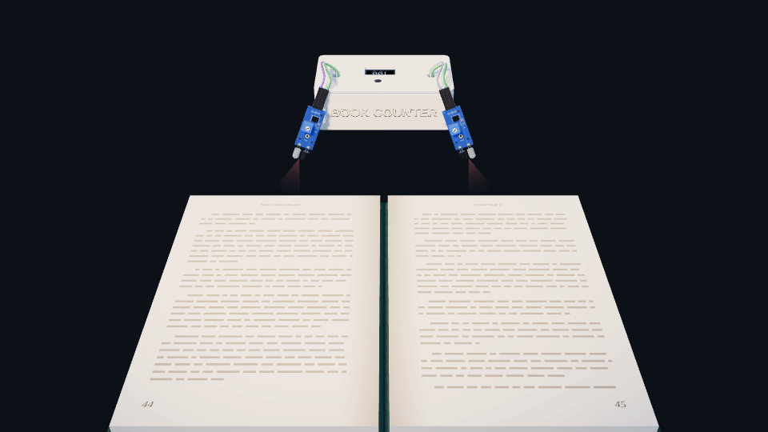
Menu
LIVE DEMO
Turn a page, watch it count
000
PAGES TURNED
Left sensor, then right sensor: −1
Turn page ►
◄ Flip back
Reset
Continue ►
Each click plays one page turn.
Notes:
This time the page went the other way: left sensor first, then right. That means minus one. The count is now 0.

Slide 31
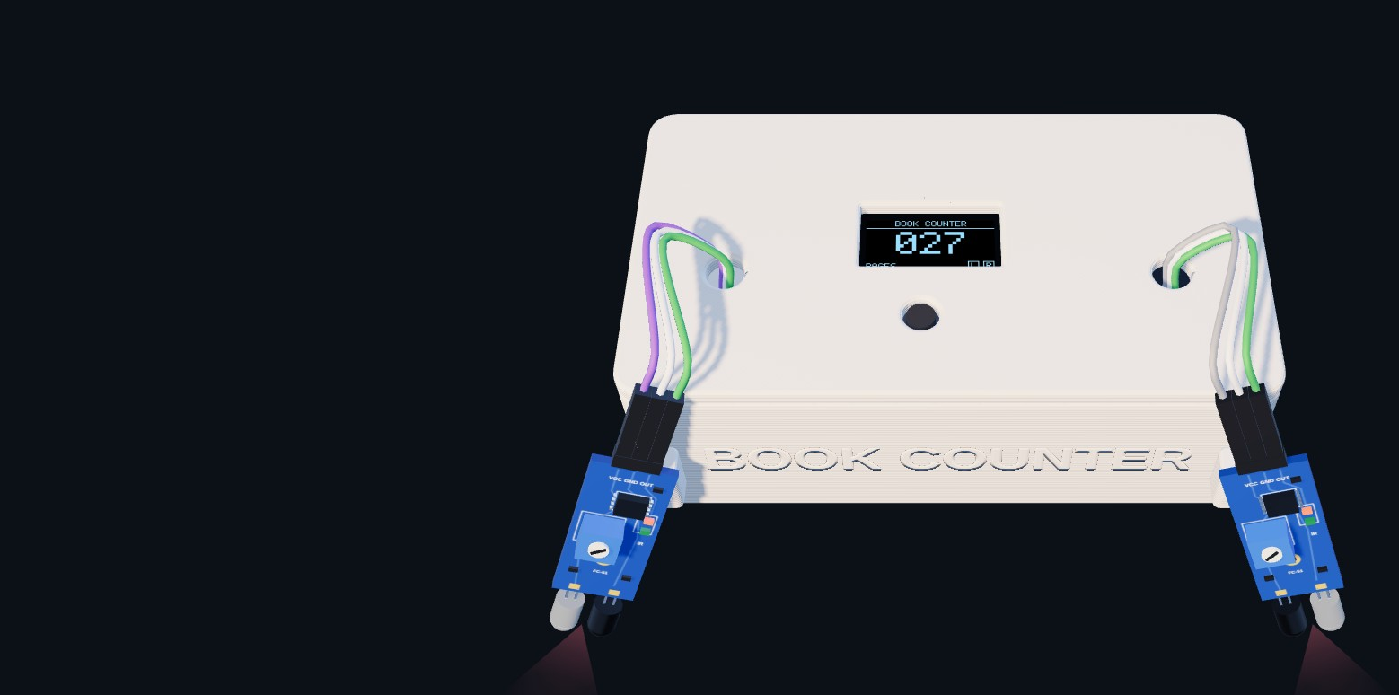
Menu
FIRMWARE
The counting logic
void hit(char side) {
if (millis() - lastCount < LOCKOUT_MS) return;
if (armed && armed != side) {
pages += (armed == 'R') ? 1 : -1;
lastCount = millis();
armed = 0;
showCount(pages);
} else {
armed = side; // wait for the other sensor
}
}
Simplified. The first sensor arms; the second one counts.
Notes:
This is the heart of our code, simplified. Every time a sensor sees a page, it calls hit with R or L. The first sensor to fire just arms and waits. When the other sensor fires, the page has finished turning: if the right one was first, we add a page, otherwise we take one away. The first line is the lock-out: if we counted less than 400 milliseconds ago, we ignore the hit.

Slide 32
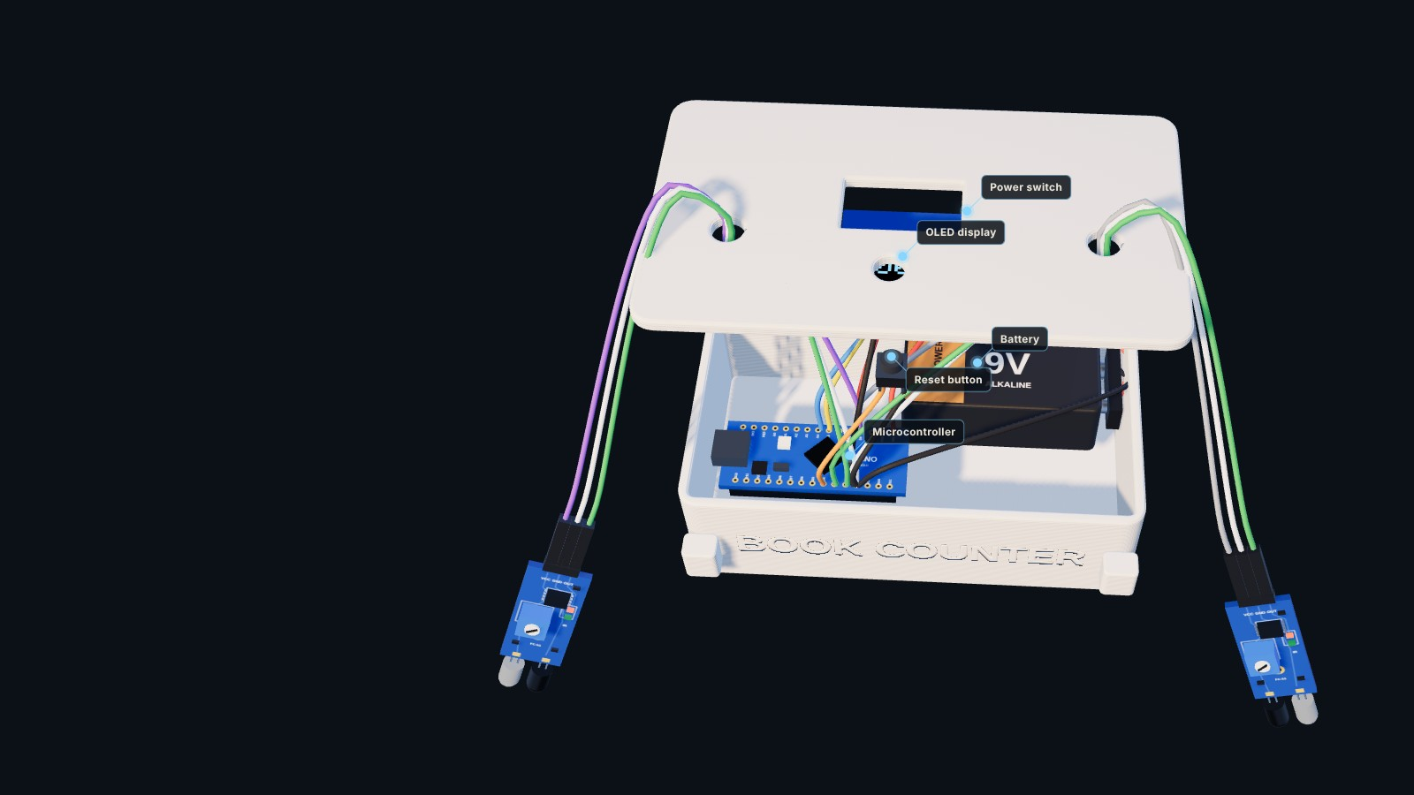
Menu
CIRCUIT
Wiring
PART | PIN | ARDUINO
IR sensor, left | OUT | D2
IR sensor, right | OUT | D3
Both IR sensors | VCC · GND | 5V · GND
OLED display | SDA · SCL | A4 · A5
OLED display | VCC · GND | 5V · GND
Reset button | leg 1 · leg 2 | D4 · GND
Battery (via switch) | + · − | VIN · GND
Each sensor needs one digital pin. The screen shares the two-wire I²C bus.
Notes:
Here's how it's wired. Each sensor has three pins: power, ground and an output. The outputs go to digital pins D2 and D3 on the Arduino. The OLED screen uses I²C, which needs only two data wires, on A4 and A5. The reset button is on D4, and the battery goes through the power switch into VIN.

Slide 33
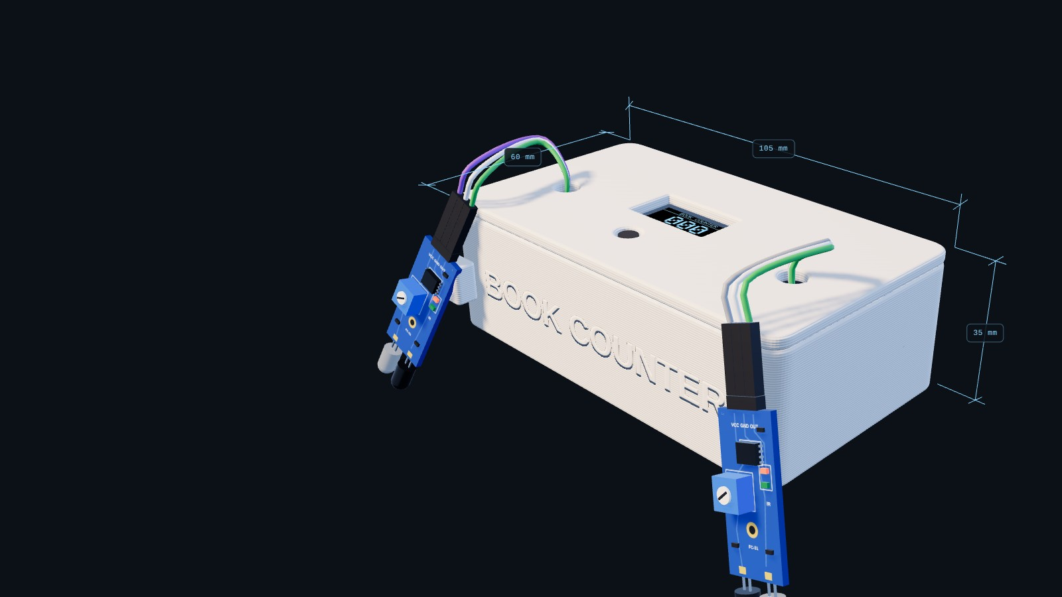
Menu
BUILD
Designed and 3D-printed
SIZE
105 × 60 × 35 mm
MATERIAL
PLA, white
PIECES
Base tray and top plate
OPENINGS
Screen window, button hole, two cable ports
LETTERING
BOOK COUNTER, embossed on the front
Notes:
We designed the shell around the parts and 3D-printed it in white PLA. It's about 105 by 60 by 35 millimetres, in two pieces, a base and a top plate, so the electronics drop in from the top. The top plate has cut-outs for the screen, the button and the sensor cables, and the name is embossed right into the front wall.

Slide 34
Menu
DESIGN CHALLENGES
What a page counter has to get right
One page could count twice.
Fix A 400 ms lock-out after every count.
Flipping back must not add pages.
Fix Two sensors, so the order of the hits gives the direction.
Room light and the page below reflect IR too.
Fix Trimmers tuned for a short range, aimed at the page's path.
Pages are thin and curl as they turn.
Fix The sensors watch the top edge, where every page passes the same way.
Notes:
A page counter sounds simple, but a few things have to be right. One page could trigger a sensor more than once, so we added a short lock-out. Flipping back shouldn't add pages, which is why we use two sensors instead of one. Infrared also reflects off other things, so we tuned each sensor's range with its trimmer. And because pages curl as they turn, the sensors watch the top edge where every page moves the same way.

Slide 35
Menu
NEXT VERSION
Where it goes next
Bluetooth sync
Send each session to a phone app with daily and weekly graphs.
Reading speed
Show pages per minute right on the screen.
Rechargeable
A lithium cell with USB-C charging instead of a 9 V battery.
Smaller
A custom circuit board so the sensor arms fold flat.
Fits any book
An adjustable clip for thin paperbacks and thick textbooks.
Notes:
There's a lot we'd like to add next. Bluetooth, so each reading session goes to a phone app with graphs. Reading speed in pages per minute. A rechargeable battery with USB-C. A custom circuit board to make it smaller, and an adjustable clip so it fits any book.

Slide 36
THANK YOU
Questions?
Book Counter counts the pages so you don't have to.
[Presenter names · Class]
Menu
Start again
Notes:
Thank you for listening. Book Counter counts the pages so you don't have to. We're happy to take questions, and the menu button lets us jump back to any part you'd like to see again.

